Slide 1
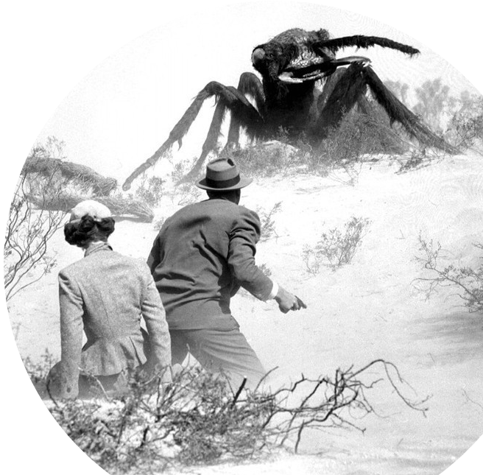
Prof. Darrell Long
CSE13
Stacks and Queues
© 2020 Darrell Long
1

Slide 2
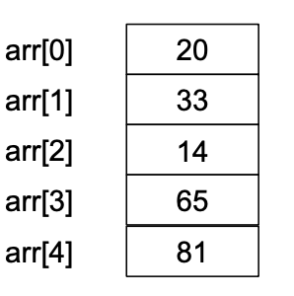
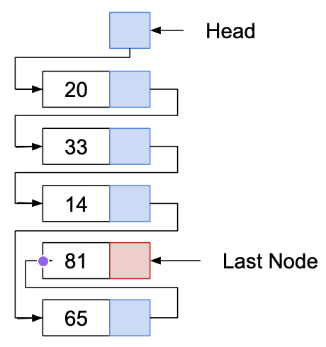
Arrays
Linked Lists
Arrays allow random access:
Each element can be accessed directly in constant time.
Linked lists allow sequential access:
Each element can only be accessed in a particular order.
© 2020 Darrell Long

Slide 3
Stacks and Queues
They are a subset of sequential data structures.
Both serve as containers for objects exhibiting special properties.
© 2020 Darrell Long

Slide 4
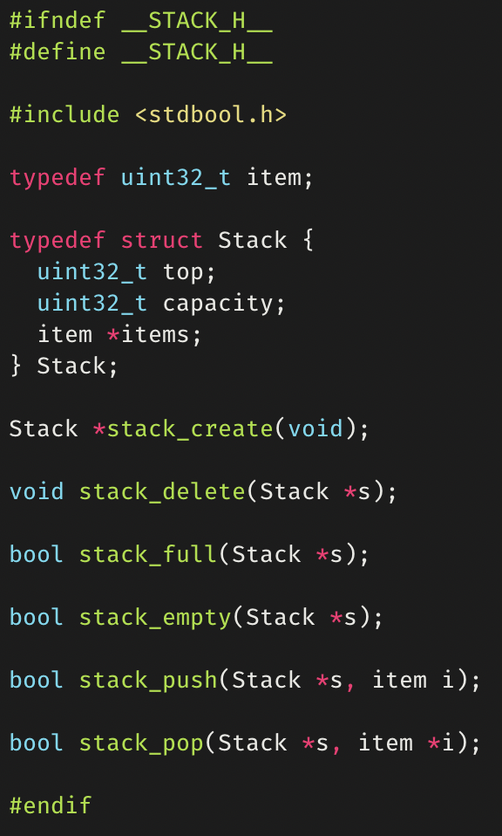
Stacks
Objects are added and removed using the last-in-first-out (LIFO) principle.
Capacity of a stack is the number of stack elements.
This capacity can be increased as number of elements increases through reallocation (dynamic)
Typically implemented with arrays.
© 2020 Darrell Long

Slide 5
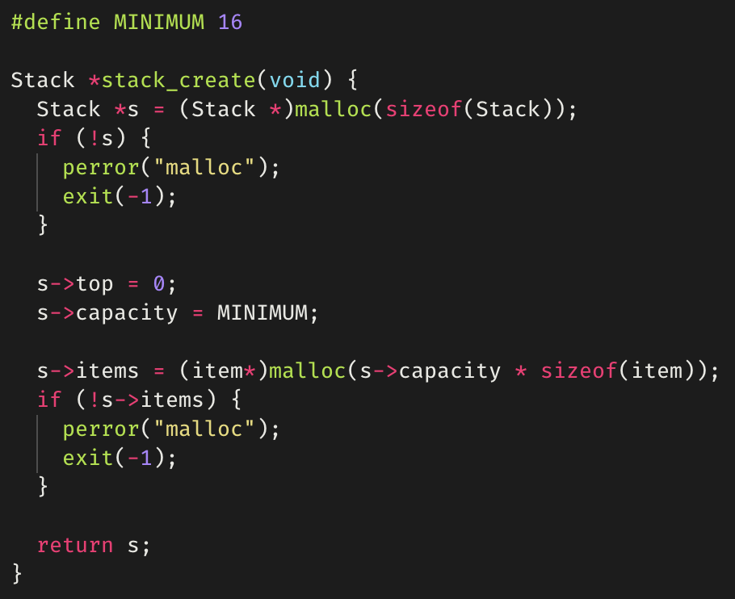
stack_create()
© 2020 Darrell Long

Slide 6
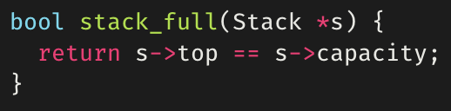
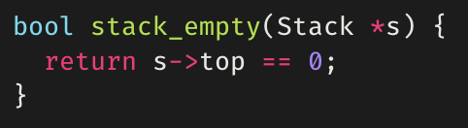
stack_full()
stack_empty()
© 2020 Darrell Long

Slide 7
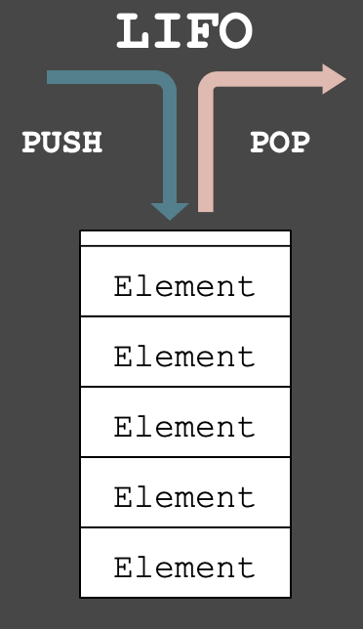
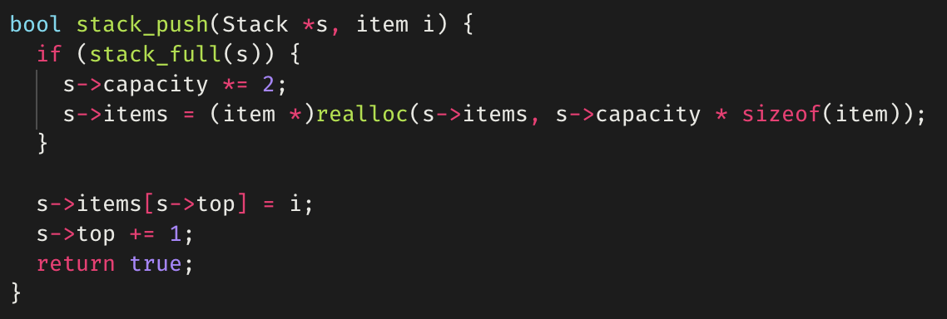
stack_push()
Adds an element to the top of a stack.
Example is for a dynamic stack, in which memory is reallocated when the stack is “full”.
© 2020 Darrell Long

Slide 8
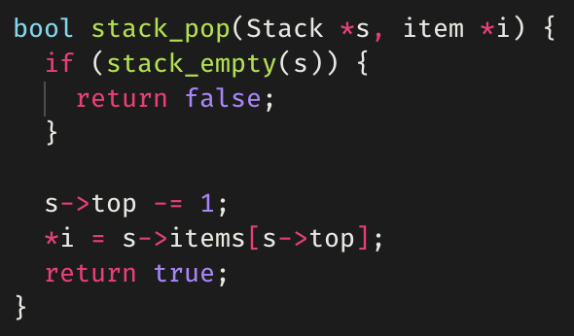
stack_pop()
Removes the element at the top of a stack.
Returns false if the stack is empty.
© 2020 Darrell Long

Slide 9
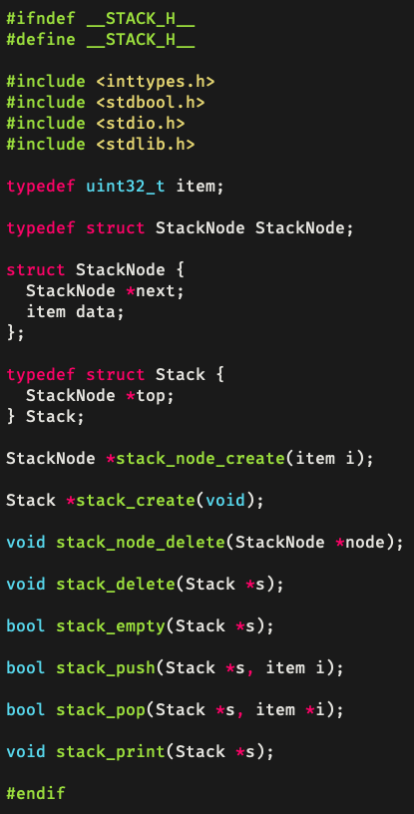
Stacks using linked lists
Stacks can also be implemented using linked lists.
Each element of the stack points to the next.
© 2020 Darrell Long

Slide 10
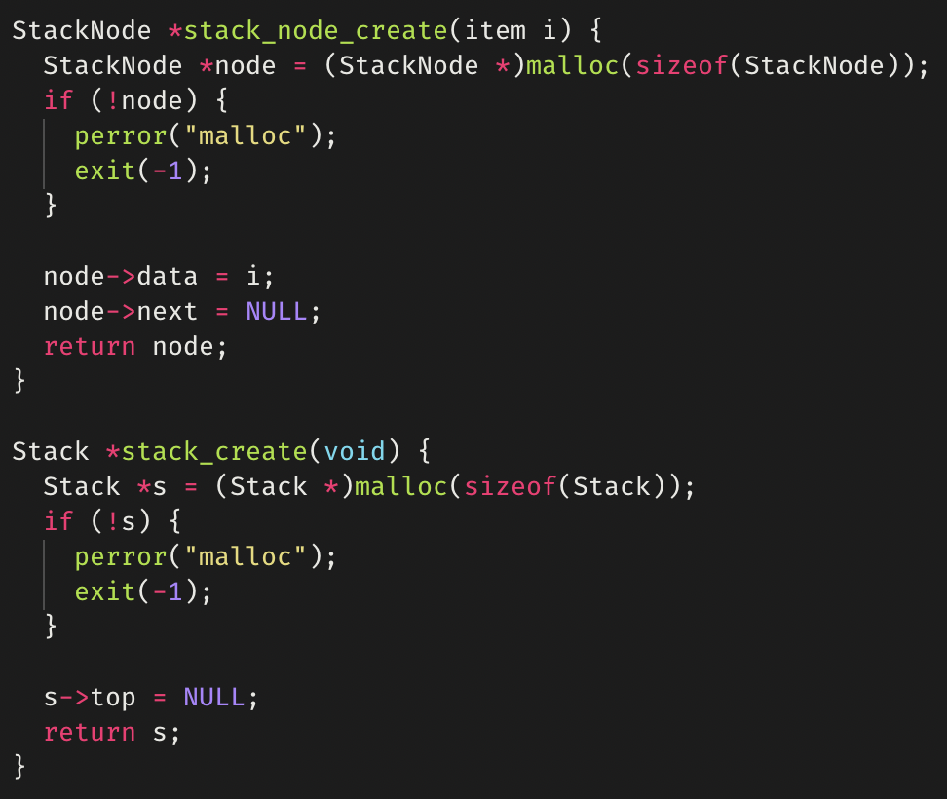
stack_create()
© 2020 Darrell Long

Slide 11
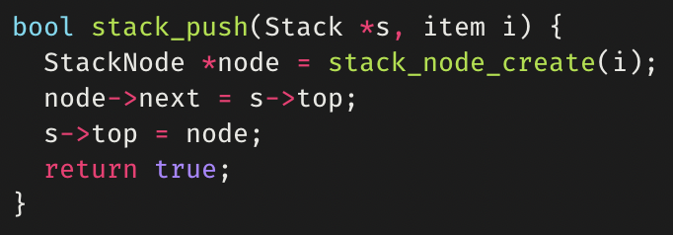
stack_push()
© 2020 Darrell Long

Slide 12
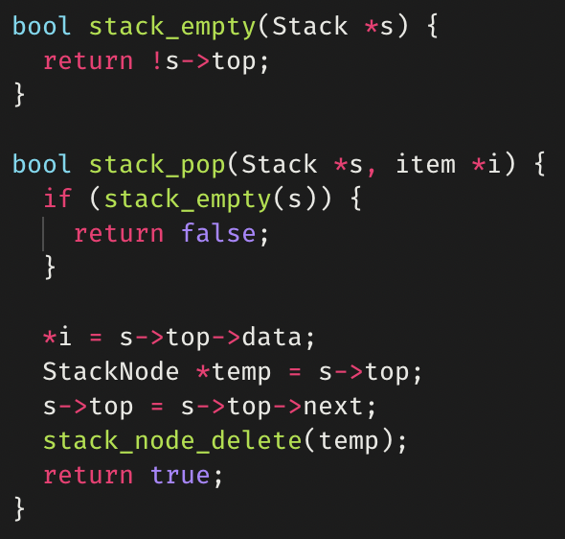
stack_pop()
© 2020 Darrell Long

Slide 13
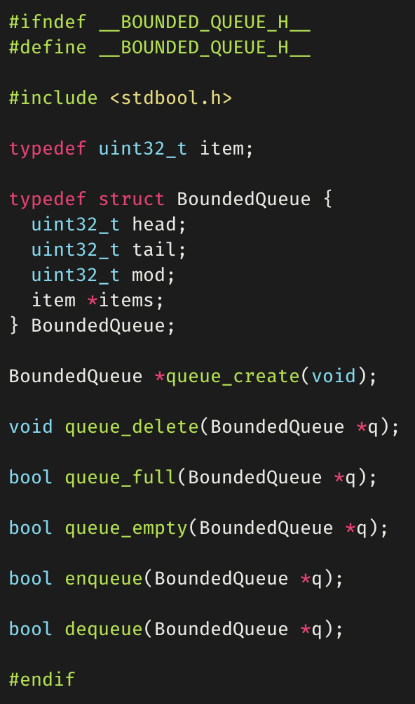
Bounded Queues
Objects are added and removed using the first-in-first-out (FIFO) principle.
Requires fields to keep track of the head, tail, and capacity (mod) of the queue.
© 2020 Darrell Long

Slide 14
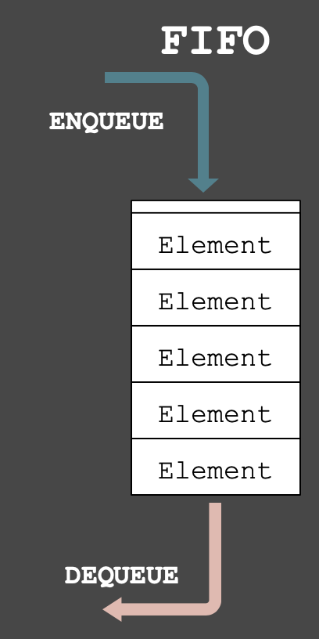
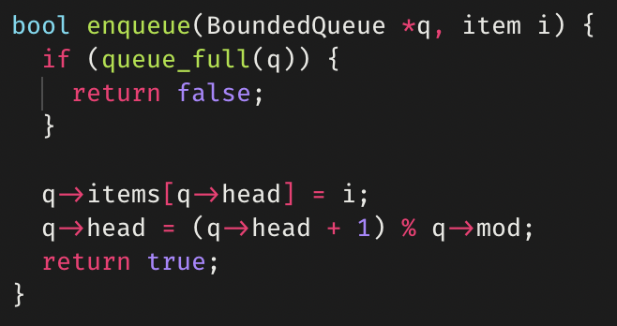
enqueue()
Adds an element to a queue.
© 2020 Darrell Long

Slide 15
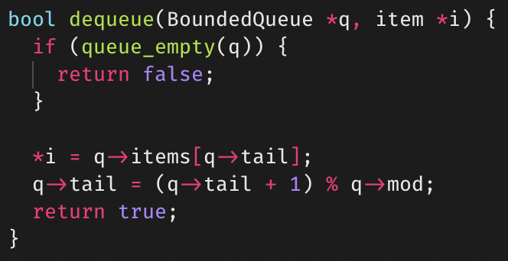
dequeue()
Removes an element from a queue.
© 2020 Darrell Long

Slide 16
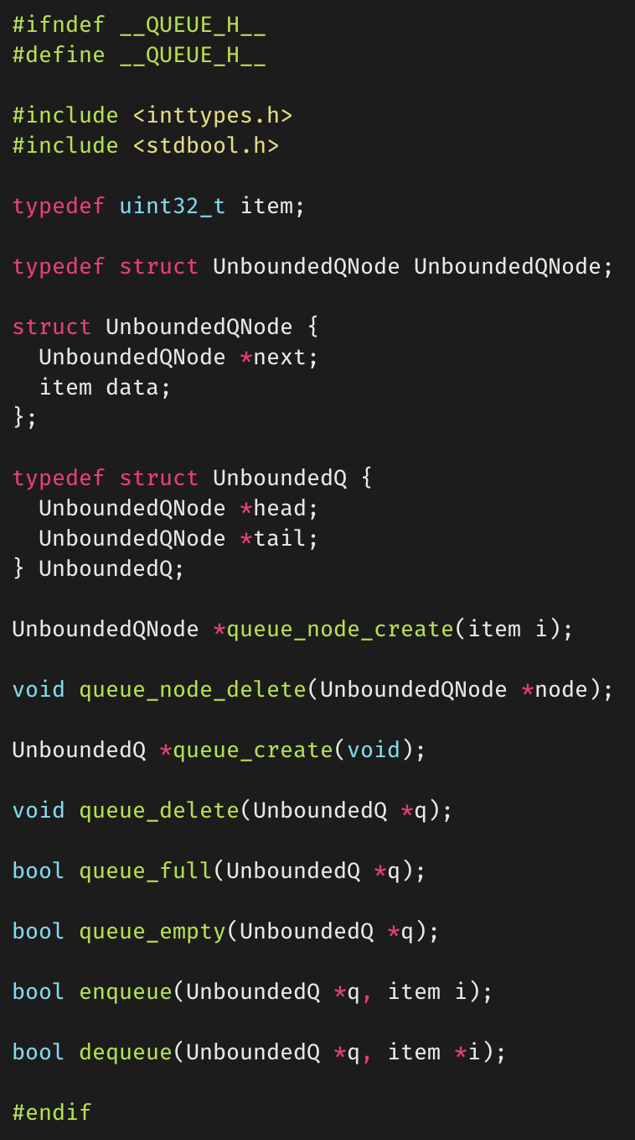
Unbounded Queues
Unbounded queues can be implemented with a linked list.
The unbounded queue itself is a wrapper for a linked list.
The wrapper keeps track of the head and tail.
© 2020 Darrell Long

Slide 17
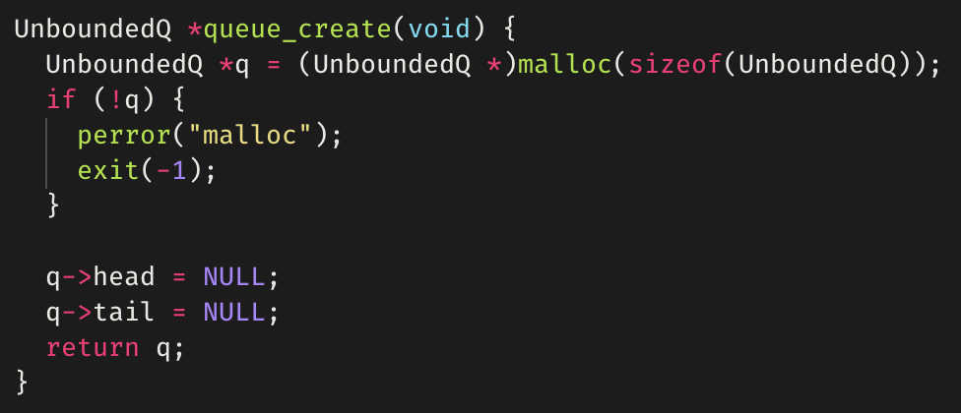
queue_create()
Creating
The unbounded queue itself is a wrapper for a linked list.
The wrapper keeps track of the head and tail.
© 2020 Darrell Long

Slide 18
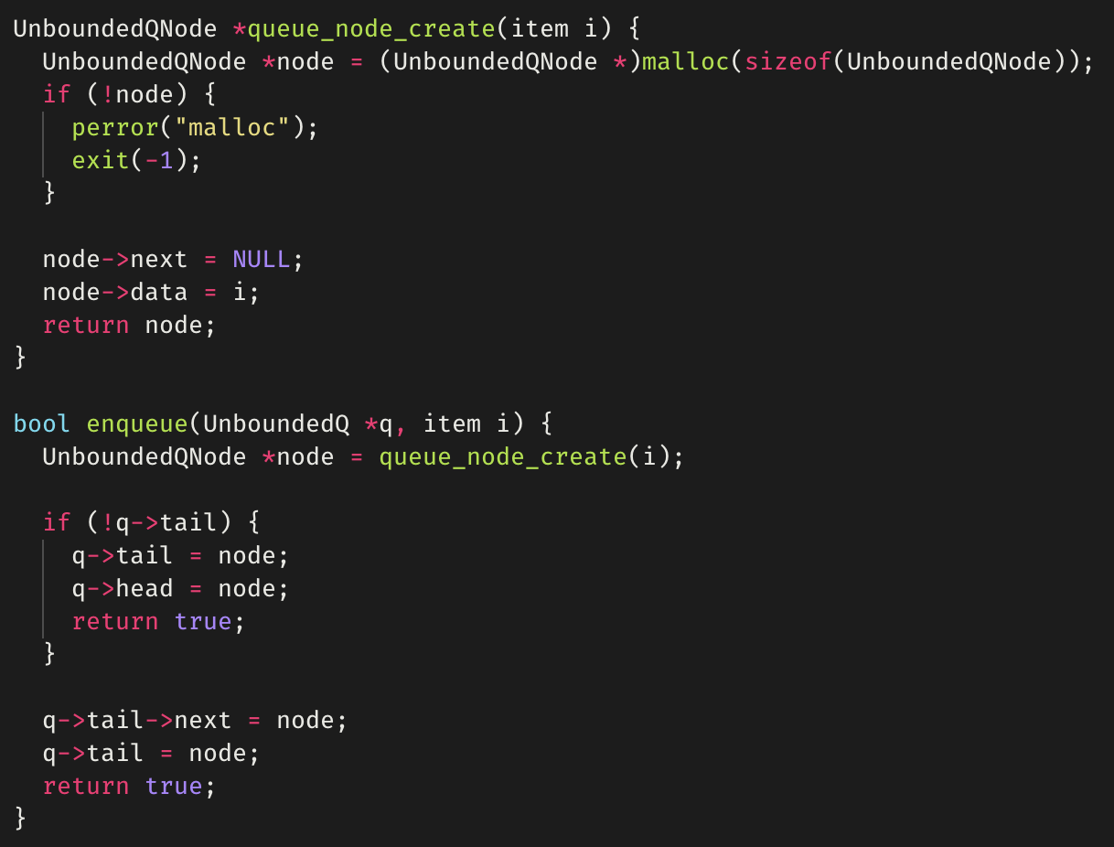
enqueue()
The enqueue() function first creates the node to enqueue.
If the queue is empty, both the head and tail point to the new node.
Else, add new node to the end.
© 2020 Darrell Long

Slide 19
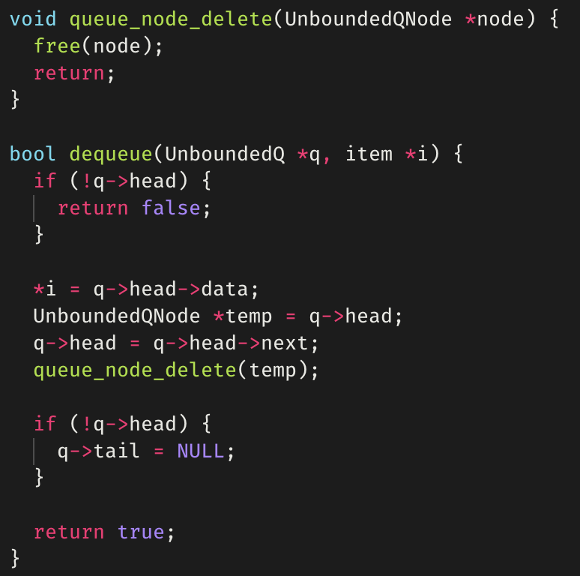
dequeue()
The dequeue() function first stores the data into the supplied item pointer.
The head of the queue is moved forward one node.
We save a pointer to it so we can free memory.
If the queue is empty now, the tail is set to NULL.
© 2020 Darrell Long

Slide 20
Differences between stacks and queues
Removing an element:
Stack removes the most recently added element.
Queue removes the least recently added element.
© 2020 Darrell Long

Slide 21
Queue implementations
Commonly Implemented using vector-based data structures:
Arrays, linked-lists, vectors (used in C++), etc.
Some queue implementations feature an algorithm, or a rule called move-to-front:
Elements that have been previously searched for in a queue are placed at the front of the queue.
Typically used as an optimization, as the recent past is a good indicator of the near future.
© 2020 Darrell Long

Slide 22
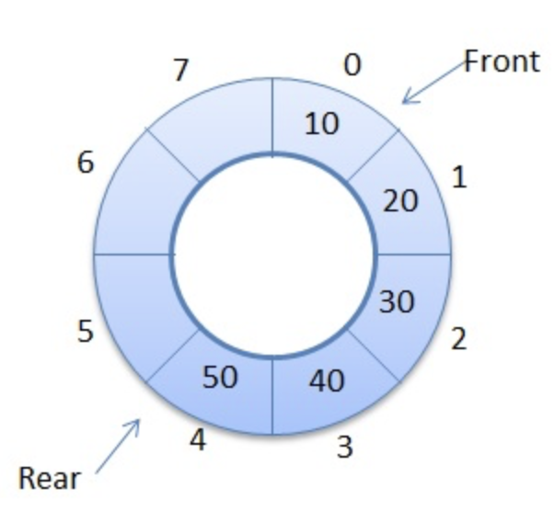
Circular Queue
Linear data structure:
Operations performed using FIFO.
Last position connected back to the first position to make a circle.
Operations on circular queue:
Front/Rear: get the front/last item of the queue.
enQueue: insert new element always in the rear end of queue.
deQueue: delete element from front position.
Also called wrap-around queue.
© 2020 Darrell Long

Slide 23
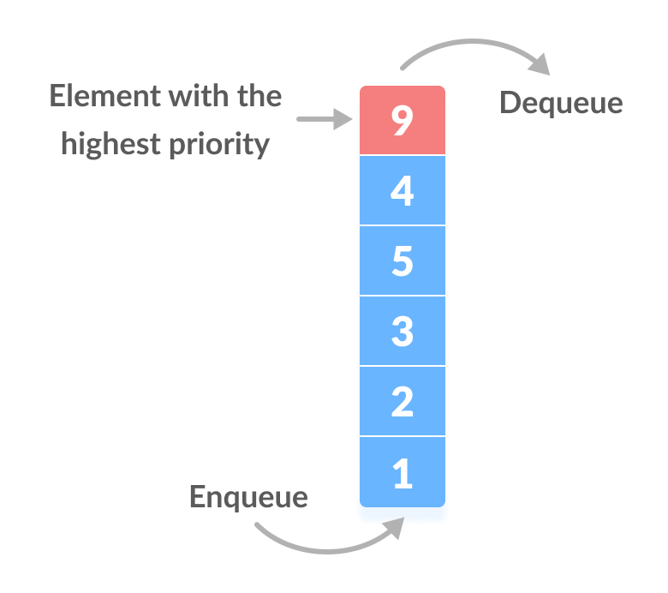
Priority Queue
Implemented like a generic queue, BUT every element has a priority associated with it.
Element of highest priority is dequeued before elements with lower priority.
In the case of two elements of the same priority, preference is given to the position of the element in the queue.
© 2020 Darrell Long

Slide 24
Summary
Stacks use LIFO
Queues use FIFO
Both can be implemented using arrays and linked lists.
© 2020 Darrell Long
24

