Slide 1

Linked Lists
Prof. Darrell Long
CSE 13S

Slide 2
Introduction
Data
Next
Data
Next
Data
Next
Null
A data structure where each element or node points to the next node.
Each node contains a data field and a pointer to the next element in the list.
The last node in the list points to a terminator, usually a null pointer.
The example shows a singly linked list.

Slide 3
Advantages
No fixed memory allocation:
Grow and shrink at run-time without pre-allocating memory.
No need to provide initial size of list.
Insertion and Deletions:
No need to shift elements after insertion or deletion.
Only update the address to the next pointer of a node.
Implementation:
Easily implement linear data structures like stacks and queues.
14 February 2020
3

Slide 4
Disadvantages
Memory usage:
Storing pointer to next node requires extra memory.
Arrays are friendlier to processor caches.
Slightly less memory efficient than arrays.
Traversal:
Cannot randomly access elements, must traverse all elements up to the element we want to access.
Reverse traversing is difficult in singly linked lists.
Easy in Doubly linked list but uses extra memory to store an additional pointer.
14 February 2020
4

Slide 5
Doubly Linked Lists
Null
Prev
Data
Next
Prev
Data
Next
Prev
Data
Next
Null
Each node has a pointer to both the previous and next nodes.
Allows traversal in two directions.
Less memory efficient than a normal linked list.

Slide 6
Circular Linked List
Data
Next
Data
Next
Data
Next
A linked list where the next pointer of the last node points to the head of the list.

Slide 7
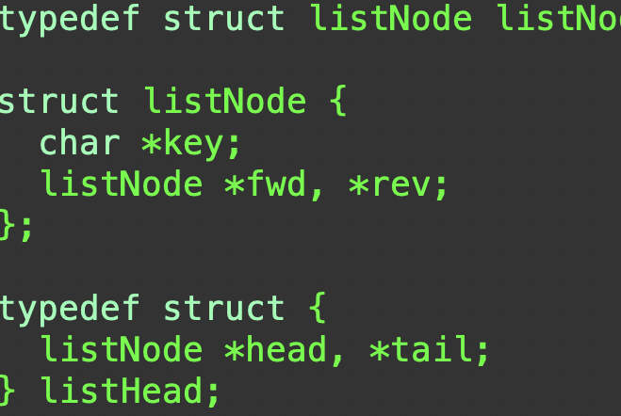
The linked list ADT

Slide 8
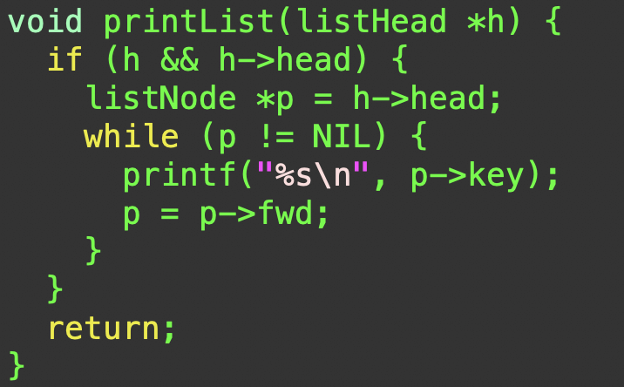
printList

Slide 9
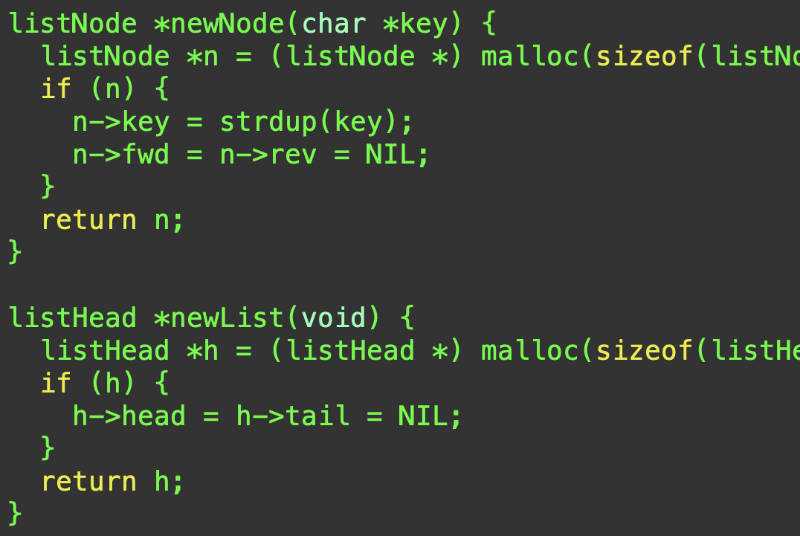
Constructors

Slide 10
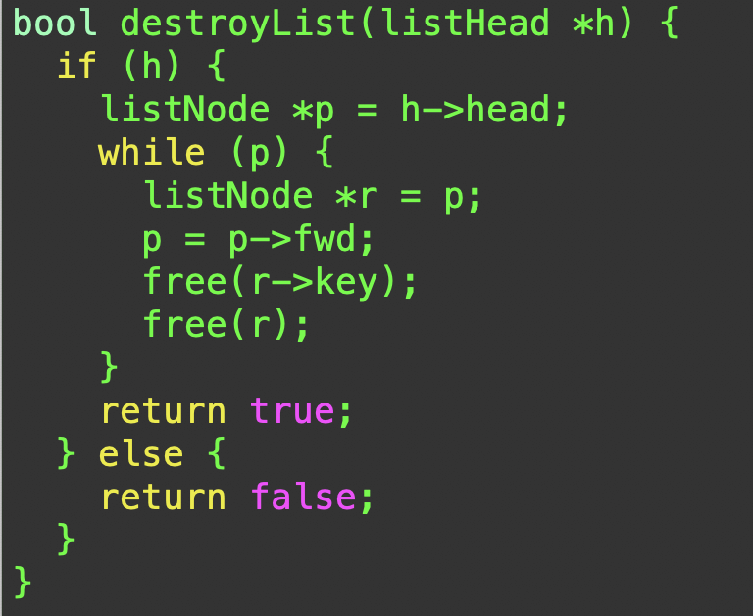
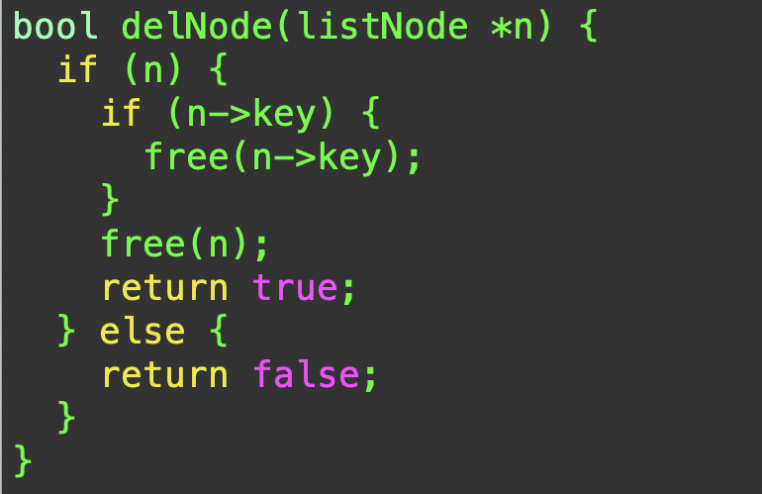
Destructors

Slide 11
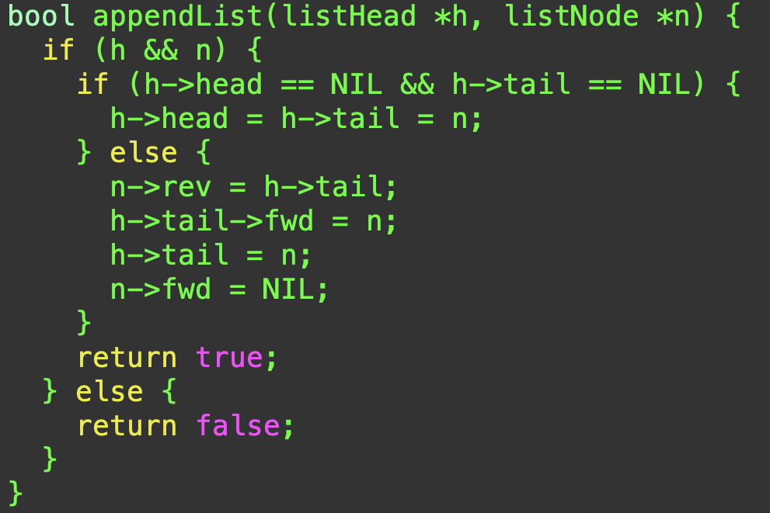
appendList

Slide 12

Searching a Linked List
We need to potentially traverse the entire linked list to search for an item.
Linear search complexity for singly and doubly linked lists is $O\left(N^{2}\right).$
Worst case is when the item sought is absent.

Slide 13
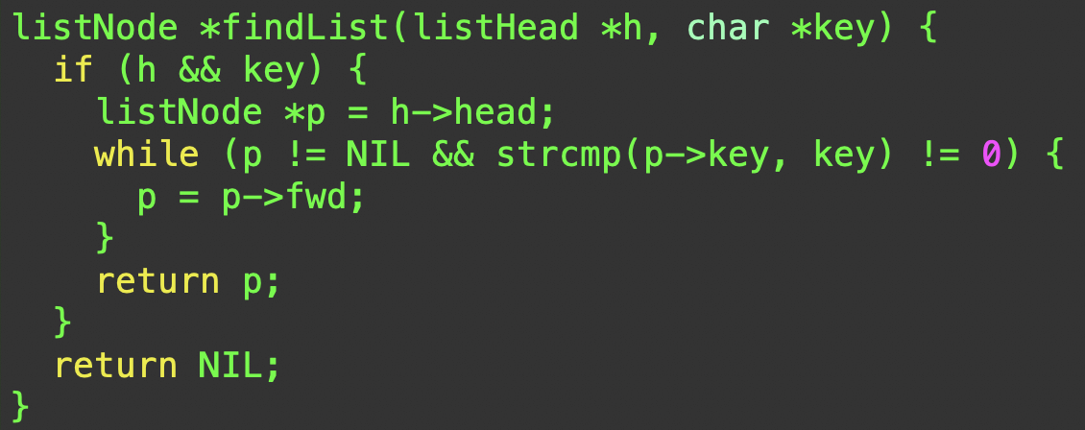
findList
Look at the first item. Is it there?
Yes, return a pointer.
No, move on the the next item.
Complexity is the same for singly or doubly linked lists.

Slide 14
Implementing Stacks with Linked Lists
Top
99
Next
50
Next
Stack size is limited only by available memory.
Every new element inserted as a top element.
The next field of the first element must always be NULL.
Example: the last inserted node is 99 and the first inserted node is 25. The order of elements inserted is 25, 32, 50 and 99.
32
Next
25
Next
Null

Slide 15
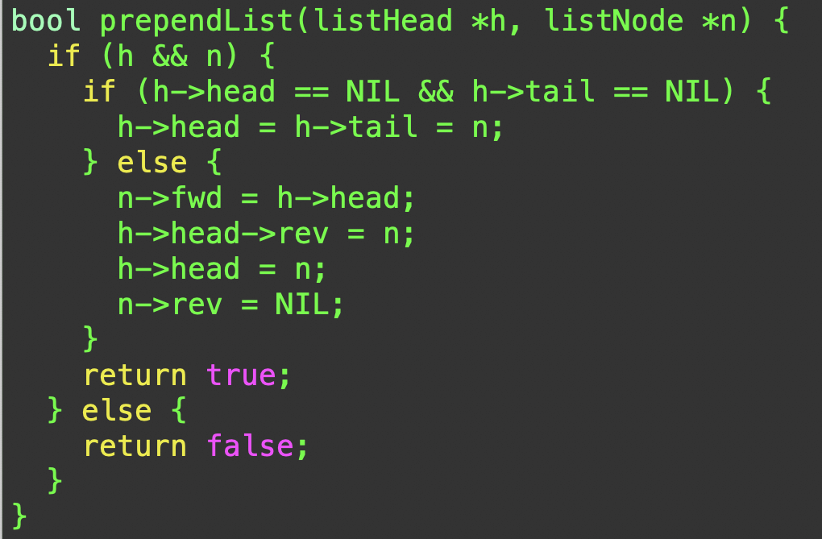
prependList

Slide 16
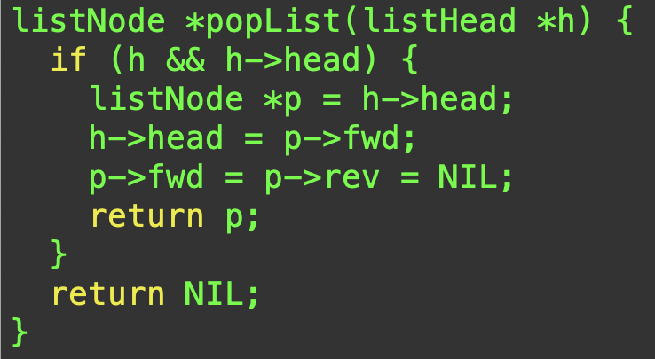
popList

Slide 17
Queues implemented with Linked Lists
Add at the head.
Remove at the tail.
That’s it!
Head
Tail
Data
Next
Data
Next
Data
Next
Null

Slide 18
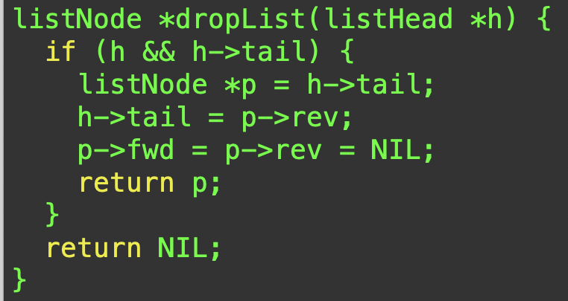
dropList
Deleting at the tail turns it into a FIFO queue.

