Slide 1
Shells and Scripting Languages
Prof. Darrell Long
CSE13S

Slide 2
What are scripting languages?
Programming languages used to automate execution of tasks
Scripting languages aren’t compiled, they are interpreted
Typically less code intensive than traditional programming languages like C and Java

Slide 3
Some scripting languages
Scripting languages loosely refer to dynamic high-level general-purpose languages such as:
Bash
Perl
Csh
Python

Slide 4
Bash
A Unix shell and scripting language
Written by Brian Fox as a replacement for the Bourne Shell
The user types in commands
Bash executes them
Bash scripts are useful for automating routines

Slide 5
Scripting with Bash
Must specify Bash interpreter using a shebang, or a hashbang
This is typically #!/bin/bash but can vary depending on your system
Another example is python 3.6 with the shebang #!/usr/bin/python3
Bash scripts have the file extension .sh
Bash scripts must have their executable bit set using chmod
chmod +x script.sh
Scripts can be run from the current directory using “./<script name>

Slide 6
Comments in Bash
Bash uses line comments start with “#”
This is why the shebang starts with “#!”
Most scripting languages use “#” as the prefix for comments
Example Bash comment:
echo “Hello, CSE13S” # prints out Hello, CSE13S

Slide 7
Variables and Arrays in Bash
Bash variables behave both as variables and as arrays
Setting a variable:
var=3
Avoid using spaces:
var = 3 this invokes command var with arguments = and 3
If you need to use spaces, you can place your expression between (( and ))
(( var = 3 ))

Slide 8
Variables and Arrays in Bash (cont’d)
Variables are referenced using “$”
var=3
echo $var prints out the value of var, which is 3
Can delete a variable using “unset”
var=3
unset var
echo $var # prints nothing
Assigning variable to each other
foo=$bar

Slide 9
Variables and Arrays in Bash (cont’d)
Every variable is an array
arr[0]=“first”
arr[1]=“second”
Referencing an array without indexing implicit refers to the first index
Indices in arrays are referenced using braces:
echo ${arr[1]} prints “second”
All values in an array can be accessed using “@” or “*”
echo ${arr[*]}prints “first second”
Can use parentheses to create an array:
arr=(1 2 3)

Slide 10
Special Variables in Bash
Bash has a set of variables to grab arguments
$n: where n refers to the n-th argument supplied to a Bash script
Note that if n is more than one digit, such as 10, you will need to surround it with curly braces
echo ${10}
$#: stores the number of arguments, like argc in C
$?: holds the exit status of the previously executed process
Exit status of zero means no errors occurred
Non-zero exit status means errors occurred

Slide 11
Environment Variables
Named values that exist in the shell
Tells the shell where to find executables, user defined variables, security credentials, etc
A special environment variable is PATH, which tells the shell where executables can be found

Slide 12
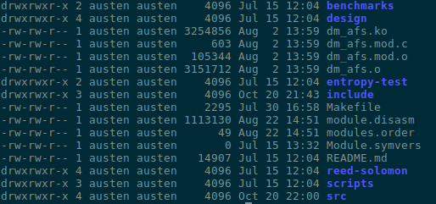
File Permissions
A file can be read from (r), written to (w), or run as an executable (x)
Each file has a user ID (UID) and a group ID (GID)
Files have three sets of access permissions, user, group, and other
Permissions are changed with chmod, chown, and chgrp

Slide 13
Files and redirection
Every process in Unix has access to the following three file descriptors:
stdin: standard input, file descriptor 0
stdout: standard output, file descriptor 1
stderr: standard error, file descriptor 2
All three file descriptors can be redirected
grep cse13s < file.txt directs file.txt into stdin with “<“
cat file1 file2 > combined.txt concatenates the standard output of file1 and file2
./prog 2> error.log places output from standard error into “error.log”

Slide 14
Pipes
Used to route stdout of one process into the stdin of another
Denoted by the pipe operator “|”
Can be chained, creating a pipeline
Example pipeline to list all processes on a Unix system that contains the string “cse13s”
ps auxxx | grep cse13s | more

Slide 15
Globs and Patterns in Bash
Bash uses glob notation to match strings and file names
echo *.{txt,jpg,pdf} prints names of all text, JPEG, and PDF files
Special glob pattern forms:
*: matches any string
?: matches a single character
[chars] matches any character in chars
[a-b] matches any character between a and b
Removing text files with 3 digit names: rm [0-9][0-9][0-9].txt
Printing strings of 3-bit numbers: echo {0,1}{0,1}{0,1}

Slide 16
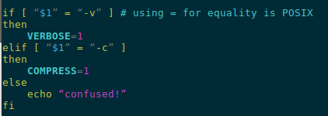
Conditionals in Bash

Slide 17
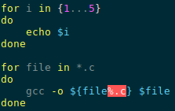

Iteration in Bash
Bash provides both while and for loops

Slide 18
Perl
A family of two high-level, general-purpose, dynamic, interpreted programming languages
Comprised of Perl 5 and 6 (maintained in parallel)
Developed by Larry Wall in 1987 as a scripting language
Often used as a “glue” language
Good for “data wrangling”, converting data from one format to another

Slide 19
AWK
Abbreviated from the developers: Aho, Weinberger, and Kernighan
Typically used for:
Scanning a file line by line
Splitting input lines into fields
Pattern matching input lines
Performing actions on matched lines
Syntax:
awk [options] ‘pattern {action}’ <file>
Printing a file using awk:
awk ‘{print}’ <file>

Slide 20
sed
Abbreviated from “stream editor”
A Unix utility that parses and transforms text
Based off the scripting features of the “ed” and “qed” editor
One of the earliest tools to support regular expressions

Slide 21
diff
Unix command to compare two files lines by line
Prints the differences between two files
diff notation:
a: add
c: change
d: delete
diff [options] <first file> <second file>
Notes:
<number>

Slide 22
diff example
Unix command to compare two files lines by line
Notes:
<number>

Slide 23
pushd and popd
Most shells utilize a stack to store directory history
A programmer can push and pop directories onto the stack using the commands pushd and popd
The command “dirs” will print the directories currently on the stack
The command pushd +1 will move the current directory to index 1 on the stack

Slide 24
grep
Can be used to search plain text using regular expressions
Can be used in conjunction with the command find to locate items within a unix system
Searches a file for a pattern and prints each line containing that pattern
grep <pattern> <file>

