Slide 1

Loops
Prof. Darrell Long
CSE 13S

Slide 2
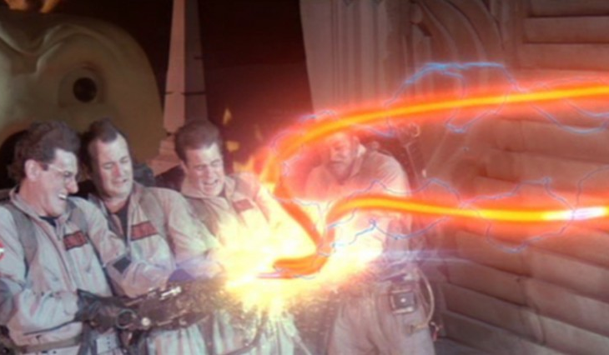
What is a loop?
A loop allows you to repeat a sequence of code.
Programs spend the vast majority of their execution time in loops.
We will focus on structured loops: while, for, and do-while.
You can also create loops with goto: but don’t, it’s ugly.
Ghostbusters don’t cross streams, and good programmers don’t cross loops.

Slide 3
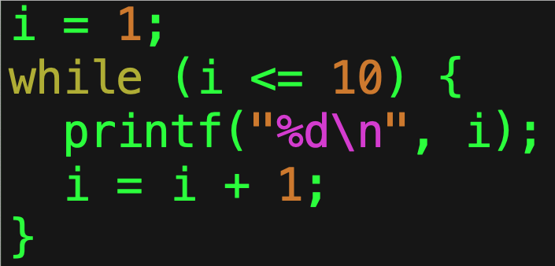
while ()
It is called a top-test loop
The test is evaluated before entering the loop.
Executes the statement as long as the Boolean condition remains true.
Executes the statement zero or more times.

Slide 4
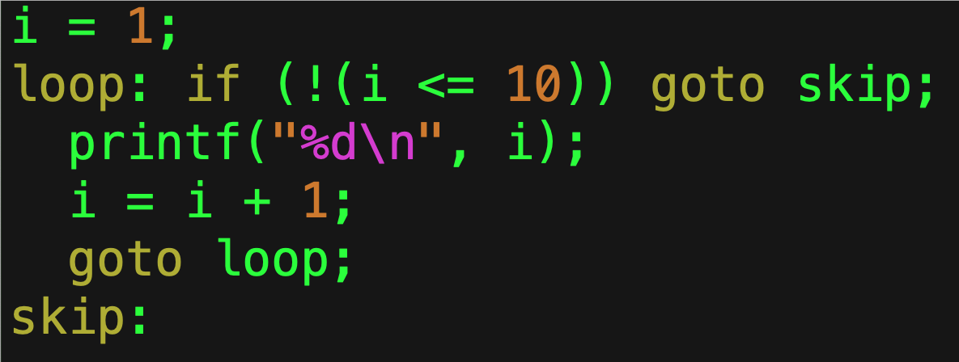
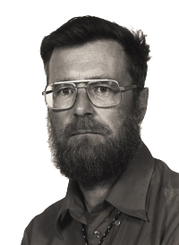
Equivalent goto Code
You can implement it with the goto statement.
Just because you can does not mean that you should.
I warned you about this in 1968!

Slide 5
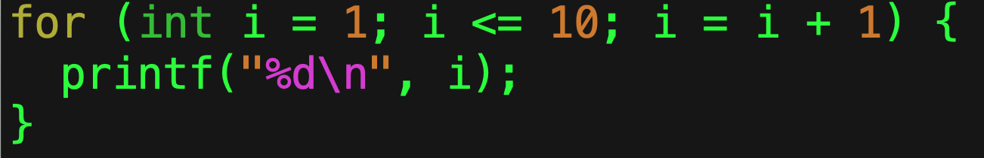
for ()
Also a top-test loop.
Puts:
Initialization,
Test, and
Increment all together.
By convention they are related, but nothing in C requires them to be.
Deze code is veel beter leesbaar!

Slide 6
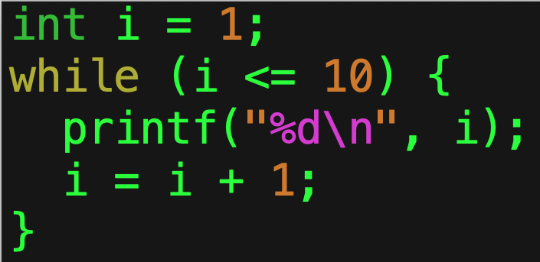
Equivalent while()
This is the equivalent while statement.
The while statement is complete
Which means you can implement any loop using it.
The Böhm-Jacopini theorem proves you can do it all with while!

Slide 7
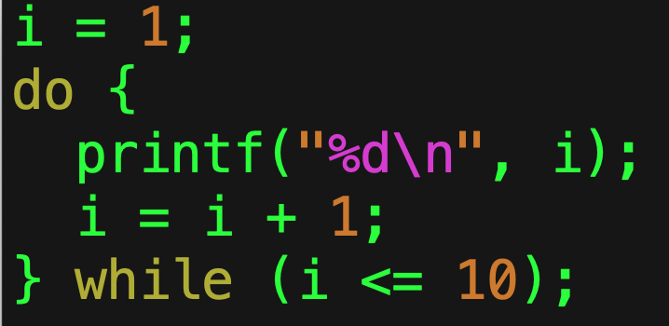
do { } while ()
This is a bottom-test loop.
Used when you want to perform the statement at least once.
Continues to execute the enclosed statement as long as the Boolean condition remains true.

Slide 8
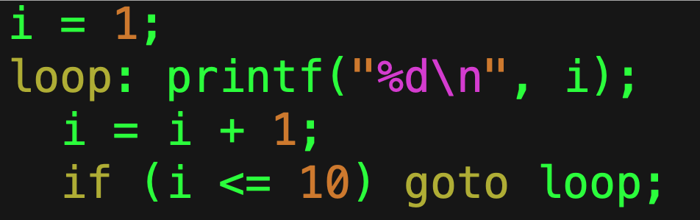
Equivalent goto Code
This is the equivalent code using goto.
You should never write code like this unless your programming language lacks the equivalent statement.

Slide 9
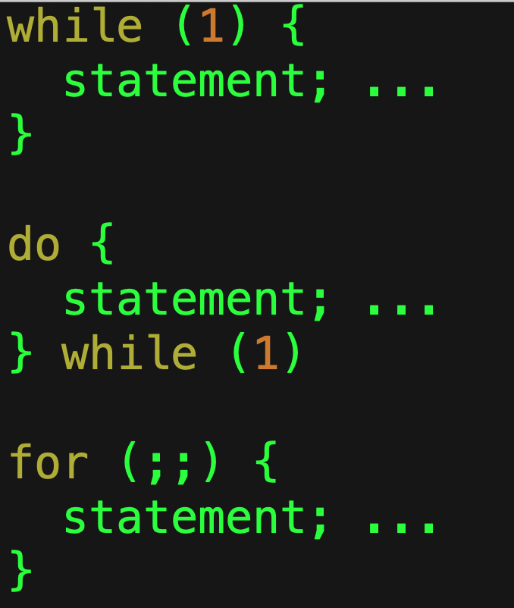
Infinite Loops
All of these execute forever.
The one you choose is a matter of style, not of substance.
How do you ever escape?
Use the break statement.

Slide 10
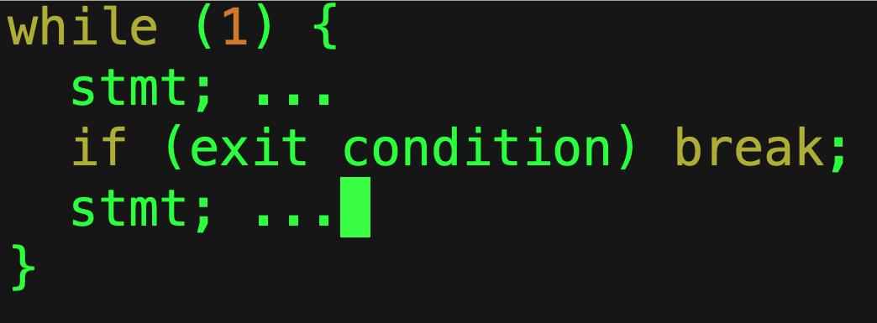
break
Immediately exits the enclosing loop.
Allows for middle-exit loops.
This is still considered structured programming, but it should be used in moderation.

Slide 11
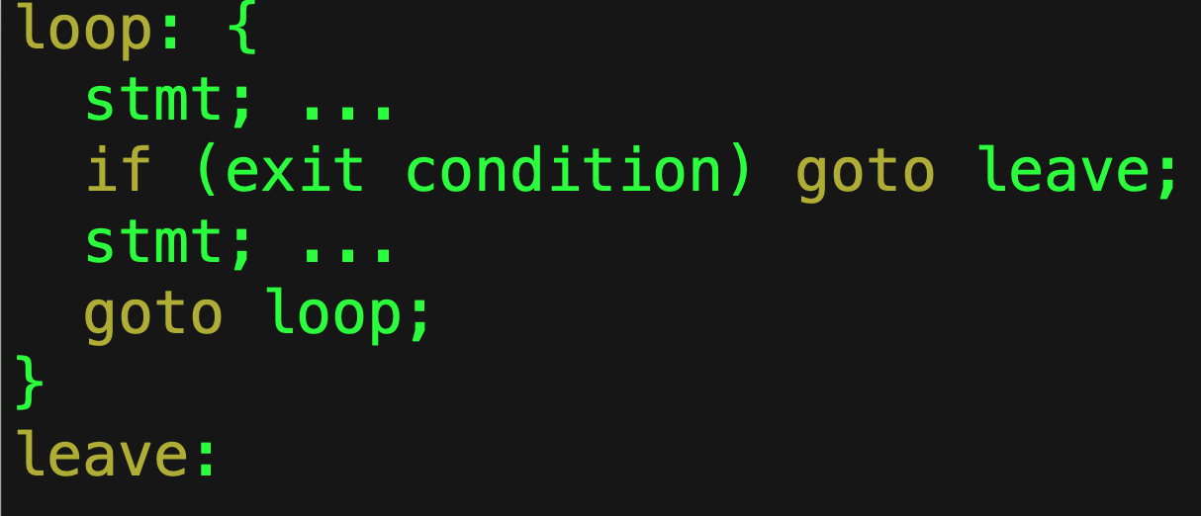
Equivalent goto Code
It goes without saying that you should not write code like this…

Slide 12
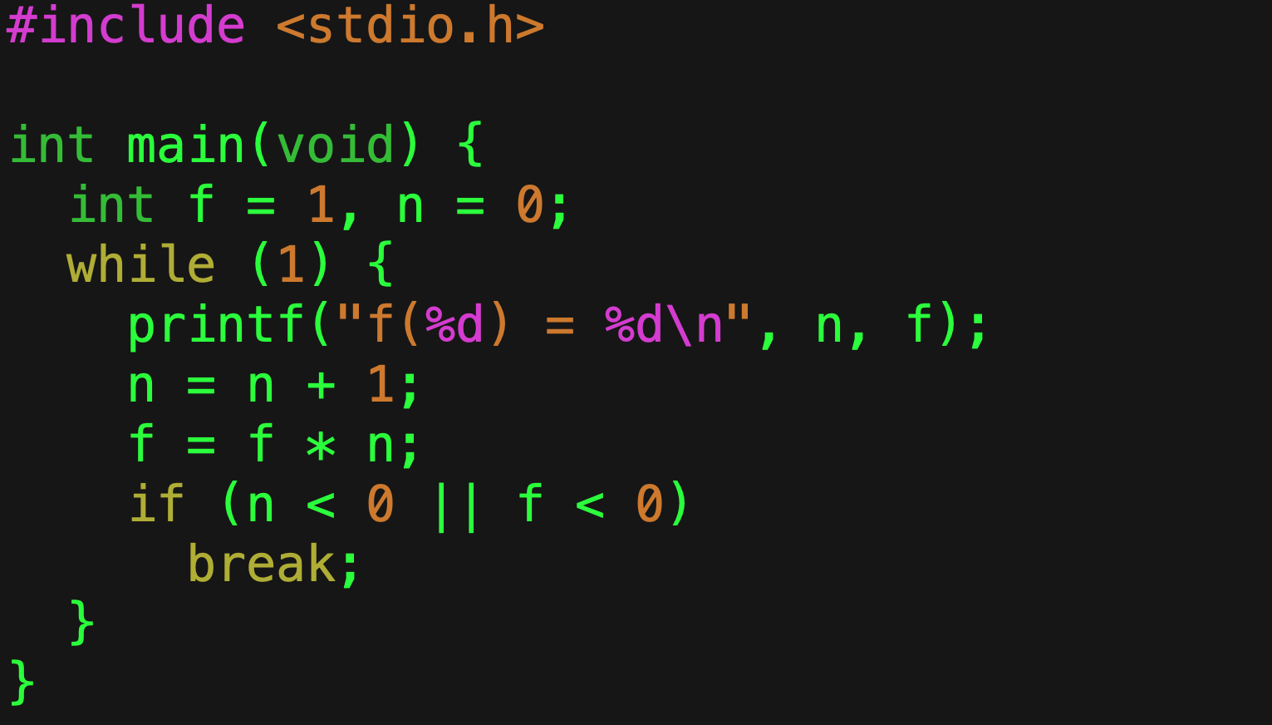

Factorial Example
$n!=n × \left(n−1\right)!$
This code will print from $0!$ to the largest that will fit in an int.
We use the fact that numbers are stored in two’s complement (and so turn negative when they exceed the positive numbers).
We are trying to be perhaps a bit too clever.
Our attempt at cleverness

Slide 13
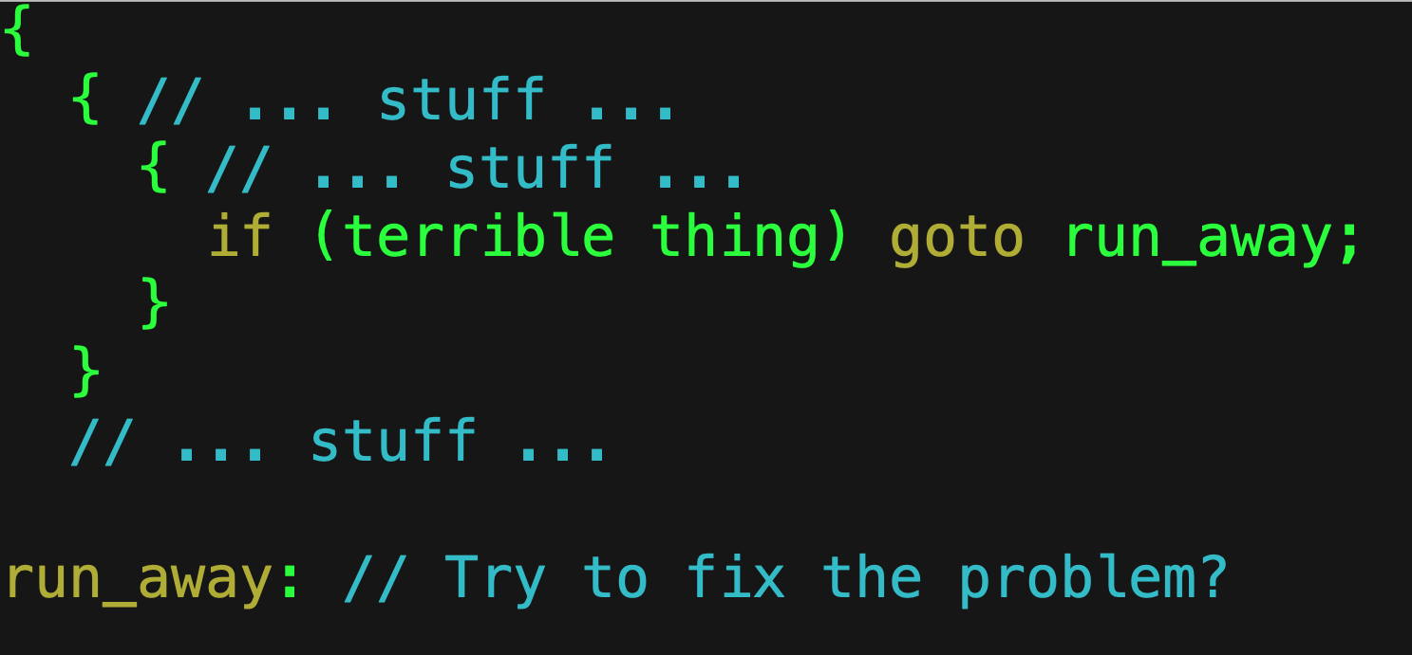
When can I use goto?
One place: non-local error handling.
This is when an exceptional condition—an error—that you cannot handle occurs.
It is not pretty.
More modern languages like C++ provide an exception handling mechanism.

Slide 14
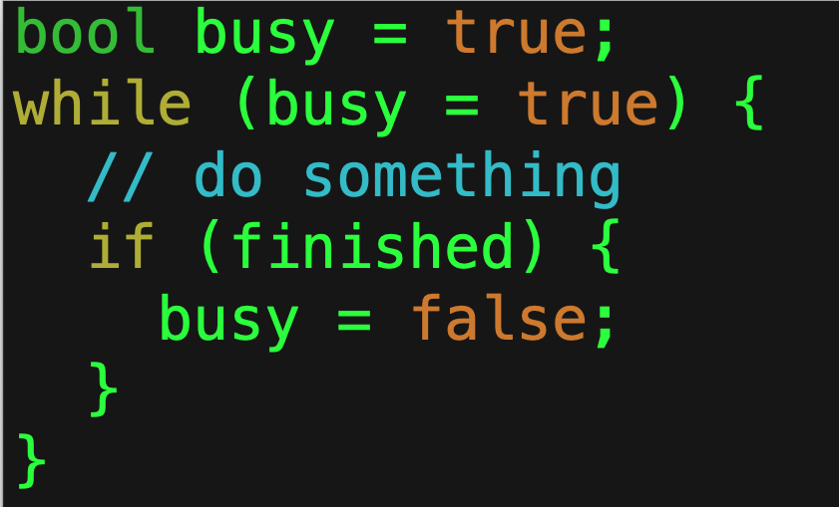
What’s wrong with this code?
This!
It’s an infinite loop!
How do I know that?
Never forget that
= is assignment and
== is equality!

Slide 15
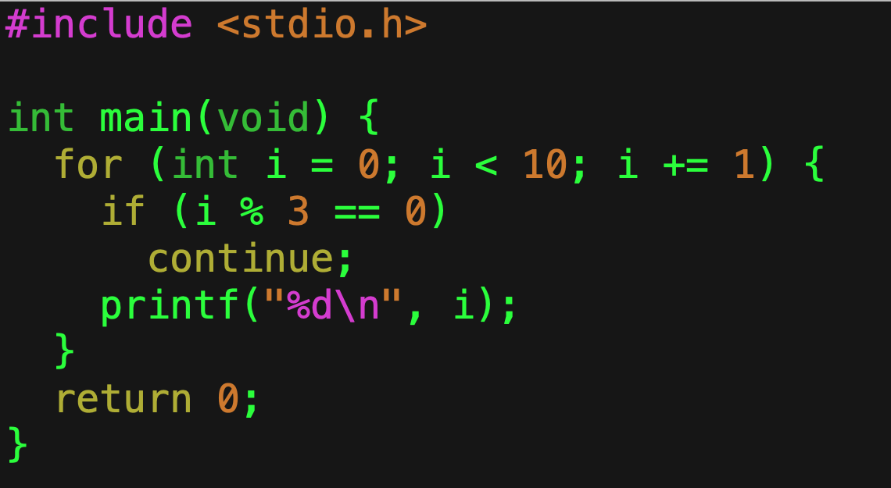
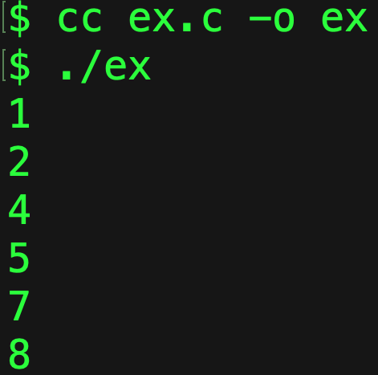
continue
You may have times when you want to skip the remainder of a loop.
For this, there is continue.
Please use it sparingly.

Slide 16
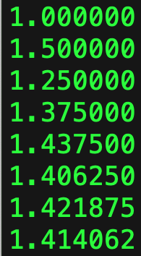
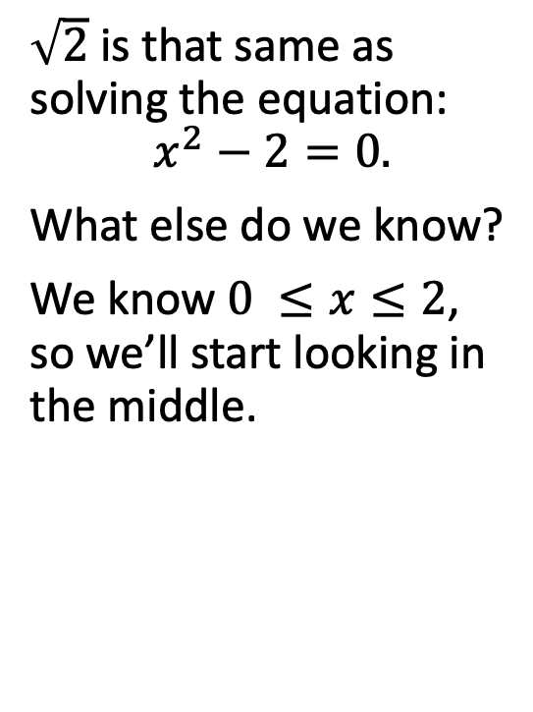
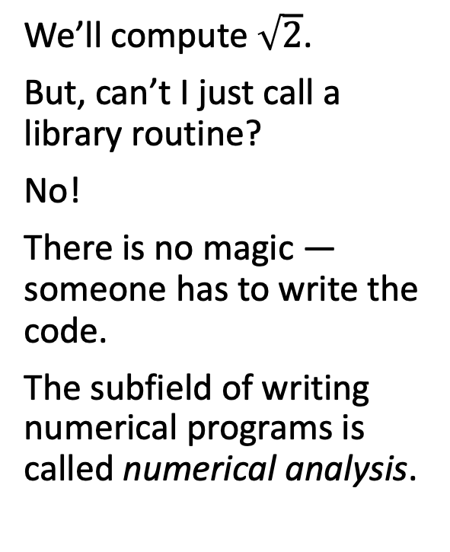
Let’s Compute!
We’ll compute $\sqrt{2}$.
But, can’t I just call a library routine?
No!
There is no magic — someone has to write the code.
The subfield of writing numerical programs is called numerical analysis.
$\sqrt{2}$ is that same as solving the equation:
$$x^{2}−2=0.$$
What else do we know?
We know $0 ≤x≤2$, so we’ll start looking in the middle.
$\sqrt{2}≈$1.414213562373095048801688724209698078569671875376948073

Slide 17
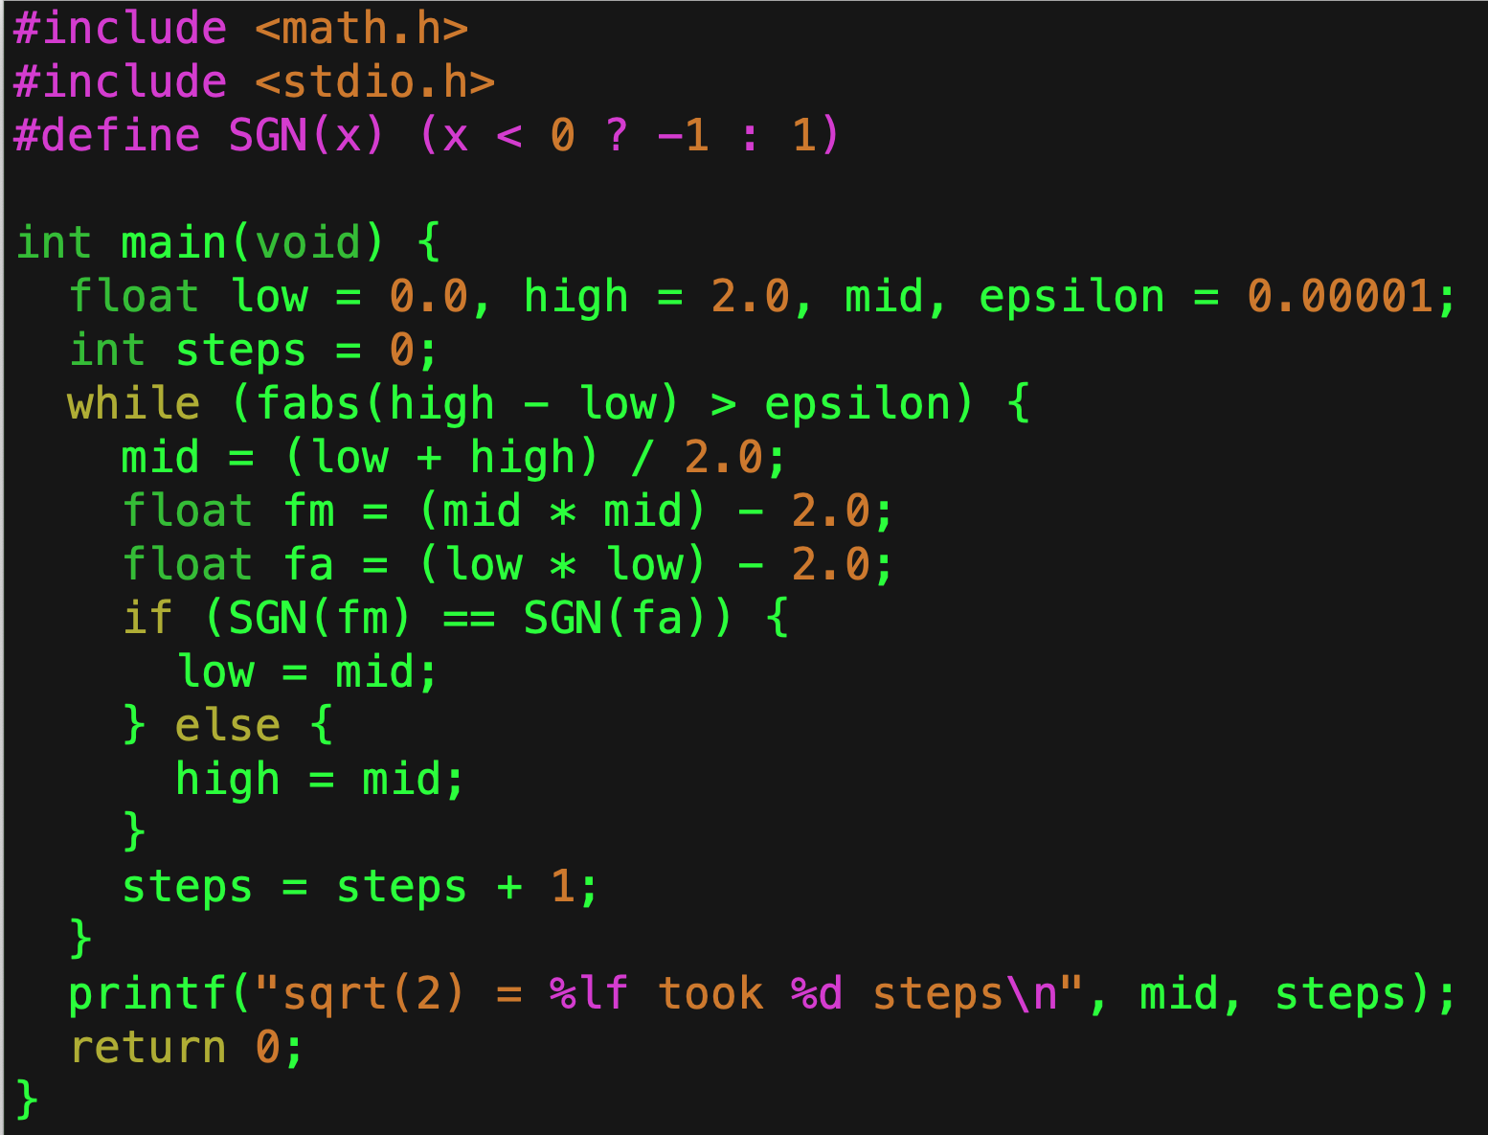
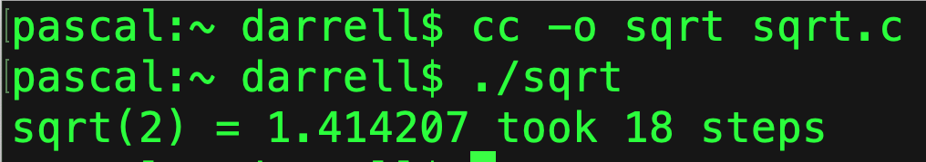
Bisection Method
What’s this?
Start in the middle.
We have two intervals:
(low, mid) and (mid, high)
If we guess to low them we choose the right interval,
If we guess too high then we choose the left interval.
We repeat until we’re within our error bound.
This requires thinking though!

Slide 18
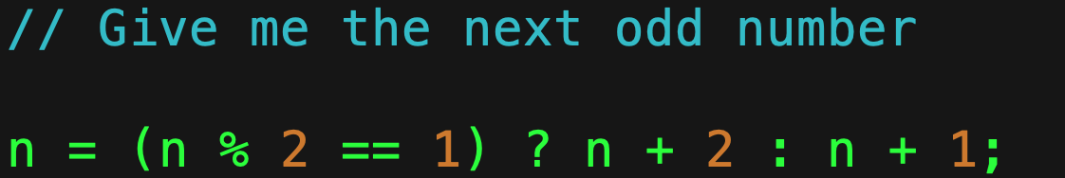
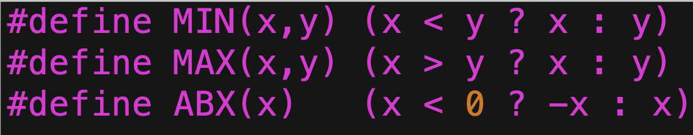
What is that thing?!
?: is a ternary operator.
It’s like an if-else statement, but it can be part of an expression.
If the first part is true, it’s value is the second part.
If the first part is false, it’s value is the third part.
Use it with care, it can lead to unreadable code if abused.
This defines a macro, more on that later.

Slide 19
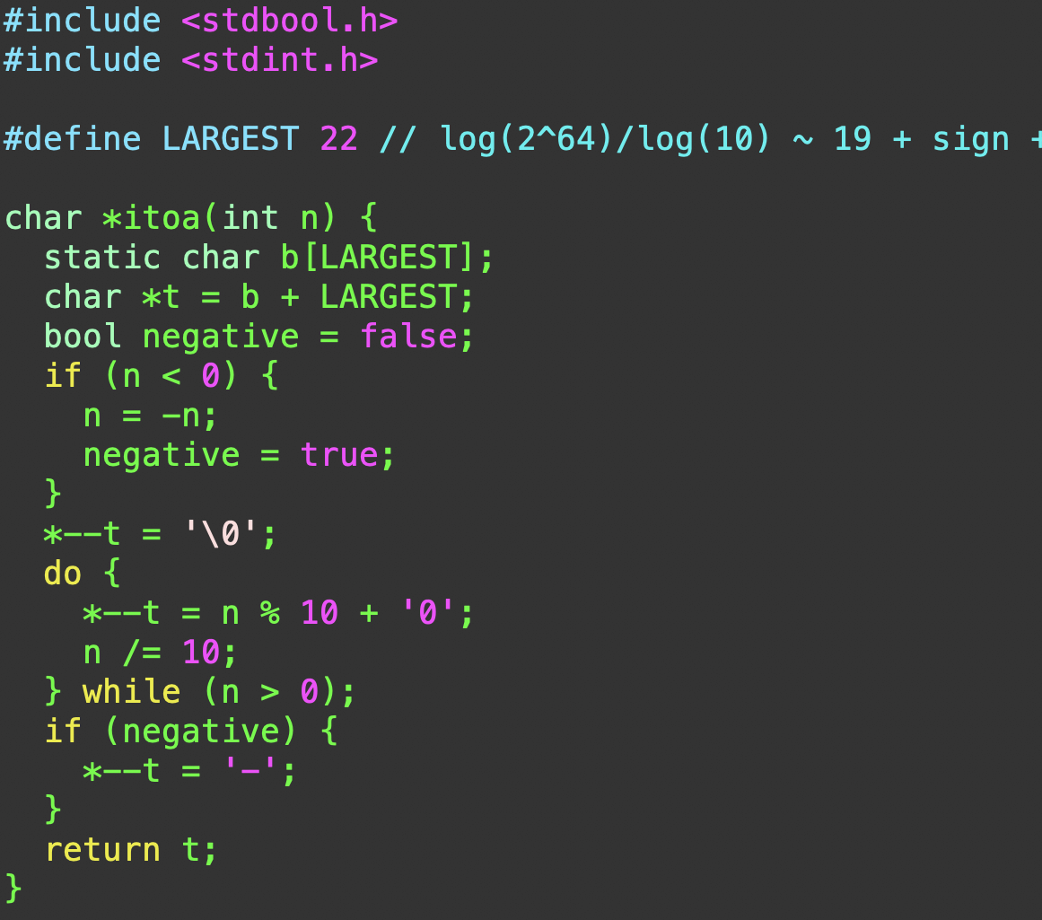
Vade Mecum

Slide 20
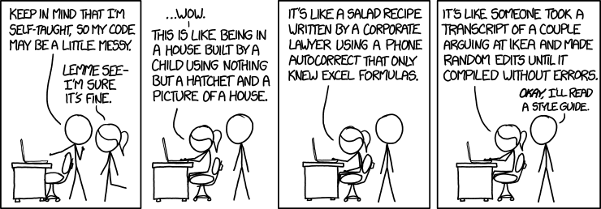
Do not be That Guy...

Slide 21
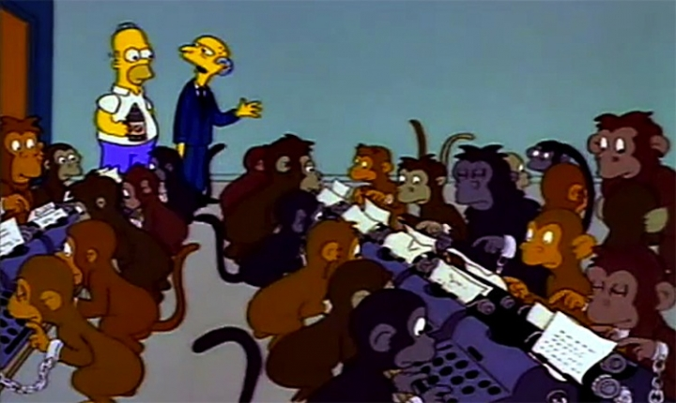
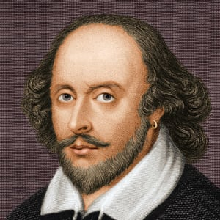
Some Advice…
You should take time to think before you code.
Work out examples on paper or on a whiteboard.
Pounding on the keyboard is unlikely to produce quality code.
Quality code requires that you rewrite it, just like you rewrite drafts of an essay.

