Slide 1
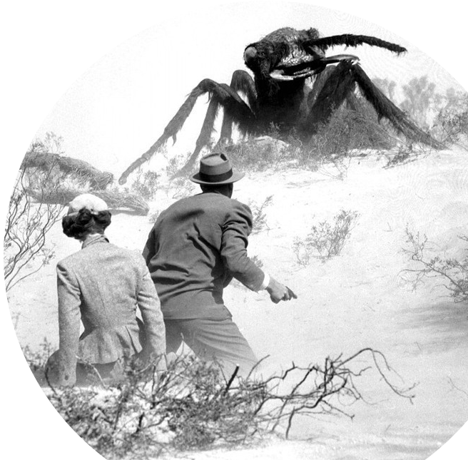
Prof. Darrell Long
CSE13
Stacks and Queues
1

Slide 2
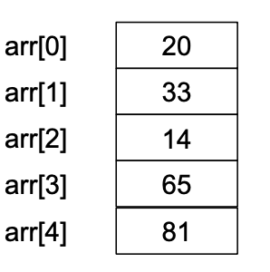
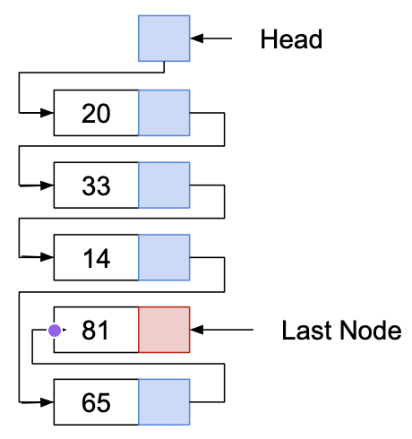
Arrays
Linked Lists
Arrays allow random access:
Each element can be accessed directly in constant time.
Linked lists allow sequential access:
Each element can only be accessed in a particular order.

Slide 3
Stacks and Queues
Stacks and queues operate as containers for other data types.
For the most part, data of any type may be placed in a stack or a queue.
Both stacks and queues:
Have well-defined semantics
A fixed set of operations
A distinct ordering to their elements

Slide 4
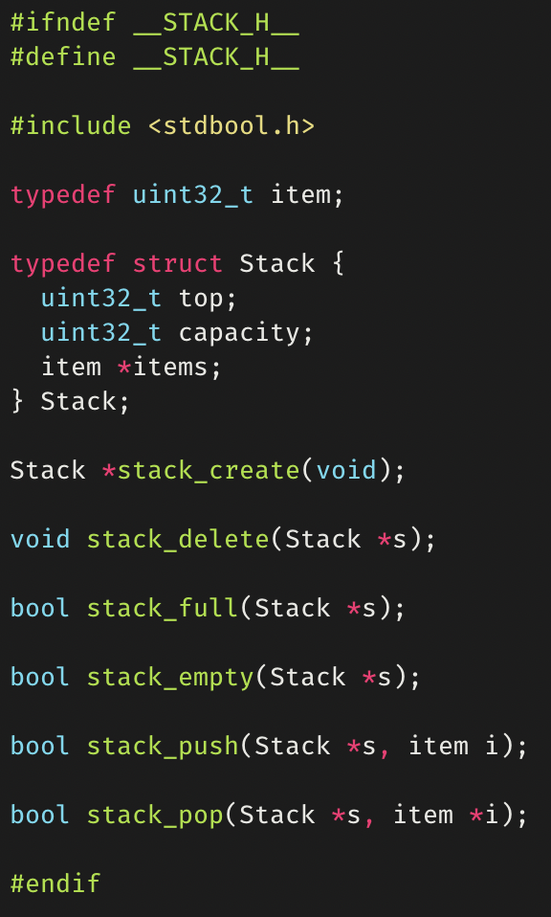
Stacks
Objects are added and removed using last-in-first-out (LIFO) order.
Capacity of a stack is the number of stack elements that will fit.
This capacity can be increased as number of elements increases through reallocation (dynamic).
Often implemented with arrays, but other possibilities exist as long as the semantics are preserved.
© 2020 Darrell Long

Slide 5
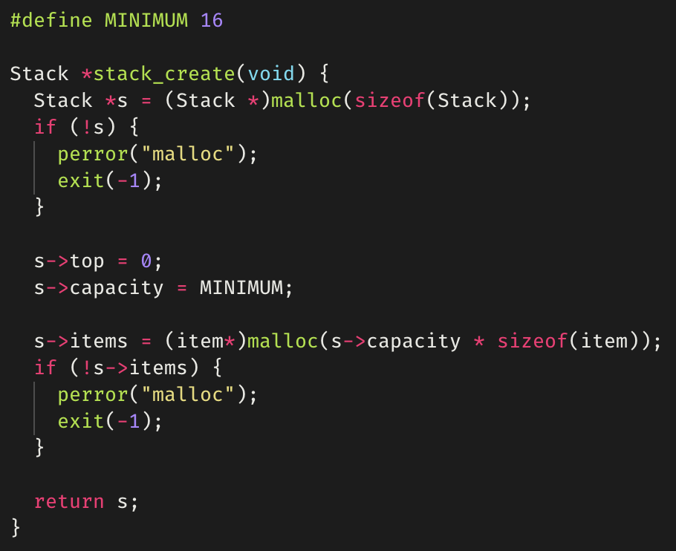
stack_create()
© 2020 Darrell Long

Slide 6
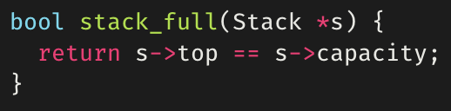
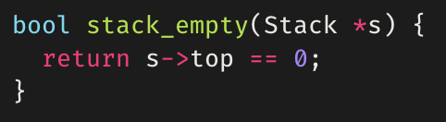
stack_full()
stack_empty()
© 2020 Darrell Long

Slide 7
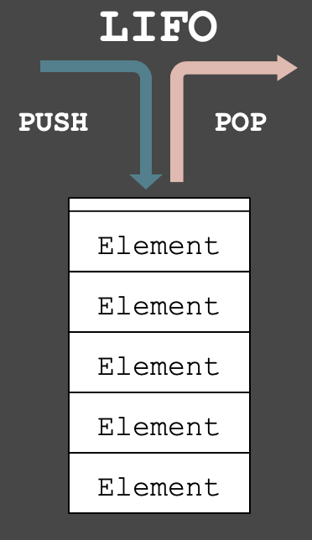
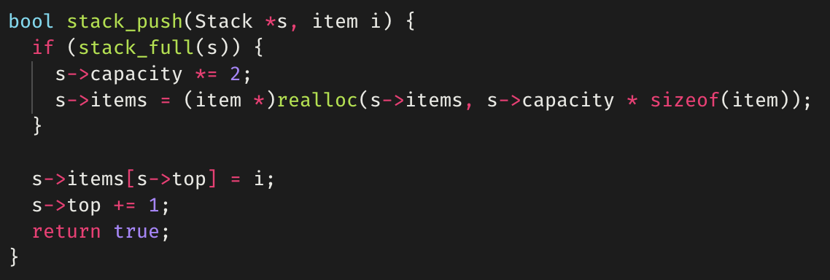
stack_push()
Adds an element to the top of a stack.
Example is for a dynamic stack, in which memory is reallocated when the stack is “full”.

Slide 8
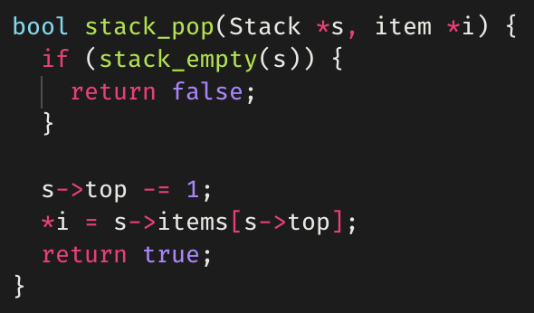
stack_pop()
Removes the element at the top of a stack.
Returns false if the stack is empty.

Slide 9
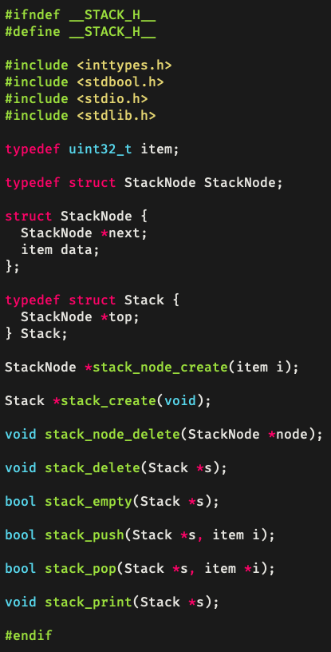
Stacks using linked lists
Stacks can also be implemented using linked lists.
Each element of the stack points to the next.
© 2020 Darrell Long

Slide 10
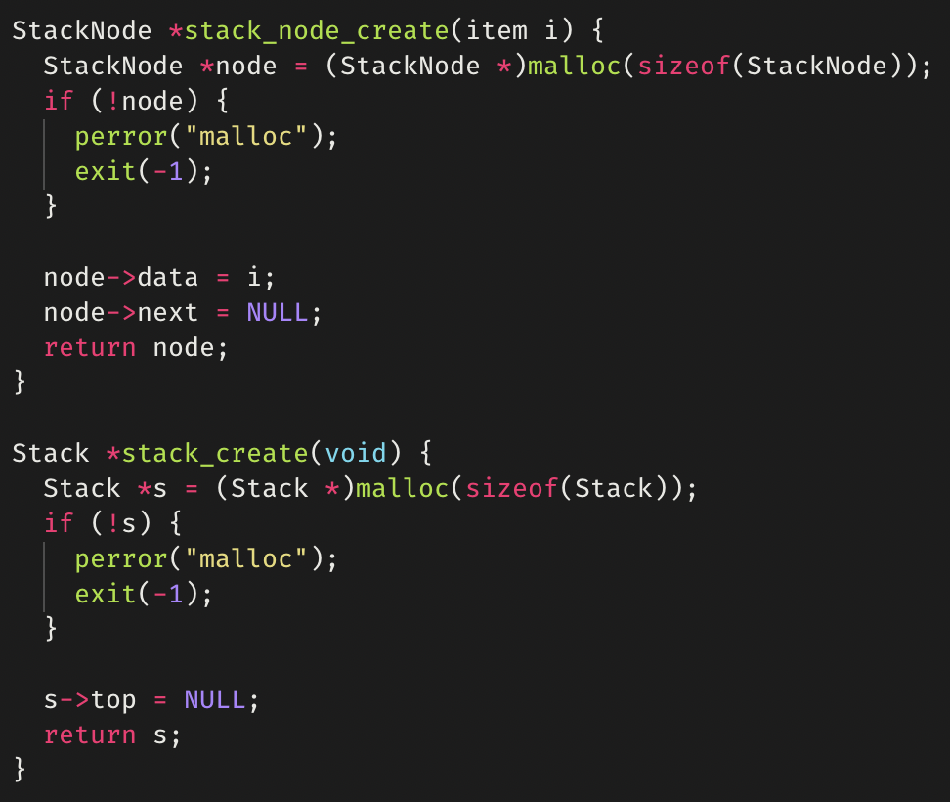
stack_create()
© 2020 Darrell Long

Slide 11
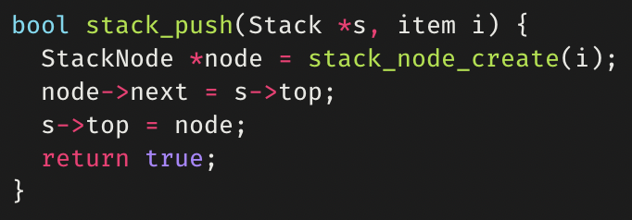
stack_push()
© 2020 Darrell Long

Slide 12
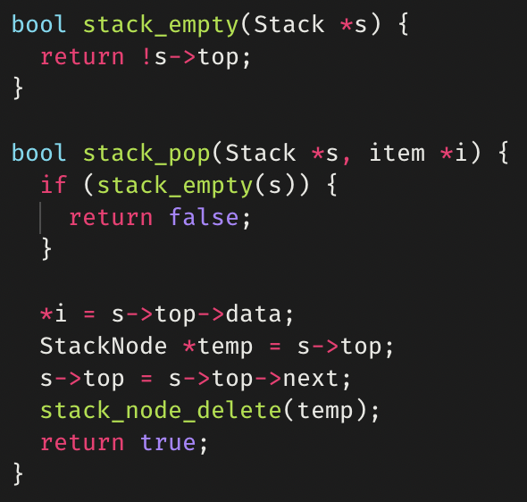
stack_pop()
© 2020 Darrell Long

Slide 13
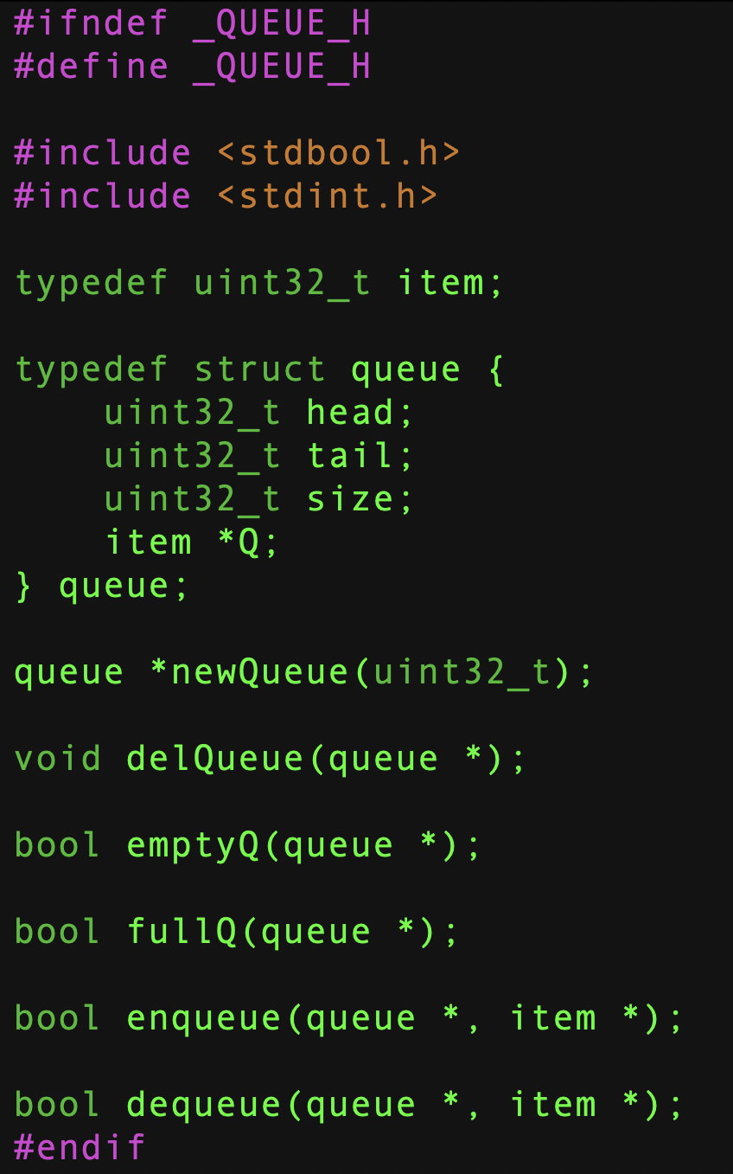
queue.h
A queue is an abstract data type (ADT), so let’s define it.
For our implementation we need:
A head, a tail, and a size, and
A pointer to an array.
A constructor
A destructor
Empty and full predicates
Enqueue — inserts into the queue
Dequeue — removes from the queue

Slide 14
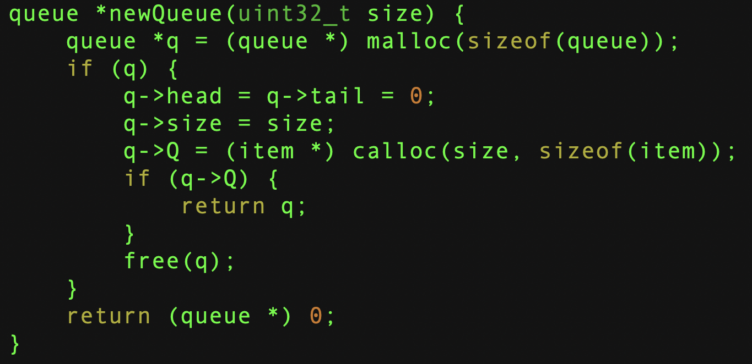
Create a Queue

Slide 15
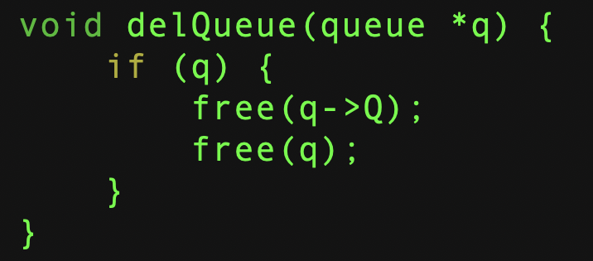
Delete a Queue

Slide 16
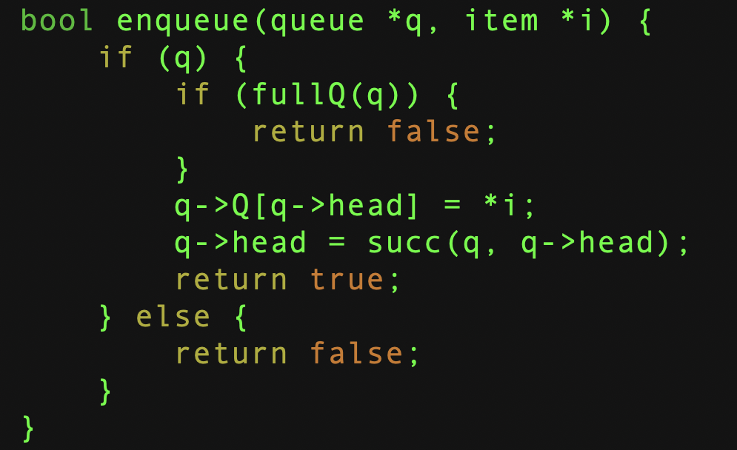
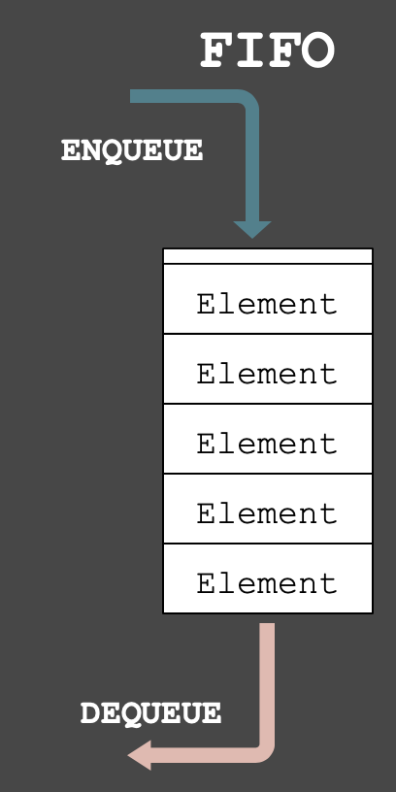
Enqueue an Item

Slide 17
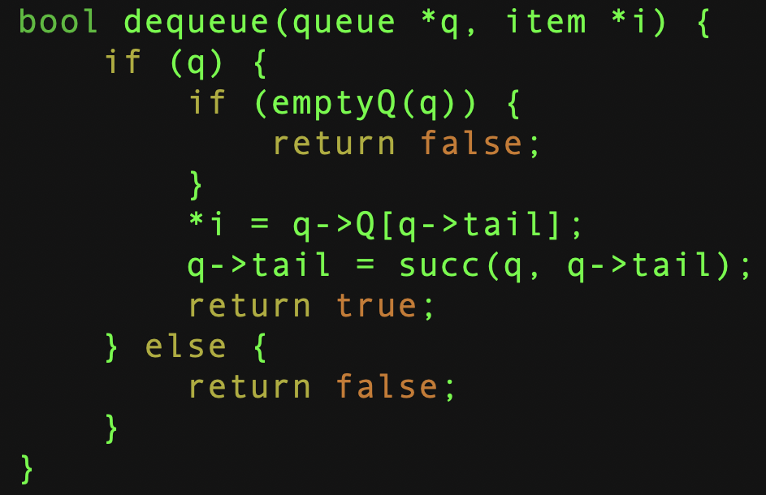
Dequeue an Item

Slide 18
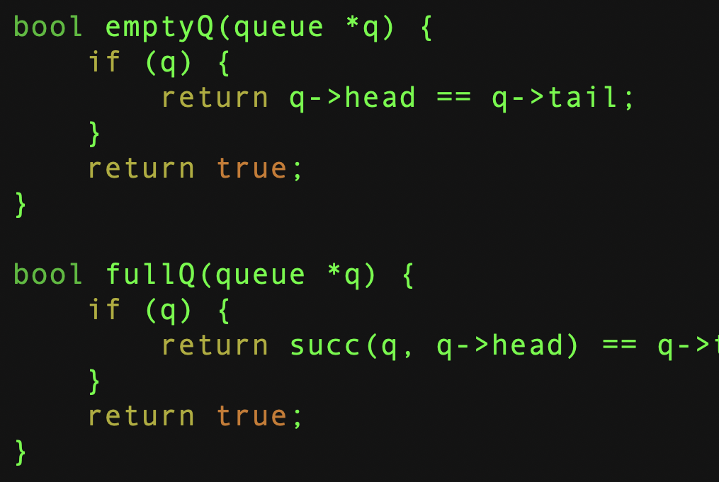
Empty? Full?

Slide 19
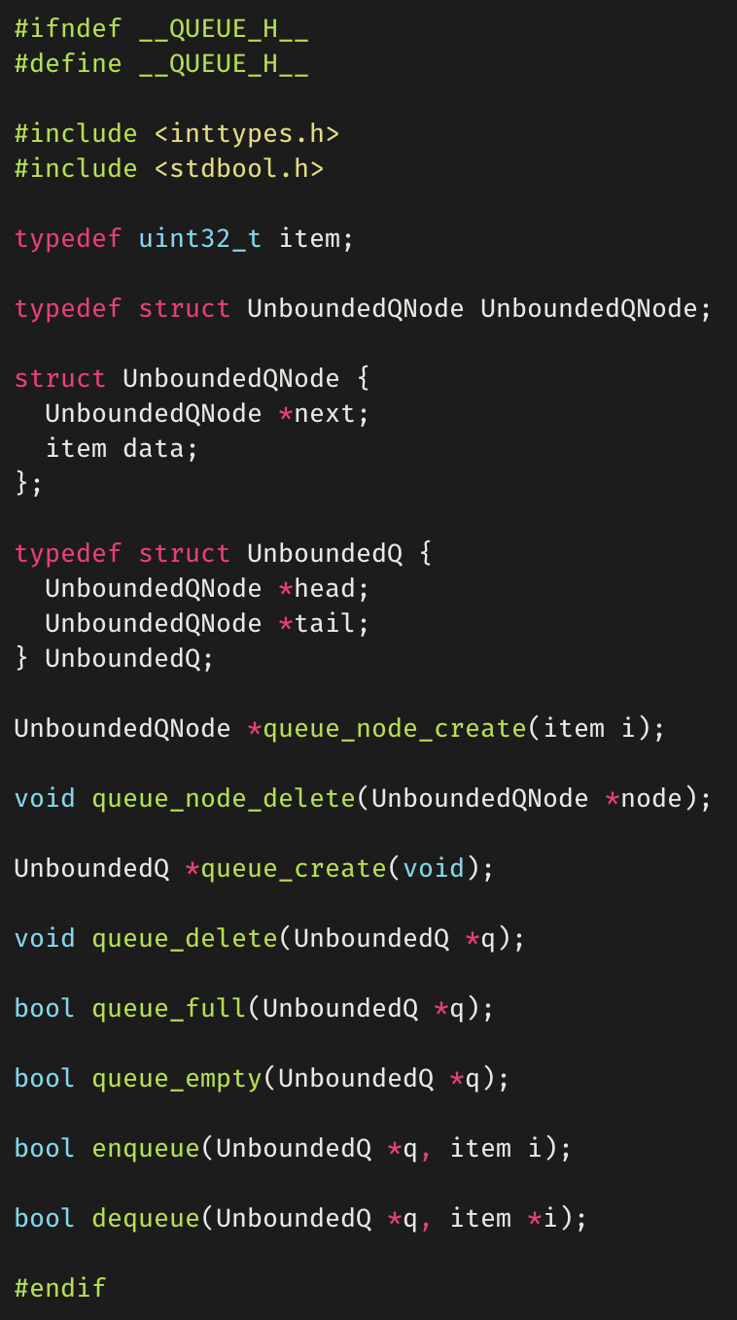
Unbounded Queues
Unbounded queues can be implemented with a linked list.
The unbounded queue itself is a wrapper for a linked list.
The wrapper keeps track of the head and tail.
© 2020 Darrell Long

Slide 20
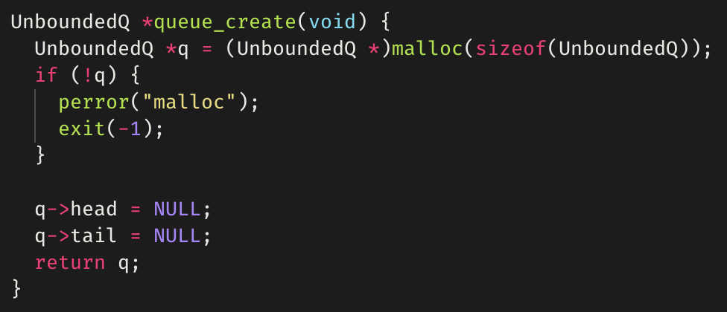
queue_create()
Creating
The unbounded queue itself is a wrapper for a linked list.
The wrapper keeps track of the head and tail.
© 2020 Darrell Long

Slide 21
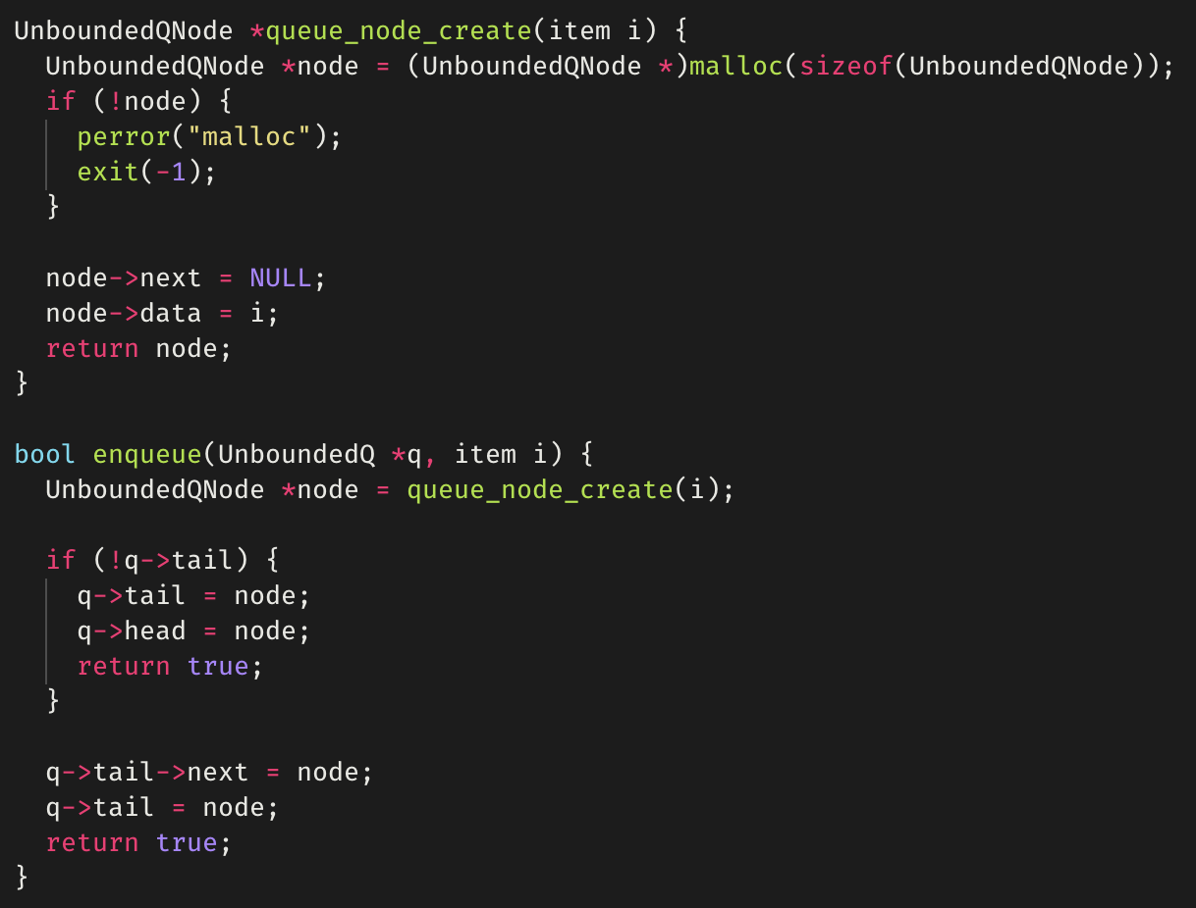
enqueue()
The enqueue() function first creates the node to enqueue.
If the queue is empty, both the head and tail point to the new node.
Else, add new node to the end.
© 2020 Darrell Long

Slide 22
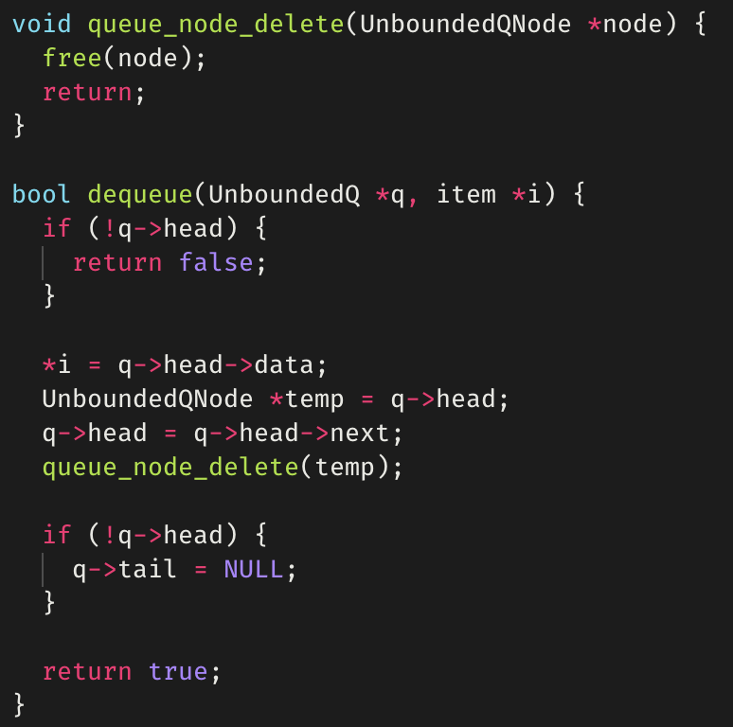
dequeue()
The dequeue() function first stores the data into the supplied item pointer.
The head of the queue is moved forward one node.
We save a pointer to it so we can free memory.
If the queue is empty now, the tail is set to NULL.
© 2020 Darrell Long

Slide 23
Differences between stacks and queues
Removing an element:
Stack removes the most recently added element.
Queue removes the least recently added element.

Slide 24
Queue implementations
Commonly Implemented using vector-based data structures:
Arrays, linked-lists, vectors (used in C++), etc.
Some queue implementations feature an algorithm, or a rule called move-to-front:
Elements that have been previously searched for in a queue are placed at the front of the queue.
Typically used as an optimization, as the recent past is a good indicator of the near future.

Slide 25
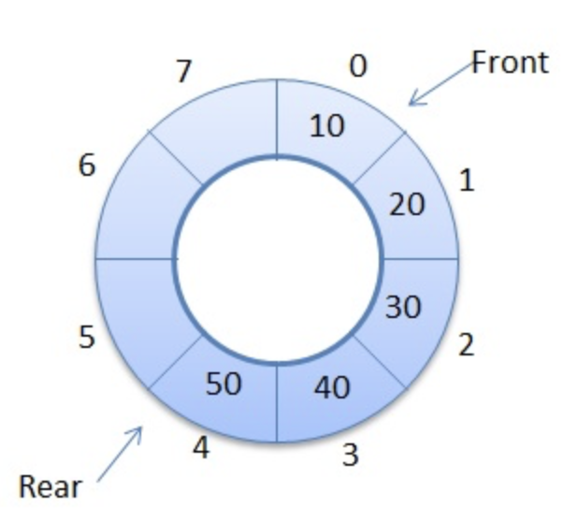
Circular Queue
Linear data structure:
Operations performed using FIFO.
Last position connected back to the first position to make a circle.
Operations on circular queue:
Front/Rear: get the front/last item of the queue.
enQueue: insert new element always in the rear end of queue.
deQueue: delete element from front position.
Also called wrap-around queue.
© 2020 Darrell Long

Slide 26
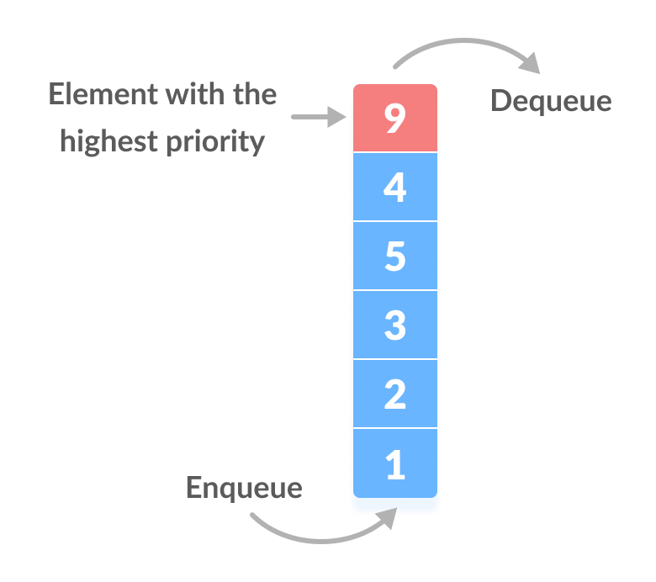
Priority Queue
Implemented like a generic queue, BUT every element has a priority associated with it.
Element of highest priority is dequeued before elements with lower priority.
In the case of two elements of the same priority, preference is given to the position of the element in the queue.

Slide 27
Summary
Stacks use LIFO
Queues use FIFO
Both can be implemented using arrays and linked lists.
27

