Slide 1

Sorting
Prof. Darrell Long
CSE 13S

Slide 2
What is sorting?
Sorting is the act of putting things into a defined order.
Dictionaries are sorted in what is called lexicographical order.
Only fancy people call it that, most people say alphabetical order.
Numbers can be sorted in their natural order, or reverse order.
There are total and partial orderings, but we will only concern ourselves with total orderings.

Slide 3
Why do we sort?
Sorting adds information to our data.
For example, we now can make assertions about before, after, lesser, greater, and so forth.
Here are a few examples:
We can search most efficiently in sorted data.
We can marge sorted lists efficiently.
We can detect duplicates efficiently.

Slide 4
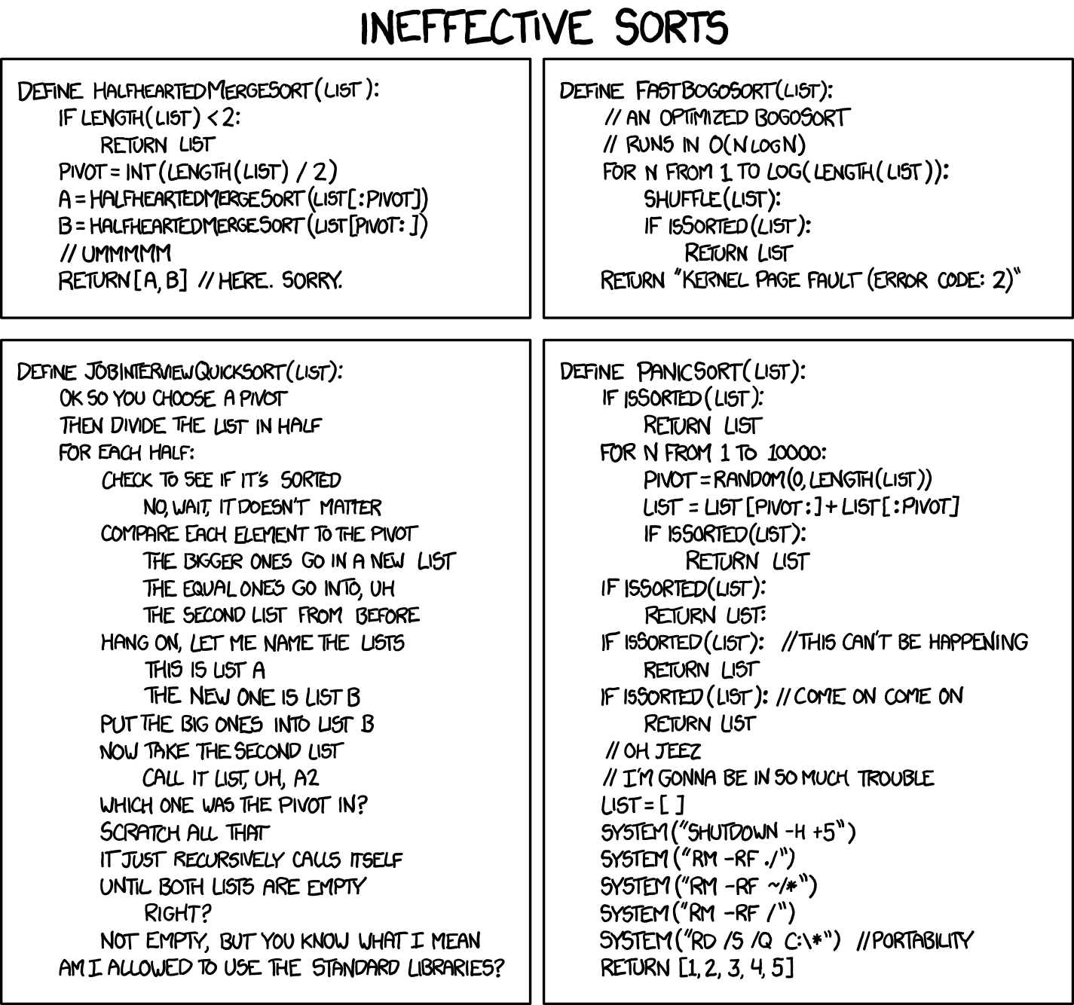
https://xkcd.com/1386/

Slide 5
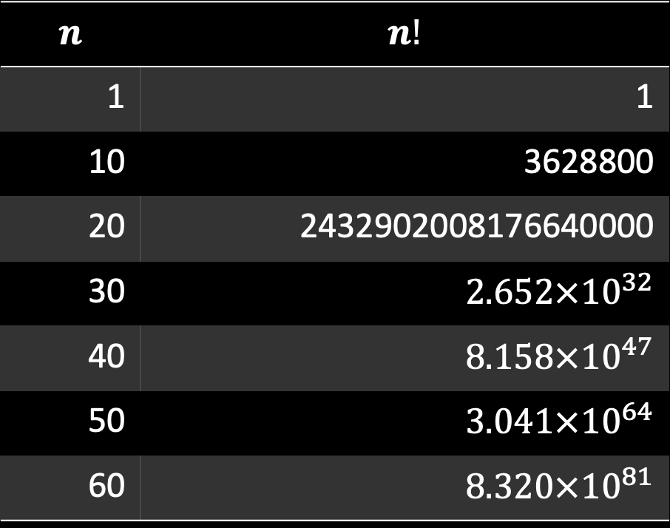

First idea…
$$n$$ | $$n!$$
1 | 1
10 | 3628800
20 | 2432902008176640000
30 | $$2.652×{10}^{32}$$
40 | $$8.158×{10}^{47}$$
50 | $$3.041×{10}^{64}$$
60 | $$8.320×{10}^{81}$$
Enumerate all of the possible orderings of n objects.
There are $n!$ such orderings
Pick the one that is in order.
On second thought, that was a bad idea.
So what should we do? Find a better idea.
This number exceeds the number of protons in the known universe.

Slide 6
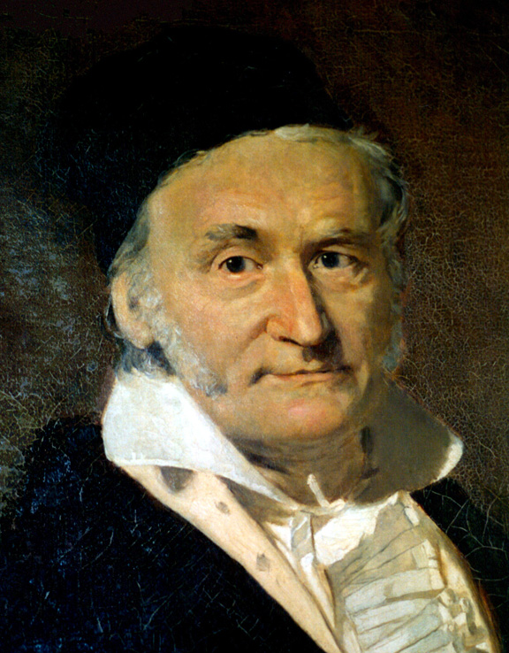
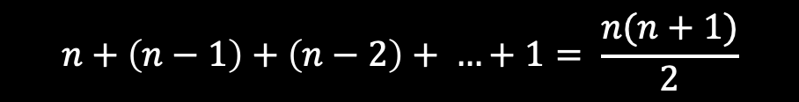

Second idea…
$$n+\left(n−1\right)+\left(n−2\right)+ …+1= \frac{n(n+1)}{2}$$
Carl Friedrich Gauß
Find the smallest item, to do that we must look at all $n$ of them.
Put it in the first slot.
What do I do with what was already there?
Let’s swap them.
Once the smallest item is found, we never look at it again. In effect, we have a smaller, by 1, unsorted array.
We repeat the same process for smaller and smaller subarrays: $n−1, n−2, …, 1$.
This is an instance of Selection Sort.

Slide 7
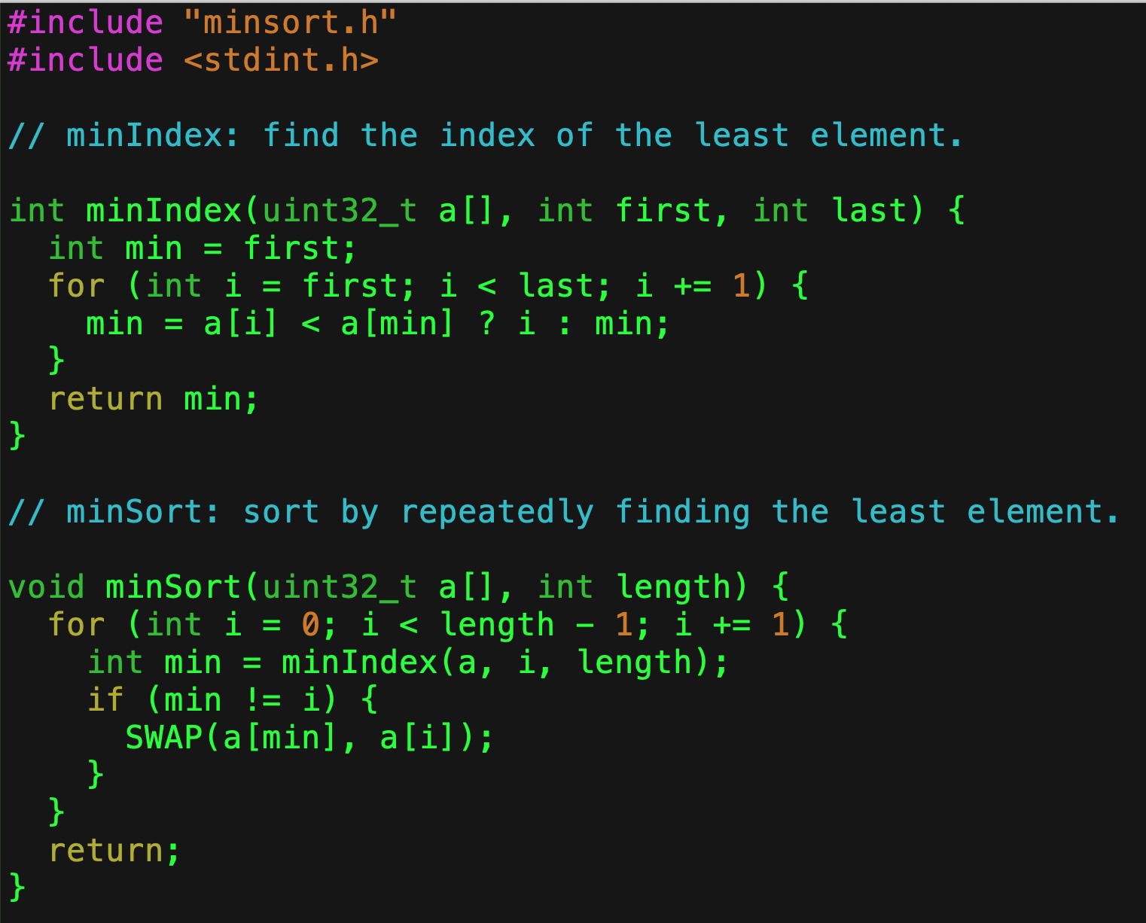
MinSort
Good use of the ternary operator

Slide 8
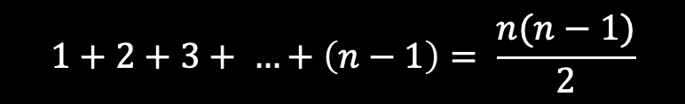
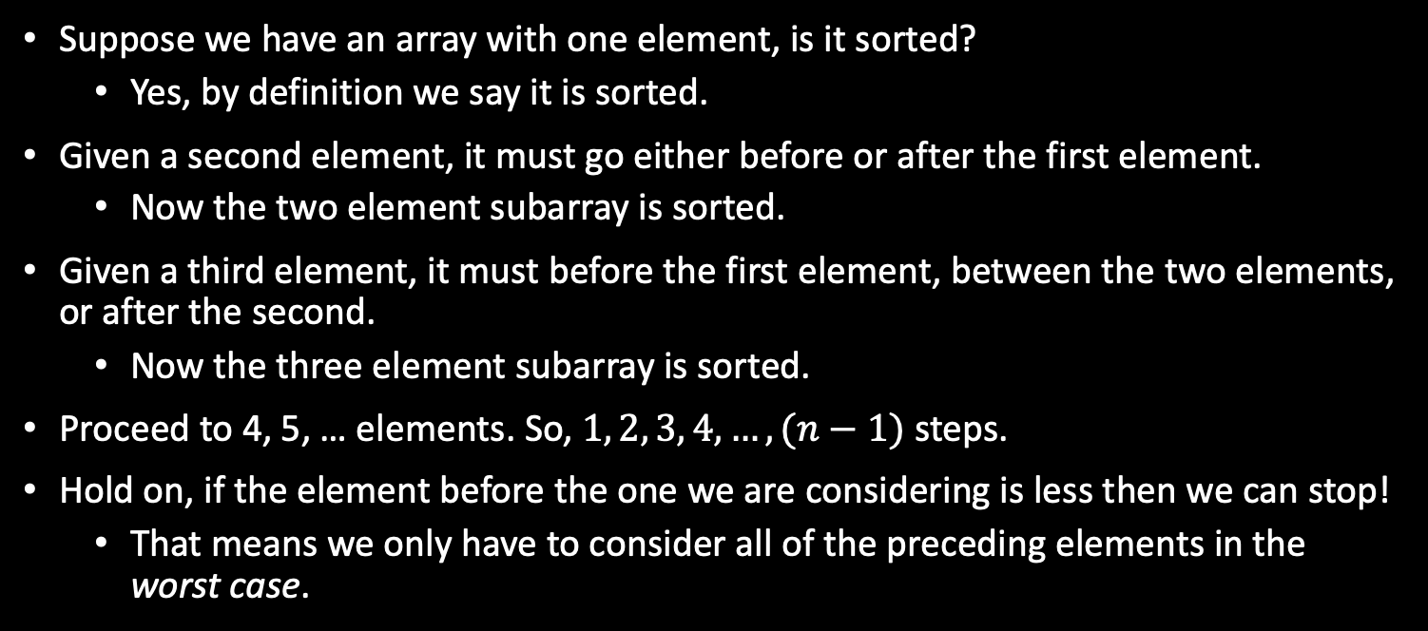
Third idea…
$$1+2+3+ …+\left(n−1\right)= \frac{n(n−1)}{2}$$
Suppose we have an array with one element, is it sorted?
Yes, by definition we say it is sorted.
Given a second element, it must go either before or after the first element.
Now the two element subarray is sorted.
Given a third element, it must before the first element, between the two elements, or after the second.
Now the three element subarray is sorted.
Proceed to 4, 5, … elements. So, $1, 2, 3, 4, …, (n−1)$ steps.
Hold on, if the element before the one we are considering is less then we can stop!
That means we only have to consider all of the preceding elements in the worst case.

Slide 9
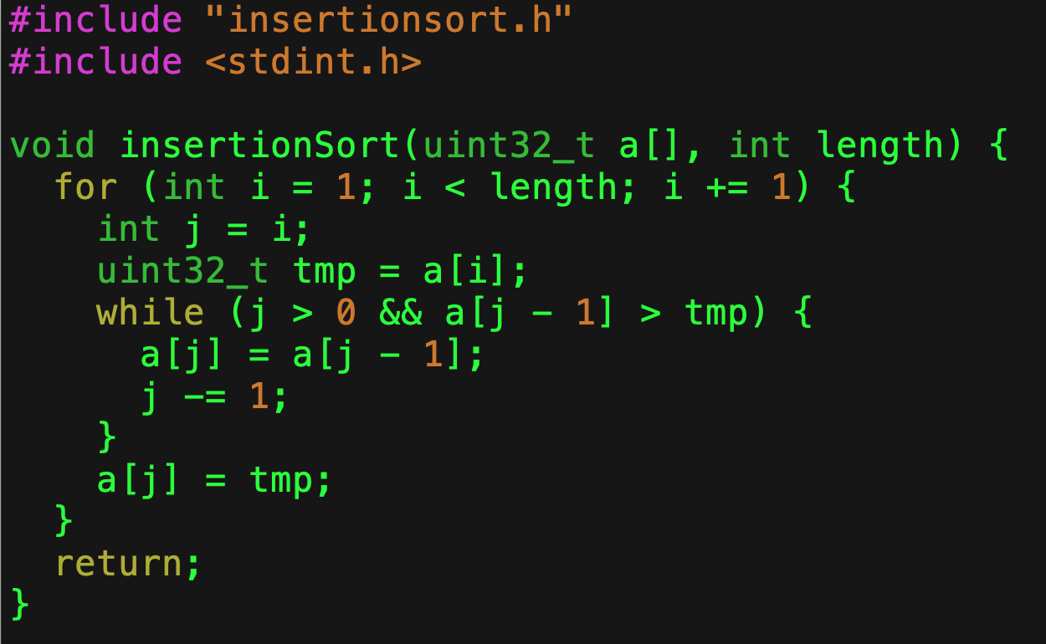
InsertionSort

Slide 10

Fourth idea…
Suppose we have an unsorted array.
Look at the first two elements, if the first is greater than the second then swap them.
Move on to the second and third elements, swap if they are out of order.
Continue on with this procedure up to the last pair of elements in the array.
What do we know?
The last element of the array is the largest! So we can now ignore it.
Repeat this procedure on the first $n−1$ elements, then on $n−2,$ …
But wait, what happens if you look at a subarray and we make no swaps?
We know that the array is sorted!
In the best case, we only examine $n−1$ pairs.

Slide 11
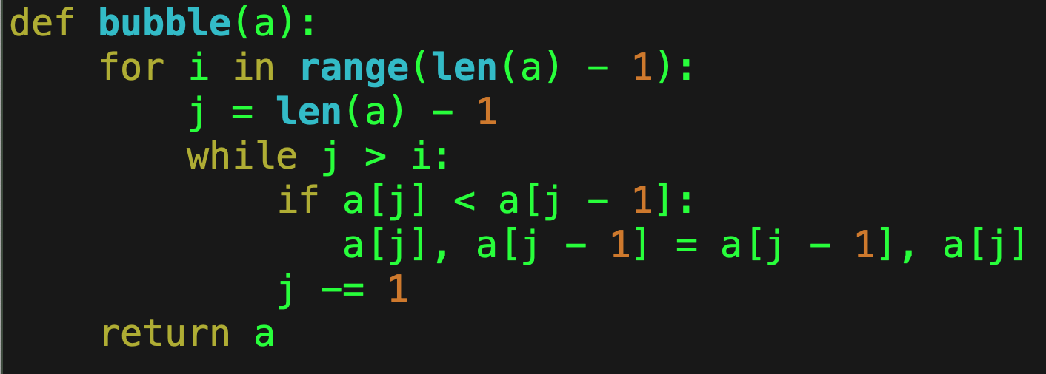
BubbleSort

Slide 12
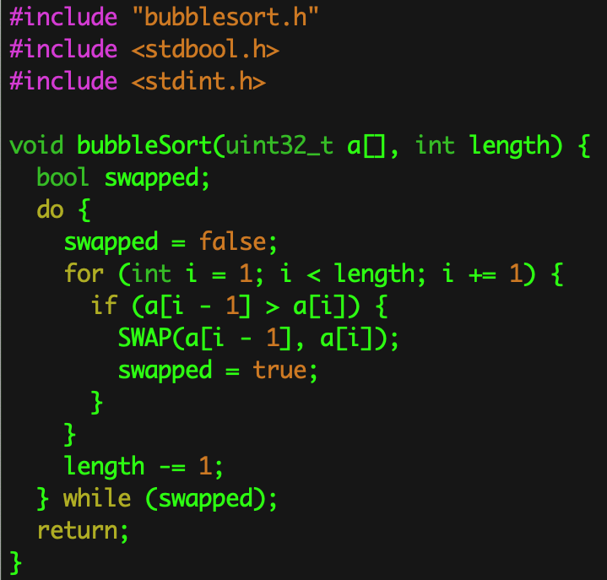
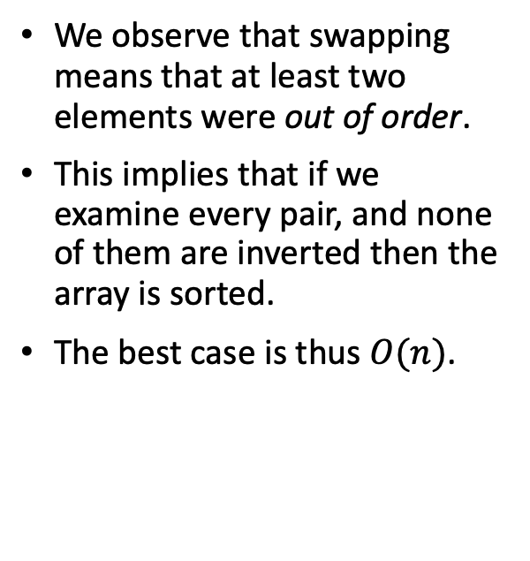
We can immediately do better!
We observe that swapping means that at least two elements were out of order.
This implies that if we examine every pair, and none of them are inverted then the array is sorted.
The best case is thus $O(n)$.

Slide 13
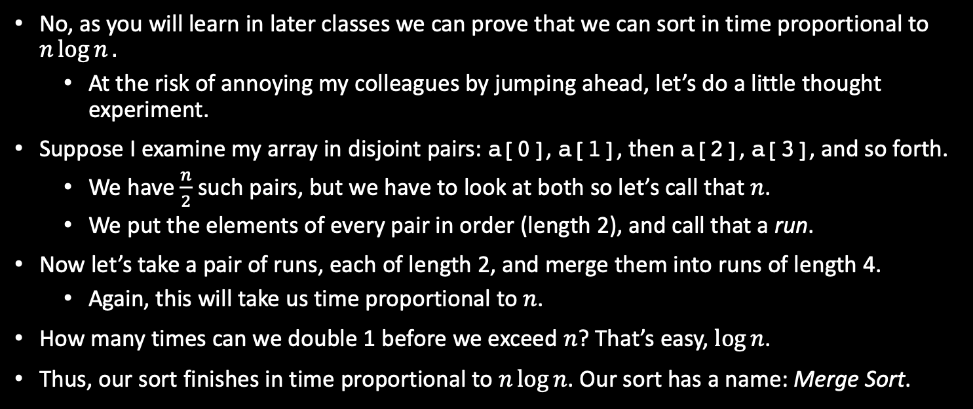
Is that the best we can do?
No, as you will learn in later classes we can prove that we can sort in time proportional to $n\log{n}.$
At the risk of annoying my colleagues by jumping ahead, let’s do a little thought experiment.
Suppose I examine my array in disjoint pairs: a[0], a[1], then a[2], a[3], and so forth.
We have $\frac{n}{2}$ such pairs, but we have to look at both so let’s call that $n$.
We put the elements of every pair in order (length 2), and call that a run.
Now let’s take a pair of runs, each of length 2, and merge them into runs of length 4.
Again, this will take us time proportional to $n$.
How many times can we double 1 before we exceed $n$? That’s easy, $\log{n}$.
Thus, our sort finishes in time proportional to $n\log{n}$. Our sort has a name: Merge Sort.

Slide 14

Comparative Sorting Algorithms
Here are some $O(n^{2})$ sorting algorithms:
Bubble Sort
Insertion Sort
Selection Sort
Quick Sort (worst case)
Shell sort is an $O(n^{\frac{5}{3}})$sorting algorithm.
It is surprisingly good!
Here are some $O(n\log{n)}$ sorting algorithms:
Merge Sort
Heap Sort
Quick Sort (average case)

Slide 15
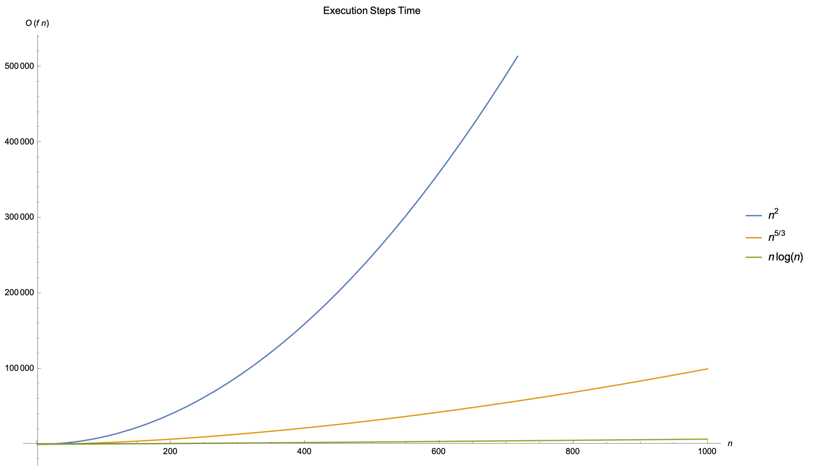
Comparison of Execution Times

Slide 16
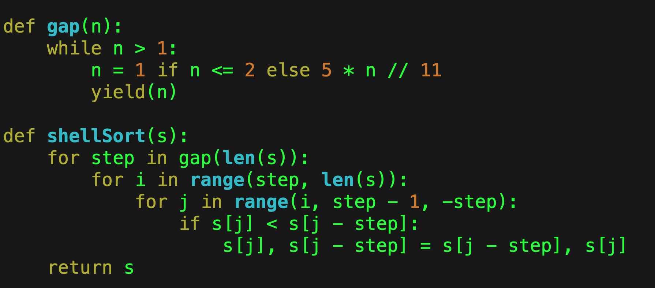
Shell Sort

Slide 17
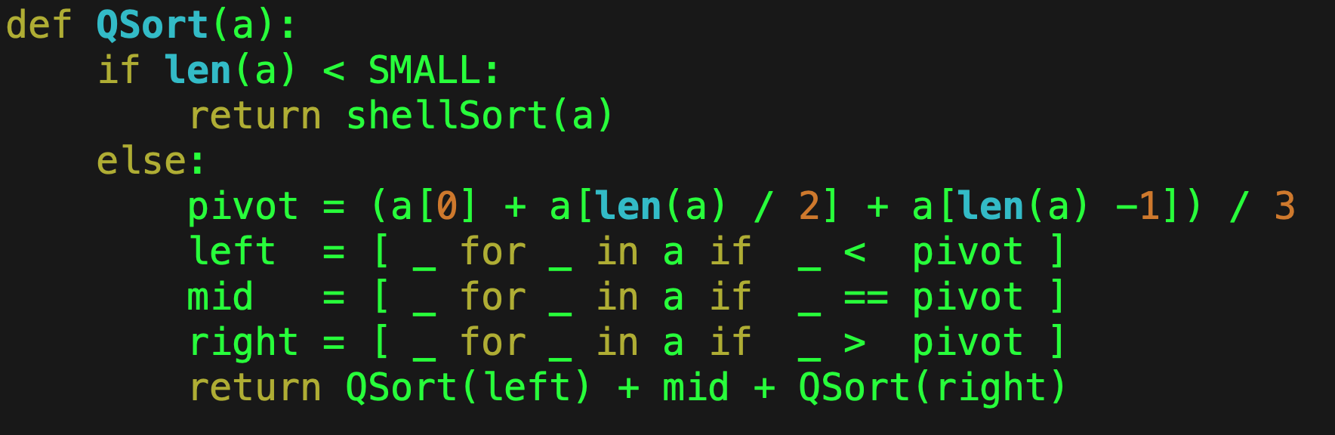
QuickSort

Slide 18
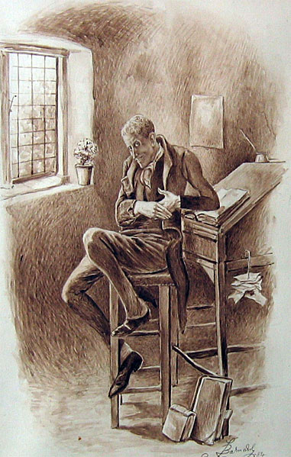
Heaps
There are many types of heaps:
Minimum/Maximum Heaps
Leftist Heaps
Binomial Heaps
Fibonacci Heaps
Brodal Heaps
Radix Heaps, …
Uriah Heeps

Slide 19
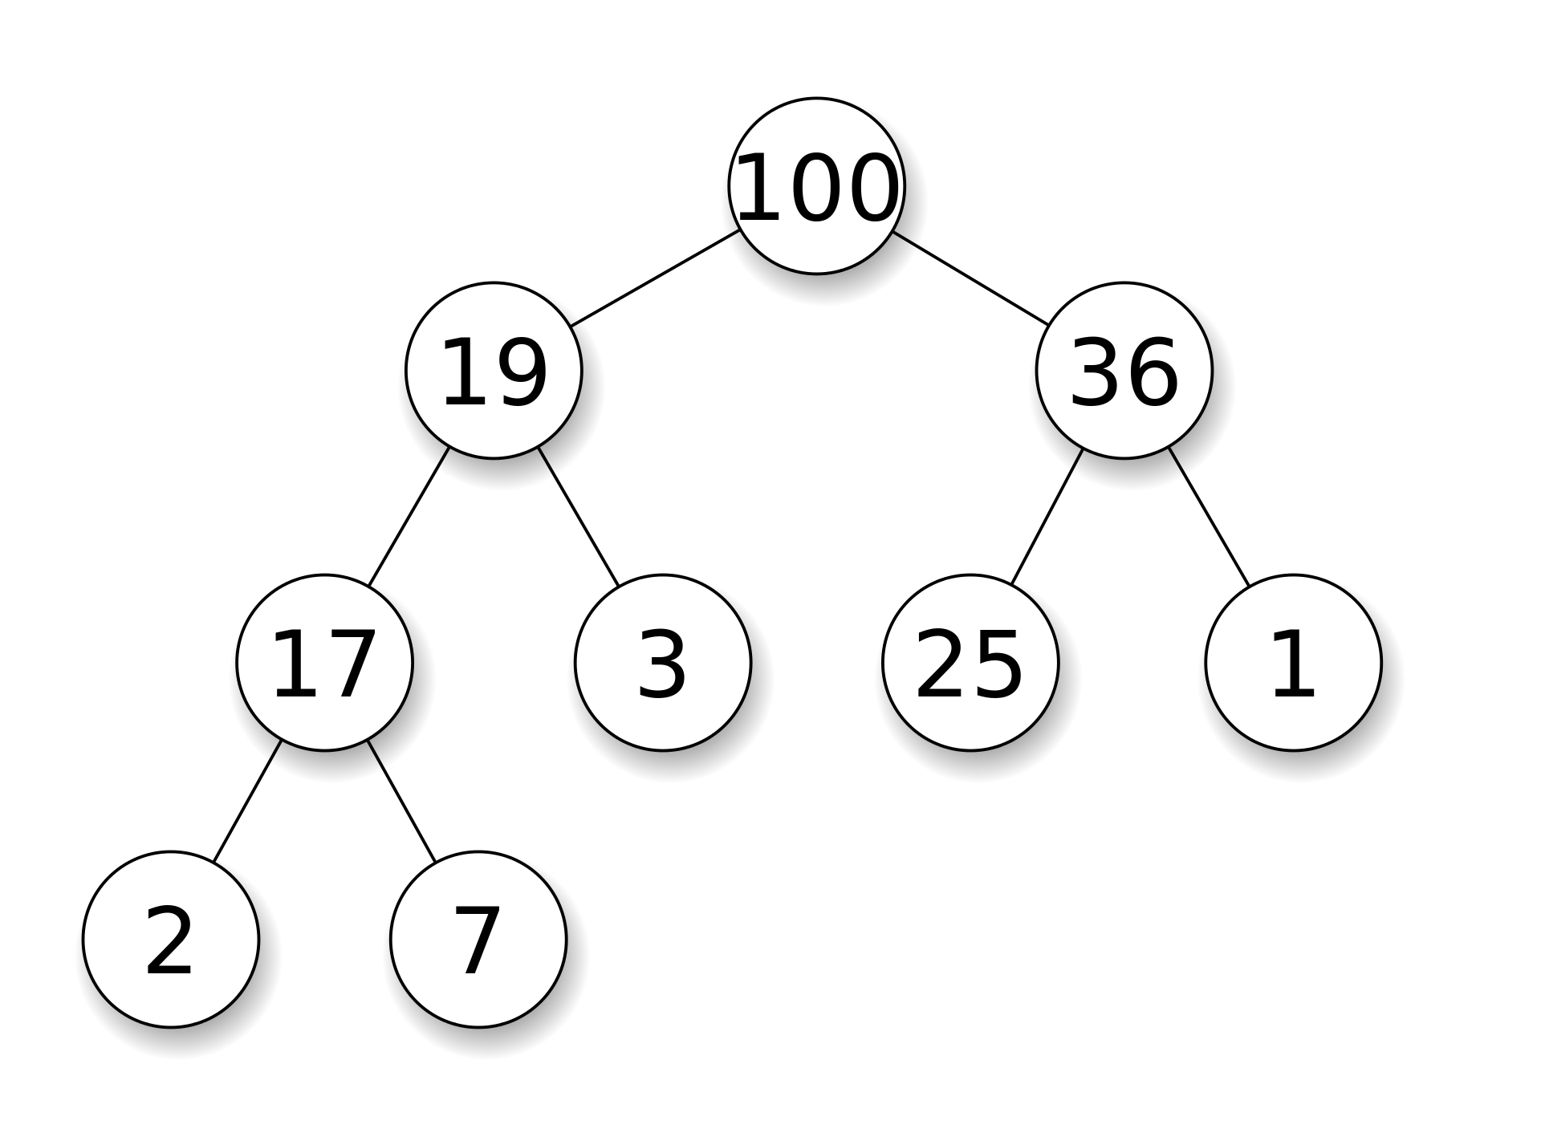
A (Max) Heap
A single node is a heap.
It is a heap if the parent is a heap and the trees rooted at both children are heaps.
A parent’s value (key) is greater than that of either child.
There is no order among the children.

Slide 20
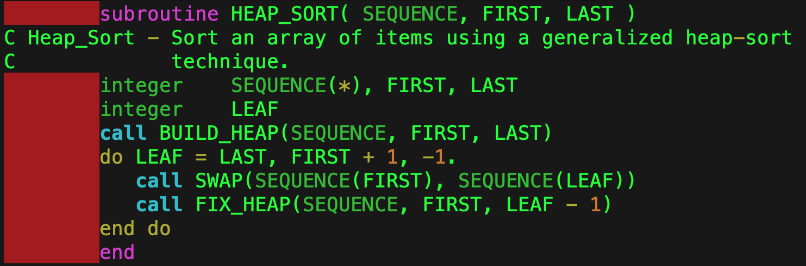
Heap Sort

Slide 21
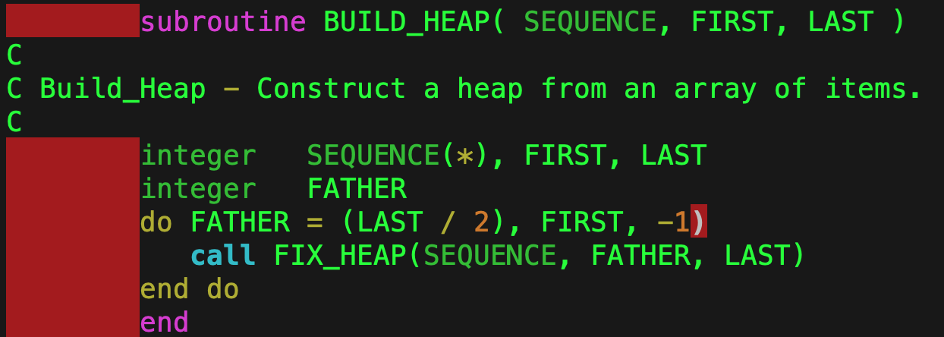
Build Heap

Slide 22
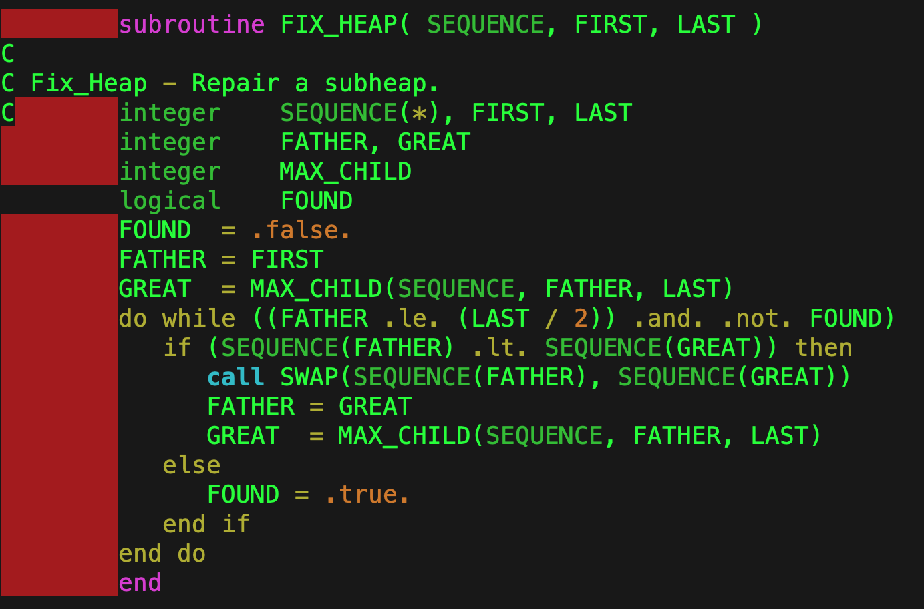
Fix Heap

Slide 23
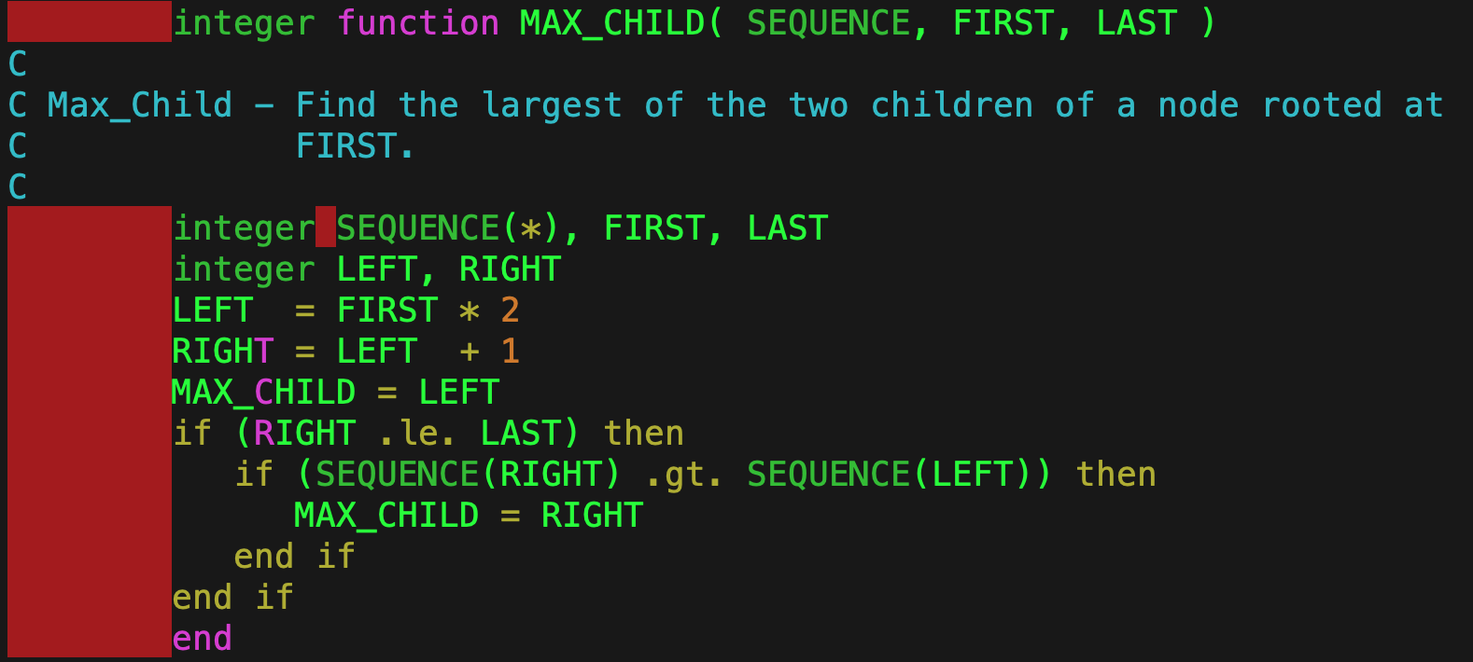
Max Child

Slide 24
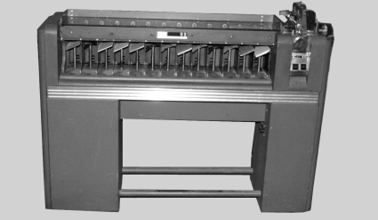
Can I do even better?
Using comparisons, the answer is no.
But, if we make some assumptions about the encoding then you can use a Radix Sort.
It runs in time proportional to the number of digits in the key times the number of records.
It was invented for the mechanical sorting of punched cards.

Slide 25

Summary
Sorting is a fundamental operation, so doing efficiently has a huge impact on computing.
Analysis of algorithm complexity is an important topic, and you will be a lot of it in your advanced classes.
A better algorithm makes a lot more difference than a faster computer.
You will encounter many instances in your career where you need to employ a sorting algorithm, and the best one will depend on the circumstances and the data structures employed.

