Slide 1

Prof. Darrell Long
CSE13
Hashing and Bloom Filters

Slide 2
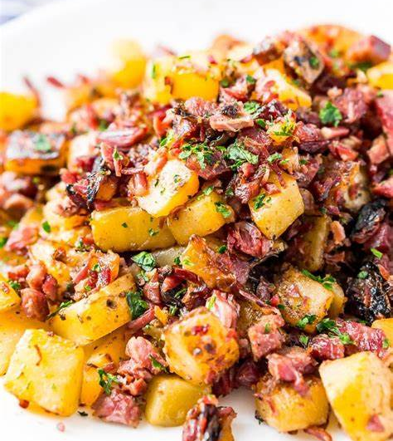
Hash?
Is it a food?
Yes.
But for us, it means chopping things up and mixing them around.
Yes, like the food.
We take a key (a string) and make a number from it.
The resulting number should be uniformly distributed.

Slide 3


Problem
We want to use this to find records based on a key.
Queries we should be able to make efficiently:
Insert a key and its corresponding value.
Search for a key and fetch the corresponding value.
Delete a key along with its corresponding value.

Slide 4

Data Structures that can be used to solve the problem?
Expected time in arrays and linked lists:
Linear search: look-ups in unsorted arrays take $O(n).$
Binary search: look-ups in sorted arrays take $O(log⁡(n)).$
Linked list look-ups take $O(n).$
Direct address table is a key-value store where the key is used as an index to the value :
Random access arrays: searching in in$O(1)$time.
Limitations:
Need prior knowledge of maximum key value.
Wastage of memory space if there is a significant difference between total records and preset maximum table size.

Slide 5

Hashing
The idea behind hashing or scatter storage is to scramble up aspects of the key and use this partial information for searching.
Improvement over Direct Address Table:
Uses a function that hashes a larger fixed key into a smaller number:
Less than or equal to the size of the table.
Uses the smaller number as index of the value.
With hashing we get $O(1)$search time on average (under reasonable assumptions) and $O(n)$in worst case.

Slide 6
An unordered collection of key-value pairs.
Offers efficient lookup, insert, and delete operations:
Neither arrays nor linked lists achieve all of these.
The Python dictionary is a hash table. Example:
my_dict = {1:’Ron’,2:’Bob’}
Key 1 is associated with the name ‘Ron’ and key 2 is associated with the name ‘Bob’.
Hash Tables

Slide 7
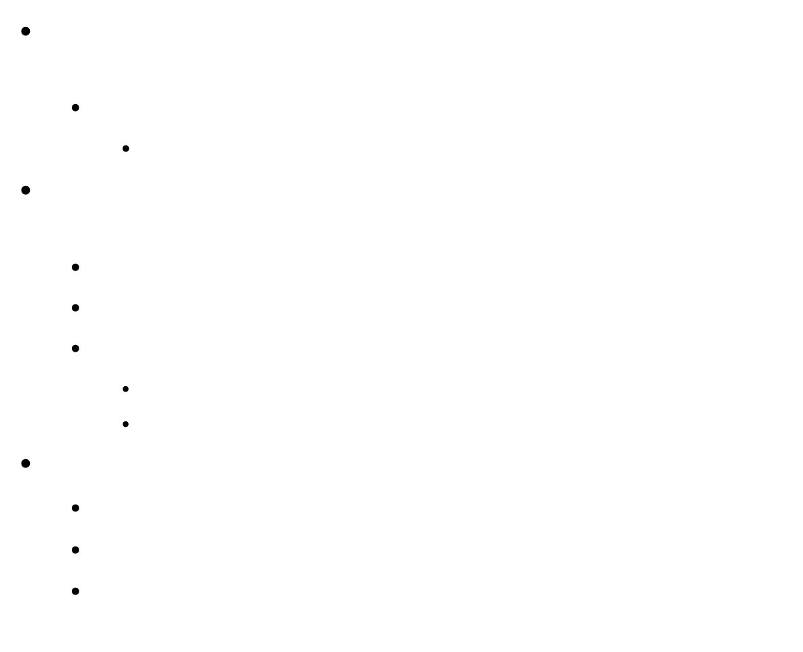
Hash functions
A function that hashes keys to generate indices for each value:
For a hash table with m slots:
$h\left(key\right)→index∈[0, m−1]$
Characteristics of a good hash function are determined by the data being hashed:
Function uses all input data.
Computation is fast.
Minimizes hash collisions:
Uniformly distributes data across entire set of possible hash values.
Generates very different hash values for similar strings.
Types of hash functions
Division based.
Multiplication based.
String-valued keys.

Slide 8

Hash functions: Division based method
Most simple method for hashing is the remainder modulo method.
Formula: $h\left(K\right)=K mod M$
$K$ is the key.
$M$ is the table size.

Slide 9


Good Values of $M$
Based on previous considerations we conclude to choose $M$ to be a prime number such that:
$$r^{b}≢± a (mod M)$$
For small values of$b$and $a$.
$r$is the radix of the alphabetic character set.

Slide 10
Hash functions: String-valued key
Sometimes you want to use string-valued keys for a hash table.
Basic approach:
Take characters from string-valued key.
Compute an integer using an appropriate method.
Integer modulo the table size.
Can we just add the letters?
Addition commutes.
No, the number of possibilities is too small.
Can we just multiply them?
No, multiplication also commutes.
Creating a good hash function is not easy.

Slide 11
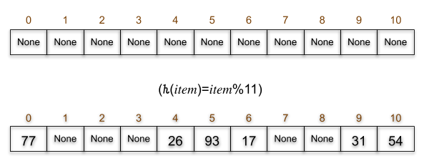

Example of a Hash Table
Begin with an empty hash table.
Store numbers with their respective keys:
{91:54, 38:26, 47:93, 56:17, 2:77, 82: 31}
Hash function $h(key)=key (mod 11)$
Remainder modulo method: key mod table size.
Remainder returned is an index whose value is between 0–10.
Values are stored in the index corresponding to each key.

Slide 12


Load Factor ($λ$)
Number of slots filled out of total slots in a hash table.
In this example, it is denoted by $λ=\frac{6}{11}$.

Slide 13

Birthday Paradox
Let’s say you are in a room with just 23 people, there’s a 50-50 chance of at least 2 people having the same birthday.
Counting pairs: with 23 people we have $\left({23 \atop 2}\right)=253$pairs
The chance of 2 people having different birthdays is $1−\frac{1}{365}=\frac{364}{365}=0.997260$.
The probability of all 253 pairs having different birthdays is $p={\left(\frac{364}{365}\right)}^{253}=0.4995$.
Therefore, the probability that we find a pair with the same birthday is $1−0.4995=0.5005$.
If you change the number of people (n) in the room the probability changes such that
$$p\left(n\right)=1−{\left(\frac{364}{365}\right)}^{n×\frac{n−1}{2}}$$
This applies to hash functions as well.

Slide 14

Hash Collisions
Occurs when two pieces of data have the same hash value.
Assume that h(x) is a hash function:
We have 2 keys $Ki$ and $Kj$ such that $K_{i}≠K_{j}$.
A collision means $h\left(K_{i}\right)=h(K_{j})$.
Good hash functions, given a proper range of possible hash values, should rarely result in collisions.
Collisions are unavoidable if the number of keys is greater than the number of hash values.
The cardinality of the domain of the hash function is larger than its range.

Slide 15
Tackling Collisions
Open Addressing allows elements to move from their preferred position to other positions:
Linear probing
Quadratic probing
Double Hashing
Chaining using linked lists
collisions
open
addressing
linked lists

Slide 16
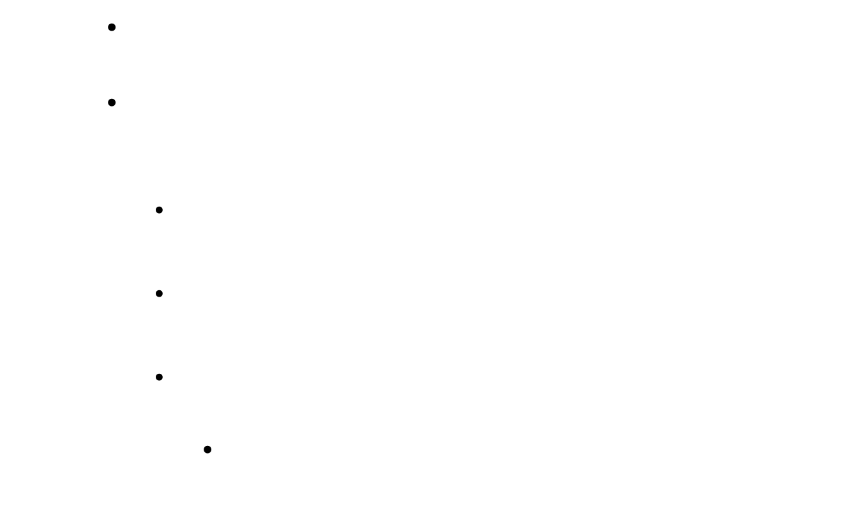
Linear Probing
Move sequentially through the hash table slots until you encounter the next empty slot.
For a table $t$ of size $SIZE$, if we want to store an element x with hash index $i$at location of $t\left[i\right],$and that position is already occupied:
Try to store it in location $t[\left(i+1\right) \% SIZE]$,
where $index = \left(i+1\right) \% SIZE$
If that position is occupied, we try
$t[\left(i+2\right) \% SIZE]$and so on.
Until we find an $index$, such that either $t[index]=x, or t[index] = NULL.$
This is for the find(), add(), and the remove()functions.

Slide 17

Quadratic Probing
Square the sequence of hash values when deciding how far to look for the next slot.
Do this if the initial probe fails.
From the previous code: if we want to store an element $x$ with hash index $i$ in the table location of $t[i]$and that position is already occupied:
Try to store it in location $t[\left(i×i\right) \% SIZE]$
If that position is occupied, we try
$t[\left(i+1\right)×\left(i+1\right) \% SIZE]$and so on.
To guarantee that quadratic probing hits every single available spot eventually:
Hash table size must be a prime number.
Hash table must never be more than half full.
Notes:
Foiled attempts?

Slide 18

Double Hashing
Like Linear and Quadratic Probing.
Uses a hash function to determine the ${(i+1)}^{st}$hash location in table $T$ containing $n$ elements.
Load Factor $λ=\frac{n}{|T|}$
For example given hash functions $h_{1},h_{2}$for a $key$:
First, we check the location of $h_{1}(key)$.
If its not empty, we calculate $h_{2}(key)$.
$T\left(i,key\right)={(h}_{1}(key)\text{ + }\text{i}×h_{2}(key)\text{) }\text{mod}\text{ |}\text{T}\text{|}$
Notes:
What does |T| mean? Does it refer to the size of the table?

Slide 19
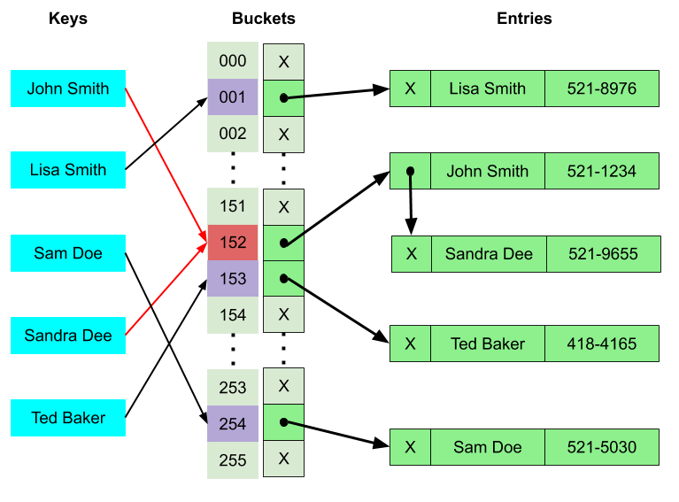
Chaining using Linked Lists
Each slot contains a link to a singly linked list:
Key-value pairs with the same hash.
Look-up algorithm searches through the list to find matching key.
Initially table slots contain nulls.
List is being created, when value with the certain hash is added for the first time.

Slide 20

Performance analysis of Chaining
m = Number of slots in hash table
n = Number of keys to be inserted in hash table
Load factor $λ = n/m$
Expected time to search = $O(1 + λ)$
Expected time to insert/delete = $O(1 + λ)$
Time complexity of search insert and delete is $O(1)$if α is $O(1).$

Slide 21
Open Addressing vs. Chaining
Open addressing is computationally intense compared to chaining.
Dynamic nature: in chaining hash table is never filled up as we can add more elements to the chain.
Chaining is less sensitive to load factor and hash function.
Cache Performance:
Chaining: bad as keys are stored using linked list.
Open Addressing: good as everything stored in the same table.
Space:
Chaining uses extra space for links and parts of the hash table is never used.
No links in open addressing and a slot can be used even if an input isn’t mapped to it.

Slide 22
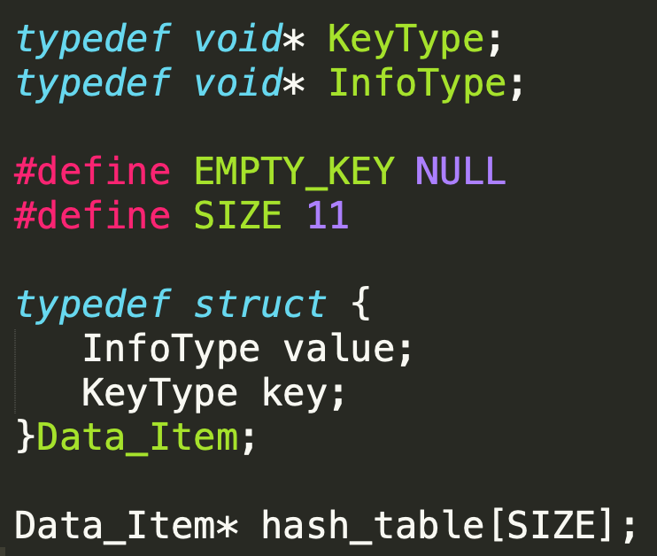
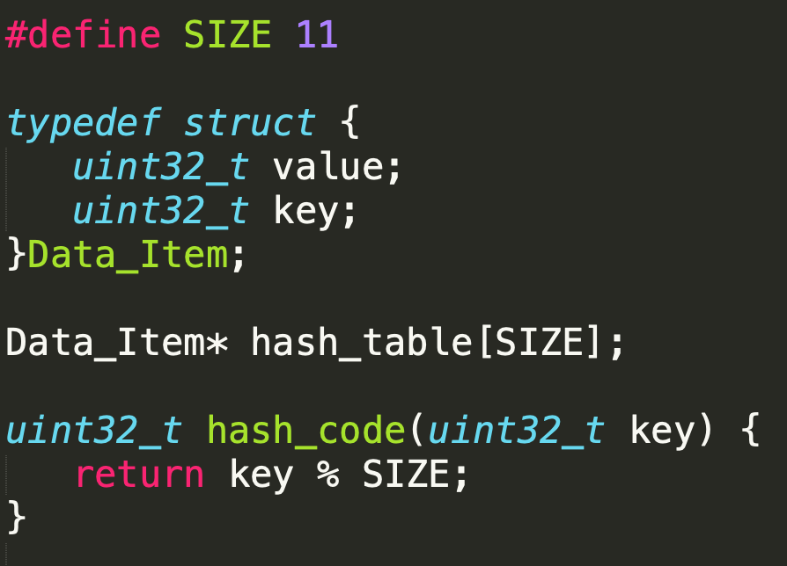
The Hash Table ADT
Figure 1 shows a general hash table ADT:
KeyType and InfoType are void * type so we can pass any type we need for our problem.
Based on the type of key, the hash function hash_code() will change.
Figure 2 shows a hash table declaration for the problem on slide 12:
Hash table of size 11: as we discussed before the hash table size should be a prime number.
Both the value and the key are unsigned 32-bit integers.
The hash function used here is the remainder method that takes a 32-bit integer as a key and returns an index in the table between 0-10.
Each data item consists of a key-value pair.
Figure 1
Figure 2

Slide 23
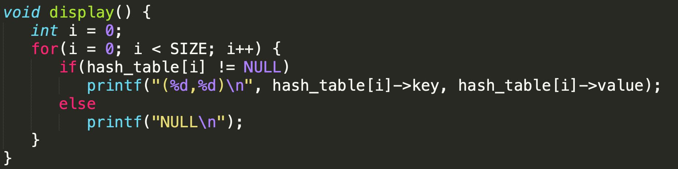
Displaying a Hash Table

Slide 24
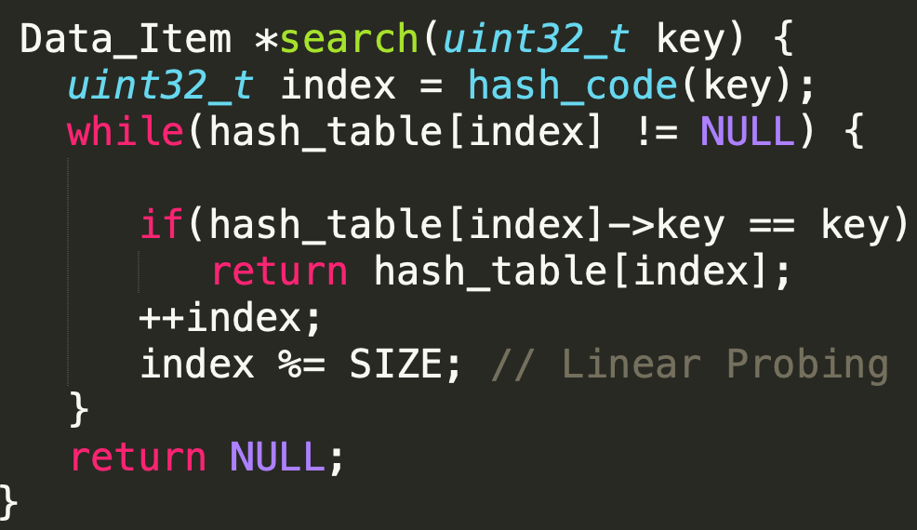
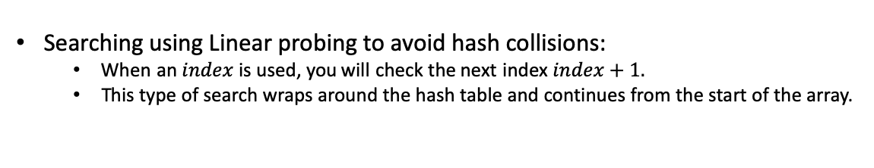
Search in a Hash Table
\
Searching using Linear probing to avoid hash collisions:
When an$index$is used, you will check the next index $index+1.$
This type of search wraps around the hash table and continues from the start of the array.

Slide 25
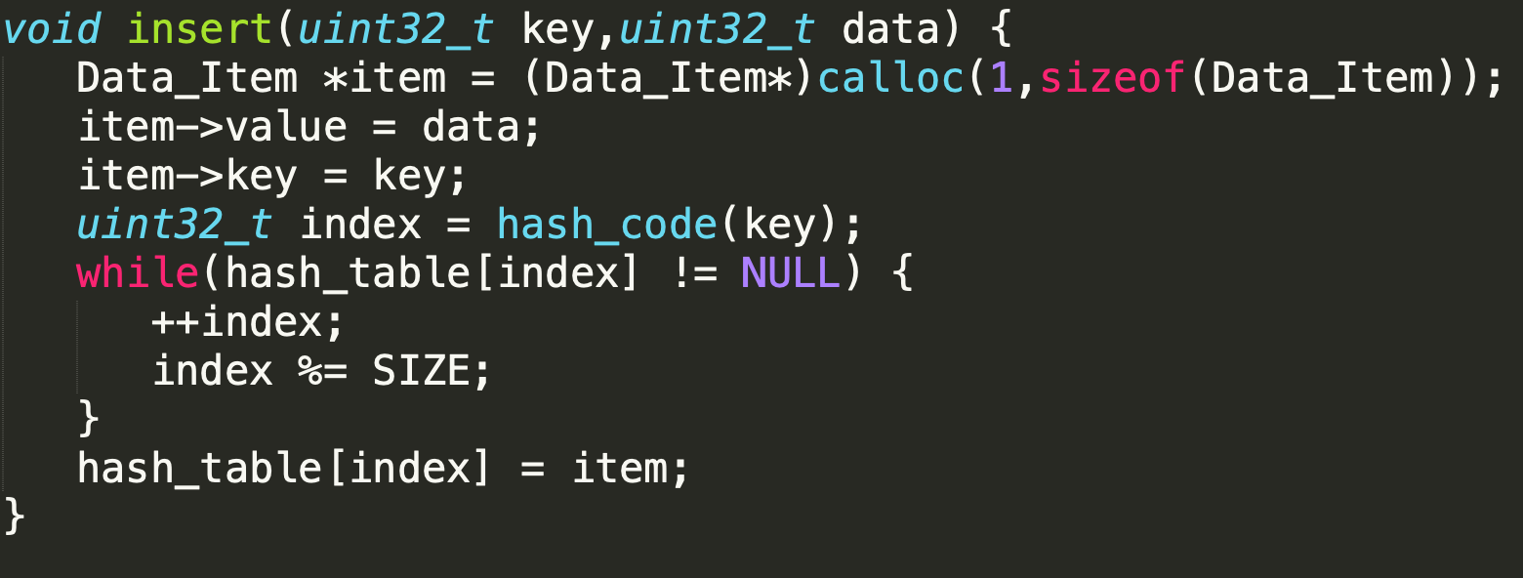
Insertion
Since traversing the Hash Table is done using linear probing:
Sequentially move forward through the indexes.
Notes:
What happens if the hash table is full?

Slide 26
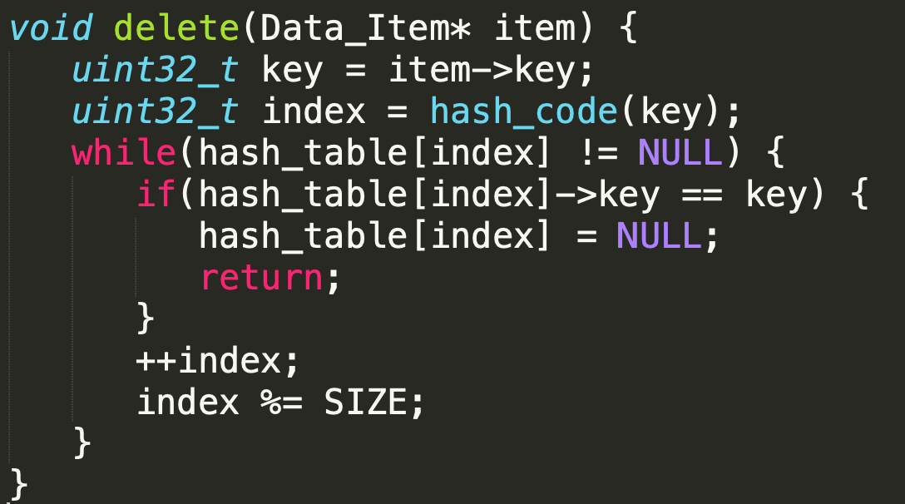
Deletion
This function takes as input a key value pair and if the contents of a hash table index matches the key, deletes the corresponding item.
Traverses forward through the hash table using linear probing.
Danger!
Notes:
There is a problem here! What happens if I delete one that is the middle of a sequence due to linear probing? I will miss things!

Slide 27
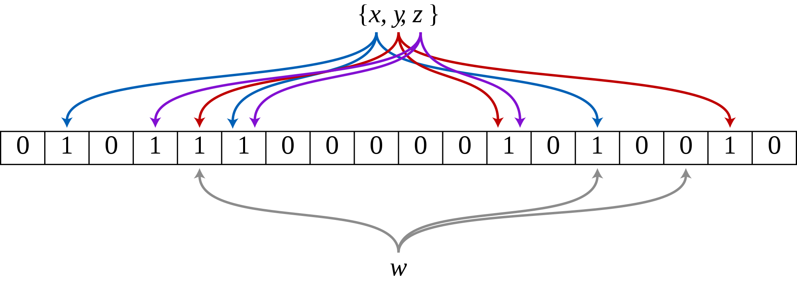

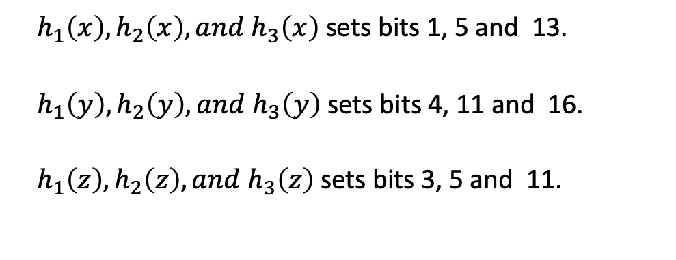

Bloom Filters
Assume that the $K$ hash functions are $h_{1},h_{2}, {and h}_{3}$.
A data structure designed to tell you whether an element is present in a set.
Internally structured like a bit array.
Two operations: Add and Search/Query.
Assume bloom filter on the right has $k=3$hash functions:
Pass elements (x, y, z} through 3 hash functions and set the corresponding bits in the bloom filter.
$h_{1}\left(x\right),h_{2}\left(x\right), and h_{3}\left(x\right)$ sets bits 1, 5 and 13.
$h_{1}\left(y\right),h_{2}\left(y\right), and h_{3}\left(y\right)$ sets bits 4, 11 and 16.
$h_{1}\left(z\right),h_{2}\left(z\right), and h_{3}\left(z\right)$ sets bits 3, 5 and 11.

Slide 28
Why Bloom Filters?
Developed by Burton Howard Bloom in 1970.
Bloom filters are fast and memory efficient.
Called filters:
Used as a first pass to filter out segments of datasets that do not match a query.
Related to hash tables:
Can be used to efficiently check if a key exists in the hash table.

Slide 29
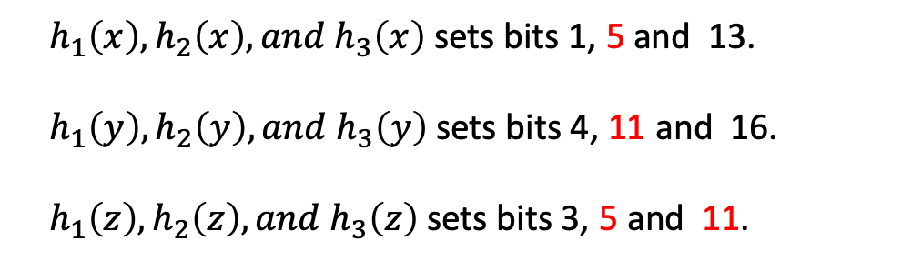
False Positives
A bloom filter query returns “possibly in set” or “definitely not in set”.
False positives:
When passed through the same 3 hash functions 2 bits are set by 2 different elements from the set.
Bit 5 was set by x and z, Bit 11 was set by y and z.
$h_{1}\left(x\right),h_{2}\left(x\right), and h_{3}\left(x\right)$ sets bits 1, 5 and 13.
$h_{1}\left(y\right),h_{2}\left(y\right), and h_{3}\left(y\right)$ sets bits 4, 11 and 16.
$h_{1}\left(z\right),h_{2}\left(z\right), and h_{3}\left(z\right)$ sets bits 3, 5 and 11.

Slide 30

Probability of False Positives
Assume that a hash function selects each array position with equal probability.
M is the number of bits in the array
K is the number of hash functions
N is the number of inserted elements.
$p={(1−e^{−\frac{K×N}{M}})}^{K}$
The more items per Bloom filter, the higher the the chances of having false positives.
Increasing the number of hash functions can reduce false positives

Slide 31

Time and Space Complexity
Size of bloom filter is $M$ bits and $K$ hash functions:
Insertion and Search will both take $O(k)$time.
The space of the actual data structure (what holds the data) is simply$O(M).$

Slide 32

Other application of hash functions: Cryptographic Hash
Message Integrity:
Alice sends Bob a message, $m | h$where the message is concatenated with the message’s hash.
Bob computes the hash over the message and compares the received hash and the calculated hash.
If they are different, the message has been altered.
Digital Signatures:
Alice signs a message with her private key.
Bob can verify Alice’s authorship with her public key.
Inefficient to sign the entire message. Better to sign the message’s hash value.
Notes:
Move to end as application

Slide 33
Cryptography based Hash Function
An ideal cryptographic hash function guarantees the following properties:
Deterministic: same message results in the same hash.
Quick to compute the hash for any given message.
Infeasible to construct a message that yields a given hash value.
Infeasible to find two different messages with the same hash value.
Avalanche effect — A small change to the message should produce a hash value that appears uncorrelated with the old hash.

Slide 34
Popular cryptographic hash functions
MD5 – broken
SHA1 – broken
SHA256
SHA512
SHA3

Slide 35
Summary
Hash functions
Map data of arbitrary size to fixed sized values.
Aim to avoid collisions
Hash table
A data structure that maps keys to values
Provides O(1) access times on average.
Index into a hash table is calculated by a hash function
Bloom Filters
Probabilistic data structure that tests whether an element is a member of a set.
The element is either not in the set or it may be in the set.

