Slide 1
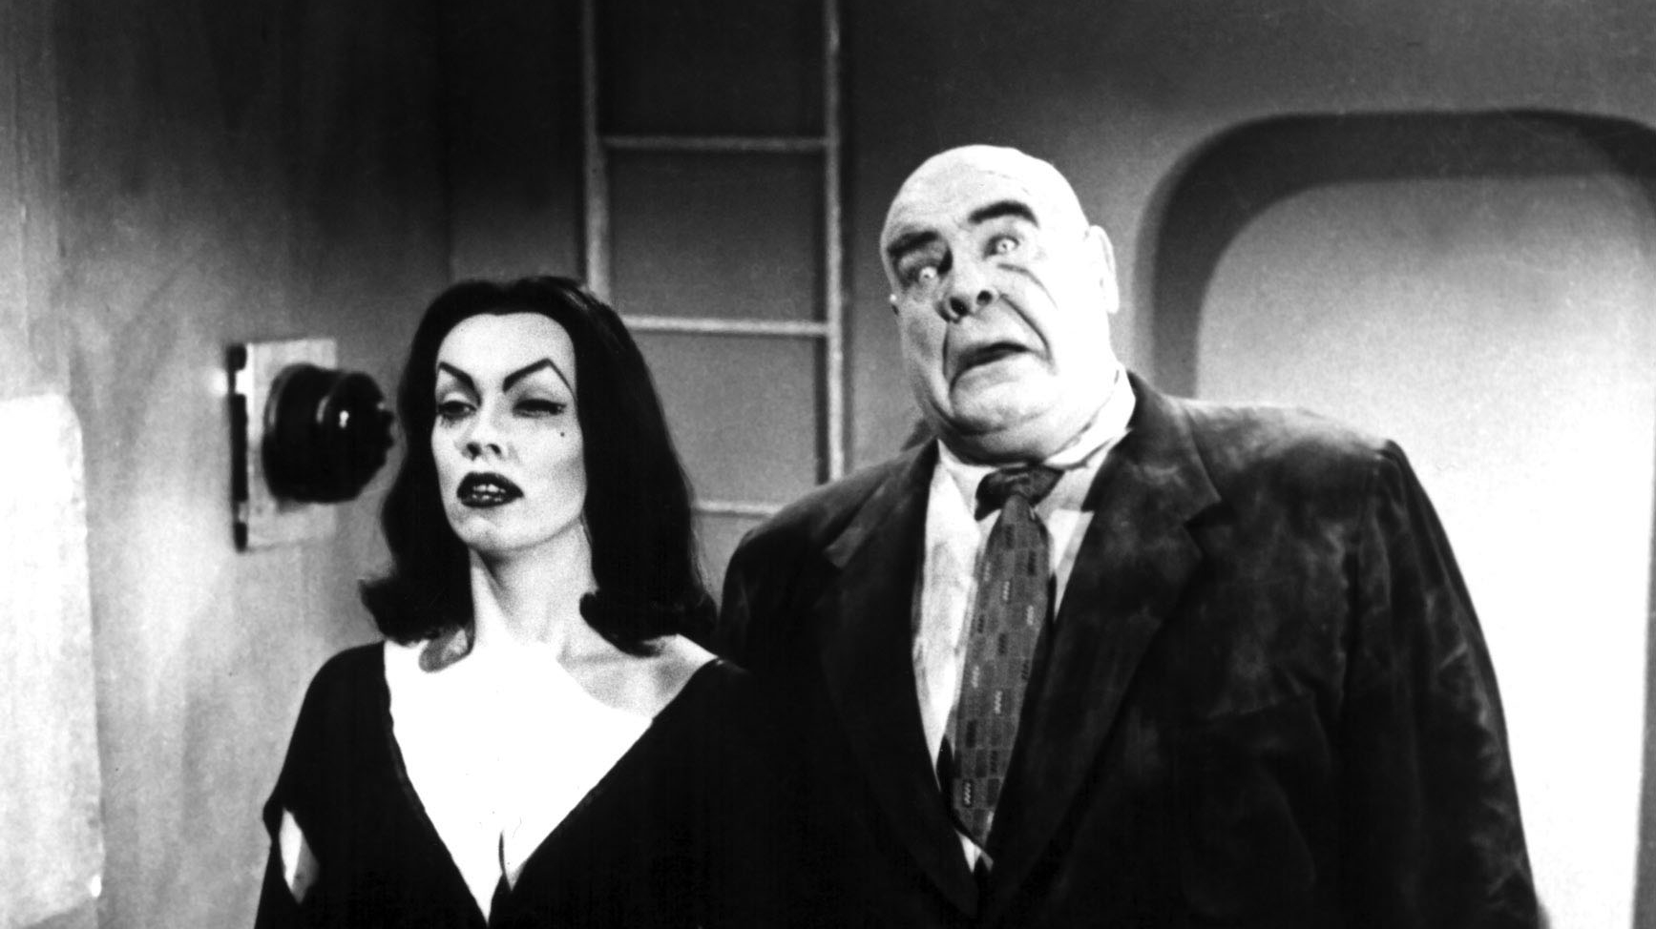
Digital Search Trees (Tries)
Prof. Darrell Long
CSE 13S

Slide 2
What is a Trie?
A specialized tree used to store a dynamic set.
Often used to store strings.
Also known as a digital tree, radix tree, or prefix tree.
© 2019 Darrell Long & the University of California
2

Slide 3
Advantages
A useful debugging tool that allows you to set breakpoints and step through a program line by line.
At each breakpoint and step you can print values or addresses of variables.
You must compile your program with debugging symbols.
-g option with clang and GCC.
Does not provide much information about memory errors.
© 2019 Darrell Long & the University of California
3

Slide 4
Disadvantages
A useful debugging tool that allows you to set breakpoints and step through a program line by line.
At each breakpoint and step you can print values or addresses of variables.
You must compile your program with debugging symbols.
-g option with clang and GCC.
Does not provide much information about memory errors.
© 2019 Darrell Long & the University of California
4

