Slide 1
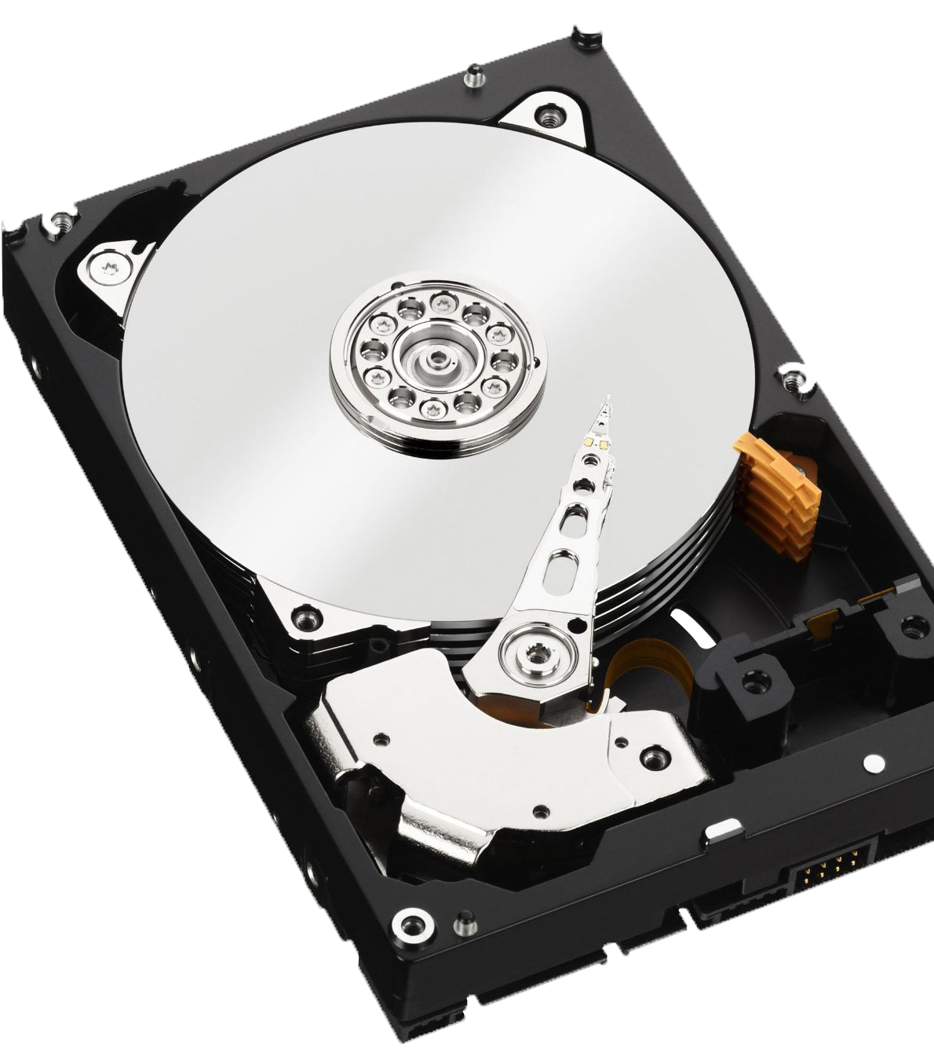
Introduction to Files
Prof. Darrell Long
CSE 13S
Notes:
Largely borrowed from Andy Tanenbaum’s OS slides. That was true long ago, but not so much these days.

Slide 2
Long-term Information Storage
We want to store large amounts of data.
The definition of large has changed by 6 orders of magnitude over the years.
Information stored must survive the termination of the process using it.
Memory (DRAM) does not survive turning the computer off.
Files are accessed using names, memory is accessed using addresses.

Slide 3
File Names
“In the once-upon-a-time days of the First Age of Magic, the prudent sorcerer regarded his own true name as his most valued possession but also the greatest threat to his continued good health, for—the stories go—once an enemy, even a weak unskilled enemy, learned the sorcerer’s true name, then routine and widely known spells could destroy or enslave even the most powerful.”
—Vernor Vinge, True Names
Your computer has millions of files.
A data center has billions of files.
The Internet has trillions of files.
How do you uniquely specify which file you want?
How do you find that file among the millions?

Slide 4
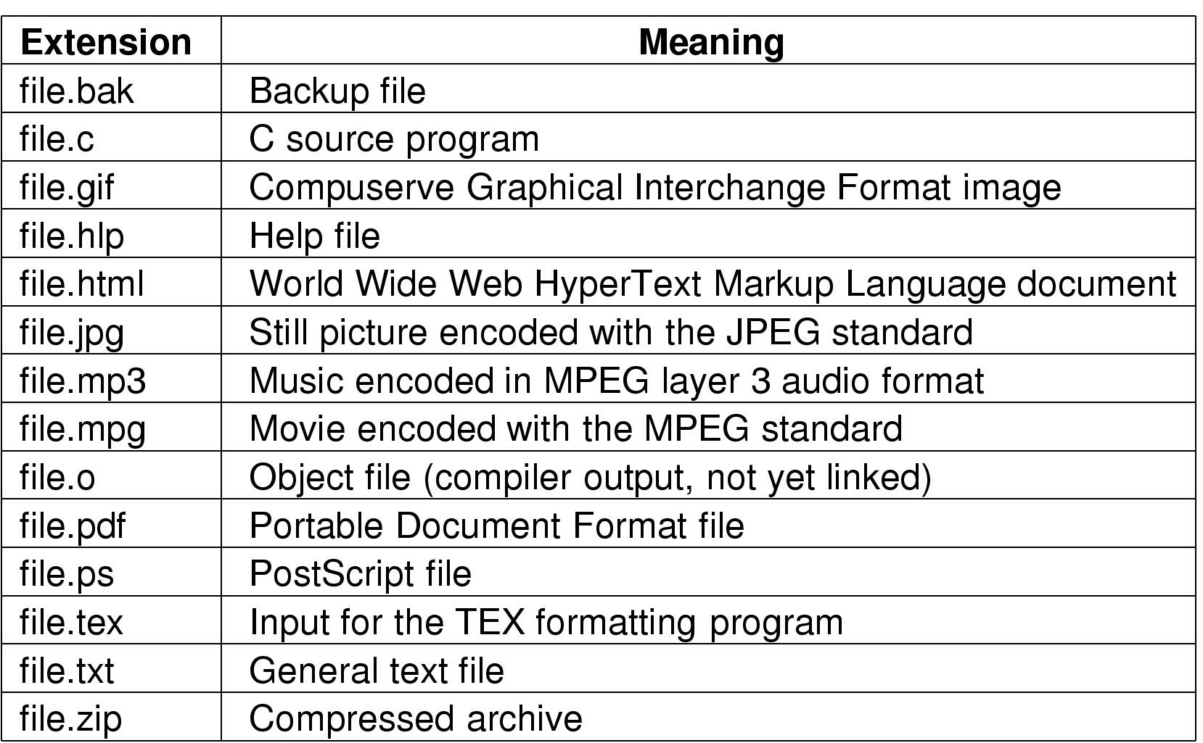
File Naming
Files have base names and extensions.
In some operating systems, the extension is a separate entity.
In UNIX, the extension is only used by convention.

Slide 5
File Structure
1 byte
1 record
12A
101
111
sab
cm
avg
pt
elm
dl
Sequence of bytes
Sequence of records
f07
s08
s15
Tree

Slide 6
Files may have internal structure
Magic number
Header
Text size
Module name
Object module
Data size
Header
BSS size
Date
Symbol table size
Owner
Entry point
Protection
Flags
Size
Text (code)
Header
Object module
Data
Header
Relocation bits
Object module
Symbol table
Executable file
Archive file

Slide 7
File Access
Sequential access
Read all bytes/records from the beginning
Cannot jump around, may rewind or back up
Convenient when medium was magnetic tape
Random access
Bytes/records read in any order
Essential for data base systems
Read can be:
Move file marker (seek), then read or …
Read and then move file marker

Slide 8
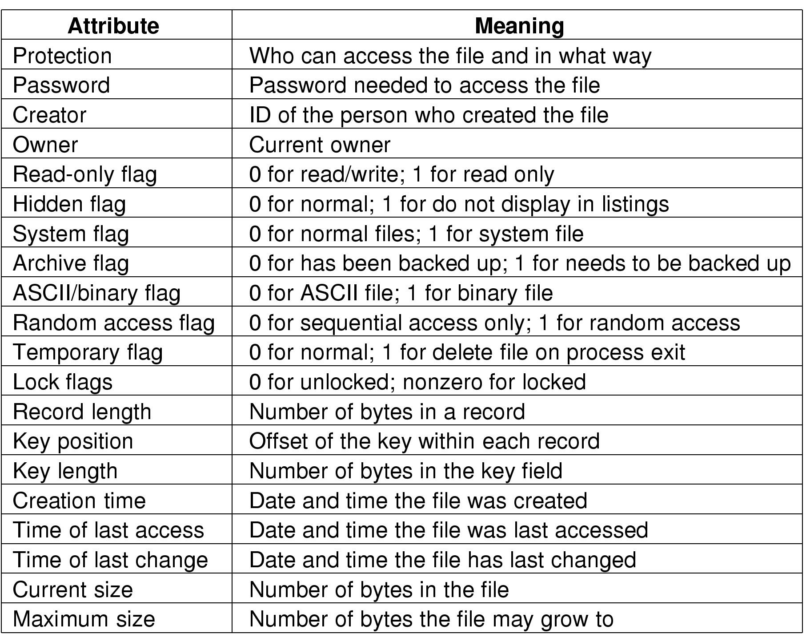
File Attributes
Possible file attributes

Slide 9
File Operations
Create
Delete
Open
Close
Read
Write
Append
Seek
Get attributes
Set Attributes
Rename

Slide 10
Directories
Naming is better than using numbers, but still limited.
Humans like to group things together for convenience.
We use hierarchy to manage complexity.
File systems allow this to be done with directories
You may call them folders.
Grouping makes it easier to:
Find files in the first place: remember the enclosing directories for the file,
Locate related files,
Determine which files are related.

Slide 11
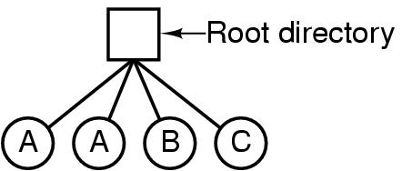
Directories Single-Level Directory Systems
A single level directory system:
Contains 4 files
Owned by 3 different people, A, B, and C

Slide 12
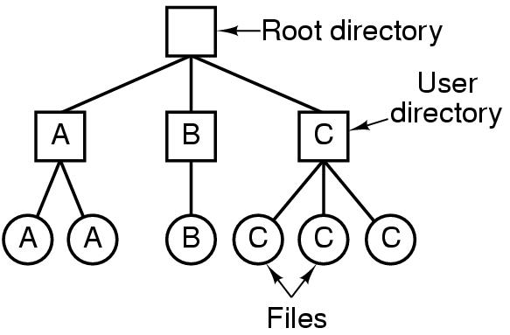
Two-level Directory Systems
Letters indicate owners of the directories and files

Slide 13
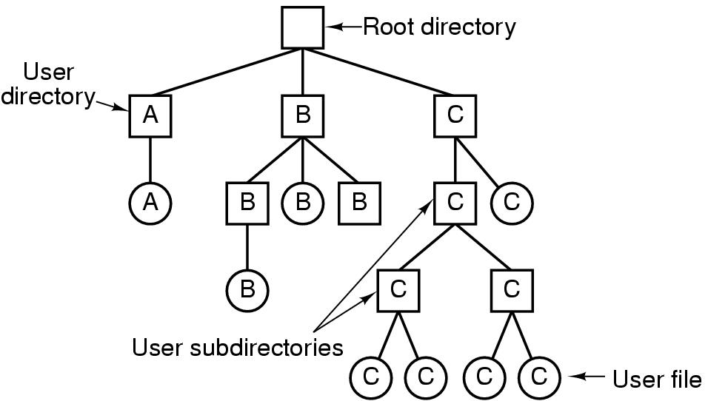
Hierarchical Directory Systems
A hierarchical directory system

Slide 14
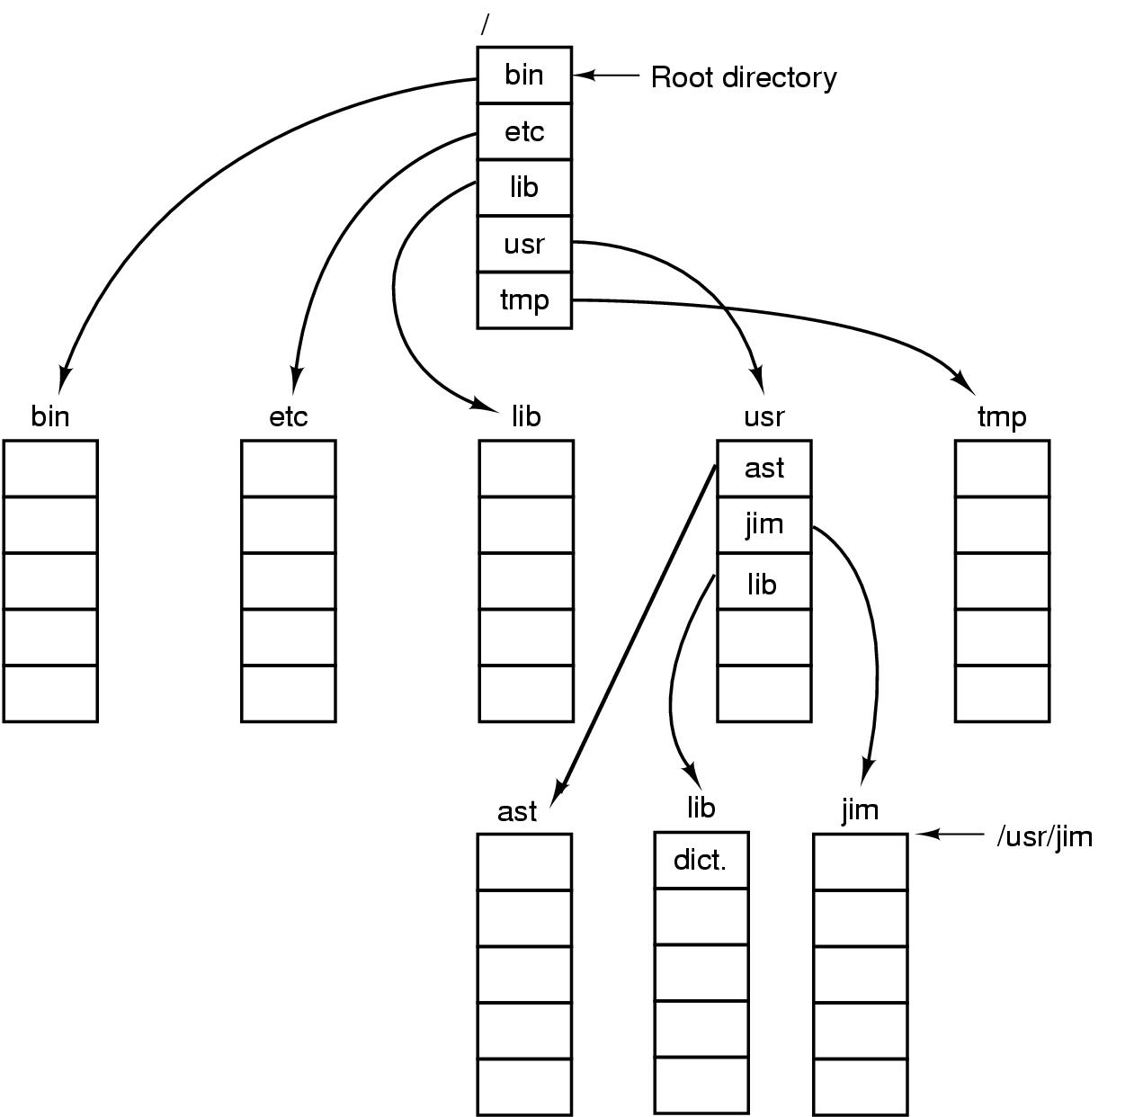
Path Names
A UNIX directory tree

Slide 15
Directory Operations
Create
Delete
Opendir
Closedir
Readdir
Rename
Link
Unlink

Slide 16
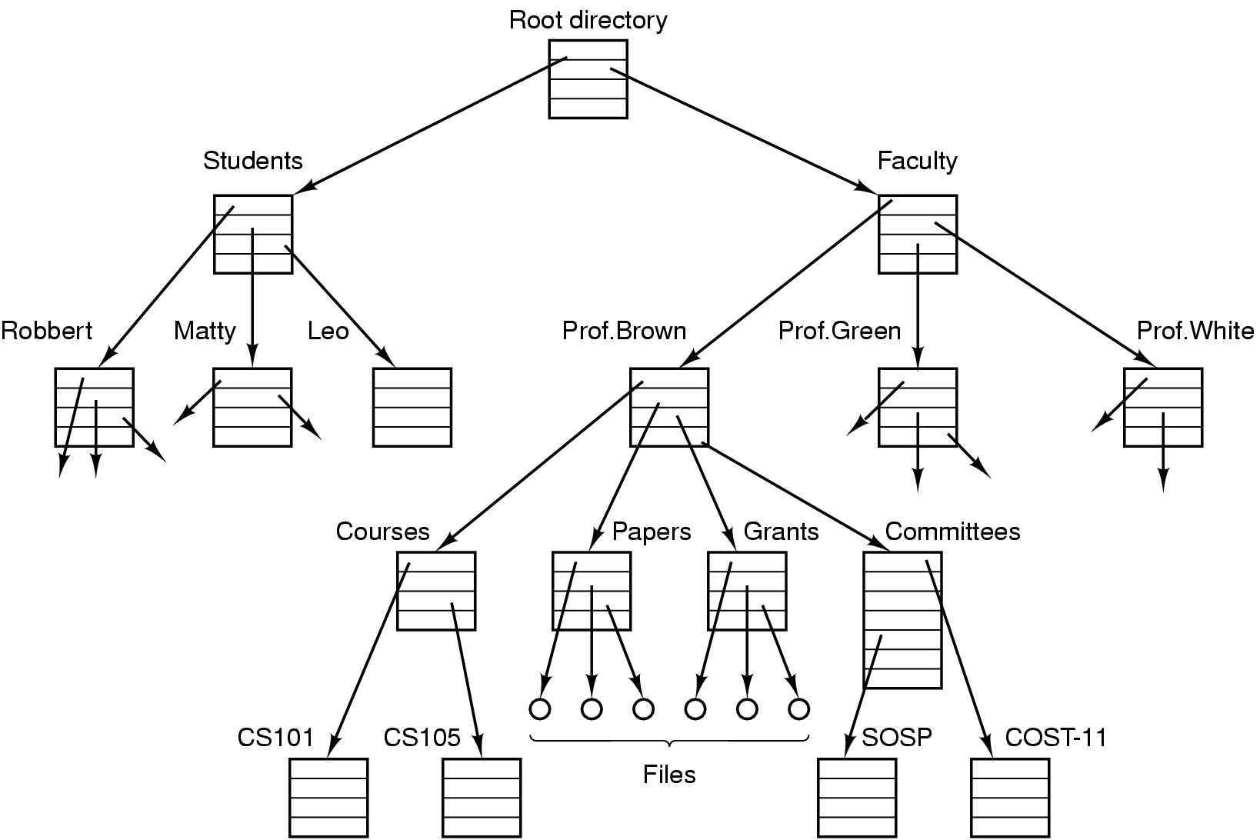
Hierarchical File System

Slide 17
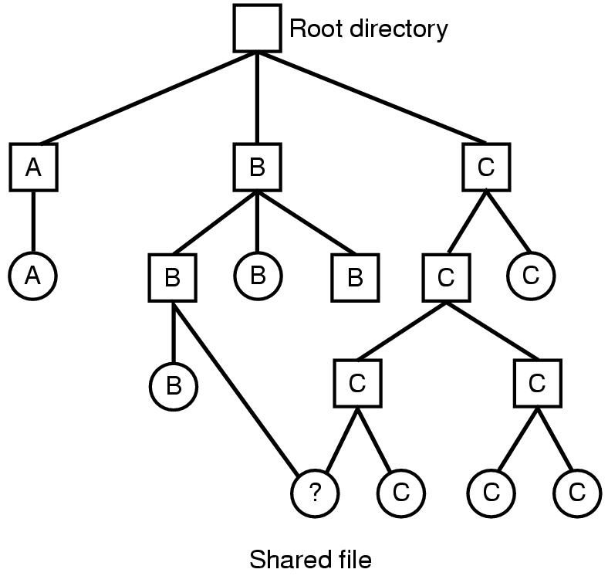
Shared Files
File system containing a shared file

Slide 18
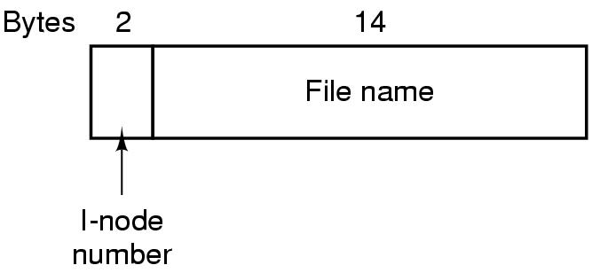
The UNIX V7 File System
A UNIX V7 directory entry

Slide 19
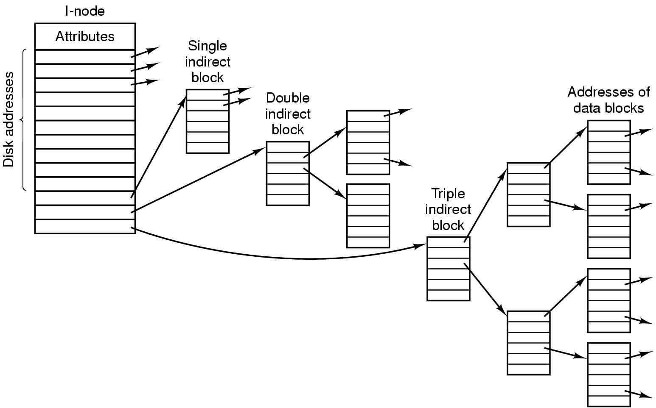
The UNIX V7 File System
A UNIX i-node

Slide 20
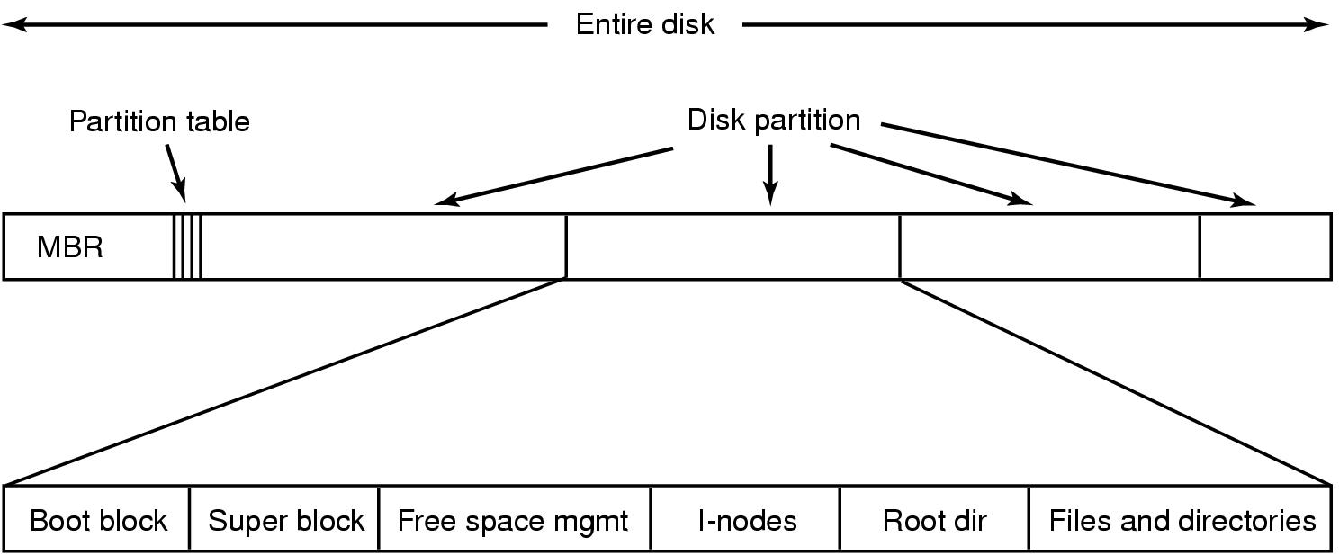
File System Implementation
A possible file system layout

Slide 21
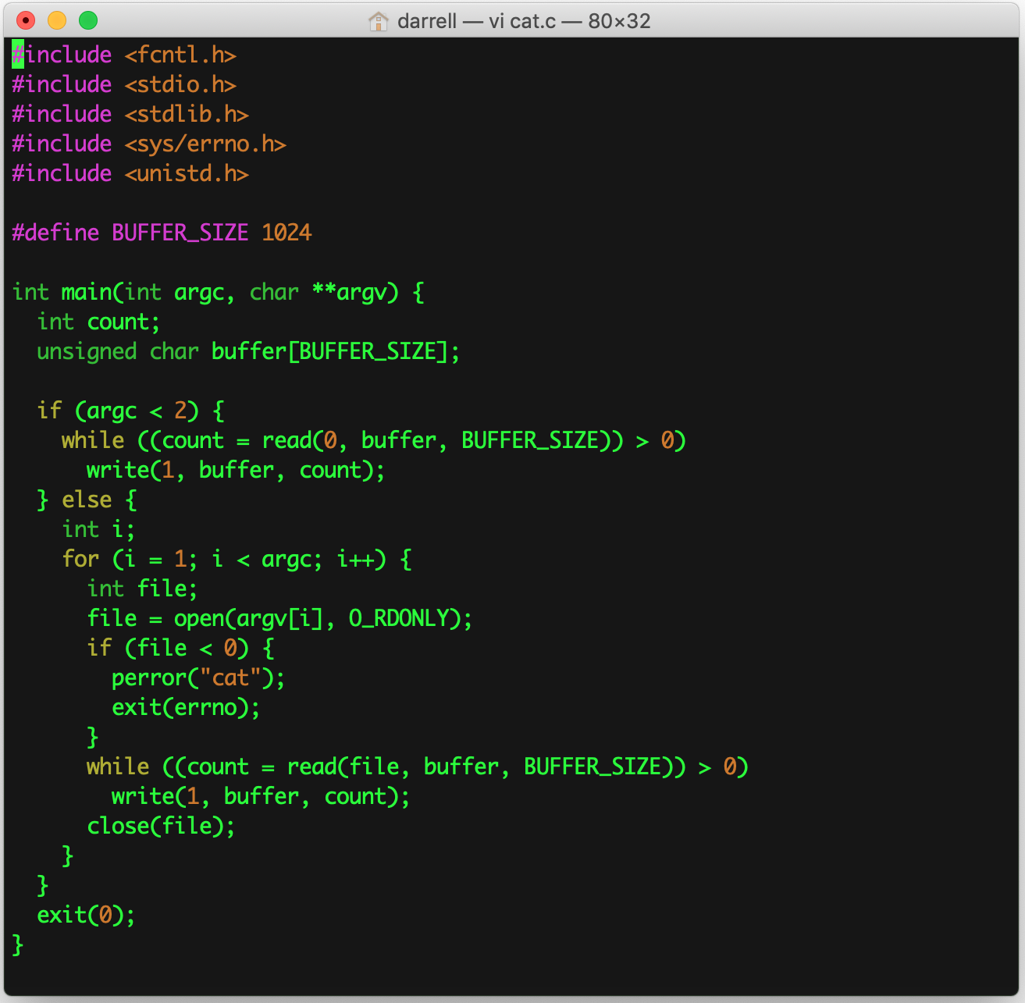
cat.c
Copies standard input to standard output, or …
Sequentially copies multiple files to standard output.
We will discuss this in more detail later.

