Slide 1
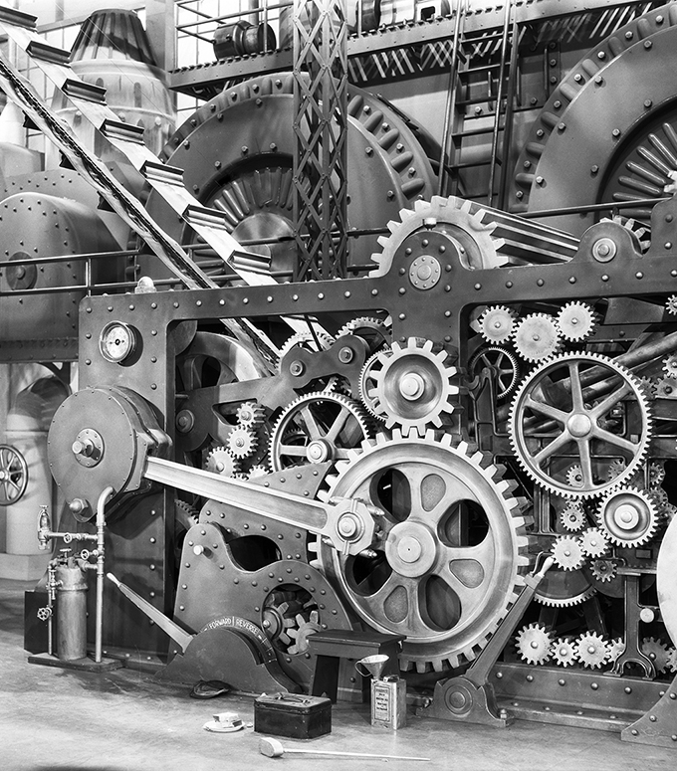
Processes
Prof. Darrell CSE
CSE 13S

Slide 2
Processes and threads
Processes
Threads
Scheduling
Inter-process communication (IPC)
Classical IPC problems

Slide 3
What is a process?
Code, data, and stack
Usually (but not always) has its own address space
Program state
CPU registers
Program counter (current location in the code)
Stack pointer
Only one process can be running in a single CPU core at any given time!
Multi-core CPUs can support multiple processes

Slide 4
What is an Address Space?
Programs execute code.
Each instruction has an address.
Programs access data.
Each byte of data also has an address.
We would like to think that our program is the only program executing on the computer –
But we would be wrong.
An address space is the region of a computer’s memory where a program executes.
Ideally, it is protected from other programs accessing it.

Slide 5
How is that accomplished?
The loader could relocate the instructions by address a base address to each one.
There could be registers that point to the first byte of the program’s memory (base register) that is added to every memory access.
The processor and operating system could provide virtual memory.

Slide 6
In an ideal world…
The ideal world has memory that is
Very large
Very fast
Non-volatile (doesn’t go away when power is turned off)
The real world has memory that is:
Very large
Very fast
Affordable!
Pick any two…
Memory management goal: make the real world look as much like the ideal world as possible
2/14/22
© 2020 Darrell Long and Ethan Miller

Slide 7
Memory hierarchy
What is the memory hierarchy?
Different levels of memory
Some are small & fast
Others are large & slow
What levels are usually included?
Cache: small amount of fast, expensive memory
L1 (level 1) cache: usually on the CPU chip
L2: may be on or off chip
L3 cache: off-chip, made of SRAM
Main memory: medium-speed, medium price memory (DRAM)
Disk: many gigabytes of slow, cheap, non-volatile storage
Memory manager handles the memory hierarchy
2/14/22
© 2020 Darrell Long and Ethan Miller
7

Slide 8
Basic memory management
Components include
Operating system (perhaps with device drivers)
Single process
Goal: lay these out in memory
Memory protection may not be an issue (only one program)
Flexibility may still be useful (allow OS changes, etc.)
No swapping or paging
2/14/22
© 2020 Darrell Long and Ethan Miller
8

Slide 9
Fixed partitions:
multiple programs
Fixed memory partitions
Divide memory into fixed spaces
Assign a process to a space when it’s free
Mechanisms
Separate input queues for each partition
Single input queue: better ability to optimize CPU usage
900K
900K
Partition 4
Partition 4
Partition 3
700K
Partition 3
700K
Partition 2
600K
Partition 2
600K
500K
500K
Partition 1
Partition 1
100K
Process
100K
OS
OS
0
0
2/14/22
© 2020 Darrell Long and Ethan Miller

Slide 10
Multiprogrammed system performance
Job | Arrival time | CPU needed
1 | 10:00 | 4
2 | 10:10 | 3
3 | 10:15 | 2
4 | 10:20 | 2
 | 1 | 2 | 3 | 4
CPU idle | 0.8 | 0.64 | 0.51 | 0.41
CPU busy | 0.2 | 0.36 | 0.49 | 0.59
CPU/process | 0.2 | 0.18 | 0.16 | 0.15
0
Time
10
15
20
22
27.6
28.2
31.7
1
2
3
4
Arrival and work requirements of 4 jobs
CPU utilization for 1–4 jobs with 80% I/O wait
Sequence of events as jobs arrive and finish
Numbers show amount of CPU time jobs get in each interval
More processes ⇒ better utilization, less time per process
2/14/22
© 2020 Darrell Long and Ethan Miller

Slide 11
Memory and multiprogramming
Memory needs two things for multiprogramming
Relocation
Protection
The OS cannot be certain where a program will be loaded in memory
Variables and procedures can’t use absolute locations in memory
Several ways to guarantee this
The OS must keep processes’ memory separate
Protect a process from other processes reading or modifying its own memory
Protect a process from modifying its own memory in undesirable ways (such as writing to program code)
2/14/22
© 2020 Darrell Long and Ethan Miller

Slide 12
Base and limit registers
0xFFFF
0x2000
Special CPU registers: base & limit
Access to the registers limited to system mode
Registers contain
Base: start of the process’s memory partition
Limit: length of the process’s memory partition
Address generation
Physical address: location in actual memory
Logical address: location from the process’s point of view
Physical address = base + logical address
Logical address larger than limit ➙ error
Limit
Process partition
Base
0x9000
OS
0
Logical address: 0x1204 Physical address: 0x1204+0x9000 = 0xa204
2/14/22
© 2020 Darrell Long and Ethan Miller

Slide 13
Allocating memory
Search through region list to find a large enough space
Suppose there are several choices: which one to use?
First fit: the first suitable hole on the list
Next fit: the first suitable after the previously allocated hole
Best fit: the smallest hole that is larger than the desired region (wastes least space?)
Worst fit: the largest available hole (leaves largest fragment)
Option: maintain separate queues for different-size holes
Allocate 20 blocks first fit
Allocate 13 blocks best fit
Allocate 12 blocks next fit
Allocate 15 blocks worst fit
1
5
18
-
6
5
-
19
14
-
52
25
-
102
30
-
135
16
-
202
10
-
302
20
-
350
30
-
411
19
-
510
3
15
2/14/22
© 2020 Darrell Long and Ethan Miller

Slide 14
Freeing memory
Allocation structures must be updated when memory is freed
Easy with bitmaps: just set the appropriate bits in the bitmap
Linked lists: modify adjacent elements as needed
Merge adjacent free regions into a single region
May involve merging two regions with the just-freed area
A
X
B
A
B
A
X
A
X
B
B
X
2/14/22
© 2020 Darrell Long and Ethan Miller

Slide 15
Buddy allocation
Allocate memory in powers of two
Good for objects of varied sizes
Split larger chunks to create two smaller chunks
When chunk is freed, see if it can be combined with its buddy to rebuild a larger chunk
This is recursive...
Allocating memory
Freeing memory

Slide 16
Virtual memory
Basic idea: allow the OS to hand out more memory than exists on the system
Keep recently used stuff in physical memory
Move less recently used stuff to disk
Keep all of this hidden from processes
Processes still see an address space from 0–max_address
Movement of information to and from disk handled by the OS without process help
Virtual memory (VM) especially helpful in multiprogrammed systems
CPU schedules process B while process A waits for its memory to be retrieved from disk
2/14/22
© 2020 Darrell Long and Ethan Miller

Slide 17

Virtual and physical addresses
CPU chip
Program uses virtual addresses
Addresses local to the process
Hardware translates virtual address to physical address
Translation done by the Memory Management Unit
Usually on the same chip as the CPU
Only physical addresses leave the CPU/MMU chip
Physical memory indexed by physical addresses
CPU
MMU
Virtual addresses from CPU to MMU
Memory
Physical addresses on bus, in memory
Disk controller

Slide 18
Paging and page tables
60 – 64K
x
Virtual Memory
56 – 60K
x
Virtual addresses mapped to physical addresses
Unit of mapping is called a page
All addresses in the same virtual page are in the same physical page
Page table entry (PTE) contains translation for a single page
Table translates virtual page number to physical page number
Not all virtual memory has a physical page
Not every physical page need be used
Example:
64 KB virtual memory
16 KB physical memory
52 – 56K
0
48 – 52K
x
44 – 48K
x
40 – 44K
x
36 – 40K
3
32 – 36K
x
28 – 32K
x
24 – 28K
x
20 – 24K
x
Physical Memory
16 – 20K
1
12 – 16K
2
8 – 12K
x
4 – 8K
x
0 – 4K
x

Slide 19
What’s in a page table entry?
Each entry in the page table contains
Valid bit: set if this logical page number has a corresponding physical frame in memory
If not valid, remainder of PTE is irrelevant
Page frame number: page in physical memory
Referenced bit: set if data on the page has been accessed
Dirty (modified) bit :set if data on the page has been modified
Protection information
Protection
D
R
V
Page Frame Number
Dirty Bit
Referenced Bit
Valid Bit

Slide 20
Mapping logical addresses to physical addresses
Split address from CPU into two pieces
Page number (p)
Page offset (d)
Page number
Index into page table
Page table contains base address of page in physical memory
Page offset
Added to base address to get actual physical memory address
Page size = 2^{d} bytes
Example:
• 4 KB (=4096 byte) pages
• 32-bit logical addresses
2^{d} = 4096
d = 12
32 - 12 = 20 bits
12 bits
p
d
32-bit logical address

Slide 21
Address Translation Architecture
Page Number
Page Frame Number
CPU
Page Frame Number
p
d
f
d
0
1
0
1
Page Offset
f
f – 1
f
f + 1
f + 2
p – 1
p
p + 1
Page Table
Physical Memory

Slide 22
Memory & paging structures
2/14/22
© 2020 Darrell Long and Ethan Miller
22
Process 0
Physical memory
Page frame number
Page 0
6
Page 1
3
0
Page 1 (P1)
Page 2
4
1
free
Page 3
9
2
Page 4 (P0)
Page 4
2
3
Page 1 (P0)
Logical memory
Page table
Free
pages
4
Page 2 (P0)
5
Page 2 (P1)
Process 1
6
Page 0 (P0)
Page 0
8
7
free
Page 1
0
8
Page 0 (P1)
Page 2
5
9
Page 3 (P0)
Logical memory
Page table

Slide 23
The Process Model
Multiple Program Counters (process point-of-view
Single Program Counter (CPU’s point-of-view)
Conceptual model of multiprogramming four programs
4 independent processes
Processes run sequentially
Only one process active at any instant
An instant can be very short
Only applies if there’s a single CPU (with a single core) in the system
A
A
B
C
D
B
C
D
B
C
B
D
A
Time

Slide 24

When is a process created?
Processes can be created in two ways
System initialization: one or more processes created when the OS starts up.
Execution of a process creation system call: something explicitly asks for a new process .
System calls can come from:
User request to create a new process (system call executed from user shell)
Already running processes
User programs
System daemons

Slide 25

When do processes end?
Conditions that terminate processes can be
Voluntary
Involuntary
Voluntary
Normal exit
Error exit
Involuntary
Fatal error (only sort of involuntary)
Killed by another process

Slide 26

Process hierarchies
Parent creates a child process
Child processes can create their own children
Forms a hierarchy
UNIX calls this a “process group”
If a process terminates, its children are “inherited” by the terminating process’s parent
Windows has process groups
Multiple processes grouped together
One process is the “group leader”

Slide 27
Process States
Created
Process in one of 5 states
Created
Ready
Running
Blocked
Exit
Transitions between states
Process enters ready queue
Scheduler picks this process
Scheduler picks a different process
Process waits for an event such as I/O
Event occurs
Process exits
(Process ended by another process)
1
Ready
5
2
3
Blocked (waiting)
4
Running
7
7
6
Exit

Slide 28
What’s in a process table entry?
Process management
Registers
Program counter
CPU status word
Stack pointer
Process state
Priority / scheduling parameters
Process ID
Parent process ID
Signals
Process start time
Total CPU usage
File management
Root directory
Working (current) directory
File descriptors
User ID
Group ID
May be stored on stack
Memory management
Pointers to text, data, stack
- or -
Pointer to page table

Slide 29
What happens on a trap/interrupt?
Hardware saves program counter (on stack or in a special register)
Hardware loads new PC, identifies interrupt
Assembly language routine saves registers
Assembly language routine sets up stack
Assembly language calls C to run service routine
Service routine calls scheduler
Scheduler selects a process to run next (might be the one interrupted…)
Assembly language routine loads PC & registers for the selected process
2/14/22
© 2020 Darrell Long and Ethan Miller
29

Slide 30
Multiple Threads in a Process
DIAGRAM
Process 1
Process 2
Process 3
Process 1
User Space
Threads
Threads
System Space
Kernel
Kernel

Slide 31
Process and Thread Information
Per process items
Address space
Open files
Child processes
Signals & handlers
Accounting info
Global variables
Per thread items:
Program counter
Registers
Stack & stack pointer
State (local variables)
Per thread items:
Program counter
Registers
Stack & stack pointer
State (local variables)
Per thread items:
Program counter
Registers
Stack & stack pointer
State (local variables)

Slide 32
Threads and Stacks
Thread 1
Thread 2
Thread 3
DIAGRAM
Process
User Space
Thread 1’s stack
Thread 3’s stack
Thread 2’s stack
Kernel

Slide 33
Why use Threads?
Allow a single application to do many things at once
Simpler programming model
Less waiting
Threads are faster to create or destroy
No separate address space
Overlap computation and I/O
Could be done without threads, but it’s harder
Example: word processor
Thread to read from keyboard
Thread to format document
Thread to write to disk

Slide 34
Three Ways to Build a Server
Multithreaded server
Parallelism
Blocking system calls
May use pop-up threads: create a new thread in response to an incoming message (rather than reusing a thread)
Single-threaded process: slow, but easier to do
No parallelism
Blocking system calls
Finite-state machine (event model)
Each activity has its own state: states change when system calls complete or interrupts occur
Parallelism
Nonblocking system calls

Slide 35
Issues with using Threads
May be tricky to convert single-threaded code to multithreaded code
Re-entrant code
Code must function properly when multiple threads are using it simultaneously
Need to be careful when using static or global variables
Returned structures
Buffers
Error management
What happens when just a single thread has an error?
Can’t simply kill the process, since other threads might be running

Slide 36
Implementing Threads
Process
Thread
Run-time system
Thread table
Kernel
Kernel
Thread table
Process table
Process table

Slide 37
POSIX threads
Thread call (Pthread_xx) | Description
create | Create a new thread
exit | Terminate the calling thread
join | Wait for a specific thread to exit
yield | Release the CPU, allowing another thread to run
Standard interface to threading library
May be implemented in either user or kernel space
Some operating systems provide support for both!
Allows thread-based programs to be portable

Slide 38
Processes & Threads in Linux
Supports POSIX standard
Linux supports kernel-level threads (lightweight processes)
Share address space, file descriptors, etc.
Each has its own process descriptor in memory
Linux processes (incl. lightweight) all have unique identifiers
Threads sharing address space are grouped into process groups
Identifier shared by the group is that of the leader
Each process has its own 8KB region that stores
Kernel stack
Kernel has a small stack: about 4KB!
Low-level thread information
Other information stored in a separate data structure
Memory allocated to the process
Open files
Signal information

