Slide 1

Bit Vectors and Sets
Prof. Darrell Long
CSE 13S

Slide 2
Units of Information
Unit | Size in Bits | Value | Notes
Bit | 1 | 0/1 | Smallest
Nibble | 4 | Hex digit
Byte | 8 | ASCII | Smallest addressable
Half word | 16
Word | 32 |  | Native size, register length
Long Word | 64 |  | Native size, register length

Slide 3
Logical Shift
Logical shift left: zeroes are shifted in on the right.
Logical shift right: zeroes are shifted in on the left.
MSB
LSB
1
0
1
0
0
1
1
1
0
0
1
0
0
1
1
1
0
MSB
LSB
0
1
0
1
0
0
1
1
1
0
1
0
1
0
0
1
1

Slide 4
Arithmetic Shift
Arithmetic shift left: zeroes are shifted in on the right.
Arithmetic shift right: sign bits are shifted in on the left.
MSB
LSB
1
0
1
0
0
1
1
1
0
0
1
0
0
1
1
1
0
MSB
LSB
1
0
1
0
0
1
1
1
1
1
0
1
0
0
1
1

Slide 5

Bitwise Operations in C
& – AND
| – OR
~ – NOT
^ – XOR
<< – Left shift
>> – Right shift

Slide 6
C’s Vexatious Right Shift (>>)
The result of v1 >> v2 is v1 right-shifted v2 bits.
If v1 is unsigned, or is signed with a non-negative value…
(v1 >> v2) == (integral v2 part of the quotient v1 / 2^{v2})
If v1 is signed with a negative value…
(v1 >> v2) == implementation defined
We don’t know for sure.

Slide 7
C’s Vexatious Left Shift (<<)
The result of v1 << v2 is v1 left-shifted v2 bits.
Zeroes are filled.
If v1 is unsigned…
(v1 << v2) == (v1 * 2^{v2}) % n
n is the maximum value of the resulting type + 1.
If v1 is signed with a non-negative value…
(v1 << v2) == (v1 * 2^{v2})
If (v1 * 2^{v2}) is representable in the resulting type
Else, the behavior is undefined.

Slide 8
AND (&) Truth Table
& | 0 | 1
0 | 0 | 0
1 | 0 | 1

Slide 9
OR (|) Truth Table
| | 0 | 1
0 | 0 | 1
1 | 1 | 1

Slide 10
XOR (^) Truth Table
^ | 0 | 1
0 | 0 | 1
1 | 1 | 0

Slide 11
NOT (~) Truth Table
~
0 | 1
1 | 0

Slide 12
Getting A High-Order Nibble
MSB
LSB
1.
0
0
1
1
0
1
1
1
High-order nibble
MSB
LSB
A high-order nibble in a byte means the most significant 4 bits.
Bit-shift right 4 times so that the high-order nibble takes the place of the low-order nibble
AND with 0x0F
2.
0
0
1
1
0
1
1
1
0
0
0
0
0
0
1
1
MSB
LSB
3.
0
0
0
0
0
0
1
1
&
0
0
0
0
1
1
1
1

Slide 13
Setting A High-Order Nibble
MSB
LSB
1.
0
0
1
1
0
1
1
1
0
1
1
1
MSB
LSB
2.
0
0
1
1
0
1
1
1
&
We want to place a nibble into the higher-order bits of a byte
AND byte with 0x0F
Bit-shift nibble left 4 times
OR byte with bit-shifted nibble
0
0
0
0
1
1
1
1
MSB
LSB
3.
0
0
0
0
0
1
1
1
0
1
1
1
0
0
0
0
MSB
LSB
4.
0
0
0
0
0
1
1
1
|
0
1
1
1
0
0
0
0

Slide 14

Sets
Well-defined unordered collections that are characterized by the elements they contain.
Sets are equivalent if and only if they have exactly the same elements.
Basic relation in set theory is membership.
Operations:
Intersection: $A⋂B$
Union: $A⋃B$
Difference: $A−B=A⋂\overline{B}$
Complement: $\overline{A}$ or $A^{C}$

Slide 15
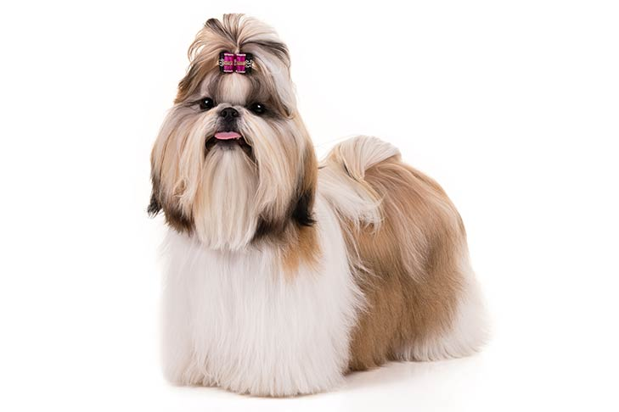
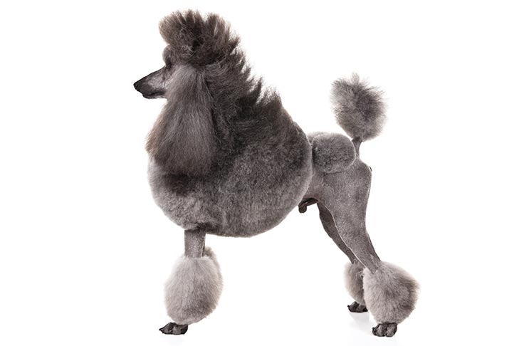
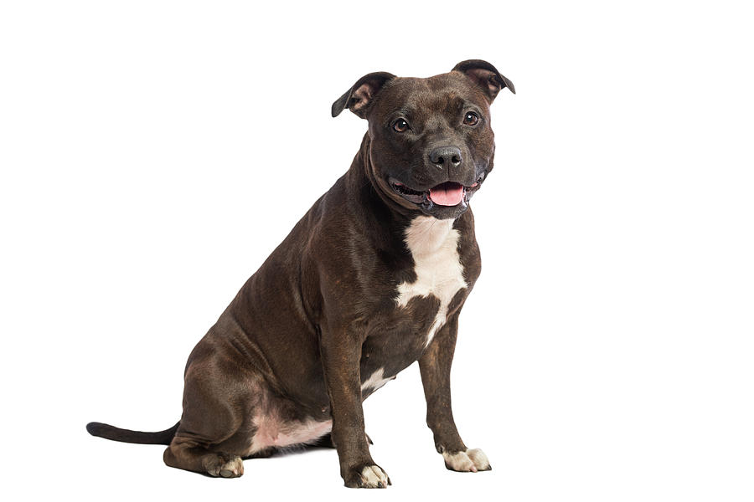
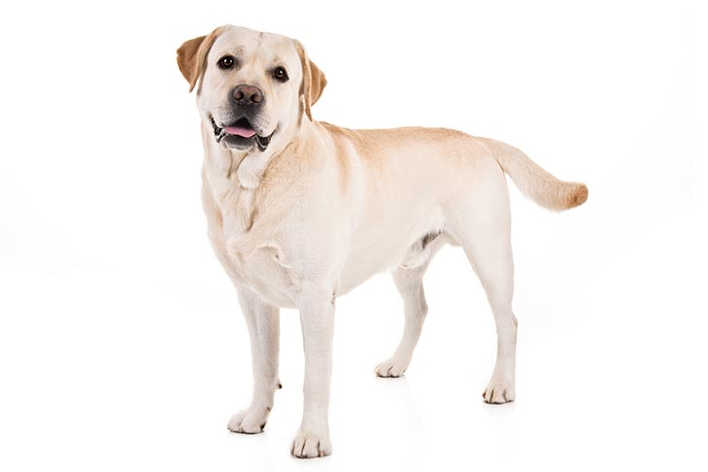
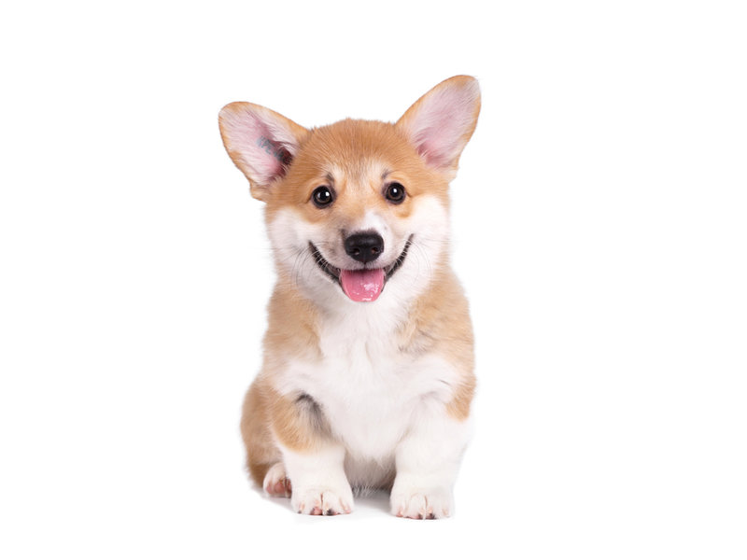
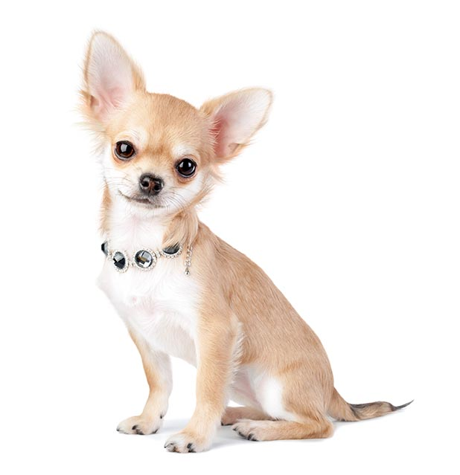
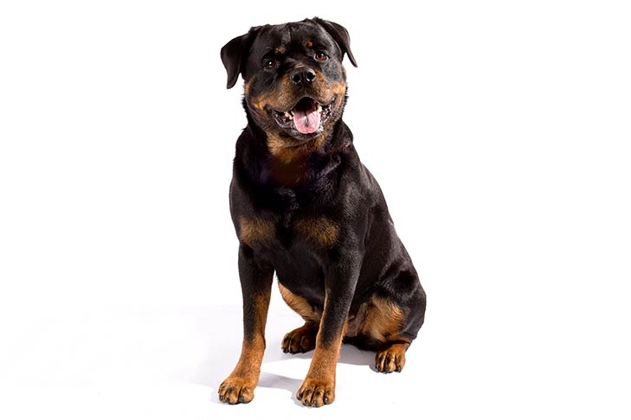

Set Operations with Dogs
dogs =
,
,
,
,
,
,
,
Let’s first define a universal set of dogs:
dogs = { shih tzu, poodle, pitbull, lab,
corgi, chihuahua, rottweiler, beagle }
7 February 2020

Slide 16
Set Intersection ( A ∩ B )
good_dogs =
,
,
,
bad_dogs =
,
,
good_dogs ∩ bad_dogs =
The set of elements in A and B.
good_dogs = { pitbull, lab, corgi, beagle }
bad_dogs = { shih tzu, poodle, pitbull }
good_dogs ∩ bad_dogs = { pitbull }

Slide 17
Set Union ( A ∪ B )
overrated_dogs =
,
cute_dogs =
,
overrated_dogs ∪ cute_dogs =
,
,
,
The set of elements in A or B.
overrated_dogs = { shih tzu, poodle }
cute_dogs = { corgi, beagle }
overrated_dogs ∪ cute_dogs = { shih tzu, poodle, corgi, beagle}

Slide 18
Set Difference ( A – B )
some_dogs =
,
,
,
cute_dogs =
,
some_dogs – cute_dogs =
,
The set of elements in A that aren’t in B.
some_dogs = { shih tzu, poodle, corgi, beagle }
cute_dogs = { corgi, beagle }
some_dogs - cute_dogs = { shih tzu, poodle }

Slide 19
Set Complement ( Ā or A^{C} )
dogs =
,
,
,
,
,
,
,
cute_dogs =
cute_dogs^{C} =
,
,
,
,
,
The set of elements not in A.
Also defined as U – A, where U is the universal set.
dogs = { shih tzu, poodle, pitbull, lab, corgi, chihuahua, rottweiler, beagle }
cute_dogs = { corgi, beagle }
cute_dogs^{C} = { shih tzu, poodle, pitbull, lab, chihuahua, rottweiler }

Slide 20
Representing Sets with Bits
dogs =
,
,
,
,
,
,
,
some_dogs =
,
,
,
,
bits =
1 , 0 , 0 , 1 , 1 , 0 , 1 , 1
Sets can be represented with bits.
A 0 indicates that the element is not a member of the set.
A 1 indicates that the element is a member of the set.

Slide 21
Setting A Bit
MSB
LSB
1.
0
0
1
1
0
1
1
1
1
We want to set the bit at index 7 in a byte.
Take another byte with the bit at index 7 set
Can do this by shifting 0x1 left 7 times.
OR the bytes together to set the bit.
MSB
LSB
2.
0
0
0
0
0
0
0
1
1
0
0
0
0
0
0
0
MSB
LSB
3.
0
0
1
1
0
1
1
1
|
1
0
0
0
0
0
0
0

Slide 22
Clearing A Bit
MSB
LSB
1.
0
0
1
1
0
1
1
1
0
MSB
LSB
We want to clear the bit at index 2 in a byte.
Take another byte with all bits set except the bit at index 2.
Can do this by shifting 0x1 left 2 times and taking the bitwise NOT of the result.
AND the bytes together to clear the bit.
2.
0
0
0
0
0
0
0
1
~
0
0
0
0
0
1
0
0
MSB
LSB
3.
0
0
1
1
0
1
1
1
&
1
1
1
1
1
0
1
1

Slide 23
Getting A Bit
MSB
LSB
1.
0
0
1
1
0
1
1
1
MSB
LSB
2.
0
0
0
0
0
0
0
1
0
0
0
1
0
0
0
0
We want to get, or return, the value of the bit at index 4 in a byte.
Take another byte with the bit at index 4 set.
Can do this by left-shifting 0x1 4 times.
AND the bytes together to mask every bit except the bit at index 4.
Right-shift the AND-ed result 4 times to get the value.
3.
MSB
LSB
0
0
1
1
0
1
1
1
&
0
0
0
1
0
0
0
0
MSB
LSB
4.
0
0
0
1
0
0
0
0
Gone
0
0
0
0
0
0
0
1

