Slide 1

Linked Lists
Prof. Darrell Long
CSE 13S

Slide 2
Linked Lists
The diagram below depicts a singly linked list.
A linked data structure.
In a singly linked list, each node contains a data field and a pointer to the next node in the list.
In a doubly linked list, each node contains a data field and pointers to the next and previous nodes in the list.
The last node in the list points to a terminator, usually a null pointer.
data
next
data
next
data
next
null

Slide 3
Linked Structures
Linked lists are members of the class of linked structures.
Linked lists
Trees
Tries
Graphs
Sparse matrices
… and more.

Slide 4
Advantages
No fixed memory allocation:
Grow and shrink at run-time without pre-allocating memory.
No need to know the initial size of the list.
Insertion and Deletions:
No need to shift elements after insertion or deletion.
Only update the address to the next pointer of a node.
Usage:
Easily implement linear data structures like stacks and queues.

Slide 5
Disadvantages
Memory usage:
Storing pointer to next node requires extra memory.
Arrays are friendlier to processor caches.
Slightly less memory efficient than arrays.
Traversal:
Cannot randomly access elements, must traverse all elements up to the element we want to access.
Reverse traversing is difficult in singly linked lists.
Easy in doubly linked list but uses extra memory to store an additional pointer.

Slide 6
Circular Singly Linked List
The last node of the linked list points back to the tail.
w
next
x
next
y
next
z
next

Slide 7
Doubly Linked Lists
Each node has a pointer to both the previous and next nodes.
Allows traversal in two directions.
Less memory efficient than a normal linked list.
Typically implemented with sentinel nodes.
null
prev
data
next
prev
data
next
null

Slide 8
Sentinel Nodes
Designated “dummy nodes” used to mark the ends of a linked list.
In a doubly linked list, sentinel nodes are placed at the head and tail.
When performing an insertion, nodes will always go between two nodes.
The grayed boxes below indicate the sentinels.
prev
head
next
prev
data
next
prev
tail
next

Slide 9
Circular Doubly Linked List
The head of the linked list points back to the tail.
The tail of the linked list points to the head.
prev
head
next
prev
x
next
prev
tail
next

Slide 10
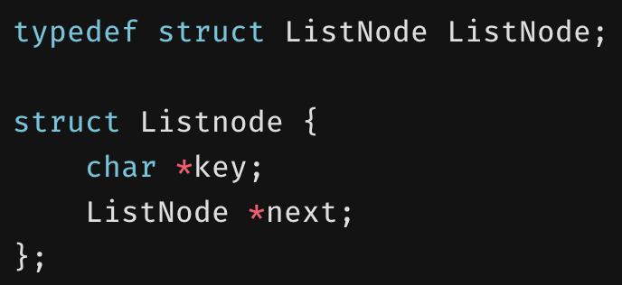
A singly linked list ADT

Slide 11
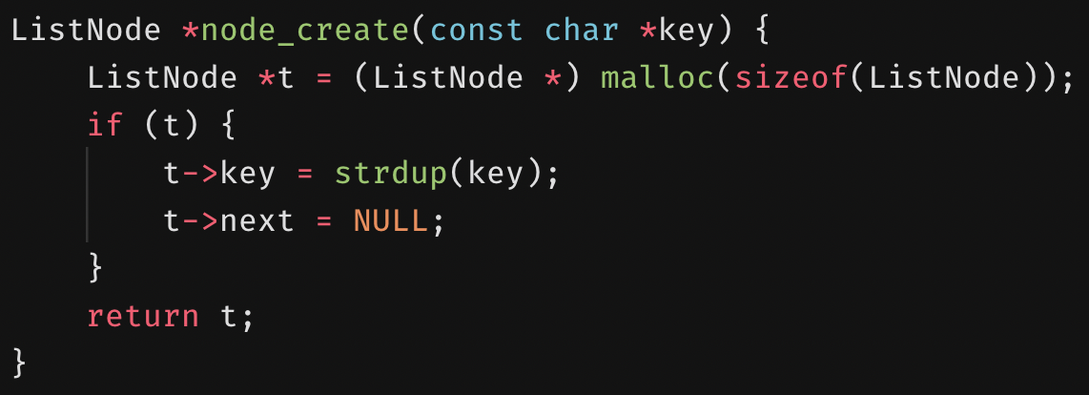
Constructor
Allocate memory needed for a single node.
A node’s key is the duplicated key.
A node initially points to NULL.

Slide 12
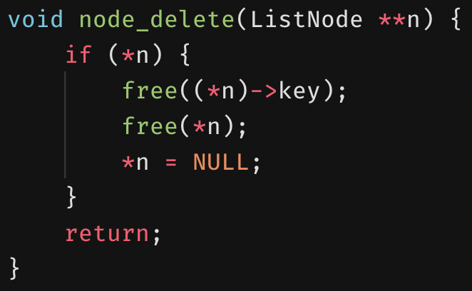
Node destructor
Free memory allocated for a node.
A double pointer is passed so we can NULL the original pointer.

Slide 13
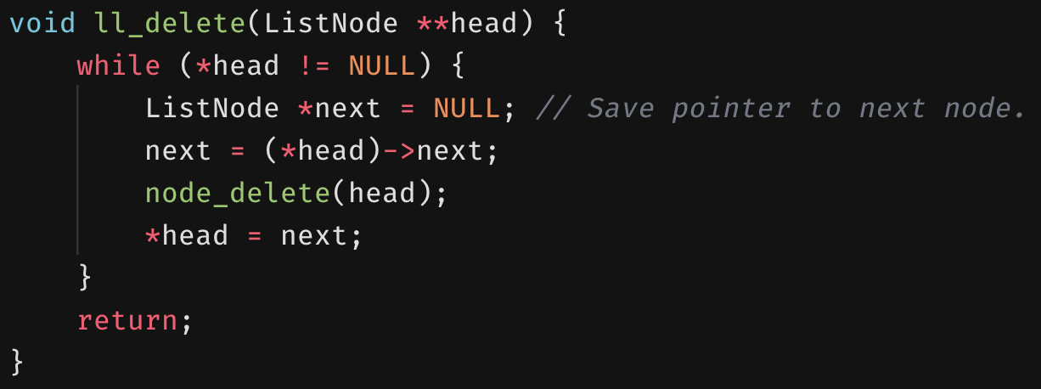
Linked list destructor
Walks the linked list and deletes each node.

Slide 14
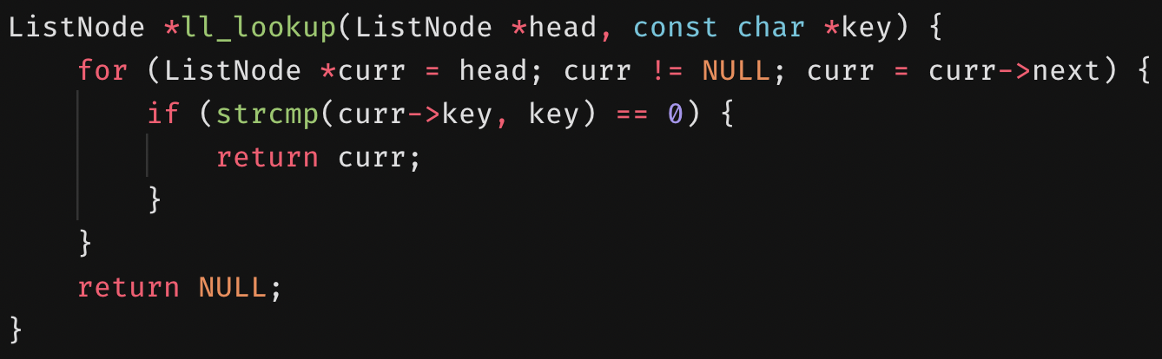
Lookup
Walks the linked list to look for a specified key.
If the key matches, then return the node, move on otherwise.
Linear search complexity for singly and doubly linked lists is O(n).
For keys that are strings with a maximum of m characters, the search complexity is O(mn).
Worst case: the key is absent.

Slide 15
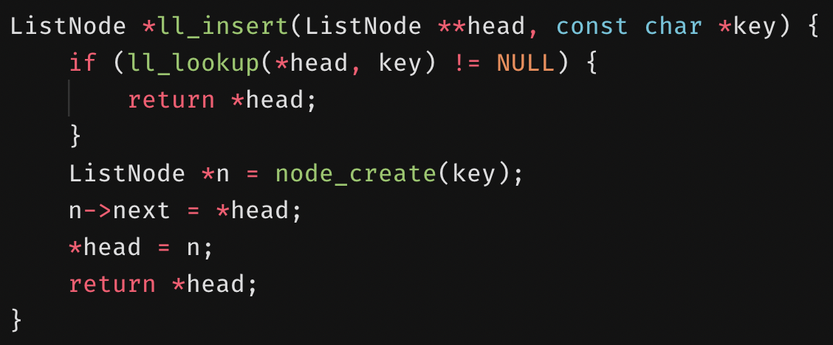
Insertion
Check if the key is already in the list.
We don’t want duplicates.
Create a node with the key.
Point the created node at the head.
The new head is the created node.

Slide 16
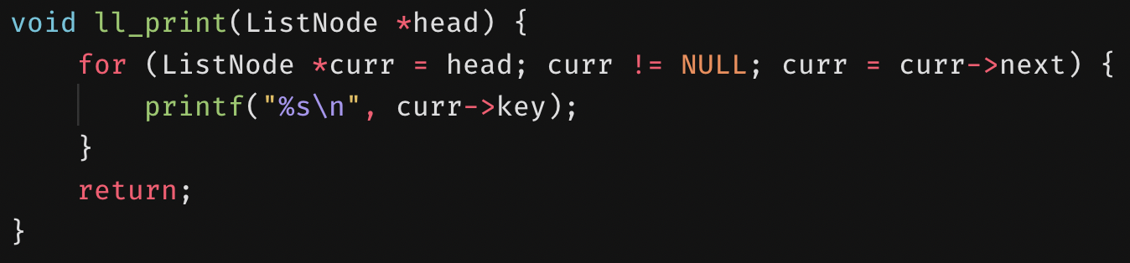
Printing
Walk through the linked list and print out each node’s key.

Slide 17
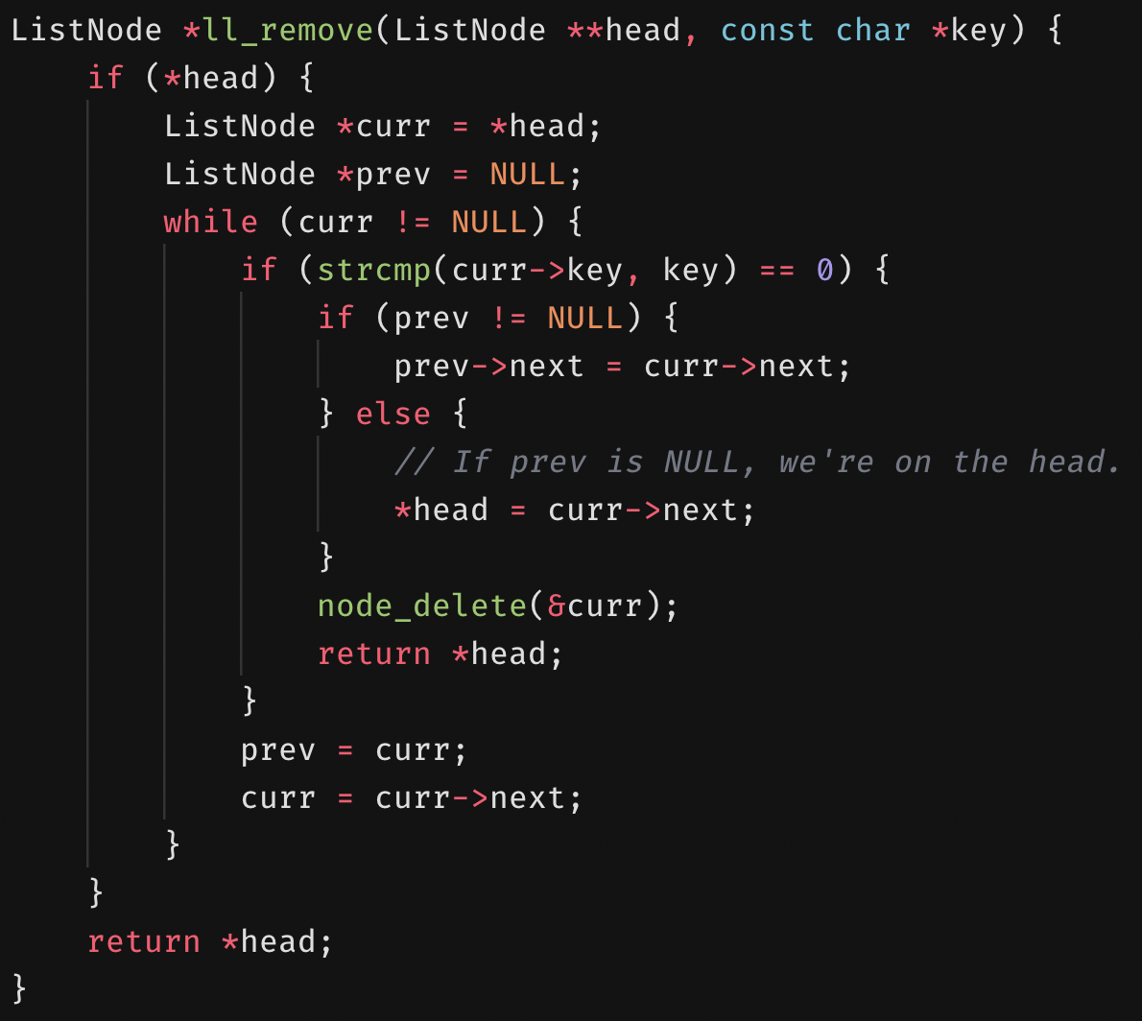
Removing
Track the current and previous nodes.
Initially, the previous node is NULL.
Walk the linked list.
If the current node contains a matching key:
If there was a previous node, point it at the node after the current node.
Else, we were on the head, so make the head point to the node the current node is point at.
Delete the found node, then we’re done.
The previous node is now the current node.
The current node is its next node.

Slide 18
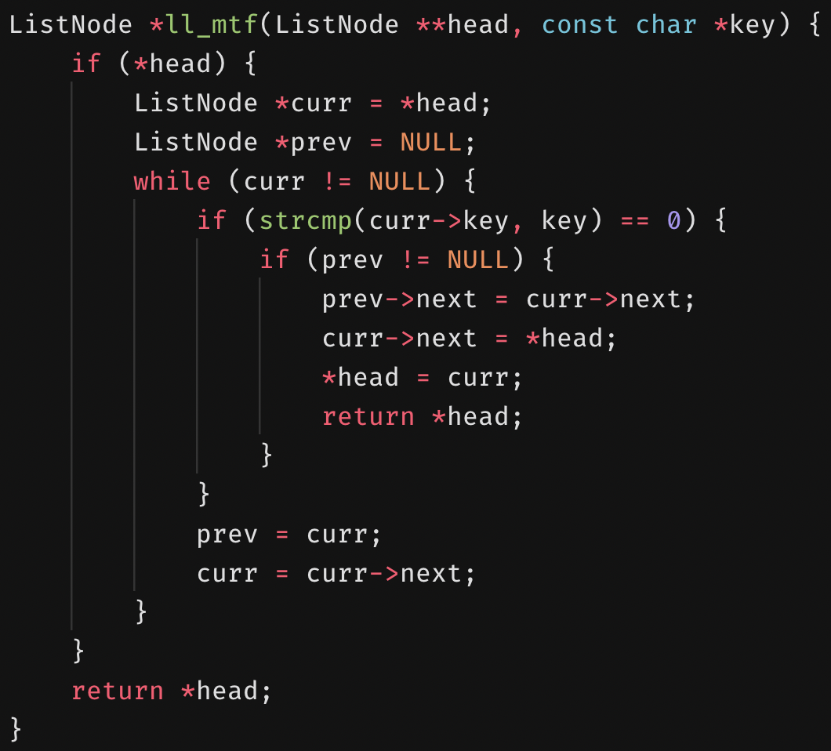
Move-to-front
Track the current and previous nodes.
Initially, the previous node is NULL.
Walk the linked list.
If the current node contains a matching key:
If there was a previous node, point it at the node after the current node.
The current node should node should now point at the head.
The new head is the current node, so we’re done.
Else, we were on the head, so no need to move to the front.
The previous node is now the current node.
The current node is its next node.

Slide 19
Linked List Stacks
Top
99
Next
50
Next
Stack size is limited only by available memory.
Pushing an element is inserting it at the head.
Popping an element is removing it from the head.
32
Next
25
Next
Null

Slide 20
Linked List Queues
Add at the tail.
Remove at the head.
Head
Tail
Data
Next
Data
Next
Data
Next
Null

Slide 21
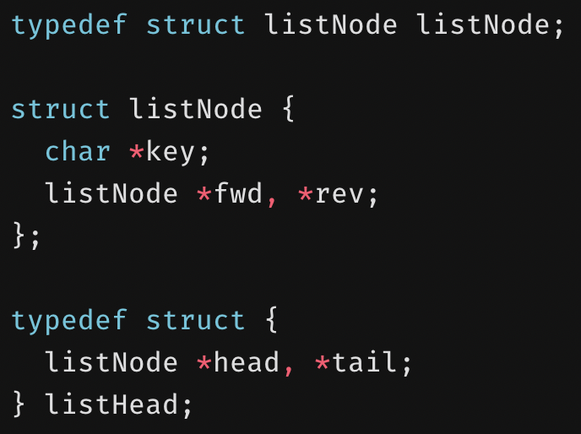
A doubly linked list ADT

Slide 22
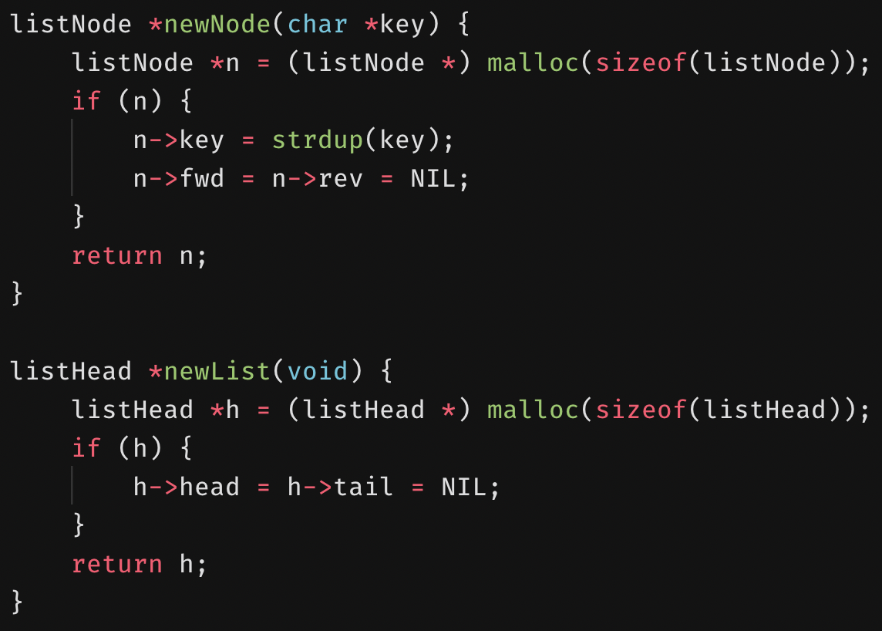
Constructors
To create a node:
Allocate memory for the node.
Duplicate the key for the node.
The forward and reverse pointers are NIL (NULL) to start with.
To create a list:
Allocate memory for the list.
The head and tail of the list are NIL to start with.

Slide 23
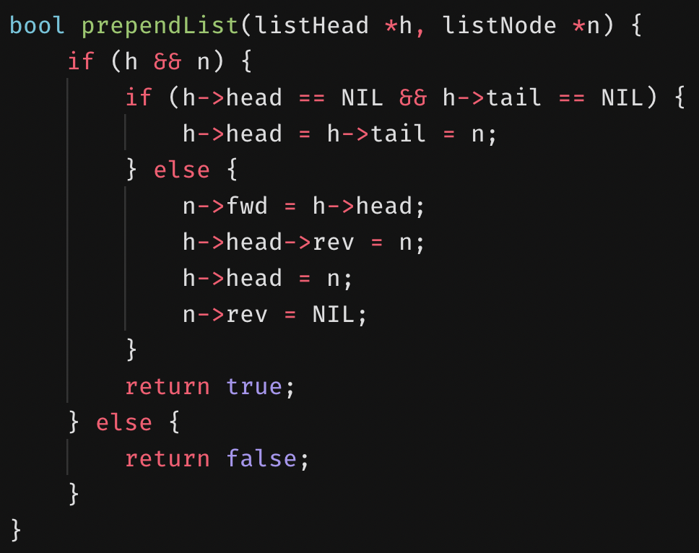
Prepending
Prepends a node n to the list (inserts at the head).
If both the head and tail are NIL:
The only node in the list is the node to prepend.
Else:
The node after n is the head.
The node before the head is now n.
The new head is n.
There is no node behind n.

Slide 24
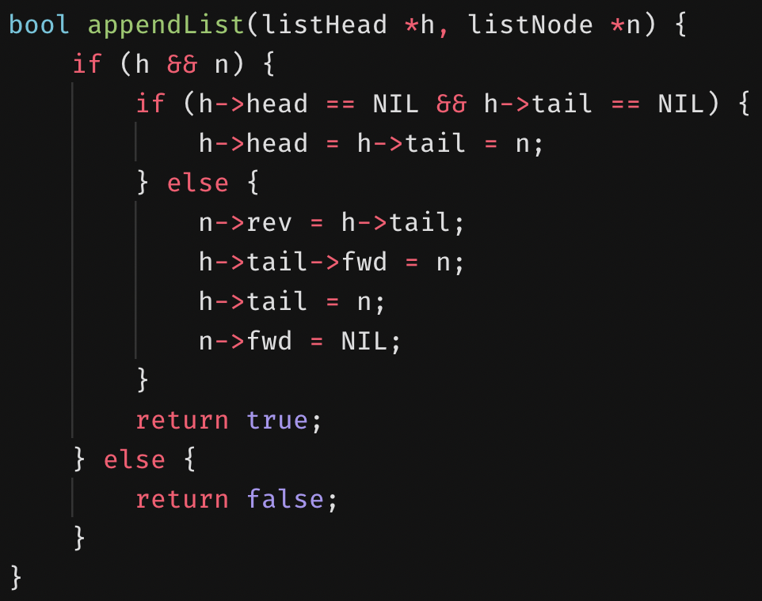
Appending
Appends a node n to the list (inserts at the tail).
If both the head and tail are NIL:
The only node in the list is the node to append.
Else:
The node before n is the tail.
The node after the tail is now n.
The new tail is n.
There is no node after n.

Slide 25
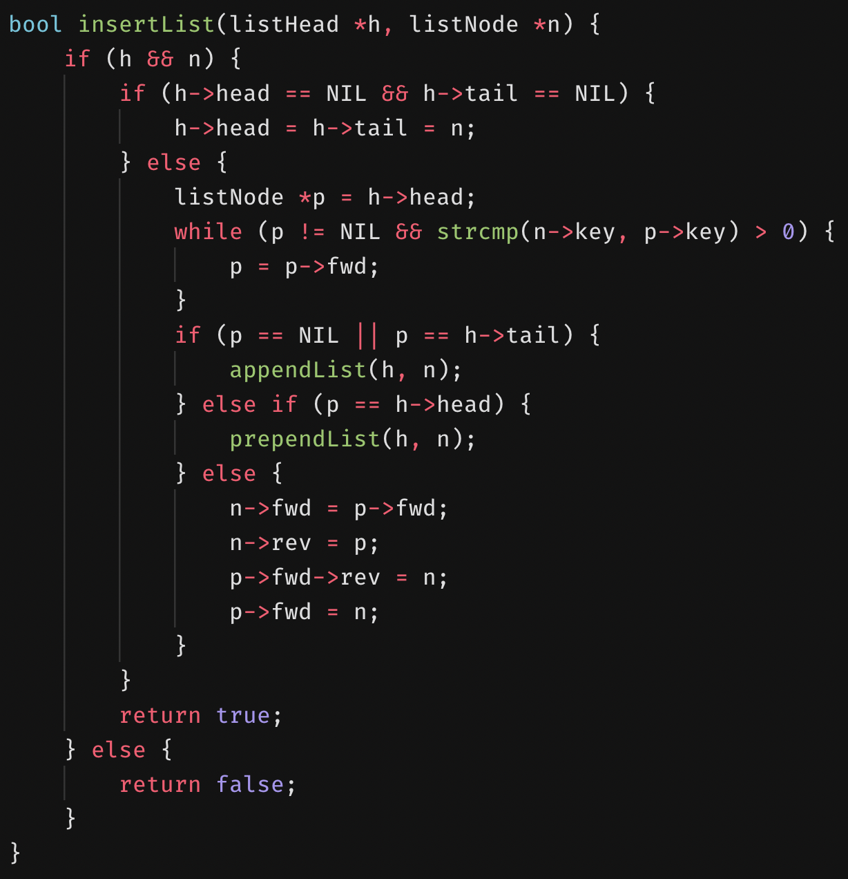
Inserting
Inserts a node n lexicographically.
Specifically, in reverse alphabetic order.
If both the head and tail are NIL:
The only node in the list is the node to insert.
Else:
Traverse to where the node should go.
If we’re at the end of the of the linked list, we append the node.
If we’re at the head of the linked list, we prepend the node.
If we’re in the middle:
The current node is p.
The node after n is the node p is point to.
The node before n is now p.
The node after p should point back to n.
The node after p is now n.

Slide 26
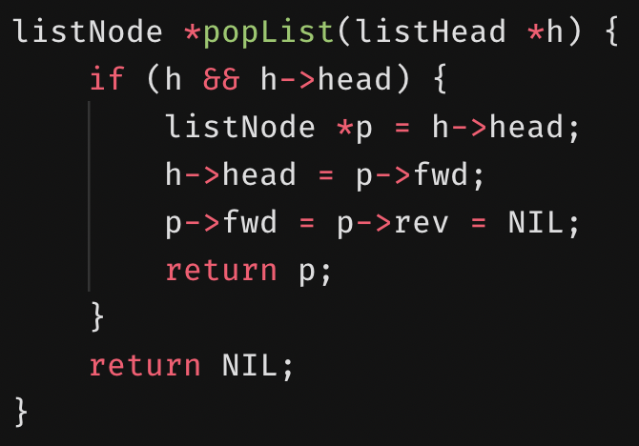
Popping
Disconnects and returns the head of the linked list.
If the head exists:
Save a pointer p to the head.
The new head is the node after p.
Make sure p doesn’t point anywhere and return it.
Else:
Return NIL.

Slide 27
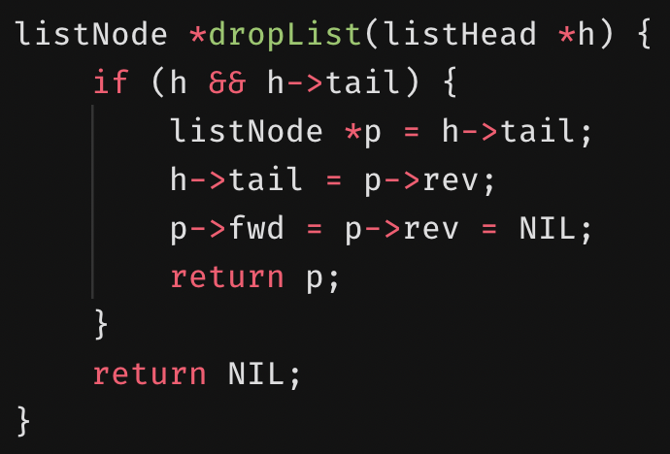
Dropping
Disconnects and returns the tail of the linked list.
If the tail exists:
Save a pointer p to the tail.
The new tail is the node before p.
Make sure p doesn’t point anywhere and return it.
Else:
Return NIL.

Slide 28
Inserting Into a Doubly Linked List
Assume there are two dummy nodes to serve as the head and tail.
These are referred to as sentinel nodes.
We’ll label them as H and T, respectively.
The presence of the sentinel nodes means there are always two nodes to insert between.
Con: Overhead of needing two extra nodes.
Pro: Cleans up the logic needed to insert a node.
Each node has its own p and n.
These are the pointers to the previous and next nodes.
p
H
n
p
T
n

Slide 29
Inserting Into a Doubly Linked List
p
N
n
We have a new node N that we will insert.
p
H
n
p
T
n

Slide 30
Inserting Into a Doubly Linked List
p
N
n
We have a new node N that we will insert into the doubly linked list.
The node after N should be the node that H was pointing to.
p
H
n
p
T
n

Slide 31
Inserting Into a Doubly Linked List
p
N
n
We have a new node N that we will insert.
The node after N should be the node that H was pointing to.
The node before N should be the head sentinel node, H.
p
H
n
p
T
n

Slide 32
Inserting Into a Doubly Linked List
p
N
n
We have a new node N that we will insert.
The node after N should be the node that H was pointing to.
The node before N should be the head sentinel node, H.
The node H is pointing to should now point back to N.
p
H
n
p
T
n

Slide 33
Inserting Into a Doubly Linked List
p
N
n
We have a new node N that we will insert.
The node after N should be the node that H was pointing to.
The node before N should be the head sentinel node, H.
The node H is pointing to should now point back to N.
The node after H should now be N.
p
H
n
p
T
n

Slide 34
Inserting Into a Doubly Linked List
We have a new node N that we will insert.
The node after N should be the node that H was pointing to.
The node before N should be the head sentinel node, H.
The node H is pointing to should now point back to N.
The node after H should now be N.
N is now at the front of the doubly linked list.
p
H
n
p
N
n
p
T
n

Slide 35
Inserting Into a Doubly Linked List
p
M
n
Let’s try inserting another node M following the same steps as done with N.
The node after M should be the node that H was pointing to.
The node before M should be the head sentinel node, H.
The node H is pointing to should now point back to M.
The node after H should now be M.
p
H
n
p
N
n
p
T
n

Slide 36
Inserting Into a Doubly Linked List
p
M
n
Let’s try inserting another node M following the same steps as done with N.
The node after M should be the node that H was pointing to.
The node before M should be the head sentinel node, H.
The node H is pointing to should now point back to M.
The node after H should now be M.
p
H
n
p
N
n
p
T
n

Slide 37
Inserting Into a Doubly Linked List
p
M
n
Let’s try inserting another node M following the same steps as done with N.
The node after M should be the node that H was pointing to.
The node before M should be the head sentinel node, H.
The node H is pointing to should now point back to M.
The node after H should now be M.
p
H
n
p
N
n
p
T
n

Slide 38
Inserting Into a Doubly Linked List
p
M
n
Let’s try inserting another node M following the same steps as done with N.
The node after M should be the node that H was pointing to.
The node before M should be the head sentinel node, H.
The node H is pointing to should now point back to M.
The node after H should now be M.
p
H
n
p
N
n
p
T
n

Slide 39
Inserting Into a Doubly Linked List
p
M
n
Let’s try inserting another node M following the same steps as done with N.
The node after M should be the node that H was pointing to.
The node before M should be the head sentinel node, H.
The node H is pointing to should now point back to M.
The node after H should now be M.
p
H
n
p
N
n
p
T
n

Slide 40
Inserting Into a Doubly Linked List
Let’s try inserting another node M following the same steps as done with N.
The node after M should be the node that H was pointing to.
The node before M should be the head sentinel node, H.
The node H is pointing to should now point back to M.
The node after H should now be M.
M is now at the front of the doubly linked list.
p
H
n
p
M
n
p
N
n
p
T
n

Slide 41
Move-to-front
Now that we’ve inserted M, we decide we don’t like the current order of the linked list.
We want N to be at the front.
p
H
n
p
M
n
p
N
n
p
T
n

Slide 42
Move-to-front
The node before N should point to the node after N.
p
H
n
p
M
n
p
N
n
p
T
n

Slide 43
Move-to-front
The node before N should point to the node after N.
The node after N should point to the node before N.
p
H
n
p
M
n
p
N
n
p
T
n

Slide 44
Move-to-front
The node before N should point to the node after N.
The node after N should point to the node before N.
The node after N should be the node that the head sentinel node H was pointing to (this will look a bit messy).
p
H
n
p
M
n
p
N
n
p
T
n

Slide 45
Move-to-front
p
H
n
p
M
n
p
N
n
p
T
n
The node before N should point to the node after N.
The node after N should point to the node before N.
The node after N should be the node that the head sentinel node H was pointing to.
The node before N should now be H.
Just to clean things up a bit.
p
N
n
p
H
n
p
M
n
p
T
n

Slide 46
Move-to-front
p
N
n
The node before N should point to the node after N.
The node after N should point to the node before N.
The node after N should be the node that the head sentinel node H was pointing to.
The node before N should now be H.
The node after H should point back to N.
p
H
n
p
M
n
p
T
n

Slide 47
Move-to-front
p
N
n
The node before N should point to the node after N.
The node after N should point to the node before N.
The node after N should be the node that the head sentinel node H was pointing to.
The node before N should now be H.
The node after H should point back to N.
The node after H should now be N.
p
H
n
p
M
n
p
T
n

Slide 48
Move-to-front
The node before N should point to the node after N.
The node after N should point to the node before N.
The node after N should be the node that the head sentinel node H was pointing to.
The node before N should now be H.
The node after H should point back to N.
The node after H should now be N.
N is now at the front.
p
H
n
p
N
n
p
M
n
p
T
n

Slide 49
Removing a node
We decide that we don’t like node M very much and want to remove it.
p
H
n
p
N
n
p
M
n
p
T
n

Slide 50
Removing a node
We decide that we don’t like node M very much and want to remove it.
The node before M should point to the node after M.
p
H
n
p
N
n
p
M
n
p
T
n

Slide 51
Removing a node
We decide that we don’t like node M very much and want to remove it.
The node before M should point to the node after M.
The node after M should point to the node before M.
p
H
n
p
N
n
p
M
n
p
T
n

Slide 52
Removing a node
We decide that we don’t like node M very much and want to remove it.
The node before M should point to the node after M.
The node after M should point to the node before M.
Goodbye M.
p
H
n
p
N
n
p
M
n
p
T
n

Slide 53
Removing a node
We decide that we don’t like node M very much and want to remove it.
The node before M should point to the node after M.
The node after M should point to the node before M.
Goodbye M.
M is removed now.
p
H
n
p
N
n
p
T
n

