Slide 1
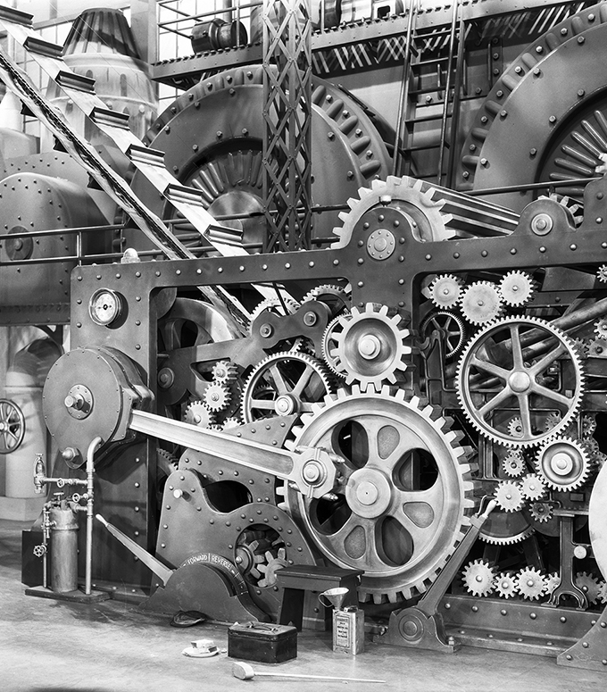
Processes
Prof. Darrell CSE
CSE 13S

Slide 2
Processes and threads
Processes
Threads
Scheduling
Inter-process communication (IPC)
Classical IPC problems

Slide 3
What is a process?
Code, data, and stack
  Usually (but not always) has its own address space
Program state
  CPU registers
  Program counter (current location in the code)
  Stack pointer
Only one process can be running in a single CPU core at any given time!
  Multi-core CPUs can support multiple processes

Slide 4
What is an Address Space?
Programs execute code.
  Each instruction has an address.
Programs access data.
  Each byte of data also has an address.
We would like to think that our program is the only program executing on the computer –
  But we would be wrong.
An address space is the region of a computer’s memory where a program executes.
  Ideally, it is protected from other programs accessing it.

Slide 5
How is that accomplished?
The loader could relocate the instructions by address a base address to each one.
There could be registers that point to the first byte of the program’s memory (base register) that is added to every memory access.
The processor and operating system could provide virtual memory.

Slide 6
In an ideal world…
The ideal world has memory that is
  Very large
  Very fast
  Non-volatile (doesn’t go away when power is turned off)
The real world has memory that is:
  Very large
  Very fast
  Affordable!
  Pick any two…
Memory management goal: make the real world look as much like the ideal world as possible
2/15/23
© 2020 Darrell Long and Ethan Miller

Slide 7
Memory hierarchy
What is the memory hierarchy?
  Different levels of memory
  Some are small & fast
  Others are large & slow
What levels are usually included?
  Cache: small amount of fast, expensive memory
    L1 (level 1) cache: usually on the CPU chip
    L2: may be on or off chip
    L3 cache: off-chip, made of SRAM
  Main memory: medium-speed, medium price memory (DRAM)
  Disk: many gigabytes of slow, cheap, non-volatile storage
Memory manager handles the memory hierarchy
2/15/23
© 2020 Darrell Long and Ethan Miller
7

Slide 8
Basic memory management
Components include
  Operating system (perhaps with device drivers)
  Single process
Goal: lay these out in memory
  Memory protection may not be an issue (only one program)
  Flexibility may still be useful (allow OS changes, etc.)
No swapping or paging
2/15/23
© 2020 Darrell Long and Ethan Miller
8

Slide 9
Fixed partitions:
multiple programs
Fixed memory partitions
  Divide memory into fixed spaces
  Assign a process to a space when it’s free
Mechanisms
  Separate input queues for each partition
  Single input queue: better ability to optimize CPU usage
900K
900K
Partition 4
Partition 4
Partition 3
700K
Partition 3
700K
Partition 2
600K
Partition 2
600K
500K
500K
Partition 1
Partition 1
100K
Process
100K
OS
OS
0
0
2/15/23
© 2020 Darrell Long and Ethan Miller

Slide 10
Multiprogrammed system performance
Job | Arrival time | CPU needed
1 | 10:00 | 4
2 | 10:10 | 3
3 | 10:15 | 2
4 | 10:20 | 2
 | 1 | 2 | 3 | 4
CPU idle | 0.8 | 0.64 | 0.51 | 0.41
CPU busy | 0.2 | 0.36 | 0.49 | 0.59
CPU/process | 0.2 | 0.18 | 0.16 | 0.15
0
Time
10
15
20
22
27.6
28.2
31.7
1
2
3
4
Arrival and work requirements of 4 jobs
CPU utilization for 1–4 jobs with 80% I/O wait
Sequence of events as jobs arrive and finish
  Numbers show amount of CPU time jobs get in each interval
  More processes ⇒ better utilization, less time per process
2/15/23
© 2020 Darrell Long and Ethan Miller

Slide 11
Memory and multiprogramming
Memory needs two things for multiprogramming
  Relocation
  Protection
The OS cannot be certain where a program will be loaded in memory
  Variables and procedures can’t use absolute locations in memory
  Several ways to guarantee this
The OS must keep processes’ memory separate
  Protect a process from other processes reading or modifying its own memory
  Protect a process from modifying its own memory in undesirable ways (such as writing to program code)
2/15/23
© 2020 Darrell Long and Ethan Miller

Slide 12
Base and limit registers
0xFFFF
0x2000
Special CPU registers: base & limit
  Access to the registers limited to system mode
  Registers contain
    Base: start of the process’s memory partition
    Limit: length of the process’s memory partition
Address generation
  Physical address: location in actual memory
  Logical address: location from the process’s point of view
  Physical address = base + logical address
  Logical address larger than limit ➙ error
Limit
Process partition
Base
0x9000
OS
0
Logical address: 0x1204
Physical address: 0x1204+0x9000 = 0xa204
2/15/23
© 2020 Darrell Long and Ethan Miller

Slide 13
Allocating memory
Search through region list to find a large enough space
Suppose there are several choices: which one to use?
  First fit: the first suitable hole on the list
  Next fit: the first suitable after the previously allocated hole
  Best fit: the smallest hole that is larger than the desired region (wastes least space?)
  Worst fit: the largest available hole (leaves largest fragment)
Option: maintain separate queues for different-size holes
Allocate 20 blocks first fit
Allocate 13 blocks best fit
Allocate 12 blocks next fit
Allocate 15 blocks worst fit
1
5
18
-
6
5
-
19
14
-
52
25
-
102
30
-
135
16
-
202
10
-
302
20
-
350
30
-
411
19
-
510
3
15
2/15/23
© 2020 Darrell Long and Ethan Miller

Slide 14
Freeing memory
Allocation structures must be updated when memory is freed
Easy with bitmaps: just set the appropriate bits in the bitmap
Linked lists: modify adjacent elements as needed
  Merge adjacent free regions into a single region
  May involve merging two regions with the just-freed area
A
X
B
A
B
A
X
A
X
B
B
X
2/15/23
© 2020 Darrell Long and Ethan Miller

Slide 15
Buddy allocation
Allocate memory in powers of two
  Good for objects of varied sizes
Split larger chunks to create two smaller chunks
When chunk is freed, see if it can be combined with its buddy to rebuild a larger chunk
  This is recursive...
Allocating memory
Freeing memory

Slide 16
Virtual memory
Basic idea: allow the OS to hand out more memory than exists on the system
Keep recently used stuff in physical memory
Move less recently used stuff to disk
Keep all of this hidden from processes
  Processes still see an address space from 0–max_address
  Movement of information to and from disk handled by the OS without process help
Virtual memory (VM) especially helpful in multiprogrammed systems
  CPU schedules process B while process A waits for its memory to be retrieved from disk
2/15/23
© 2020 Darrell Long and Ethan Miller

Slide 17

Virtual and physical addresses
CPU chip
Program uses virtual addresses
  Addresses local to the process
  Hardware translates virtual address to physical address
Translation done by the Memory Management Unit
  Usually on the same chip as the CPU
  Only physical addresses leave the CPU/MMU chip
Physical memory indexed by physical addresses
CPU
MMU
Virtual addresses
from CPU to MMU
Memory
Physical addresses
on bus, in memory
Disk controller

Slide 18
Paging and page tables
60 – 64K
x
Virtual Memory
56 – 60K
x
Virtual addresses mapped to physical addresses
  Unit of mapping is called a page
  All addresses in the same virtual page are in the same physical page
  Page table entry (PTE) contains translation for a single page
Table translates virtual page number to physical page number
  Not all virtual memory has a physical page
  Not every physical page need be used
Example:
  64 KB virtual memory
  16 KB physical memory
52 – 56K
0
48 – 52K
x
44 – 48K
x
40 – 44K
x
36 – 40K
3
32 – 36K
x
28 – 32K
x
24 – 28K
x
20 – 24K
x
Physical Memory
16 – 20K
1
12 – 16K
2
8 – 12K
x
4 – 8K
x
0 – 4K
x

Slide 19
What’s in a page table entry?
Each entry in the page table contains
  Valid bit: set if this logical page number has a corresponding physical frame in memory
    If not valid, remainder of PTE is irrelevant
  Page frame number: page in physical memory
  Referenced bit: set if data on the page has been accessed
  Dirty (modified) bit :set if data on the page has been modified
  Protection information
Protection
D
R
V
Page Frame Number
Dirty Bit
Referenced Bit
Valid Bit

Slide 20
Mapping logical addresses to physical addresses
Split address from CPU into two pieces
  Page number (p)
  Page offset (d)
Page number
  Index into page table
  Page table contains base address of page in physical memory
Page offset
  Added to base address to get actual physical memory address
Page size = 2^{d} bytes
Example:
• 4 KB (=4096 byte) pages
• 32-bit logical addresses
2^{d} = 4096
d = 12
32 - 12 = 20 bits
12 bits
p
d
32-bit logical address

Slide 21
Address Translation Architecture
Page Number
Page Frame Number
CPU
Page Frame Number
p
d
f
d
0
1
0
1
Page Offset
f
f – 1
f
f + 1
f + 2
p – 1
p
p + 1
Page Table
Physical Memory

Slide 22
Memory & paging structures
2/15/23
© 2020 Darrell Long and Ethan Miller
22
Process 0
Physical
memory
Page frame number
Page 0
6
Page 1
3
0
Page 1 (P1)
Page 2
4
1
free
Page 3
9
2
Page 4 (P0)
Page 4
2
3
Page 1 (P0)
Logical memory
Page table
Free
pages
4
Page 2 (P0)
5
Page 2 (P1)
Process 1
6
Page 0 (P0)
Page 0
8
7
free
Page 1
0
8
Page 0 (P1)
Page 2
5
9
Page 3 (P0)
Logical memory
Page table

Slide 23
The Process Model
Multiple Program Counters (process point-of-view
Single Program Counter (CPU’s point-of-view)
Conceptual model of multiprogramming four programs
  4 independent processes
  Processes run sequentially
Only one process active at any instant
  An instant can be very short
  Only applies if there’s a single CPU (with a single core) in the system
A
A
B
C
D
B
C
D
B
C
B
D
A
Time

Slide 24

When is a process created?
Processes can be created in two ways
  System initialization: one or more processes created when the OS starts up.
  Execution of a process creation system call: something explicitly asks for a new process .
System calls can come from:
  User request to create a new process (system call executed from user shell)
  Already running processes
    User programs
    System daemons

Slide 25

When do processes end?
Conditions that terminate processes can be
  Voluntary
  Involuntary
Voluntary
  Normal exit
  Error exit
Involuntary
  Fatal error (only sort of involuntary)
  Killed by another process

Slide 26

Process hierarchies
Parent creates a child process
  Child processes can create their own children
Forms a hierarchy
  UNIX calls this a “process group”
  If a process terminates, its children are “inherited” by the terminating process’s parent
Windows has process groups
  Multiple processes grouped together
  One process is the “group leader”

Slide 27
Process States
Created
Process in one of 5 states
  Created
  Ready
  Running
  Blocked
  Exit
Transitions between states
  Process enters ready queue
  Scheduler picks this process
  Scheduler picks a different process
  Process waits for an event such as I/O
  Event occurs
  Process exits
  (Process ended by another process)
1
Ready
5
2
3
Blocked (waiting)
4
Running
7
7
6
Exit

Slide 28
What’s in a process table entry?
Process management
Registers
Program counter
CPU status word
Stack pointer
Process state
Priority / scheduling parameters
Process ID
Parent process ID
Signals
Process start time
Total CPU usage
File management
Root directory
Working (current) directory
File descriptors
User ID
Group ID
May be
stored
on stack
Memory management
Pointers to text, data, stack
- or -
Pointer to page table

Slide 29
What happens on a trap/interrupt?
Hardware saves program counter (on stack or in a special register)
Hardware loads new PC, identifies interrupt
Assembly language routine saves registers
Assembly language routine sets up stack
Assembly language calls C to run service routine
Service routine calls scheduler
Scheduler selects a process to run next (might be the one interrupted…)
Assembly language routine loads PC & registers for the selected process
2/15/23
© 2020 Darrell Long and Ethan Miller
29

Slide 30
Multiple Threads in a Process
DIAGRAM
Process 1
Process 2
Process 3
Process 1
User Space
Threads
Threads
System Space
Kernel
Kernel

Slide 31
Process and Thread Information
Per process items
Address space
Open files
Child processes
Signals & handlers
Accounting info
Global variables
Per thread items:
Program counter
Registers
Stack & stack pointer
State (local variables)
Per thread items:
Program counter
Registers
Stack & stack pointer
State (local variables)
Per thread items:
Program counter
Registers
Stack & stack pointer
State (local variables)

Slide 32
Threads and Stacks
Thread 1
Thread 2
Thread 3
DIAGRAM
Process
User Space
Thread 1’s stack
Thread 3’s stack
Thread 2’s stack
Kernel

Slide 33
Why use Threads?
Allow a single application to do many things at once
  Simpler programming model
  Less waiting
Threads are faster to create or destroy
  No separate address space
Overlap computation and I/O
  Could be done without threads, but it’s harder
Example: word processor
  Thread to read from keyboard
  Thread to format document
  Thread to write to disk

Slide 34
Three Ways to Build a Server
Multithreaded server
  Parallelism
  Blocking system calls
  May use pop-up threads: create a new thread in response to an incoming message (rather than reusing a thread)
Single-threaded process: slow, but easier to do
  No parallelism
  Blocking system calls
Finite-state machine (event model)
  Each activity has its own state: states change when system calls complete or interrupts occur
  Parallelism
  Nonblocking system calls

Slide 35
Issues with using Threads
May be tricky to convert single-threaded code to multithreaded code
Re-entrant code
  Code must function properly when multiple threads are using it simultaneously
  Need to be careful when using static or global variables
    Returned structures
    Buffers
Error management
  What happens when just a single thread has an error?
  Can’t simply kill the process, since other threads might be running

Slide 36
Implementing Threads
Process
Thread
Run-time system
Thread table
Kernel
Kernel
Thread table
Process table
Process table

Slide 37
POSIX threads
Thread call (Pthread_xx) | Description
create | Create a new thread
exit | Terminate the calling thread
join | Wait for a specific thread to exit
yield | Release the CPU, allowing another thread to run
Standard interface to threading library
May be implemented in either user or kernel space
  Some operating systems provide support for both!
Allows thread-based programs to be portable

Slide 38
Processes & Threads in Linux
Supports POSIX standard
Linux supports kernel-level threads (lightweight processes)
  Share address space, file descriptors, etc.
  Each has its own process descriptor in memory
Linux processes (incl. lightweight) all have unique identifiers
  Threads sharing address space are grouped into process groups
  Identifier shared by the group is that of the leader
Each process has its own 8KB region that stores
  Kernel stack
    Kernel has a small stack: about 4KB!
  Low-level thread information
Other information stored in a separate data structure
  Memory allocated to the process
  Open files
  Signal information

