Slide 1
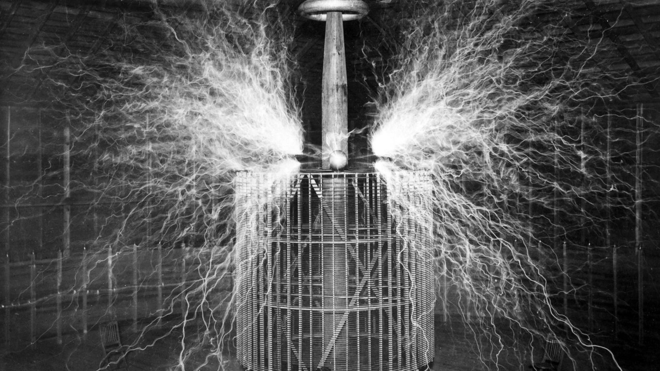
Trees
Prof. Darrell Long
CSE 13s

Slide 2
What’s a tree?
A tree is a type of directed acyclic graph, typically composed of nodes.
There is exactly one path between any two nodes.
The definition on the right:
A tree is can either be NULL,
Or be a node pointing to two trees.
An example of a rooted binary tree.
Tree = NULL
| Node Tree Tree

Slide 3
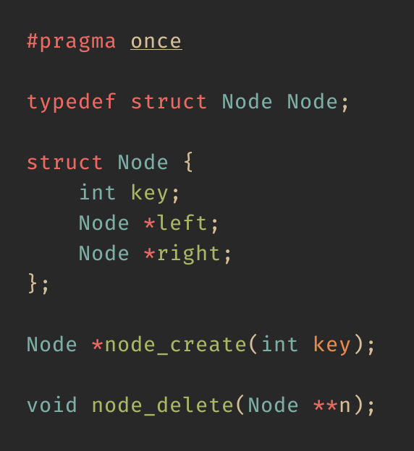
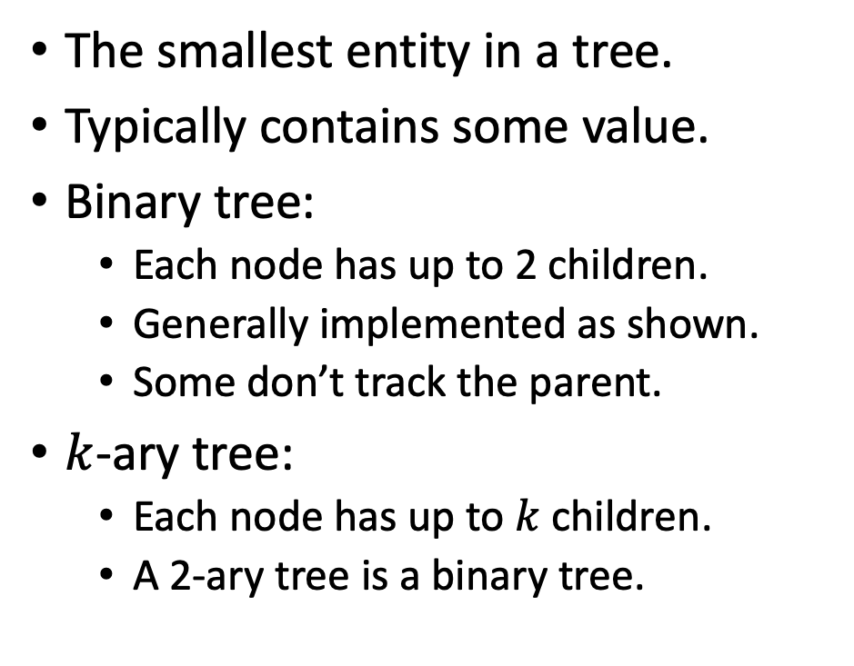
What’s a node?
The smallest entity in a tree.
Typically contains some value.
Binary tree:
Each node has up to 2 children.
Generally implemented as shown.
Some don’t track the parent.
$k$-ary tree:
Each node has up to $k$ children.
A 2-ary tree is a binary tree.

Slide 4
Terminology
Root
The starting point of the tree.
If NULL, then the tree is empty.
Parent
Child
Subtree
Leaf
Traversal
Successor
Predecessor
root

Slide 5
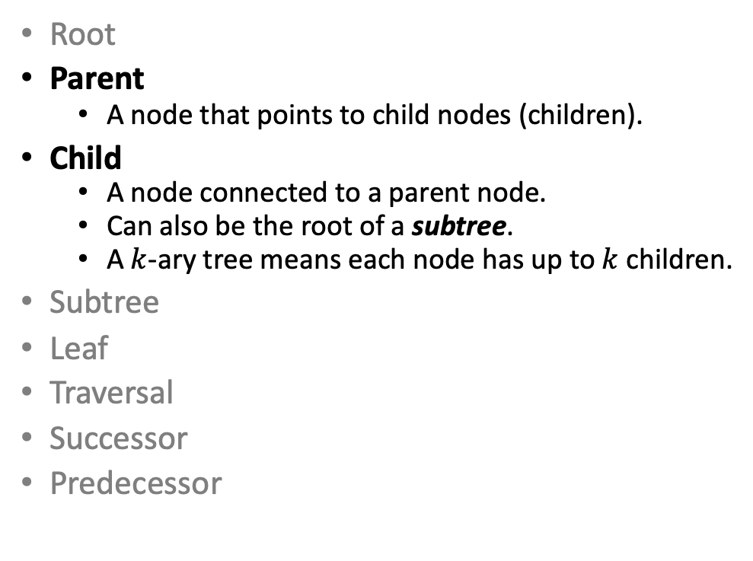
Terminology
Root
Parent
A node that points to child nodes (children).
Child
A node connected to a parent node.
Can also be the root of a subtree.
A $k$-ary tree means each node has up to $k$ children.
Subtree
Leaf
Traversal
Successor
Predecessor
parent
child
child

Slide 6
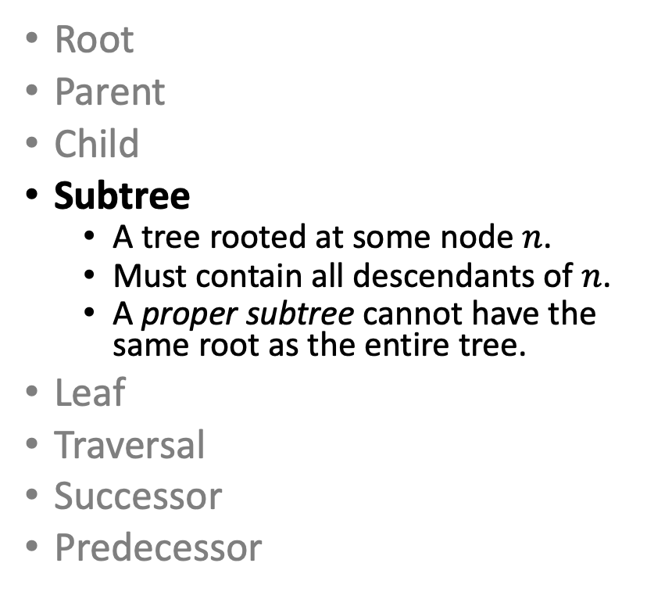
Terminology
Root
Parent
Child
Subtree
A tree rooted at some node $n$.
Must contain all descendants of $n$.
A proper subtree cannot have the same root as the entire tree.
Leaf
Traversal
Successor
Predecessor
subtree

Slide 7
Terminology
Root
Parent
Child
Subtree
Leaf
A node that contains no children.
This means the children are NULL.
Traversal
Successor
Predecessor
leaf

Slide 8
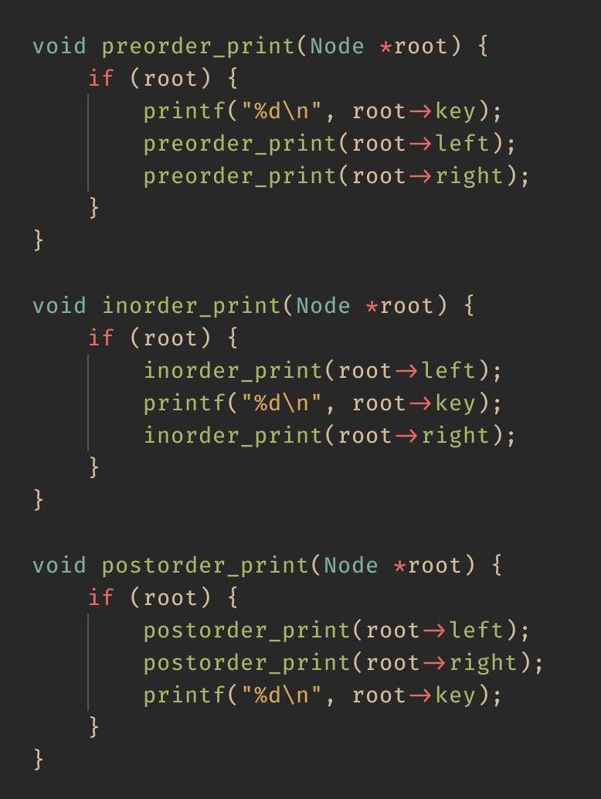
Terminology
Root
Parent
Child
Subtree
Leaf
Traversal
A means of visiting each node exactly once.
Four traversals:
Preorder
Inorder
Postorder
Level order
Successor
Predecessor

Slide 9
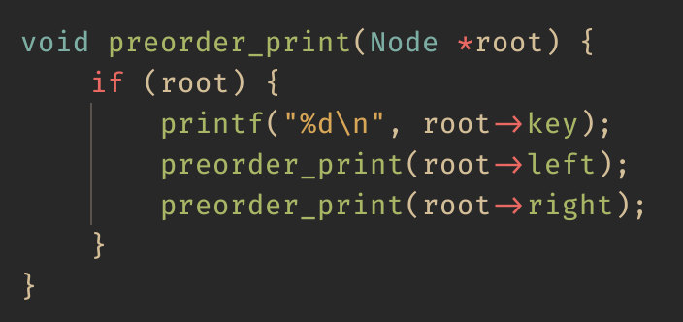
Preorder Traversal
unvisited
visited
Print order:
printed
4
2
6
1
3
5

Slide 10
Preorder Traversal
unvisited
visited
Print order:
printed
4
2
6
1
3
5

Slide 11
Preorder Traversal
unvisited
visited
Print order: 4
printed
4
2
6
1
3
5

Slide 12
Preorder Traversal
unvisited
visited
Print order: 4
printed
4
2
6
1
3
5

Slide 13
Preorder Traversal
unvisited
visited
Print order: 4, 2
printed
4
2
6
1
3
5

Slide 14
Preorder Traversal
unvisited
visited
Print order: 4, 2
printed
4
2
6
1
3
5

Slide 15
Preorder Traversal
unvisited
visited
Print order: 4, 2, 1
printed
4
2
6
1
3
5

Slide 16
Preorder Traversal
unvisited
visited
Print order: 4, 2, 1
printed
4
2
6
1
3
5

Slide 17
Preorder Traversal
unvisited
visited
Print order: 4, 2, 1, 3
printed
4
2
6
1
3
5

Slide 18
Preorder Traversal
unvisited
visited
Print order: 4, 2, 1, 3
printed
4
2
6
1
3
5

Slide 19
Preorder Traversal
unvisited
visited
Print order: 4, 2, 1, 3, 6
printed
4
2
6
1
3
5

Slide 20
Preorder Traversal
unvisited
visited
Print order: 4, 2, 1, 3, 6
printed
4
2
6
1
3
5

Slide 21
Preorder Traversal
unvisited
visited
Print order: 4, 2, 1, 3, 6, 5
printed
4
2
6
1
3
5

Slide 22
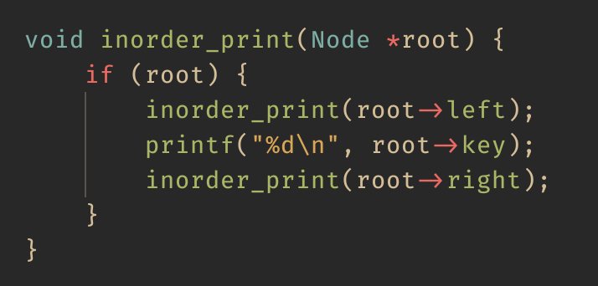
Inorder Traversal
unvisited
visited
Print order:
printed
4
2
6
1
3
5

Slide 23
Inorder Traversal
unvisited
visited
Print order:
printed
4
2
6
1
3
5

Slide 24
Inorder Traversal
unvisited
visited
Print order:
printed
4
2
6
1
3
5

Slide 25
Inorder Traversal
unvisited
visited
Print order:
printed
4
2
6
1
3
5

Slide 26
Inorder Traversal
unvisited
visited
Print order: 1
printed
4
2
6
1
3
5

Slide 27
Inorder Traversal
unvisited
visited
Print order: 1, 2
printed
4
2
6
1
3
5

Slide 28
Inorder Traversal
unvisited
visited
Print order: 1, 2
printed
4
2
6
1
3
5

Slide 29
Inorder Traversal
unvisited
visited
Print order: 1, 2, 3
printed
4
2
6
1
3
5

Slide 30
Inorder Traversal
unvisited
visited
Print order: 1, 2, 3, 4
printed
4
2
6
1
3
5

Slide 31
Inorder Traversal
unvisited
visited
Print order: 1, 2, 3, 4
printed
4
2
6
1
3
5

Slide 32
Inorder Traversal
unvisited
visited
Print order: 1, 2, 3, 4
printed
4
2
6
1
3
5

Slide 33
Inorder Traversal
unvisited
visited
Print order: 1, 2, 3, 4, 5
printed
4
2
6
1
3
5

Slide 34
Inorder Traversal
unvisited
visited
Print order: 1, 2, 3, 4, 5, 6
printed
4
2
6
1
3
5

Slide 35
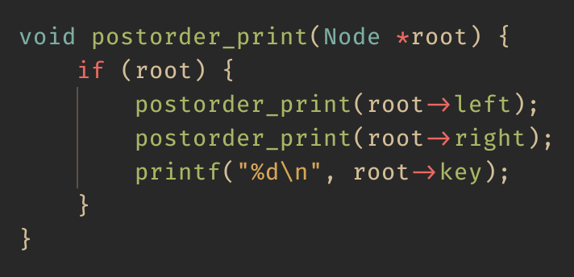
Postorder Traversal
unvisited
visited
Print order:
printed
4
2
6
1
3
5

Slide 36
Postorder Traversal
unvisited
visited
Print order:
printed
4
2
6
1
3
5

Slide 37
Postorder Traversal
unvisited
visited
Print order:
printed
4
2
6
1
3
5

Slide 38
Postorder Traversal
unvisited
visited
Print order:
printed
4
2
6
1
3
5

Slide 39
Postorder Traversal
unvisited
visited
Print order: 1
printed
4
2
6
1
3
5

Slide 40
Postorder Traversal
unvisited
visited
Print order: 1
printed
4
2
6
1
3
5

Slide 41
Postorder Traversal
unvisited
visited
Print order: 1, 3
printed
4
2
6
1
3
5

Slide 42
Postorder Traversal
unvisited
visited
Print order: 1, 3, 2
printed
4
2
6
1
3
5

Slide 43
Postorder Traversal
unvisited
visited
Print order: 1, 3, 2
printed
4
2
6
1
3
5

Slide 44
Postorder Traversal
unvisited
visited
Print order: 1, 3, 2
printed
4
2
6
1
3
5

Slide 45
Postorder Traversal
unvisited
visited
Print order: 1, 3, 2, 5
printed
4
2
6
1
3
5

Slide 46
Postorder Traversal
unvisited
visited
Print order: 1, 3, 2, 5, 6
printed
4
2
6
1
3
5

Slide 47
Postorder Traversal
unvisited
visited
Print order: 1, 3, 2, 5, 6, 4
printed
4
2
6
1
3
5

Slide 48
Level Order Traversal
Same as BFS in a graph.
Nodes in a tree are visited level by level.
Uses a queue.
4
2
6
1
3
5
Order: 4, 2, 6, 1, 3, 5

Slide 49
Terminology
Successor
The next node in some order.
Predecessor
The previous node in some order.
Both are well-defined for preorder, inorder, and postorder.
We will use inorder for binary search trees.

Slide 50
Binary Search Trees
An example of an ordered tree.
Nodes in a tree do not necessarily need an order.
But it is more useful if there is an order.
Keys less than a node’s value go under its left subtree.
Keys greater than a node’s value go under its right subtree.
Duplicates are generally ignored.
4
2
6
1
3
5

Slide 51
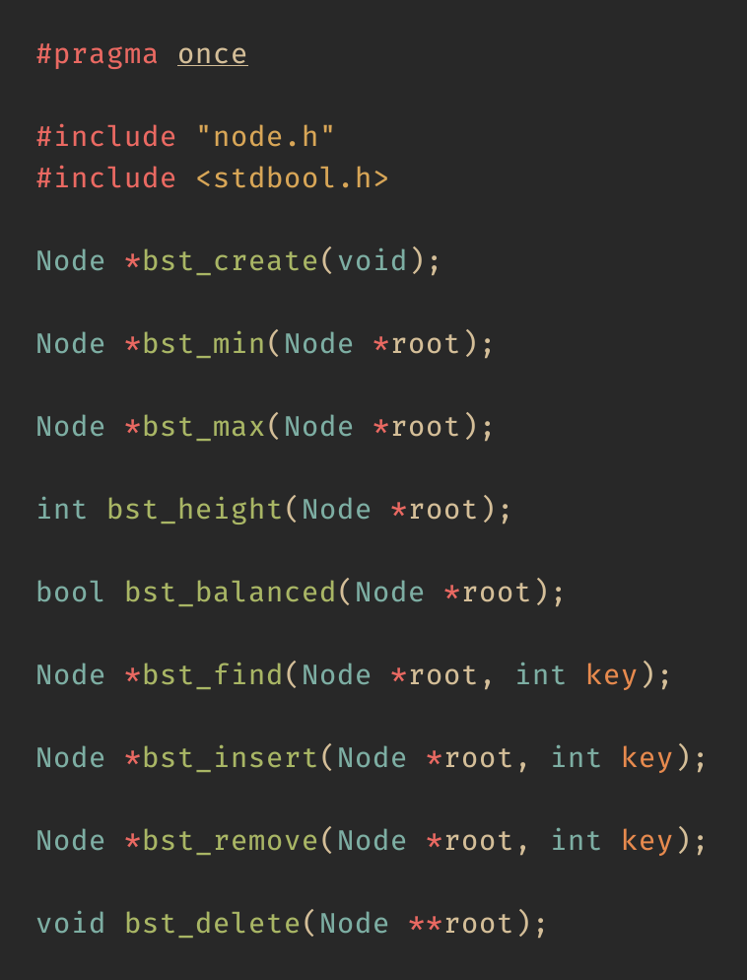
Binary Search Trees in C
API:
Create an empty tree.
Find the minimum node in a tree.
Find the maximum node in a tree.
Find the height of a tree.
Check if a tree is balanced.
Find some key in a tree.
Insert a new key into a tree.
Remove a key from a tree.
Delete a tree.

Slide 52
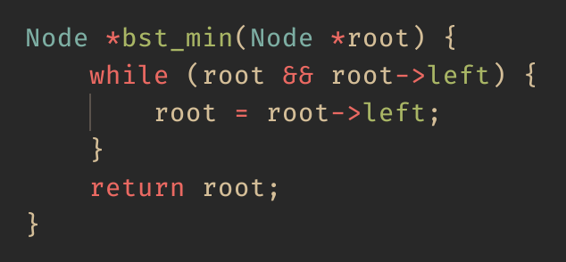
Finding the minimum
4
Start from the root.
Walk all the way to the left.
2
6
1
3
5

Slide 53
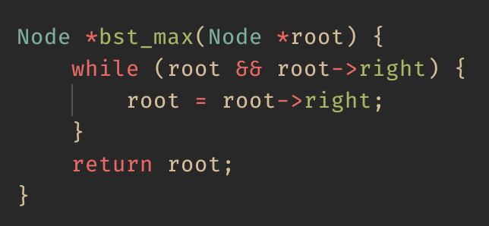
Finding the maximum
4
Start from the root.
Walk all the way to the right.
2
6
1
3
5

Slide 54
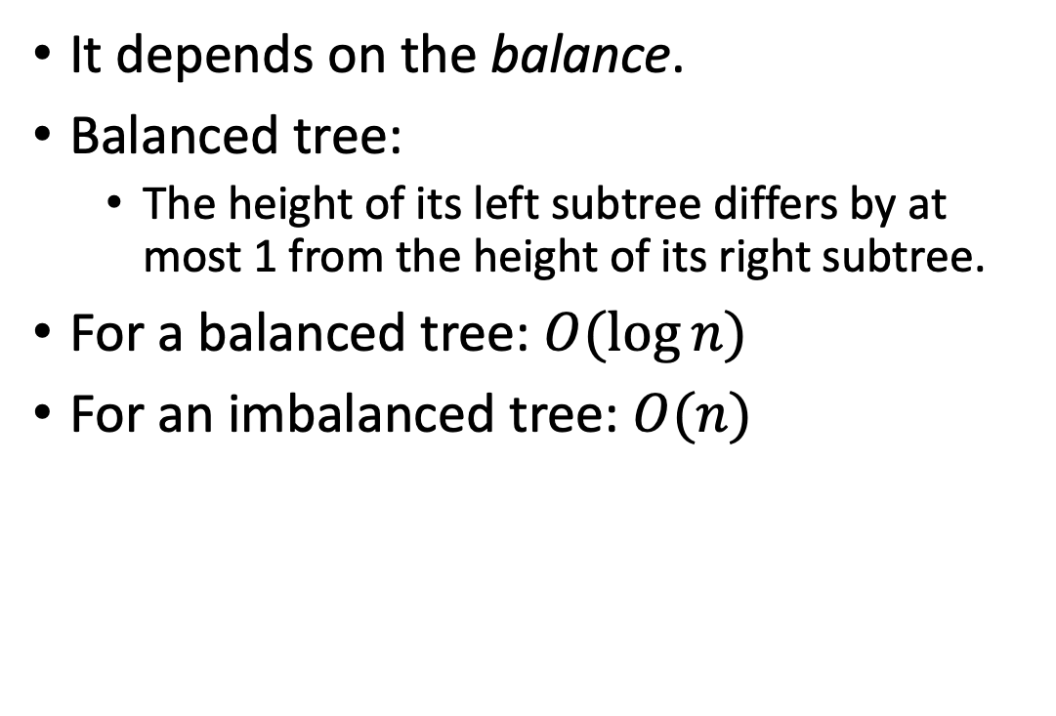
Time complexity for finding extrema
Balanced
It depends on the balance.
Balanced tree:
The height of its left subtree differs by at most 1 from the height of its right subtree.
For a balanced tree: $O(\log{n)}$
For an imbalanced tree: $O(n)$
4
2
6
1
3
5
Imbalanced
4
2
6
1
3
0

Slide 55
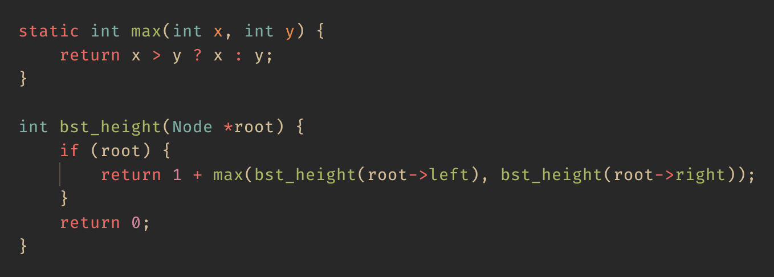
Finding the height of a tree

Slide 56
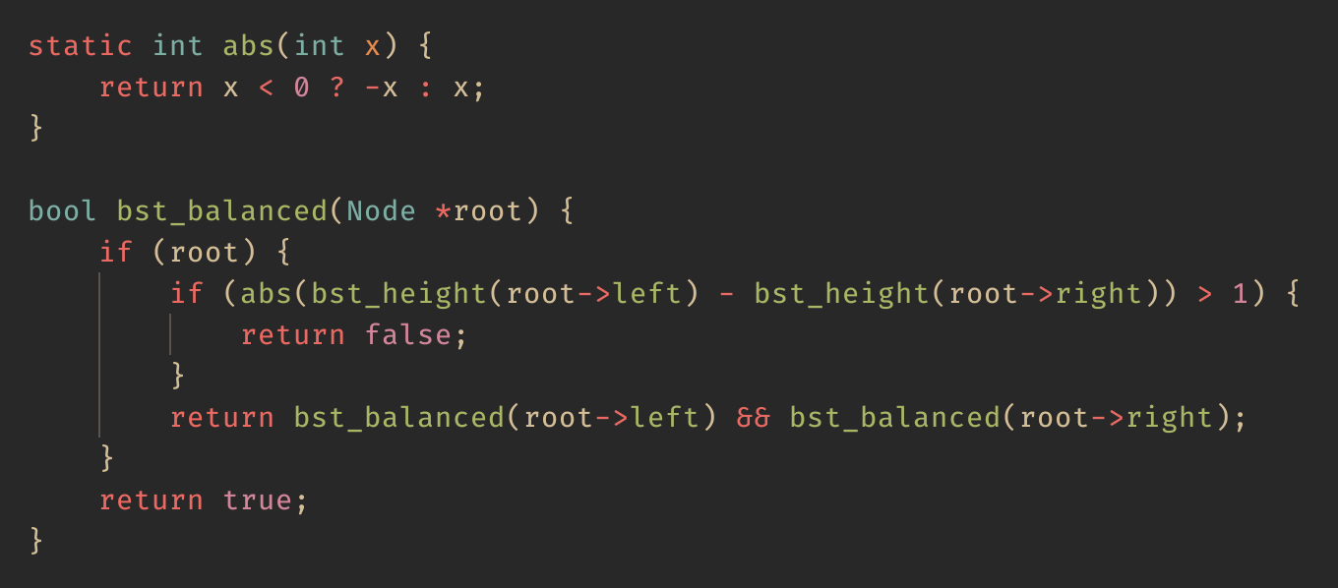
Checking if a tree is balanced

Slide 57
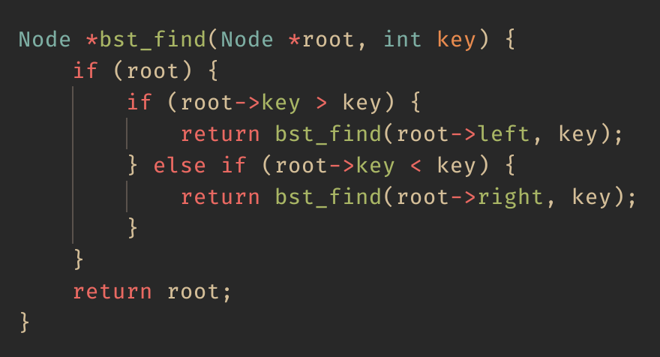
Finding a key
Three cases:
Current node’s key greater than key.
Current node’s key less than key.
Current node’s key matches key.
Case (1) Recursively find the key in the left subtree.
Case (2) Recursively find the key in the right subtree.
Case (3) We have found the node with the key.

Slide 58
Finding a key
Find 3 in the tree.
4
2
6
1
3

Slide 59
Finding a key
Find 3 in the tree.
4 > 3, so look in left subtree.
4
2
6
1
3

Slide 60
Finding a key
Find 3 in the tree.
4 < 3, so look in left subtree.
2 < 3, so look in right subtree.
4
2
6
1
3

Slide 61
Finding a key
Find 3 in the tree.
4 < 3, so look in left subtree.
2 < 3, so look in right subtree.
We found 3!
4
2
6
1
3

Slide 62
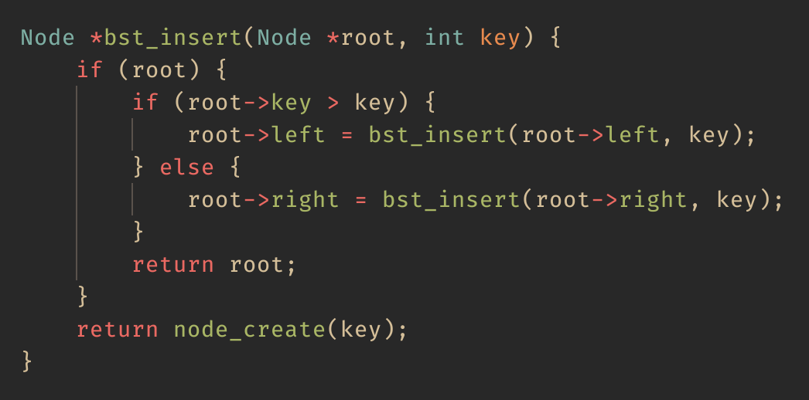
Inserting a new key
Three cases:
Current node is NULL.
Current node’s key greater than key.
Current node’s key less key.
Case (1) Create new node as the root.
Case(2) Recursively insert key in left subtree.
Case(3) Recursively insert key in right subtree.

Slide 63
Inserting a new key
Insert 5 into the tree.
4
2
6
1
3

Slide 64
Inserting a new key
Insert 5 into the tree.
5 > 4, so insert into right subtree.
4
2
6
1
3

Slide 65
Inserting a new key
Insert 5 into the tree.
5 > 4, so insert into right subtree.
5 < 6, so insert into left subtree.
4
2
6
1
3

Slide 66
Inserting a new key
Insert 5 into the tree.
5 > 4, so insert into right subtree.
5 < 6, so insert into left subtree.
Left subtree is NULL.
4
2
6
1
3

Slide 67
Inserting a new key
Insert 5 into the tree.
5 > 4, so insert into right subtree.
5 < 6, so insert into left subtree.
Left subtree is NULL.
Use new node as subtree root.
4
2
6
1
3
5

Slide 68
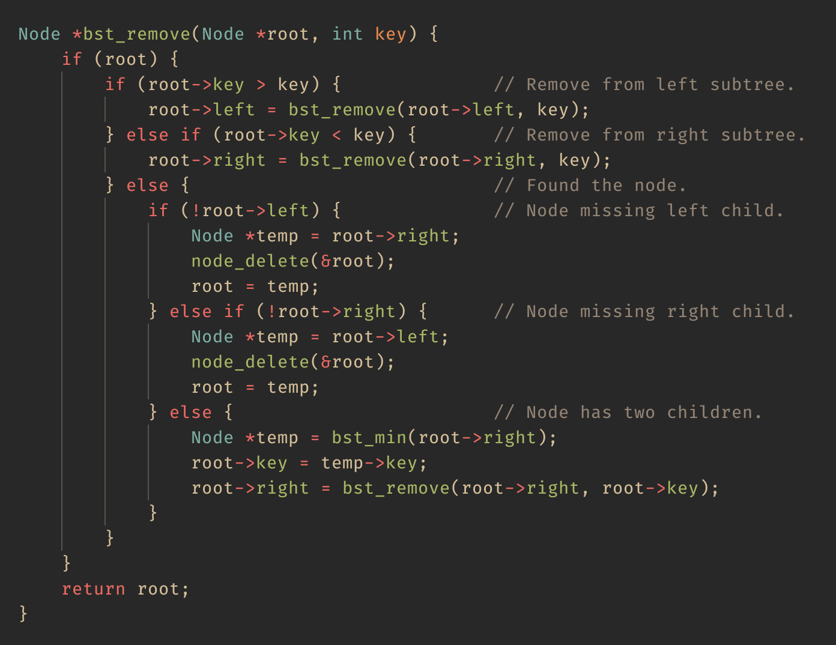
Remove a key
The trickiest of all the operations.
Follows DFS to find the node containing the key.
Three cases:
Node to remove is missing left child.
Node to remove is missing right child.
Node to remove has two children.

Slide 69
Remove a key (missing either child)
If left child is missing, replace with right child.
If right child is missing, replace with left child.
(1)
(2)

Slide 70
Remove a key (missing either child)
First, find the inorder successor.
Walk down the left from the right child.
This is finding the minimum rooted from right child!
Copy the successor’s value.
Remove the successor.

Slide 71
Remove a key (two children)
Remove 4 from the tree.
First, find the inorder successor.
From the right child, walk down the left.
Same as the finding minimum rooted from right child!
Copy the successors value.
Remove the successor.
4
2
6
1
3
5

Slide 72
Remove a key (two children)
Remove 4 from the tree.
First, find the inorder successor.
From the right child, walk down the left.
Same as the finding minimum rooted from right child!
Copy the successors value.
Remove the successor.
5
2
6
copy
1
3
5

Slide 73
Remove a key (two children)
Remove 4 from the tree.
First, find the inorder successor.
From the right child, walk down the left.
Same as the finding minimum rooted from right child!
Copy the successors value.
Remove the successor.
This is the other removal case!
5
2
6
1
3
5

Slide 74
Remove a key (missing either child)
Remove 5 from the tree.
The successor from last slide.
5
2
6
1
3
5

Slide 75
Remove a key (missing either child)
Remove 5 from the tree.
The successor from last slide.
Left child is missing (NULL).
Replace with right child (also NULL).
Delete the node.
5
2
6
1
3
5

Slide 76
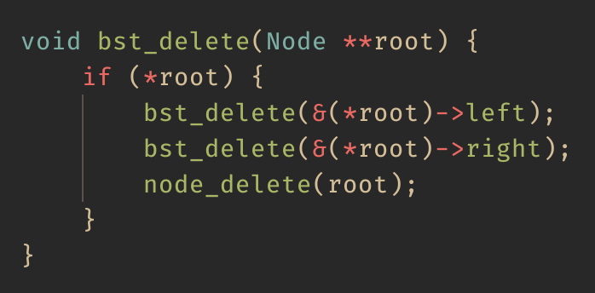
Deleting a tree
Performed through a postorder traversal.
Children are handled before their parents.
5
2
6
1
3

Slide 77
Deleting a tree
Traverse down left subtree.
5
2
6
1
3

Slide 78
Deleting a tree
Traverse down left subtree.
5
2
6
1
3

Slide 79
Deleting a tree
Nowhere else to traverse.
Delete the node and go back up.
5
2
6
3

Slide 80
Deleting a tree
Traverse down right subtree.
5
2
6
3

Slide 81
Deleting a tree
Nowhere else to traverse.
Delete the node and go back up.
5
2
6

Slide 82
Deleting a tree
Delete the node and go back up.
5
6

Slide 83
Deleting a tree
Traverse down right subtree.
5
6

Slide 84
Deleting a tree
Nowhere else to traverse.
Delete the node and go back up.
5

Slide 85
Deleting a tree
Delete the node.
The tree has been deleted.

Slide 86
Summary
Trees are widely used through computer science.
Great for representing hierarchy (like for a filesystem!)
Does not need to impose an ordering, but useful to.
Total ordering (binary search tree)
Partial ordering (min/max heap)
Nodes can have an arbitrary number of children.
Four main ways of traversing a tree:
Preorder, inorder, postorder, and level order.

