Slide 1

I/O Devices
IO, IO, use <stdio.h> that’s how to code in Unix you know, IO, IO, …
Bonus
Lecture
CSE 13S
Prof. Darrell Long

Slide 2


Input/Output
Principles of I/O hardware
Principles of I/O software
I/O software layers
Disks
Clocks
Character-oriented terminals
Graphical user interfaces
Network terminals
Power management

Slide 3
How fast is I/O hardware?
Device | Data rate (typical)
Keyboard | 10 bytes/sec
Mouse | 100 bytes/sec
56K modem | 7 KB/sec
Printer / scanner | 1 MB/sec
USB | 1.5 / 60 / 625 MB/sec
Digital camcorder | 4 MB/sec
Gigabit Ethernet | 125 MB/sec
Hard drive | 125 MB/sec
Flash drive (SSD) | 200 MB/sec
DisplayPort | 1.62 / 2.7 / 5.4 / 8.1 Gbit/s per lane data rate per lane; 1, 2, or 4 lane
PCIe bus | 985 MB/sec per lane
Notes:
Up to 16 lanes for PCIe.
1-4 lanes for DisplayPort

Slide 4
Device controllers
I/O devices have components
Mechanical component
Electronic component
Electronic component controls the device
May be able to handle multiple devices
May be more than one controller per mechanical component (example: hard drive)
Controller's tasks
Convert serial bit stream to block of bytes
Perform error correction as necessary
Make available to main memory

Slide 5
How is memory-mapped I/O done?
CPU
Memory
I/O
Single-bus
All memory accesses go over a shared bus
I/O and RAM accesses compete for bandwidth
Dual-bus
RAM access over high-speed bus
I/O access over lower-speed bus
Less competition for bus
More hardware (more expensive…)
CPU
Memory
I/O
This port allows I/O devices access into memory

Slide 6
Direct Memory Access (DMA)
1: CPU programs the DMA controller
DMA
controller
Disk
controller
Address
Main
memory
CPU
Count
4: ACK
Buffer
Control
5: Interrupt when done
2: DMA controller requests transfer to memory
3: Data is transferred

Slide 7

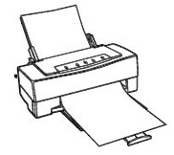
Hardware’s view of interrupts
1. Device finishes
Interrupt controller
3. CPU ACKs interrupt
CPU
2. Controller issues interrupt
Bus

Slide 8
I/O software: goals
Device independence
Programs can access any I/O device
No need to specify device in advance
Uniform naming
Name of a file or device is a string or an integer
Doesn’t depend on the machine (underlying hardware)
Error handling
Done as close to the hardware as possible
Isolate higher-level software
Synchronous vs. asynchronous transfers
Blocked transfers vs. interrupt-driven
Buffering
Data coming off a device cannot be stored in final destination
Sharable vs. dedicated devices

Slide 9
Programmed I/O: printing a page
Printed page
Printed page
Printed page
User
ABCD EFGH
ABCD EFGH
ABCD EFGH
A
AB
ABCD EFGH
ABCD EFGH
Kernel

Slide 10
Code for programmed I/O
copy_from_user (buffer, p, count); // copy into kernel buffer
for (j = 0; j < count; j++) { // loop for each char
// wait for printer to be ready while (*printer_status_reg != READY) ; // output a single character *printer_data_reg = p[j];
}
return_to_user();

Slide 11
Interrupt Driven I/O
Run by system call
Run by interrupt
if (count == 0) { unblock_user();
} else { *printer_data_reg = p[j]; count--; j++;
}
acknowledge_interrupt();
return_from_interrupt();
copy_from_user (buffer, p, count);
j = 0;
enable_interrupts();
while (*printer_status_reg != READY) ;
*printer_data_reg = p[0];
scheduler(); // and block user

Slide 12
Layers of I/O software
User software & libraries
User
Device-independent OS code
Operating system (kernel)
Device drivers
Interrupt handlers
Hardware
Notes:
Start here on Wed 5/6.

Slide 13
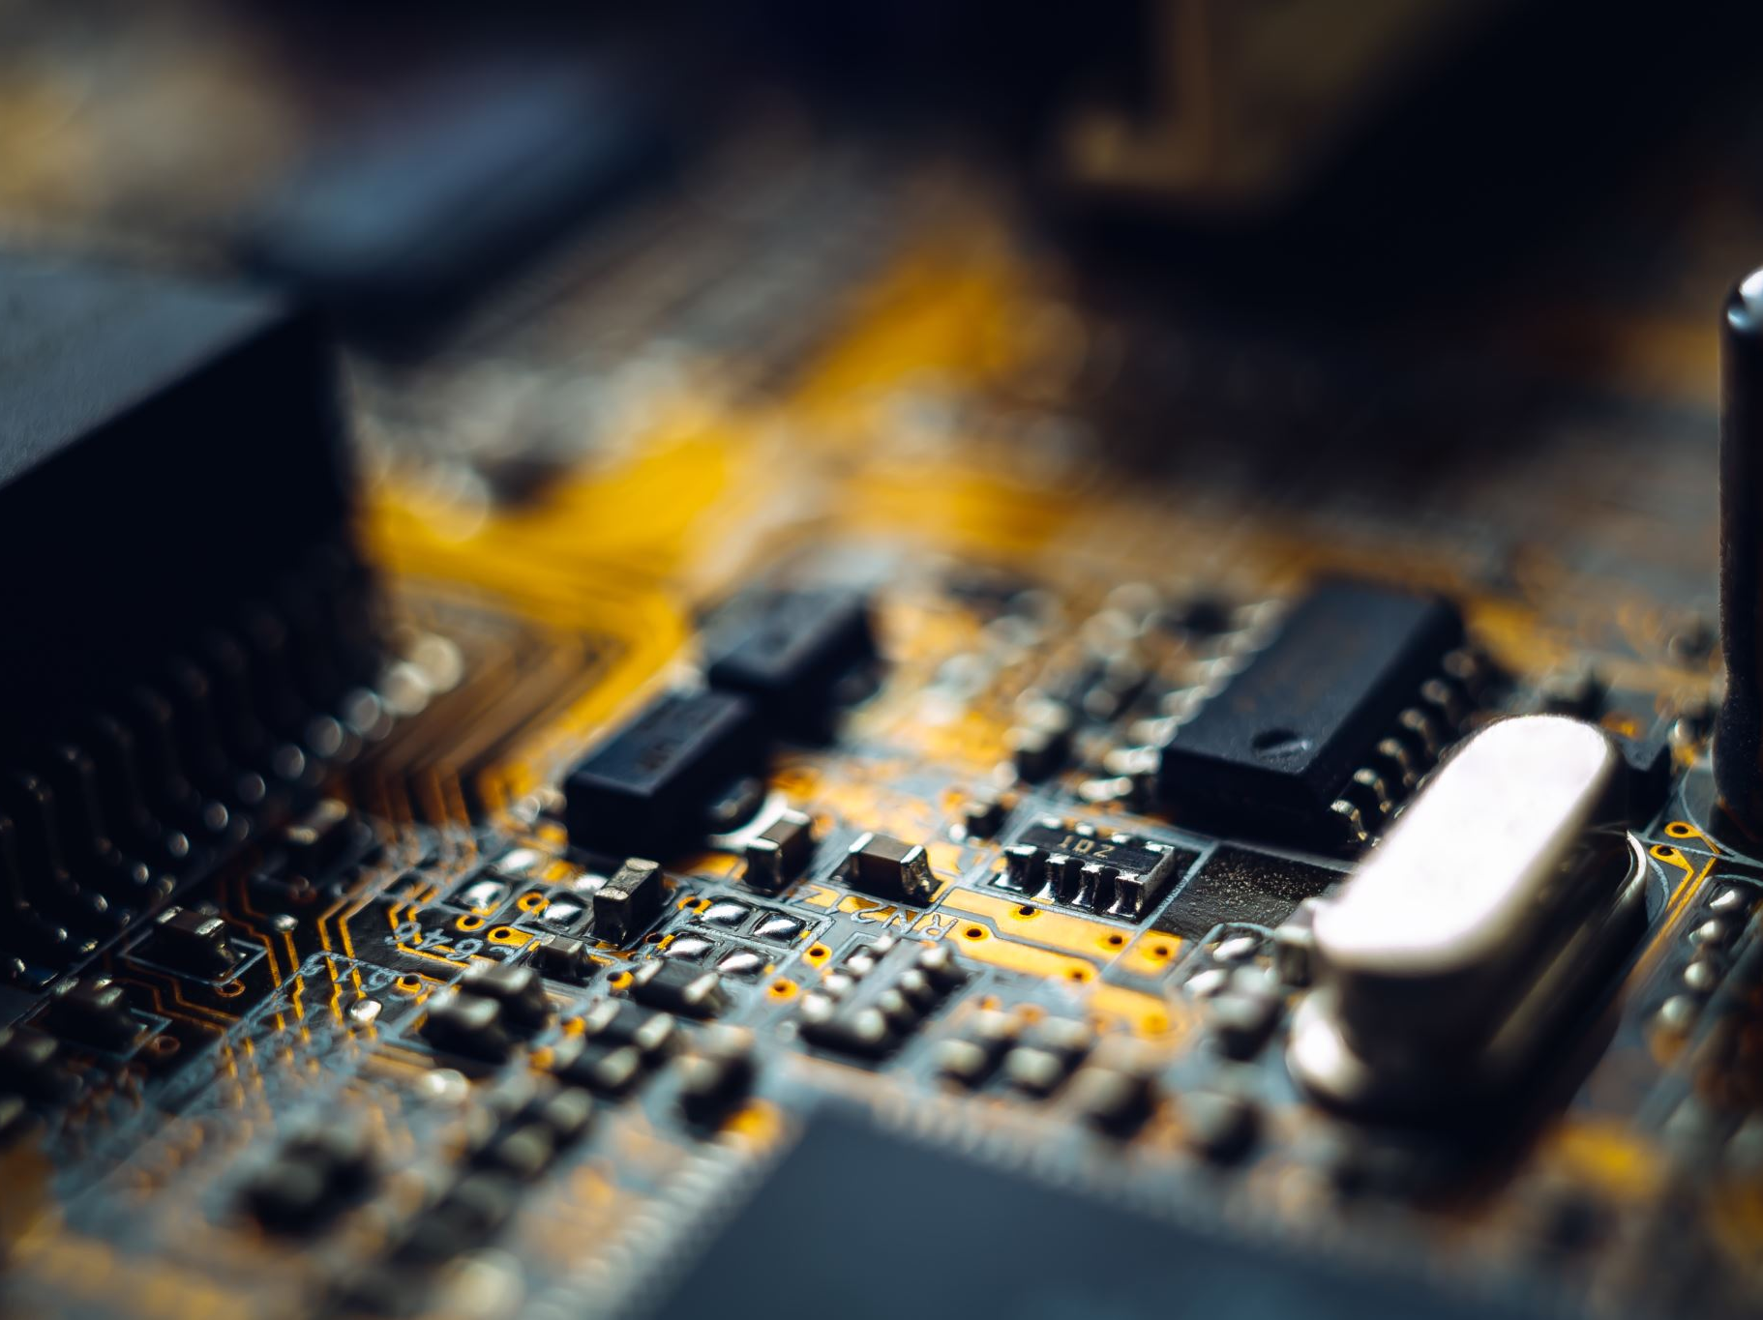
Interrupt handlers
Interrupt handlers are best hidden
Driver starts an I/O operation and blocks
Interrupt notifies of completion
Interrupt procedure does its task
Then unblocks driver that started it
Perform minimal actions at interrupt time
Some of the functionality can be done by the driver after it is unblocked
Interrupt handler must
Save registers not already saved by interrupt hardware
Set up context for interrupt service procedure

Slide 14

What happens on an interrupt
Set up the stack for interrupt service procedure
Ack interrupt controller, reenable interrupts
Copy registers from where saved
Run service procedure
(optional) Pick a new process to run next
Set up MMU context for process to run next
Load new process’ registers
Start running the new process

Slide 15

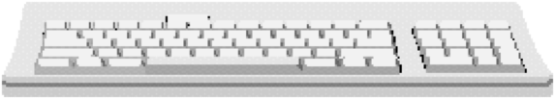
Device drivers
user program
Device drivers go between device controllers and rest of OS
Drivers standardize interface to widely varied devices
Device drivers communicate with controllers over bus
Controllers communicate with devices themselves
Kernel space
Rest of the OS
Keyboard driver
Disk drive driver
Keyboard controller
Disk drive controller

Slide 16
Device-independent I/O software
Device-independent I/O software provides common “library” routines for I/O software
Helps drivers maintain a standard appearance to the rest of the OS
Uniform interface for many device drivers for
Buffering
Error reporting
Allocating and releasing dedicated devices
Suspending and resuming processes
Common resource pool
Device-independent block size (keep track of blocks)
Other device driver resources

Slide 17
Why a standard driver interface?
Operating system
Operating system
Non-standard device driver interface
Different interface for each driver
High OS complexity
Less code reuse
Standard device driver interface
Less OS/driver interface code
Lower OS complexity
Easy to add new drivers

Slide 18
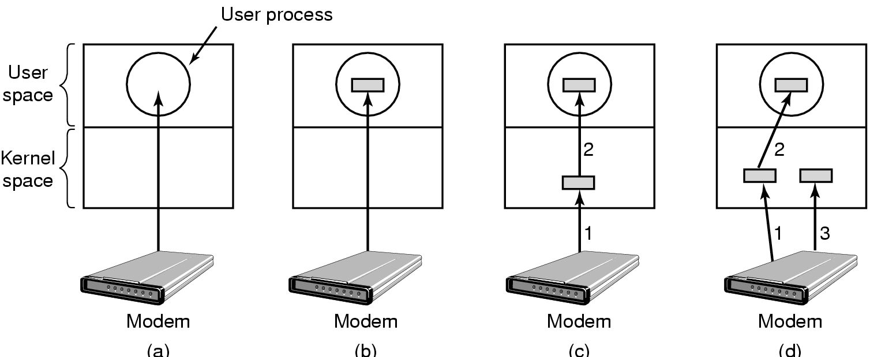
Buffering device input
User space
User space
User space
User space
Kernel space
Kernel space
Kernel space
Kernel space
Unbuffered input
Buffering in user space
Buffer in kernel Copy to user space
Double buffer in kernel

Slide 19
What happens where on an I/O request?
Request
Make I/O call; format I/O; spooling
Naming, protection blocking / buffering / allocation
User processes
Device-independent code
Manage device registers & status
Device drivers
Signal device driver on completed I/O
Interrupt handlers
Hardware
Actually do the I/O (in hardware)
Reply

Slide 20
Disk drive structure
head
sector
Data stored on surfaces
Up to two surfaces per platter
One or more platters per disk
Data in concentric tracks
Tracks broken into sectors
256B–4KB per sector
Cylinder: corresponding tracks on all surfaces
Data read and written by heads
Actuator moves heads
Heads move in unison
platter
track
cylinder
surfaces
spindle
actuator

Slide 21
Disk drive specifics
 | IBM 360KB floppy | Seagate 3 TB HD
Cylinders | 40 | 240,000 (estimate)
Tracks per cylinder | 2 | 10
Sectors per track | 9 | 2500 (average)
Sectors per disk | 720 | 6 × 10⁹
Bytes per sector | 512 | 512
Capacity | 360 KB | 3 TB
Seek time (minimum) | 6 ms | 1.5 ms (?)
Seek time (average) | 77 ms | 4.16 ms
Rotation time | 200 ms | 8.3 ms
Spinup time | 250 ms | ~5 sec (?)
Sector transfer time | 22 ms | 3.4 μsec

Slide 22
Structure of a disk sector
Preamble
Data
ECC
Preamble contains information about the sector
Sector number & location information
Data is usually 512 or 1024 bytes
Newer disks moving to 4KB sectors
ECC (Error Correcting Code) is used to detect & correct minor errors in the data

Slide 23
Sector layout on disk
Sectors numbered sequentially on each track
Numbering starts in different place on each track: sector skew
Allows time for switching head from track to track
Done to minimize delay in sequential transfers
Zoning
Different zones have different number of sectors per track
Outer zones have higher transfer rate
Typically 8–30 zones (or more)
Zones set at time of manufacture

Slide 24
Disk Addressing
Millions of sectors on the disk must be labeled
Two possibilities
Cylinder/track/sector
Sequential numbering
Modern drives use sequential numbers
Disks map sequential numbers into specific location
Mapping may be modified by the disk
Remap bad sectors
Optimize performance
Hide the exact geometry, making life simpler for the OS

Slide 25
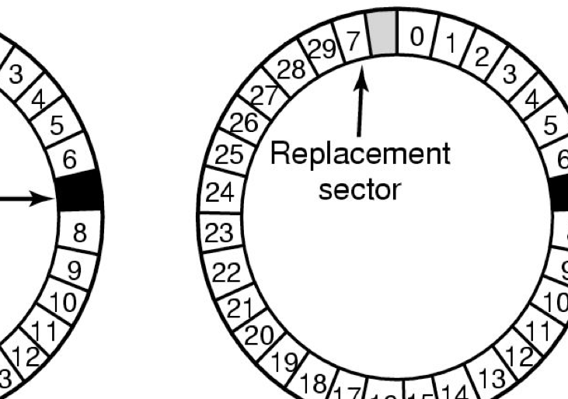
When good disks go bad…
Disks have defects
With billions of sectors, this isn’t surprising!
ECC helps with errors, but sometimes this isn’t enough
Disks keep spare sectors (normally unused) and remap bad sectors into these spares
If there’s time, the whole track could be reordered…
All of this is transparent to the user (and, typically, OS)

Slide 26
Building a better disk
Problem: CPU performance has been increasing exponentially, but disk performance hasn’t
Disks are limited by mechanics
Problem: disks aren’t all that reliable
Solution: distribute data across disks, and use some of the space to improve reliability
Data transferred in parallel
Data stored across drives (striping)
Problem: more disks means less reliability
Generate & store additional information to allow data from a failed disk to be recovered

Slide 27
Calculating parity
Goal: keep extra information to recover from device failure
Use the extra information to rebuild the data on the missing device
There are formulas to recover from more than one failure with additional “parity” devices
D0 ⊕ D1 ⊕ D2 ⊕ D3 = P
D0 ⊕ D1 ⊕ D2 ⊕ D3 = P
⊕ (D2 ⊕ P)
⊕ (D2 ⊕ P)
D0 ⊕ D1 ⊕ D3 ⊕ P = D2
Notes:
Suppose D2 fails. How do we recover it?
Note that we need to know that D2 is the disk that failed; this doesn’t work if we don’t know where the failure is.
Can we recover from more than one failure? Yes, if we have more than one parity disk (and a different formula).

Slide 28
What’s in a disk request?
Time required to read or write a disk block determined by 3 factors
Seek time
Typically around 2–8 ms, depending on distance
Longer seeks take longer, but not linear with distance
Rotational delay
Average delay = 1/2 rotation time
Example: rotate in 10 ms, average rotation delay = 5 ms
Actual transfer time
Transfer time = time to rotate over sector
Example: rotate in 10 ms, 1000 sectors/track ⇒ 10/1000 ms = 0.01 ms (10 μs) transfer time per sector
Seek time and rotation time comparable
Error checking is done by on-disk controller
Notes:
Cover disk requests on Monday 5/11. Then skip past flash.

Slide 29
Disk request scheduling
Goal: use disk hardware efficiently
Bandwidth as high as possible
Disk transferring as often as possible (and not seeking)
We want to
Minimize disk seek time (moving from track to track)
Minimize rotational latency (waiting for disk to rotate the desired sector under the read/write head)
Calculate disk bandwidth by
Total bytes transferred / time to service request
Seek time & rotational latency are overhead (no data is transferred), and reduce disk bandwidth
Minimize seek time & rotational latency by
Using algorithms to find a good sequence for servicing requests
Placing blocks of a given file “near” each other

Slide 30
Disk scheduling algorithms
Schedule disk requests to minimize disk seek time
Seek time increases as distance increases (though not linearly)
Minimize seek distance ➔ minimize seek time
Disk seek algorithm examples assume a request queue & head position (disk has 200 cylinders)
Queue = 100, 175, 51, 133, 8, 140, 73, 77
Head position = 63

Slide 31
First-Come-First Served (FCFS)
Requests serviced in the order in which they arrived
Easy to implement!
May involve lots of unnecessary seek distance
Seek order = 100, 175, 51, 133, 8, 140, 73, 77
Seek distance = (100-63) + (175-100) + (175-51) + (133-51) + (133-8) + (140-8) + (140-73) + (77-73) = 646 cylinders

Slide 32
Shortest Seek Time First (SSTF)
Service the request with the shortest seek time from the current head position
Form of SJF scheduling
May starve some requests
Seek order = 73, 77, 51, 8, 100, 133, 140, 175
Seek distance = 10 + 4 + 26 + 43 + 92 + 33 + 7 + 35 = 250 cylinders

Slide 33
SCAN (elevator algorithm)
Disk arm starts at one end of the disk and moves towards the other end, servicing requests as it goes
Reverses direction when it gets to end of the disk
Also known as elevator algorithm
Seek order = 51, 8, 0 , 73, 77, 100, 133, 140, 175
Seek distance = 12 + 43 + 8 + 73 + 4 + 23 + 33 + 7 + 35 = 238 cylinders

Slide 34
C-SCAN
Identical to SCAN, except head returns to cylinder 0 when it reaches the end of the disk
Treats cylinder list as a circular list that wraps around the disk
Waiting time is more uniform for cylinders near the edge of the disk
Seek order = 73, 77, 100, 133, 140, 175, 199, 0, 8, 51
Distance = 10 + 4 + 23 + 33 + 7 + 35 + 24 + 199 + 8 + 43 = 386 cyls

Slide 35
C-LOOK
Identical to C-SCAN, except head only travels as far as the last request in each direction
Saves seek time from last sector to end of disk
Seek order = 73, 77, 100, 133, 140, 175, 8, 51
Distance = 10 + 4 + 23 + 33 + 7 + 35 + 167 + 43 = 322 cylinders

Slide 36
Picking a disk scheduling algorithm
SSTF is easy to implement and works OK if there aren’t too many disk requests in the queue
SCAN-type algorithms perform better for systems under heavy load
More fair than SSTF
Use LOOK rather than SCAN algorithms to save time
Long seeks aren’t too expensive, so choose C-LOOK over LOOK to make response time more even
Disk request scheduling interacts with algorithms for allocating blocks to files
Make scheduling algorithm modular: allow it to be changed without changing the file system
Use SSTF or FCFS for lightly loaded systems
Use C-LOOK for heavily loaded systems

Slide 37
Flash memory (and SSDs)
Compared to disk, flash is
Faster (shorter access time, but lower bandwidth)
More expensive
More reliable (devices)
Less reliable (sectors)
Compared to DRAM, flash is
Cheaper (a bit)
Non-volatile (data survives power loss)
Slower
Use flash as a level between disk and memory?
Issues
Can’t overwrite sectors “in place”
Flash wears out: can only write 3,000–100,000 times per memory cell

Slide 38
Writing to flash memory
Can’t overwrite page in place
Need to write to “clean” region
Unit of erase is “erase block”
One solution: copy entire erase block to new location
Modify the page being written
This isn’t efficient!
Flash vendors spend a lot of time on Flash Translation Layers
FTLs map logical page numbers to physical pages
Also manage wear leveling: distribute erases among blocks

Slide 39
Handling flash in the OS
Treat it like a disk?
Flash is written in blocks, just like a disk
Blocks have to be erased first: somewhat slow
Erase blocks are much larger than pages
Flash is random access, just like a disk
This approach is often used!
Need to be careful about wearing out flash
Most flash devices do “wear leveling”: remap blocks internally when they’re erased
File systems for flash should take wear into account
Many don’t, including the standard VFAT file system

Slide 40
Clock hardware
Crystal oscillator with fixed frequency (only when computer is on)
Typically used to time short intervals (~ 1 second)
May be used to correct time-of-day clock
Time-of-day clock (runs when system is off)
Keeps minutes, hours, days
May not be too accurate…
Used to load system clock at startup
Time kept in seconds and ticks (often 10²–10⁶ per second)
Number of seconds since a particular time
For many versions of Unix, tick 0 was on January 1, 1970
Number of ticks this second
Advance ticks once per clock interrupt
Advance seconds when ticks “overflow”
Notes:
Start here on Monday 5/11, but cover disk scheduling first.

Slide 41
Keeping time
Check time via the Web
Protocol to get time from accurate time servers (ntp)
What happens when system clock is slow?
Advance clock to the correct current time
May be done all at once or over a minute or two
What happens when system clock is fast?
Can’t have time run backwards!
Instead, advance time more slowly than normal until the clock is correct
Track clock drift, do periodic updates to keep clock accurate

Slide 42
Using timers in software
Use short interval clock for timer interrupts
Specified by applications
No problems if interrupt frequency is low
May have multiple timers using a single clock chip
Use soft timers to avoid interrupts
Kernel checks for soft timer expiration before it exits to user mode
Less accurate than using a hardware timer
How well this works depends on rate of kernel entries
Notes:
Start here on Thursday 5/14.

Slide 43
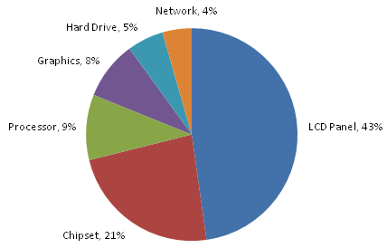
Where does the power go?
How much power does each part of a laptop computer use?
Display is the biggest energy hog, by far!
Chipset (including memory) is next
Save power by
Reducing display power
Turning down the backlight
Slowing down CPU
Using “less” of the CPU
Using an alternate GPU
Powering down hard drive
Using a flash-based drive
Source: http://blogs.msdn.com/b/e7/archive/2009/01/06/windows-7-energy-efficiency.aspx

Slide 44
Reducing CPU power usage
Running at full clock speed
Jobs finish quickly
High energy consumption: proportional to shaded area
Intel processors may use 50–75 watts!
Cutting voltage by two
Cuts clock speed by two: processes take longer
Cuts power by four
Cuts energy consumption (= power × time) in half

Slide 45
How can we reduce power usage?
Tell the programs to use less energy
May mean poorer user experience
Makes batteries last longer!
Examples
Dim the screen
Switch to lower-power processor modes
Dynamic voltage scaling for the CPU
Shut down CPU cores
Use a lower-power GPU
Fewer image updates per second (one reason why Kindle is so power efficient)
Use application-specific chips (Apple M7/M8 for motion capture)
Notes:
Kindle actually uses e-Ink.

