Slide 1
IST - 736 Project
Darrell Nelson
Taylor Moorman
Wes Stanis

Slide 2

Introduction - NYC Open Data
Open data platform
Reading/downloading access for all
Data warehouse is hosted by the City of New York and updated weekly
Civil Services and Government data
Mission:
Open Data is an opportunity to engage New Yorkers in the information that is produced and used by City government. We believe that every New Yorker can benefit from Open Data, and Open Data can benefit from every New Yorker.

Slide 3


Motivation
City agencies keep the government in touch with the people it serves
What are their needs?
What do they do?
Deeper understanding into the day to day issues of their constituents
Hold city agents accountable
Using data, the general population can see if their local government has used their funds in the manner in which they promised (e.g. infrastructure, schools, prison reform)

Slide 4


Problem Statement
Determine the needs of the NYC communities through the lens of employment
New York city current job postings dataset
What type of skills are required?
What skills may lead to a higher paying job?
Can we predict the salary of a position given its requirements?

Slide 5
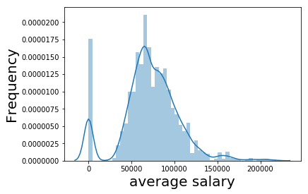
Understanding The Data
Data has attributes such as salary ranges, job titles, job descriptions, qualifications, etc.
Averaging the salary ranges was best for generalizing.

Slide 6
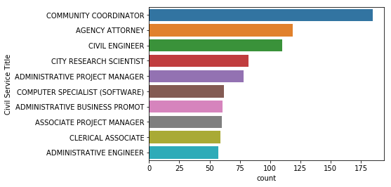
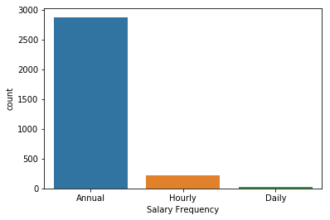
Types of Employees
Let’s see what different types of employees there are by job titles and how they get paid.

Slide 7
Textual Data
Columns of interest involving textual data:
0 division of economic financial opportunity de...
1 the new york city department of small business...
Name: Job Description, dtype: object
0 1a bachelor degree from an accredited college ...
1 1 a bachelor degree from an accredited college...
Name: Minimum Qual Requirements, dtype: object
0 excellent interpersonal and organizational ski...
1 NaN
2 1 a high school diploma or ged 2 cdl driver…
Name: Preferred Skills, dtype: object
Converted everything to lowercase, removed non-alphanumeric characters, and replaced strings to their correct spelling.

Slide 8
Textual Data Preliminary Cleaning Results
BEFORE AFTER
'1.\tA baccalaureate degree from an accredited college and two years of experience in community work or community centered activities in an area related to the duties described above; or 2.\tHigh school graduation or equivalent and six years of experience in community work or community centered activities in an area related to the duties as described above; or 3.\tEducation and/or experience which is equivalent to "1" or "2" above. However, all candidates must have at least one year of experience as described in "1" above.'
'baccalaureate', 'degree', 'an', 'accredited', 'college', 'two', 'years', 'experience', 'community', 'work', 'community', 'centered', 'activities', 'an', 'area', 'related', 'toduties', 'high', 'school', 'graduation', 'equivalent', 'six', 'years', 'experience', 'community', 'work', 'community', 'centered', 'activities', 'an', 'area', 'related', 'toduties', 'described', 'or', 'education', 'andor', 'experience', 'whichequivalent', 'or', 'above', 'however', 'candidates', 'have', 'least', 'one', 'year', 'experience', 'described', 'above'

Slide 9
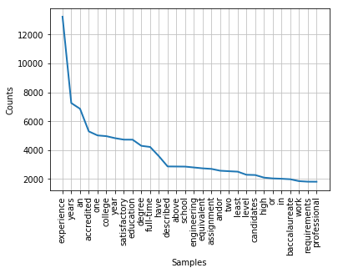
Minimal Qualifications Required Frequencies

Slide 10
Predicting Salary from Qualification Requirements
NAIVE BAYES
65% Accuracy when splitting the data (hold-out testing)
60% with a 10 fold cross validation method

Slide 11
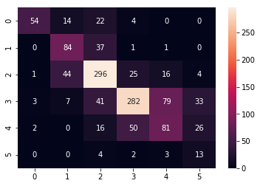
Predicting Salary from Qualification Requirements
NAIVE BAYES
precision recall f1-score support
0 0.90 0.57 0.70 94
1 0.56 0.68 0.62 123
2 0.71 0.77 0.74 386
3 0.77 0.63 0.70 445
4 0.45 0.46 0.46 175
5 0.17 0.59 0.27 22
micro avg 0.65 0.65 0.65 1245
macro avg 0.60 0.62 0.58 1245
weighted avg 0.69 0.65 0.66 1245

Slide 12
Predicting Salary from Qualification Requirements
1. science
2. semester
3. must
4. equivalent
5. conditioned
6. credits
7. continuance
8. described
9. matriculation
10. acceptable
11. upon
12. including
13. year
14. employment
15. education
16. course
17. satisfactory
18. study
19. fulltime
20. level
21. accredited
22. student
23. assignment
24. graduate
25. years
26. technology
27. information
28. school
29. college
30. experience
Naive Bayes
Top 30 words related to very low paying jobs

Slide 13
Predicting Salary from Qualification Requirements
1. systems
2. business
3. computer
4. programming
5. candidates
6. responsible
7. including
8. fulltime
9. 18
10. data
11. andor
12. bachelor
13. least
14. administration
15. capacity
16. satisfactory
17. months
18. described
19. education
20. administrative
21. executive
22. equivalent
23. management
24. managerial
25. accredited
26. degree
27. college
28. must
29. years
30. experience
Naive Bayes
Top 30 words related to very high paying jobs

Slide 14
Predicting Salary from Qualification Requirements
Support Vector Machine
73% Accuracy when splitting the data
74% Accuracy when splitting using bigram features
69% Accuracy with a 10 fold cross validation method

Slide 15
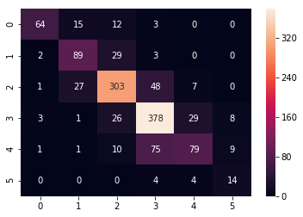
Predicting Salary from Qualification Requirements
SUPPORT VECTOR MACHINE
BIGRAM FEATURES
precision recall f1-score support
0 0.90 0.68 0.78 94
1 0.67 0.72 0.70 123
2 0.80 0.78 0.79 386
3 0.74 0.85 0.79 445
4 0.66 0.45 0.54 175
5 0.45 0.64 0.53 22
micro avg 0.74 0.74 0.74 1245
macro avg 0.70 0.69 0.69 1245
weighted avg 0.75 0.74 0.74 1245

Slide 16
Predicting Salary from Qualification Requirements
1. make equivalent
2. library
3. employment
4. program accredited
5. enrolled
6. degree program
7. license
8. school health
9. student
10. maximum
11. archival
12. school maximum
13. grade
14. acceptable experience
15. ability
16. issued new
17. equivalent however
18. helper
19. program
20. law
21. endorsement
22. upon
23. required
24. license registered
25. agency
26. possession
27. state license
28. possession valid
29. committee
30. candidates
Support Vector Machine
Top 30 words related to very low paying jobs

Slide 17
Predicting Salary from Qualification Requirements
1. organizational
2. college three
3. satisfactory fulltime
4. similar
5. practice
6. capacity
7. combination education
8. 2a
9. duties
10. years progressively
11. years administrative
12. organization
13. consultative capacity
14. executive
15. combination
16. Experience administrative
17. administration
18. management
19. years
20. consultative
21. five
22. five years
23. executive consultative
24. urban
25. andor
26. housing
27. description
28. university five
29. requirements
30. internal
Support Vector Machine
Top 30 words related to very high paying jobs

Slide 18
Conclusion
SVM Model outperformed the NB by ~9%
SVM 10-fold cross validation accuracy: 69%
NB 10-fold cross validation accuracy: 60%
Top Skill requirements in NYC:
Experience, degree, and engineering
Top terms associated with low paying jobs
Semester, ‘program accredited’, and equivalent
All words having to deal with moderate or alternative education
Top terms associated with high paying jobs
Executive, business, computer, and programming
Business and computer science majors are 2 of the most high-paying fields
Jobs at an Managerial / admin / executive level
Salaries can be predicted given an applicants requirements

Slide 19
What can we do with this?
Most companies / organizations post their open positions online.
Not all job openings advertise the salary associated with the position.
There are other online sources to compare salary ranges amongst specific positions, e.g. Glassdoor, Indeed.
For the city of New York, if a position does not list its salary, we can take the requirements and predict what category it will pay with almost 70% accuracy.
As someone looking to get a desired salary, this can give us insights on what requirements we need and skills to work at developing.

