Slide 1
What makes a Super Bowl Winner?
Darrell Nelson, Taylor Moorman, Eric Yager, Sarena Zhao
IST – 718 Final Project
http://www.free-powerpoint-templates-design.com

Slide 2

Introduction
Professional American Football is heralded as America’s wealthiest and most popular sports entertainment
The National Football League (NFL), the biggest supplier of professional football, took in over $15 billion last season (2018 - 2019)
Super Bowl ad revenue > $450 million
Approximately $5 billion bet on last year’s Super Bowl
With so much media attention, hype, and money on the line teams are clamoring to find a competitive advantage

Slide 3
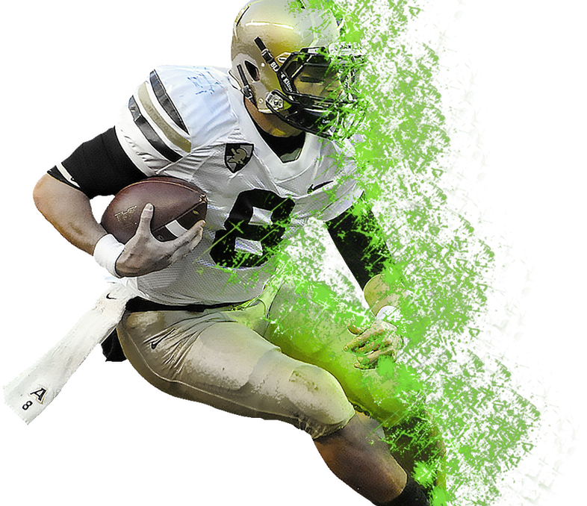
Data Questions
What combination of skills, performance, and coaching maximizes the chances of winning the big one?
Can we effectively predict the winner of the Super Bowl?
You can simply impress your audience and add a unique zing and appeal to your Presentations. Easy to change colors, photos and Text. Get a modern PowerPoint Presentation that is beautifully designed. You can simply impress your audience and add a unique zing and appeal to your Presentations.

Slide 4

Overview
Investigate over 60 offensive and defensive metrics for all 32 teams
www.pro-football-reference.com
Target variable: final team rankings for past 9 years (2010 – 2018)
2018 used as testing set
2010 – 2017 used as training set
Models developed on the premise of predicting where a team will finish based off their regular season statistics

Slide 5
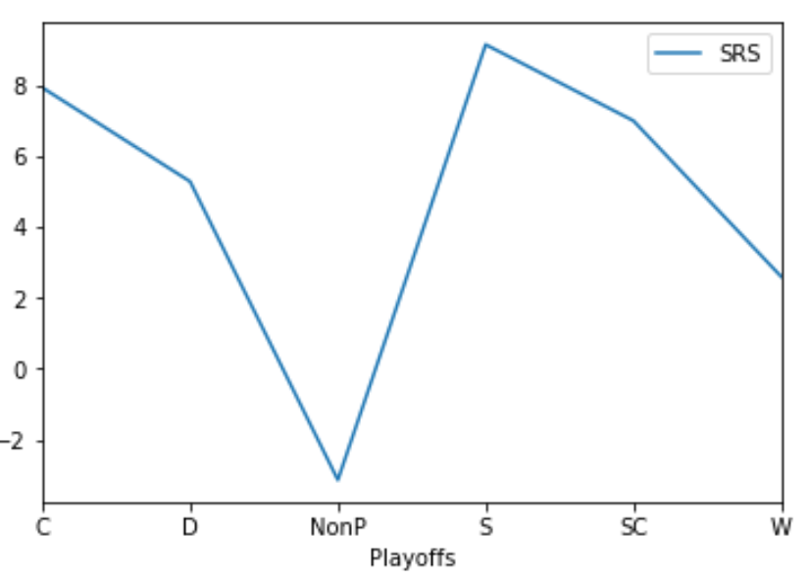
SRS: Team Quality Relative to Average (0.0)
C = Conference Round Loser
D = Divisional Round Loser
NonP = Did not make playoffs
S = Super Bowl Loser
SC = Super Bowl Champion
W = Wild Card Loser
Superbowl champ has a slightly lower SRS (Simple Rating System) than the conference runner-up.

Slide 6
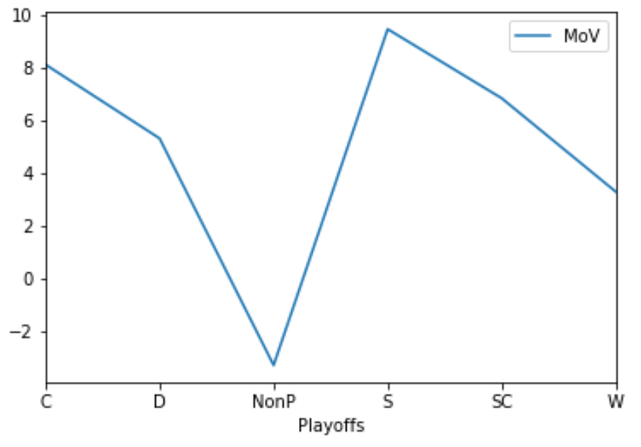
MoV: Margin of Victory (0.0)
C = Conference Round Loser
D = Divisional Round Loser
NonP = Did not make playoffs
S = Super Bowl Loser
SC = Super Bowl Champion
W = Wild Card Loser
Superbowl champ has a slightly lower MoV (Margin of Victory) than the conference runner-up.

Slide 7
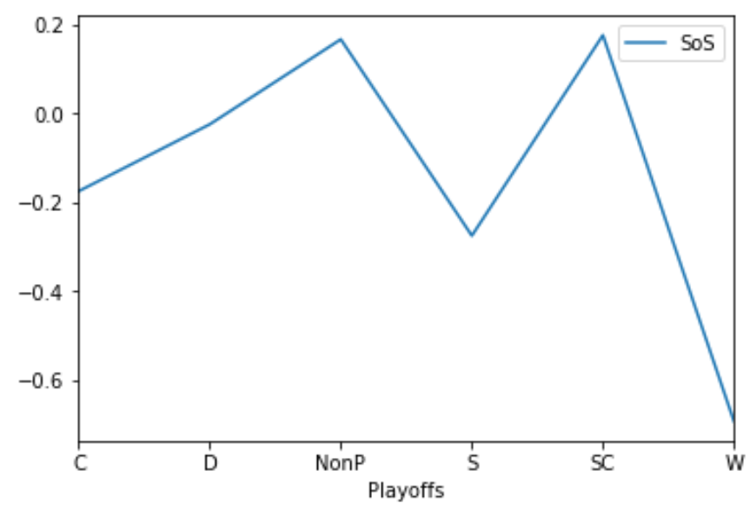
SoS: Strength of Schedule
C = Conference Round Loser
D = Divisional Round Loser
NonP = Did not make playoffs
S = Super Bowl Loser
SC = Super Bowl Champion
W = Wild Card Loser
Superbowl champ tends to have a stronger SoS than the rest of the playoff teams. Very similar to non-playoff teams.

Slide 8
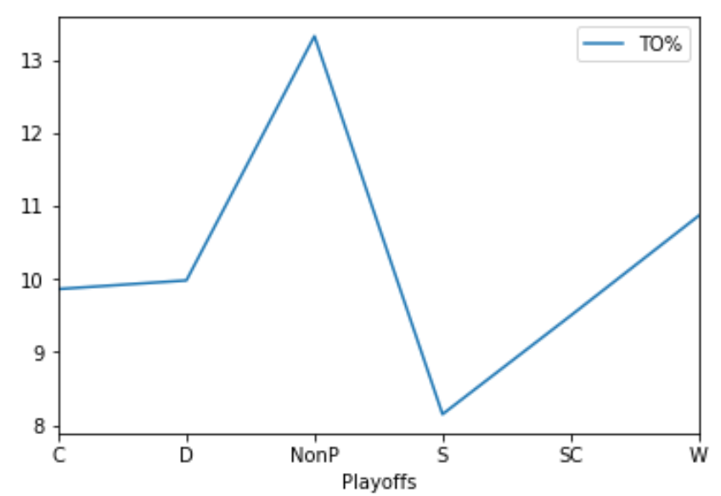
TO%: Percent of Drives Ending in Turn Overs
C = Conference Round Loser
D = Divisional Round Loser
NonP = Did not make playoffs
S = Super Bowl Loser
SC = Super Bowl Champion
W = Wild Card Loser
Superbowl champs/runner-ups don’t turn the ball over!!

Slide 9
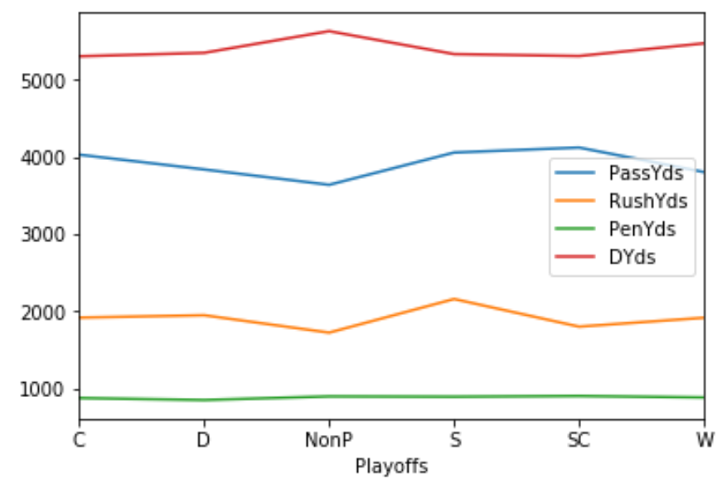
MoV: Margin of Victory (0.0)
C = Conference Round Loser
D = Divisional Round Loser
NonP = Did not make playoffs
S = Super Bowl Loser
SC = Super Bowl Champion
W = Wild Card Loser
No significant differences between penalty yards, offensive yards, and defensive yards allowed.

Slide 10
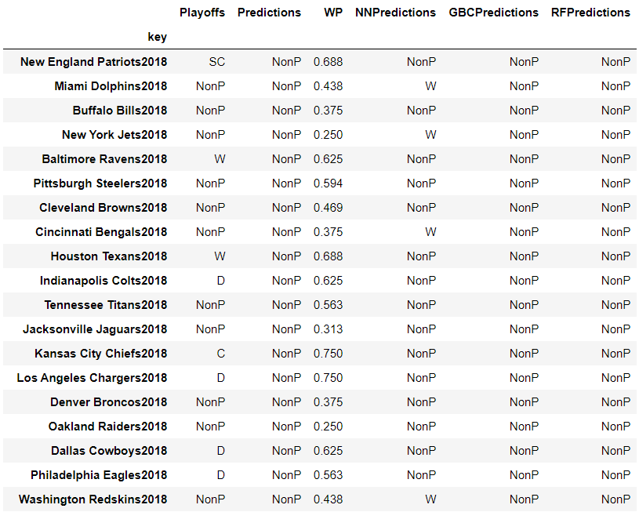
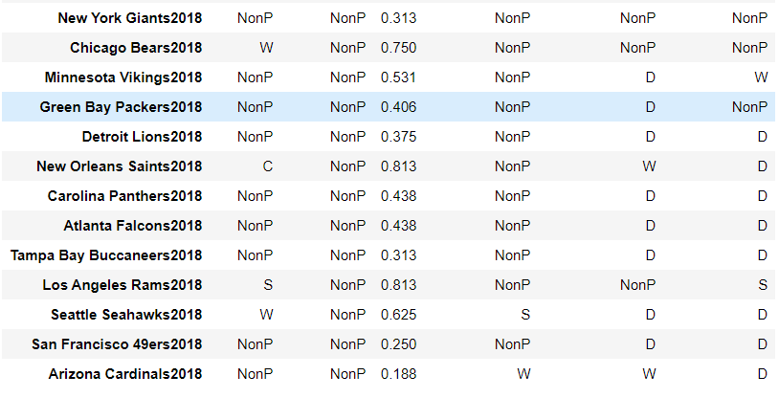
Individual Model Results

Slide 11
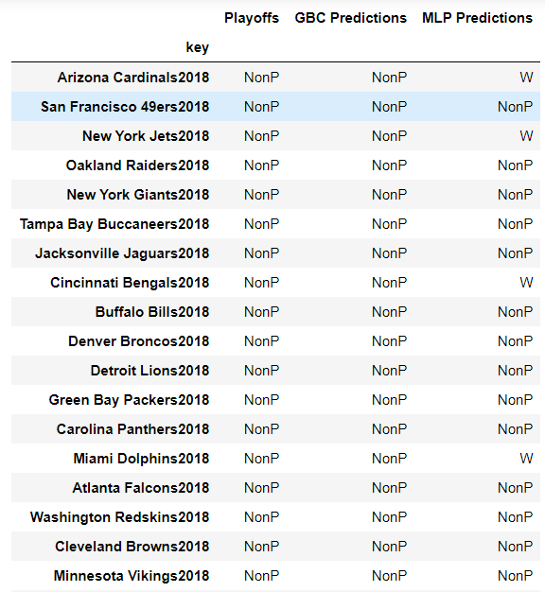
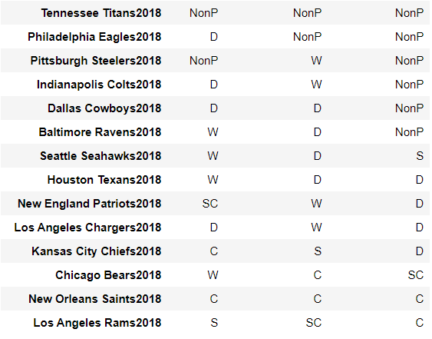
Iterative Model Results
Accuracy 71%

Slide 12
Conclusion
Very difficult to outright predict the placing of all teams
Much easier to predict the two teams who will be in the Superbowl
Smallest margin between division losers and wildcard losers
Superbowl champion almost never best team statistically
On the average, Superbowl champion has toughest schedule

Slide 13
Future Steps
Develop script that runs the various models on all teams then assigns the teams based on a hierarchical structure
Highest class probabilities are chosen first instead of first come first serve method
Going back even further to collect more season(s) worth of data
Isolating further the most telling features

Slide 14
Thank you! Any Questions?

