Slide 1


Tooling for the HTTP Uniform Interface
Darrel Miller
Notes:
Welcome to this talk on…

Slide 2
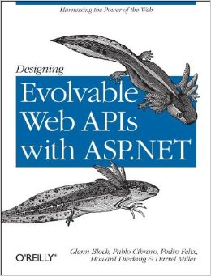


Who am I?
Twitter: @darrel_miller
http://www.bizcoder.com/
Solve API Problems Fast
Notes:
I stir up trouble here on twitter
I blog about all things HTTP on bizcoder.com
I work as a developer advocate for Runscope
Build tools to log, monitor, measure and share HTTP requests
Co-authored book on designing evolvable Web APIs
Integration MVP

Slide 3



The Tools
https://github.com/tavis-software
Tavis.UriTemplates
Tavis.Link
Tavis.Home
Tavis.Problem
Tavis.Hal
Tavis.JsonPatch
Tavis.Status
Tavis.JsonPointer
Tavis.HttpHeaders
Tavis.Owin
Tavis.TreeRoute
Tavis.PrivateCache
https://github.com/darrelmiller
https://github.com/runscope
Notes:
You will find my OSS work in a variety of places.
Today we’re focusing on the projects found under the Tavis Software Org
Sample projects tend to live in the darrelmiller org
And Runscope related tools in the Runscope org

Slide 4
The Plan
Constructing URLs the easy way
Consuming HTTP APIs without hiding them
Reusable media types with a purpose
Notes:
We are going to start

Slide 5
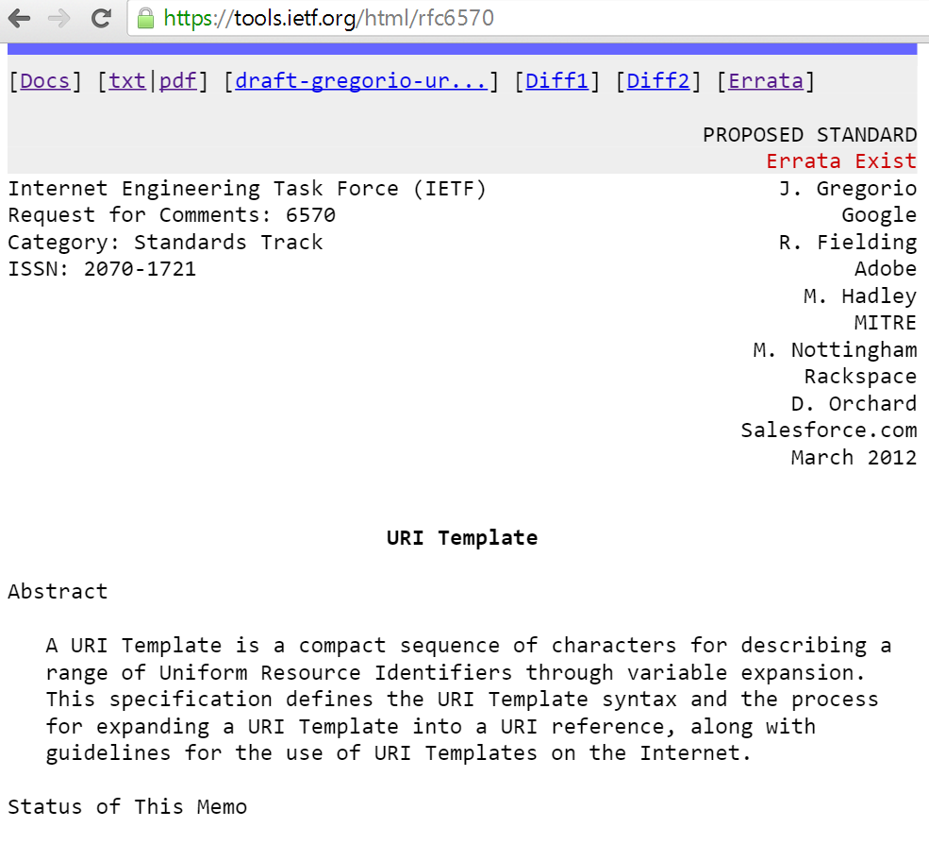
Constructing URLs the easy way
Notes:
Constructing URLs is a pain
Several years ago…
I wrote a .net library that implements it
Code Example… but before let’s go to api.github.com
Go to code steps 1

Slide 6
Constructing URLs the easy way
Implementations
https://code.google.com/p/uri-templates/wiki/Implementations
More Details
http://www.bizcoder.com/constructing-urls-the-easy-way
http://www.bizcoder.com/solving-dropbox-s-url-problems

Slide 7


Consuming HTTP APIs without hiding them
Notes:
There is an expression known to many physicsts… “assuming a spherical cow in a vacuum”. We have a tendency to treat the complexity in distributed systems a little bit the same way by trying to hide it.
I will show what I mean by that and present tools that enable an alternative that begins to treat HTTP APIs more like the web itself.
Goto to code steps 2 and 3

Slide 8
Reusable Media Types with a Purpose
application/home+json
application/http-problem+json
application/vnd.collection+json

Slide 9
The Tools
https://github.com/tavis-software
Tavis.UriTemplates
Tavis.Link
Tavis.Home
Tavis.Problem
Tavis.Hal
Tavis.JsonPatch
Tavis.Status
Tavis.JsonPointer
Tavis.HttpHeaders
Tavis.Owin
Tavis.TreeRoute
Tavis.PrivateCache
https://github.com/darrelmiller
https://github.com/runscope
Notes:
You will find my OSS work in a variety of places.
Today we’re focusing on the projects found under the Tavis Software Org
Sample projects tend to live in the darrelmiller org
And Runscope related tools in the Runscope org

Slide 10
Thank you
@darrel_miller
darrel@runscope.com

