Slide 1
Introduction to
Natural Language Processing
HW 3
Multimodal Retrieval-Augmented Generation

Slide 2
Task introduction
Building your own Retrieval-Augmented Generation (RAG) retriever that, given a question about a document, selects the most relevant pieces of evidence from the document to support answering that question.
The documents in this task are multimodal, containing both text and images. We provide textual descriptions for every image, so a text-only retriever is sufficient; using the raw images (e.g., via a VLM) is optional.
For each question, return a single ranked list of the top-5 most relevant evidence items overall (text and images combined, not 5 per modality), ordered from most to least relevant. Your goal is to maximize the overlap with the ground-truth evidence.
Note: This assignment only evaluates the retrieval stage — you do not need to generate final answers.
Requirement :
Submit a report and your source code to E3
Upload your submission to Kaggle

Slide 3
Task rules & constraints
Model size limit: Your model must be ≤ 80B total parameters (MoE included — count total params, not active). We judge this by the model's advertised size in its official name: anything labeled 80B or below qualifies, regardless of the exact parameter count. Open-weight only (e.g., Qwen3-80B-A3B, Llama-3.1-70B, Gemma-3-27B).
Any approach is allowed: You are free to use any approach you like — the only constraints are the model size limit and the open-weight requirement.
API usage policy: Any API used in your retrieval pipeline (embedding, reranking, query rewriting, etc.) must be backed by an open-weight model within the 80B parameter limit. Closed-source APIs such as GPT-5, Claude are NOT allowed.

Slide 4
Dataset
The dataset consists of question-document pairs built from real-world long documents, where relevant evidence may appear in different modalities such as text, tables, and figures.
HW3_dataset
File | Data_nums | Description
train.jsonl | 2055 | Labeled samples for training and experimentation
test.jsonl | 1798 | Unlabeled samples for submission
image | 14826 | Image assets referenced by the samples
sample_submission.csv | 1798 | Example submission file

Slide 5
Data Introduction
Each sample in dev_15.jsonl is a JSON object:
q_id: Unique question ID.
doc_name / domain: Source document name and its category.
question: Natural-language question to answer from the document.
evidence_modality_type: Modalities that may contain evidence, such as text, table, figure, or chart.
text_quotes: A list of candidate text snippets, each with a quote_id and the original text content..
img_quotes: A list of candidate image evidences (tables / charts / figures), each with a quote_id, an img_path pointing to the file under image/, and an img_description a pre-generated natural-language description of the image. You may use this description directly as text evidence, or generate your own with a multimodal model if you prefer.
gold_quotes: Ground-truth supporting quote_ids. Only available in dev_15.jsonl.
answer_short / answer_interleaved: Reference answers for development only.
Note: test.jsonl has the same public fields but excludes gold labels and reference answers.

Slide 6

Kaggle Submission (70%)
Kaggle link Use your @nycu.edu.tw email address
to join the competition.
Display team name: <student ID>
team name error: -5%
Submission format
A CSV file with 2 columns: q_id, gold_quotes.
Each row corresponds to one question in test.jsonl.
q_id must match the question ID exactly.
gold_quotes contains your top-5 retrieved quote_ids, separated by a single space.
Column names must be exactly q_id, gold_quotes.
There are one simple baseline and one strong baseline, beat them to get the higher score.
Evaluation metric: Recall@5. Submit at most 5 quote_ids per row; extra ones beyond the 5th will be ignored. Submitting fewer than 5 is allowed but reduces your maximum recall.

Slide 7
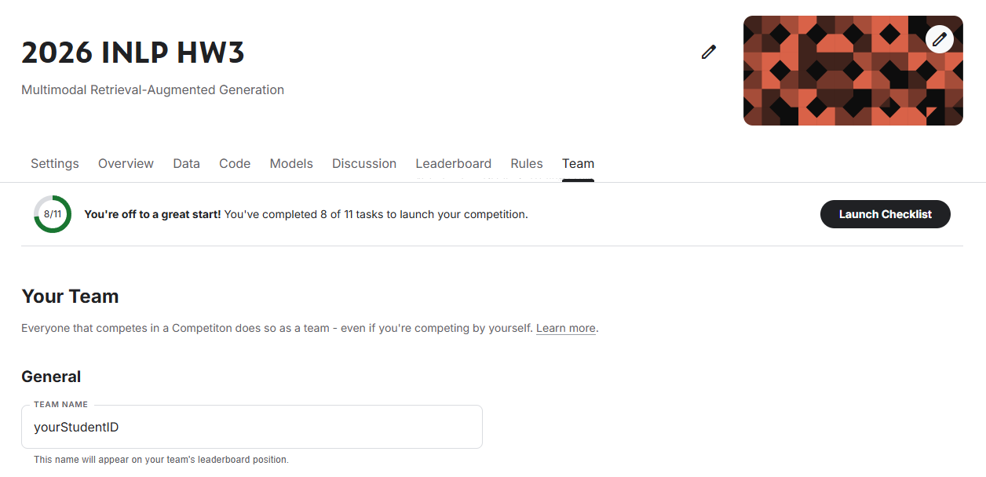
Change your team name
Please remember to change the team name to <student ID>, or there will be a deduction of 5 points for HW 3.

Slide 8
Kaggle Submission (70%)
Public leaderboard is calculated with approximately 30% of the test data, private leaderboard is calculated with the other 70%, so the final standings may be different. You can only view your private leaderboard score after the competition has ended.
Your submission is evaluated by Recall@5, which measures how many ground-truth evidence quote_ids are covered by your top-5 retrieved results.
You can submit at most 5 times each day and choose 3 of the submissions to be considered for the private leaderboard, or will otherwise default to the best public scoring submissions.

Slide 9
Report Submission
Please answer the following 4 questions in detail:
Q1. Method Description (5%)
Clearly describe your overall retrieval pipeline and the main idea behind your method.
Explain the retriever, evidence preprocessing, ranking procedure, and any additional techniques you used.
Q2. Comparison of Retrieval Methods (5%)
Based on your experimental results, compare the performance of BM25, Dense Retriever, direct LLM selection, and your own method.
Analyze the strengths and weaknesses of all four methods, and explain what you think causes the performance differences.

Slide 10
Report Submission
Q3. Multimodal Embedding vs. Text-Description Retrieval for Image Evidence(10%)
There are two common ways to retrieve image evidence :
(a) Use a multimodal embedding model to encode the image directly into a vector, then compare it with the question embedding.
(b) Convert each image into a text description, then retrieve it together with other text evidence using a text-only retriever. You may either use the img_description field that is already provided in the dataset, or generate your own description with a VLM / image-captioning model.
Briefly state which option you chose and why.
Compare your experimental results for these two approaches. Discuss which one performs better on this task and explain what you think causes the difference.
Q4. Modality Preference Analysis (10%)
Examine whether your retriever shows a preference for a particular modality in its retrieval results.
For example, does it tend to retrieve more text evidence, or does it favor image evidence?
Based on your actual experimental results, describe this preference and analyze what you think causes it.
even if your retriever shows no clear preference, you are still expected to explain what aspects of your method cause this balanced behavior.
Please answer the questions in detail to get full credit for each question.

Slide 11
Grading policy
Kaggle (70%)
30% based on the public leaderboard score and 70% based on the private leaderboard score
Basic score : Over strong baseline : 55 Over simple bassline : 40 Under simple baseline : 25
Ranking score: 15-(15/N)*(ranking-1), N=numbers of people in the interval
Report (30%)
10% for each quesiton
You will receive 0 points if you do not submit the source code.

Slide 12
E3 Submission
Submit your source code and report to E3 before 5/26(Tue) 23:59, no late submissions will be accepted !
Format：
HW3_<student ID>.zip
Source code : HW3_<student ID>.py or HW3_<student ID>.ipynb
report : HW3_<student ID>.pdf
If you have any question about HW 3, please feel free to contact with TA: Ting-Shian Kuo
through email chad910713.cs14@nycu.edu.tw

Slide 13
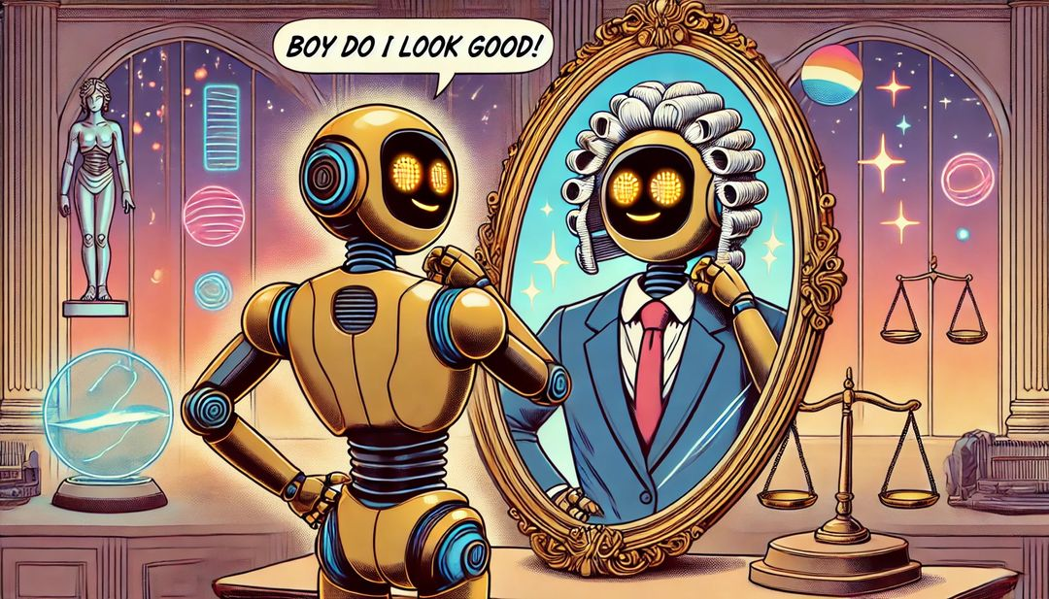
Have Fun !

