Slide 1
ST2187 Business Analytics, Applied Modelling, and Prediction (2024-2025)
DARREN ALEXANDER

Slide 2
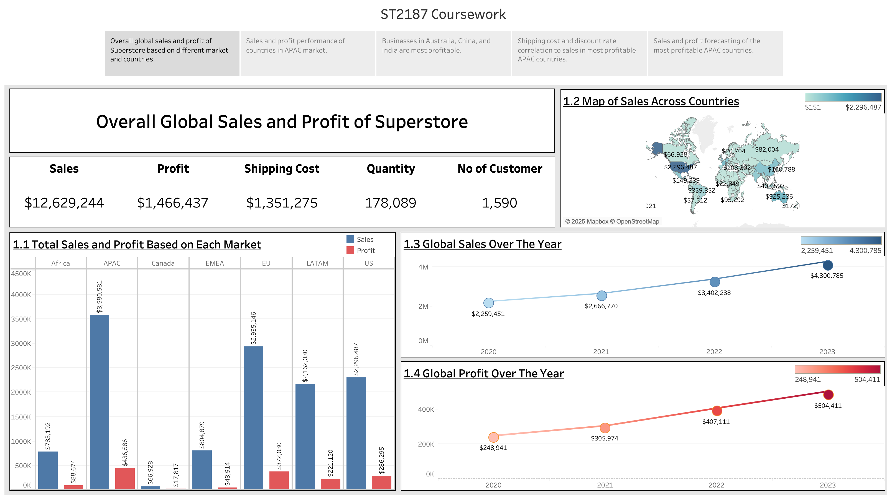

Slide 3
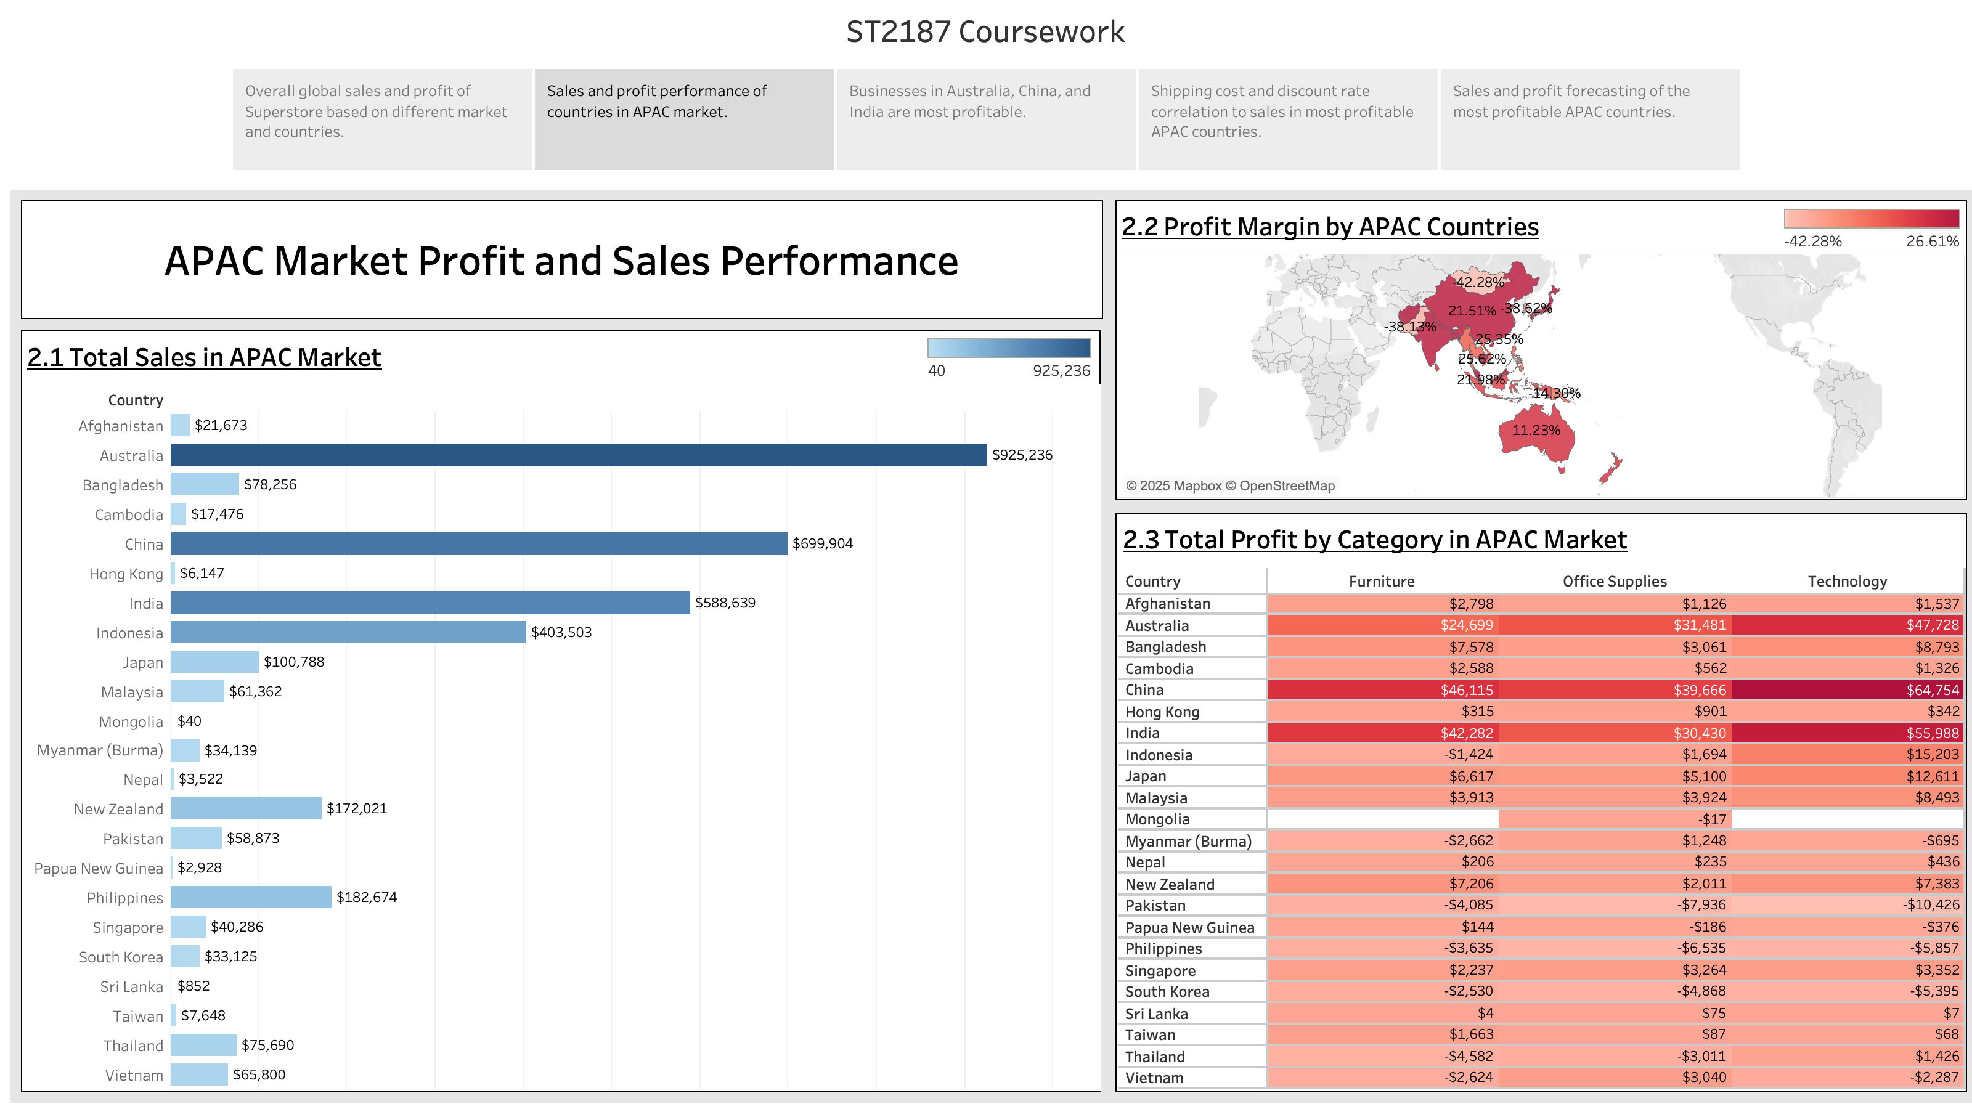

Slide 4
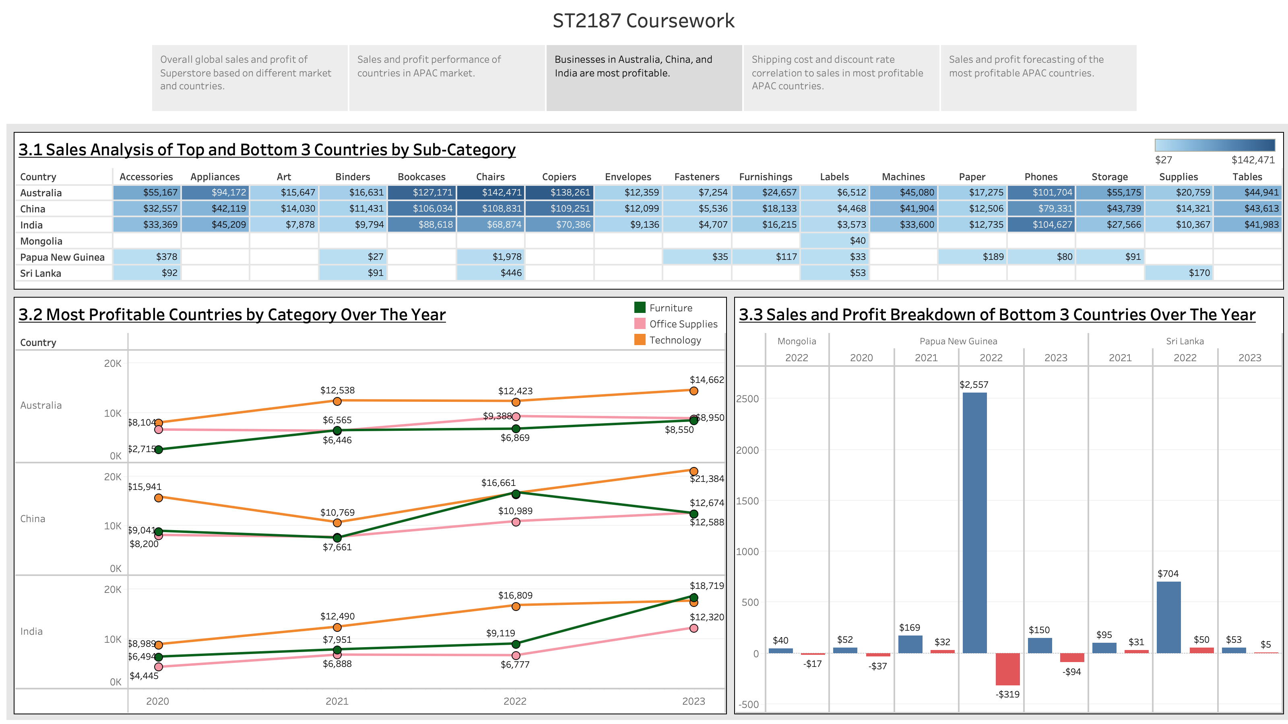

Slide 5
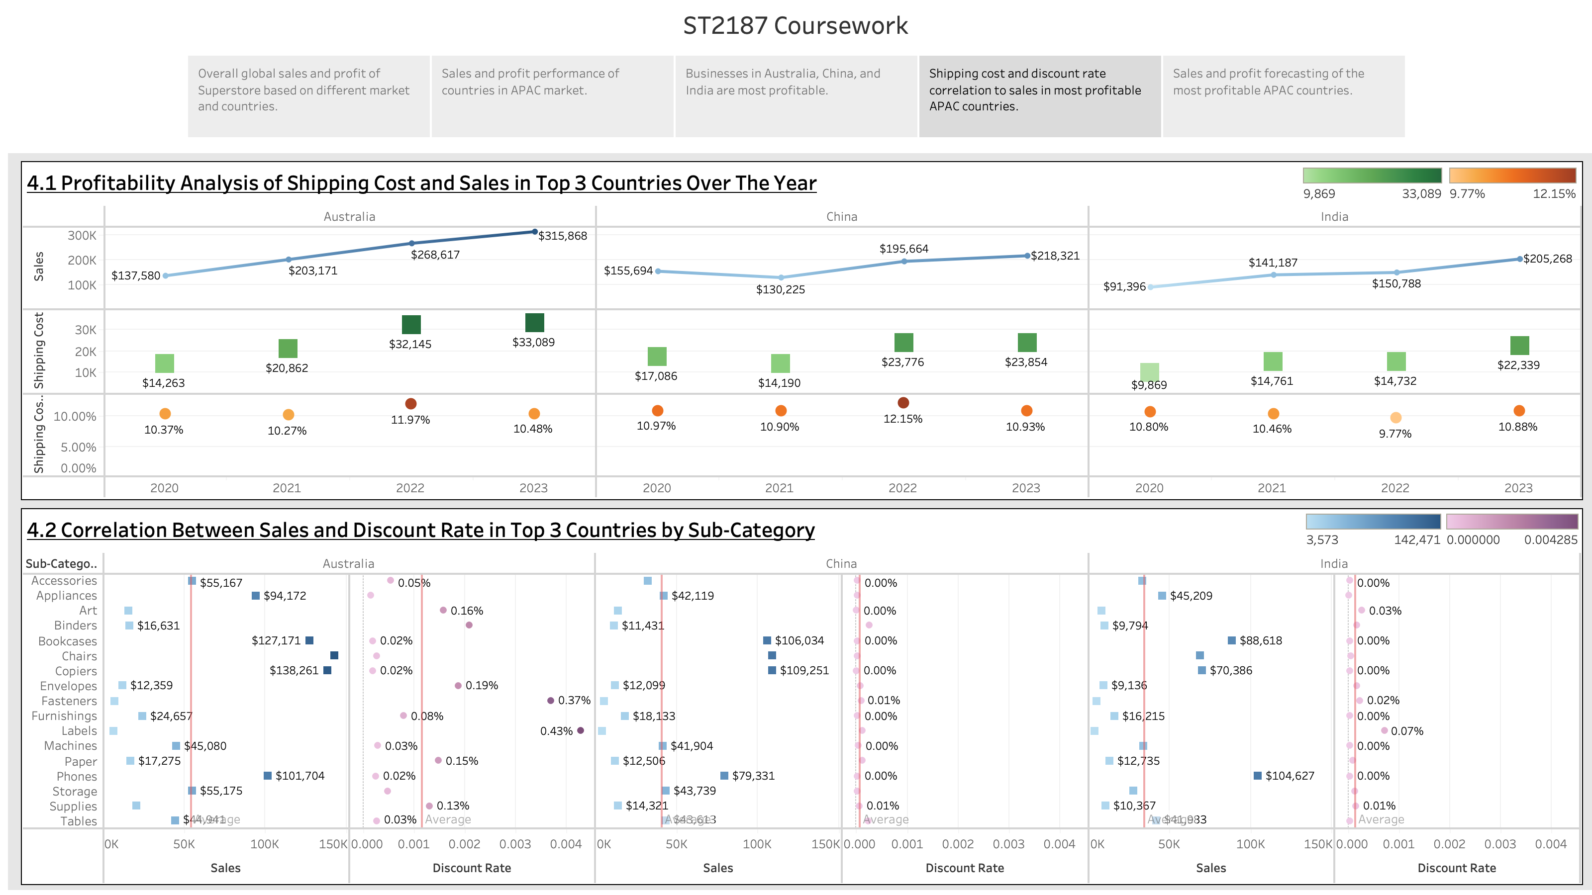

Slide 6
