Slide 1
Get a free Azure subscription
ISEP - Lab
Microsoft Azure Public Cloud

Slide 2
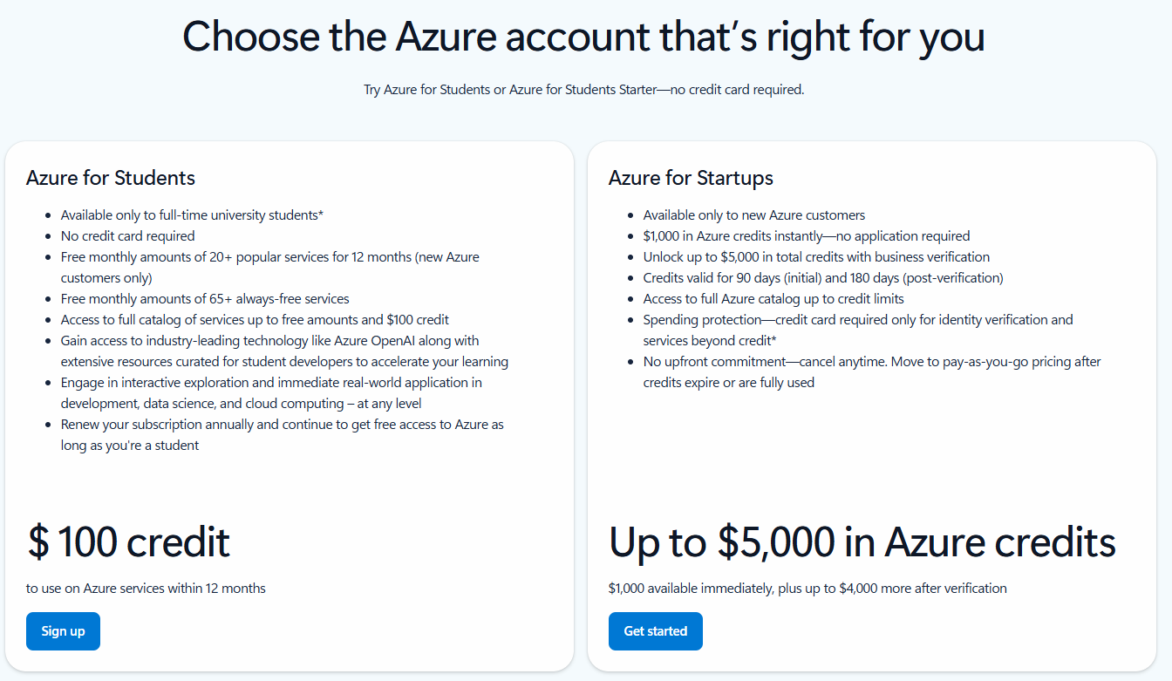
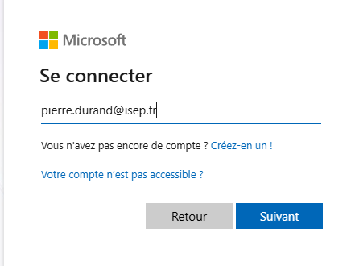
How it works?
Azure for Students | Microsoft Azure

Slide 3
Create an Azure DevOps Organization
ISEP - Lab
Microsoft Azure Public Cloud

Slide 4
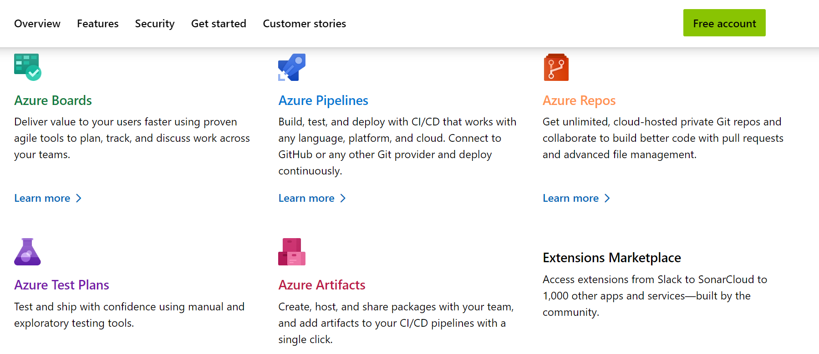
Azure devOps features
https://azure.microsoft.com/en-us/products/devops

Slide 5
Azure DevOps – Step by Step
1. Go to Azure DevOps
https://dev.azure.com
2. Sign in with your personal Microsoft account (NOT school account)
Do not connect to your Azure subscription.
Azure DevOps free tier does not require a subscription or credit card.
3. Click “New organization”
4. Choose a unique organization name (e.g., student‑devops‑john)
5. Choose region (closest to your country)
6. Click Continue → your Azure DevOps organization is created
7. Use the free tier features immediately
Azure DevOps includes a permanently free plan:
First 5 users fully free
Unlimited private Git repos
Azure Boards (Kanban, sprints)
Azure Pipelines: 1 free Microsoft‑hosted job, 1,800 minutes/month
1 free self‑hosted agent with unlimited minutes

Slide 6
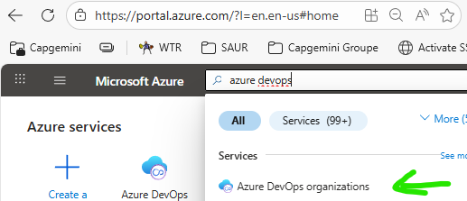
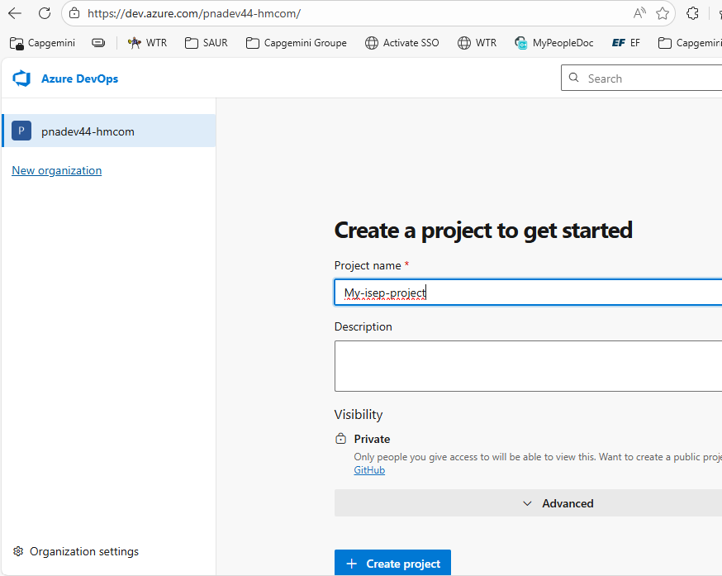
Create your Azure DevOps organization (no credit card)

