Slide 1

Attribute Driven design
Darren BOUTROS
09/11/2022

Slide 2




Architecture Design Challenges
Notes:
https://www.commentcavole.com/un-avion-de-a-a-z-2eme-partie-cockpit-dun-avion-de-ligne/
https://www.cnetfrance.fr/news/ou-sont-passes-les-tant-promis-drones-de-livraison-39940719.htm
https://www.forbes.com/sites/bernardmarr/2020/07/17/5-ways-self-driving-cars-could-make-our-world-and-our-lives-better/?sh=c97699042a33
Since the system must react within milliseconds and one single fault can mean a loss of lives
IoT applications should be secure, safe and user-friendly. Having all these features also makes them complex. Complex systems need a solid, well-designed architecture.

Slide 3
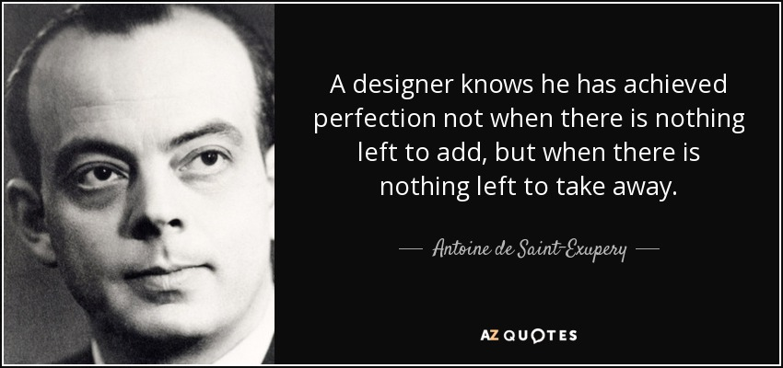
Notes:
https://www.azquotes.com/quote/256897

Slide 4
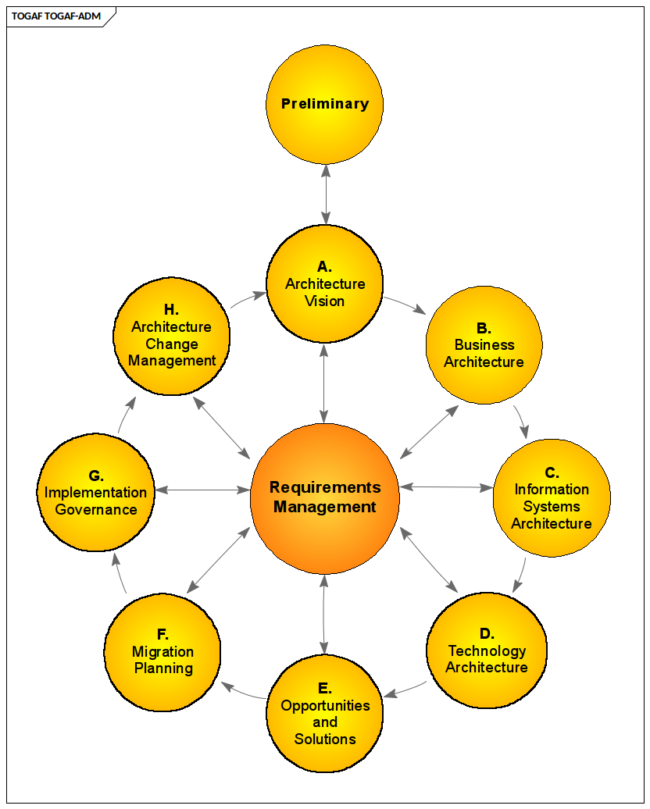
Architecture Development Methods
“It describes a method for developing and managing the lifecycle of an Enterprise Architecture, and forms the core of the TOGAF standard. It integrates elements of the TOGAF standard described in this document as well as other available architectural assets, to meet the business and IT needs of an organization.”
Notes:
https://pubs.opengroup.org/architecture/togaf9-doc/arch/

Slide 5

Can we say?
Most Architecture Development Methods cover the whole architecture lifecycle and provide few details on how to perform the design activity
Notes:
https://www.brightconcept-consulting.com/en/blog/leadership/how-to-develop-the-7-skills-of-critical-thinking

Slide 6
Attribute-Driven Design
Developed by Software Engineering Institute SEI
A systematic step-by-step method for designing the software architecture of a software-intensive system.
Approach to defining software architectures by basing the design process on the architecture's quality attribute requirements
follows a recursive process that decomposes a system or system element by applying architectural tactics and patterns that satisfy its driving quality attribute requirements.
Version 2.0 released November 2006
Version 3.0 released April 2015 ?
Notes:
https://resources.sei.cmu.edu/library/asset-view.cfm?assetid=484077#:~:text=Abstract-,The%20SEI%20Attribute%2DDriven%20Design%20(ADD)%20method%20is%20a,the%20architecture's%20quality%20attribute%20requirements.
ADD 3.0: Rethinking Drivers and Decisions in the Design Process

Slide 7
ADD steps

Slide 8
Design Objectives**
Primary functional requirement
Quality attribute scenarios
Constraints
Concerns**
Step 1: Review Inputs
Step 2: Establish Iteration Goal and select the input to be considered in the iteration **
Step 3: Choose one or more elements of the system to decompose **
Step 4: Choose one or more design concepts that satisfy the inputs considered in the iteration
From a previous round of iterations
Or from an existing system
Key
Iterate if necessary
Step 5: Instantiate architectural elements, allocate responsibilities and define interfaces
driver
Step 6: Sketch views and record design decisions
Architecture Design
Step 7: Perform analysis of current design and review iteration goal and design objectives
Process
Precedent
(Refined) Software Architecture Design
Artifact flow

Slide 9
Design Objectives**
Primary functional requirement
Quality attribute scenarios
Constraints
Concerns**
Step 1: Review Inputs
Step 2: Establish Iteration Goal and select the input to be considered in the iteration **
Step 3: Choose one or more elements of the system to decompose **
Step 4: Choose one or more design concepts that satisfy the inputs considered in the iteration
From a previous round of iterations
Or from an existing system
Key
Iterate if necessary
Step 5: Instantiate architectural elements, allocate responsibilities and define interfaces
driver
Step 6: Sketch views and record design decisions
Architecture Design
Step 7: Perform analysis of current design and review iteration goal and design objectives
Process
Precedent
(Refined) Software Architecture Design
Artifact flow
Notes:
Design Objectives: Before you can begin you need to be clear about why you are designing.
Your objectives will change what and how you design, e.g. design for value, design for cost
avant de commencer, vous devez être clair sur la raison pour laquelle vous concevez.
Vos objectifs changeront quoi et comment vous concevez, par ex. conception pour la valeur, conception pour le coût

Slide 10
Design Objectives**
Primary functional requirement
Quality attribute scenarios
Constraints
Concerns**
Step 1: Review Inputs
Step 2: Establish Iteration Goal and select the input to be considered in the iteration **
Step 3: Choose one or more elements of the system to decompose **
Step 4: Choose one or more design concepts that satisfy the inputs considered in the iteration
From a previous round of iterations
Or from an existing system
Key
Iterate if necessary
Step 5: Instantiate architectural elements, allocate responsibilities and define interfaces
driver
Step 6: Sketch views and record design decisions
Architecture Design
Step 7: Perform analysis of current design and review iteration goal and design objectives
Process
Precedent
(Refined) Software Architecture Design
Artifact flow
Notes:
Functional requirements: what functions a system must provide to meet stated and implied stakeholder needs when the software is used under specific conditions
Use case, user Story, As who, I want what so that why
- The system shall allow users to buy and sell securities.
- The system shall allow users to review account activity.
- The system shall notify operators of reactor core temperature changes
User Stories with Gherkin
Feature: Payments with Visa Classic As a Visa Classic Cardholder, I want to use my Visa Card, For paying my purchases. Scenario: The Visa Cardholder use the Visa Classic for paying Given I am a Visa Classic Cardholder When I pay with my Visa Classic Then My Visa card is accepted

Slide 11
Design Objectives**
Primary functional requirement
Quality attribute scenarios
Constraints
Concerns**
Step 1: Review Inputs
Step 2: Establish Iteration Goal and select the input to be considered in the iteration **
Step 3: Choose one or more elements of the system to decompose **
Step 4: Choose one or more design concepts that satisfy the inputs considered in the iteration
From a previous round of iterations
Or from an existing system
Key
Iterate if necessary
Step 5: Instantiate architectural elements, allocate responsibilities and define interfaces
driver
Step 6: Sketch views and record design decisions
Architecture Design
Step 7: Perform analysis of current design and review iteration goal and design objectives
Process
Precedent
(Refined) Software Architecture Design
Artifact flow
Notes:
Quality attributes are measurable or testable property of a system that is used to indicate how well the system satisfies the needs of stakeholder beyond the basic function of the system
Availability, Deployability, Integrability, Performance, Modifiability, Safty, Security, Testability,usability, Energy Efficency, ....
Prioritized by the customer according to importance to the success of the system (H, M, L)
Prioritized by the architect according to technical risk (H, M, L)

Slide 12
Design Objectives**
Primary functional requirement
Quality attribute scenarios
Constraints
Concerns**
Step 1: Review Inputs
Step 2: Establish Iteration Goal and select the input to be considered in the iteration **
Step 3: Choose one or more elements of the system to decompose **
Step 4: Choose one or more design concepts that satisfy the inputs considered in the iteration
From a previous round of iterations
Or from an existing system
Key
Iterate if necessary
Step 5: Instantiate architectural elements, allocate responsibilities and define interfaces
driver
Step 6: Sketch views and record design decisions
Architecture Design
Step 7: Perform analysis of current design and review iteration goal and design objectives
Process
Precedent
(Refined) Software Architecture Design
Artifact flow
Notes:
Design constraints are decisions about a system’s design that must be incorporated into any final design of the system
They may be technical or organizational
They may originate from the customer but also from the development organization
Usually, limit the alternatives that can be considered for design decisions
The system shall integrate with legacy applications.

Slide 13
Design Objectives**
Primary functional requirement
Quality attribute scenarios
Constraints
Concerns**
Step 1: Review Inputs
Step 2: Establish Iteration Goal and select the input to be considered in the iteration **
Step 3: Choose one or more elements of the system to decompose **
Step 4: Choose one or more design concepts that satisfy the inputs considered in the iteration
From a previous round of iterations
Or from an existing system
Key
Iterate if necessary
Step 5: Instantiate architectural elements, allocate responsibilities and define interfaces
driver
Step 6: Sketch views and record design decisions
Architecture Design
Step 7: Perform analysis of current design and review iteration goal and design objectives
Process
Precedent
(Refined) Software Architecture Design
Artifact flow
Notes:
Concerns represent design decisions that should be made whether they are stated explicitly as part of the goals or the requirements.
Examples include:
Deployment and updating
Data migration and backup
Exception management and logging

Slide 14
Design Objectives**
Primary functional requirement
Quality attribute scenarios
Constraints
Concerns**
Step 1: Review Inputs
Step 2: Establish Iteration Goal and select the input to be considered in the iteration **
Step 3: Choose one or more elements of the system to decompose **
Step 4: Choose one or more design concepts that satisfy the inputs considered in the iteration
From a previous round of iterations
Or from an existing system
Key
Iterate if necessary
Step 5: Instantiate architectural elements, allocate responsibilities and define interfaces
driver
Step 6: Sketch views and record design decisions
Architecture Design
Step 7: Perform analysis of current design and review iteration goal and design objectives
Process
Precedent
(Refined) Software Architecture Design
Artifact flow
Notes:
Before starting with design, ensure that there is clarity on the overall design problem that needs solved.
The purpose for a design round may be, to produce a design for early estimation
To refine an existing design to build a new incrent of system
Design prototype to mitigate certain technical rsicks
Know the existing architecture’s design if not greenfield development
No design decisions are made during this step

Slide 15
Design Objectives**
Primary functional requirement
Quality attribute scenarios
Constraints
Concerns**
Step 1: Review Inputs
Step 2: Establish Iteration Goal and select the input to be considered in the iteration **
Step 3: Choose one or more elements of the system to decompose **
Step 4: Choose one or more design concepts that satisfy the inputs considered in the iteration
From a previous round of iterations
Or from an existing system
Key
Iterate if necessary
Step 5: Instantiate architectural elements, allocate responsibilities and define interfaces
driver
Step 6: Sketch views and record design decisions
Architecture Design
Step 7: Perform analysis of current design and review iteration goal and design objectives
Process
Precedent
(Refined) Software Architecture Design
Artifact flow
Notes:
An iteration starts by sub-deciding which problem to address. (goals) performance issue, Use Case
No design decisions are made during this step

Slide 16
Design Objectives**
Primary functional requirement
Quality attribute scenarios
Constraints
Concerns**
Step 1: Review Inputs
Step 2: Establish Iteration Goal and select the input to be considered in the iteration **
Step 3: Choose one or more elements of the system to decompose **
Step 4: Choose one or more design concepts that satisfy the inputs considered in the iteration
From a previous round of iterations
Or from an existing system
Key
Iterate if necessary
Step 5: Instantiate architectural elements, allocate responsibilities and define interfaces
driver
Step 6: Sketch views and record design decisions
Architecture Design
Step 7: Perform analysis of current design and review iteration goal and design objectives
Process
Precedent
(Refined) Software Architecture Design
Artifact flow
Notes:
Top-down approach , bottom-up approach, or mix of both approach
Sometimes you may needs to reverse the order of steps 2 and 3, greenfield focus on elements of the ystem and start the iteration by selecting a particular element and then considering the drivers
Based on priority
No design decisions are made during this step

Slide 17
Design Objectives**
Primary functional requirement
Quality attribute scenarios
Constraints
Concerns**
Step 1: Review Inputs
Step 2: Establish Iteration Goal and select the input to be considered in the iteration **
Step 3: Choose one or more elements of the system to decompose **
Step 4: Choose one or more design concepts that satisfy the inputs considered in the iteration
From a previous round of iterations
Or from an existing system
Key
Iterate if necessary
Step 5: Instantiate architectural elements, allocate responsibilities and define interfaces
driver
Step 6: Sketch views and record design decisions
Architecture Design
Step 7: Perform analysis of current design and review iteration goal and design objectives
Process
Precedent
(Refined) Software Architecture Design
Artifact flow
Notes:
Step 4 (selecting design decisions) can be particularly challenging
Most sub-problems that are addressed during an iteration can be solved using existing solutions, i.e. design concepts – We want to avoid re-inventing the wheel – It is better (and faster) to use a proven solution to a problem for which we may not be experts – Creativity in design involves identifying, adapting and combining them
Reference Architectures – Deployment Patterns – Architectural / Design Patterns – Tactics– Externally developedcomponents (e.g. Frameworks)

Slide 18
Design Objectives**
Primary functional requirement
Quality attribute scenarios
Constraints
Concerns**
Step 1: Review Inputs
Step 2: Establish Iteration Goal and select the input to be considered in the iteration **
Step 3: Choose one or more elements of the system to decompose **
Step 4: Choose one or more design concepts that satisfy the inputs considered in the iteration
From a previous round of iterations
Or from an existing system
Key
Iterate if necessary
Step 5: Instantiate architectural elements, allocate responsibilities and define interfaces
driver
Step 6: Sketch views and record design decisions
Architecture Design
Step 7: Perform analysis of current design and review iteration goal and design objectives
Process
Precedent
(Refined) Software Architecture Design
Artifact flow
Notes:
Fo example if you selected layed parttern as design concept, you must decide how many layes will be used, their allowed relationships, sinces the pattern itself does not prescribe these
how software elements map to each other
communication among the various elements, both internal software elements and external entities
dependencies between the internal software elements
how quality attribute requirements will be addressed
Note that an interface is not simply a list of operation signatures. Interfaces describe the PROVIDES and REQUIRES assumptions that software elements make about one another.
the external interfaces to the system • the interfaces between high-level system partitions • the interfaces between applications within high-level system partitions • the interfaces to the infrastructure

Slide 19
Design Objectives**
Primary functional requirement
Quality attribute scenarios
Constraints
Concerns**
Step 1: Review Inputs
Step 2: Establish Iteration Goal and select the input to be considered in the iteration **
Step 3: Choose one or more elements of the system to decompose **
Step 4: Choose one or more design concepts that satisfy the inputs considered in the iteration
From a previous round of iterations
Or from an existing system
Key
Iterate if necessary
Step 5: Instantiate architectural elements, allocate responsibilities and define interfaces
driver
Step 6: Sketch views and record design decisions
Architecture Design
Step 7: Perform analysis of current design and review iteration goal and design objectives
Process
Precedent
(Refined) Software Architecture Design
Artifact flow
Notes:
As you instantiate design concepts you will typically create sketches. These are initial documentation for your architecture.

Slide 20
Design Objectives**
Primary functional requirement
Quality attribute scenarios
Constraints
Concerns**
Step 1: Review Inputs
Step 2: Establish Iteration Goal and select the input to be considered in the iteration **
Step 3: Choose one or more elements of the system to decompose **
Step 4: Choose one or more design concepts that satisfy the inputs considered in the iteration
From a previous round of iterations
Or from an existing system
Key
Iterate if necessary
Step 5: Instantiate architectural elements, allocate responsibilities and define interfaces
driver
Step 6: Sketch views and record design decisions
Architecture Design
Step 7: Perform analysis of current design and review iteration goal and design objectives
Process
Precedent
(Refined) Software Architecture Design
Artifact flow
Notes:
Verify that all functional requirements, quality attribute requirements, and design constraints assigned to the parent element have been allocated to one or more child elements in the decomposition.
Translate any responsibilities that were assigned to child elements into functional requirements for the individual elements
Refine quality attribute requirements for individual child elements as necessary No design decisions are made during this step.

Slide 21
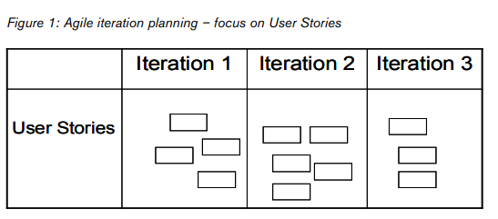
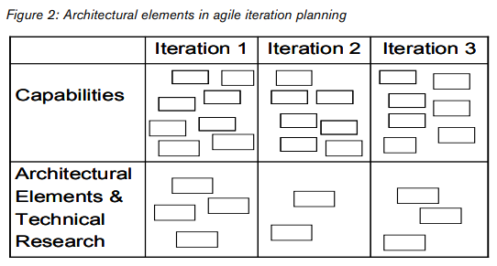
Enabling Agility Through Architecture
Notes:
For effective Architectural Agility, dependencies between capabilities and architectural elements need to be identified not only to fulfill the current release, but to plan for future releases as well (Figure 4)

Slide 22
For furtur read
Software Architecture in Practice (SEI Series in Software Engineering), 4th Edition,
by Len Bass (Author), Paul Clements (Author), Rick Kazman (Author)
Attribute-Driven Design (ADD), Version 2.0, 2006
Rob Wojcik, Felix Bachmann, Len Bass, Paul Clements, Paulo Merson, Robert Nord, Bill Wood
Software Architecture Technology Initiative, Unlimited distribution subject to the copyright
ADD 3.0: Rethinking Drivers and Decisions in the Design Process, 2015
Rick Kazman, Humberto Cervantes
Enabling Agility Through Architecture, 2010
Nanette Brown, Robert Nord, Ipek Ozkaya
Software Engineering Institute, Carnegie Mellon University

