Slide 1

Lab – Azure
ISEP – 03/2023
Prerequisites V0.1

Slide 2
Get a free Azure subscription

Slide 3
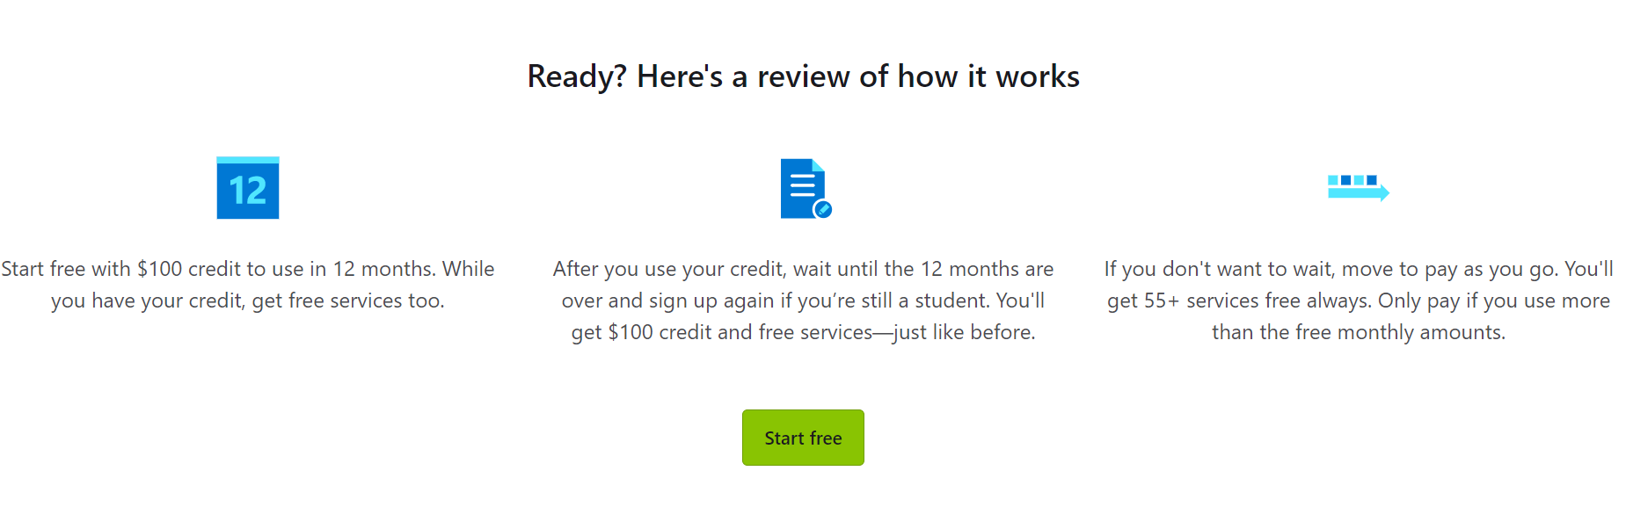
How it works?

Slide 4
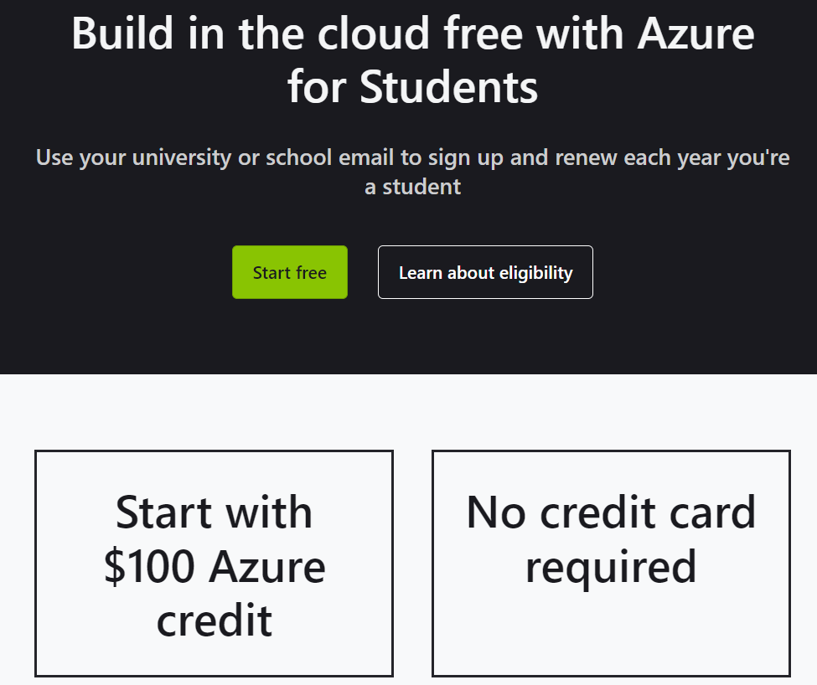
Azure for Students
https://azure.microsoft.com/en-us/free/students/

Slide 5
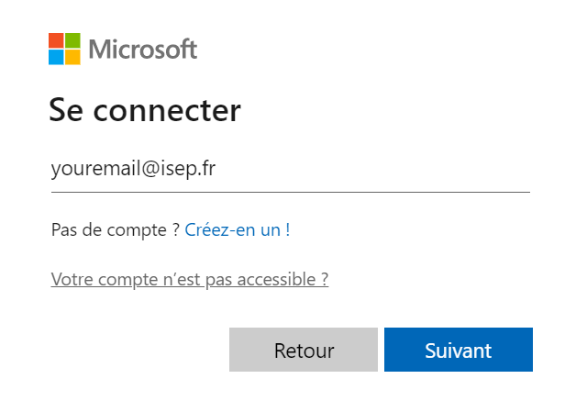
Connect with your ISEP email account

Slide 6
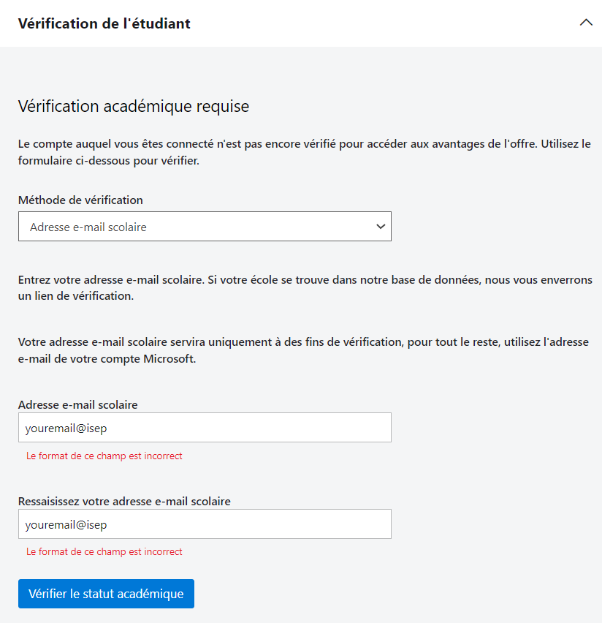
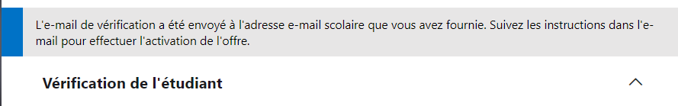
Academic status control

Slide 7
Create An Azure devops account

Slide 8
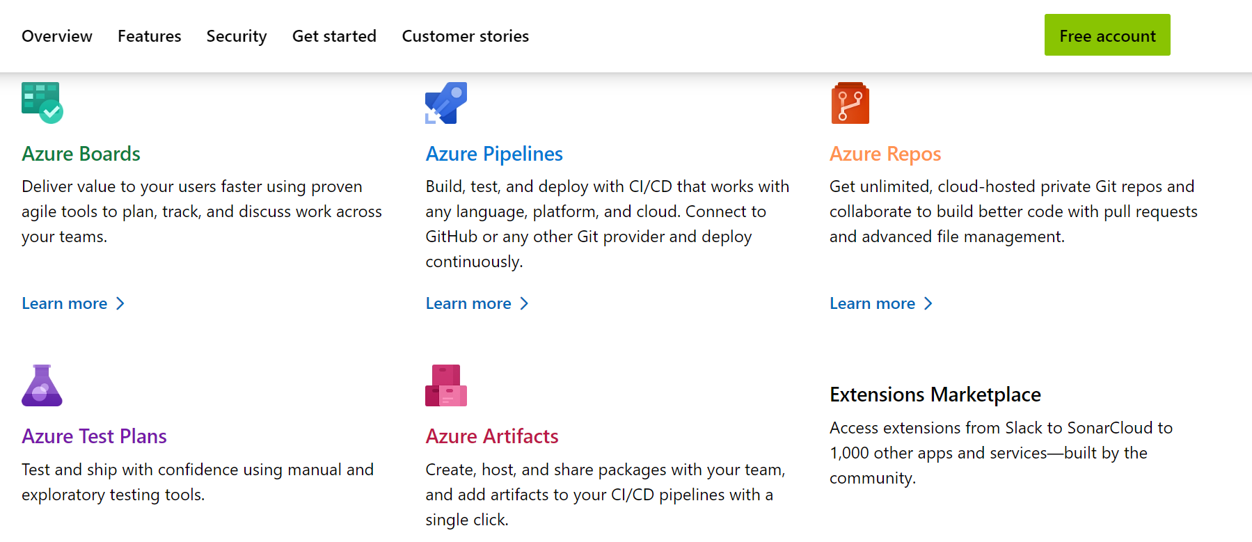
Azure devops features
https://azure.microsoft.com/en-us/products/devops

Slide 9
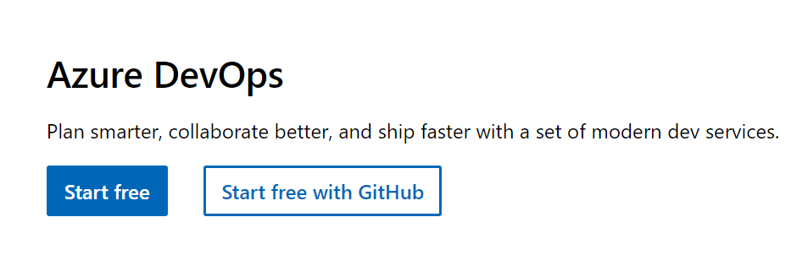
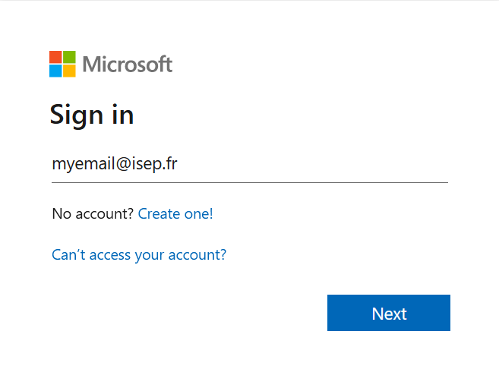
Create your account in azure devops for free

