Slide 1

Lab - Azure
ISEP – 03/2023
Part #2
V0.1

Slide 2

GET THE FUTURE YOU WANT

Slide 3
#Storage
3

Slide 4
Azure storage account
Introduction
Azure provides many ways to store your data. There are multiple database options like Azure SQL Server, Azure Cosmos DB, and Azure Table Storage. Azure offers multiple ways to store and send messages, such as Azure Queues and Event Hubs. You can even store loose files using services like Azure Files and Azure Blobs.
Azure selected four of these data services and placed them together under the name Azure Storage. The four services are Azure Blobs, Azure Files, Azure Queues, and Azure Tables
Data in your storage account is durable and highly available, secure, and massively scalable.
For more information : https://docs.microsoft.com/en-us/azure/storage/common/storage-account-overview

Slide 5
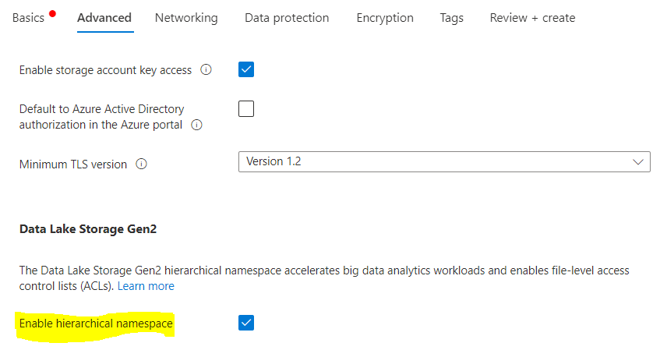
Azure storage account
Create a storage account + a container & Upload a file.
Follow the steps in : https://docs.microsoft.com/en-us/azure/storage/common/storage-account-create?tabs=azure-portal but don’t delete the storage account ;)
Name: saweisap2023<yourtrigram>01
Use region = westeurope
Check “Enable hierarchical namespace”
Create a Container named “image”
Upload an image in your container

Slide 6
Azure storage account
Upload
Follow steps in : https://docs.microsoft.com/en-us/azure/storage/blobs/storage-quickstart-blobs-portal
Use region = westeurope
When you upload your object to the blob container, right click on it and generate a Shared Access Signature (SAS), this later allows you to give temporary access to anyone without communicating the storage Key or giving a role-based access.
You can specify an expiration date and allow Ip addresses
Communicate your public Ip Address to a mate and ask him to generate a SAS so that only you can access to his file during 5 minutes

