Slide 1
A Vanilla Deterministic Policy Gradient Approach for Portfolio Management

Slide 2
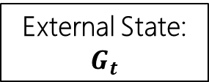
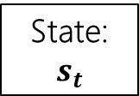
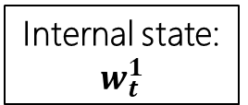
Project analysis slide 2
Problem Formulation
Our Goal:
Use historical data of (OHLC) to train an agent with Deterministic Policy Gradient so that it can automatically allocate our wealth to a pre-selected number of assets, so that the final wealth is maximised.
MDP Definitions:
Cash + No. of asset
State:
$$s_{t}$$
No. of asset
(M)
Low
Internal state:
$$w_{t}^{1}$$
High
Open
Closed
Feature (F)
Window length (L)
External State:
$$G_{t}$$
*Normalized by

Slide 3
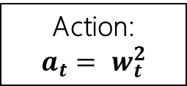
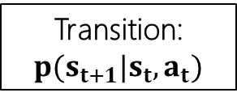
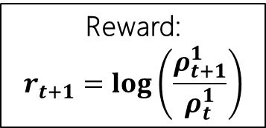
Project analysis slide 2
Problem Formulation
Our Goal:
Use historical data of (OHLC) to train an agent with Deterministic Policy Gradient so that it can automatically allocate our wealth to a pre-selected number of assets, so that the final wealth is maximised.
MDP Definitions:
Descriptions:
Growth of wealth due from t to t + 1 due to market changes and transaction costs
Descriptions:
Market change of all prices (OHLC) for all asset from t to t + 1
Cash + No. of asset
Reward:
$$r_{t+1}=log\left(\frac{ρ_{t+1}^{1}}{ρ_{t}^{1}}\right)$$
Action:
$$a_{t}= w_{t}^{2}$$
Transition: ${p(s}_{t+1}|s_{t},a_{t})$

Slide 4








Project analysis slide 2
Problem Formulation
Our Goal:
Use historical data of (OHLC) to train an agent with Deterministic Policy Gradient so that it can automatically allocate our wealth to a pre-selected number of assets, so that the final wealth is maximised.
Changes due to market
$$s_{t−1}$$
$$s_{t}$$
$$s_{t+1}$$
t - 1
t
t + 1
$$w_{t−1}^{2},ρ_{t−1}^{2}$$
$$w_{t}^{1},ρ_{t}^{1}$$
$$w_{t}^{2},ρ_{t}^{2}$$
$$w_{t+1}^{1},ρ_{t+1}^{1}$$
$$μ_{t}^{cost}$$
Agent takes action
Cost is incurred that decreases portfolio value

Slide 5




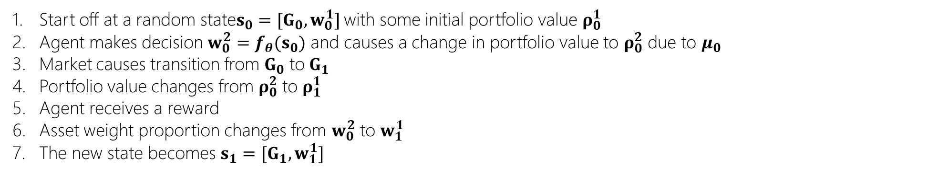




Project analysis slide 2
Starting Off Example
$$s_{t−1}$$
$$s_{0}$$
$$s_{1}$$
t - 1
0
1
$$w_{t−1}^{2},ρ_{t−1}^{2}$$
$$w_{0}^{1},ρ_{0}^{1}$$
$$w_{0}^{2},ρ_{0}^{2}$$
$$w_{1}^{1},ρ_{1}^{1}$$
$$μ_{0}$$
Start off at a random state$s_{0}=[G_{0}, w_{0}^{1}]$ with some initial portfolio value $ρ_{0}^{1}$
Agent makes decision $w_{0}^{2}=f_{θ}(s_{0})$ and causes a change in portfolio value to $ρ_{0}^{2}$ due to $μ_{0}$
Market causes transition from $G_{0}$ to$G_{1}$
Portfolio value changes from $ρ_{0}^{2}$ to $ρ_{1}^{1}$
Agent receives a reward
Asset weight proportion changes from $w_{0}^{2}$ to $w_{1}^{1}$
The new state becomes ${s_{1}=[G}_{1},w_{1}^{1}]$
Repeat until end of train/test date

Slide 6
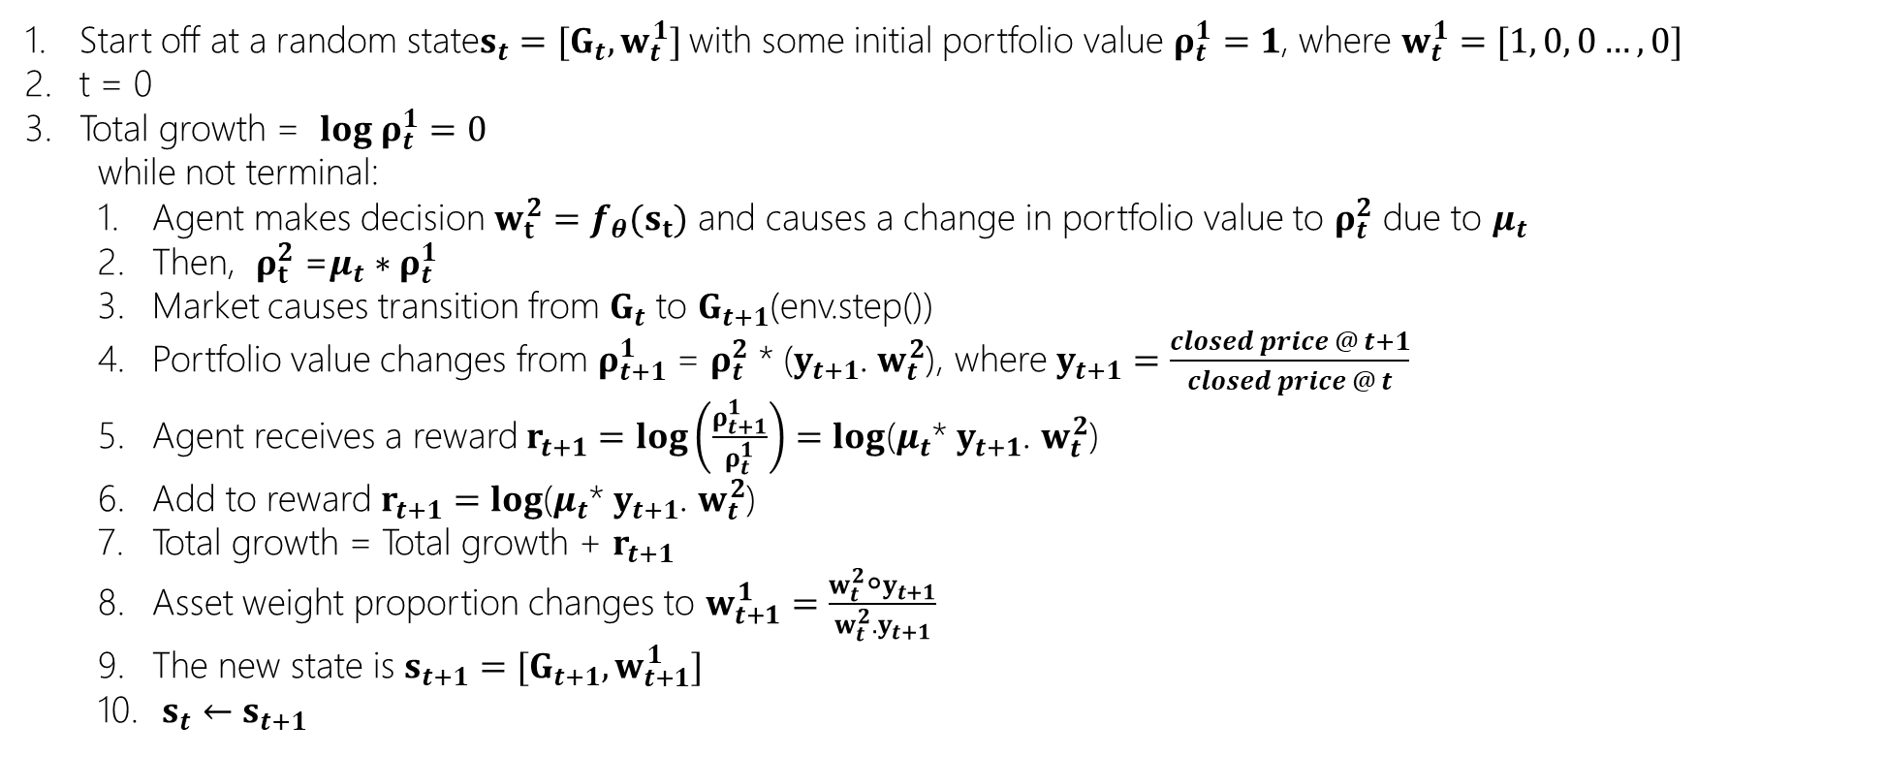
Project analysis slide 2
Algorithm
Start off at a random state$s_{t}=[G_{t},w_{t}^{1}]$ with some initial portfolio value $ρ_{t}^{1}=1$, where $w_{t}^{1}=[1, 0, 0…,0]$
t = 0
Total growth = ${log ρ}_{t}^{1}=0$
while not terminal:
Agent makes decision $w_{t}^{2}=f_{θ}(s_{t})$ and causes a change in portfolio value to $ρ_{t}^{2}$ due to $μ_{t}$
Then, $ρ_{t}^{2}$ =$μ_{t}∗ρ_{t}^{1}$
Market causes transition from $G_{t}$ to $G_{t+1}$(env.step())
Portfolio value changes from $ρ_{t+1}^{1}$ = $ρ_{t}^{2}$ * ($y_{t+1}$. $w_{t}^{2}$), where $y_{t+1}=\frac{closed price @ t+1}{closed price @ t}$
Agent receives a reward $r_{t+1}=log\left(\frac{ρ_{t+1}^{1}}{ρ_{t}^{1}}\right)=log$($μ_{t}$* $y_{t+1}$. $w_{t}^{2}$)
Add to reward $r_{t+1}=log$($μ_{t}$* $y_{t+1}$. $w_{t}^{2}$)
Total growth = Total growth + $r_{t+1}$
Asset weight proportion changes to $w_{t+1}^{1}=\frac{w_{t}^{2}\text{∘}y_{t+1}}{w_{t}^{2}.y_{t+1}}$
The new state is $s_{t+1}=[G_{t+1},w_{t+1}^{1}]$
$s_{t}←s_{t+1}$
Repeat until end of train/test date

Slide 7
Thank You

