Slide 1
ADS-B
Intruder Position
RTA (Collins)
LOGIC (Kestrel)
Intruder Trajectory
Prediction
Intruder Trajectory
Target Aircraft (Intruder)
SWC Assessment
Assessment
Plan Selector
Own-ship
Trajectory Prediction
LEC or
BAF
Own-ship Trajectory (LEC)
Own-ship Trajectory (BAF)
Aircraft State and
Initial Flight Plan
ADS-B messages
LEC
LEC Avoidance Plan
Plan Switch
Autonomous Executive
Test Aircraft
Avoidance
Plan
Commands
DAA
Avoidance Alert
Alert
Safe backup planner
BAF Avoidance Plan

Slide 2
ADS-B
Intruder Position
Run-Time Assurance
Intruder Trajectory
Prediction
Target Aircraft (Intruder)
Remain Well Clear Assessment
Plan Selector
Own ship
Trajectory Prediction
LEC or
BAP
ADS-B messages
Aircraft State and
Initial Flight Plan
LEC
Planner
LEC Avoidance Plan
Plan Switch
Autonomous Executive
Test Aircraft
(Own ship)
Avoidance
Plan
Commands
DAA
Avoidance Alert
Alert
Backup Avoidance Planner
BAP Avoidance Plan

Slide 3
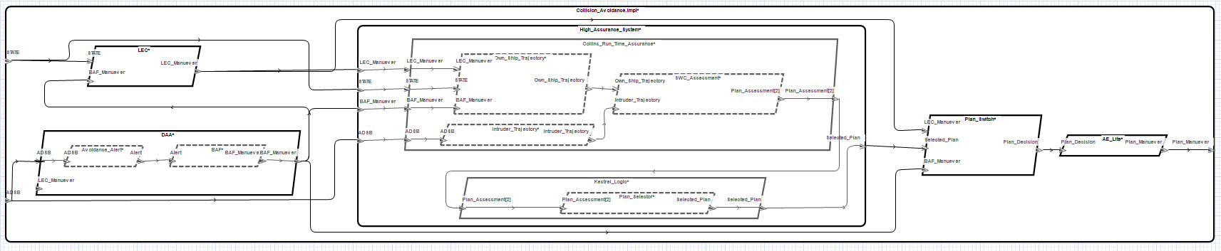
Plan_Assessment(BAF)
Plan_Assessment(LEC)
assume: safe(BAF)
guarantee:
“Aircraft always has safe flight plan”
safe(Flight_Plan)
LEC
MONITOR
PREDICT
ASSESS
PLAN
SWITCH
DAA / BAF
SELECT LOGIC
if safe(LEC) then LEC
elseif safe(BAF) then BAF

Slide 4
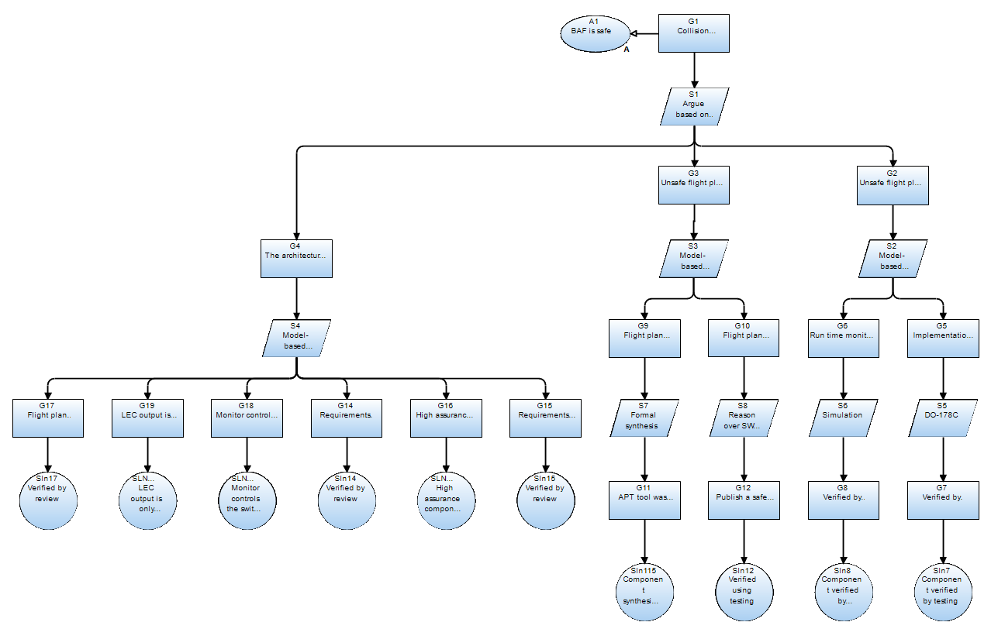
RTA architecture
Logic is
correct
Backup is
safe
Architecture is correct
APT synthesis
AGREE verification
AGREE
analysis

Slide 5
inhibiting | LEC valid | BAF valid | LEC safe | BAF safe | LEC tCPA > 179 | BAF tCPA > 179 | LEC pmd < BAF pmd | currtime > LEC.time + 3 | currtime > BAF.time + 3 | output
1 | - | - | - | - | - | - | - | - | - | NO_PUBLISH
0 | 0 | 0 | - | - | - | - | - | - | - | NO_PUBLISH
0 | 1 | 0 | - | - | - | - | - | 0 | - | NO_PUBLISH
0 | 1 | 0 | - | - | - | - | - | 1 | - | PUBLISH_LEC
0 | 0 | 1 | - | - | - | - | - | - | 0 | NO_PUBLISH
0 | 0 | 1 | - | - | - | - | - | - | 1 | PUBLISH_BAF
0 | 1 | 1 | 0 | 0 | - | - | 1 | - | - | PUBLISH_BAF
0 | 1 | 1 | 0 | 0 | - | - | 0 | - | - | PUBLISH_LEC
0 | 1 | 1 | 1 | 0 | - | - | - | - | - | PUBLISH_LEC
0 | 1 | 1 | 0 | 1 | - | - | - | - | - | PUBLISH_BAF
0 | 1 | 1 | 1 | 1 | 0 | 0 | - | - | - | PUBLISH_LEC
0 | 1 | 1 | 1 | 1 | 1 | 0 | - | - | - | PUBLISH_BAF
0 | 1 | 1 | 1 | 1 | 0 | 1 | - | - | - | PUBLISH_LEC
0 | 1 | 1 | 1 | 1 | 1 | 1 | 1 | - | - | PUBLISH_BAF
0 | 1 | 1 | 1 | 1 | 1 | 1 | 0 | - | - | PUBLISH_LEC
Only one valid plan received :
select that plan
Time out
Neither is safe :
select the least unsafe
Only one plan is safe :
select that plan
Both plans are safe : select LEC
UNLESS LEC CPA is beyond assessment horizon
OR both CPAs are beyond horizon :
select the least unsafe

