Slide 1
ADS-B
Intruder Position
RTA (Collins)
LOGIC (Kestrel)
Intruder Trajectory
Prediction
Intruder Trajectory
Target Aircraft (Intruder)
SWC Assessment
Assessment
Plan Selector
Own-ship
Trajectory Prediction
LEC or
BAF
Own-ship Trajectory (LEC)
Own-ship Trajectory (BAF)
Aircraft State and
Initial Flight Plan
ADS-B messages
LEC
LEC Avoidance Plan
Plan Switch
Autonomous Executive
Test Aircraft
Avoidance
Plan
Commands
DAA
Avoidance Alert
Alert
Safe backup planner
BAF Avoidance Plan

Slide 2
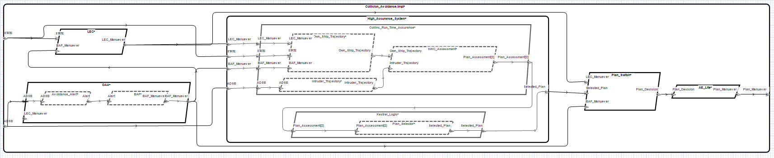
Plan_Assessment(BAF)
Plan_Assessment(LEC)
assume: safe(BAF)
guarantee:
“Aircraft always has safe flight plan”
safe(Flight_Plan)
LEC
MONITOR
PREDICT
ASSESS
PLAN
SWITCH
DAA / BAF
SELECT LOGIC
if safe(LEC) then LEC
elseif safe(BAF) then BAF

Slide 3
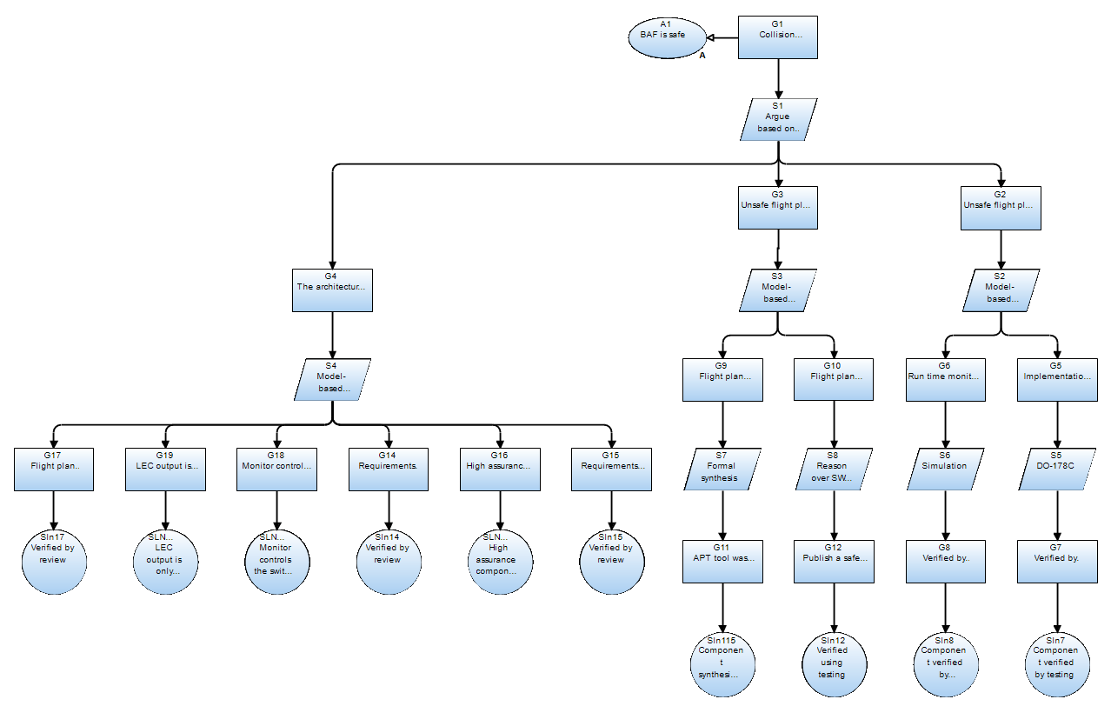
RTA architecture
Logic is
correct
Backup is
safe
Architecture is correct
APT synthesis
AGREE verification
AGREE
analysis

Slide 4
inhibiting | LEC valid | BAF valid | LEC safe | BAF safe | LEC tCPA > 179 | BAF tCPA > 179 | LEC pmd < BAF pmd | currtime > LEC.time + 3 | currtime > BAF.time + 3 | output
1 | - | - | - | - | - | - | - | - | - | NO_PUBLISH
0 | 0 | 0 | - | - | - | - | - | - | - | NO_PUBLISH
0 | 1 | 0 | - | - | - | - | - | 0 | - | NO_PUBLISH
0 | 1 | 0 | - | - | - | - | - | 1 | - | PUBLISH_LEC
0 | 0 | 1 | - | - | - | - | - | - | 0 | NO_PUBLISH
0 | 0 | 1 | - | - | - | - | - | - | 1 | PUBLISH_BAF
0 | 1 | 1 | 0 | 0 | - | - | 1 | - | - | PUBLISH_BAF
0 | 1 | 1 | 0 | 0 | - | - | 0 | - | - | PUBLISH_LEC
0 | 1 | 1 | 1 | 0 | - | - | - | - | - | PUBLISH_LEC
0 | 1 | 1 | 0 | 1 | - | - | - | - | - | PUBLISH_BAF
0 | 1 | 1 | 1 | 1 | 0 | 0 | - | - | - | PUBLISH_LEC
0 | 1 | 1 | 1 | 1 | 1 | 0 | - | - | - | PUBLISH_BAF
0 | 1 | 1 | 1 | 1 | 0 | 1 | - | - | - | PUBLISH_LEC
0 | 1 | 1 | 1 | 1 | 1 | 1 | 1 | - | - | PUBLISH_BAF
0 | 1 | 1 | 1 | 1 | 1 | 1 | 0 | - | - | PUBLISH_LEC
Only one valid plan received :
select that plan
Time out
Neither is safe :
select the least unsafe
Only one plan is safe :
select that plan
Both plans are safe : select LEC
UNLESS LEC CPA is beyond assessment horizon
OR both CPAs are beyond horizon :
select the least unsafe

