Slide 1

EduAble
STEM notetaking for all
Zayne
University of Cambridge
Computer Science
Notes:
Hi everyone, I’m Zayne, a first year Computer Science student at Cambridge, and I’m on a mission to make STEM notetaking accessible for all.
Before we begin, I’d like you to imagine its your first day of lectures at Cambridge. As the professor starts diving into the complexities of calculus, you try to keep up, typing notes into Notion. But then, the lecture quickly accelerates into a maze of complex symbols and expressions. Your fingers freeze over the keyboard. How could you possibly type all the integral symbols, square roots, or funny-looking Greek alphabets quickly enough?

Slide 2
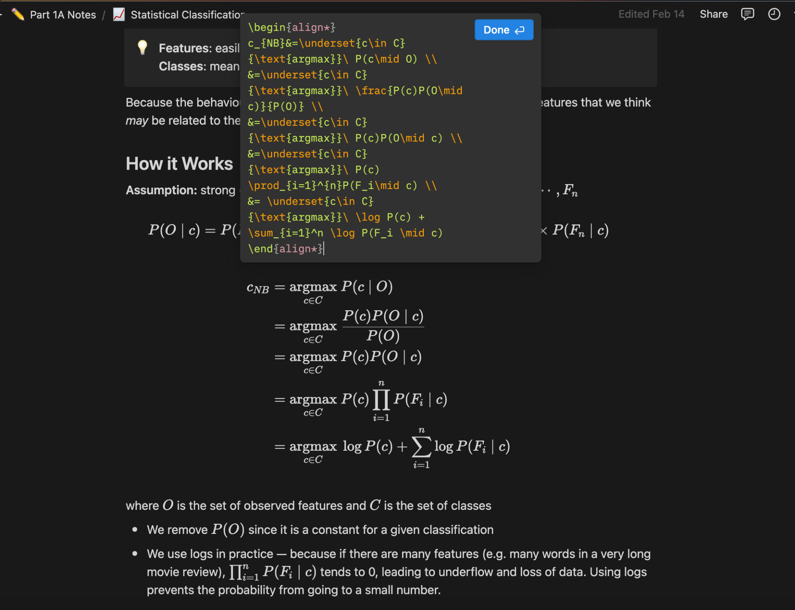
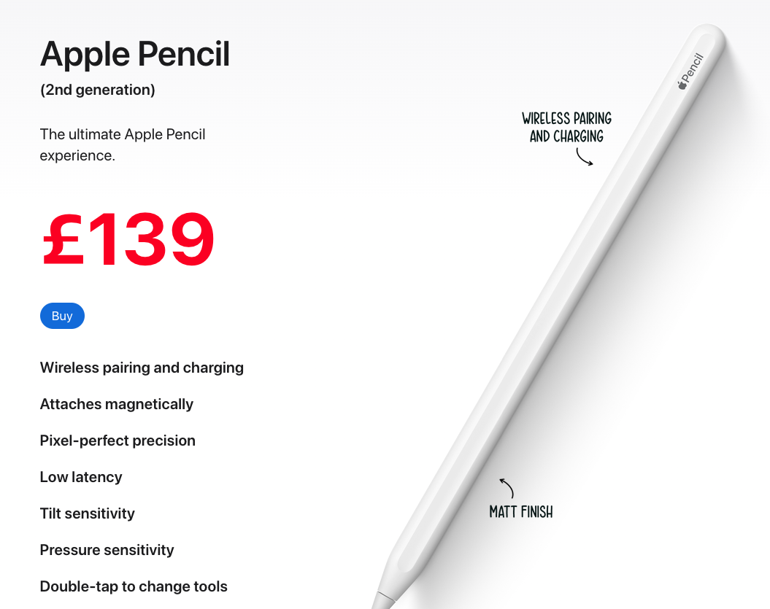
Digital STEM notetaking sucks.
Math input in Notion
…or iPad + Apple Pencil
Notes:
I think we can all agree that STEM notetaking kinda sucks.
Either you pay for expensive hardware to handwrite your notes, which you can’t copy-paste anywhere, or you hope that you can type those math expressions quickly enough
If only there was a way to automatically transcribe the lecture, while still keeping the mathematical notations and expressions intact... that way, you don't have to worry about figuring out the right LaTeX expressions and can focus on engaging with the material, rather than on typing or writing.

Slide 3
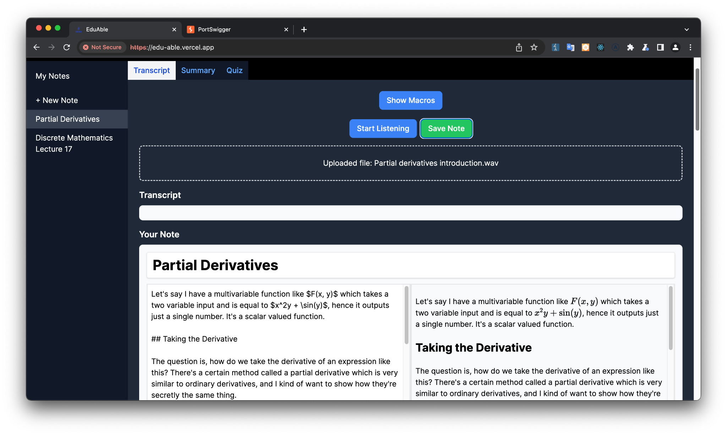
Enter EduAble
Accessible
Supports a diverse range of input methods, such as speech-to-text
STEM-based
Transcribes natural language to Markdown and LaTeX
Notes:
Enter EduAble. It performs real time transcription from voice to Markdown and LaTeX, allowing you to transcribe lectures in real-time, or simply to take notes without using your hands.
Summaries and quizzes generated from the transcribed notes.

Slide 4
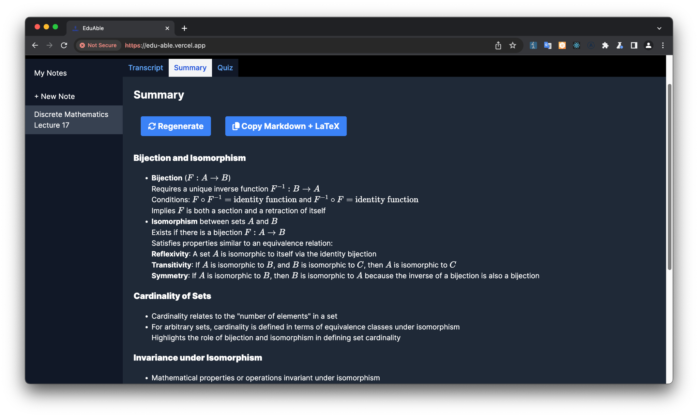
Enter EduAble
Personal
Generates effective lecture summaries and quizzes
Notes:
Enter EduAble. It performs real time transcription from voice to Markdown and LaTeX, allowing you to transcribe lectures in real-time, or simply to take notes without using your hands.
Summaries and quizzes generated from the transcribed notes.

Slide 5
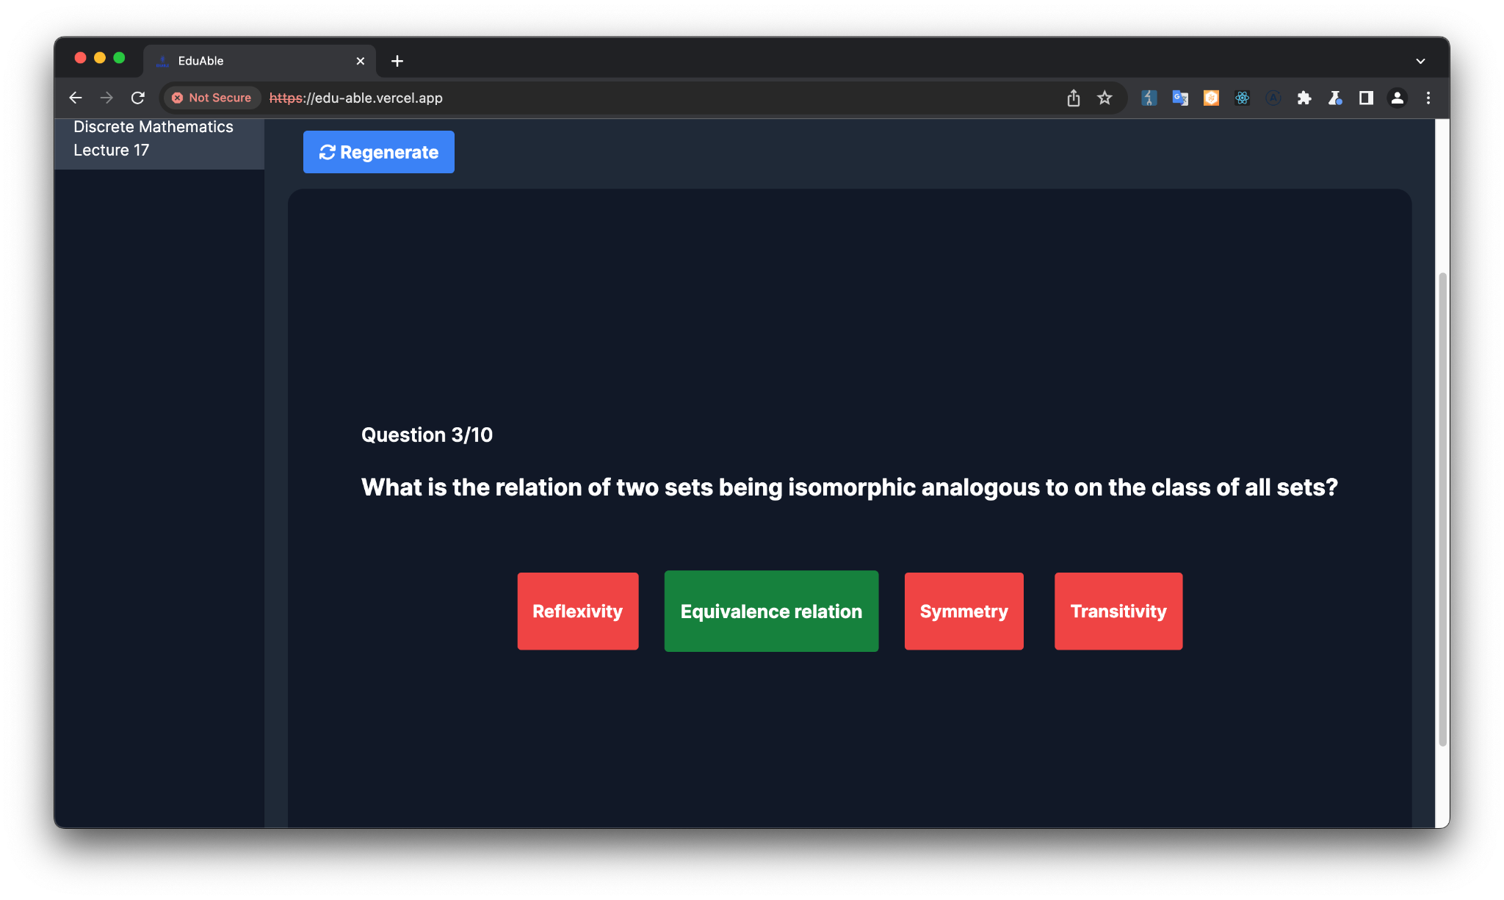
Enter EduAble
Personal
Generates effective lecture summaries and quizzes
Notes:
Enter EduAble. It performs real time transcription from voice to Markdown and LaTeX, allowing you to transcribe lectures in real-time, or simply to take notes without using your hands.
Summaries and quizzes generated from the transcribed notes.

Slide 6
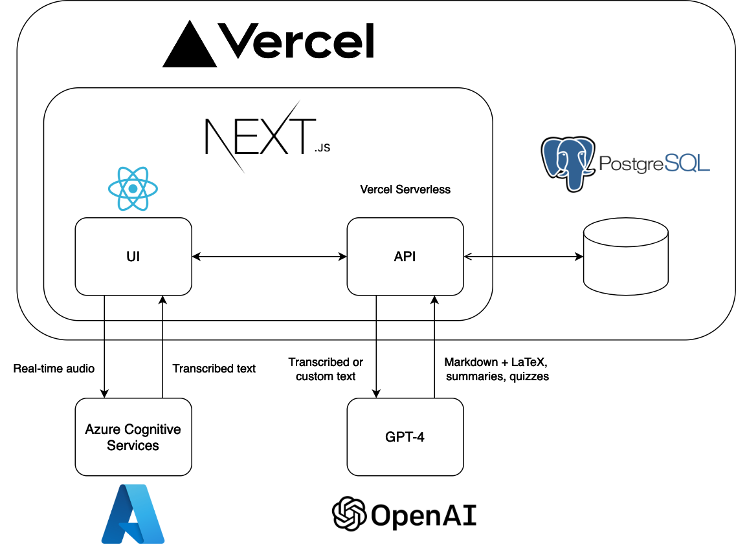
Notes:
App built on Next.js, deployed with Vercel
Use Azure Cognitive Services for speech to text translation
Use GPT-4 for Markdown and LaTeX conversion

Slide 7
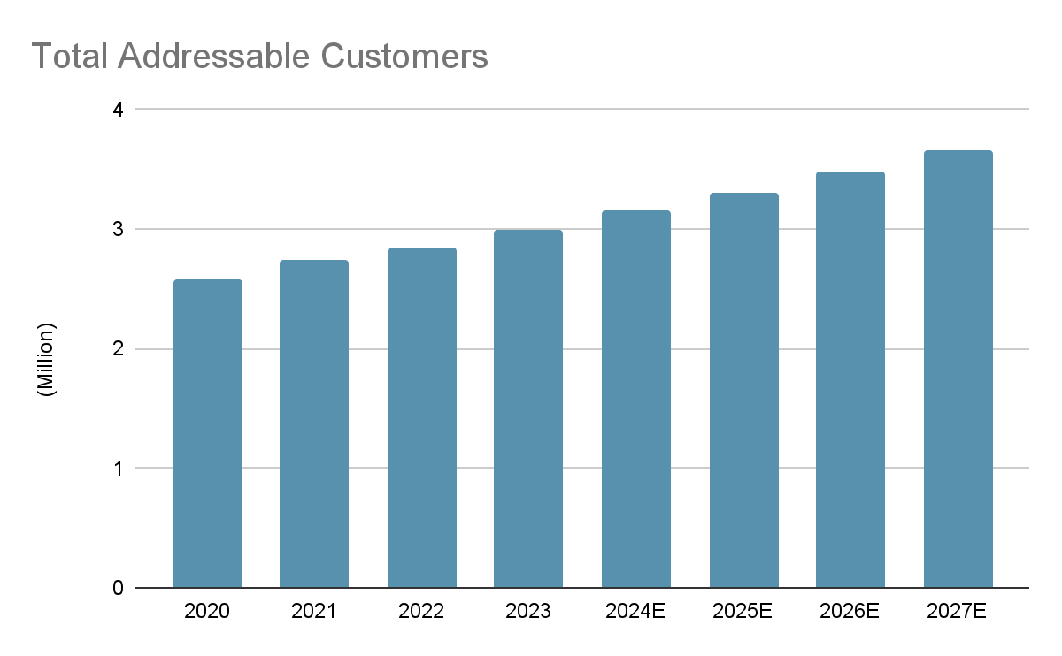
Market on the Rise
Market on the Rise
Pre-Uni Students
Higher Edu
Growth Trend: Past & Future
Total Population
9.13M
3.35M
Penetration
Rate
17.98%
44.90%
(disability)
(STEM)
5.11% CAGR
(hesa.uk, gov.uk)
1.64M
1.51M
3.15 M of Addressable Customers
£8 per Month, 20% Annual Discount
Increasing rate in disability
Growing proportion of STEM
£242 Million a Year (2024E)
Expected CAGR: 5.11%
(Total Addressable Market)

Slide 8
Thanks!
Do you have any questions?
https://edu-able.vercel.app
zz513-eduable@srcf.net

