Slide 1
Effect of HDB Resale Portal on Agents
Lim Kang Heng
Govtech Case Study - Section 1 (Question 1)

Slide 2
Bottom Line Up Front
Study Context
The HDB Resale Portal was launched in Jan 2018 to streamline resale flat transactions between buyers and sellers → How has the role of property agents changed since its’ inception?
Key Investigation: Effects on resale buyer-side and seller-side agents
Hypothesis: As the resale portal can simplify a buyer’s journey (e.g., flat search, eligibility checks), buyers may be more willing to transact without an agent. While sellers may continue to rely on agents for pricing, marketing and negotiation → Hypothesise relatively larger decline in buy-side transactions
Study Approach: Difference-in-Differences (DID)
Key Findings:
Causal Impact: DID estimates show that the HDB resale portal led to significant decline in buy-side agent activities, handling fewer cases on average after 2018.
Market Adaptation: While buy-side activity initially declined, the share of buy-side agent activities partially recovered after 2020, suggesting that agents adapted their roles and value propositions amid a strong resale market recovery.

Slide 3
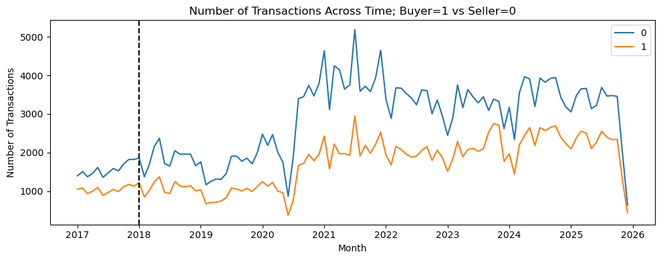
Impact of HDB Resale Portal on Buy Vs. Sell-side Transactions
1. Visualise Number of Buyer & Sell-side Transactions
Key Observations
Before Launch - both buy and sell-side activities have a stable gap, with sell-side activity being consistently higher.
After Launch - Gap between buy and sell-side activities generally widened, with sell-side activities increasing much more strongly.
2. Formulate an ordinary least squares (OLS) equation:
Control for Seasonalty & Time Trends
Signal for Buyer / Seller Transactions
$$Transaction Count \sim Post + Buyer + Post:Buyer + Month + Time +Intercept$$
Signal for before / after launch of HDB resale portal
Measures impact of the HDB resale portal on buyer-side agents

Slide 4
Impact of HDB Resale Portal on Buy Vs. Sell-side Transactions
3. Extract Weights*:
Term | Weights / Value | Interpretation
Intercept | 1,487 | Before portal launch, sell-side agents handled about 1,487 cases per month, on average
Buyer | - 514 | Before portal launch, buy-side agents handled about 514 fewer cases per month than sell-side agents (973 cases), on average
Post | 405 | After portal launch, sell-side agents handled about 405 more cases per month than before the launch, on average
Post:Buyer | - 642 | After portal launch, buy-side agents handled about 642 fewer cases per month than sell-side agents, on average
4. Key Findings from the DiD Study:
Overall agent-handled resale activity continued to grow post-2018.
There is reduced reliance on buy-side property agents, suggesting a structural shift toward self-directed transactions from buyers.
* Robust (HC1) standard errors are used. All key coefficients discussed are statistically significant at the 1% level unless otherwise stated.

Slide 5
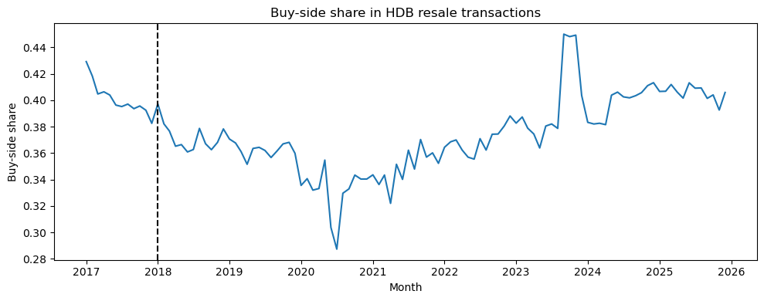

Changing Reliance on Buy-side Agents Over Time
$$Buy−side Share =\frac{Buy−side Transactions}{Buy + Sell−side Transactions}$$
Buy-side share increased after 2020
Key Findings:
Agents shifted toward seller representation initially.
Over time (after 2020), agents repositioned buyer services (i.e., market adaptation) amidst strong demand for HDB resale post-COVID (HDB resale article).

Slide 6
Study Limitations, Future Considerations & Conclusion
1. Income Impact
Agent activity could be linked to transaction values or commissions to examine income impacts.
2. Estate Transactions
Study heterogeneity across towns (maturity, distance from city center) to identify where the portal has the strongest effects.
3. External shocks post-2018
Other confouding shocks may affect transaction activities such as COVID-19 policies, interest rate adjustments and housing policy changes.
Concluding Remarks - This study illustrates how digital public services can improve consumer efficiency while reshaping — rather than displacing — professional service roles.

