Slide 1
COE Price Prediction & Elasticity Analysis
Lim Kang Heng
Govtech Case Study - Section 1 (Question 2)

Slide 2
Bottom Line Up Front
Study Context & Objective
Quarterly quota adjustments by LTA are a key policy lever, yet the price response of COE premiums to marginal quota changes is not well understood. This study evaluates:
Whether COE prices can be reliably forecasted (data source).
How sensitive prices are to quota changes for Categories A and B.
Study Approach: SARIMA Forecasting Model Exogenous Features (SARIMAX). The process includes:
Feature Engineering, Train-Test Split, Time-series Cross Validation & Grid Search for Hyperparameter Tuning
Key Findings:
COE prices exhibit strong persistence, with current prices closely tracking past auction outcomes.
The forecasting models perform well (4% MAPE), capturing medium-term price dynamics without overfitting short-term auction noise.
Small, marginal quota increases have limited short-run impact on prices, once demand pressure and price dynamics are accounted for.

Slide 3

Model Features
Motivation: To convert auction mechanics into economically meaningful signals that drive prices
1. Oversubscription Ratio - Captures competitiveness of each auction
$$Oversubscription Ratio = \frac{Bid Received}{Quota}$$
2. Quota - Policy lever under LTA’s control. Subsequently used for elasticity interpretation
3. Lagged Prices - Captures expectations and inertia between bidding exercises
4. Month of Year - Captures cyclical patterns (Apply sin/cos encoding - Dec & Jan treated as adjacent periods)
Apply log-transformations where applicable to stabilize variance and reduce effect of extreme values

Slide 4
Hyperparameter Tuning
Monthly Seasonality
Model: $SARIMAX(p,d,q, P, D, Q, 12)$
Tuning Method:
Train-test Separation - Train set (2010 - 2021), test set (2022 - 2025)
Time-series Cross Validation within train set
Grid Search Process* - Selects parameters with the lowest cross-validated average RMSE
Model Efficacy:
Performance Measure - Performance evaluated on the held-out test set (gives realistic estimate of future performance)
Separate tuning for Cat A and Cat B - Reflects different buyer profiles & demand sensitivities
* Parameters tuned: p, q $∈$ {0, 1, 2}, P, D, Q, d $∈$ {0, 1}.

Slide 5
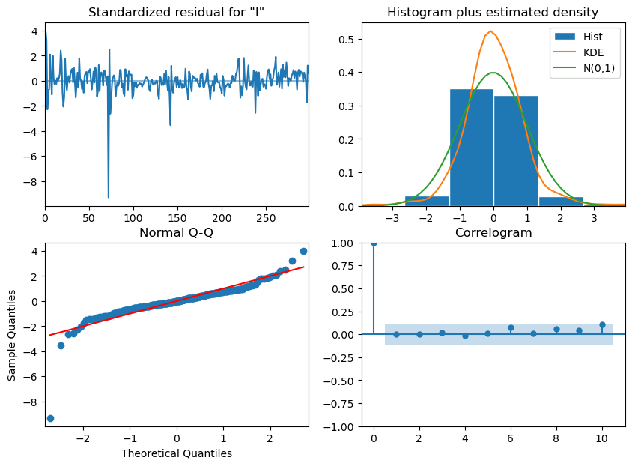
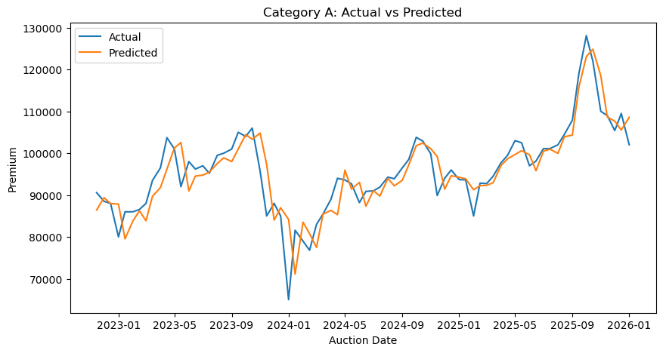
Category A Pricing Forecast Model & Performance
No Seasonal Factors
Optimised Model: $SARIMAX(1, 0, 1, 0, 0, 0, 12)$
Model Diagnostic Check: Model Well-specified & Adequate for Forecasting
1
2
Model Predictions Performance:
1: Random Fluctuations;
No Obvious Trending / Persistence
2 & 3: Errors Approximately Normal
3
4
4: No Significant Autocorrelations
RMSE: 4,806 SGD
MAE: 3,397 SGD
MAPE: 4 % (predictions within 4% of actual prices)

Slide 6
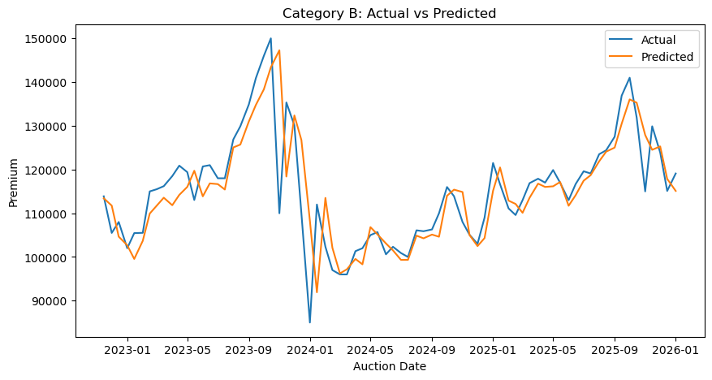
Category B Pricing Forecast Model & Performance
No Seasonal Factors
Optimised Model: $SARIMAX(1, 0, 2, 0, 0, 0, 12)$
Model Diagnostic Check: Model Well-specified & Adequate for Forecasting (Same Conclusion as Cat A Model)
1
2
Model Predictions Performance:
1: Random Fluctuations;
No Obvious Trending / Persistence
2 & 3: Errors Approximately Normal
3
4
4: No Significant Autocorrelations
RMSE: 7,388 SGD
MAE: 4,606 SGD
MAPE: 4 % (predictions within 4% of actual prices)

Slide 7
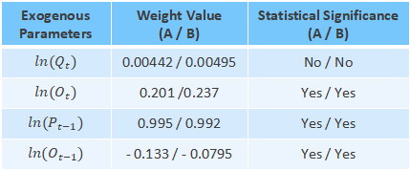
Price Elasticity of COE Quotas
Quota
Oversubscription Rate
COE Price
General Model Equation: $ln(P_{t})=β_{q}ln(Q_{t})+β_{o}ln(O_{t})+...+ARMA terms+ε_{t}$
Exogenous Parameters | Weight Value (A / B) | Statistical Significance (A / B)
$$ln(Q_{t})$$ | 0.00442 / 0.00495 | No / No
$$ln(O_{t})$$ | 0.201 /0.237 | Yes / Yes
$$ln(P_{t−1})$$ | 0.995 / 0.992 | Yes / Yes
$$ln(O_{t−1})$$ | - 0.133 / - 0.0795 | Yes / Yes
Interpretation: The short-run sensitivity of COE prices to marginal quota changes is very small (approx. zero).
Interpretation: COE prices exhibit strong persistence from previous auction outcomes.
Price Elasticity of COE Quotas:
A 1% increase in quota is associated with about only 0.004% increase in premiums (for both Cat A and Cat B)
In other words, with 1,100 existing quotas for Cat A, adding 200 quotas (18%) would raise premiums by 0.07%, from 18,500 SGD to 18,513 SGD (i.e., tens of dollars increase)

Slide 8
Study Limitations, Future Considerations & Conclusion
1. Forecast Accuracy-optimised Model
The SARIMAX specification prioritises predictive accuracy, resulting in strong price persistence that limits the precision of short-run quota elasticity estimates.
2. Model-implied Elasticity
Estimated quota sensitivity reflects historical correlations captured by the model and should be interpreted as policy sensitivity rather than a causal effect.
3. External Policy & Market Shocks
Shifts in market sentiment or policy expectations can cause price spikes that are difficult to predict using historical data alone.
Concluding Remarks - COE prices are primarily driven by expectations and price persistence, with marginal quota adjustments having limited short-run effects.

