Slide 1
Preschools Resource Planning
Lim Kang Heng
Govtech Case Study - Section 2 (Scenario 1)

Slide 2
Bottom Line Up Front
Key Challenge:
Preschool demand and supply are unevenly distributed across subzones, leading to some preschools being oversubscribed and families have to face long waiting time.
Key Approach:
Forecast demand from existing residents (population trends) and new households (BTO completions), and match demand against current preschool supply.
Key Findings:
Prioritse Expansion: Tampines North / West, Punggol–Seletar, Bukit Batok West
Consider Reallocation: Bedok / Marine Parade, Tampines East

Slide 3

Mismatch of Demand and Supply for Preschools at Various Subzones
20%
of Singapore’s preschool capacity was unfilled.
However, familes in high-growth towns (e.g., Punggol) face long waiting times for enrolment → Highlighting that pre-school shortage is a distribution problem, not a capacity problem.
This spatial mismatch motivates the need for a data-driven assessment to advise on the redistribution of preschool supply to better align capacity with local demand.

Slide 4

Forecasting of Preschool Demand from Existing Families
Data: 2000 - 2025 Singapore Residents Population, Segregated by Planning Area (PA), Subzone (SZ) and Age (1 - 6 Years Old) (Singstat)
Forecasting Method: Rolling Compound Annual Growth Rate (CAGR)
$$CAGR = {(\frac{End}{Start})}^{1/k} − 1$$
Example (Ang Mo Kio Town Centre SZ)
Year | Actual Population* | CAGR (k = 2) [%]
2021 | 230 | N.A.
2022 | 250
2023 | 210 | - 4
2024 | 180 | - 15
2025 | 150 | -15
Predicted Population | Error
N.A.
201 | 21
153 | 3
* Number of children aged between 1 - 6 years old
Interpretation: Between 2023 & 2021, the population has dropped by 4% each year
CAGR window (k) is selected via backtesting, and the optimal value is assessed to be 5 years for a 5-year prediction horizon. The average forecast error is 110 children.

Slide 5
Forecasting of Preschool Demand from New Families (BTOs)
Data: 2026 - 2030 BTO Completion Data (Github)
Example (Yishun PA, Lower Seletar SZ)
Year | Number of Units Completed | Cumulated # Units Completed | Estimated Demand
2026 | 0 | 0 | 0
2027 | 0 | 0 | 0
2028 | 699 | 699 | 550
2029 | 2295 | 2994 | 2352
2030 | 0 | 2994 | 2353
Key Assumptions:
Total Fertility Rate = 0.97 (Singstat) → Approx. one 0 - 6 year-old children per household
Take-up Rate for Pre-school = 0.90 (estimate)
New Families Factor = 0.90 (estimate) (not all BTO occupants are new families)
Preschool demand from BTO households is cumulative over the 5-year analysis window, as children remain within the preschool-age cohort (< 6 years) throughout this period
$×$ 0.97 $×$ 0.9 $×$ 0.9

Slide 6
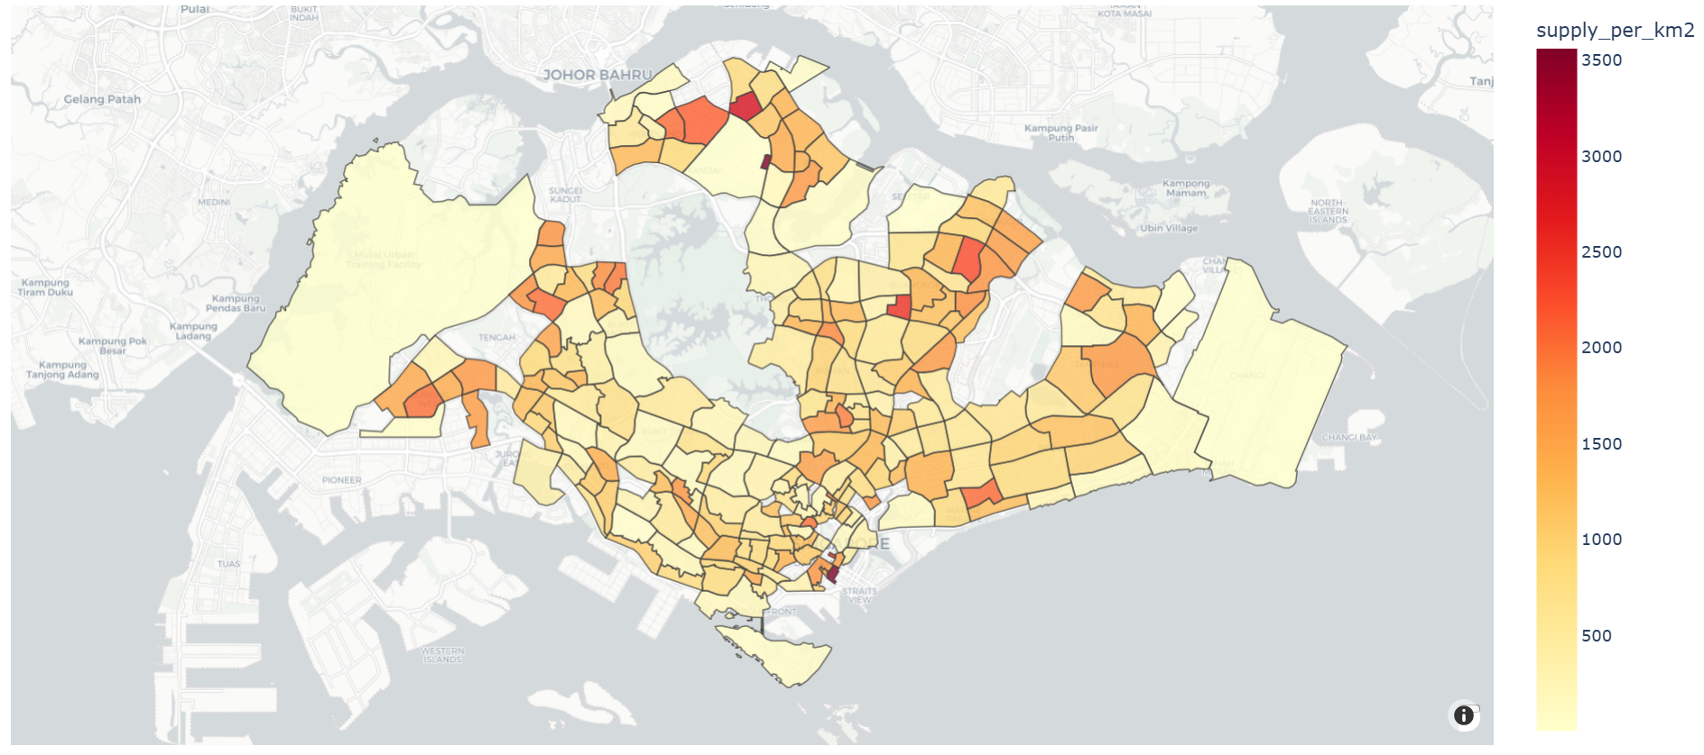


Preschool Capacity Supply
Data: 2024 Preschool Locations (data.gov.sg) and Subzone Boundaries (data.gov.sg)
Post-processed Data: Number of preschools & supply* within each SZ
Preschool Supply Density by SZ
Mandai Estate (Dense)
Num Preschools: 5
Area: 0.143 ${km}^{2}$
Supply Density: 3500 children/${km}^{2}$
Sentosa (Sparse)
Num Preschools: 4
Area: 4.91 ${km}^{2}$
Supply Density: 81 children/${km}^{2}$
* This study asssumes that each preschool provides 100 supply / capacity

Slide 7
Expected 2026 - 2030 (5-year) Demand vs. Existing Supply
Assess Preschool Supply Surplus / Shorfall for each SZ. Example (Ang Mo Kio Town Centre SZ)
Year | Demand (From Existing Families) | Demand (From New Familes) | Total Demand | Existing Supply | Supply Surplus
2026 | 125 | 0 | 125 | 400 | 275
2027 | 113 | 0 | 113 | 400 | 287
2028 | 99 | 704 | 803 | 400 | -402
2029 | 87 | 704 | 791 | 400 | -391
2030 | 77 | 704 | 781 | 400 | -381
* Number of children aged between 1 - 6 years old
Subsequently, extract Top-3 Over/Under-subscribed SZ:
Over-subscribed SZ
Under-subscribed SZ
PA / SZ | Avg. Supply Shortfall
Tampines / Tampines North | 8,900
Bukit Batok / Brickworks | 3,900
Punggol / Northshore | 3,700
PA / SZ | Avg. Supply Surplus
Tampines / Tampines East | 2,200
Bedok / Frankel | 2,000
Marine Parade / Katong | 1,800
Non-mature** Estates
Mature** Estates
** In this analysis, estate maturity is referenced from the relative median age between SZ as of 2025. SZ below the 33rd percentile of median age are treated as non-mature, otherwise mature
Notes:
33 - 38, 44 y old

Slide 8
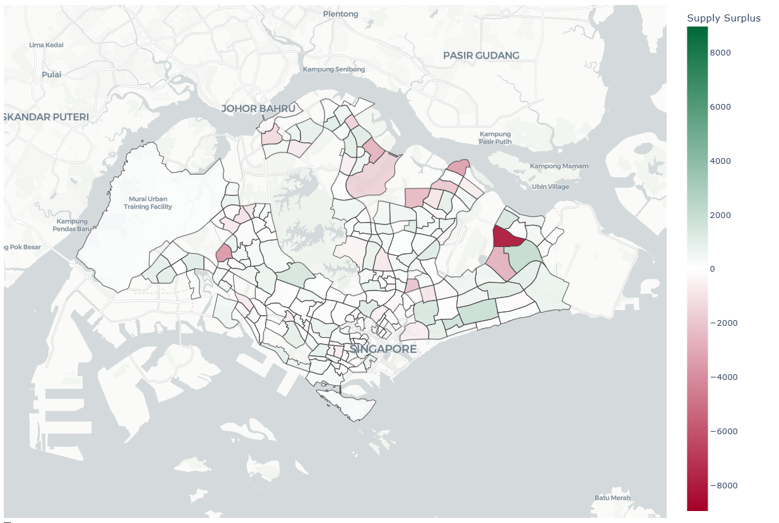
Prioritization of Building Preschools (2026 - 2030)
Punggol / Sengkang / Seletar
Reallocation
Bukit Batok West
Tampines North / West
Prioritization
Notes:
33 - 38, 44 y old

Slide 9
Reallocation of Existing Preschools (2026 - 2030)
Reallocation
Bedok /
Marine Parade
Prioritization
Notes:
33 - 38, 44 y old

Slide 10



Software Development Architecture
Data Layer
Decision-Support Frontend
Population Statistics (DOS)
BTO Project Information (HDB)
Preschool Location & Capacity (ECDA)
Subzone Boundaries (URA)
Model Parameters & CONFIG
Subzone Heatmaps
Time Slider (Forecast Horizon)
Summary Data Tables & Rankings
Analytics & Processing Backend
Data Preprocessing
Demand Forecasting
BTO-driven Demand Estimation
Model Evaluation & Recalibration - Triggered upon updates in population statistics or BTO pipelines
Notes:
33 - 38, 44 y old

Slide 11
Study Limitations & Future Considerations
1. Spatial Accessibility within Subzones
Preschools may be unevenly distributed within a subzone, resulting in longer travel distances for some households.
2. Non-spatial Enrolment Considerations
Religious affiliation, pedagogical preferences, and affordability may limit effective access to nearby preschools.
3. Cross-subzone Enrolment Behaviour
Families may enrol children in preschools outside their residential subzone.
4. Simplified BTO move-in Assumptions
Household occupancy and child enrolment may occur gradually rather than immediately upon project completion.
Overall, this study demonstrates how integrating demographic trends, housing pipelines, and spatial data can support more targeted and efficient preschool infrastructure planning.

