Slide 1
Category review: Chips
February 2023
Retail Analytics
Brand note: If client logo is not required, use alternate title page layout right click slide thumbnail > Layout > Title

Slide 2
Notes:
To view Privacy video explaining how important data privacy is to Quantium, please click here: https://www.youtube.com/watch?v=Zq1QDAkoRzU
or here Q:\Company Reference\Brand & Design\Brand videos\Q Privacy.mp4
At Quantium, we believe that data is the behavioural footprint of humanity and that it has to be treated with the utmost care and responsibility.
Histories, attitudes, indeed lives are stored within it in ways that aren’t always apparent – and that’s what makes its potential so powerful.
To work with it responsibly, sensitively, we set ourselves the highest data privacy protection and governance standards.
We have spent 17 years perfecting privacy-by-design and secure-by-design principles. Central to this is not holding any personally identifiable information about people –
we neither receive it, and put the necessary protections in place to be unable to decipher it.
Every aspect of handling data is safeguarded: from its de-identification, to its encryption – data security is paramount and of the highest grade.
We pride ourselves on gaining the trust of iconic organisations around the world through years of securely working with their data,
and in turn the trust that builds with their stakeholders.

Slide 3
Executive summary
01
Task 1
The most popular brands are Kettle, Smiths, Doritos and Pringles and the most popular sizes are 175g, 150g and 134g.
Mainstream customers spend the most, followed by Budget and Premium customers.
Older customers spend more than younger customers and Families purchase more than other customer life stages.
Sales are primarily driven by population sizes of each customer segment.
02
Task 2
Trial stores 77 and 88 had a positive significant difference compared to their respective control stores for two of the three months in the trial period.
Trial store 86 did not replicate the performance seen in trial stores 77 and 88.
Overall, the trials performed were successful and were positively significant due to increased total sales and total customers.

Slide 4
01
Category

Slide 5

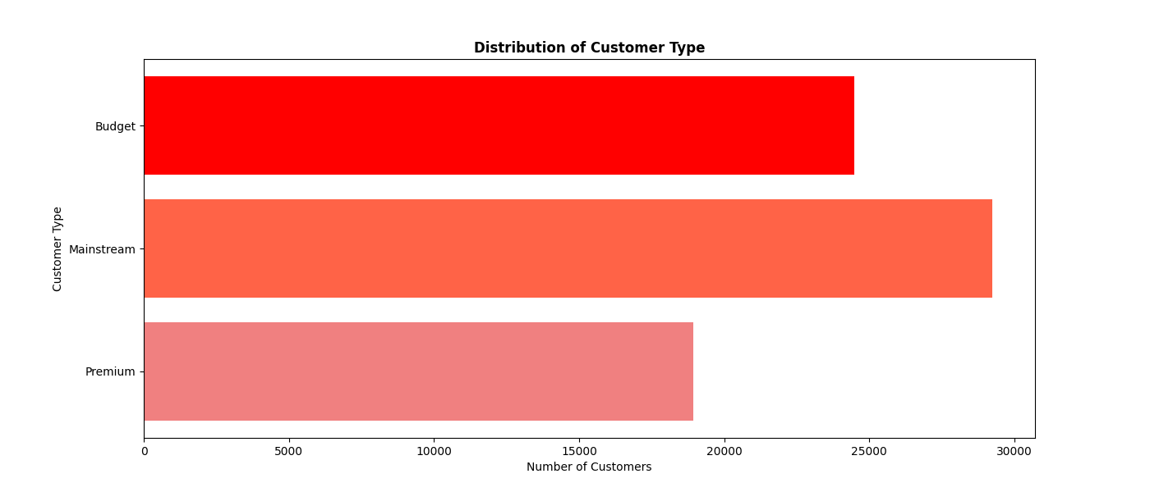
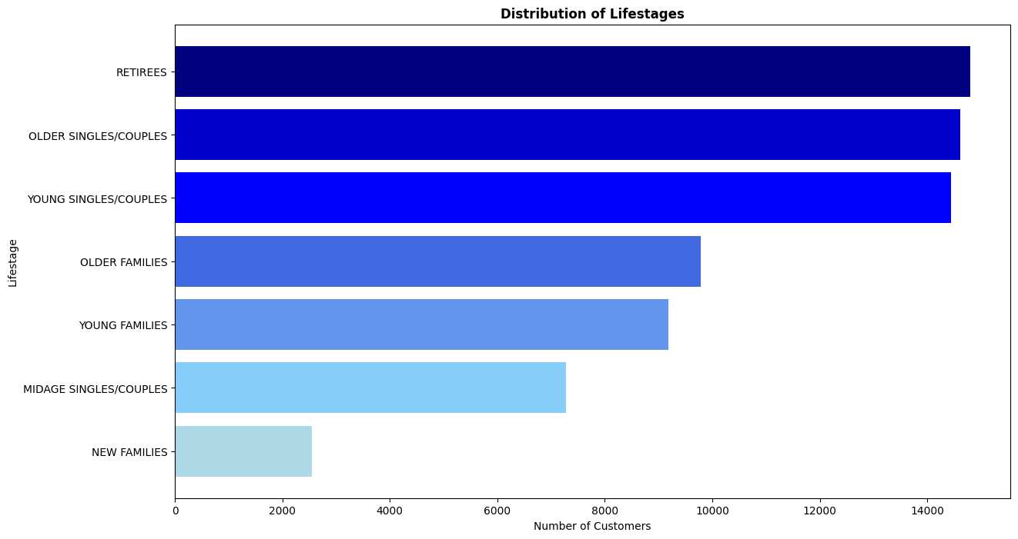
Overview: Distribution of the Customer Base
Retirees, Older Singles/Couples and Young Singles/Couples make up the majority of the customer base.
Mainstream customers make up the majority of the customer base, followed by Budget and Premium customers.

Slide 6
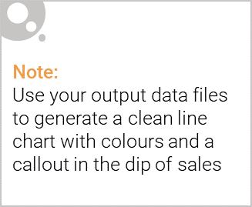
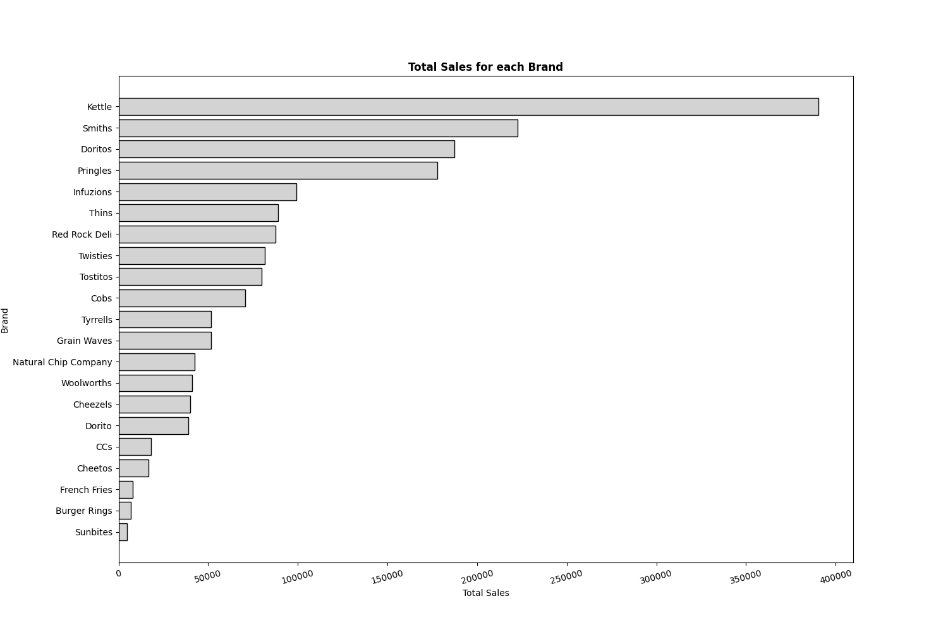
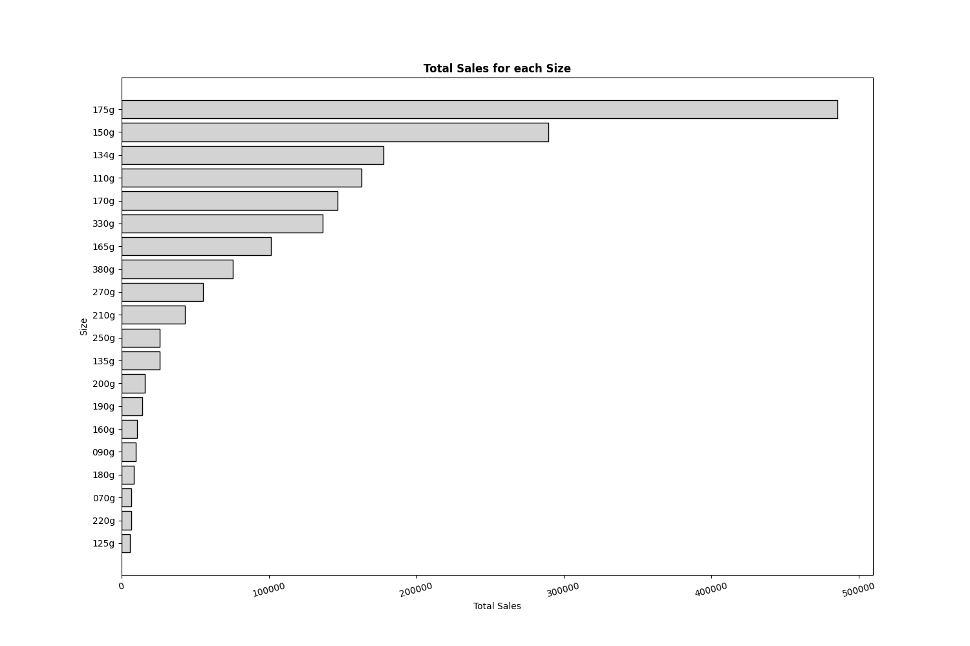
Overview: Total Sales for Each Chip Brand & Size
The top selling Brands are Kettle, Smiths and Doritos.
The top selling Sizes are 175g, 150g and 134g.

Slide 7
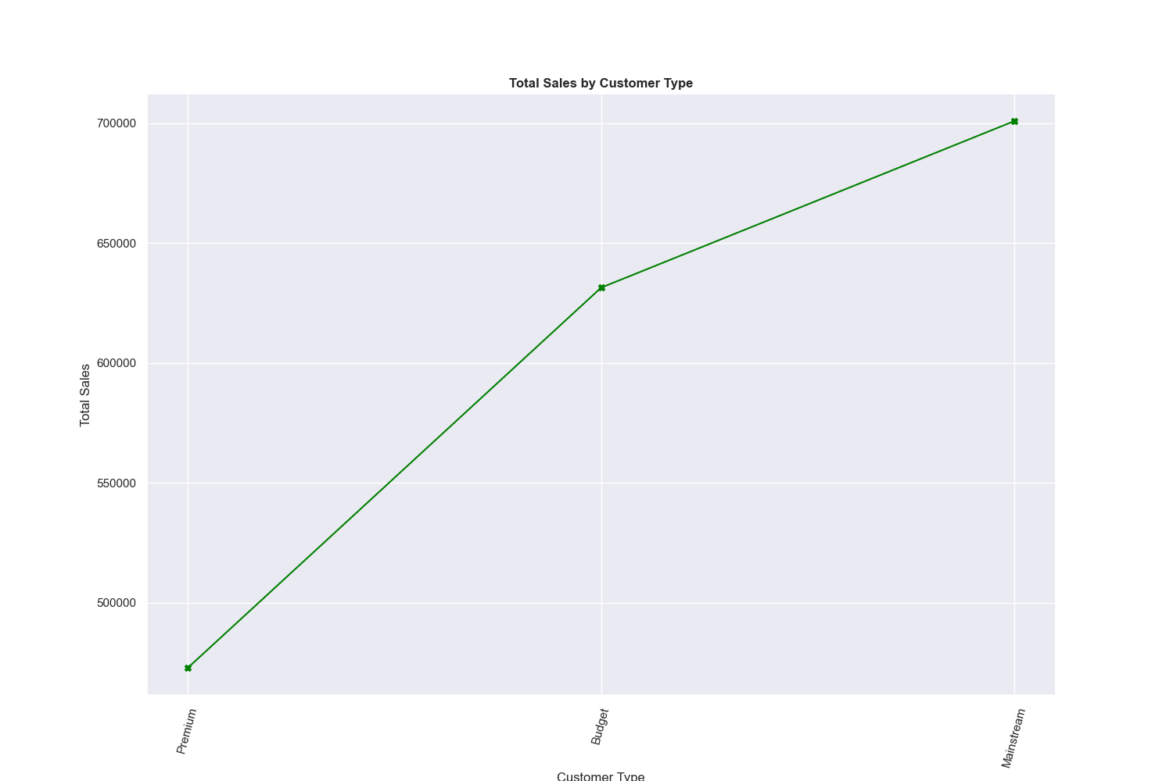
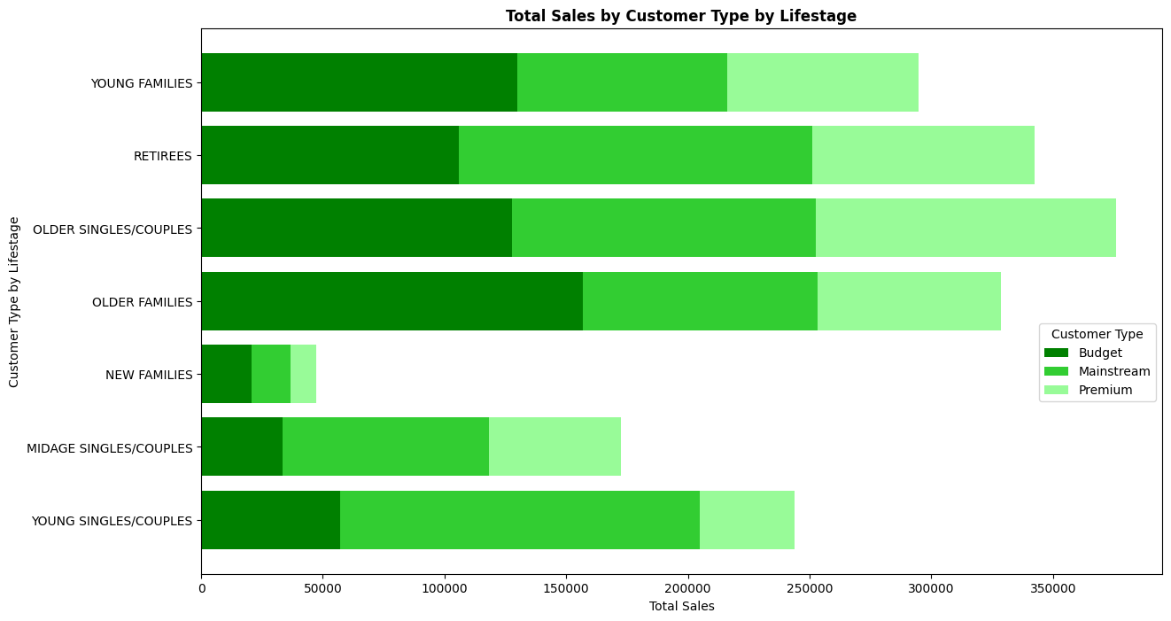
Overview: Total Sales by Customer Type by Lifestage
Older customers spend more than younger customers and
Mainstream customers make up the most sales.

Slide 8
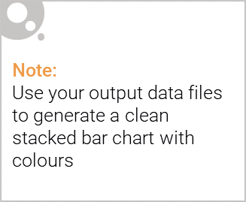
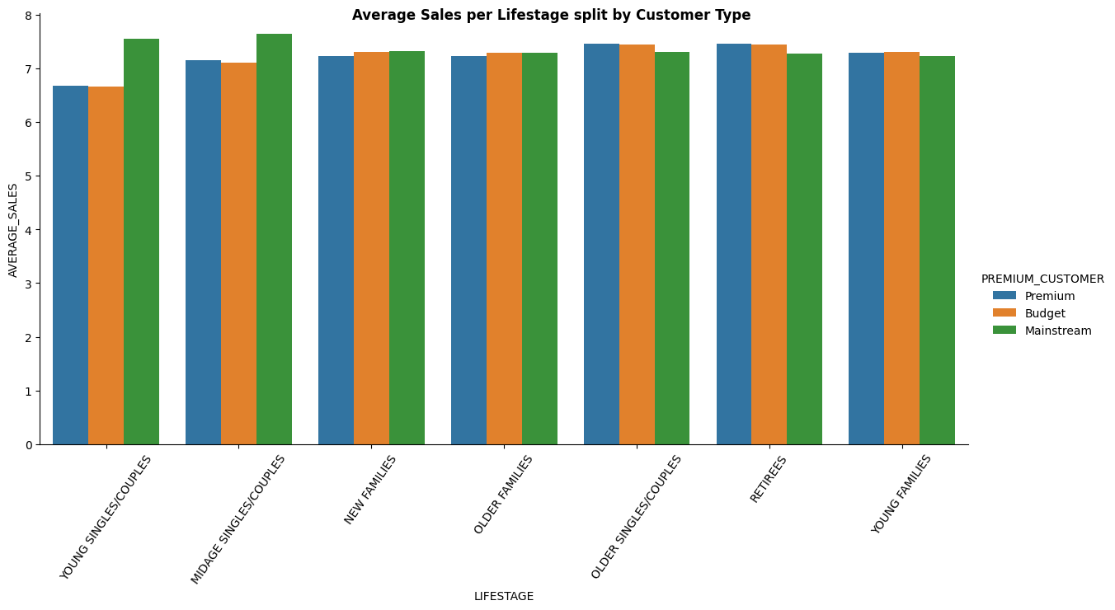
Editable (delete this)
Overview: Average Sales per Lifestage per Customer Type
Mainstream Young Singles/Couples and Midage Singles/Couples spend more per purchase than Budget and Premium Young Singles/Couples and Midage Singles/Couples.

Slide 9
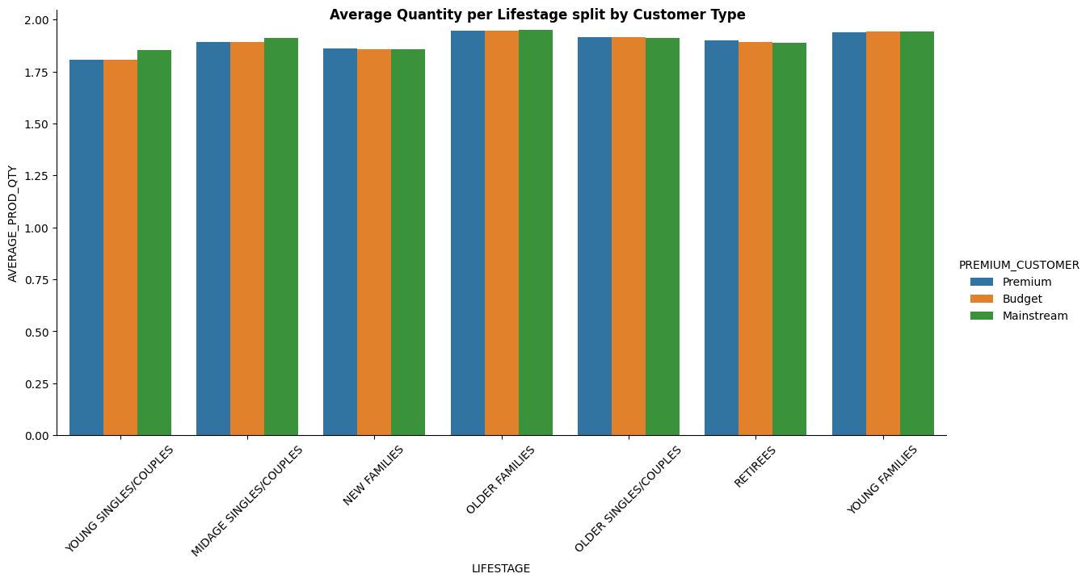
Overview: Average Quantity Bought per Lifestage per Customer Type
Young Families and Older Families (Families) purchase more packets of chips on average compared to the other customer segments

Slide 10
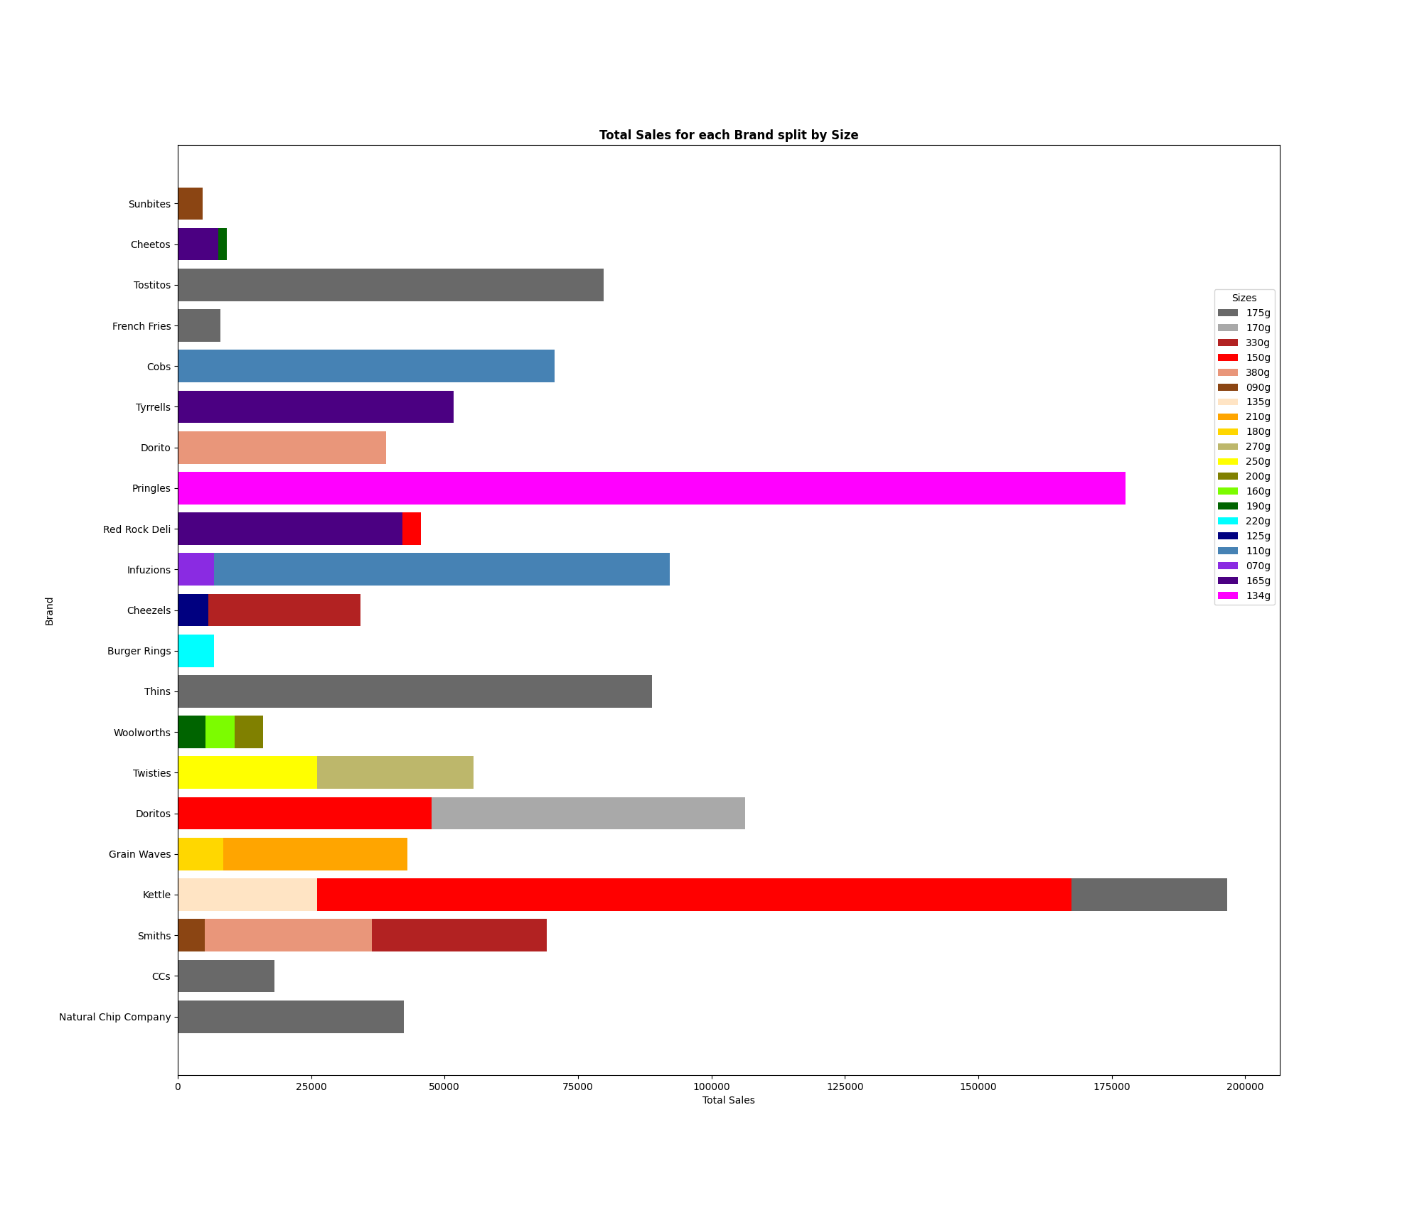
Overview: Total Sales per Brand per Size
Brands with less available sizes sell more, e.g. Pringles has the 2nd highest sales with only one size available (134g).

Slide 11
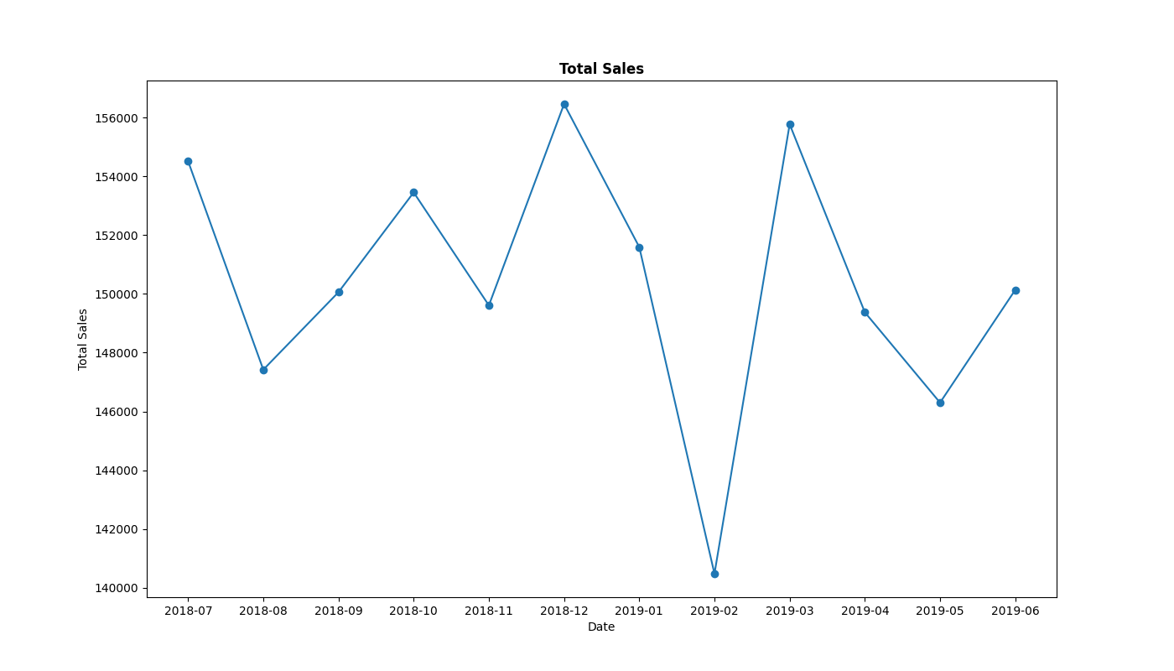
Overview: Total Sales
Consistent data seen for the entire period, but a significant drop after the holiday season.

Slide 12
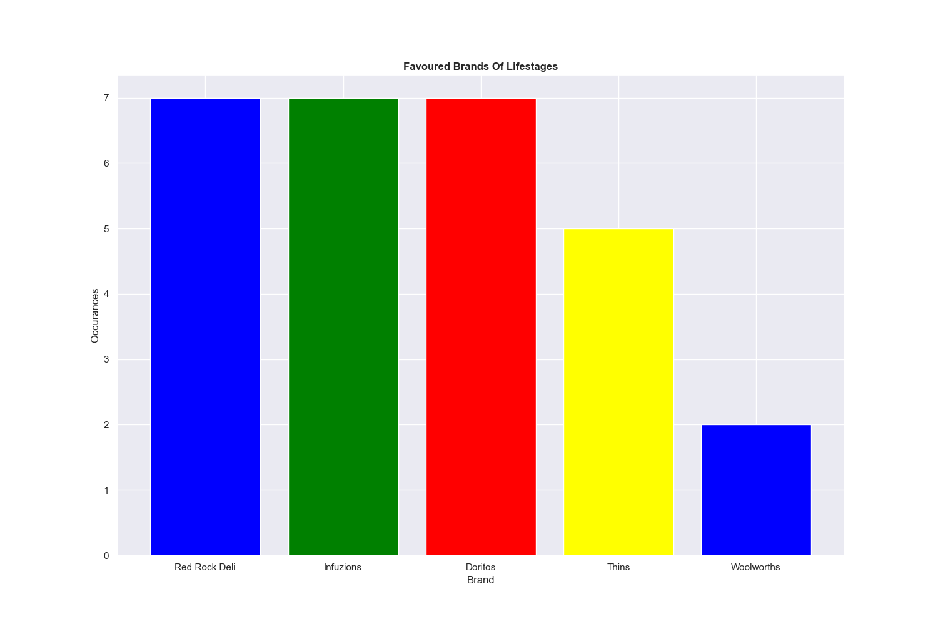
Overview: Favoured Brands (Does not include Kettle, Pringles, Smiths)
Excluding the popular brands (Kettle, Pringles, Smiths), Red Rock Deli chips are the most popular, followed by Infuzions, Doritos, Thins and Woolworths.

Slide 13
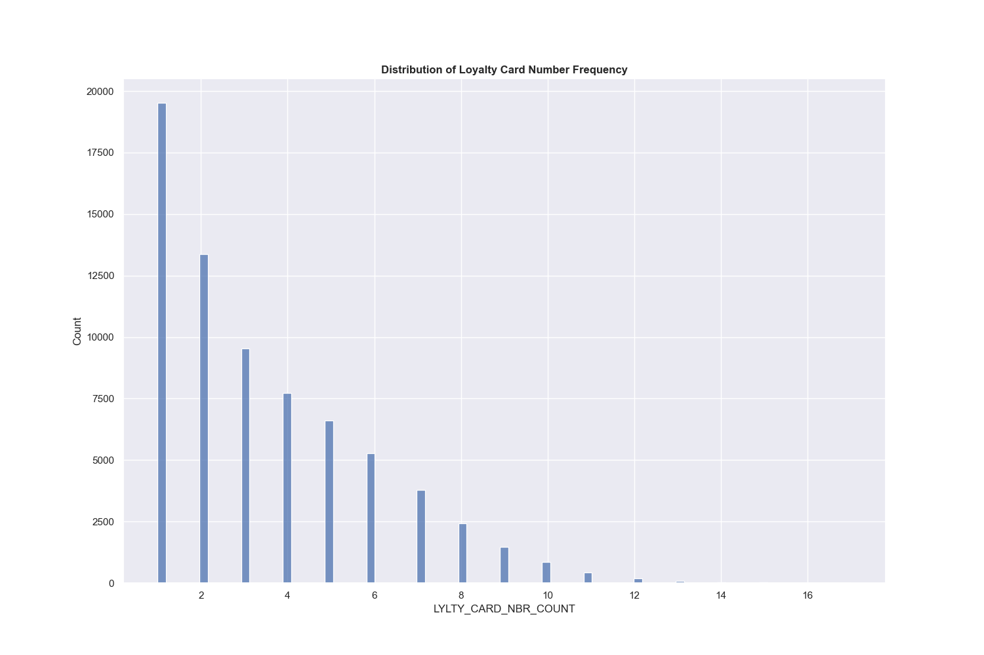
Overview: Distribution of Loyalty Card Number Transactions
Customers who have only purchased once over the entire date range are the most common in the data.

Slide 14
Effects on consumer buying for the category of chips
The most popular brands by sales and quantity sold are Kettle, Smiths, Doritos and Pringles. These brands have the highest figures by a significant amount.
175g, 150g and 134g packet sizes are the most popular sizes purchased, with 175g packets being the most popular by a large margin.
Older Singles/Couples have the highest sales, followed by Retirees, Older Families, Young Families, Young Singles/Couples, Midage Singles/Couples and New Families.
Brands that offer 1 - 2 packet sizes sell more.
Mainstream customers have the highest sales followed by Budget and then Premium customers.
The average sales and quantity purchased amount by life stage split by customer type is similar for all life stages.
Customer segments with the lowest sales reflect upon their low population sizes. Hence, sales and quantity bought is proportional to population.
Customers who purchase less than 6 times over the entire timeframe for the data make up a significant proportion of the transactions.
Red Rock Deli, Infuzions and Doritos are the second most preferred and bought chips, followed by Thins and Woolworths chips (excluding Smiths, Pringles and Kettle).

Slide 15
Recommendations
1 | Run advertisements and promotions that cater towards the Mainstream group of customers in order to retain and advance sales.
2 | Market regularly towards Families and Older customers.
3 | Introduce loyalty programs/spend-for-rewards initiatives to encourage consistent spending.
4 | Promotions should be more catered for Mainstream and Budget customers.
5 | Try new initiatives to increase figures for the Premium customers.
6 | Research unique selling points and promotions to cater towards products like Pringles and Doritos. These products are popular among Families and Young customers and should be marketed with products and concepts known to these demographics.
7 | Ensure 175g packet sizes and Kettle chips are always exposed to customers but put more effort in other brands like Thins and Woolworths to increase total sales.
8 | Offer many promotions during the month after holiday events in order to avoid big drops in sales after traditional heavy spending periods.

Slide 16
02
Trial store performance

Slide 17
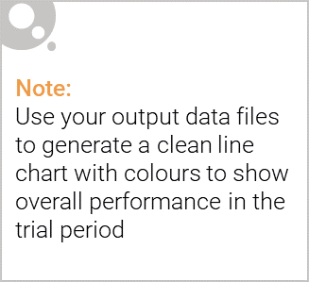
Explanation of the control store vs other stores
The Trial stores are 77, 86 and 88.
The trial period was from February 2019 to April 2019.
The Control stores were chosen based on the following metrics:
Total Sales
Total Number of Customers
Average Number of Transactions per Customer
Correlation Score based on store performance
Magnitude Difference based on store performance
Trial Store | Control Store
77 | 233
86 | 155
88 | 237

Slide 18
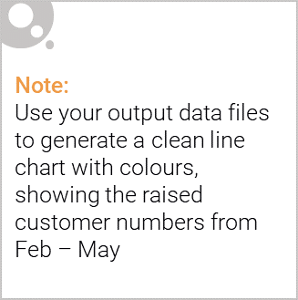
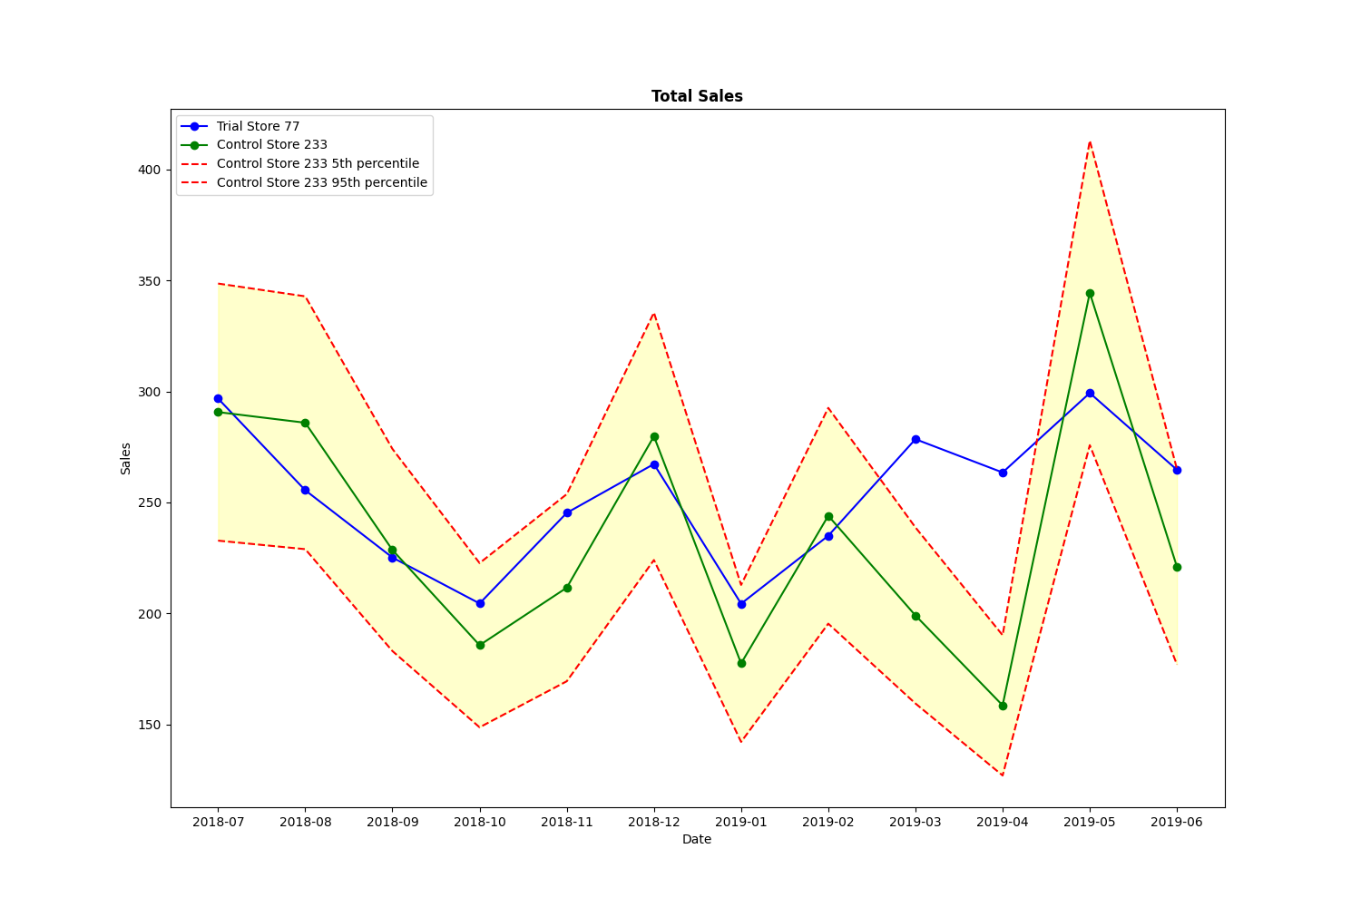
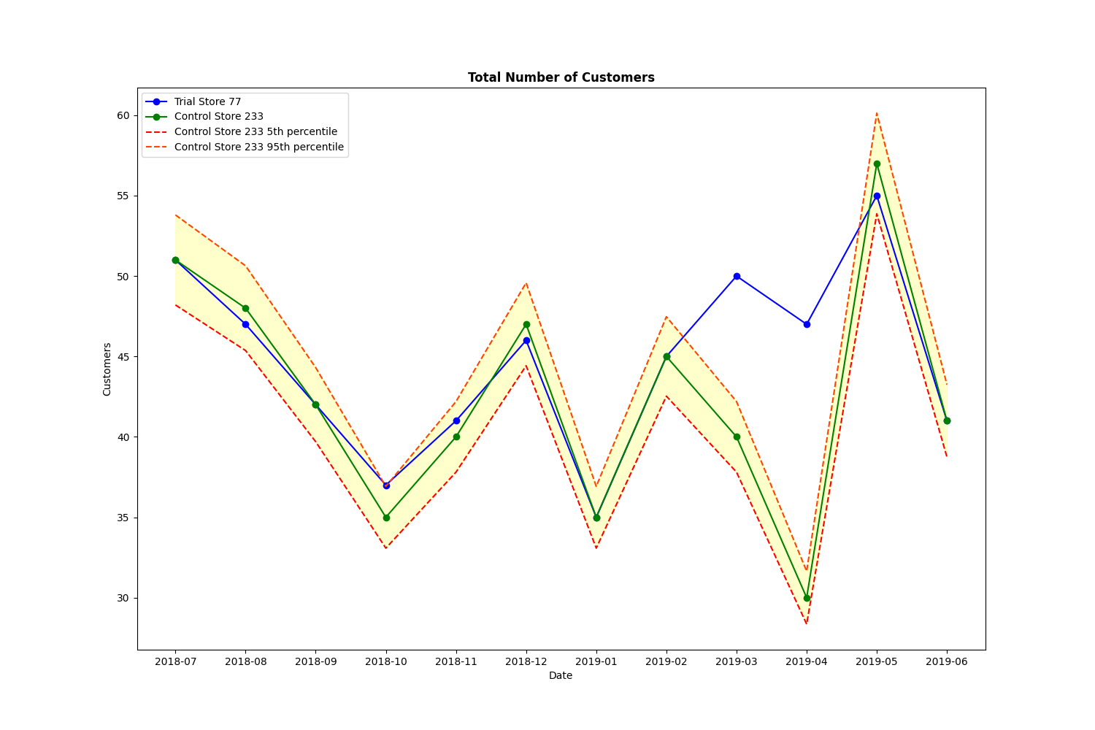
Performance – Store 77
Store 77 (Trial) is significantly different than Store 233 (Control). It performed better in 2 of the 3 months of the trial period.

Slide 19
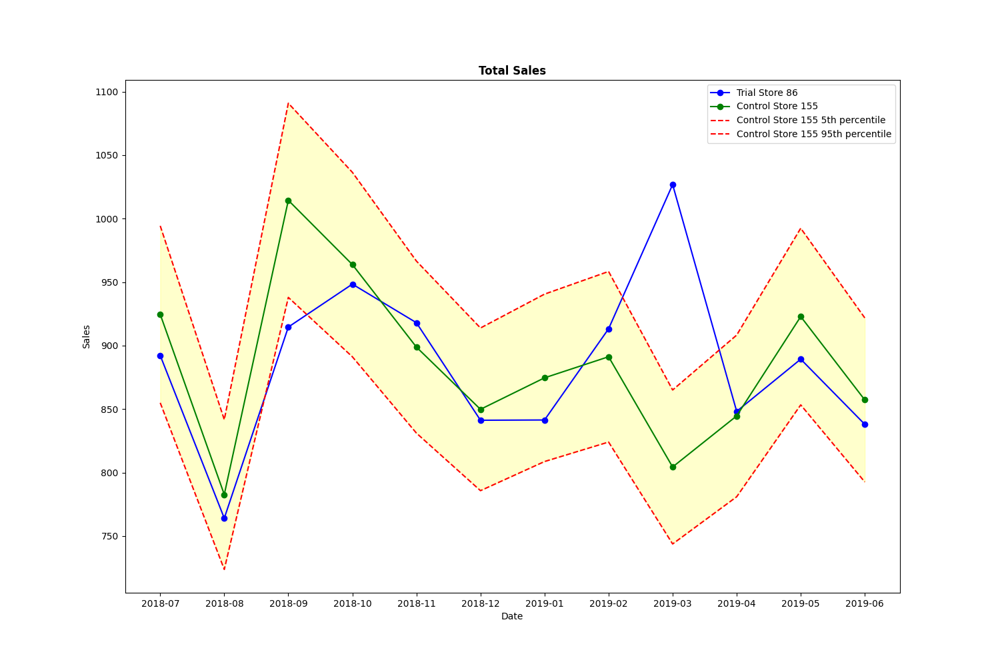
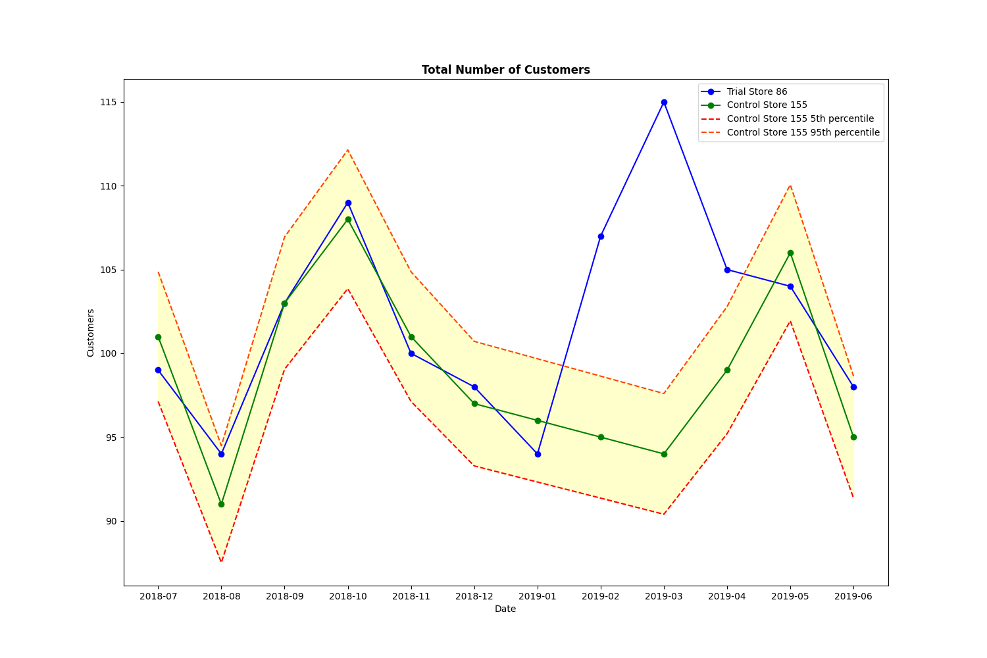
Performance – Store 86
Store 86 (Trial) is fairly significantly different than Store 155 (Control). It only performed better in 1 of the 3 months of the trial period for sales but performed better in all months of the trial for customer count.

Slide 20
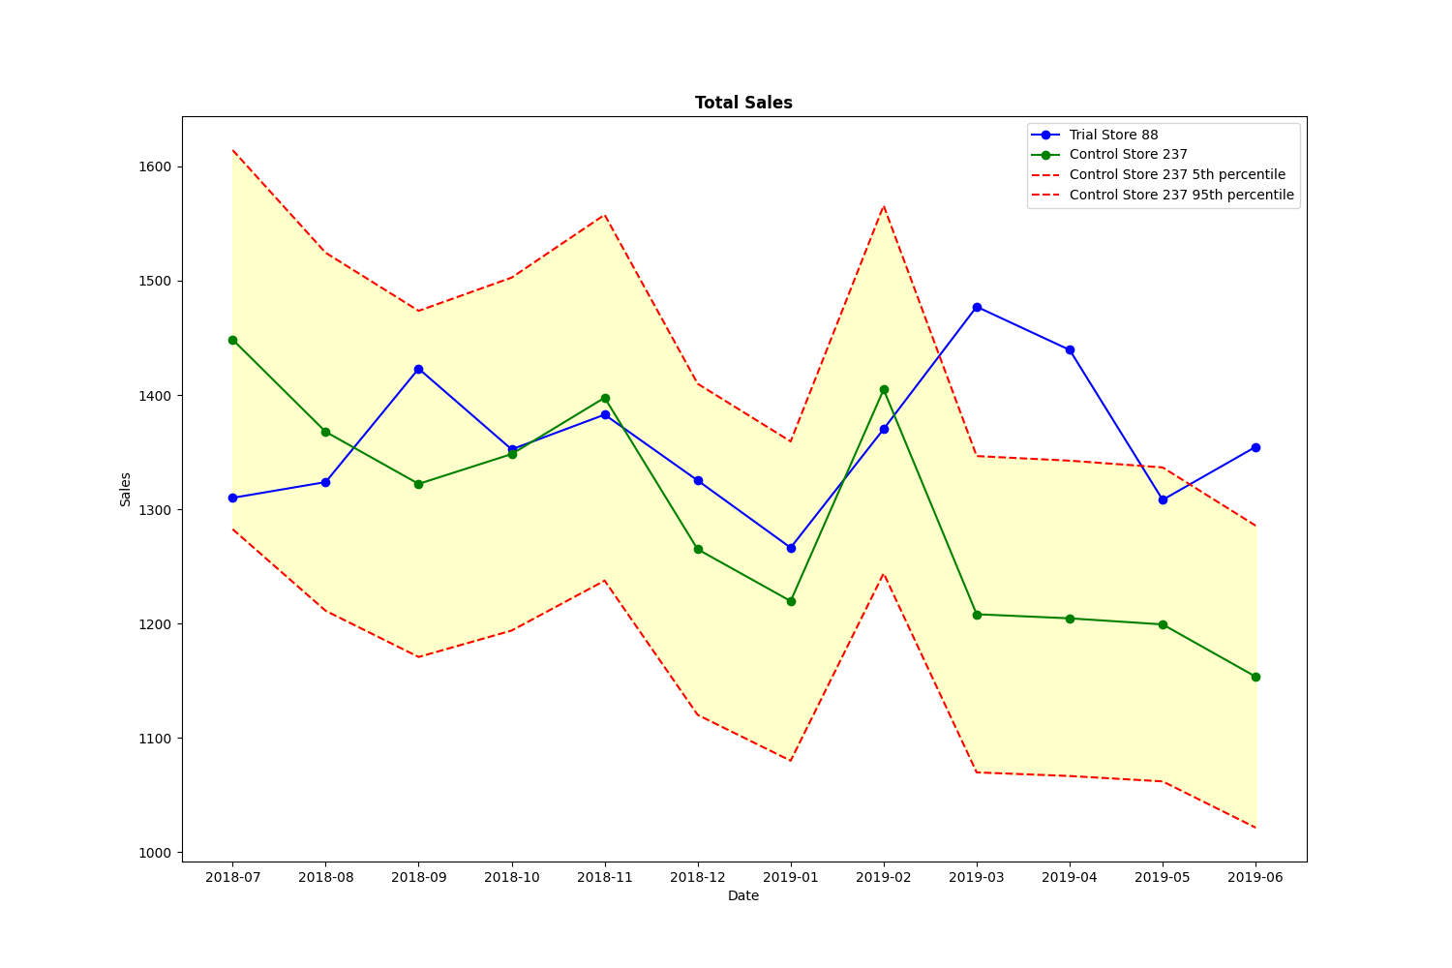
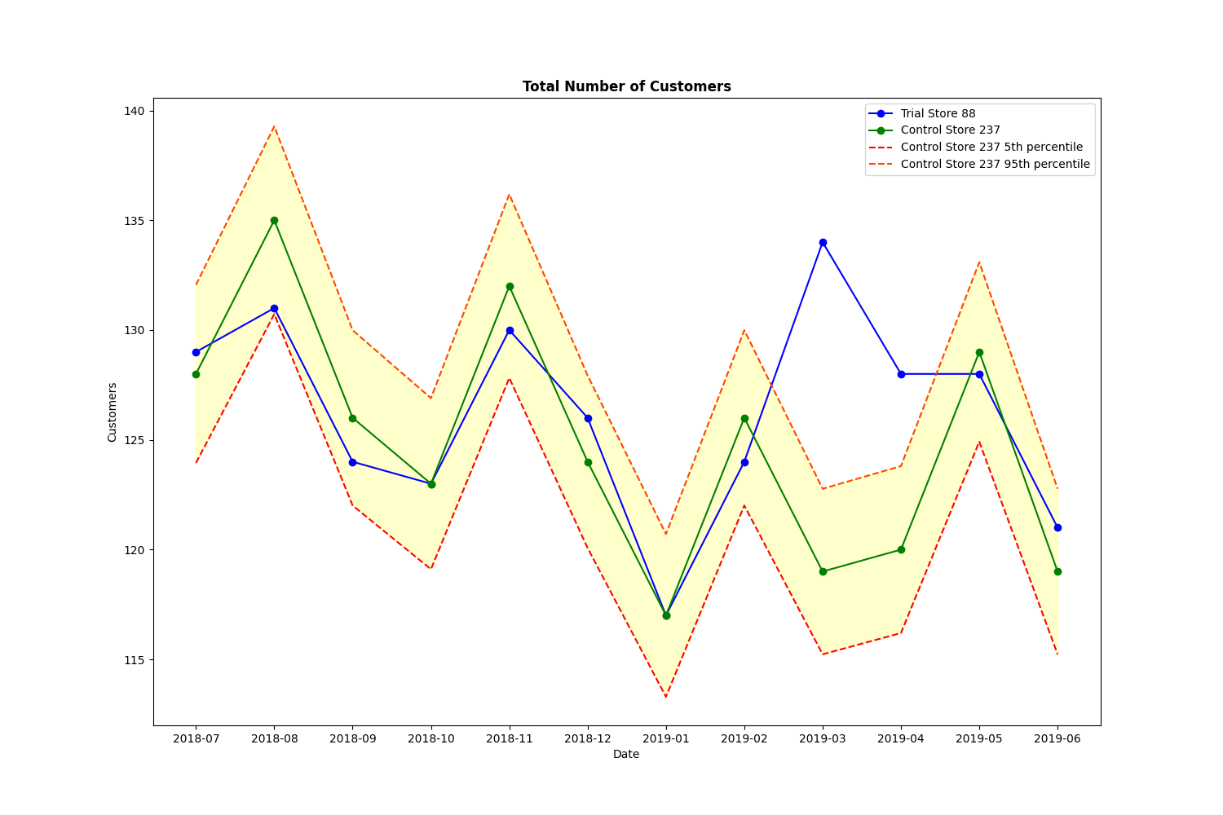
Performance – Store 88
Store 88 (Trial) is significantly different than Store 237 (Control). It performed better in 2 of the 3 months of the trial period.

Slide 21
Conclusion
There was a significant increase in total sales and total customers for Store 77 and Store 88 during March 2019 and April 2019 for the trial period which goes from February 2019 to April 2019. Both total sales and total customers exceeded their respective control stores.
However, Store 86 needs a further investigation given that it only had a significant increase in total sales for March 2019 but had a significant increase for all trial months in total customers.
Overall, the trials performed were successful and were positively significant due to increased total sales and total customers.

