Slide 1
Information Systems and Databases
DATA PROTECTION
SOCIAL AND ETHICAL ISSUES PART I

Slide 2

In the News….
Data Protection
Safe Harbour
Cookies

Slide 3
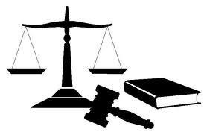
Data Protection
I S Y O U R D A T A S A F E ?

Slide 4

Data protection is about your fundamental
right to privacy.
Those who keep data about you have to comply with data protection principles. You can access and correct data about yourself.

Slide 5
The office of the Data Protection Commissioner is established under the 1988 Data Protection Act, which was passed on the 13th July 1988, and came fully into force on the 19th April, 1989
“Our Mission is to protect the individual's right to privacy by enabling people to know, and to exercise control over how their personal information is used, in accordance with the Data Protection Acts, 1988 & 2001.”
https://www.dataprotection.ie

Slide 6

Recognise this person?

Slide 7
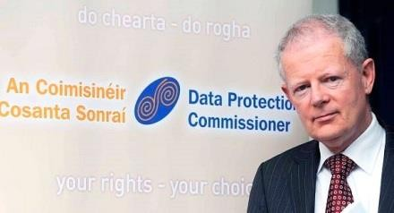
Billy Hawkes was appointed Data Protection Commissioner in July
2005.
In September 2014 he was replaced by Helen Dixon.
The Data Protection Commissioner is responsible for upholding the rights of individuals as set out in the Acts, and enforcing the obligations upon data controllers.
Appointed by the Government and independent in the exercise of
his functions.

Slide 8

What is data protection?
When you give your personal details to an organisation or individual, they have a duty to keep these details private and safe. This process is known as data protection.
Personal data
This is data which relate to a living individual who can be identified from those data, or from those data and other information which is in the possession of, or is likely to come into the possession of, the data controller. Data protection does not apply to those who are deceased or corporations.

Slide 9
Data Protection Roles
Data Controllers – organisations/individuals who control the contents and use of your personal details
Data Subject – a person to whom personal data relates.
Data Processor – a person that processes personal data on behalf of a data controller.

Slide 10

We refer to organisations or individuals who control the
contents and use of your personal details as 'data controllers'.
Data Controllers are subject to 8 obligations. Obligated to ensure that data is:
Obtained and processed fairly
Kept only for one or more specified lawful purposes
Kept safe and secure
Kept accurate
Adequate, relevant and not excessive
Retained for no longer than is necessary
Not disclosed to third parties except where appropriate

Slide 11

Legislation confers certain rights
The right to know that personal data is being held
The right of access to all the data
The right to have data corrected, if it is inaccurate
The right to have data erased, if there is not a
legitimate reason for retaining it, or if it is out of date
The right to seek compensation for damage or distress caused by inaccurate data or improper disclosure

Slide 12

If you hold or process personal data, but do not exercise responsibility for or control over the personal data, then you are a "data processor
Data processors have a very limited set of responsibilities under the Data Protection Act
Examples include payroll companies, accountants and market research companies, all of which could hold or process personal information on behalf of someone else.

Slide 13
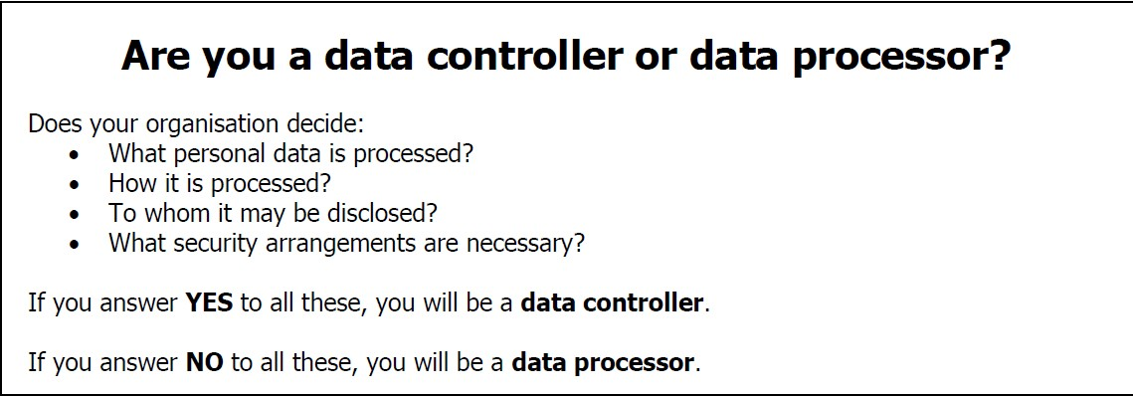

Slide 14

You have the right to data protection when your details are:
held on a computer;
held on paper or other manual form as part of a filing system;
made up of photographs or video recordings of your
image or recordings of your voice.

Slide 15
Data Breach at Loyaltybuild
A data breach occurred at Loyaltybuild in October resulting in the breach of personal data of some 1.5 million individuals (including 376,000 individuals whose full credit card data was compromised).
The initial indications are that these breaches were an external criminal act.
Affected 70,000 Supervalue customers, 8000 AXA Leisure Break
customers and 6700 Electric Ireland customers
In November the ODPC received a full client company list from Loyaltybuild in respect of those client companies whose customer data was exposed during the data breach. The ODPC immediately instructed Loyaltybuild to notify these client companies of the breach of their customer’s data and received confirmation from Loyaltybuild that this has taken place.
The ODPC investigation is continuing with the focus now on security practices and procedures employed by the company. Part of this phase of the investigation will also involve the carrying out of a follow up inspection. The company has ceased its processing of personal data until
such time as it can satisfy this Office that adequate security measures are in place.

Slide 16

Data Protection Case Studies
What data protection obligation was
not upheld ?
How did it come to light?
How was it resolved?

Slide 17


Under Section 3 of the Data Protection Actions, you have a right to find out, free of charge, if a person (individual or organisation) holds information about you. You have a right to be given a description of the information and to be told the purpose(s) for holding your information. You must make the request in writing. The person must send you the information within 21 days.

Slide 18

Under Section 4 of the Data Protection Acts, 1988
and 2003, you have a right to obtain a copy, clearly explained, of any information relating to you kept on computer or in a structured manual filing system or intended for such a system by any entity or organisation.You need to write to the organisation concerned and ask for it under the Data Protection Acts. You may be asked for evidence of your identity. This is to make sure that personal information is not given to the wrong person. You may be asked to pay a fee, but this cannot exceed €6.35.

Slide 19
People will have easier access to their own data and be able to transfer personal data from one service provider to another more easily;
A “right to be forgotten” will be introduced to help people better manage data protection risks online. People will also be able to delete their data if there are no legitimate grounds for a business to retain it;.
EU rules will be applied if personal data is handled abroad by companies active in the EU market and who offer their services to EU citizens — Google and Facebook, for example;
Independent national data protection authorities will be strengthened and given the power to fine firms that violate EU rules up to €1m or 2% of their global annual turnover.

Slide 20



The U.S. Department of Commerce (DOC) drew up the Safe Harbor Privacy Principles
in conjunction with the EU. In July 2000, the EU approved those principles and the Safe Harbor program went into effect in November 2000.
Participation in the Safe Harbor Program is voluntary, but the DOC asserts that it eliminates the necessity of prior approval in order for companies to conduct electronic data transfers.
In exchange for Safe Harbor certification, U.S. companies are shielded from prosecution under the EU data- protection laws.

Slide 21


Notice - Individuals must be informed that their data is being
collected and about how it will be used.
Choice - Individuals must have the ability to opt out of the collection and forward transfer of the data to third parties.
Onward Transfer - Transfers of data to third parties may only occur to other organizations that follow adequate data protection principles.
Security - Reasonable efforts must be made to prevent loss of collected information.
Data Integrity - Data must be relevant and reliable for the purpose
it was collected for.
Access - Individuals must be able to access information held about them, and correct or delete it if it is inaccurate.
Enforcement - There must be effective means of enforcing these
rules.

Slide 22
Privacy is Not Dead
http://www.independent.ie/business/technology/adrian-weckler- privacy-is-not-dead-yet-as-europe-gives-the-us-an-ultimatum-on- spying-29790225.html
“The personal data of EU citizens sent to the US under Safe Harbour may be accessed and further processed by US authorities in a way incompatible with the grounds on which the data was originally collected," said a Commission document on the matter, revealed first by 'The Financial Times' earlier this week. "The Commission has the authority to suspend or revoke the Safe Harbour decision if the scheme no longer provides an adequate level of protection."
“What this would effectively mean is that Facebook, Google and other organisations would have to set up completely new companies within the EU and without the ability to send personal data to the US.”

Slide 23

Since July 2011 all websites must provide information and capture consent for dropping or accessing cookies or other information on a user’s computer equipment when a user visits their site.

Slide 24


Cookies are not programs
Small text files stored on the user’s pc
Typically contain a site name and unique id
Enable web sites to identify the user
Allow sites to build up up a profile of user
behaviour
Do not contain personal details or passwords

Slide 25

BID
VYey5TaycNFeQCKUbfLOehzX6I9A43fTjwnYXI3zL3Q3WfYxURcPwwJO xvO5c2XbpR7U6mIfvOkOACgiZ5g0
ticketmaster.ie/ 1024
314833816
32108254
1601253568
30184417
*

Slide 26

The Data Protection Commissioner has written to some 80 websites seeking information on the steps that they have taken to meet the so called "cookie" obligations placed upon them with effect from 1 July 2011. Since that date all websites must provide information and capture consent for dropping or accessing cookies or other information on a user’s computer equipment when a user visits their site.

Slide 27
The Law and the Cloud ...
I S T H E L A W O N Y O U R S I D E ?

Slide 28

If you use a cloud infrastructure sourced from a cloud services provider, you must impose all legal or regulatory requirements that apply to your enterprise on your supplier as well. This is your responsibility, not the provider’s.
http://www.youtube.com/watch?v=eobKSp5Ut8Q

Slide 29

Who is controller? Data controller must
choose appropriate data processors, and must seek adequate contractual protection from them.Cloud providers are the data processor.
Which law is applicable?
Are you transferring data outside of EU?

Slide 30
Summary
L E G A L R E Q U I R E M E N T S A R E T H E S A M E R E G A R D L E S S O F T H E T E C H N O L O G Y D E P L O Y E D WHETHER:
OU T S O U R C E D
C L O U D
IN - H O U S E
D A T A C E N T R E

