Slide 1


Dublin Business School Data Analytics Workshop Hewlett Packard September 5th/6th 2017 Darren Redmond

Slide 2

Highly sought after and rare combination of skills

Slide 3

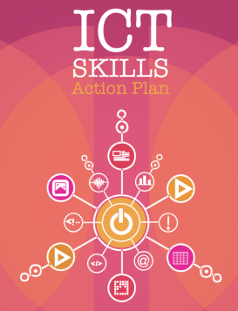

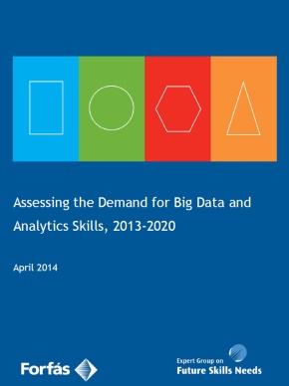
Background
Big data and analytics represent a new area of opportunity characterised by rapid growth.
There is a global shortage of data analytics talent.
At present, no one country or region stands out in the provision of data analytics services.
For Ireland to become a leading country in data analytics services it is essential that our skills capability base is sufficient to drive performance.

Slide 4
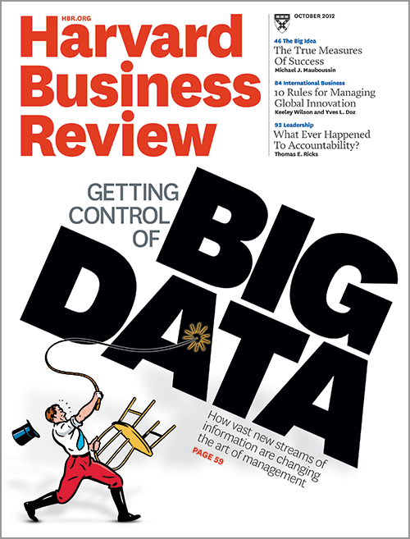

Background
“Data Scientist: The Sexiest Job of the 21st Century.” - HBR, Oct 2012.
According to the EGFSN:
The economic and social benefits available from enhanced adoption of big data and analytics are potentially transformative
The government’s ambition to become a leading country in Big Data can be achieved by:
Enhancing the employability of graduates and delivering relevant skills.
Appealing to the broadest possible talent pool – both domestically and internationally.
Inspiring the next generation of analytics talent.

Slide 5
Data Analytics @ DBS
DBS provides Data Analytics programmes to Level 9 on the NFQ.
Over the past number of years, DBS has been involved in industry-led education and training initiatives which have incorporated a number of Government funded projects to meet the needs of the ICT sector.
2011, DBS launched Springboard programmes
2011, DBS launched ICT Skills Conversion Programme
2014, DBS launched new programmes under the Springboard initiative in the areas of Data Management and Analytics and Digital Marketing.
2015, Sucessfully validated HDip in Science in Data Analytics
2017, Sucessfully validated MSc in Data Analytics
These programmes reflect an industry-led approach and this sentiment and experience has continued through to these current programme proposals.

Slide 6
The Science of Data Analytics
Our Programme
We present a rigorous and accelerated Level 8 conversion programme providing learners with a systematic understanding of the analytical, technical and business skills required in the field of data analytics.
It is estimated that the demand for Big Data and Analytical Skills related employment in Ireland will reach approximately 40,450 by 2020.
–Source: Assessing the Demand for Big Data and Analytics Skills, 2013-2020).

Slide 7
International Trends and Approaches : A brief note
Our Programme
As international institutes compete to address the challenge of rapidly formulating Data Analytics programs, a common interdisciplinary approach has emerged.
The key trend is for universities to re-orientate and / or leverage existing resources and collaborate across many academic departments including computing, business, statistics, marketing and economics.

Slide 8
Aims and Objectives
Meet the market appetite for an accelerated delivery Level 8 Higher Diploma Conversion programme in Data Analytics.
Provide graduates with the applied knowledge and technical competencies required of an Data Analytical professional.
Develop learners criticality in order to analyse industry trends in Big Data.
Provide learners with a platform to develop the requisite technical and design skills required by industry and to deepen knowledge of statistical analysis and analytical models
Enable learners to implement scalable Big Data applications.
Ensuring graduates are industry ready and professional, possessing the correct approach to apply the knowledge they have gained.
Provides an academic progression route for Level 8 graduates on to Masters Programmes at Level 9 (F/T or P/T).

Slide 9











Programme Design Input
“Businesses, who embrace analytics and data, outpace their competition. Statistics, big data technologies and analytical thinking will be the new literacy in the 21st century. The proposed course will give its learners a solid grounding in these techniques and prepare them for the next business revolution.”
-Ger Hartnett, Head of Technical Services, MongoDB

Slide 10
DBS - Unique Selling Point
Combination of Factors
Accelerated Level 8 ICT conversion programme
Industry-led approach with collaboration with employers at the design and implementation phase.
Genuine focus on and expertise in student support, especially with students from non-traditional backgrounds.
Applied Nature of Programme, focus on skills-building
Internationalisation.

Slide 11
Data Scientist Attributes
Graduates
Analytical Skills: Statistical/Analytical Skills
Big data savvy: Exploit analytics to drive business performance
Supporting Technology Roles: Skilled in the application of supporting technology
Communication and Teamwork Skills: Translate insights into actionable goals.
Future Development: Solid foundation for further professional and academic development.

Slide 12
Your Unique Selling Points
Storage 2. Retrieval 3.Analysis
Databases 2. Programming/ETL 3. Stats / ML

Slide 13
Skills
Databases and Business Applications
Data Warehousing & Business Intelligence
Data Visualisation & Communications
Programming – R, Python, Java
Statistics
Tools for Data Analytics
Data and Web Mining
Advanced Data Analytics
Machine Learning & Artificial Intelligence

Slide 14
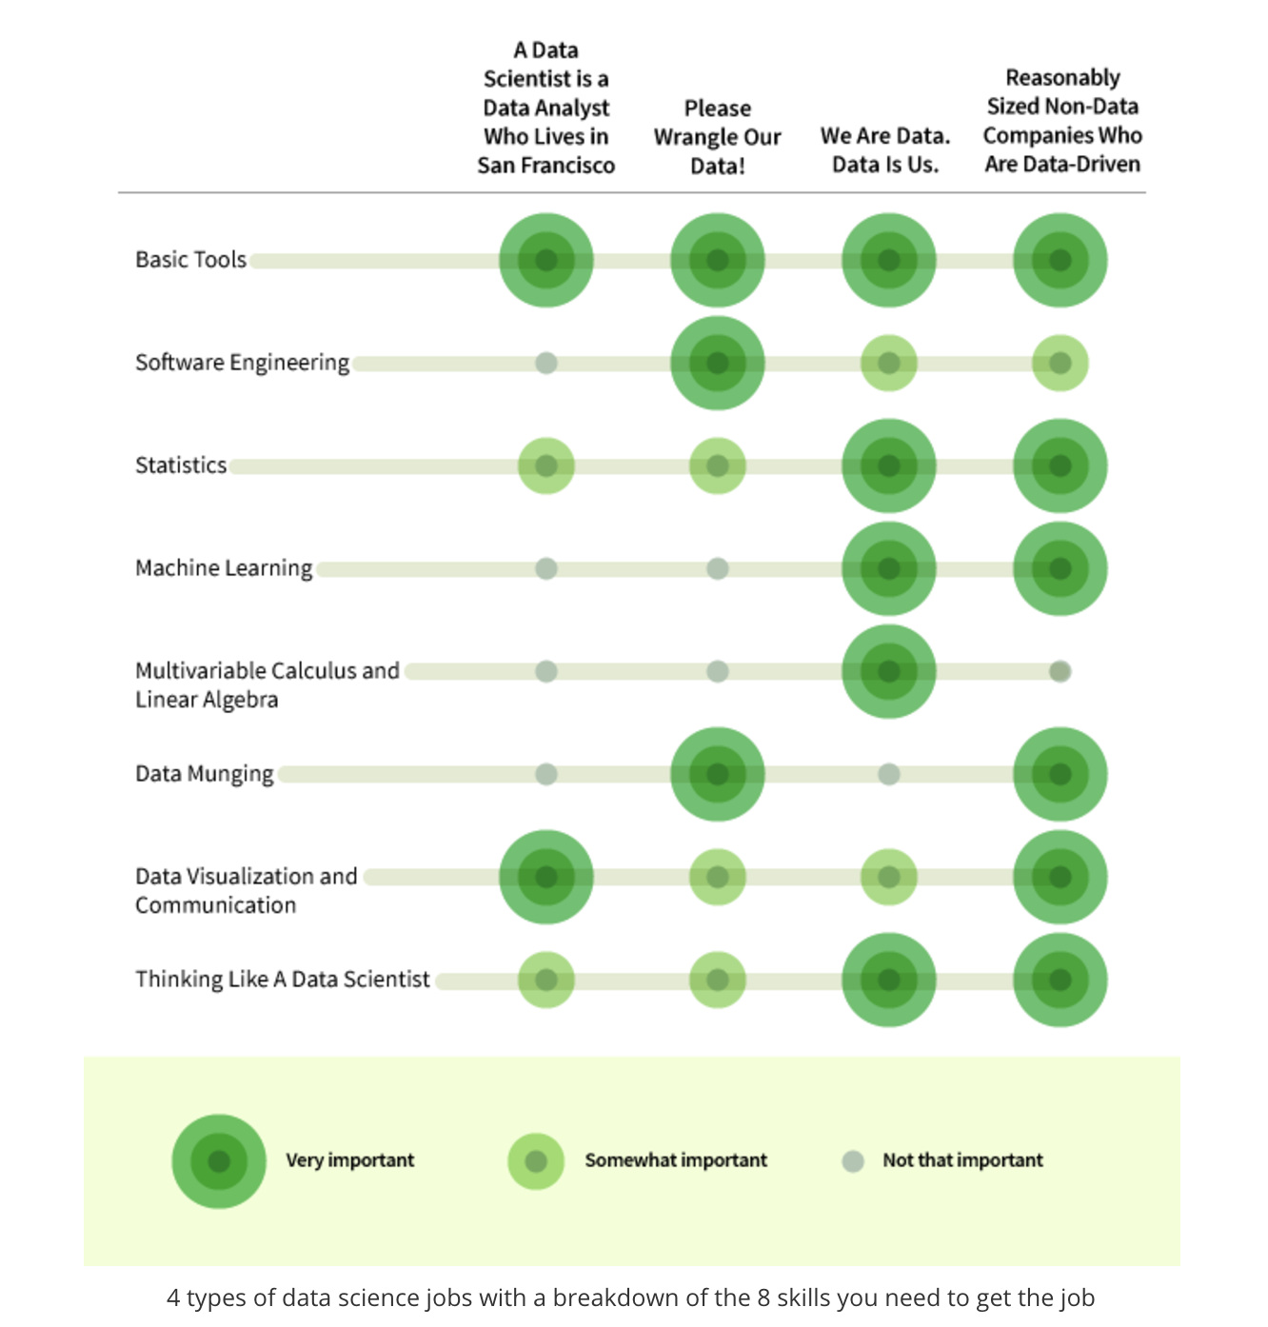
Skills

Slide 15
Tools
There is an essential focus on Python, R and SQL as core technologies supplemented, complemented and integrated with tools such as:
SAS, RapidMiner, Tableau, D3, Hadoop, Spark, Neo4j; Excel, PowerBI, SPSS; Google Fusion Tables, Big Query; IBM Watson Analytics; Mathematica; MATLAB, Qlikview, Tibco SpotFire among others.

Slide 16
Thank you for your time Questions? Next Up – Big Data

