Slide 1
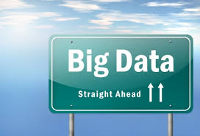
Darren Redmond
Notes:
Video: Understanding Big Data http://inside-bigdata.com/2012/12/26/video-understanding-big-data/

Slide 2
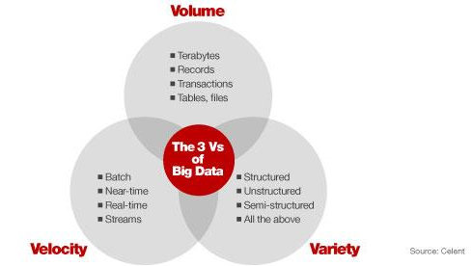

Slide 3
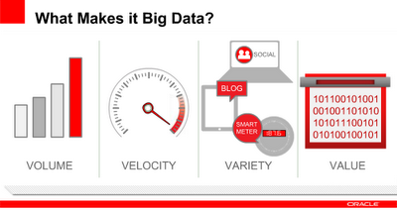

Volume
With Big Data, the volumes of data are larger than those conventional relational database infrastructures can cope with, processing options break down broadly into a choice between massively parallel processing architectures — data warehouses or databases such as Teradata, Greenplum and Apache Hadoop-based solutions.
This choice is often informed by the degree to which one of the other “Vs” — variety —comes into play. Typically, data warehousing approaches involve predetermined schemas, suiting a regular and slowly evolving dataset.
Apache Hadoop, on the other hand, places no conditions on the structure of the data it can process.
Hadoop is a platform for distributing computing problems across a number of servers.

Slide 4
Volume
Hadoop was first developed and released as open source by Yahoo, it implements the MapReduce approach pioneered by Google in compiling its search indexes. Hadoop’s MapReduce involves distributing a dataset among multiple servers and operating on the data: the “map” stage. The partial results are then recombined: the “reduce” stage.
To store data, Hadoop utilizes its own distributed filesystem, HDFS, which makes data available to multiple computing nodes. Because of this, Hadoop is not itself a database or data warehouse solution, but can act as an analytical adjunct to one.
One of the most well-known Hadoop users is Facebook, whose model follows this pattern. A MySQL database stores the core data. This is then reflected into Hadoop, where computations occur, such as creating recommendations for you based on your friends’ interests. Facebook then transfers the results back into MySQL, for use in pages served to users.
`

Slide 5
Velocity
Problems previously restricted to segments of industry are now presenting themselves in a much broader setting.
Specialized companies such as financial traders have long turned systems that cope with fast moving data to their advantage.
Now it’s our turn. Why is that so? The Internet and mobile era means that the way we deliver and consume products and services is increasingly instrumented, generating a data flow back to the provider.
Online retailers are able to compile large histories of customers’ every click and interaction: not just the final sales. Those who are able to quickly utilize that information, by recommending additional purchases, for instance, gain competitive advantage. The smartphone era increases again the rate of data inflow, as consumers carry with them a streaming source of geo-located imagery and audio data.
Notes:
The Velocity is the speed at which the data is created, stored, analysed and visualized. In the past, when batch processing was common practice, it was normal to receive an update from the database every night or even every week. Computers and servers required substantial time to process the data and update the databases. In the big data era, data is created in real-time or near real-time. With the availability of Internet connected devices, wireless or wired, machines and devices can pass-on their data the moment it is created.

Slide 6
Velocity
It’s not just the velocity of the incoming data that’s the issue: it’s possible to stream fast-moving data into bulk storage for later batch processing, for example. The importance lies in the speed of the feedback loop, taking data from input through to decision.
As mentioned above, it’s not just about input data. The velocity of a systems’ outputs can matter too. The tighter the feedback loop, the greater the competitive advantage. The results might go directly into a product, such as Facebook’s recommendations, or into dashboards used to drive decision-making.

Slide 7
Variety
Even on the web, where computer-to-computer communication ought to bring some guarantees, the reality of data is messy. Different browsers send different data, users withhold information, they may be using differing software versions or vendors to communicate with you. And you can bet that if part of the process involves a human, there will be error and inconsistency.
A common use of big data processing is to take unstructured data and extract ordered meaning, for consumption either by humans or as a structured input to an application. One such example is entity resolution, the process of determining exactly what a name refers to. Is this city London, England or London, Texas? By the time your business logic gets to it, you don’t want to be guessing.
The process of moving from source data to processed application data involves the loss of information. When you tidy up, you end up throwing stuff away. This underlines a principle of big data: when you can, keep everything.

Slide 8
Variety
This underlines a principle of big data: when you can, keep everything. There may well be useful signals in the bits you throw away. If you lose the source data, there’s no going back.
Despite the popularity and well understood nature of relational databases, it is not the case that they should always be the destination for data, even when tidied up. Certain data types suit certain classes of database better.
Even where there’s not a radical data type mismatch, a disadvantage of the relational database is the static nature of its schemas. In an agile, exploratory environment, the results of computations will evolve with the detection and extraction of more signals. Semi-structured NoSQL databases meet this need for flexibility: they provide enough structure to organize data, but do not require the exact schema of the data before storing it.

Slide 9
More Vs
Big Data
Volume
Veracity
Variety
Velocity
Value

Slide 10
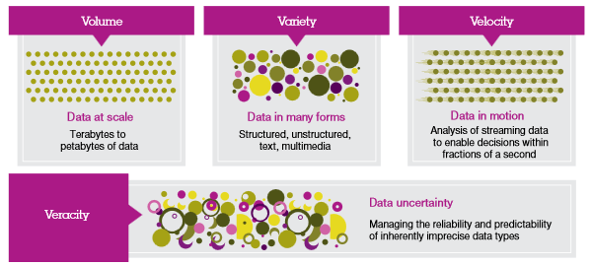










Notes:
http://www.practicalecommerce.com/articles/3960-6-Uses-of-Big-Data-for-Online-Retailers

Slide 11
Veracity
Uncertainty of Data
It’s hard to know which information is accurate and which is out of date. This is why one in three business leaders do not trust the information they use to make decisions.
Poor data quality costs the U.S. economy around $3.1 trillion each year, giving scientists a huge incentive for establishing systems that maintain the veracity of data.
Having a lot of data in different volumes coming in at high speed is worthless if that data is incorrect. Incorrect data can cause a lot of problems for organisations as well as for consumers. Therefore, organisations need to ensure that the data is correct as well as the analyses performed on the data are correct.
Especially in automated decisionmaking, where no human is involved anymore. Be sure that both the data and the analyses are correct.

Slide 12
Veracity
If organized and used correctly, big data can help us spot business trends, prevent diseases, and combat crime, among other things. As humans continue to create more data in their daily lives, the work of data scientists will become that much more important and useful.
http://www.ibmbigdatahub.com/sites/default/files/infographic_file/4-Vs-of-big-data.jpg

Slide 13
Value
It is important that businesses make a business case for any attempt to collect and leverage big data. It is so easy to fall into the buzz trap and embark on big data initiatives without a clear understanding of costs and benefits. Investing in big data technologies/analytics may not be a good idea unless you can achieve value from it.
All that available data will create a lot of value for organisations, societies and consumers. Big data means big business and every industry will reap the benefits from big data. McKinsey states that potential annual value of big data to the US Health Care is $ 300 billion, more than double the total annual health care spending of Spain. They also mention that big data has a potential annual value of € 250 billion to the Europe’s public sector administration. Even more, in their well-regarded report from 2011, they state that the potential annual consumer surplus from using personal location data globally can be up to $ 600 billion in 2020. That is a lot of value.

Slide 14
Value
Of course, data in itself is not valuable at all. The value is in the analyses done on that data and how the data is turned into information and eventually turning it into knowledge. The value is in how organisations will use that data and turn their organisation into an information-centric company that relies on insights derived from data analyses for their decision-making.
http://www.bigdata-startups.com/3vs-sufficient-describe-big-data/

Slide 15
More V’s?
Variability
Variability means that the meaning is changing (rapidly). E.g. the same words having a totally different meaning in different contexts. This is very relevant if companies wish to perform sentiment analyses.
http://www.bigdata-startups.com/3vs-sufficient-describe-big-data/
In addition to the increasing velocities and varieties of data, data flows can be highly inconsistent with periodic peaks. Is something trending in social media? Daily, seasonal and event-triggered peak data loads can be challenging to manage.
http://www.sas.com/en_us/insights/big-data/what-is-big-data.html
Visualisation
Making all that vast amount of data comprehensible in a manner that is easy to understand and read. With the right analyses and visualizations, raw data can be put to use otherwise raw data remains essentially useless
http://www.bigdata-startups.com/3vs-sufficient-describe-big-data/

Slide 16
More V’s?
Still a lot of discussion on-going, many of the original adaptors of big data still adhere to the 3 core V’s, however the fourth V is becoming increasingly adapted.
As regards others V’s, some industry experts are indicating that there are too many ‘new’ characteristics being put forward, and that the original characteristics encompass the ‘new’ ones.
For further reading you should read the following:
http://www.wired.com/2013/05/the-missing-vs-in-big-data-viability-and-value/
http://www.informationweek.com/big-data/big-data-analytics/big-data-avoid-wanna-v-confusion/d/d-id/1111077?
http://inside-bigdata.com/2013/09/12/beyond-volume-variety-velocity-issue-big-data-veracity/
Video: How to Successfully Manage the Four V's of Big Data http://inside-bigdata.com/2013/01/04/video-how-to-successfully-manage-the-four-vs-of-big-data/

