Slide 1
Introduction to IS
What is an Information System?
What is Data?
How is data processed?
What is good quality information?
Decision-making in organisations
Knowledge

Slide 2
Information Systems
A set of interrelated components that collect, manipulate & disseminate data & information & provide feedback to meet an objective.
An information system (I.S.) can be any organised combination of people, hardware, software, communications networks and data resources that collects, transforms & distributes information in an organisation.
Examples: ATMs; airline reservation systems; course reservation systems
Notes:
An information system is a collection of related things that work together to achieve a common goal. The components collect, process or transform, and distribute data and information.
Common examples of information systems include: ATMs, point of sale (POS) systems used by grocery checkout clerks; information systems used by airlines to make reservations or schedule flights; and the system you use at your university to register for classes.

Slide 3
Activities of an Info.System (IS)
Input
collection of raw data from within business or environment
Processing
converting raw input to more useful information
Output
transfer of processed information to people/activities
Feedback/Control
output returned to people to help refine the input/processing phase

Slide 4
data

Slide 5
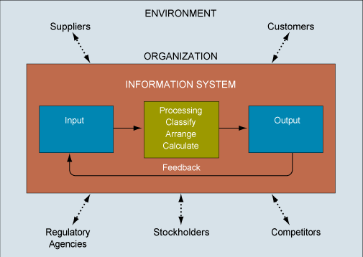

Slide 6
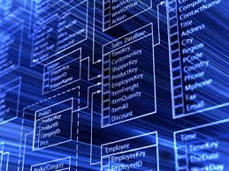
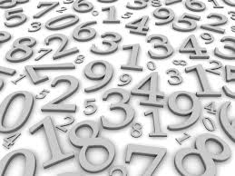
Data
Data is a collection of facts, such as values or measurements.
It can be numbers, words, measurements, observations or even just descriptions of things.
E.g the current temperature
(The term data is plural; datum is singular)

Slide 7
Qualitative vs Quantitative
Data can be qualitative or quantitative.
Qualitative data is descriptive information (it describes something)
Quantitative data, is numerical information (numbers).
Data
Qualitative data (Who, what, when, where, how)
Quantitative data (1,2,3,4,5 etc…)

Slide 8
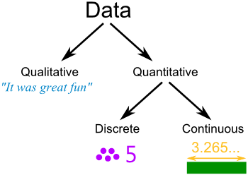
Quantitative data can also be Discrete or Continuous:
Discrete data can only take certain values (like whole numbers), i.e. it can be counted.
Continuous data can take any value (within a range), i.e. it can be measured.

Slide 10
Data Processes 1
Classification
This involves placing data into categories.
E.G. categorising sales of soft drinks into either sales of low-fat drinks or sales of energy drinks.
€ Sales
of total
Soft Drinks
€ Sales of
Regular Soft Drinks
€ Sales of
Diet/Low-fat
soft drinks
€ Sales of
Energy
soft drinks

Slide 11

Data Processes 2
Rearranging/Sorting
This involves organising data so that items are grouped together or placed into a particular order.
E.G. sorting employee data alphabetically or by geographical region.

Slide 12

Data Processes 3
Aggregating
This involves summarising data
E.G. calculating totals, sub-totals or averages

Slide 13
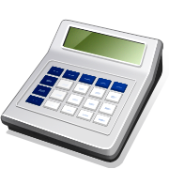
Data Processes 4
Performing Calculations
This involves performing calculations to the data
E.G. calculating an employee’s gross pay by multiplying the number of hours worked by the hourly rate of pay

Slide 14
Data Processes 5
Selection
This involves choosing or discarding items of data based on a set of selection criteria.
E.G. Create a list of all your customers who have spent more than €10k in the past 6 months only.

Slide 15
Information

Slide 17
Creating Information
Processing Data is necessary to place them into a meaningful context so that they can be easily understood by the recipient.
Data
Transformation Process
Information
The basic function of an information system is to transform data into useful information.

Slide 18
Data becoming information
21/04/1954
Notes:
Employees DOB.
Retirement date? Succession planning? Offer early retirement? Offer incentives to remain longer/work as a consultant? Training for other staff? Retirement planning for employee?

Slide 19
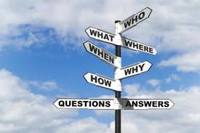
Information
Information is data that have a particular meaning within a particular context.
E.g. the current temperature (data) becomes information if you’re deciding what to wear.
Information can also be described as; a collection of facts organised in such a way that they have value beyond the facts themselves.

Slide 20
Information
involves transforming data using a defined process;
involves placing data in some form of meaningful context;
is produced in response to an information need and therefore serves a specific purpose;
helps reduce uncertainty, thereby improving decision behaviour.

Slide 21
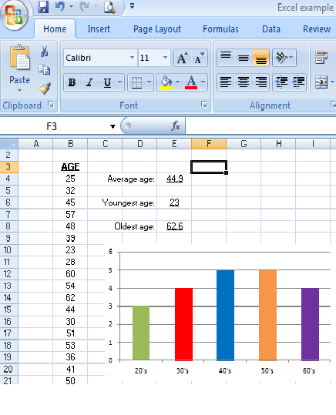
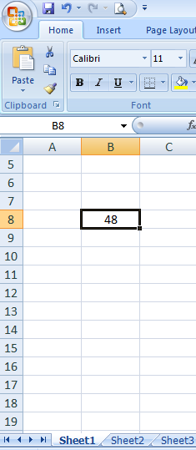
Data and Information

Slide 22
Business Intelligence
This is collective information – about your customers, your competitors, your business partners, your competitive environment and your own internal operations that gives you the ability to make effective, important and often strategic business decisions.

Slide 23
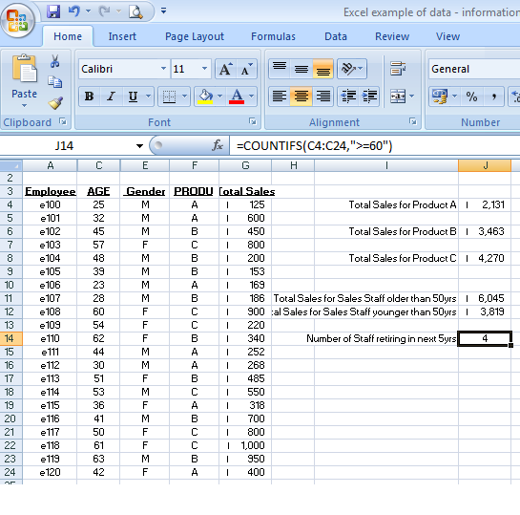
Notes:
When you start to combine multiple sets of information, you can generate a considerable amount of business intelligence. Business Intelligence helps you make effective strategic business decisions.

Slide 24
Sources of Information
Formal communication (eg: company report)
Characteristics
Structured, consistency in format, accurate, specific
Inflexible
Informal communication (eg: conversation)
Characteristics
Rich, flexible, detailed, variable scope
Unstructured, ?Relevance?, ? Accuracy ?
What are the characteristics of
“good quality” information

Slide 25
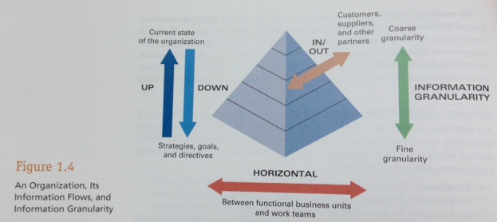
Information in an Organisation
“Management Information Systems for the Information Age”, 2007, Haag/Cummings, McGraw-Hill, 7th edition

Slide 26
Value of Information
Tangible
A value or benefit that can be measured directly, usually in monetary terms.
Intangible
A value or benefit that is difficult or impossible to quantify.
Example. Better decision making

Slide 27
Activity 1.1 - Value of Information
State whether each of the following shows tangible or intangible value of information:
Improved inventory control
Enhanced customer service
Increased production
Reduced administration costs
Greater customer loyalty
Enhanced public image

Slide 28
Sources of Information
FORMAL COMMUNICATION
Structured, presented in a consistent manner
INFORMAL COMMUNICATION
Less well structured, presented by informal means
Word of Mouth

Slide 29
More Information
Notice how data, information and BI build on each other.
Information is a more complete picture of multiple data points.
Due to the use of data and information to assist in strategic decision making in an organisation, their quality is critical.

Slide 30
Qualities of Information
Qualities of good information
It should be relevant for its purpose.
It should be complete for its purpose.
It should be accurate for its purpose.
It should be clear to the user.
It should be prepared using consistent methods.
The user should be able to rely on it.
It should be communicated to the right person.
It should not be excessive – its volume should be manageable.
It should be timely – to be communicated at the right time.
It should be provided at a cost lesser than the value of benefits.

Slide 31
Three dimensions of information quality
Timeliness
Currency
Frequency
Time Period
Time
Form
Content
Clarity
Detail
Order
Presentation
Media
Accuracy
Relevance
Completeness
Conciseness
Scope

Slide 32
Qualities of Information
Time Dimension
Timeliness, Currency, Frequency, Time Period
Content Dimension
Accuracy, Relevance, Completeness, Conciseness, Scope
Form Dimension
Clarity, Detail, Order, Presentation, Media

Slide 33
Time
Timeliness - Is the information available when needed? (not too early & not too late)
Currency - Is the information current? It needs to refer to current circumstances, I.e. must be relevant.
Frequency – is it available as & when needed?
Time Period – it should cover the correct time period.

Slide 34
Content
Accuracy – is it accurate? If it contains errors then it has little/no value to the company
Relevance – info must be relevant to the particular situation.
Completeness – All of the info required, needs to be provided to the recipient. Incomplete information can compromise the information.
Conciseness – Only info relevant to the needs of the recipient should be supplied, and in the most compact form possible.
Scope – Does the information need to include internal organisational information, or is external economic/competitor/industry information also required?

Slide 35
Form
Clarity – needs to be presented in an appropriate form. The recipient should be able to find what they need quickly.
Detail – the correct level of detail should be included. E.g. top mgt may only require a summary, whereas line managers will require more specific information.
Order – Info should be provided in the correct order.
Presentation – Info should be presented in an appropriate format for the recipient. E.g. numerical data is typically presented in graphs/tables.
Media – Info should be presented using the correct media, e.g. a presentation would be presented using a projector, formal information would be presented in a printed report, information for employees may be sent using email.

Slide 36
Other Attributes
Confidence – is there confidence in the source of the information?
Reliability – Information must be reliable if it is to be accepted & used by the recipients.
Appropriateness – Is the information appropriate to the current needs of the organisation? (e.g. spam email)
Received by the correct person – For information to have value, it needs to be received & acted upon by the correct person. E.g. there is little point in a competitor analysis being sent to the companys’ receptionist – this info should be received by top mgt instead.
Sent by correct channels – information, such as a formal complaint should be sent via the correct channels – usually a formal letter etc… rather than by word of mouth.

Slide 37
Decision making

Slide 38
Decisions
Decision Behaviour describes how people make decisions and the factors that influence them.
Structured Decisions
Unstructured Decisions

Slide 39
Decision Behaviour
1. Structured Decisions – tend to involve situations where the rules & constraints governing the decision are known.
routine/repetitive,
number of possible courses of actions is small.
For example, if stock levels fall below a certain number, then a fixed quantity of new stock will be ordered.
2. Unstructured Decisions – tend to involve more complex situations, where the rules governing the decision are complicated or unknown.
infrequently
rely heavily on experience, judgement & knowledge of the decision maker.
For example, deciding whether or not the company should open a new branch somewhere.

Slide 40
Analytical or Intuitive?
Analytical manager – prefers quantitative information, and will often overlook qualitative information.
Examines situations in fine detail & may overlook the wider issues that might influence a decision.
Likely to be most effective when making structured decisions.
Intuitive Manager – relies on prior experience, judgement & intuition.
Also more willing to accept qualitative information.
Tends to examine situations as a whole, taking into account the wide range of factors that might influence a decision.
Likely to be most effective when making unstructured decision.

Slide 41
Quantitative & Qualitative
Quantitative Data:
Includes use of numbers & statistics.
Measures/Quantifies
AKA: Hard data.
Qualitative Data:
Describes without the use of figures e.g. Interviews, observations, written documents
Describes the qualities or characteristics.
AKA: soft data

Slide 42
Levels of managerial decision making
Strategic
Tactical
Operational
Long-term organisational planning. (Unstructured)
Medium-term planning.
(Semi-structured)
Short-term planning & day-to-day control of activities. (Structured)

Slide 43
Examples of managerial decision making
How should the organisation be structured?
Which business area should the organisation be in?
How do we deal with a takeover bid?
What foreign markets should we target?
How do we target our most profitable customers?
What is the best pricing structure for this product?
What should the budget be for next year?
How should we process a sales order?
When should we order new stock?
What level of discount will we give this customer?
What should we do about a faulty machine?

Slide 44
Activity 1.2 – Decision Characteristics & Mgt level
Mgt Level | Type of Decision | Time Scale | Impact on Org | Frequency of decisions
Strategic | Unstructured | Long | Large | Infrequent
Tactical | <-> | Medium | Medium | <->
Operational | Structured | Short | Small | Frequent

Slide 45
Decision Characteristics & Mgt level
Mgt Level | Type of Decision | Time Scale | Impact on Org | Frequency of decisions
Strategic | Unstructured | Long | Large | Infrequent
Tactical | <-> | Medium | Medium | <->
Operational | Structured | Short | Small | Frequent

Slide 46
Activity 1.3 – Complete the following:
 | Decision Type (structured, semi-structured, unstructured) | Org Level (Strategic, Tactical, Operational)
Should we expand abroad? | unstructured | Strategic
What should we do about a faulty machine? | Structured | Operational
What new markets should we move into? | Semi-structured | Tactical
How should we deal with a takeover bid? | Unstructured | Strategic
Should we employ more staff to cope with an urgent order? | Structured | Operational
Should we launch an advertising campaign? | Semi-structured | Tactical
At what level should we set the budget for next year? | Semi-structured | Tactical

Slide 47
Structure of decision-making
Structured decisions
Clear rules
Information needed is unambiguous and easy to specify
Unstructured decisions
Unclear with no set rules
Semi-structured
Combination of both
Give examples of each of the above types of decision

Slide 48
Information characteristics for decisions by management levels
Management Level | Time period | Frequency | Source | Certainty | Scope | Detail
Strategic | Wide | Infrequent | External | Less Certain | Wide | Summarised
Tactical | ↔ | ↔ | ↔ | ↔ | ↔ | ↔
Operational | Narrow | Frequent | Internal | More certain | Narrow | Detailed
Ref: “Business Information Systems” (Bocij et al)

Slide 49
Decision making involves selecting the correct action from a variety of choices.
In IS, diagrams are used to show the decision in a structured way and to ensure that the rules are defined correctly.
A Decision Tree, is a diagram that shows the sequence of events, decisions and consequent actions that occur in a decision-making process.

Slide 50
Decision Tree
Order Received
Credit OK?
No
Yes
Refuse Order
Process Order

Slide 51
Order Received
Yes
Payment with Order?
No
Yes
Items in Stock?
No
Credit OK?
No
Yes
Rule 1
Deliver items to customer
Rule 2
Hold until items received
Rule 3
Refuse Order
Yes
Items in stock?
No
Rule 4
Deliver items to customer
Rule 5
Hold until items received

Slide 52
knowledge

Slide 53
Data, Information & Knowledge
Data: are raw facts that describe a particular person/place/thing/event…
Information: collection of facts organized in such a way that they have value beyond the facts themselves i.e. they have value
Knowledge : ??
Notes:
The terms data & information are often used interchangeably. However, there is an important distinction: information is value-added data. Data is processed, organized or transformed to become information.
Data are raw facts. For example, if you write down your age & grade on an English test & hand it to me, I see 2 numbers – raw data. However, if you include the average age and average test score for your class, the data would have some meaning to me as a teacher… it would become information. Interestingly, your name and grade – data to me- could very well be information to you. In the context of your life or experiences, those 2 numbers alone would most likely have meaning.
Similarly, a grocery store manager would most likely find a list of every item sold today to be of little use – it is data. However, the amount that the store’s total sales are over or under planned sales would be information.

Slide 54
Knowledge – broad term that can describe many things…
Contextual explanation for business intelligence
Actions to take to affect business intelligence
Intellectual assets such as patents and trademarks
Organizational know-how for things such as best practices
Combined result of a person’s experiences and the information they possess.
Knowledge Management Topic will follow later…

Slide 55
Summary
A managers work involves making decisions to direct a company’s efforts towards it’s goals.
The efficiency and effectiveness of the decision-making process depends on the quality of the information held by the company.
Many companies now realise that information has an impact on almost every activity, and must therefore be seen as an important asset, hence the rise of the Data industry.

