Slide 1
Business intelligence (BI)
Data + Information + Knowledge
Decision Making
Notes:
READ THIS: http://analytics.ncsu.edu/sesug/2008/BI-001.pdf

Slide 2
Pre requisites
Prior to understanding more about BI, it’s important that you review the following (from class notes and from text book)
Data, Information & Knowledge (notes & chapter 1, Laudon & Laudon)
Foundations of BI: Databases and Information Management (notes & chapter 6, Laudon & Laudon)

Slide 3
MoneyBall Case Study
Problem: Limited resources and outdated metrics
Solutions: Use improved statistical analysis to identify affordable, overlooked players
Demonstrates the use of business intelligence to optimize performance and keep costs low
Illustrates how information systems can provide advantages for a limited time

Slide 4
Business Intelligence
This is collective information – about your customers, your competitors, your business partners, your competitive environment and your own internal operations that gives you the ability to make effective, important and often strategic business decisions.

Slide 5
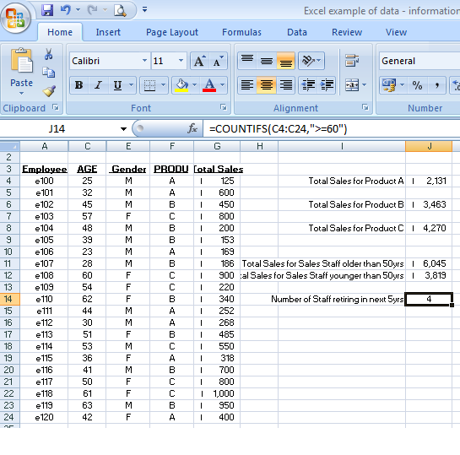
Notice how data, information and BI build on each other.
Notes:
When you start to combine multiple sets of information, you can generate a considerable amount of business intelligence. Business Intelligence helps you make effective strategic business decisions.

Slide 6
Big Data
Big data
Massive sets of unstructured/semi-structured data from Web traffic, social media, sensors, and so on
Petabytes, exabytes of data
Volumes too great for typical DBMS
Businesses are interested in big data because they can reveal more patterns and interesting anomalies than smaller data sets, with the potential to provide new insights into customer behaviour, weather patterns, financial market activity etc…
However, to derive business value from these data, new technologies & tools are needed , which are capable of managing and analysing non-traditional data along with their traditional enterprise data.
Notes:
Some interesting videos on Googe Tech Talks http://www.youtube.com/user/GoogleTechTalks?feature=watch
What is Big Data? http://www.youtube.com/watch?v=c4BwefH5Ve8
This slide discusses how very large databases are used to produce valuable information for firms. The text gives the example of how, by analyzing data from customer credit card purchases, Louise’s Trattoria, a Los Angeles restaurant chain, learned that quality was more important than price for most of its customers, who were college educated and liked fine wine. The chain responded to this information by introducing vegetarian dishes, more seafood selections, and more expensive wines, raising sales by more than 10%.

Slide 7
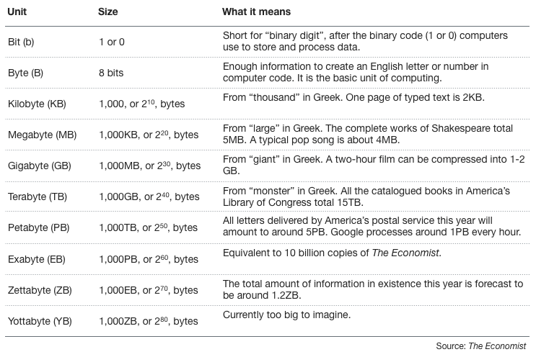
Data sizes…
7.2kb – The Harwell Dekatron – 1951.
Notes:
http://highscalability.com/blog/2012/9/11/how-big-is-a-petabyte-exabyte-zettabyte-or-a-yottabyte.html

Slide 8
Using Databases to Improve Business Performance and Decision Making
Business intelligence infrastructure
Today includes an array of tools for separate systems, and big data
Contemporary tools:
Data warehouses
Data marts
Hadoop
In-memory computing
Analytical platforms
Notes:
Business intelligence is a very amorphous notion that is not well defined. In this course we refer instead to a “business intelligence” environment which is composed of many different components (including both technology and management dimensions).

Slide 9
Using Databases to Improve Business Performance and Decision Making
Data warehouse:
Stores current and historical data from many core operational transaction systems
Consolidates and standardizes information for use across enterprise, but data cannot be altered
Provides analysis and reporting tools
Data marts:
Subset of data warehouse
Summarized or focused portion of data for use by specific population of users
Typically focuses on single subject or line of business
Notes:
This slide discusses the use of data warehouses, and data marts, by firms.
Ask students why having a data warehouse is an advantage for firms hoping to perform business analyses on the data? Why does there have to be a repository of data that is separate from the transaction database?

Slide 10
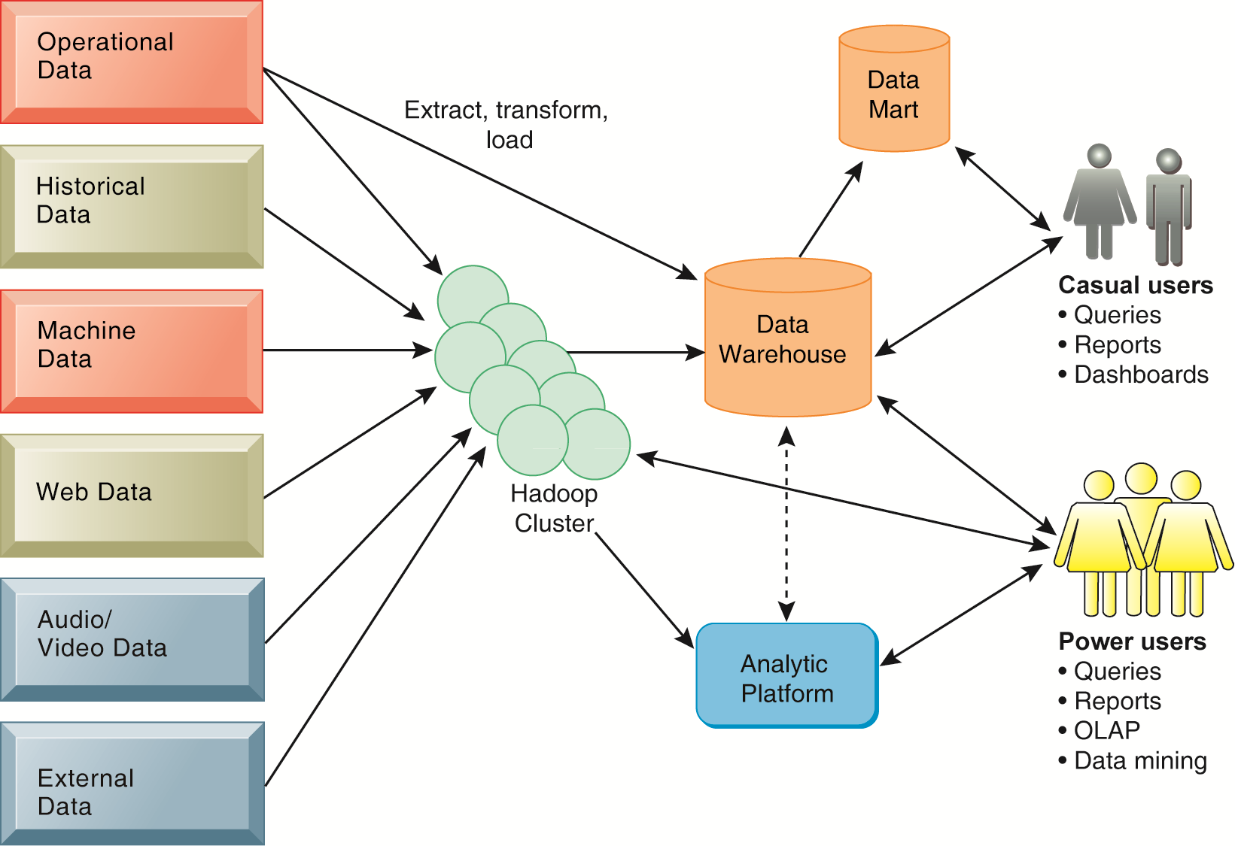
COMPONENTS OF A DATA WAREHOUSE
A contemporary business intelligence infrastructure features capabilities and tools to manage and
analyze large quantities and different types of data from multiple sources. Easy-to-use query and
reporting tools for casual business users and more sophisticated analytical toolsets for power users
are included.
FIGURE 6-12
Notes:
This graphic illustrates the components of a data warehouse system. It shows that the data warehouse extracts data from multiple sources, both internal and external, including a Hadoop cluster, and transforms it as needed for the data warehouse systems. An analytic platform has tools for power users, including reporting, OLAP, and data mining, to extract meaningful information from the data warehouse and Hadoop cluster. A subset of the data warehouse is collected in a data mart for casual groups of users.

Slide 11
Using Databases to Improve Business Performance and Decision Making
Hadoop
Enables distributed parallel processing of big data across inexpensive computers
Key services
Hadoop Distributed File System (HDFS): data storage
MapReduce: breaks data into clusters for work
Hbase: NoSQL database
Used by Facebook, Yahoo, NextBio
What is Hadoop? Other big data terms like MapReduce? Cloudera's CEO talks us through big data trends
http://www.youtube.com/watch?v=S9xnYBVqLws
Lecture from Standford University ‘Introducting Apache Hadoop’ – it’s long, but interesting!
http://www.youtube.com/watch?v=d2xeNpfzsYI
Explaining Hadoop to your CEO:
http://www.forbes.com/sites/danwoods/2011/11/03/explaining-hadoop-to-your-ceo/
Notes:
In-Memory Computing: The Next Big Thing is Already Here – 30Jan2014 – 39minutes. http://www.youtube.com/watch?v=GKFD9q3Worw

Slide 12
Using Databases to Improve Business Performance and Decision Making
In-memory computing
Used in big data analysis
Use computers main memory (RAM) for data storage to avoid delays in retrieving data from disk storage
Can reduce hours/days of processing to seconds
Requires optimized hardware
Analytic platforms
High-speed platforms using both relational and non-relational tools optimized for large datasets
Information Week Article – ’16 Top Big Data Analytics Platforms’
http://www.informationweek.com/big-data/big-data-analytics/16-top-big-data-analytics-platforms/d/d-id/1113609
Notes:
In-memory cloud computing explained: http://www.youtube.com/watch?v=nenRLlYoNw8
What’s RAM? http://www.diffen.com/difference/RAM_vs_ROM

Slide 13
Using Databases to Improve Business Performance and Decision Making
Analytical tools: Relationships, patterns, trends
Tools for consolidating, analyzing, and providing access to vast amounts of data to help users make better business decisions
Multidimensional data analysis (OLAP)
Data mining
Text mining
Web mining
Refer also to article reviewed in-class “An Overview of Business Intelligece Technology” By Surajit Chaudhuri, Umeshwar Dayal, Vivek Narasayya, Communications of the ACM, Vol. 54 No. 8, Pages 88-98
Notes:
This slide illustrates the role and types of analytical tools and techniques for finding useful information and relationships in large data sets.

Slide 14
Using Databases to Improve Business Performance and Decision Making
Online analytical processing (OLAP)
Supports multidimensional data analysis
Viewing data using multiple dimensions
Each aspect of information (product, pricing, cost, region, time period) is different dimension
Example: How many washers sold in East in June compared with other regions?
OLAP enables rapid, online answers to ad hoc queries
Notes:
This slide discusses online analytical processing, one of the three principle tools for gathering business intelligence.
Ask students to come up with additional examples of what a multidimensional query might be.

Slide 15
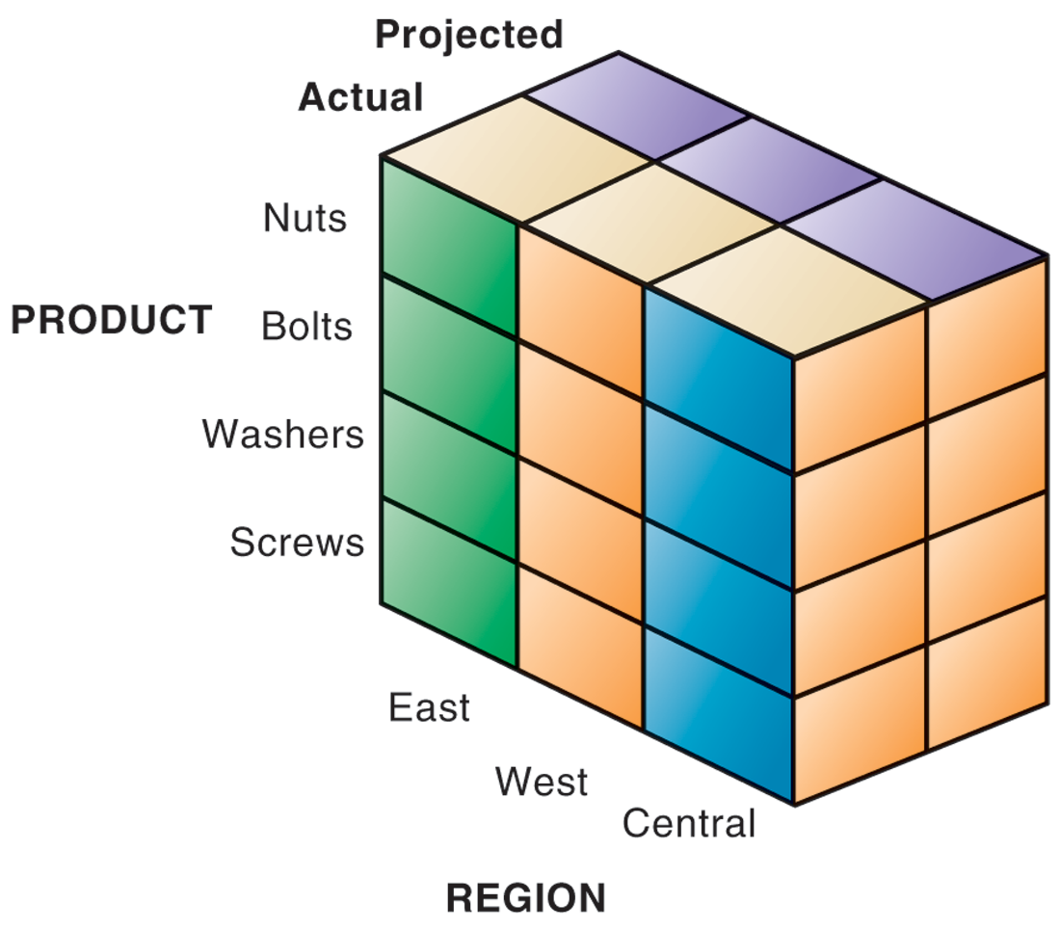
MULTIDIMENSIONAL DATA MODEL
The view that is showing is product versus region. If you rotate the cube 90 degrees, the face that will show product versus actual and projected sales. If you rotate the cube 90 degrees again, you will see region versus actual and projected sales. Other views are possible.
FIGURE 6-13
Notes:
This graphic illustrates the concept of dimensions as it relates to data. Product is one dimension. East is a dimension, and projected and actual sales are two more dimensions. Altogether, we are trying to analyze four dimensions. The business question is: In the Eastern region, what are the actual and projected sales of our products (nuts, bolts, washers, and screws)? Sometimes referred to as a “data cube,” the graphic can depict this four dimensional view of the data. More importantly, when compared to a spreadsheet model of the same data, a graphical data cube is much faster, easier to understand and visualize the relationships.

Slide 16
Using Databases to Improve Business Performance and Decision Making
Data mining:
Finds hidden patterns, relationships in datasets
Example: customer buying patterns
Infers rules to predict future behavior
Types of information obtainable from data mining:
Associations: Occurrences linked to single event
Sequences: Events linked over time
Classification: Recognizes patterns that describe group to which item belongs
Clustering: Similar to classification when no groups have been defined; finds groupings within data
Forecasting: Uses series of existing values to forecast what other values will be
Notes:
This slide discusses another business intelligence tool driven by databases, data mining. Data mining provides insights into data that cannot be discovered through OLAP, by inferring rules from patterns in data.
Ask students to describe the types of information listed:
Associations: Occurrences linked to single event
Sequences: Events linked over time
Classification: Recognizes patterns that describe group to which item belongs
Clustering: Similar to classification when no groups have been defined; finds groupings within data
Forecasting: Uses series of existing values to forecast what other values will be

Slide 17
Using Databases to Improve Business Performance and Decision Making
Text mining
Extracts key elements from large unstructured data sets
Stored e-mails
Call center transcripts
Legal cases
Patent descriptions
Service reports, and so on
Sentiment analysis software
Mines e-mails, blogs, social media to detect opinions
Notes:
Whereas data mining describes analysis of data in databases, there are other types of information that can be “mined,” such as text mining and Web mining. Ask students what other types of unstructured textual data sets a company might store, and what kind of useful information might be extracted from them.

Slide 18
Using Databases to Improve Business Performance and Decision Making
Web mining
Discovery and analysis of useful patterns and information from Web
Understand customer behavior
Evaluate effectiveness of Web site, and so on
Web content mining
Mines content of Web pages
Web structure mining
Analyzes links to and from Web page
Web usage mining
Mines user interaction data recorded by Web server
Notes:
This slide continues the exploration of mining stored data for valuable information. In addition to text mining, there are several ways to mine information on the Web. The text uses the example of marketers using Google Trends and Google Insights for Search services, which track the popularity of various words and phrases used in Google search queries, to learn what people are interested in and what they are interested in buying. What type of Web mining is this? Why might a marketer be interested in the number of Web pages that link to a site?

Slide 19
CHAPTER 12: ENHANCING DECISION MAKING
Decision Making and Information Systems
Three main reasons why investments in information technology do not always produce positive results
Information quality
High-quality decisions require high-quality information
Management filters
Managers have selective attention and have variety of biases that reject information that does not conform to prior conceptions
Organizational inertia and politics
Strong forces within organizations resist making decisions calling for major change

Slide 20
Decision Making and Information Systems
High-velocity automated decision making
Made possible through computer algorithms precisely defining steps for a highly structured decision
Humans taken out of decision
For example: High-speed computer trading programs
Trades executed in 30 milliseconds
Responsible for “Flash Crash” of 2010
Require safeguards to ensure proper operation and regulation

Slide 21
Business Intelligence in the Enterprise
Business intelligence
Infrastructure for collecting, storing, analyzing data produced by business
Databases, data warehouses, data marts
Business analytics
Tools and techniques for analyzing data
OLAP, statistics, models, data mining
Business intelligence vendors
Create business intelligence and analytics purchased by firms

Slide 22
Analytics Help the Cincinnati Zoo Know Its Customers
What management, organization, and technology factors were behind the Cincinnati Zoo losing opportunities to increase revenue?
Why was replacing legacy point-of-sale systems and implementing a data warehouse essential to an information system solution?
How did the Cincinnati Zoo benefit from business intelligence? How did it enhance operational performance and decision making? What role was played by predictive analytics?
Visit the IBM Cognos Web site and describe the business intelligence tools that would be the most useful for the Cincinnati Zoo.
Notes:
http://www.youtube.com/watch?v=IlNu15rVKSg

Slide 23
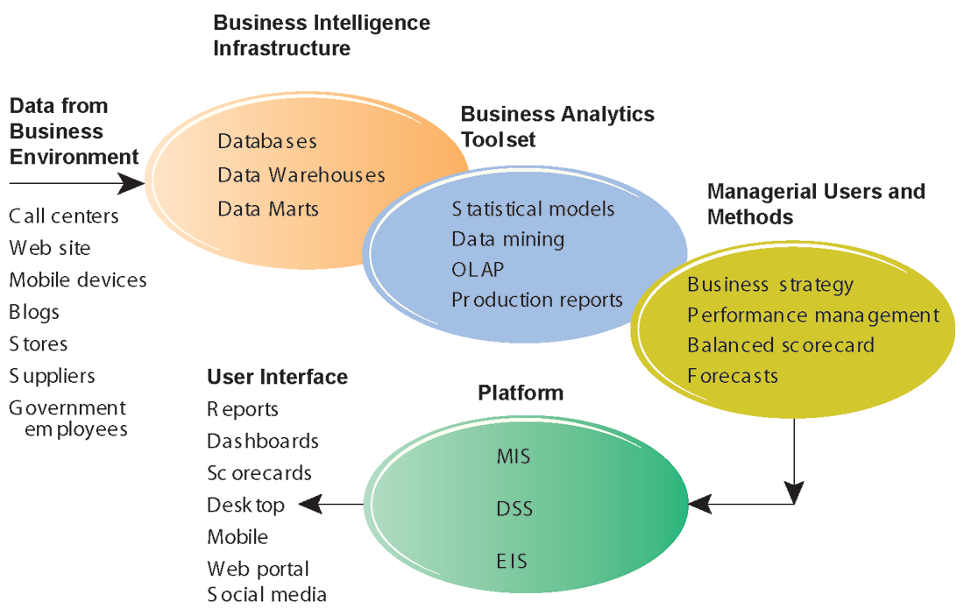
BUSINESS INTELLIGENCE AND ANALYTICS FOR DECISION SUPPORT
Business intelligence and analytics requires a strong database foundation, a set of analytic tools, and an involved management team that can ask intelligent questions and analyze data.
FIGURE 12-3

Slide 24
Business Intelligence in the Enterprise
Six elements in the business intelligence environment
Data from the business environment
Business intelligence infrastructure
Business analytics toolset
Managerial users and methods
Delivery platform—MIS, DSS, ESS
User interface

Slide 25
Business Intelligence in the Enterprise
Business intelligence and analytics capabilities
Goal is to deliver accurate real-time information to decision makers
Main functionalities of BI systems
Production reports
Parameterized reports
Dashboards/scorecards
Ad hoc query/search/report creation
Drill down
Forecasts, scenarios, models

Slide 26
Business Intelligence in the Enterprise
Business intelligence users
80% are casual users relying on production reports
Senior executives
Use monitoring functionalities
Middle managers and analysts
Ad-hoc analysis
Operational employees
Prepackaged reports
For example: sales forecasts, customer satisfaction, loyalty and attrition, supply chain backlog, employee productivity

Slide 27
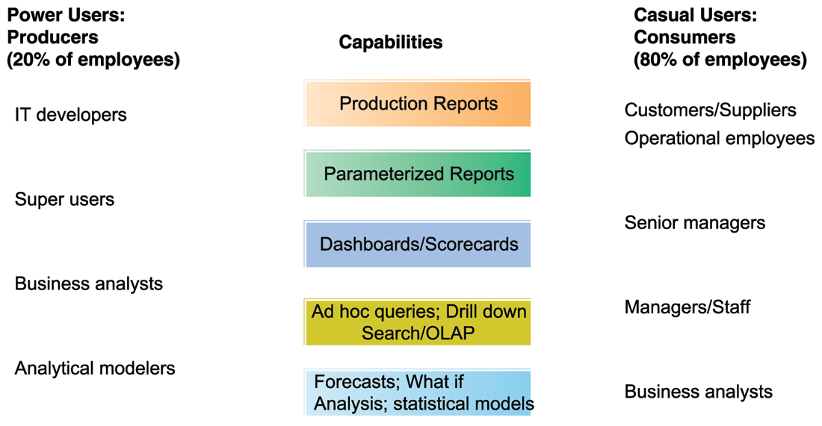
BUSINESS INTELLIGENCE USERS
FIGURE 12-4
Casual users are consumers of BI output, while intense power users are the producers of reports, new analyses, models, and forecasts.

Slide 28
Business Intelligence in the Enterprise
Production reports
Most widely used output of BI suites
Common predefined, prepackaged reports
Sales: Forecast sales; sales team performance
Service/call center: Customer satisfaction; service cost
Marketing: Campaign effectiveness; loyalty and attrition
Procurement and support: Supplier performance
Supply chain: Backlog; fulfillment status
Financials: General ledger; cash flow
Human resources: Employee productivity; compensation

Slide 29
Business Intelligence in the Enterprise
Predictive analytics
Use variety of data, techniques to predict future trends and behavior patterns
Statistical analysis
Data mining
Historical data
Assumptions
Incorporated into numerous BI applications for sales, marketing, finance, fraud detection, health care
Credit scoring
Predicting responses to direct marketing campaigns

Slide 30
Business Intelligence in the Enterprise
Big data analytics
Big data: Massive datasets collected from social media, online and in-store customer data, and so on
Help create real-time, personalized shopping experiences for major online retailers
Hunch.com, used by eBay
Customized recommendations
Database includes purchase data, social networks
Taste graphs map users with product affinities
Notes:
Ref: article on Moodle about Fedex CIO.

Slide 31
Business Intelligence in the Enterprise
Additional BI applications
Data visualization and visual analytics tools
Help users see patterns and relationships that would be difficult to see in text lists
Rich graphs, charts
Dashboards
Maps
Geographic information systems (GIS)
Ties location-related data to maps
Example: For helping local governments calculate response times to disasters

Slide 32
Business Intelligence in the Enterprise
Two main management strategies for developing BI and BA capabilities
One-stop integrated solution
Hardware firms sell software that run optimally on their hardware
Makes firm dependent on single vendor—switching costs
Multiple best-of-breed solution
Greater flexibility and independence
Potential difficulties in integration
Must deal with multiple vendors

Slide 33
Business Intelligence Constituencies
Operational and middle managers
Use MIS (running data from TPS) for:
Routine production reports
Exception reports
“Super user” and business analysts
Use DSS for:
More sophisticated analysis and custom reports
Semistructured decisions

Slide 34
Business Intelligence Constituencies
Decision support systems
Use mathematical or analytical models
Allow varied types of analysis
“What-if” analysis
Sensitivity analysis
Backward sensitivity analysis
Multidimensional analysis / OLAP
For example: pivot tables

Slide 35
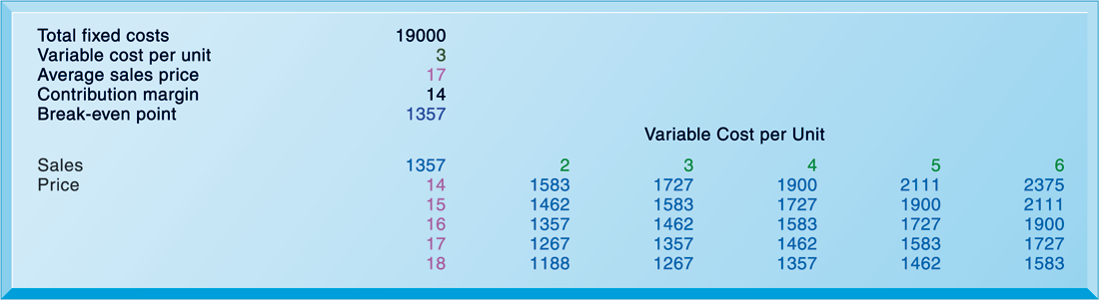
SENSITIVITY ANALYSIS
FIGURE 12-5
This table displays the results of a sensitivity analysis of the effect of changing the sales price of a necktie and the cost per unit on the product’s break-even point. It answers the question, “What happens to the break-even point if the sales price and the cost to make each unit increase or decrease?”

Slide 36
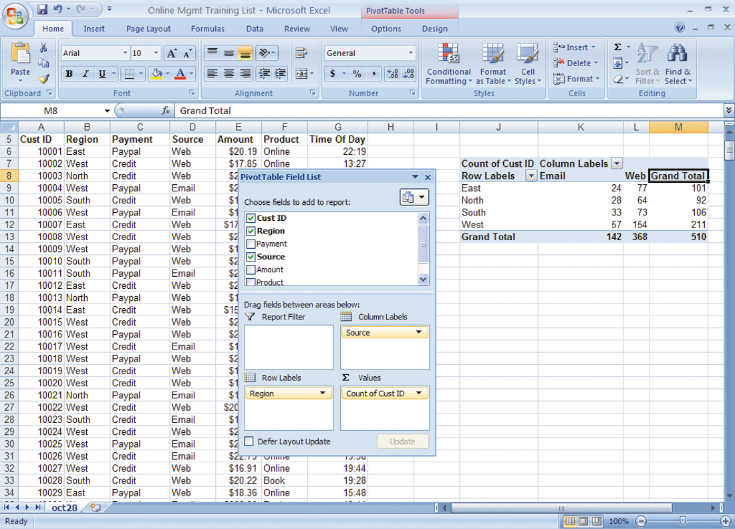
A PIVOT TABLE THAT EXAMINES CUSTOMER REGIONAL DISTRIBUTION AND ADVERTISING SOURCE
In this pivot table, we are able to examine where an online training company’s customers come from in terms of region and advertising source.
FIGURE 12-6
Notes:
This graphic shows the same Microsoft Excel spreadsheet with a PivotTable with two dimensions—it shows where customers come from in terms of region and advertising source.

Slide 37
Page 506, chapter 12 in text book.
Colgate-Palmolive Keeps Managers Smiling with Executive Dashboards
Describe the different types of business intelligence users at Colgate-Palmolive.
Describe the “people” issues that were affecting Colgate’s ability to use business intelligence.
What management, organization, and technology factors had to be addressed in providing business intelligence capabilities for each type of user?
What kind of decisions does Colgate’s new business intelligence capability support? Give three examples. What is their potential business impact?
Notes:
Text is on pg.506 of the textbook, Management Information Systems, 13th edition by Laudon & Laudon.

