Slide 1

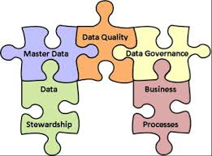
Data Management
Maria Barry
May 2014

Slide 2
Data Management
Master Data Management (MDM)
Data Governance
Data Quality

Slide 3
Master Data Management (MDM)
Master data management (MDM) is a technology-enabled discipline in which business and IT work together to ensure the uniformity, accuracy, stewardship, semantic consistency and accountability of the enterprise’s official shared master data assets. Master data is the consistent and uniform set of identifiers and extended attributes that describes the core entities of the enterprise including customers, prospects, citizens, suppliers, sites, hierarchies and chart of accounts.(Gartner, 2013)
Source: Gartner (2013) http://www.gartner.com/it-glossary/master-data-management-mdm Accessed 26/05/2014.

Slide 4
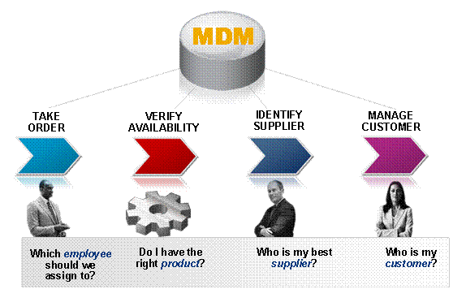
Click image for link to source;
http://help.sap.com/saphelp_mdm550/helpdata/en/47/1c5928cd0412b8e10000000a1553f7/content.htm
Notes:
So the definition and handling of master data is a task of paramount importance for a company because:
● Master data is needed to make decisions on all company levels.
● Business processes throughout the entire company rely on master data.
● High-quality master data helps to improve the operational efficiency of a company.
● With high-quality master data, costs can be reduced. With a Global Spend Analysis you can negotiate better prices granted from the suppliers.

Slide 5
What is Master Data?
Master Data is common data about customers, suppliers, partners, products, materials, accounts and other critical “entities,” that is commonly stored and replicated across IT systems.
Master Data is the high-value, core information used to support critical business processes across the enterprise. It is at the heart of every business transaction, application, report and decision.
Big data really means all data - both structured and unstructured. The combination of MDM and emerging big data technologies provides a 360-degree view of customers and products.
Source: IBM, http://www-01.ibm.com/software/data/master-data-management/overview.html Accessed 26/05/2014

Slide 6
Master Data Is The Lifeblood Of Most Enterprises
Companies can’t conduct their day-to-day activities without having basic records on customers, products, suppliers, employees, locations, assets and more.
Yet across virtually every industry, the volume of operational information is rising exponentially in both size and complexity.
The goal of any MDM initiative should be to provide processes for collecting, aggregating, matching, consolidating, assuring quality and distributing critical data throughout an organization to ensure consistency and control in the ongoing maintenance and application use of this information.
Source: Lyngsø, Mikael (2013), http://www.information-management.com/news/find-mdm-success-in-a-big-data-world-10025085-1.html Accessed 26/05/2014

Slide 7

In most organizations, operational information is duplicated and scattered across multiple systems and applications, which makes it difficult for decision-makers to achieve a unified view of operational intelligence.
Disparate information also prevents customers from getting the accurate and timely information they need to make purchasing decisions.
In fact, most transactional data is linked in some way to master data.
So, missing data, low quality information and untrustworthy or inaccurate records have a big impact on revenue, productivity, costs, compliance, agility and decision-making.
Therefore, managing this master-level information proactively as it flows through the organization is essential to improving business performance.

Slide 8
Organisations may need MDM if any of the following are true:
Business groups manage data within Excel spreadsheets.
Data is in disparate systems.
The company is unable to control brand consistency.
Organization has multiple (potentially inconsistent) versions of the same data.
Data quality is suspect or unreliable.
Classification, identification and reconciliation of data is inconsistent.
The company is going through or planning a merger or acquisition.

Slide 9
Master Data Management
MDM is enabled by integration tools and techniques for ETL, EAI, EII, and replication. MDM is related to data governance, which aims to improve data’s quality, share it broadly, leverage it for competitive advantage, manage change, and comply with regulations and standards.
Source: http://tdwi.org/portals/master-data-management.aspx Accessed 26/05/2014.
Notes:
ETL (Extract, Transform, Load): ETL systems are commonly used to integrate data from multiple applications, typically developed and supported by different vendors or hosted on separate computer hardware.
Enterprise application integration (EAI) is the use of software and computer systems architectural principles to integrate a set of enterprise computer applications.
Enterprise Information Integration or EII is defined in Wikipedia as “a process of information integration, using data abstraction to provide a single interface for viewing all the data within an organization, and a single set of structures and naming conventions to represent this data; the goal of EII is to get a large set of heterogeneous data sources to appear to a user or system as a single, homogeneous data source.”

Slide 10

What is Master Data Management (MDM)? Video by SAS software

Slide 11
Data Governance

Slide 12
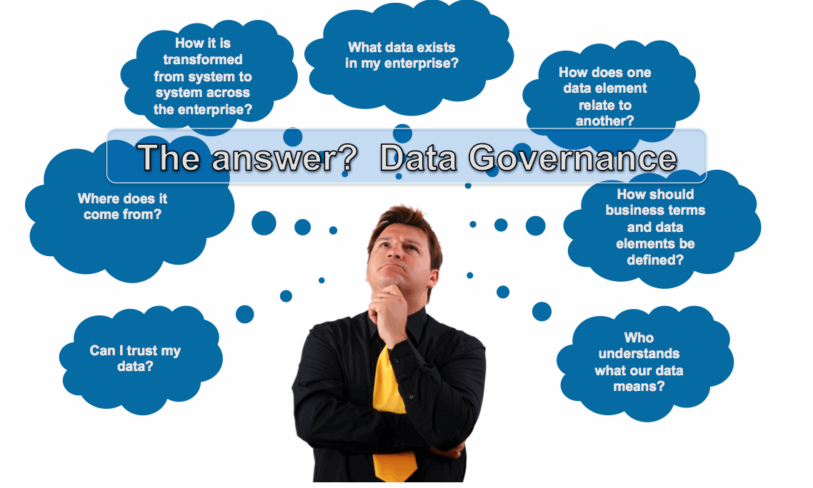

Slide 13
What is Data Governance? Video by SAS software

Slide 14
Data Governance
“Best Practice” is that Data Governance is a Business responsibility
Needs an unambiguous “top down” structure to carve this out and to implement some form of Steering oversight
Business Roles
C-Level
Data Owners
Data Stewards
Needs significant “bottom up” resourcing to perform the corresponding tasks.
MUST, MUST align Data Governance with the politics of your Organisation structure.

Slide 15
Data Governance
According to Eckerson (2011): A data governance framework defines guiding principles, goals, policies, roles, decision rights, accountability, processes, measurements and oversight committees.
It is wise to recruit outside experts to mentor this effort because it’s not a technology initiative; it’s a change management endeavor.
http://www.beyeresearch.com/study/15310

Slide 16
Data Governance
C-Level
C-Level executive ultimately responsible for all Data in the organisation
Who?
No single “right answer”
Chief Financial Officer ? Chief Information Officer ?
In larger organisations a new role has emerged
Chief Data Officer
Implement a Data Steering Structure
Set Direction and Priorities
Dismantle Organisational Road-Blocks, Neutralize Organisational Siloes

Slide 17
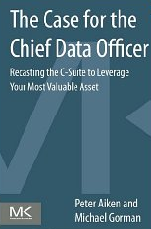
Data Governance
Chief Data Officer
Executive role dedicated to Data
Brings Data to the top table
Three job pillars are:
dedication solely to leveraging data assets
unconstrained by an IT project mindset
reports directly to the business.

Slide 18
Data Governance
Data Owner
Senior Business Manager
Strategic Responsibility for a subset of the organisations data
e.g. “Customer Data” or “Product Data” or “Financial Data”
Implements C-Level directives / policies / prioritization etc.
Change Management Responsibility for that data
Sponsor Own Projects
Influence / Mandate Other Projects
Adjudicate balance between “Local” and “Enterprise” business needs

Slide 19
Data Governance
Data Owner
Drive Strategy and Vision for that data
What, Why, How etc.
Assign / Manage Data Stewards
Collaborate with all other Data Owners on Steering Group
Collective Standards / Practices / Investment etc.

Slide 20
Data Governance
Data Steward
Operational Business Staff
Operational Responsibility for assigned subset of the organisations data
e.g. “Customer Demographics” or “Customer Transactions”
Ongoing, Day-to-Day tasks
Implements Data Owner directives / policies / standards etc.

Slide 21
Data Governance
Data Steward
Specific Responsibilities
Agreement on Data Characteristics such as names, attributes (eg. column length / data type / optionality).
Confirmation that data adheres to Statutory Regulations (eg. Data Protection Act guidelines on appropriate data for electronic capture).
Documentation of requirement for Historical Versions of base data.
Text definition of Business Meaning to ensure that each data element is unambiguously understood across the enterprise.
Definition of Service Level Agreement (aka SLA) including the business criticality prioritisation of each database table.

Slide 22
Data Governance
Data Steward
Specific Responsibilities
Definition of Content Quality within broad categories (eg. perfect, high, medium, low). For example, accounting data is generally of guaranteed data quality whereas demographic data such as ‘date of birth’ or ‘number of cattle’ tends to be of lesser quality.
Proactive monitoring of Data Quality, for example through defining business rules to be executed within Data Quality Scorecards and through analyzing Data Profiles..
Definition of Access Rules taking cognisance of Chinese Walls, contractual agreements, statutory regulations and any restricted/sensitive data.
Formal Approval of Requests for direct (e.g. analyst) or indirect (e.g. application) data access based on assessment that data is fit for the purpose and that the purpose is appropriate

Slide 23
Data Governance
Information Architecture
Information Quality Management
Relevance & Master Data Management
Data Warehousing & Business Intelligence
Structured Data Management
Unstructured Data Management
Meta Data Management
Information Security Management

Slide 24
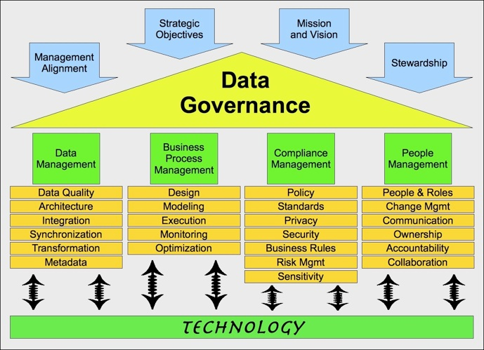

Slide 25
Data Quality

Slide 26
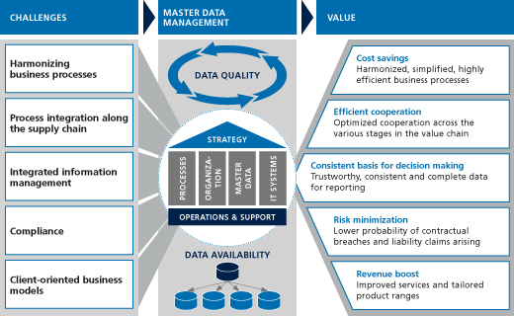
Notes:
http://www.camelot-itlab.com/en/products/master-data-management/

Slide 27
Poor Quality Data?
Data Quality By Example: Old Beer bought by Old Man
http://www.information-management.com/blogs/dq-by-example-old-beer-bought-by-old-man-10024988-1.html?portal=governance-risk-compliance

Slide 28
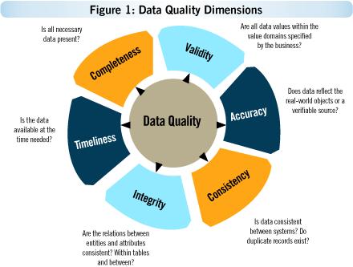
Dimensions of Good Quality Data?
Completeness
Timeliness
Consistency
Validity
Integrity
Accuracy
Notes:
Image source: http://www.information-management.com/issues/2007_58/master_data_management_mdm_quality-10015358-1.html

Slide 29
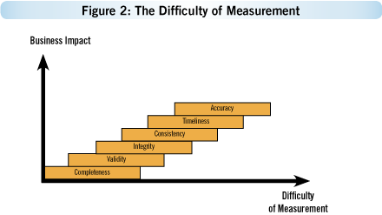
Dimensions of Good Quality Data?
Notes:
Image source: http://www.information-management.com/issues/2007_58/master_data_management_mdm_quality-10015358-1.html

Slide 30
Completeness of data
Completeness of data is the extent to which the expected attributes of data are provided.
For example, a customer data is considered as complete if:
All customer addresses, contact details and other information are available.
Data of all customers is available.
Data Completeness definition is the 'expected completeness'. Every data requirement has 'mandatory' and 'optional' aspects. For example customer's mailing address is mandatory and it is available and because customer’s office address is optional, it is OK if it is not available.
Data can be complete, but inaccurate:
All the customers' addresses are available, but many of them are not correct.
The health records of all patients have 'last visit' date, but some of it contains the future dates.

Slide 31
Data Timeliness
'Data delayed' is 'Data Denied'
The timeliness of data is extremely important. This is reflected in:
Companies are required to publish their quarterly results with in a given frame of time.
Customers service providing up-to date information to the customers.
Credit system checking on the credit card account activity.
The timeliness depends on user expectation. An online availability of data could be required for room allocation system in Hospitality, but an overnight data is fine for a billing system.
Example of Data not being timely:
The courier package status is delivered, but it will be updated in the system only in the night batch run. This means that online status will not be available.
The financial statements of a company are published one month after the year-end.
The census data is available two years after the census is done.

Slide 32
Data Consistency
Consistency of Data means that data across the enterprise should be in synch with each other.
Example of data in-consistency:
A credit card is cancelled, and inactive, but the card billing status shows 'due'.
Data can be accurate (i.e., it will represent what happened in real world), but still inconsistent.
An Airline promotion campaign closure date is Jan 31, and there is a passenger ticket booked under the campaign on Feb. 2.
Data is inconsistent, when it is in synch in the narrow domain of an organization, but not in synch across the organization. For example:
Collection management system has the Cheque status as 'cleared', but in the accounting system, the money is not shown being credited to the bank account. Reason for this kind of inconsistency is that system interfaces are synchronized during the end-of-day batch runs.

Slide 33
Other Data Quality Dimensions
Validity – is the data itself valid? Context is v.important here. E.g. a phone number would not be expected to include #, @, or % characters, if it did it would be invalid. Validation rules can be implemented in a database to ensure phone numbers are entered in the correct format.
Data integrity is data that has a complete or whole structure. All characteristics of the data including business rules, rules for how pieces of data relate, dates, definitions and lineage must be correct for data to be complete.
Entity integrity concerns the concept of a primary key. Entity integrity is an integrity rule which states that every table must have a primary key and that the column or columns chosen to be the primary key should be unique and not null.
Referential integrity concerns the concept of a foreign key. The referential integrity rule states that any foreign key value can only be in one of two states. The usual state of affairs is that the foreign key value refers to a primary key value of some table in the database. Occasionally, and this will depend on the rules of the business, a foreign key value can be null. In this case we are explicitly saying that either there is no relationship between the objects represented in the database or that this relationship is unknown.

Slide 34
Other Data Quality Dimensions
Data accuracy is one of the components of data quality. It refers to whether the data values stored for an object are the correct values. To be correct, a data values must be the right value and must be represented in a consistent and unambiguous form.
For example, Freds birth date is December 13, 1941. If a personnel database has a BIRTH_DATE data element that expects dates in USA format, a date of 12/13/1941 would be correct. A date of 12/14/1941 would be inaccurate because it is the wrong value. A date of 13/12/1941 would be wrong because it is a European representation instead of a USA representation.

Slide 35
Articles to read
Implementing an Enterprise Data Quality Strategy - Nancy Couture (2013)
Creating an Enterprise Data Strategy: Managing Data as a Corporate Asset - Wayne Eckerson (2011)

