Slide 1

Advanced Business Datat Analysis
Lecture Basic Statistics using R
Semester II – 2015/2016

Slide 2
R – why?
Ability to run regression analyses, experience with R or other Statistical Software a definite plus. (Data Specialist)
Experience of big data and related data analytics, with knowledge of R or similar statistics tools. (Business Intelligence Analyst)
Source: Linkedin Jobs
Notes:
If you can work with R you will pick up transferable skills and other stats packages won’t be a problem.
It is good thing to have on your CV!

Slide 3

R – why?
Not a Programming Class!
R for:
Descriptive statistics
Inferential statistics
Plotting charts

Slide 4

R – why?
http://www.meetup.com/DublinR
Free
Online resources
Continuous learning
R Community
Recent meetups:
Going Beyond Linear Regression
Making Maps with R
The Hitchhikers Guide to Statistics with R
Notes:
R is an open source language commonly used for statistical computing. There are an estimated 1 million R users worldwide, and that number is rapidly growing.
The Dublin R Users Group is dedicated to promoting R in Ireland, and the bringing together R practitioners to exchange tips, ideas and knowledge.
Dublin R also looks at emergent programming languages related to technical computing and data analytics, such as Julia ( with a view to providing a foundation for a Julia specific user group)

Slide 5
R – What You Should Already Know
Expressions
Statements
Data Types & Structures
Functions
Input/Output
celciusInput <- readline("please enter a Celcius value:")
celciusNumeric <- as.numeric(celciusInput)
fahrResults <- ((9/5)*celciusNumeric)+32
fahrString <- sprintf("%.2f", fahrResults)
message <- paste("the result is", fahrString, sep=" ")
print(message)
Notes:
Source (this and following slides): Programming for Big Data module

Slide 6
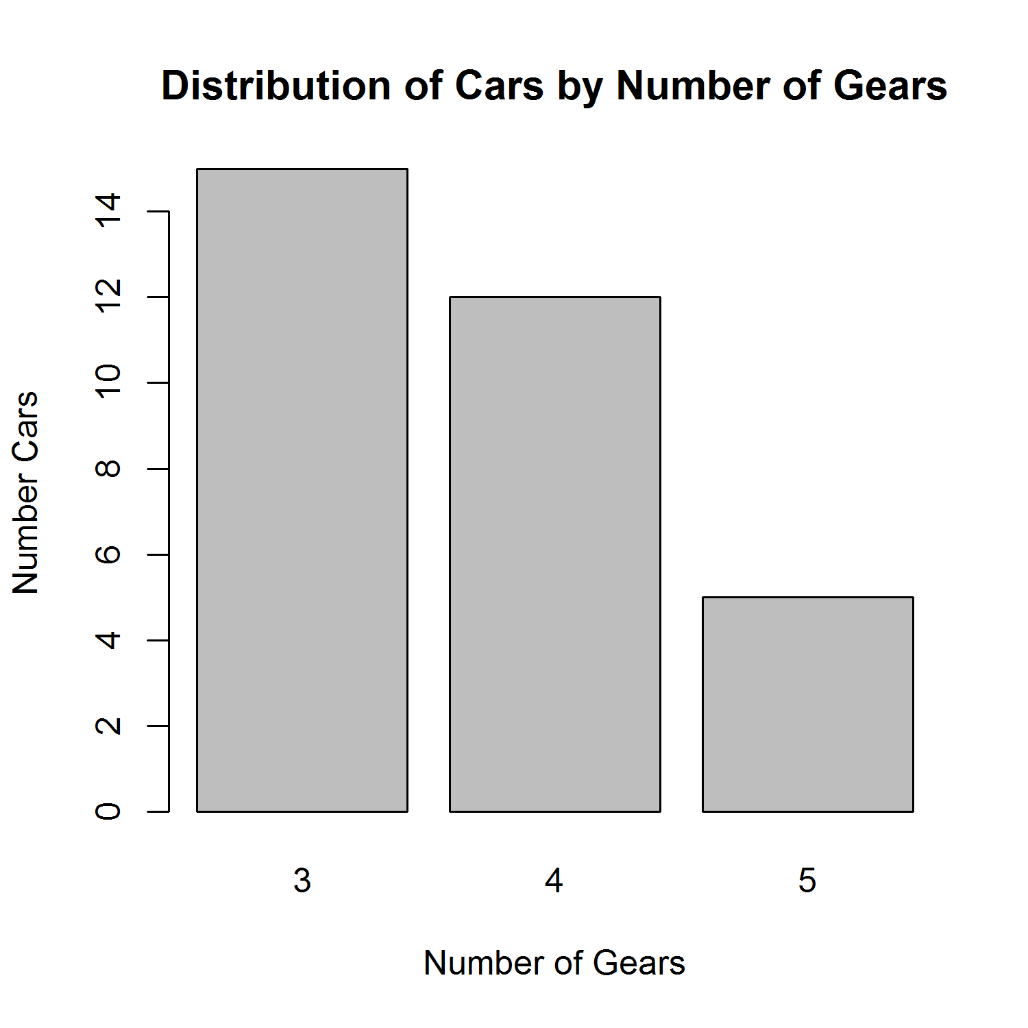
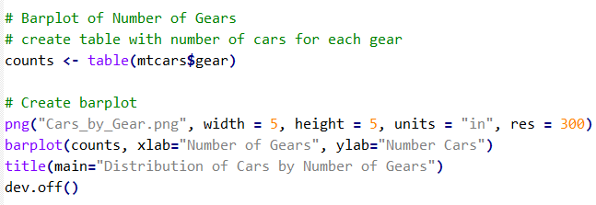
R – What You Should Already Know
Data.frame
Tabular data
Graphics
Notes:
Source (this and following slides): Programming for Big Data module

Slide 7


R – Functions
Function:
A sequence of reusable statements that performs a desired operation
Syntax
Contains a header and a body R syntax without a return value
function header
functionName <-function(list of parameters){
funtionStatementblock
}
function body
Notes:
Sample code from Programming for Big Data module notes

Slide 8
R – Packages
Install following R packages:
install.packages ("stats")
install.packages("ggplot2")
install.packages(“moments")
install.packages(“design")
Load a package using:
library(package name)
Commonly Used Statistical Packages in R
Notes:
Source: http://web.stanford.edu/group/ssds/cgi-bin/drupal/files/Guides/Guide%20to%20R%20Packages_0.pdf
Once a package has been installed, you do not need to reinstall it. However, you will need to load it into a library in each session when you wish to use it.
Note: whereas install.packages() requires quotation marks around the package name, library() takes no quotation marks.
Design: Regression modeling, testing, estimation, validation, graphics, prediction, and typesetting by storing enhanced model design attributes in the fit. Design is a collection of about 180 functions that assist and streamline modeling, especially for biostatistical and epidemiologic applications. It also contains new functions for binary and ordinal logistic regression models and the Buckley-James multiple regression model for right-censored responses, and implements penalized maximum likelihood estimation for logistic and ordinary linear models. Design works with almost any regression model, but it was especially written to work with logistic regression, Cox regression, accelerated failure time models, ordinary linear models, the Buckley-James model, and generalized least squares for serially or spatially correlated observations.
moments: Functions to calculate: moments, Pearson's kurtosis, Geary's kurtosis and skewness; tests related to them.

Slide 9

R – Edgar Anderson's Iris Data
This famous (Fisher's or Anderson's) iris data set gives the measurements in centimetres of the variables:
Sepal length
Sepal width
Petal length
Petal width
….respectively, for 50 flowers from each of 3 species of iris
Iris setosa (Image source: http://www.signa.org
Notes:
From: https://stat.ethz.ch/R-manual/R-devel/library/datasets/html/iris.html
Anderson's Iris Data
Description
This famous (Fisher's or Anderson's) iris data set gives the measurements in centimeters of the variables sepal length and width and petal length and width, respectively, for 50 flowers from each of 3 species of iris. The species are Iris setosa, versicolor, and virginica.
Usage
iris
iris3
Format
iris is a data frame with 150 cases (rows) and 5 variables (columns) named Sepal.Length, Sepal.Width, Petal.Length, Petal.Width, and Species.
iris3 gives the same data arranged as a 3-dimensional array of size 50 by 4 by 3, as represented by S-PLUS. The first dimension gives the case number within the species subsample, the second the measurements with names Sepal L., Sepal W., Petal L., and Petal W., and the third the species.
Source
Fisher, R. A. (1936) The use of multiple measurements in taxonomic problems. Annals of Eugenics, 7, Part II, 179–188.
The data were collected by Anderson, Edgar (1935). The irises of the Gaspe Peninsula, Bulletin of the American Iris Society, 59, 2–5.
References
Becker, R. A., Chambers, J. M. and Wilks, A. R. (1988) The New S Language. Wadsworth & Brooks/Cole. (has iris3 as iris.)
See Also
matplot some examples of which use iris.
Examples
dni3 <- dimnames(iris3) ii <- data.frame(matrix(aperm(iris3, c(1,3,2)), ncol = 4, dimnames = list(NULL, sub(" L.",".Length", sub(" W.",".Width", dni3[[2]])))), Species = gl(3, 50, labels = sub("S", "s", sub("V", "v", dni3[[3]])))) all.equal(ii, iris) # TRUE

Slide 10

R – Edgar Anderson's Iris Data
Display Iris data
iris$Sepal.Length
iris$Sepal.Width
iris$Petal.Length
iris$Petal.Width
> library(datasets)
> Data(iris)
> iris
Sepal.Length Sepal.Width Petal.Length Petal.Width Species
1 5.1 3.5 1.4 0.2 setosa
2 4.9 3.0 1.4 0.2 setosa
3 4.7 3.2 1.3 0.2 setosa
4 4.6 3.1 1.5 0.2 setosa
...
149 6.2 3.4 5.4 2.3 virginica
150 5.9 3.0 5.1 1.8 virginica
Notes:
See: http://www2.warwick.ac.uk/fac/sci/moac/people/students/peter_cock/r/iris_plots/

Slide 11
R – Edgar Anderson's Iris Data
Display Iris variables:
iris$Sepal.Length
iris$Sepal.Width
iris$Petal.Length
iris$Petal.Width
> iris$Sepal.Length
[1] 5.1 4.9 4.7 4.6 5.0 5.4 4.6 5.0 4.4 4.9 5.4 4.8 4.8 4.3
[15] 5.8 5.7 5.4 5.1 5.7 5.1 5.4 5.1 4.6 5.1 4.8 5.0 5.0 5.2
[29] 5.2 4.7 4.8 5.4 5.2 5.5 4.9 5.0 5.5 4.9 4.4 5.1 5.0 4.5
[43] 4.4 5.0 5.1 4.8 5.1 4.6 5.3 5.0 7.0 6.4 6.9 5.5 6.5 5.7
[57] 6.3 4.9 6.6 5.2 5.0 5.9 6.0 6.1 5.6 6.7 5.6 5.8 6.2 5.6
[71] 5.9 6.1 6.3 6.1 6.4 6.6 6.8 6.7 6.0 5.7 5.5 5.5 5.8 6.0
[85] 5.4 6.0 6.7 6.3 5.6 5.5 5.5 6.1 5.8 5.0 5.6 5.7 5.7 6.2
[99] 5.1 5.7 6.3 5.8 7.1 6.3 6.5 7.6 4.9 7.3 6.7 7.2 6.5 6.4
[113] 6.8 5.7 5.8 6.4 6.5 7.7 7.7 6.0 6.9 5.6 7.7 6.3 6.7 7.2
[127] 6.2 6.1 6.4 7.2 7.4 7.9 6.4 6.3 6.1 7.7 6.3 6.4 6.0 6.9
[141] 6.7 6.9 5.8 6.8 6.7 6.7 6.3 6.5 6.2 5.9
>

Slide 12
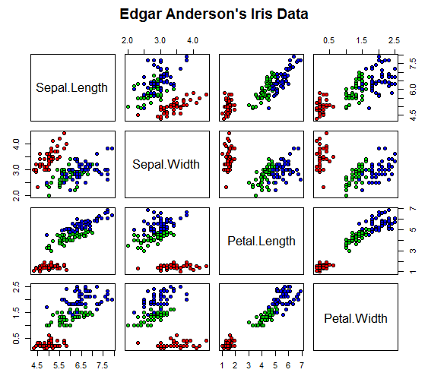
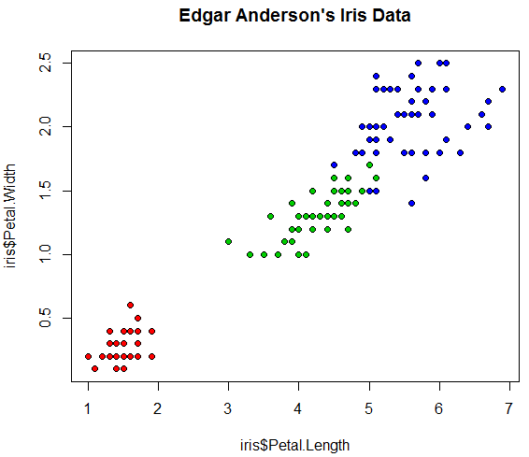
R – Edgar Anderson's Iris Data
Some plots:
> #Scatter plot (colour)
> plot(iris$Petal.Length, iris$Petal.Width, pch=21, bg=c("red","green3","blue")
[unclass(iris$Species)], main="Edgar Anderson's Iris Data")
> # Pairs Scatter Plot
> pairs(iris[1:4], main = "Edgar Anderson's Iris Data", pch = 21, bg = c("red", "green3", "blue")[unclass(iris$Species)])
Notes:
Code to do these:
Scatter plot (colour)
plot(iris$Petal.Length, iris$Petal.Width, pch=21, bg=c("red","green3","blue")[unclass(iris$Species)], main="Edgar Anderson's Iris Data")
Pairs Scatter Plot
pairs(iris[1:4], main = "Edgar Anderson's Iris Data", pch = 21, bg = c("red", "green3", "blue")[unclass(iris$Species)])

Slide 13
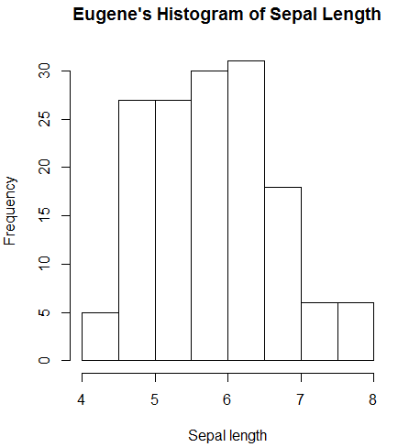
R – Lab 1
Descriptives for Sepal Length variable
> mean(iris$Sepal.Length)
> median(iris$Sepal.Length)
> max(iris$Sepal.Length)
> min(iris$Sepal.Length)
> range(iris$Sepal.Length)
> diff(range(iris$Sepal.Length) > var(iris$Sepal.Length)
> sd(iris$Sepal.Length))
> kurtosis(iris$Sepal.Length)
> skewness(iris$Sepal.Length)
> summary(iris$Sepal.Length) > summary(iris) > hist(iris$Sepal.Length, main=“Sepal Histogram", xlab="Sepal length")
Notes:
Store as script – also provide file in Moodle.

Slide 14
R – Lab 1
Inferential statistics using BDA data
Input and read data from a file
Set working directory (folder)
> # Set working Directory DIFFERENT FOR STUDENTS! > # > # Tom’s path: C:\Users\Tom\Google Drive\Documents\R > #
> setwd(file.path("C:", "Users", “Tom", "Google Drive", "Documents", "R"))
>
Notes:
If want to use Iris data:
> t.test(iris$Sepal.Length, iris$Petal.Length, alternative = "less")

Slide 15
R – Lab 1
Unpaired/Independent t test
# Read in data file (from Salkind, p203)
data1 <- read.csv(file="Salkind-t-Test-p203.csv",head=TRUE,sep=",")
#
data1 # display the data file
#
# t Test - Independent/Unpaired
t.test(data1$Group.1, data1$Group.2, alternative = "two.sided", paired = FALSE)
#
Welch Two Sample t-test
data: data_p203$Group.1 and data_p203$Group.2
t = -0.1371, df = 47.635, p-value = 0.8915
alternative hypothesis: true difference in means is not equal to 0
95 percent confidence interval:
-1.566803 1.366803
sample estimates:
mean of x mean of y
5.433333 5.533333
Output
Notes:
If want to use Iris data:
> t.test(iris$Sepal.Length, iris$Petal.Length, alternative = "less")

Slide 16
R – Lab 1
Paired/Dependent t test
> # Read in data file
> data2 <- read.csv(file="t-Test-Paired-Example.csv",head=TRUE,sep=",")
> #
> data2 # display data
> t.test(data2$Sample.A, data2$Sample.B, alternative = "two.sided", paired = TRUE)
Paired t-test
data: data_paired$Sample.A and data_paired$Sample.B
t = -2.3781, df = 14, p-value = 0.03219
alternative hypothesis: true difference in means is not equal to 0
95 percent confidence interval:
-10.3970850 -0.5362483
sample estimates:
mean of the differences
-5.466667
Output

Slide 17
R – Lab 1
Drug A 4 5 4 3 2 4 3 4 4
Drug B 6 8 4 5 4 6 5 8 6
Drug C 6 7 6 6 7 5 6 5 5
One-Way ANOVA
> # Read in data > pain = c(4, 5, 4, 3, 2, 4, 3, 4, 4, 6, 8, 4, 5, 4, 6, 5, 8, 6, 6, 7, 6, 6, 7, 5, 6, 5, 5) #
> drug = c(rep("A",9), rep("B",9), rep("C",9)) migraine = data.frame(pain,drug)
> # run ANOVA test
> results = aov(pain ~ drug, data=migraine)
> #
> summary(results) # display ANOVA table
Output
Df Sum Sq Mean Sq F value Pr(>F)
drug 2 28.22 14.111 11.91 0.000256 ***
Residuals 24 28.44 1.185
---
Notes:
#
# Do same test reading data from a file - "ANOVA-Drugs-Test2.csv"
#
data_drugs <- read.csv(file="ANOVA-Drugs-Test-2.csv",head=TRUE,sep=",")
#
data_drugs # display data
#
# Use anova function
#
anova(lm(Values ~ Group, data_drugs)) # Run the test should give result F = 11.906
#
# Use aov function
#
results2 = aov(Values ~ Group, data=data_drugs) # run test - should get same result
summary(results2) # display ANOVA table
#

Slide 18
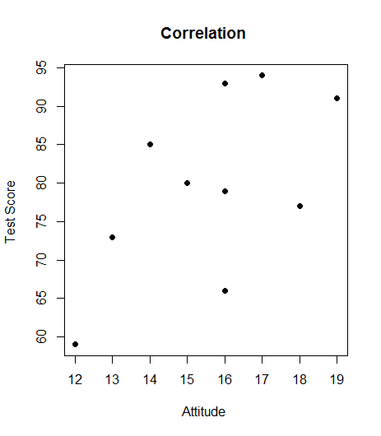
R – Lab 1
Correlation
> # Read in data > correl_data <- read.csv(file="CorrelationData.csv",head=TRUE,sep=",")
> correl_data # Display data
> cor(correl_data$Test_Score, correl_data$Attitude) # Calculate r
#
> plot(correl_data$Test_Score, correl_data$Attitude, main="Correlation ", xlab="Attitude ", ylab="Test Score ", pch=19) >
Output
[1] 0.5960948

Slide 19
R Overview
R is a comprehensive statistical and graphical programming language and is a dialect of the S language:
1988 - S2: RA Becker, JM Chambers, A Wilks
1992 - S3: JM Chambers, TJ Hastie
1998 - S4: JM Chambers
R: initially written by Ross Ihaka and Robert Gentleman at Dep. of Statistics of U of Auckland, New Zealand during 1990s.
Since 1997: international “R-core” team of 15 people with
access to common CVS archive.
Notes:
This to end taken from Jer Hayes notes.

Slide 20
R Overview
A key skill to using R effectively is learning how to use the built-in help system. Other sections describe the working environment, inputting programs and outputting results, installing new functionality through packages etc.
A fundamental design feature of R is that the output
from most functions can be used as input to other
functions. This is described in reusing results.

Slide 21
R Interface
Start the R system, the main window (RGui) with a sub window (R Console) will appear
In the `Console' window the cursor is waiting for you to type in some R commands.

Slide 22
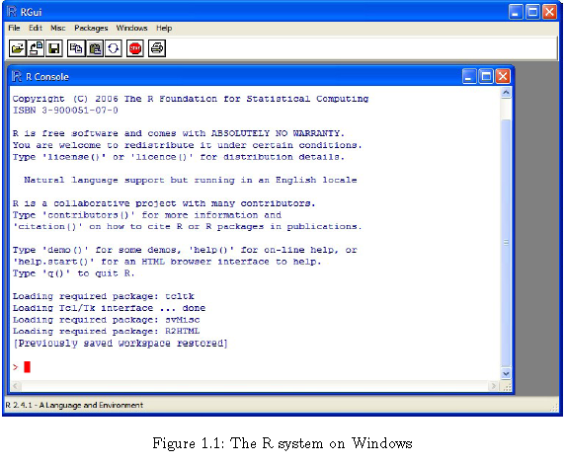
Typical R Session

Slide 23
R Introduction
Results of calculations can be stored in objects using the assignment operators:
An arrow (<-) formed by a smaller than character and a hyphen without a space!
The equal character (=).

Slide 24
R Help
Once R is installed, there is a comprehensive
built-in help system. At the program's command
prompt you can use any of the following:
help.start() # general help
help(foo) # help about function foo
?foo # same thing
apropos("foo") # list all function containing string foo
example(foo) # show an example of function foo

Slide 25
R Datasets
R comes with a number of sample datasets that
you can experiment with. Type
> data( )
to see the available datasets. The results will
depend on which packages you have loaded.
Type
help(datasetname)
for details on a sample dataset.
If you use R for data mining (and you should!) you will come across many classic data sets, e.g., the IRIS data set.

Slide 26
R Packages
One of the strengths of R is that the system can easily be extended.
The system allows you to write new functions and package those
functions in a so called `R package' (or `R library').
The R package may also contain other R objects, for example data
sets or documentation.
There is a lively R user community and many R packages have been
written and made available on CRAN for other users. Just a few
examples, there are packages for portfolio optimization, drawing
maps, exporting objects to html, time series analysis, spatial statistics
and the list goes on and on.

Slide 27
Graphs
To redirect graphic output use one of the
following functions. Use dev.off( ) to return
output to the terminal.
Function | Output to
pdf("mygraph.pdf") | pdf file
win.metafile("mygraph.wmf") | windows metafile
png("mygraph.png") | png file
jpeg("mygraph.jpg") | jpeg file
bmp("mygraph.bmp") | bmp file
postscript("mygraph.ps") | postscript file

Slide 28
Redirecting Graphs
# example - output graph to jpeg file
jpeg("c:/mygraphs/myplot.jpg")
plot(x)
dev.off()

Slide 29
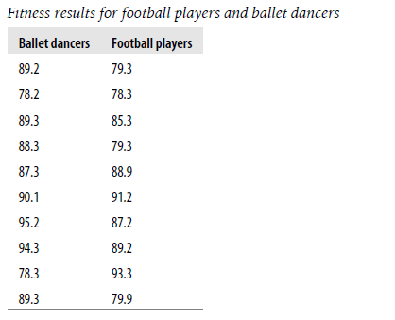
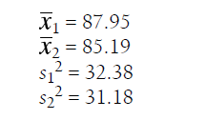
Example

Slide 30
In R
> football <- c(79.3,78.3,85.3,79.3,88.9,91.2,87.2,89.2,93.3,79.9) > ballet <- c(89.2,78.2,89.3,88.3,87.3,90.1,95.2,94.3,78.3,89.3) > t.test(ballet,football,"two.sided",0,FALSE,TRUE,0.95) Two Sample t-testdata: ballet and football t = 1.0947, df = 18, p-value = 0.2881 alternative hypothesis: true difference in means is not equal to 0 95 percent confidence interval: -2.536815 8.056815 sample estimates: mean of x mean of y 87.95 85.19
Remember:
> help(t.test)

Slide 31
Summary
What are the preconditions for the tests we have looked?
Using statistical packages to check some of these preconditions.
Looking at more than one dimension / factor with the ANOVA and regression.
Multiple linear regression
Two-way ANOVA…
Dimension reduction and classification.
Factor analysis…
Power and effect.
Some non-parametric alternatives to the tests we have looked at.

