Slide 1
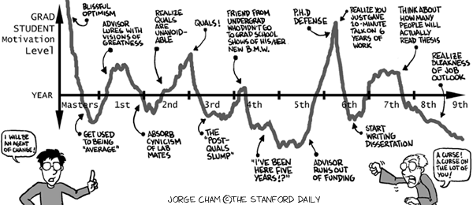
Basic Statistical Concepts
www.phdcomics.com

Slide 2
So, you have collected your data …
Now what?
We use statistical analysis to
  test our hypotheses
  make claims about the population
This type of analyses are called inferential statistics

Slide 3
But, first we must …
Organize, simplify, and describe our body of data (distribution).
These statistical techniques are called descriptive statistics

Slide 4
Distributions
Recall a variable is a characteristic that can take different values
A distribution of a variable is a summary of all the different values of a variable
  Both type (each value) and token (each instance)

Slide 5






Distribution
How excited are you about learning statistical concepts?
1 2 3 4 5 6 7
Comatose Hyperventilating
1
2
2
3
4
4
5
6
7
7 Types: 1,2,3,4,5,6,7
9 Tokens: 1,2,2,3,4,4,5,6,7

Slide 6
Distribution
2
1
1
2
3
4
5
6
7
N = 9

Slide 7
Properties of a Distribution
Shape
  symmetric vs. skewed
  unimodal vs. multimodal
Central Tendency
  where most of the data are
  mean, median, and mode
Variability (spread)
  how similar the scores are
  range, variance, and standard deviation

Slide 8
Representing a Distribution
Often it is helpful to visually represent distributions in various ways
Graphs
  continuous variables (histogram, line graph)
  categorical variables (pie chart, bar chart)
Tables
  frequency distribution table

Slide 9
Distribution
What if we collected 200 observations instead of only 9?
…

Slide 10
Distribution
N = 200
50
40
30
20
10
1
2
3
4
5
6
7

Slide 11
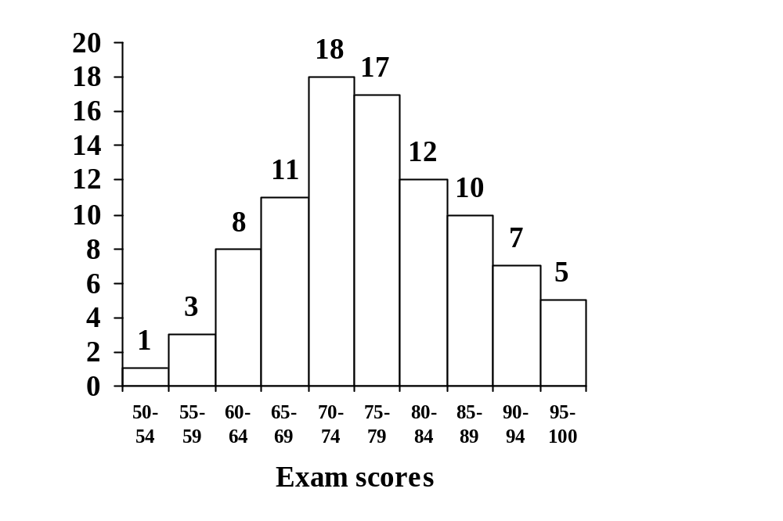
Continuous Variables

Slide 12
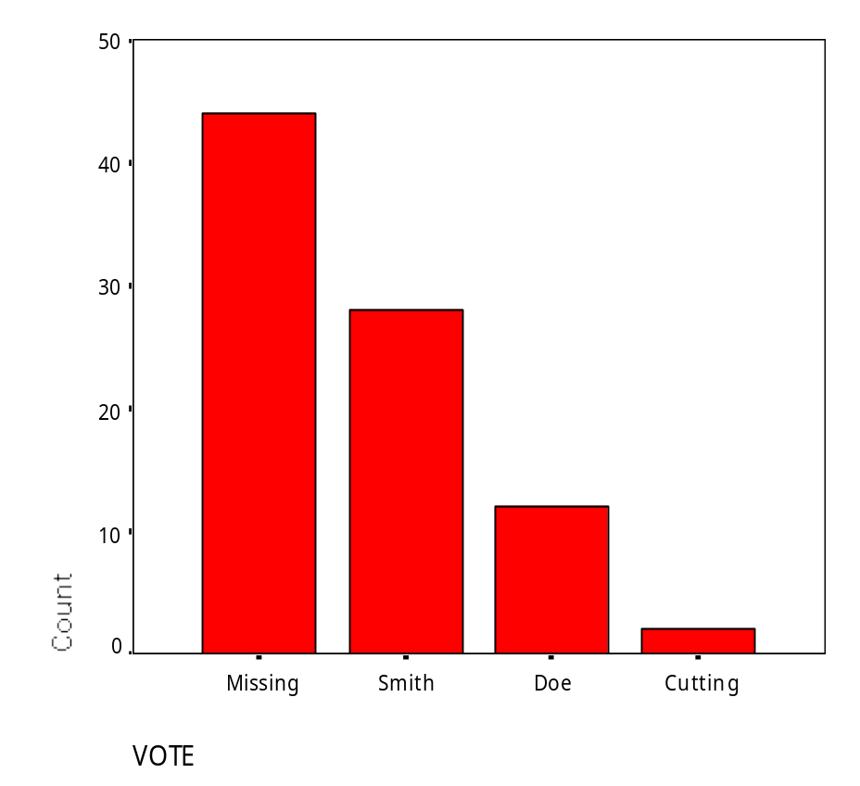
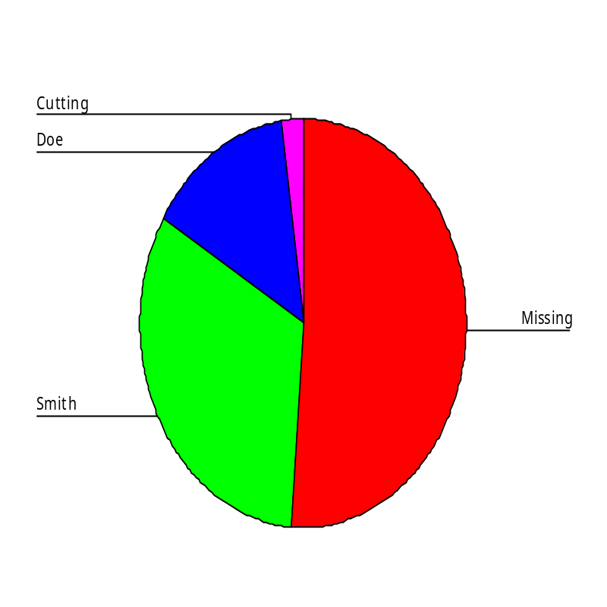
Categorical Variables

Slide 13
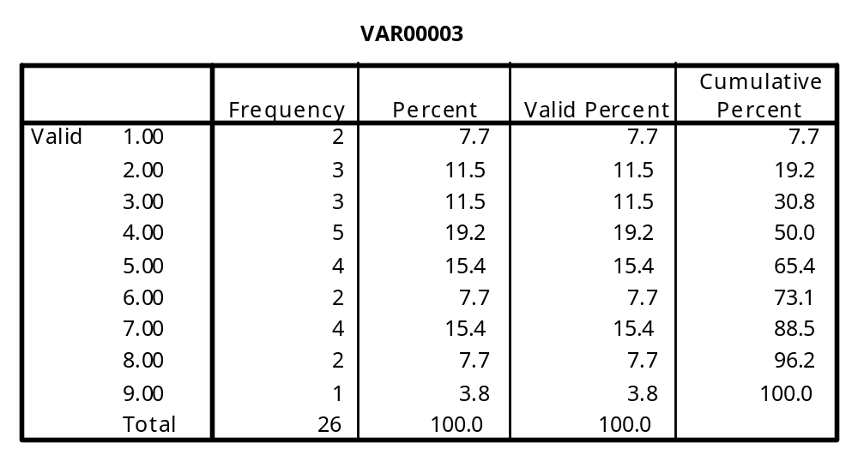
Frequency Distribution Table

Slide 14
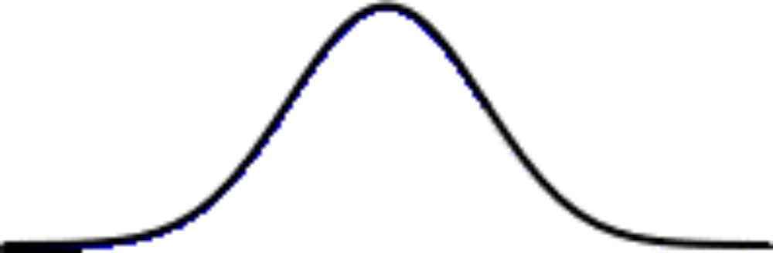
Shape of a Distribution
Symmetrical (normal)
  scores are evenly distributed about the central tendency (i.e., mean)

Slide 15
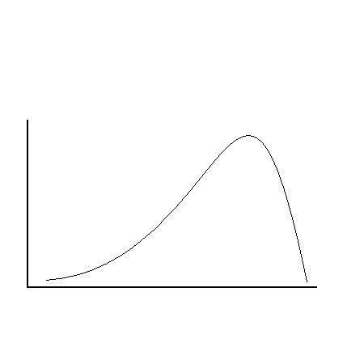
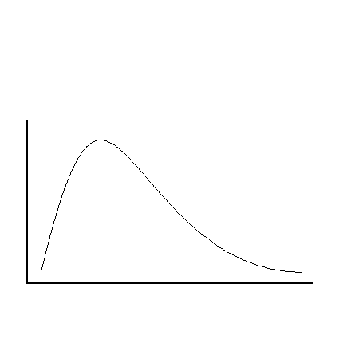
Shape of a Distribution
Skewed
  extreme high or low scores can skew the distribution in either direction
Negative skew
Positive skew

Slide 16
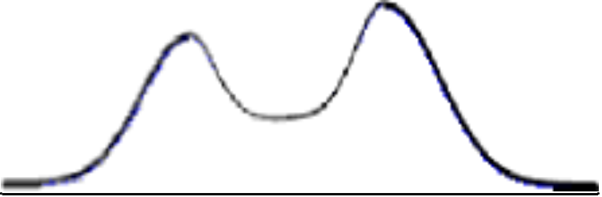
Shape of a Distribution
Unimodal
Multimodal
Minor Mode
Major Mode

Slide 17
Distribution
So, ordering our data and understanding the shape of the distribution organizes our data
Now, we must simplify and describe the distribution
What value best represents our distribution? (central tendency)

Slide 18
Central Tendency
Mode: the most frequent score
  good for nominal scales (eye color)
  a must for multimodal distributions
Median: the middle score
  separates the bottom 50% and the top 50% of the distribution
  good for skewed distributions (net worth)

Slide 19
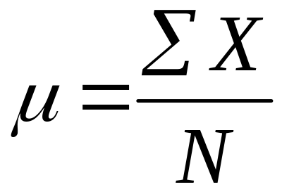
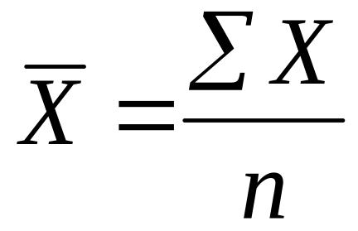
Central Tendency
Mean: the arithmetic average
  add all of the scores and divide by total number of scores
  This the preferred measure of central tendency (takes all of the scores into account)
population
sample

Slide 20
Computing a Mean
10 scores: 8, 4, 5, 2, 9, 13, 3, 7, 8, 5
ξΧ = 64
ξΧ/n = 6.4

Slide 21
Central Tendency
Is the mean always the best measure of central tendency?
No, skew pulls the mean in the direction of the skew

Slide 22
Central Tendency and Skew
Mode
Median
Mean

Slide 23
Central Tendency and Skew
Mode
Median
Mean

Slide 24
Distribution
So, central tendency simplifies and describes our distribution by providing a representative score
What about the difference between the individual scores and the mean?
(variability)

Slide 25
Variability
Range: maximum value – minimum value
  only takes two scores from the distribution into account
  easily influenced by extreme high or low scores
Standard Deviation/Variance
  the average deviation of scores from the mean of the distribution
  takes all scores into account
  less influenced by extreme values

Slide 26
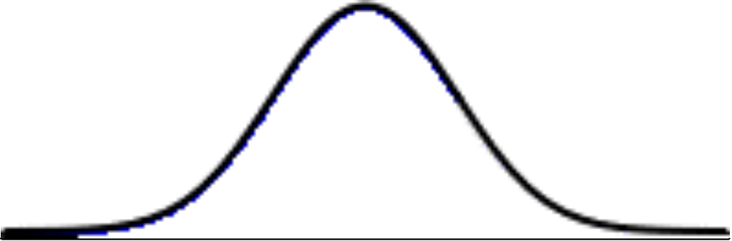
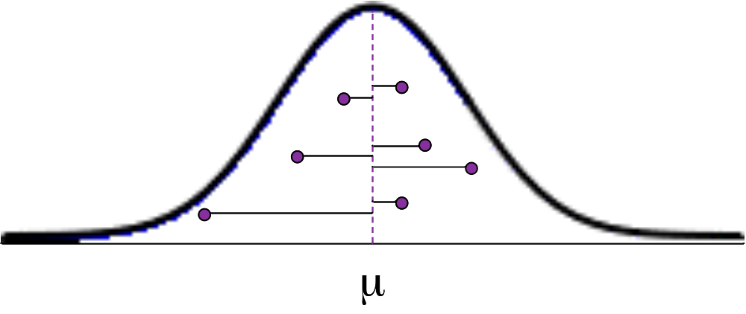
Standard Deviation
most popular and important measure of variability
a measure of how far all of the individual scores in the distribution are from a standard (mean)

Slide 27
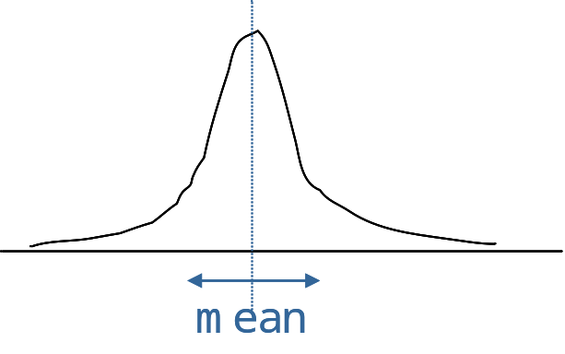
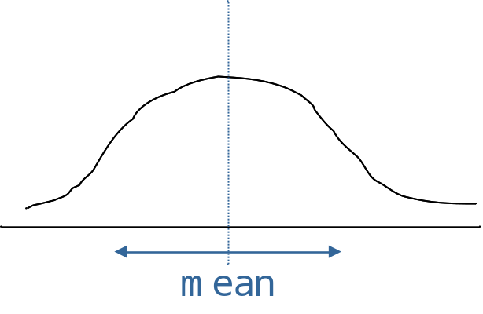
Standard Deviation
low variability
small SD
high variability
large SD

Slide 28
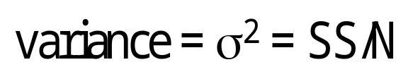
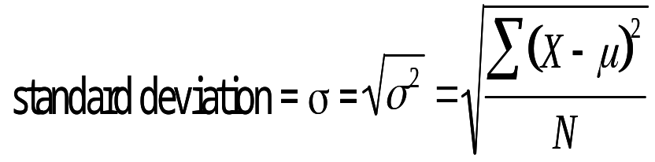
Computing a Standard Deviation
10 scores: 8, 4, 5, 2, 9, 13, 3, 7, 8, 5
ξΧ/n = 6.4
8 – 6.4 =
4 – 6.4 =
5 – 6.4 =
2 – 6.4 =
9 – 6.4 =
13 – 6.4 =
3 – 6.4 =
7 – 6.4 =
8 – 6.4 =
5 – 6.4 =
1.6
- 2.4
- 1.4
- 4.4
2.6
6.6
- 3.4
0.6
1.6
- 1.4
2.56
5.76
1.96
19.36
6.76
43.56
11.56
0.36
2.56
1.96
SS = 96.4
10.71
3.27

Slide 29
Standard Deviation
In a perfectly symmetrical (i.e. normal) distribution 2/3 of the scores will fall within +/- 1 standard deviation
-1
+1
3.13
6.4
9.67

Slide 30
Variance vs. SD
So, SD simplifies and describes the distribution by providing a measure of the variability of scores
If we only ever report SD, then why would variance be considered a separate measure of variability?
Variance will be an important value in many calculations in inferential statistics

Slide 31
Review
Descriptive statistics organize, simplify, and describe the important aspects of a distribution
This is the first step toward testing hypotheses with inferential statistics
Distributions can be described in terms of shape, central tendency, and variability
There are small differences in computation for populations vs. samples
It is often useful to graphically represent a distribution

Slide 32
Basics of Statistics
Definition: Science of collection, presentation, analysis, and reasonable interpretation of data.
Statistics presents a rigorous scientific method for gaining insight into data. For example, suppose we measure the weight of 100 patients in a study. With so many measurements, simply looking at the data fails to provide an informative account. However statistics can give an instant overall picture of data based on graphical presentation or numerical summarization irrespective to the number of data points. Besides data summarization, another important task of statistics is to make inference and predict relations of variables.

Slide 33
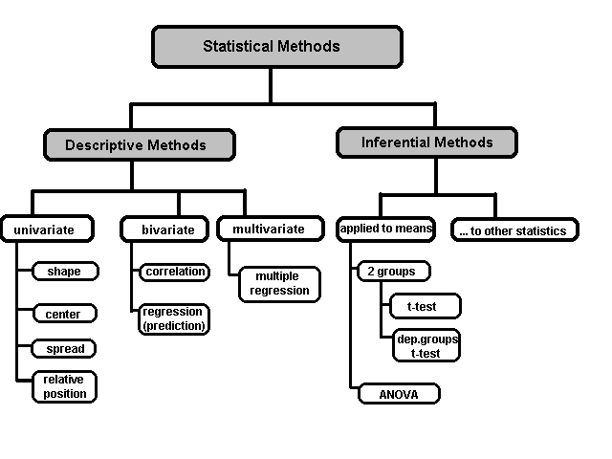
A Taxonomy of Statistics

Slide 34
Statistical Description of Data
Statistics describes a numeric set of data by its
    Center
    Variability
    Shape
Statistics describes a categorical set of data by
    Frequency, percentage or proportion of each category

Slide 35
Some Definitions
Variable - any characteristic of an individual or entity. A variable can take different values for different individuals. Variables can be categorical or quantitative. Per S. S. Stevens…
Nominal - Categorical variables with no inherent order or ranking sequence such as names or classes (e.g., gender). Value may be a numerical, but without numerical value (e.g., I, II, III). The only operation that can be applied to Nominal variables is enumeration.
Ordinal - Variables with an inherent rank or order, e.g. mild, moderate, severe. Can be compared for equality, or greater or less, but not how much greater or less.
Interval - Values of the variable are ordered as in Ordinal, and additionally, differences between values are meaningful, however, the scale is not absolutely anchored. Calendar dates and temperatures on the Fahrenheit scale are examples. Addition and subtraction, but not multiplication and division are meaningful operations.
Ratio - Variables with all properties of Interval plus an absolute, non-arbitrary zero point, e.g. age, weight, temperature (Kelvin). Addition, subtraction, multiplication, and division are all meaningful operations.

Slide 36
Some Definitions
Distribution - (of a variable) tells us what values the variable takes and how often it takes these values.
  Unimodal - having a single peak
  Bimodal - having two distinct peaks
  Symmetric - left and right half are mirror images.

Slide 37
Frequency Distribution
Consider a data set of 26 children of ages 1-6 years. Then the frequency distribution of variable ‘age’ can be tabulated as follows:
Frequency Distribution of Age
Age | 1 | 2 | 3 | 4 | 5 | 6
Frequency | 5 | 3 | 7 | 5 | 4 | 2
Grouped Frequency Distribution of Age:
Age Group | 1-2 | 3-4 | 5-6
Frequency | 8 | 12 | 6

Slide 38
Cumulative Frequency
Cumulative frequency of data in previous page
Age | 1 | 2 | 3 | 4 | 5 | 6
Frequency | 5 | 3 | 7 | 5 | 4 | 2
Cumulative Frequency | 5 | 8 | 15 | 20 | 24 | 26
Age Group | 1-2 | 3-4 | 5-6
Frequency | 8 | 12 | 6
Cumulative Frequency | 8 | 20 | 26

Slide 39
Data Presentation
Two types of statistical presentation of data - graphical and numerical.
Graphical Presentation: We look for the overall pattern and for striking deviations from that pattern. Over all pattern usually described by shape, center, and spread of the data. An individual value that falls outside the overall pattern is called an outlier.
Bar diagram and Pie charts are used for categorical variables.
Histogram, stem and leaf and Box-plot are used for numerical variable.

Slide 40
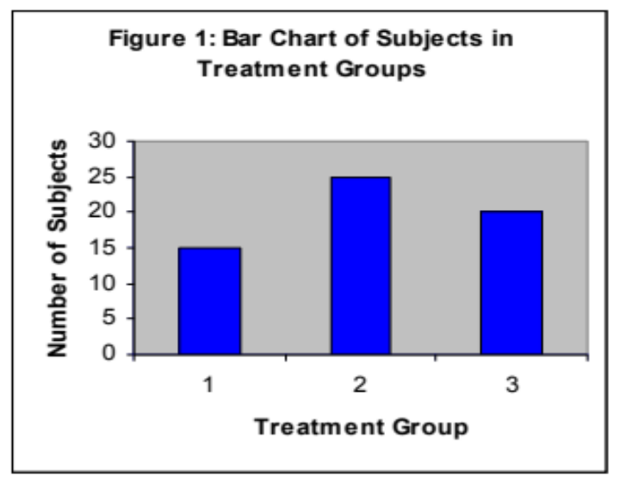
Data Presentation –Categorical Variable
Bar Diagram: Lists the categories and presents the percent or count of individuals who fall in each category.
Treatment Group | Frequency | Proportion | Percent (%)
1 | 15 | (15/60)=0.25 | 25.0
2 | 25 | (25/60)=0.333 | 41.7
3 | 20 | (20/60)=0.417 | 33.3
Total | 60 | 1.00 | 100

Slide 41
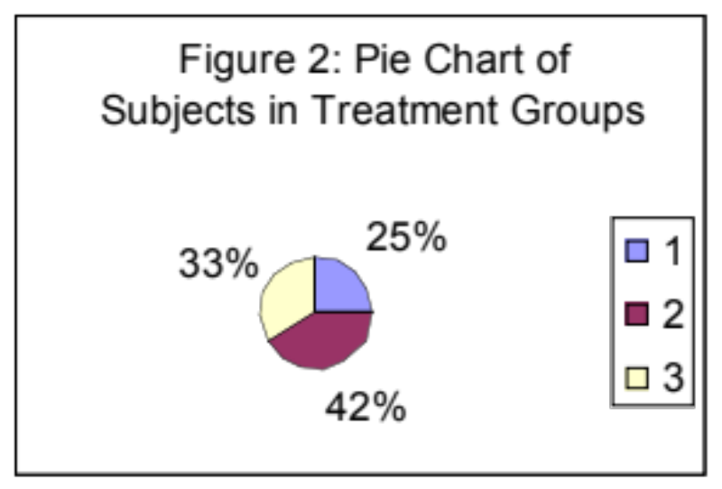
Data Presentation –Categorical Variable
Pie Chart: Lists the categories and presents the percent or count of individuals who fall in each category.
Treatment Group | Frequency | Proportion | Percent (%)
1 | 15 | (15/60)=0.25 | 25.0
2 | 25 | (25/60)=0.333 | 41.7
3 | 20 | (20/60)=0.417 | 33.3
Total | 60 | 1.00 | 100

Slide 42
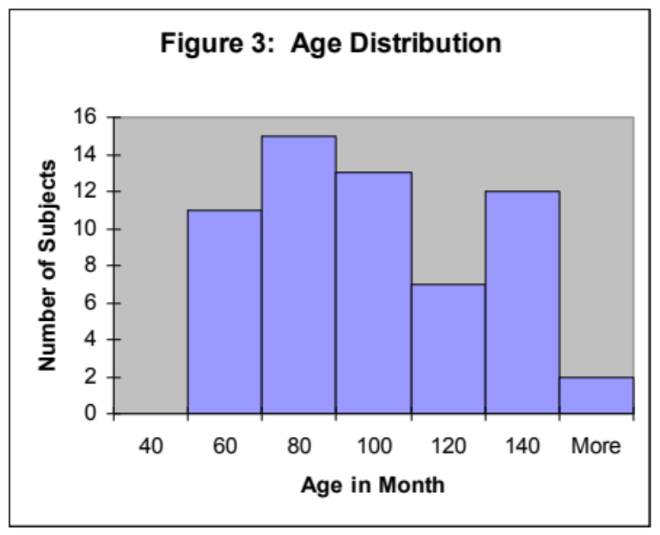
Graphical Presentation –Numerical Variable
Histogram: Overall pattern can be described by its shape, center, and spread. The following age distribution is right skewed. The center lies between 80 to 100. No outliers.
Mean | 90.41666667
Standard Error | 3.902649518
Median | 84
Mode | 84
Standard Deviation | 30.22979318
Sample Variance | 913.8403955
Kurtosis | -1.183899591
Skewness | 0.389872725
Range | 95
Minimum | 48
Maximum | 143
Sum | 5425
Count | 60

Slide 43
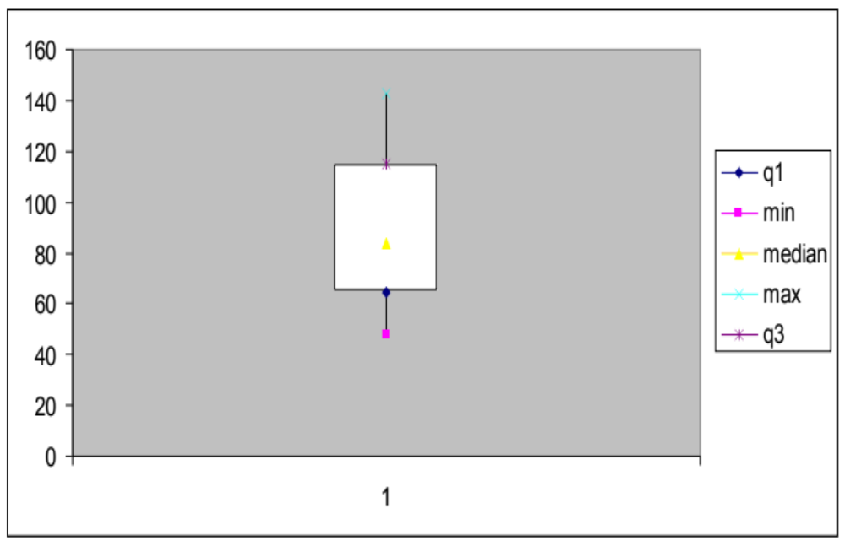
Graphical Presentation –Numerical Variable
Box-Plot: Describes the five-number summary
Figure 3: Distribution of Age
Box Plot

Slide 44
Numerical Presentation
A fundamental concept in summary statistics is that of a central value for a set of observations and the extent to which the central value characterizes the whole set of data. Measures of central value such as the mean or median must be coupled with measures of data dispersion (e.g., average distance from the mean) to indicate how well the central value characterizes the data as a whole.
To understand how well a central value characterizes a set of observations, let us consider the following two sets of data:
  A: 30, 50, 70
  B: 40, 50, 60
The mean of both two data sets is 50. But, the distance of the observations from the mean in data set A is larger than in the data set B. Thus, the mean of data set B is a better representation of the data set than is the case for set A.

Slide 45
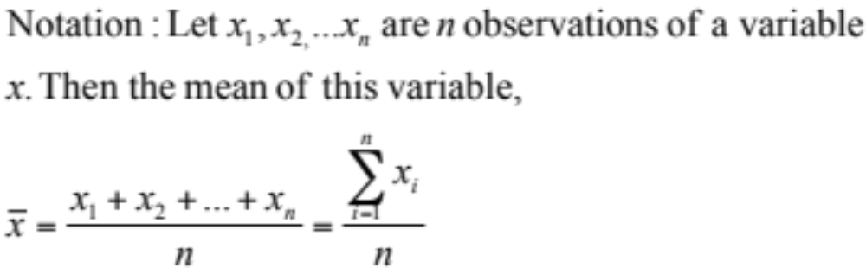
Methods of Center Measurement
Center measurement is a summary measure of the overall level of a dataset
Commonly used methods are mean, median, mode, geometric mean etc.
Mean: Summing up all the observation and dividing by number of observations. Mean of 20, 30, 40 is (20+30+40)/3 = 30.

Slide 46
Methods of Center Measurement
Median: The middle value in an ordered sequence of observations. That is, to find the median we need to order the data set and then find the middle value. In case of an even number of observations the average of the two middle most values is the median. For example, to find the median of {9, 3, 6, 7, 5}, we first sort the data giving {3, 5, 6, 7, 9}, then choose the middle value 6. If the number of observations is even, e.g., {9, 3, 6, 7, 5, 2}, then the median is the average of the two middle values from the sorted sequence, in this case, (5 + 6) / 2 = 5.5.
Mode: The value that is observed most frequently. The mode is undefined for sequences in which no observation is repeated.

Slide 47
Mean or Median
The median is less sensitive to outliers (extreme scores) than the mean and thus a better measure than the mean for highly skewed distributions, e.g. family income. For example mean of 20, 30, 40, and 990 is (20+30+40+990)/4 =270. The median of these four observations is (30+40)/2 =35. Here 3 observations out of 4 lie between 20-40. So, the mean 270 really fails to give a realistic picture of the major part of the data. It is influenced by extreme value 990.

Slide 48
Methods of Variability Measurement
Variability (or dispersion) measures the amount of scatter in a dataset.
Commonly used methods: range, variance, standard deviation, interquartile range, coefficient of variation etc.
Range: The difference between the largest and the smallest observations. The range of 10, 5, 2, 100 is (100-2)=98. It’s a crude measure of variability.

Slide 49
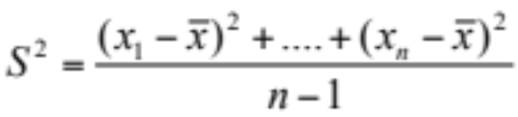
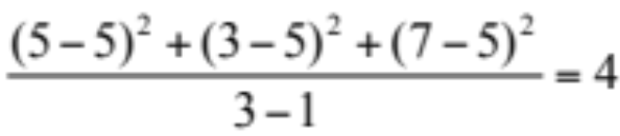
Methods of Variability Measurement
Variance: The variance of a set of observations is the average of the squares of the deviations of the observations from their mean. In symbols, the variance of the n observations x₁, x₂,…x_{n} is
Variance of 5, 7, 3? Mean is (5+7+3)/3 = 5 and the variance is
Standard Deviation: Square root of the variance. The standard deviation of the above example is 2.

Slide 50
Methods of Variability Measurement
Quartiles: Data can be divided into four regions that cover the total range of observed values. Cut points for these regions are known as quartiles.
In notations, quartiles of a data is the ((n+1)/4)q^{th} observation of the data, where q is the desired quartile and n is the number of observations of data.
The first quartile (Q1) is the first 25% of the data. The second quartile (Q2) is between the 25th and 50th percentage points in the data. The upper bound of Q2 is the median. The third quartile (Q3) is the 25% of the data lying between the median and the 75% cut point in the data.
Q1 is the median of the first half of the ordered observations and Q3 is the median of the second half of the ordered observations.

Slide 51
Methods of Variability Measurement
In the following example Q1= ((15+1)/4)1 =4th observation of the data. The 4th observation is 11. So Q1 is of this data is 11.
An example with 15 numbers
3 6 7 11 13 22 30 40 44 50 52 61 68 80 94 Q1 Q2 Q3
The first quartile is Q1=11. The second quartile is Q2=40 (This is also the Median.) The third quartile is Q3=61.
Inter-quartile Range: Difference between Q3 and Q1. Inter-quartile range of the previous example is 61- 40=21. The middle half of the ordered data lie between 40 and 61.

Slide 52
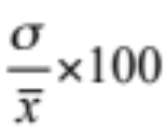
Deciles and Percentiles
Deciles: If data is ordered and divided into 10 parts, then cut points are called Deciles
Percentiles: If data is ordered and divided into 100 parts, then cut points are called Percentiles. 25th percentile is the Q1, 50th percentile is the Median (Q2) and the 75th percentile of the data is Q3.
In notations, percentiles of a data is the ((n+1)/100)p th observation of the data, where p is the desired percentile and n is the number of observations of data.
Coefficient of Variation: The standard deviation of data divided by it’s mean. It is usually expressed in percent.
Coefficient of Variation =

Slide 53
Five Number Summary
Five Number Summary: The five number summary of a distribution consists of the smallest (Minimum) observation, the first quartile (Q1),
The median(Q2), the third quartile, and the largest (Maximum) observation written in order from smallest to largest.
Box Plot: A box plot is a graph of the five number summary. The central box spans the quartiles. A line within the box marks the median. Lines extending above and below the box mark the smallest and the largest observations (i.e., the range). Outlying samples may be additionally plotted outside the range.

Slide 54
Boxplot
Distribution of Age in Month

Slide 55
Choosing a Summary
The five number summary is usually better than the mean and standard deviation for describing a skewed distribution or a distribution with extreme outliers. The mean and standard deviation are reasonable for symmetric distributions that are free of outliers.
In real life we can’t always expect symmetry of the data. It’s a common practice to include number of observations (n), mean, median, standard deviation, and range as common for data summarization purpose. We can include other summary statistics like Q1, Q3, Coefficient of variation if it is considered to be important for describing data.

Slide 56
Shape of Data
Shape of data is measured by
  Skewness
  Kurtosis

Slide 57
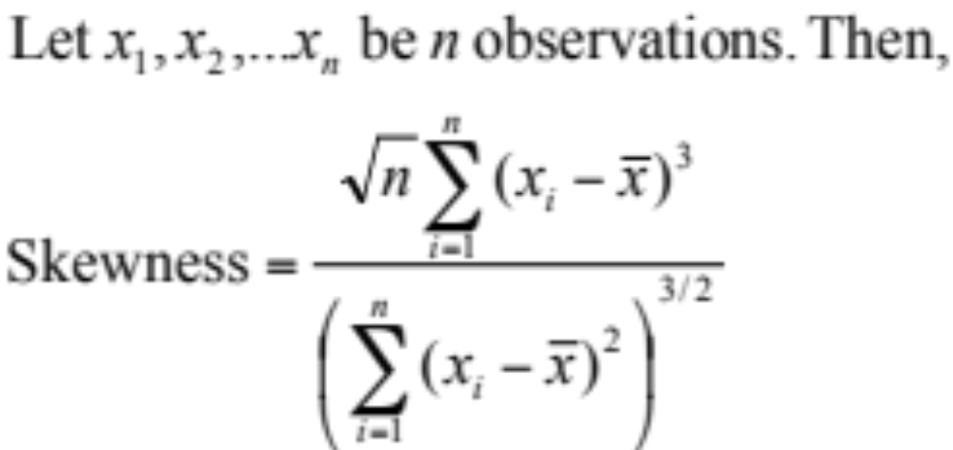
Skewness
Measures asymmetry of data
  Positive or right skewed: Longer right tail
  Negative or left skewed: Longer left tail

Slide 58
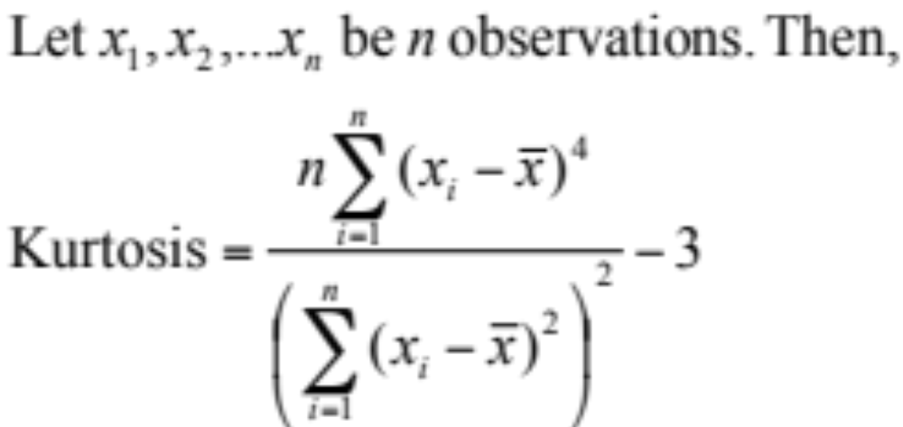
Kurtosis
Measures peakedness of the distribution of data. The kurtosis of normal distribution is 0.

Slide 59
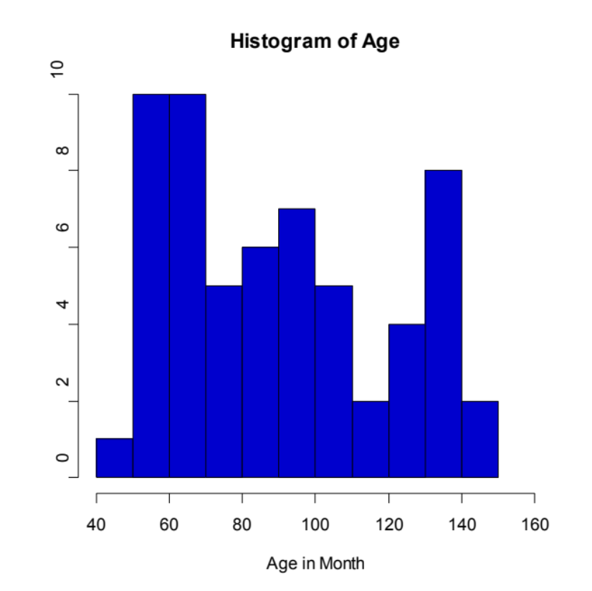
Summary of the Variable ‘Age’ in the given data set
Mean | 90.41666667
Standard Error | 3.902649518
Median | 84
Mode | 84
Standard Deviation | 30.22979318
Sample Variance | 913.8403955
Kurtosis | -1.183899591
Skewness | 0.389872725
Range | 95
Minimum | 48
Maximum | 143
Sum | 5425
Count | 60

Slide 60
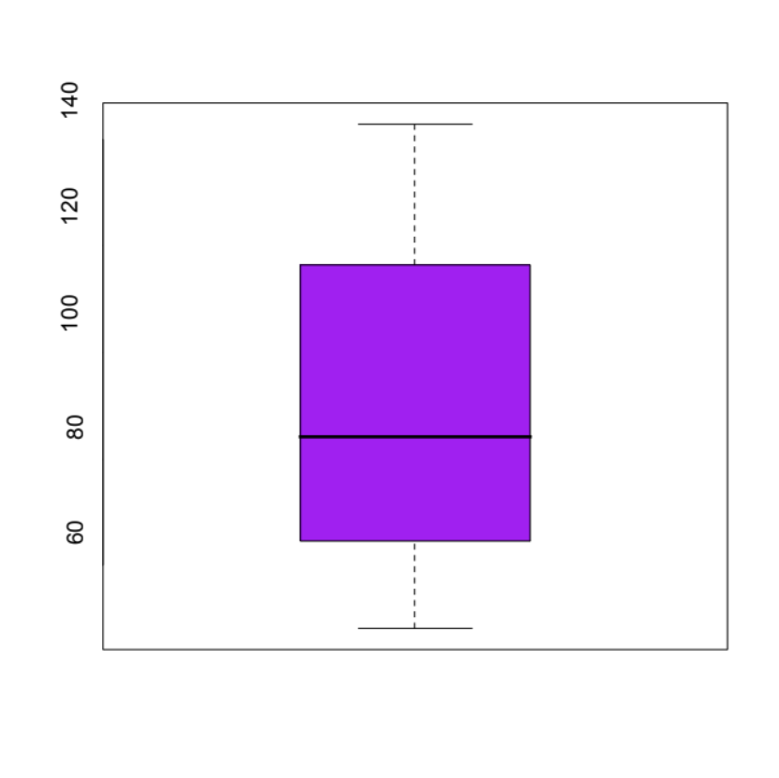
Summary of the Variable ‘Age’ in the given data set

Slide 61
Class Summary (First Part)
So far we have learned-
Statistics and data presentation/data summarization
Graphical Presentation: Bar Chart, Pie Chart, Histogram, and Box Plot
Numerical Presentation: Measuring Central value of data (mean, median, mode etc.), measuring dispersion (standard deviation, variance, co-efficient of variation, range, inter-quartile range etc), quartiles, percentiles, and five number summary
Any questions ?

Slide 62
Brief concept of Statistical Softwares
There are many softwares to perform statistical analysis and visualization of data. Some of them are SAS (System for Statistical Analysis), S-plus, R, Matlab, Minitab, BMDP, Stata, SPSS, StatXact, Statistica, LISREL, JMP, GLIM, HIL, MS Excel etc. We will discuss MS Excel and SPSS in brief.
Some useful websites for more information of statistical softwares-
http://www.galaxy.gmu.edu/papers/astr1.html
http://ourworld.compuserve.com/homepages/Rainer_Wuerlaender/statsoft.htm#archiv
http://www.R-project.org

Slide 63
Where We’re Going
Develop the notion of a random variable
Numerical data and discrete random variables
Discrete random variables and their probabilities
McClave, Statistics, 11th ed. Chapter 4: Discrete Random Variables

Slide 64
4.1: Two Types of Random Variables
A random variable is a variable hat assumes numerical values associated with the random outcome of an experiment, where one (and only one) numerical value is assigned to each sample point.
McClave, Statistics, 11th ed. Chapter 4: Discrete Random Variables

Slide 65

4.1: Two Types of Random Variables
A discrete random variable can assume a countable number of values.
  Number of steps to the top of the Eiffel Tower*
A continuous random variable can assume any value along a given interval of a number line.
  The time a tourist stays at the top
  once s/he gets there
*Believe it or not, the answer ranges from 1,652 to 1,789. See Great Buildings
McClave, Statistics, 11th ed. Chapter 4: Discrete Random Variables

Slide 66


4.1: Two Types of Random Variables
Discrete random variables
  Number of sales
  Number of calls
  Shares of stock
  People in line
  Mistakes per page
Continuous random variables
  Length
  Depth
  Volume
  Time
  Weight
McClave, Statistics, 11th ed. Chapter 4: Discrete Random Variables

Slide 67
4.2: Probability Distributions for Discrete Random Variables
The probability distribution of a discrete random variable is a graph, table or formula that specifies the probability associated with each possible outcome the random variable can assume.
  p(x) ≥ 0 for all values of x
  Σp(x) = 1
McClave, Statistics, 11th ed. Chapter 4: Discrete Random Variables

Slide 68
4.2: Probability Distributions for Discrete Random Variables
x | P(x)
1 | .30
2 | .21
3 | .15
4 | .11
5 | .07
6 | .05
7 | .04
8 | .02
9 | .02
10 | .01
Say a random variable x follows this pattern: p(x) = (.3)(.7)^{x-1}
for x > 0.
  This table gives the probabilities (rounded to two digits) for x between 1 and 10.
McClave, Statistics, 11th ed. Chapter 4: Discrete Random Variables

Slide 69
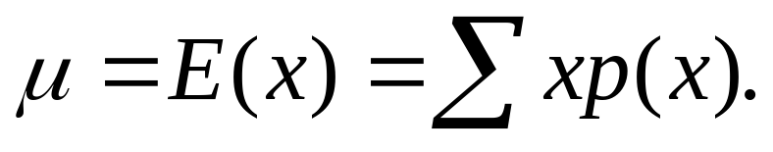
4.3: Expected Values of Discrete Random Variables
The mean, or expected value, of a discrete random variable is
McClave, Statistics, 11th ed. Chapter 4: Discrete Random Variables

Slide 70
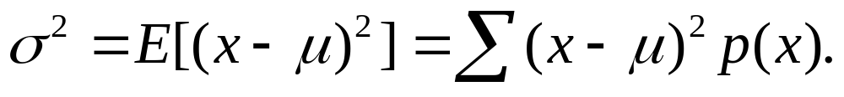
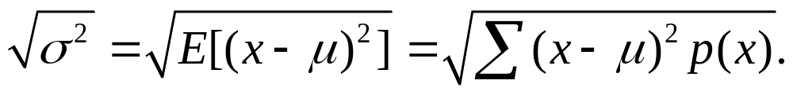
4.3: Expected Values of Discrete Random Variables
The variance of a discrete random variable x is
The standard deviation of a discrete random variable x is
McClave, Statistics, 11th ed. Chapter 4: Discrete Random Variables

Slide 71
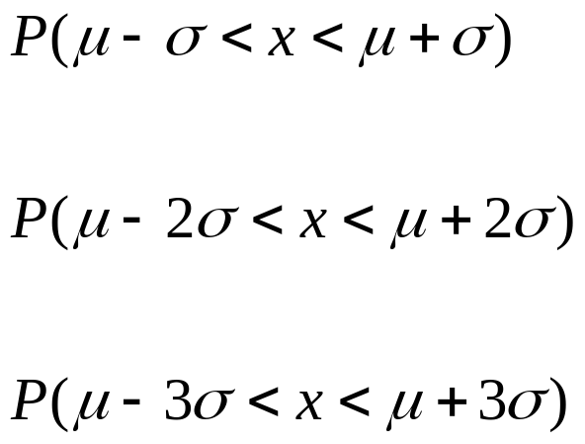
4.3: Expected Values of Discrete Random Variables
Chebyshev’s Rule | Empirical Rule
≥ 0 | ≅ .68
≥ .75 | ≅ .95
≥ .89 | ≅ 1.00
McClave, Statistics, 11th ed. Chapter 4: Discrete Random Variables

Slide 72
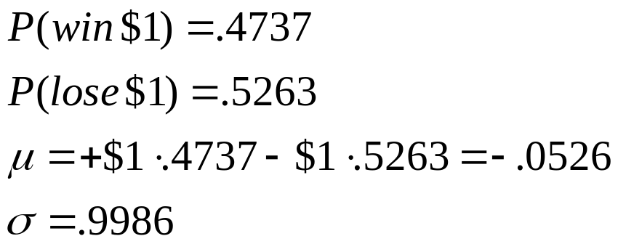
4.3: Expected Values of Discrete Random Variables
In a roulette wheel in a U.S. casino, a $1 bet on “even” wins $1 if the ball falls on an even number (same for “odd,” or “red,” or “black”).
The odds of winning this bet are 47.37%
On average, bettors lose about a nickel for each dollar they put down on a bet like this.
(These are the best bets for patrons.)
McClave, Statistics, 11th ed. Chapter 4: Discrete Random Variables

Slide 73
4.4: The Binomial Distribution
A Binomial Random Variable
  n identical trials
  Two outcomes: Success or Failure
  P(S) = p; P(F) = q = 1 – p
  Trials are independent
  x is the number of Successes in n trials
McClave, Statistics, 11th ed. Chapter 4: Discrete Random Variables

Slide 74
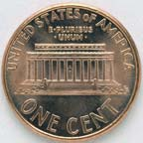
4.4: The Binomial Distribution
A Binomial Random Variable
  n identical trials
  Two outcomes: Success or Failure
  P(S) = p; P(F) = q = 1 – p
  Trials are independent
  x is the number of S’s in n trials
  Flip a coin 3 times
  Outcomes are Heads or Tails
  P(H) = .5; P(F) = 1-.5 = .5
  A head on flip i doesn’t change P(H) of flip i + 1
McClave, Statistics, 11th ed. Chapter 4: Discrete Random Variables

Slide 75
4.4: The Binomial Distribution
Results of 3 flips | Probability | Combined | Summary
HHH | (p)(p)(p) | p³ | (1)p³q⁰
HHT | (p)(p)(q) | p²q
HTH | (p)(q)(p) | p²q | (3)p²q¹
THH | (q)(p)(p) | p²q
HTT | (p)(q)(q) | pq²
THT | (q)(p)(q) | pq² | (3)p¹q²
TTH | (q)(q)(p) | pq²
TTT | (q)(q)(q) | q³ | (1)p⁰q³
McClave, Statistics, 11th ed. Chapter 4: Discrete Random Variables

Slide 76
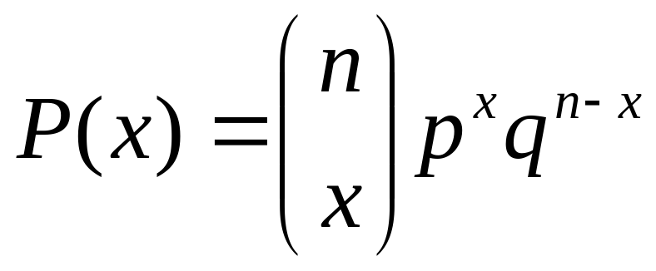
4.4: The Binomial Distribution
The Binomial Probability Distribution
  p = P(S) on a single trial
  q = 1 – p
  n = number of trials
  x = number of successes
McClave, Statistics, 11th ed. Chapter 4: Discrete Random Variables

Slide 77
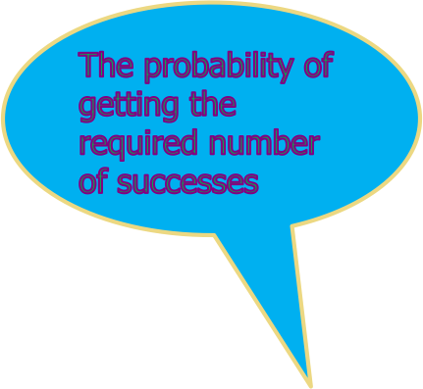
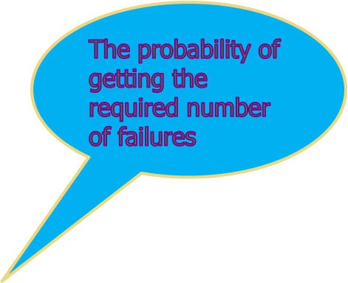

4.4: The Binomial Distribution
The Binomial Probability Distribution
McClave, Statistics, 11th ed. Chapter 4: Discrete Random Variables

Slide 78
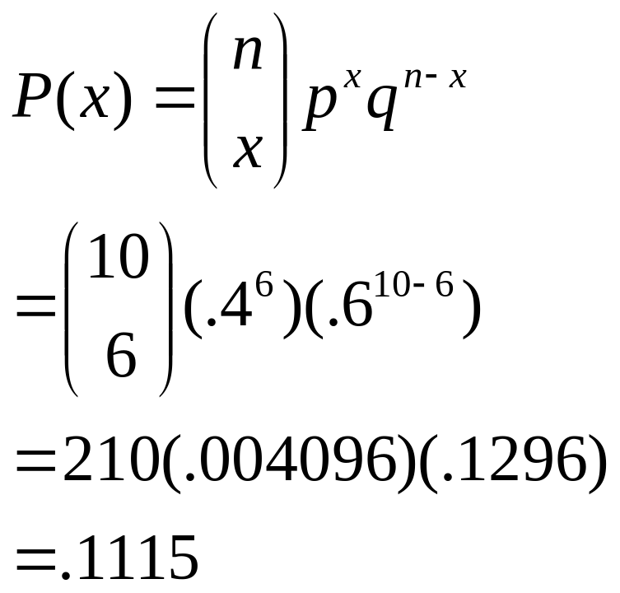
4.4: The Binomial Distribution
Say 40% of the class is female.
What is the probability that 6 of the first 10 students walking in will be female?
McClave, Statistics, 11th ed. Chapter 4: Discrete Random Variables

Slide 79
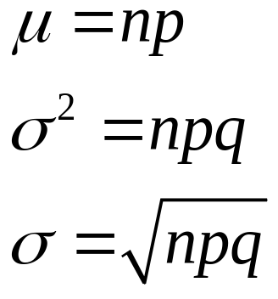
4.4: The Binomial Distribution
A Binomial Random Variable has
  Mean
  Variance
  Standard Deviation
McClave, Statistics, 11th ed. Chapter 4: Discrete Random Variables

Slide 80
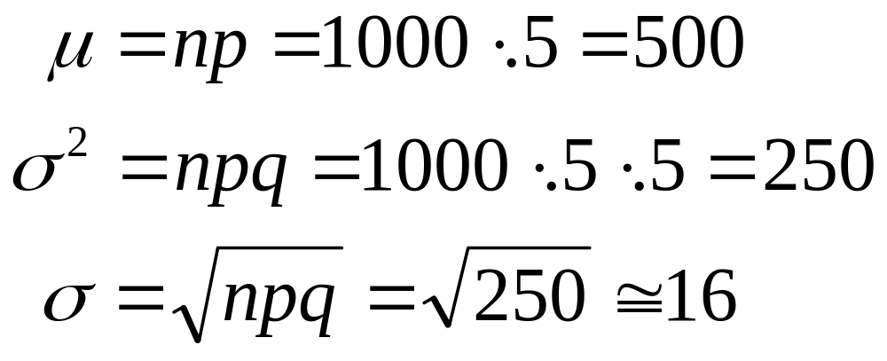
4.4: The Binomial Distribution
For 1,000 coin flips,
The actual probability of getting exactly 500 heads out of 1000 flips is
just over 2.5%, but the probability of getting between 484 and 516 heads
(that is, within one standard deviation of the mean) is about 68%.
McClave, Statistics, 11th ed. Chapter 4: Discrete Random Variables

Slide 81
4.5: The Poisson Distribution
Evaluates the probability of a (usually small) number of occurrences out of many opportunities in a …
  Period of time
  Area
  Volume
  Weight
  Distance
  Other units of measurement
McClave, Statistics, 11th ed. Chapter 4: Discrete Random Variables

Slide 82
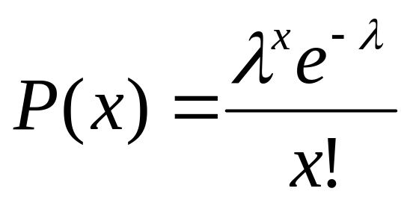
4.5: The Poisson Distribution
● = mean number of occurrences in the given unit of time, area, volume, etc.
e = 2.71828….
µ = 
² = 
McClave, Statistics, 11th ed. Chapter 4: Discrete Random Variables

Slide 83
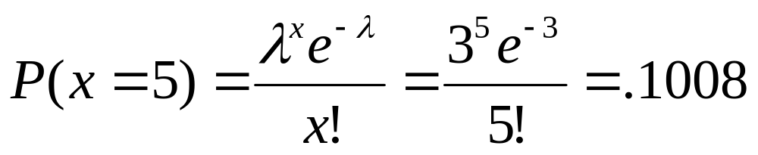

4.5: The Poisson Distribution
Say in a given stream there are an average of 3 striped trout per 100 yards. What is the probability of seeing 5 striped trout in the next 100 yards, assuming a Poisson distribution?
McClave, Statistics, 11th ed. Chapter 4: Discrete Random Variables

Slide 84
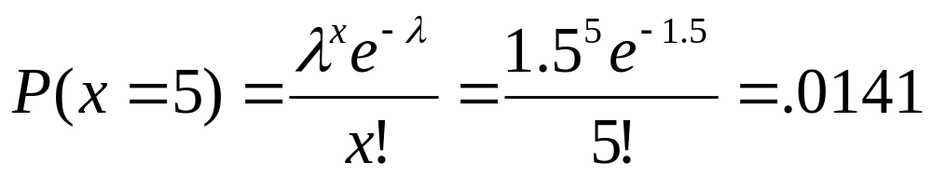
4.5: The Poisson Distribution
How about in the next 50 yards, assuming a Poisson distribution?
  Since the distance is only half as long,  is only half as large.
McClave, Statistics, 11th ed. Chapter 4: Discrete Random Variables

Slide 85
4.6: The Hypergeometric Distribution
In the binomial situation, each trial was independent.
  Drawing cards from a deck and replacing the drawn card each time
If the card is not replaced, each trial depends on the previous trial(s).
  The hypergeometric distribution can be used in this case.
McClave, Statistics, 11th ed. Chapter 4: Discrete Random Variables

Slide 86
4.6: The Hypergeometric Distribution
Randomly draw n elements from a set of N elements, without replacement. Assume there are r successes and N-r failures in the N elements.
The hypergeometric random variable is the number of successes, x, drawn from the r available in the n selections.
McClave, Statistics, 11th ed. Chapter 4: Discrete Random Variables

Slide 87
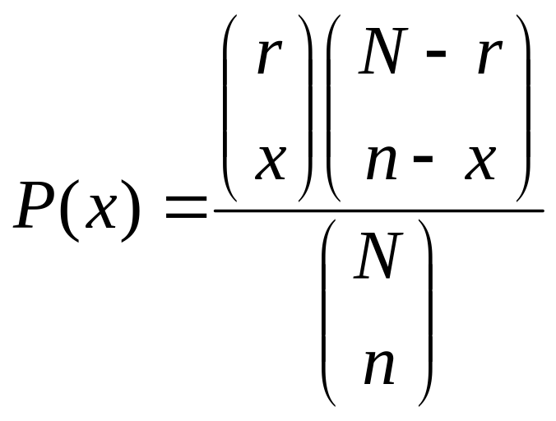
4.6: The Hypergeometric Distribution
where
N = the total number of elements
r = number of successes in the N elements
n = number of elements drawn
X = the number of successes in the n elements
McClave, Statistics, 11th ed. Chapter 4: Discrete Random Variables

Slide 88
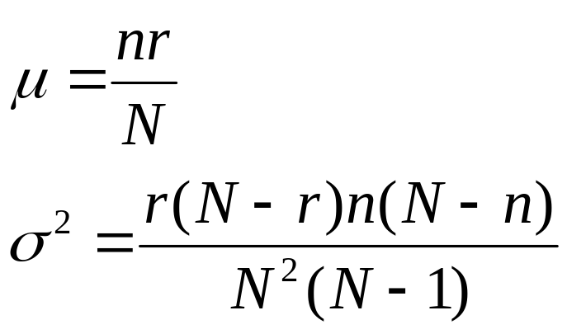
4.6: The Hypergeometric Distribution
McClave, Statistics, 11th ed. Chapter 4: Discrete Random Variables

Slide 89
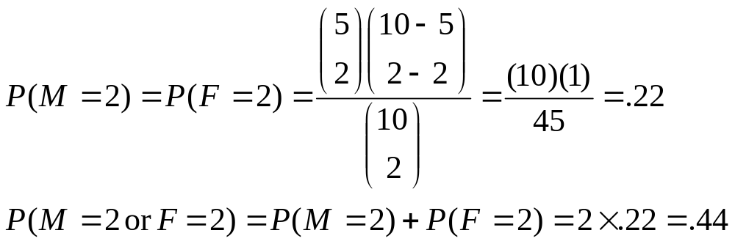

4.6: The Hypergeometric Distribution
Suppose a customer at a pet store wants to buy two hamsters for his daughter, but he wants two males or two females (i.e., he wants only two hamsters in a few months)
If there are ten hamsters, five male and five female, what is the probability of drawing two of the same sex? (With hamsters, it’s virtually a random selection.)
people.stern.nyu.edu/adamodar/New_Home_Page/StatFile/statdistns.htm
McClave, Statistics, 11th ed. Chapter 4: Discrete Random Variables

Slide 90
Statistical Distributions
http://people.stern.nyu.edu/adamodar/New_Home_Page/StatFile/statdistns.htm
Binomial Distribution.
Poisson Distribution.
Geometric Distribution.
Hypergeometric Distribution.
Normal Distribution.
Cauchy Distribution.
Uniform Distribution.
Lognormal Distribution.
Exponential Distribution.
Gamma Distribution.
Beta Distribution.
Pareto Distribution.

