Slide 1
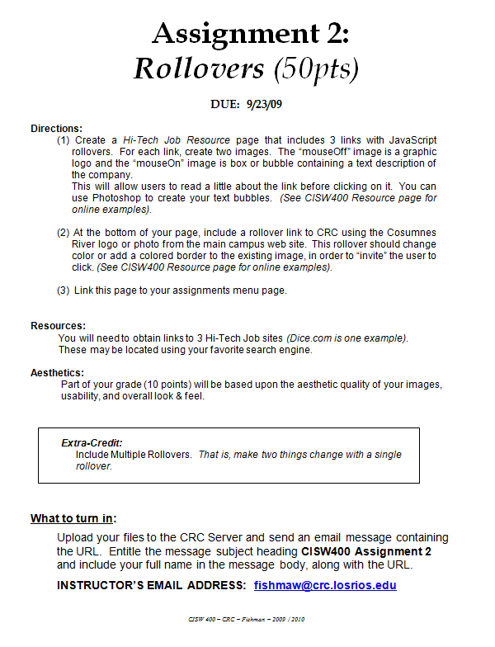
CISW 400 (Online) – Client-side Scripting for the Internet
PRESENTATION A2:
Assignment 2
Help
Tips, Hints,
& Examples
Cosumnes River College • Fishman • 2020
CISW 400 - CRC - Fishman 2019 / 2020

Slide 2
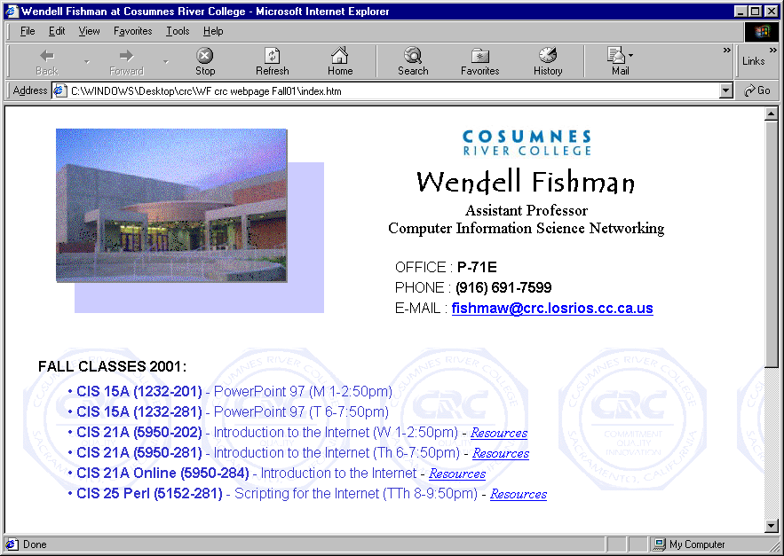






Assignment 2
Rollovers (Image Swapping)
Assignment 2 is a single page with a total of 4 JavaScript rollovers. You may use Photoshop, or your favorite Paint program to create buttons and rollover images. An online example is available at the instructors website.
To begin, read Presentation 2b carefully to understand JavaScript Rollovers.
CISW 400 - CRC - Fishman 2019 / 2020

Slide 3





What it should look like:
4 Rollovers
Each Image should change when rolled over.
CISW 400 - CRC - Fishman 2019 / 2020

Slide 4
Textboxes
When a rollover occurs, each job resource image should display a textual description of their services.
This “textbox” is an image file (gif or jpeg), created in PhotoShop, or your favorite Paint program.
CISW 400 - CRC - Fishman 2019 / 2020

Slide 5


Extra Credit
Multiple Rollovers
To receive extra credit, create a rollover that changes two different elements on the page, simultaneously.
Here, for example, in addition to swapping the job link for a textbox, the other links are faded out.
Note that for extra-credit I will not provide assistance, until after the assignment due date. However, you are welcome to collaborate with classmates through the discussion board.
For more info, visit the following link:
CISW 400 - CRC - Fishman 2019 / 2020

Slide 6
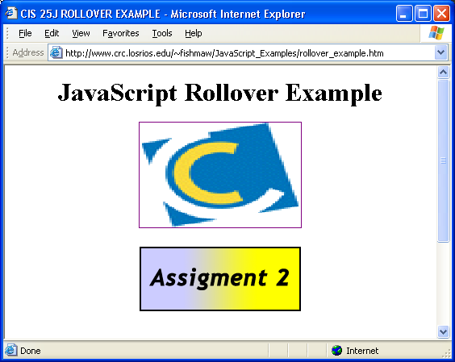
Tips for this Assignment:
Online Example
Visit my school web site to see an example utilizing JavaScript rollovers.
By examining the source code, you should find what you need to complete
this assignment.
http://wserver.crc.losrios.edu/~fishmaw/examples/cisw400_examples/rollover_example.htm
CISW 400 - CRC - Fishman 2019 / 2020

