Slide 1
Evolutionary Topic Modeling
Kenny Darrell

Slide 2
Overview
Background - http://sifaka.cs.uiuc.edu/czhai/pub/kdd05-ttm.pdf
Data - Journal of Machine Learning Research (http://jmlr.org)
Goal - Learn about text mining, see how machine learning topics have evolved over time

Slide 3
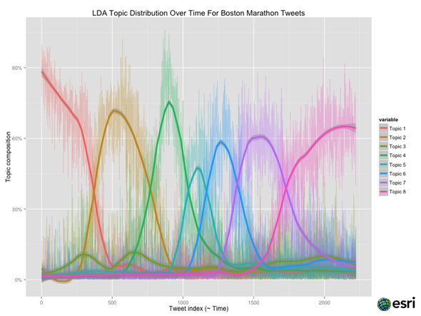
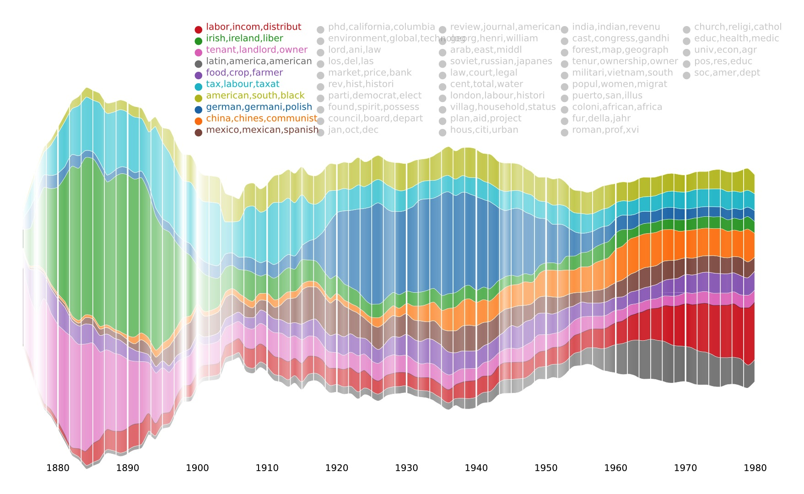
Other Efforts

Slide 4
RSS
<item>
<title>
Dynamic Affine-Invariant Shape-Appearance Handshape Features and Classification in Sign Language Videos; Anastasios Roussos, Stavros Theodorakis, Vassilis Pitsikalis, Petros Maragos
</title>
<link>http://jmlr.org/papers/v14/roussos13a.html</link>

Slide 5





Used R to parse RSS and copy pdf local
Used Scala with Tika to transform pdf to text
Used Mallet to create topic models
Used R parse Mallet output and create *.gexf file
Used Gephi to visualize *.gexf files

Slide 6
Outcome
Current results are terrible
Need to do common text mining tasks, stop-lists, pre-processing, cleaning, etc
Learn more of what Mallet is doing instead of just telling it to give me 15 or 100 topics

Slide 7
Result

