Slide 1
Two problems, two applications,
one lifecycle run twice.
AIML-515 Capstone · Workshops 1–6
GridPilot AI
Meridian Financial
Source-cited answers for utility engineers
Reconciles bank statements against live account feeds
gridpilot-ai-fb150.web.app
meridian-792468836580.us-central1.run.app
Presented by [ your name ]
Notes:
This capstone covers two complete applications, each taken through all six phases of the AI/Tech project lifecycle. GridPilot AI is a knowledge assistant for electric utility engineers. Meridian Financial is a personal finance ledger that reconciles statements against live account feeds. Both are deployed and publicly reachable right now, and both URLs are on this slide. Everything I show today can be opened and checked.

Slide 2
EXECUTIVE SUMMARY
What was built, and what it does
APP 1
APP 2
GridPilot AI
Meridian Financial
The problem
The problem
Utility engineers answer technical questions by searching scattered PDF manuals, standards and procedure binders.
Money sits across many institutions, and each institution's statement disagrees with its own live feed more often than people think.
The solution
The solution
A role-aware assistant that answers in plain language, cites the exact source passage, and declines when no source is confident enough.
Imports statements in five formats, merges them with the account feed without duplicating, and reports what does not reconcile.
27
3
0
3,350
153
205
source files
user roles
invented answers
transactions
documents
backend tests
Notes:
Both applications solve a problem where the information already exists but is too scattered or too tedious to check by hand. GridPilot is a front-end prototype with simulated retrieval, and it says so plainly. Meridian is a full-stack application with a real backend, database and parsers. The 'zero invented answers' figure is a design property, not a marketing claim: when no source scores high enough, GridPilot returns a decline card instead of an answer.

Slide 3
WORKSHOPS 1–6
The same six phases, run twice
1
2
3
4
5
6
Problem framing
Technical solution
Design & prototype
Testing & evaluation
Deployment
Feedback & iteration
GridPilot AI
Field crews and analysts hunt through binders
Retrieval + citations, no invented answers
Claude Artifacts, then Vite + React in an IDE
Playwright at 3 viewports, security pass
Firebase Hosting, CI/CD from GitHub
Mobile layout rebuilt after testing
Meridian Financial
Statements and account feeds silently disagree
Local model only, deterministic matching
Written brief first, then 15 milestones
205 backend tests, real-model runs
Cloud Run container, scale to zero
Demo profiles seeded end to end
Notes:
This is the map for the rest of the deck. Six phases across the top, one row per application. The second run was faster not because the work was smaller, but because decisions that were made late the first time were made first the second time. The clearest example is deployment: GridPilot was built and then deployed; Meridian was designed around its deployment target from the first migration. Each column becomes a slide or two in the sections that follow.

Slide 4
APP 1 · PHASE 1 · PROBLEM FRAMING
APP 1 · GRIDPILOT AI
Answers exist. Finding them is the job.
“What is the maintenance interval for an unmonitored microprocessor relay?”
What the assistant has to do differently
1
Cite the passage
The answer is one line in PRC-005-6, Table 1-1. Finding it means knowing the standard exists, having the current revision, and reading to the right table.
Not a document name. The exact paragraph, shown beside the answer.
2
Decline when unsure
A confident wrong answer about a relay interval is worse than no answer.
Who this hurts
3
Respect the role
Protection engineers
Relay settings, maintenance standards, vendor manuals
A field crew running a switching order should not be handed a maintenance standard.
Compliance analysts
NERC CIP, TOP and BAL obligations across revisions
Work on a tablet
4
In the field, one column, large targets, gloved hands.
Field crews
Switching procedures, grounding order, on a tablet, in gloves
Notes:
The problem is not that utility engineering knowledge is missing. It is published, often mandated, and sitting in PDFs. The problem is retrieval under time pressure, and the cost of a wrong answer is regulatory as well as physical. That shaped four requirements that most chat assistants do not meet: cite the passage, decline when unsure, scope by role, and work on a tablet in the field. Those four requirements drove every design decision that follows.

Slide 5
APP 1 · PHASE 2 · TECHNICAL SOLUTION
APP 1 · GRIDPILOT AI
Choosing the stack, and what it cost
CHOSEN
SIMULATED
DELIBERATE
CHOSEN
React 18 + Vite
In-memory retrieval
No backend
lucide-react only
Component reuse and a fast dev loop. Vite's production build is what Firebase serves.
Keyword scoring in src/lib/retrieval.js stands in for a hybrid vector search.
Nothing to secure, nothing to pay for, nothing between the demo and the reviewer.
Three dependencies total, so the supply-chain surface stays small.
The honest trade, stated in the README rather than discovered by a reviewer
Retrieval is keyword scoring over a seeded document set. There is no vector database and no language model in the deployed build. That is written at the top of the repository, and the production gaps are listed with named technologies: a managed vector store and embeddings, a hosted model for synthesis with a guardrail against uncited claims, an ingestion pipeline, Okta SSO, and CIP-appropriate hosting with audit logging.
Notes:
Every choice here was made for a prototype that had to be reviewable by someone who is not going to install anything. The important line is the last panel. Simulating retrieval was a legitimate scope decision for Workshop 1, but calling it AI-powered without qualification would not have been. The README opens with the limitation and lists what a real deployment would add, by name. That habit — write the limitation where the reader will hit it first — carried into the second application.

Slide 6
APP 1 · PHASE 2 · ARCHITECTURE
APP 1 · GRIDPILOT AI
How a question becomes a cited answer
Role
Query
Score
Band
Answer
Protection engineer,
compliance analyst,
or field crew
Natural language,
validated and
length-clamped
Tokenize, score every
visible document
section by overlap
High / low / none,
from the top score
and its margin
Synthesized text with
the cited passage
beside it
No confident source
→ decline card
3
personas, each with
its own document set
4
workspace tabs:
search, library, upload, admin
100%
client side — no network
calls, no third-party scripts
1,586
lines across
27 source files
Notes:
Five stages, all in the browser. The one worth pausing on is the fourth. Banding decides whether the app answers at all. If the top-scoring passage is not far enough ahead of the rest, the app returns a decline card rather than a low-confidence guess. That is the difference between a demo that always says something and a tool an engineer could trust. The admin dashboard records every declined and low-confidence query, so the gaps in the document set become a work list for a content owner.

Slide 7
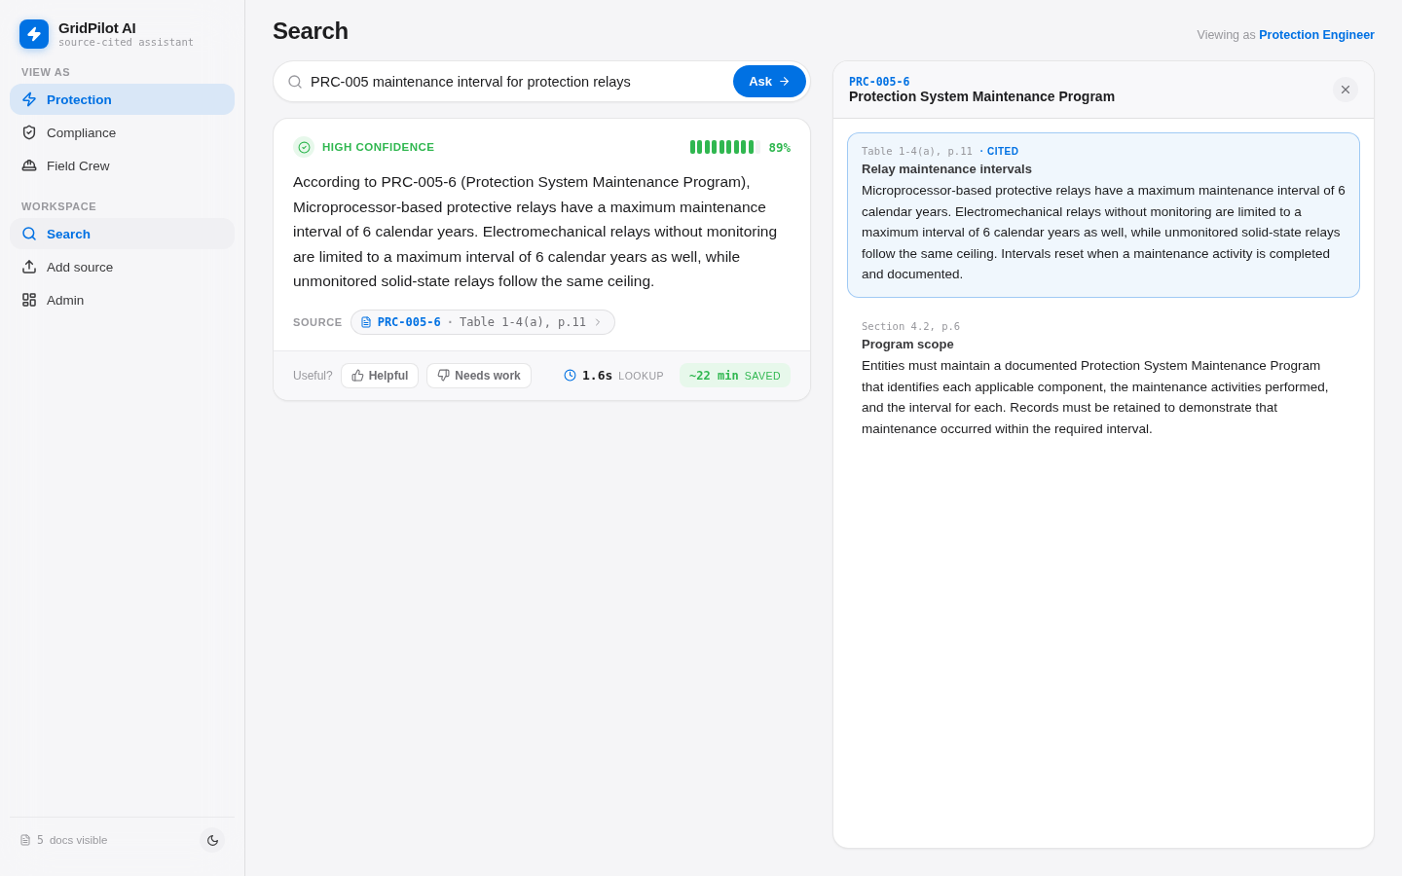
APP 1 · PHASE 3 · DESIGN & PROTOTYPE
APP 1 · GRIDPILOT AI
From a single artifact file to a real project
Workshop 1 — Claude Artifacts
The first version was a single-file artifact: one React component, seeded documents inline, no build step. Good for proving the interaction was worth building. Impossible to test, review, or deploy.
Workshop 2 — into an IDE
Migrated to Vite + React as 27 files: components, design tokens, role definitions, seeded data, and the retrieval logic isolated in src/lib/retrieval.js so it could be reasoned about on its own.
1 file → 27 files
The migration was not cosmetic: separating retrieval from rendering is what made the confidence banding testable, and the design tokens are what made a full dark theme a one-file change.
The running app: query, cited answer, and the source passage beside it
Notes:
The prototype answered one question: is a cited-answer interface actually better than searching a PDF? Once that was clear, the single file became the constraint. Splitting the project into 27 files was what made the rest of the work possible. Retrieval moved into its own module, so confidence banding could be reasoned about without touching the UI. Design tokens moved into theme.js, so light and dark are one palette definition rather than scattered overrides. This is the screenshot of the migrated app running locally at the end of Workshop 2.

Slide 8
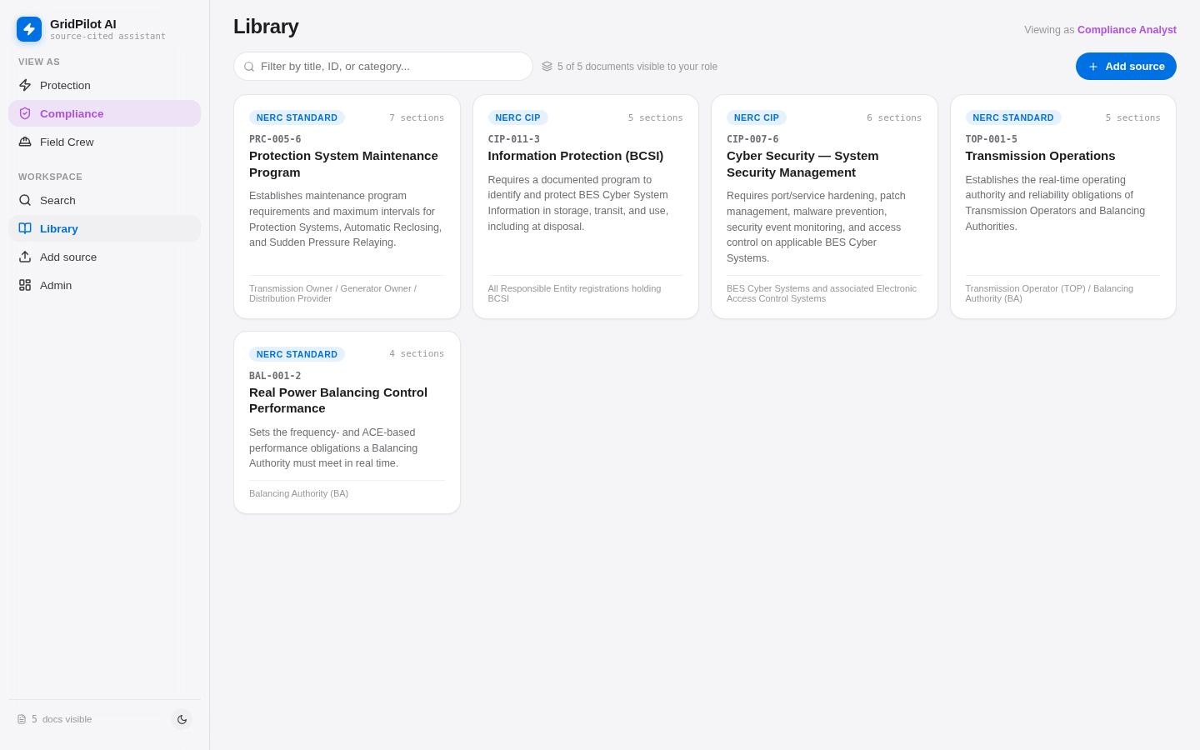
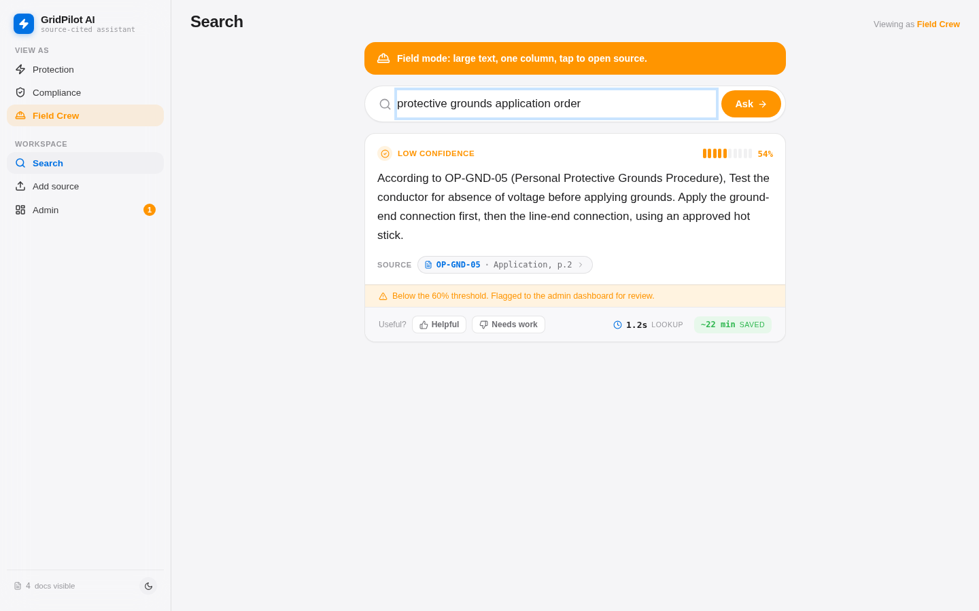
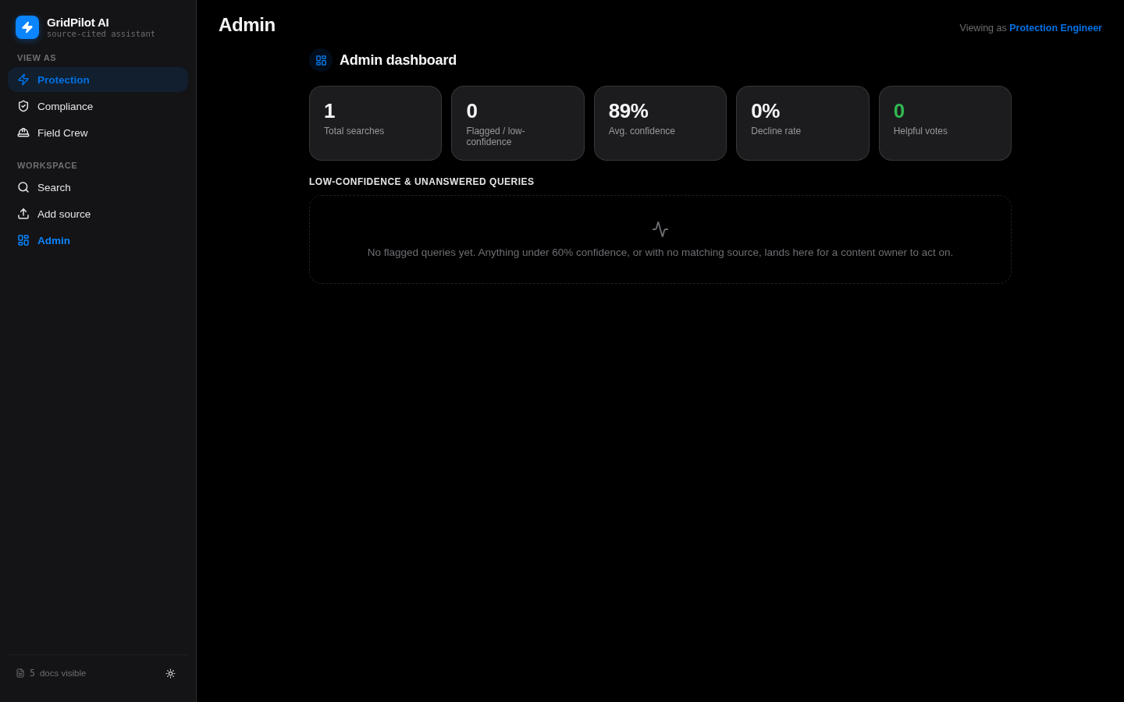
APP 1 · PHASE 3 · INTERFACE
APP 1 · GRIDPILOT AI
One product, three ways to look at it
Library
Field mode
Admin
Role-scoped document grid, filterable, with a full reader behind every card
One column, large targets, tinted in the field crew's accent, for gloved use
Searches, average confidence, decline rate, and every flagged query
Role scoping is product design, not a limitation.
A field crew view deliberately does not surface PRC-005 or the CIP standards. A compliance analyst sees the full standards set but not the relay setting sheet. Each role sees the documents its work actually uses.
Notes:
Three screens, one product. The library gives browsing rather than only search, because engineers often want the whole procedure, not the paragraph that matched. Field mode is the design decision I am most pleased with. It is not a responsive breakpoint; it is a different layout chosen by role, because a crew on a tablet has different needs from an analyst at a desk. The admin dashboard closes the loop: every query the assistant could not answer is recorded, so the document set improves based on evidence.

Slide 9
APP 1 · PHASE 4 · TESTING & RESPONSIBLE AI
APP 1 · GRIDPILOT AI
Tested in a real browser, at three sizes
18
3
0
1
automated checks
viewports
console errors
script error, not a bug
Driven through Chromium with Playwright
390 phone, 768 tablet, 1440 desktop
Across every run and every route
The test asserted a section title that had been renamed
What was verified
Responsible AI as behaviour, not a disclaimer
Search across high-confidence, low-confidence and declined paths
Role switching, and that the library contents change with it
Upload validation, then immediate searchability of the new document
Feedback thumbs, and the admin metrics that count them
Light and dark appearance, persisting across reload
Production build, clean, with no warnings
Every answer carries its source
The passage is shown beside the answer, not just named.
The assistant declines
Below the confidence threshold it says so instead of guessing.
Uncertainty is visible
A confidence meter, with an accessible value, sits on every answer.
Gaps are recorded
Declined queries land on the admin dashboard for a human to fix.
Notes:
Testing was done by driving the real app in a real browser, not by reasoning about the code. Playwright at three viewports, with screenshots at each step for manual review. The single failure was a test-script error rather than an application bug: it asserted an old section title that had been deliberately renamed. Worth reporting honestly, because a green suite that never fails is usually a suite that never checks anything. On the right is the responsible-AI position. Every item is a behaviour you can observe in the running app, not a paragraph in a policy document.

Slide 10
APP 1 · PHASE 4 · BUGS FOUND AND FIXED
APP 1 · GRIDPILOT AI
The bug that only appears at 390 pixels
FOUND
FIXED
Mobile layout was fundamentally broken
Two breakpoints, both verified in-browser
The 252px sidebar never collapsed, squeezing content into a sliver
Header text overlapped the search bar
The two-pane search compressed both columns past readability
≤980px: sidebar becomes a drawer, with a scrim and Escape to close
≤700px: the two panes stack, answer first, source below
Measured at 390px and 768px: no horizontal overflow
Found in the same pass: reduced motion missed the loading shimmer
Nobody had opened it at phone width. It looked correct on a laptop, and the checklist item that caught it existed only because responsive behaviour was written down as something to test.
Accessibility went in alongside: focus rings on every control, ARIA on the confidence meter, keyboard-only navigation verified end to end.
Full detail in docs/testing-report.md and docs/security-checklist.md in the repository.
Notes:
This is the first appearance of the lesson that ends up defining the whole capstone: the code was correct in the environment I was looking at, and broken in one I was not. The fix was two breakpoints and a drawer, but the interesting part is how it was found. Responsive behaviour was a written checklist item, so it got opened at 390 pixels deliberately rather than by accident. The reduced-motion gap came out of the same pass. The animations were disabled under prefers-reduced-motion, except the one added last.

Slide 11
APP 1 · PHASE 5 · DEPLOYMENT
APP 1 · GRIDPILOT AI
Push to main, and it is live
1
Commit
2
Build
3
Deploy
4
Serve
Push to GitHub
npm ci, then vite build
Firebase Hosting, live channel
HTTPS, global CDN, immutable assets
What the pipeline does for free
Live now
Pull requests get their own preview URL, commented on the PR
Only pushes to main go to the live channel
Hashed assets cached for a year; index.html never cached
Rollback is redeploying a previous commit
gridpilot-ai-fb150.web.app
Verified reachable, HTTP 200, serving the built bundle. No sign-in, no setup — the role switcher is in the sidebar and the seeded document set is already there.
Notes:
Deployment for a static React app is a solved problem, and the point of this slide is that connecting GitHub to hosting turns deployment from an event into a property of the repository. The preview-URL behaviour is worth calling out: every pull request gets its own temporary URL, so a change can be reviewed running rather than as a diff. The cache headers matter more than they look. Hashed assets are immutable for a year, index.html is never cached — and the second application later broke in exactly the way that rule prevents.

Slide 12
APP 1 · PHASE 5 · CHALLENGES
APP 1 · GRIDPILOT AI
What deployment actually taught me
Choosing the service
A static bundle does not need a container or a server. Picking hosting that matches the shape of the artifact removed most of the work rather than adding to it.
RIGHT-SIZED
Secrets in CI
The deploy needs a service-account credential. It lives in a GitHub secret and is never in the repository, and the workflow declares least-privilege permissions.
HANDLED
Cache correctness
Hashed assets immutable, index.html never cached. Get this backwards and users load an HTML file pointing at bundles that no longer exist.
CONFIGURED
The third item is the one that came back. Meridian shipped a blank page for exactly this reason, and the fix was the rule GridPilot already had.
Notes:
Three challenges, and the honest ranking is that the first was the largest at the time and the third mattered most in the end. Choosing hosting that matched the artifact removed work. I had assumed deployment meant a server, and a static bundle does not need one. The caching rule is the one to remember. GridPilot got it right by configuration. Meridian got it wrong months later and rendered a blank white page, and the fix was the same rule.

Slide 13
APP 1 · PHASE 6 · FEEDBACK & ITERATION
APP 1 · GRIDPILOT AI
What the showcase changed
“How do I even run this?”
Double-click launchers for Windows and macOS that check for Node, install once, start the server, and open the browser — no terminal, no URLs to find.
“Is it making the answers up?”
The source passage moved beside the answer rather than behind a click, and the confidence meter became a permanent part of every answer card.
“What happens when it doesn't know?”
The decline path became a demonstrated feature: a distinct card, and every declined query recorded on the admin dashboard.
Every item above shipped. The launchers and the two-pane answer layout are in the deployed build today.
Notes:
Three pieces of feedback from the Workshop 4 showcase, and what each one changed. The first is the one I did not expect. I had been running the app with a dev server for weeks and had stopped seeing that command lines are a barrier. The launchers exist because of that comment. The second and third are the same underlying question — can I trust this — asked two ways. The answer in both cases was to make the app's honesty visible rather than documented: show the source, show the confidence, and show the decline.

Slide 14
APP 2 · WORKSHOP 5 · PROBLEM & AI USE CASE
APP 2 · MERIDIAN
A harder problem, on purpose
Two records of the same account routinely disagree.
The AI use case, and its hard boundary
Categorising thousands of cryptic merchant descriptors and answering questions about a ledger is genuine model work. But financial data is the last thing that should leave a machine, so the model runs on 127.0.0.1 and a start-up check refuses any endpoint that does not resolve to loopback.
A charge posts twice. An authorisation hold never clears. A cheque clears on paper and never reaches the app's feed. Catching that by hand means reading a year of statements against a year of app history, line by line, so nobody does it.
2
11
3,350
13
profiles, fully isolated
accounts, 7 institutions
generated transactions
planted events to catch
The dataset was generated with thirteen deliberate anomalies planted in it — a duplicate charge, a card compromise, a subscription that creeps up, a cheque the feed never saw — so the app could be measured on whether it finds them rather than on whether it runs.
Notes:
The second application was chosen to be harder in a specific way: it needed a real backend, real parsing, and a correctness problem where being almost right is worse than being obviously wrong. The privacy boundary is the defining constraint. The AI layer talks only to a local model, and that is enforced by a start-up check rather than a promise in the README. The thirteen planted events are how the project avoided grading itself on vibes. The dataset has known answers, so the reconciliation engine can be measured.

Slide 15
APP 2 · ARCHITECTURE
APP 2 · MERIDIAN
Layers, and the rules between them
Interface
Compiled into the backend and served by it, so the container needs no Node at runtime
The AI layer
React 18 · TypeScript · Vite · Tailwind
Ollama
qwen2.5 · local
Routers
HTTP only. No business logic lives here
FastAPI · async · cookie sessions
127.0.0.1
only
Services
All the judgment. Returns domain objects, never ORM rows
Enforced at
start-up, not
by configuration
Ingestion · dedupe · reconciliation · budgets · coach
Repositories
All the SQL. A structural test fails the build if a method forgets the user
Judgment in the model.
Guarantees in code.
SQLAlchemy 2 · every method scoped by user_id
Storage
Totals, confidence ceilings and category identifiers are computed in Python after the model answers.
Money is integer cents everywhere, never a float
SQLite today, PostgreSQL-compatible schema · Alembic migrations
Layering rule: routers do no business logic, services do no SQL, repositories do no HTTP.
Notes:
Five layers with one rule between them: routers do no business logic, services do no SQL, repositories do no HTTP. Two of these are enforced rather than encouraged. A structural test reads the repository signatures and fails if any method can be called without a user id, which is how profile isolation stays true as the code grows. And money is integer cents everywhere. The panel on the right is the phrase the whole AI design comes down to. The model is allowed to have opinions about categories and phrasing. It is never allowed to be the reason a number is correct.

Slide 16
APP 2 · THE HARD PART
APP 2 · MERIDIAN
Five formats in, one ledger out
American Bank
Chase
Discover
Ally
Capital One
MM/DD/YY
Mon DD, YYYY
MM/DD/YYYY
ISO 8601
Mon DD, no year
Date, description,
amount, balance
Card purchases print
positive, so signs flip
Transaction and post
dates in separate columns
Unsigned columns — direction
lives in the running balance
Year comes from the
billing period header
Plus CSV exports from four platforms and monthly OFX files.
Deduplication is where correctness is won or lost
The proof
The same purchase arrives from the feed and from a statement, dated a day or three apart, described differently. Match too eagerly and a real transaction disappears from someone's ledger. Match too cautiously and every purchase shows twice.
153
documents imported
into seeded profiles
1
new row created — every
other line matched what
the feed already had
Two layers: an occurrence-aware hash, then a one-to-one assignment pass over amount-exact candidates within three days.
Notes:
Five PDF layouts, deliberately different, because a parser that only handles one bank has not been tested. The last two are the interesting ones. Ally prints withdrawals and deposits as separate unsigned columns, so nothing on the row says which direction the money went — the parser derives it from the running balance. Capital One prints no year on the row at all. The numbers on the right are the deduplication result, and they are the single best evidence in the project. 153 documents imported into profiles that had already synced, and exactly one row was genuinely new.

Slide 17
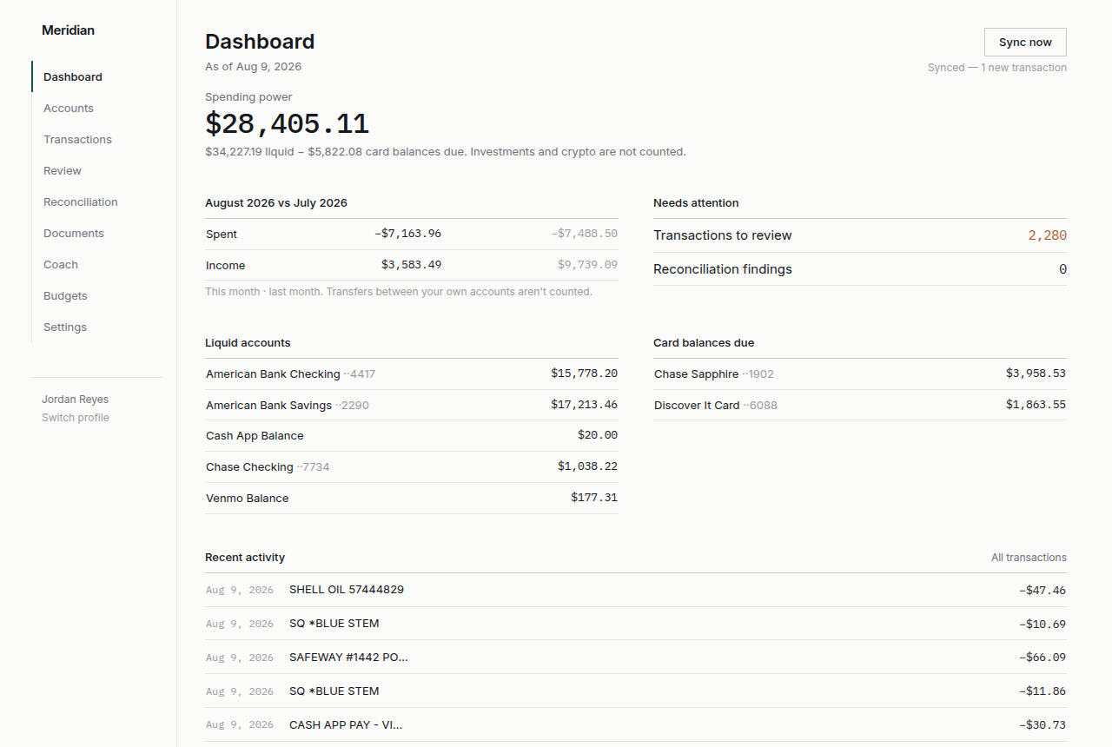
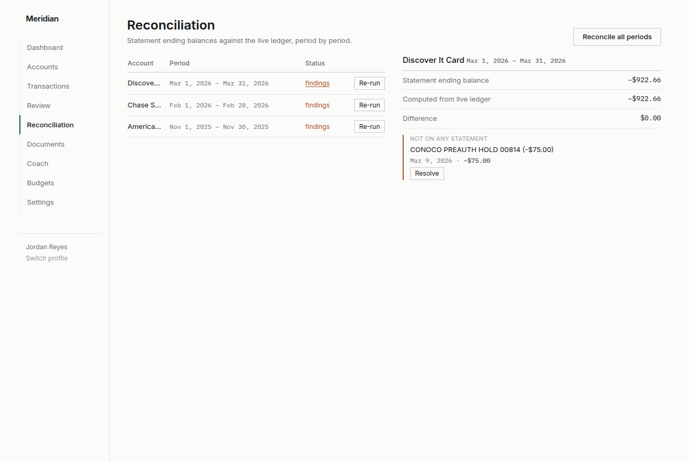
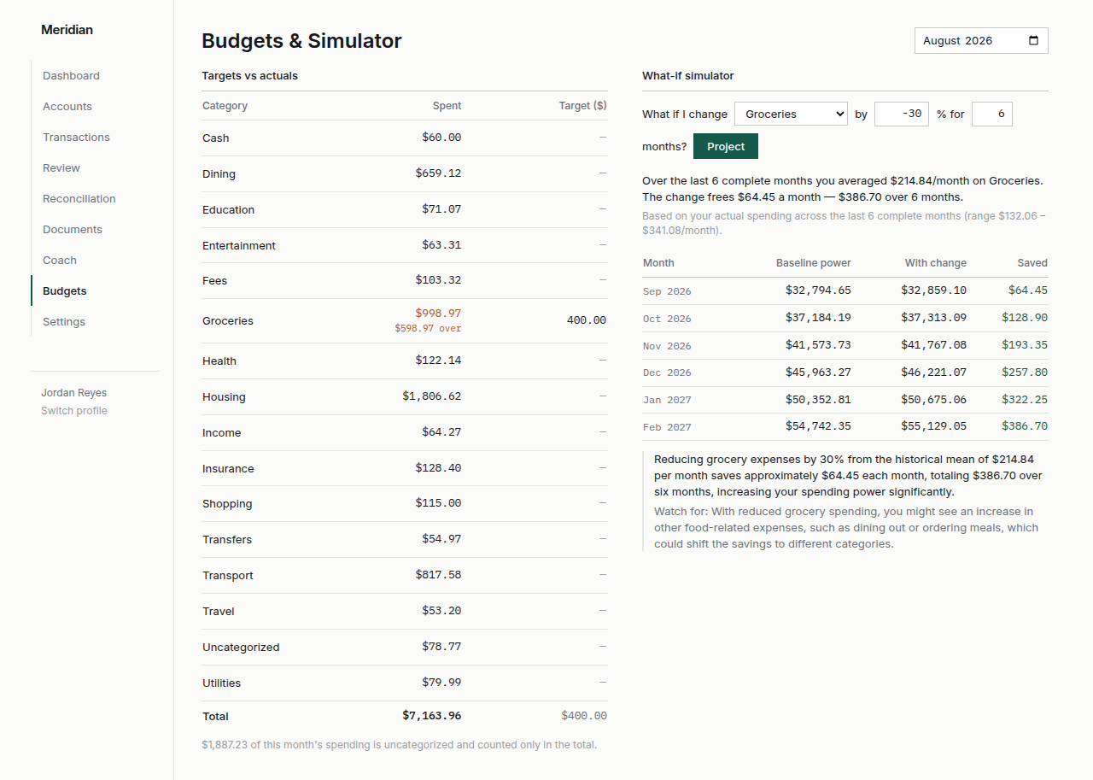
APP 2 · THE APPLICATION
APP 2 · MERIDIAN
Eight screens, and what each one is for
Dashboard
Reconciliation
Budgets
Spending power, not just a balance: liquid funds minus what is already committed
Every statement period, its status, and the arithmetic that does not close
Targets against real spending, with a simulator for changing one and seeing the effect
Plus Accounts, Transactions, Documents, Review and Coach — and the Coach says plainly when the local model is missing rather than pretending to answer.
Notes:
Three of the eight screens. The dashboard leads with spending power rather than a balance, because a balance that includes money already committed to a credit card bill is misleading. Reconciliation is the screen the whole application exists for. Every period, its status, and where the arithmetic does not close. Budgets are set per category per month and measured against categorised spending, with a simulator for testing a change before committing to it.

Slide 18
APP 2 · TESTING & SECURITY
APP 2 · MERIDIAN
205 backend tests, and what they defend
Tests that exist because of a real defect
A poisoned MIME map, so a bad registry cannot break the bundle
index.html must never be cached, or a rebuild renders blank
Absolute SQLite paths, after one silently became relative
Login throttling, from the security audit
Security posture
Argon2id hashing; JWT in an HttpOnly SameSite=Strict cookie
Every query scoped by user_id, enforced structurally
Uploads capped and type-checked; errors leak nothing
No secrets in the repository; config from the environment
Plus 13 frontend tests and a TypeScript build gate in CI.
Notes:
205 backend tests, and the shape of the chart is the point. Well over half are golden-file parser tests, because parsing other people's PDF layouts is where silent corruption enters a ledger. The four tests on the top right did not exist when the code was written. Each one exists because something broke in a way the suite could not see — a Windows MIME map, a cached HTML file, a path that lost its leading slash, and unlimited password guesses against demo accounts published in the README. That is what a regression test is for: not proving the fix works today, but making the environment that broke it part of the suite.

Slide 19
APP 2 · WORKSHOP 6 · DEPLOYMENT
APP 2 · MERIDIAN
A container that costs nothing while idle
1
Push
2
Build
3
Store
4
Run
GitHub
Cloud Build reads the Dockerfile
Artifact Registry
Cloud Run, scale to zero
Live now
meridian-792468836580.us-central1.run.app
Both demo profiles sign in with one click.
Two limits, stated rather than hidden
The database is a file in the container, so live edits reset on restart
AI features are off on the public URL — a container has no local model
Migrating and seeding 3,350 transactions ran on every scale-from-zero. The same work now happens once, at image build time.
Notes:
One command deploys this: gcloud run deploy from the repository root. Cloud Build reads the Dockerfile, Artifact Registry stores the image, Cloud Run serves it and scales to zero between visits, which is why it costs nothing. The chart is a real measurement. Migrating and seeding thousands of transactions ran on every cold start until the database was baked into the image at build time. The two limits on the right are deliberate. The AI one especially: the app refuses to send financial data to a model it does not host, and a cloud container has no local model, so those features report themselves unavailable rather than quietly using someone's API.

Slide 20
APP 2 · WORKSHOP 6 · FEEDBACK & ITERATION
APP 2 · MERIDIAN
The demo was working. It just looked broken.
“My downloaded version does not have the same outputs as the screenshots you show.”
What shipped in response
Documents
0
117 and 36
Reconciled periods
0
79 and 36
Correct, and my fault. The demo profiles were seeded with account data only, so Documents, Reconciliation and Budgets opened empty. Three of eight screens looked unimplemented, which is the opposite of what a demo is for.
Budget targets
0
6 and 6
Review queue
0
309 waiting
Seeding now runs the whole pipeline, and the finished result is built into the image and the download.
Deliberately still empty: 309 transactions in the review queue
Those are the cryptic descriptors — SQ *BLUE STEM, TST* MERIDIAN 04 — that exist to be triaged. Pre-filling them from the generator's own answer key would have deleted the feature they were built to demonstrate. The one-click demo sign-in shipped in the same pass.
Notes:
This is the most useful feedback I received across both applications, and it came from someone downloading the app rather than watching me demo it. The features worked. The demo data did not exercise them. Seeding now runs the entire pipeline — import, categorise, reconcile, budget — and the finished result is baked into both the container image and the download, so it costs nothing at start-up. The last panel is the judgment call. I deliberately left 309 transactions uncategorised, because those are the ones the review queue exists for.

Slide 21
AI'S ROLE
How the AI was actually used
1
2
3
Write the brief before the code
Judgment in the model, guarantees in code
Log the decision, not just the change
The second project started with a written build plan and fifteen milestones, produced and argued over before a single file existed. Every later prompt could refer to it.
The model proposes categories and phrasing. Totals, confidence ceilings and identifiers are computed in Python afterwards.
Thirty numbered decision records, each with the reasoning and the rejected alternative.
Prevented the drift that costs the most time: rewriting something because the shape was wrong.
A 3B model was overconfident about cryptic descriptors. The fix was a deterministic cap in code, not a sterner prompt.
Made it possible to answer 'why is it like this' months later, and to hand context to a fresh session.
Tools: Claude Artifacts for the first prototype · Claude Code in the terminal for both builds · Playwright for browser testing · a local qwen2.5 through Ollama as the application's own model
Notes:
Three patterns that changed how much the assistance was worth. Writing the brief first was the single biggest improvement between the two applications. The first was built by conversation; the second started from a plan we argued about before any code existed. The middle one is the design principle for anything that has to be correct. When a smaller model was overconfident about cryptic merchant descriptors, the fix was a deterministic confidence cap in code. Writing a sterner prompt made the model worse, not better. The decision log mattered more than expected, because it let a fresh session pick up months of context without re-deriving it.

Slide 22
LESSONS LEARNED
What changed between the first and the second
GridPilot AI
Meridian Financial
Where the plan lived
In the conversation
In a written brief, argued before any code
When deployment was decided
After it was built
Before the first migration was written
What tests covered
The features, in one browser
The features, plus the environments that broke them
How the model was trusted
Asked, then checked by eye
Constrained in code, tested against a real local model
What the demo data proved
That the app runs
That the app finds thirteen known anomalies
The lesson underneath all five: a green test run proves the code is correct in the environment the tests run in. Download, install and deployment are each a different environment.
Notes:
Five concrete changes, and one lesson underneath them. The three worst bugs in the second application all lived where the tests do not run. A blank white page on Windows because that machine maps .js to text/plain. A blank page after a rebuild because a cached HTML file pointed at bundles that no longer existed. A database path that silently lost its leading slash inside a container. None is a logic error. No amount of unit testing would have found them, because they live in the gap between environments. What I would do differently is treat download, install and deploy as testable environments from the first week.

Slide 23
VALUE & IMPACT · APP 1
APP 1 · GRIDPILOT AI
What GridPilot is worth to a utility
Where the time goes today
Illustrative annual value
An engineer with a standards question opens a shared drive, finds a PDF, checks it is the current revision, and reads to the right table. Ten to fifteen minutes when it goes well. Longer when the answer is in a document they did not know existed.
200 engineers × 2 lookups a week × 10 minutes saved ≈ 3,470 hours a year
Assumption-based, not measured. The point is the shape: the saving scales with headcount and question volume, and the platform cost does not.
Compliance risk
Onboarding
An answer that cites its source is auditable. An answer from memory is not.
A new analyst asks the workspace instead of asking a senior engineer.
Content gaps
Field safety
Declined queries are recorded, so the document set improves from evidence.
The right procedure, on a tablet, without a laptop or a phone call.
Notes:
The arithmetic on this slide is labelled illustrative because it is. I have assumptions, not measurements, and presenting an estimate as a finding is exactly the habit this course taught me to avoid. What I would defend is the shape. The saving scales with headcount and question volume, and the hosting cost does not move. The four benefits below are harder to price and probably matter more. The compliance one especially: in a regulated environment, an answer that cites its source is auditable and an answer from memory is not.

Slide 24
VALUE & IMPACT · APP 2
APP 2 · MERIDIAN
What Meridian is worth to a household
13
3
79
anomalies planted
actionable findings
periods reconciled
and every one detected by the app itself
across a full year, with zero false positives
in under a minute, unattended
The value is the errors nobody would have found
Where it goes commercially
A duplicate restaurant charge two days apart. A cheque that cleared on paper and never reached the account feed, leaving a balance permanently overstated by $230. A hold that never released. Each is small. Each would have sat there for years, because checking by hand costs more than the error.
Bookkeepers and small firms
The same reconciliation, run against client accounts, is billable work today.
Privacy as the product
A finance tool that provably never sends data off the machine has a market that cloud tools cannot serve.
An hour of statement-checking a month is the realistic alternative, and almost nobody does it.
Cost to run
Zero while idle on scale-to-zero hosting; a hosted database is roughly nine dollars a month.
Notes:
The three tiles are measured, not estimated. Thirteen anomalies were planted in the generated dataset and the application detects every one, surfacing three as actionable with no false positives. Zero false positives is the number I would lead with commercially. A reconciliation tool that cries wolf gets switched off in a week. On the right, the privacy angle is the real commercial argument. Every competing tool asks you to upload a year of transaction history. This one refuses to send it anywhere, and that refusal is enforced in code.

Slide 25
CONCLUSION
Two applications, live, and what comes next
GridPilot AI
Meridian Financial
Roadmap
Roadmap
1
Real retrieval: managed vector store, embeddings, hybrid search
1
A hosted database, so the live URL keeps what people put into it
2
A hosted model for synthesis, with a guardrail against uncited claims
2
A real provider integration behind the interface the mock already implements
3
Okta SSO with role mapping, CIP-appropriate hosting and audit logging
3
A rules screen, so a correction becomes a rule the user can see and edit
gridpilot-ai-fb150.web.app
meridian-792468836580.us-central1.run.app
Pick a role in the sidebar and ask it something
Sign in with one click and open Reconciliation
Two problems framed, two applications built, tested, deployed, shown to users, and changed because of what they said.
Notes:
Both applications are live right now, and both URLs are on this slide. Please open them. The roadmaps are honest about what each one is missing. GridPilot needs real retrieval to be more than a convincing prototype. Meridian needs a hosted database before anyone could keep their own data in it. What I take from running this lifecycle twice is that the second time was faster for one reason: the decisions that hurt the first time were made first the second time. Deployment shape, testing surface, and where the model is allowed to be authoritative.

