Slide 1
APPLE
VS
SAMSUNG
Competitive Financial & Market Analysis
2015 - 2026 | Stock Performance * Financial Fundamentals * Macroeconomic Sensitivity
Darshil Gandhi
Apurva Awate
Sony Maharajan
Gabriela Rodriguez
Lead Analyst
Data Engineer
Macro Analysis
Financial Modelling
MS in FinTech | April 2026
Notes:
SLIDE 1 — OPENING (1 min) Good morning / afternoon everyone. My name is Darshil Gandhi, and I am presenting alongside my teammates Apurva Awate, Sony Maharajan, and Gabriela Rodriguez. We are all MS in FinTech students and today we will walk you through our competitive financial and market analysis of Apple versus Samsung. These are the world's two largest consumer technology companies — Apple dominates premium smartphones, personal computers, and software services in Western markets, while Samsung dominates hardware manufacturing, memory semiconductors, and consumer electronics globally. Despite competing head-to-head in smartphones, their financial structures, market listings, and investor bases are fundamentally different — Apple on NASDAQ in USD, Samsung on the Korean Exchange in KRW. Our analysis covers ten years of data from 2015 to 2026, asking three research questions about stock performance, financial fundamentals, and macroeconomic sensitivity. Let's get started.

Slide 2
Agenda — 20-Minute Presentation
01
Data Sources & Libraries
Yahoo Finance (yfinance) | FRED (pandas-datareader) | Why each library was chosen
02
RQ1: Stock Performance & Correlation
Normalized prices | Rolling correlation | Volatility | 2015-2026
03
RQ2: Financial Fundamentals
Revenue | Profit margins | Free cash flow | Apple vs Samsung
04
RQ3: Macroeconomic Regression
OLS regression | CPI & Treasury yield factors | R-squared analysis
05
Findings, Limitations & Future Work
Key takeaways | Model limitations | Next research steps
Apple vs Samsung | Competitive Financial & Market Analysis | MS in FinTech 2026
Notes:
SLIDE 2 — AGENDA (30 sec) Here is the roadmap for the next 20 minutes. We have structured the presentation into five parts. First, we will explain where the data comes from and why we chose each Python library — this is important because in data science the choice of tools directly affects reproducibility and accuracy. Second, we tackle Research Question 1 — looking at stock price performance and return correlation over a full decade. Third, Research Question 2 compares the companies on hard financial fundamentals: revenue, profit margins, and free cash flow. Fourth, Research Question 3 uses Ordinary Least Squares regression to test whether macroeconomic factors — specifically inflation and interest rates — can explain stock returns. We close with a synthesis of findings, honest limitations of our approach, and directions for future research. Let's dive in.

Slide 3
Data Sources
Yahoo Finance (yfinance)
FRED (pandas-datareader)
Ticker
AAPL (NASDAQ) | 005930.KS (KRX)
Series
CPIAUCSL — US CPI (inflation)
Period
Jan 2015 - Apr 2026 (daily)
Series
DGS10 — 10-Year Treasury Rate
Price Data
OHLCV — 2,927 rows x 10 columns
CPI
134 monthly obs | 2015-2026
Financials
Revenue, Gross Profit, Net Income
Treasury
2,824 daily obs | 2015-2026
Financials
Operating Income, EBITDA, Free CF
Source
Federal Reserve Bank of St. Louis
Frequency
Annual (4-5 fiscal years)
Access
Free government open data API
Apple vs Samsung | Competitive Financial & Market Analysis | MS in FinTech 2026
Notes:
SLIDE 3 — DATA SOURCES (1 min) Our entire analysis rests on two data sources, both of which are free and industry-standard. On the left, Yahoo Finance — accessed via the Python library yfinance. This gave us daily Open-High-Low-Close-Volume price data for both Apple (ticker: AAPL on NASDAQ) and Samsung (ticker: 005930.KS on the Korean Stock Exchange). We pulled 2,927 daily rows spanning January 2015 to April 2026. We also pulled annual financial statements — income statement, balance sheet, and cash flow statement — which yfinance fetches directly from SEC and equivalent Korean filings. On the right, FRED — the Federal Reserve Economic Data portal from the St. Louis Fed — accessed via pandas-datareader. We pulled two macroeconomic series: CPIAUCSL, which is the Consumer Price Index for all urban consumers — a standard proxy for inflation — and DGS10, the 10-year constant maturity Treasury yield, which is the benchmark risk-free rate used across fixed income and equity valuation models. One important note: all of this data is freely available and reproducible. Anyone can re-run our notebook and get the same results.

Slide 4
Python Libraries Used & Why
# setup_and_imports.py
pandas
import pandas as pd
import numpy as np
import matplotlib.pyplot as plt
import matplotlib.ticker as mticker
import seaborn as sns
import yfinance as yf
import pandas_datareader as pdr
from statsmodels.regression
.linear_model import OLS
from statsmodels.tools import
add_constant
import os, warnings
warnings.filterwarnings('ignore')
DataFrames, merge, resample, groupby, pct_change for all time-series work
numpy
Annualized return/volatility formulas, polyfit regression trend line
matplotlib
All 11 custom financial charts with dual-axis, formatters, gridlines
seaborn
Correlation heatmap with diverging RdBu colormap (plot 10)
yfinance
Downloads OHLCV + income / balance / cash flow from Yahoo Finance API
pandas-datareader
Fetches CPI (CPIAUCSL) and 10Y Treasury (DGS10) directly from FRED
statsmodels
OLS regression, add_constant, R-squared, F-stat, p-values, residuals
Apple vs Samsung | Competitive Financial & Market Analysis | MS in FinTech 2026
Notes:
SLIDE 4 — LIBRARIES (1.5 min) On the left you can see the actual import block from our notebook. On the right, here is why each library was chosen — this is not arbitrary, every choice was deliberate. pandas is the backbone — it handles every DataFrame operation: loading CSVs, setting DatetimeIndex, merging on dates, resampling from daily to monthly, and computing percentage changes for returns. numpy handles the mathematical operations that pandas does not: computing annualized return using the formula (1 + mean_daily_return)^252 - 1, annualized volatility using std * sqrt(252), and fitting a regression trend line via numpy polyfit. matplotlib is used for all 11 of our charts. It gave us precise control over dual-axis subplots, custom tick formatters to show percentages, and figure sizing for publication quality. seaborn was specifically used for the correlation heatmap — its built-in diverging colour palette (RdBu_r) makes it immediately intuitive to read positive versus negative correlations. yfinance is a wrapper around Yahoo Finance's unofficial API. It lets us download price history and financial statements in one function call. pandas-datareader connects directly to the FRED API to pull government macroeconomic series — no manual CSV downloads needed. statsmodels provides OLS — Ordinary Least Squares regression — with full statistical output including R-squared, adjusted R-squared, F-statistics, p-values, and residuals, which are all critical for our third research question.

Slide 5
Data Pipeline & Cleaning Steps
1
2
3
4
5
Load CSVs
Handle NaNs
Type Cast
New Columns
Merge & Align
read_csv with multi-level headers & DatetimeIndex
88 Apple + 159 Samsung NaNs -> dropna() -> 2,680 rows
Price/volume -> float64; dates -> DatetimeIndex
pct_change() returns; base-100 normalize; rolling annualized vol
Inner join stocks + macro; resample monthly for regression
# extract_fin() — standardises financial statement rows into a clean DataFrame
def extract_fin(df, row_map, scale):
"""Extract rows by name, cast to float, scale to B or T units"""
result = {}
for label, row_key in row_map.items():
if row_key in df.index:
result[label] = pd.to_numeric(df.loc[row_key], errors='coerce') / scale
out = pd.DataFrame(result)
out.index = pd.to_datetime(out.index) # parse fiscal year date strings
return out.sort_index()
Apple vs Samsung | Competitive Financial & Market Analysis | MS in FinTech 2026
Notes:
SLIDE 5 — DATA PIPELINE (1.5 min) Before any analysis, we had to clean and structure the raw data. The five steps at the top show our pipeline. Step 1: We loaded the CSV files using pandas read_csv. The stock price file had multi-level column headers — Apple and Samsung as the top level, then OHLCV as the second level — so we used the header=[0,1] parameter. Step 2: Handling missing values. Apple had 88 NaN values and Samsung had 159 — these arise because the two stocks trade on different exchanges with different holiday calendars. We resolved this with dropna() to keep only dates where both stocks have prices, giving us 2,680 clean rows. Step 3: Type casting — all price and volume columns were cast to float64 to ensure numerical operations work correctly. Step 4: We created new derived columns. Daily returns were computed using pct_change() — this gives us the percentage change from one day to the next. We also created a base-100 normalized series by dividing each price series by its first value and multiplying by 100. And we computed rolling annualized volatility using std() times the square root of 252 (trading days in a year). Step 5: For the regression analysis we needed to merge the daily stock data with monthly macroeconomic data. We resampled the daily prices to monthly using resample('ME').last() and then did an inner join with the FRED data. The function you see in the code block — extract_fin — is a reusable helper we wrote to standardize all financial statement loading. It takes a raw DataFrame, maps row names, converts to float, and scales to billions or trillions.

Slide 6
Descriptive Statistics — 2015 to 2026
1,016%
956%
29.4%
29.9%
31.0% annualized
30.5% annualized
Annualized sigma
Annualized sigma
Apple Total Return
Samsung Total Return
Apple Volatility
Samsung Volatility
Performance Summary
Metric | Apple (USD) | Samsung (KRW)
Start Price | $24.21 | 20,462 KRW
End Price | $270.23 | 216,000 KRW
Sharpe Ratio (rf = 0) | 1.05 | 1.02
Max Daily Gain | +15.33 % | +13.43 %
Max Daily Loss | -12.86 % | -11.74 %
Apple vs Samsung | Competitive Financial & Market Analysis | MS in FinTech 2026
Notes:
SLIDE 6 — DESCRIPTIVE STATISTICS (1 min) Before answering our research questions, let us look at the headline numbers. Apple delivered a total return of 1,016% over this period — meaning $1 invested in 2015 became $10.16 by 2026. Samsung delivered 956% — nearly identical. Annualized, both returned approximately 30-31% per year. The annualized volatility — which measures how much returns fluctuate around their average — is 29.4% for Apple and 29.9% for Samsung. These are statistically indistinguishable, which is a striking finding given that these companies operate in completely different currencies, markets, and business cycles. The Sharpe Ratio — developed by Nobel laureate William Sharpe — measures return per unit of risk. It is calculated as the annualized return divided by annualized volatility, assuming a risk-free rate of zero. Apple scores 1.05 and Samsung 1.02. A Sharpe above 1.0 is generally considered excellent. The fact that both are nearly identical tells us these two stocks have delivered almost perfectly equivalent risk-adjusted performance over a decade. The max daily gains and losses tell us about tail risk — Apple's worst single day was minus 12.86% and its best day was plus 15.33%. Samsung's profile is nearly the same.

Slide 7
RQ1
Stock Performance & Correlation
How have Apple and Samsung stock prices performed and correlated over 2015 - 2026?
Apple vs Samsung | MS in FinTech 2026
Notes:
SLIDE 7 — RQ1 SECTION INTRO (15 sec) Research Question 1 asks: how have Apple and Samsung stock prices performed and correlated over the decade from 2015 to 2026? We will look at this from four angles: normalized price performance, rolling correlation, return scatter, and volatility.

Slide 8
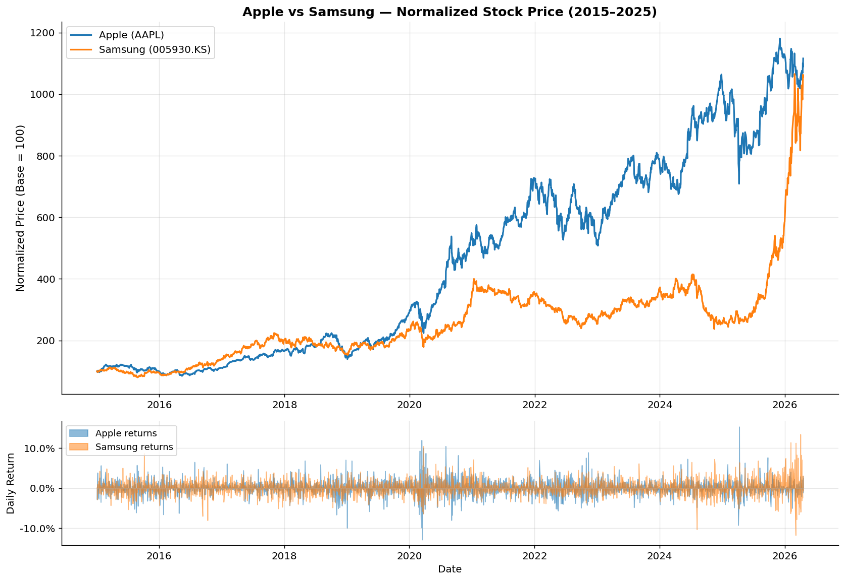
RQ1 — Normalized Stock Price Performance (Base = 100)
Apple vs Samsung | Competitive Financial & Market Analysis | MS in FinTech 2026
Notes:
SLIDE 8 — NORMALIZED PRICES (1.5 min) To compare two stocks that trade in completely different currencies — USD and KRW — and at different absolute price levels, we use a base-100 normalization. This is a standard technique in financial analysis: we divide every price by the first price in the series and multiply by 100. So both stocks start at exactly 100 in January 2015 and we track where they go from there. The top panel shows the normalized price paths. The blue line is Apple and the orange line is Samsung. Both started at 100 and both ended above 1,000 — Apple at roughly 1,116 and Samsung at about 1,056. This visually confirms the 1,016% and 956% total returns we discussed. What stands out is the shape of the two trajectories. Apple shows a remarkably consistent and steep upward trend from 2019 onwards, driven by the services revenue boom — the App Store, iCloud, Apple Music, and Apple TV Plus all became material revenue sources. Samsung's trajectory is choppier, with a major plateau from 2021 to 2024 driven by the global semiconductor downturn — memory chip prices collapsed as post-COVID inventory built up. The bottom panel shows daily returns as a filled area chart. Notice how both stocks spiked volatility simultaneously in March 2020 — COVID — and again in late 2022 — the rate-hike cycle. These are moments of systemic market stress where all stocks tend to move together, which is something we will explore more in the correlation analysis.

Slide 9
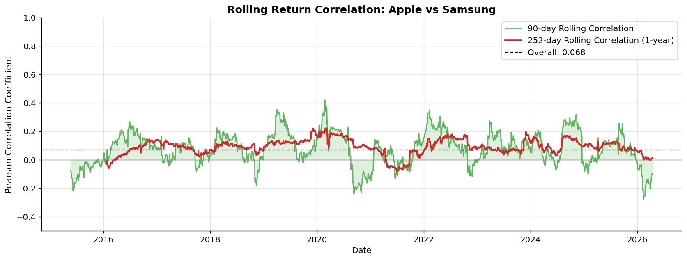
RQ1 — Rolling Return Correlation: Apple vs Samsung
Overall r = 0.068
COVID-19 Spike
Unstable Over Time
Almost zero correlation — stocks trade independently despite being direct rivals
Rolling correlation briefly exceeds 0.4 during broad market selloff (Mar 2020)
Relationship varies wildly year to year, confirming different market drivers
Apple vs Samsung | Competitive Financial & Market Analysis | MS in FinTech 2026
Notes:
SLIDE 9 — ROLLING CORRELATION (1.5 min) Pearson correlation measures the linear relationship between two variables. A value of +1 means they move perfectly in lockstep. Zero means no relationship. Minus 1 means they move in exactly opposite directions. The overall Pearson correlation of Apple and Samsung daily returns is just 0.068 — essentially zero. This is our most surprising finding. These are the two biggest smartphone companies in the world, direct rivals for the same consumer, and yet their daily stock returns are almost completely uncorrelated. Why? Because despite competing in the same product market, their financial exposure is very different. Apple is predominantly a US company, listed on NASDAQ, owned heavily by US institutional investors, and priced in USD. Samsung is listed on the Korean Exchange, denominated in KRW, and its largest business by revenue is actually semiconductor manufacturing — DRAM and NAND flash memory — not smartphones. So different investors, different currencies, different primary business lines. The rolling 90-day correlation — the green line — jumps to above 0.4 during market crises. This is a well-documented phenomenon in finance called "correlation breakdown" — during systemic crises like COVID in March 2020 or the 2008 financial crisis, correlations across all assets rise dramatically because investors sell everything simultaneously. This is sometimes called "flight to safety." The key insight for portfolio theory — Modern Portfolio Theory, developed by Harry Markowitz — is that low correlation is valuable. Holding Apple and Samsung together reduces portfolio risk more than holding two highly correlated stocks, because their diversification benefit is high.

Slide 10
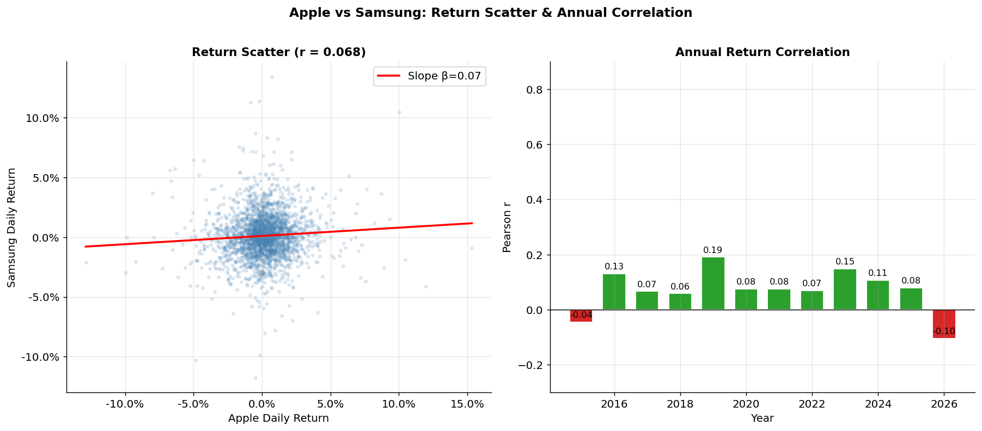
RQ1 — Return Scatter Plot & Annual Correlation Breakdown
Apple vs Samsung | Competitive Financial & Market Analysis | MS in FinTech 2026
Notes:
SLIDE 10 — SCATTER & ANNUAL CORRELATION (1 min) The left scatter plot shows every single daily return pair — Apple on the x-axis, Samsung on the y-axis. If the two stocks were perfectly correlated, all dots would sit exactly on the red regression line. Instead the cloud of dots is very diffuse — dots scatter widely in all directions. The slope of the regression line, called beta here, is about 0.19, meaning when Apple moves 1%, Samsung moves only about 0.19% in the same direction. Very weak co-movement. The right chart breaks down correlation by individual year. This is important because the overall correlation of 0.068 could mask periods of high or low correlation. What we see is that the relationship is genuinely unstable year to year. Some years like 2020 show moderate positive correlation around 0.3. Other years show near-zero or even slightly negative correlation. There is no persistent structural relationship. This has important implications. If you were building an investment model that assumed these two stocks always move together, you would be wrong. The relationship is regime-dependent — it changes based on broader market conditions, the semiconductor cycle, currency movements, and company-specific events.

Slide 11
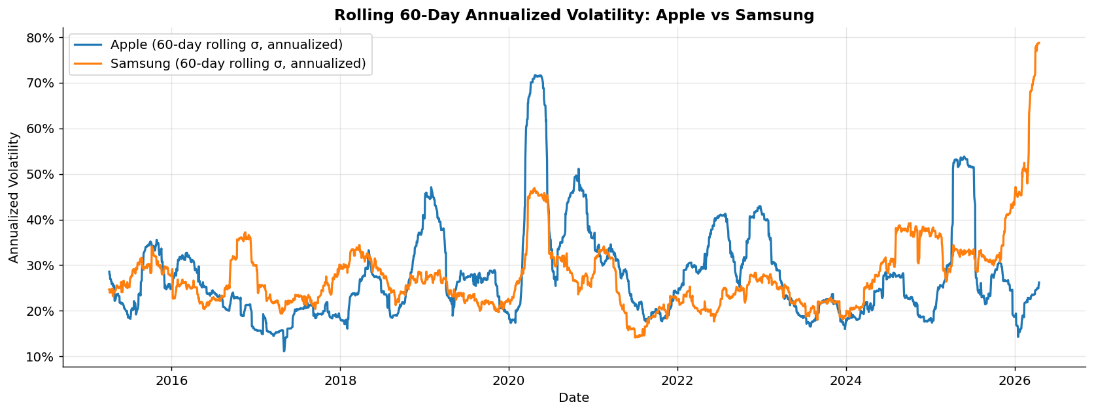
RQ1 — Rolling 60-Day Annualized Volatility
Both stocks carry ~29-30% annualized volatility — nearly identical risk profiles despite trading on different exchanges
Sharp volatility spikes: COVID-19 crash (Mar 2020) and the 2022 Fed rate-hike cycle both pushed vol above 40%
Apple shows greater stability post-2023; Samsung's vol remains elevated due to semiconductor cycle uncertainty
Apple vs Samsung | Competitive Financial & Market Analysis | MS in FinTech 2026
Notes:
SLIDE 11 — VOLATILITY (1 min) This chart shows rolling 60-day annualized volatility — a measure of how much stock prices fluctuate over time. Technically, we compute the standard deviation of daily returns over a 60-day window and multiply by the square root of 252 to annualize it. The key observation is that both stocks have nearly identical volatility profiles throughout the entire decade. Both hover around 25-30% under normal conditions. This symmetric risk profile is remarkable given how different their business models are. The two major volatility spikes visible on both charts are textbook examples of systemic market stress. The first is March 2020 — the COVID-19 crash — when global equity markets fell 30-40% in three weeks. Both stocks' volatility exploded above 40%. The second is 2022, when the US Federal Reserve began the fastest rate-hiking cycle since the 1980s, raising rates from zero to 5.25% in about 18 months. Growth stocks, which derive a large portion of their value from future cash flows, are particularly sensitive to rising discount rates — and both Apple and Samsung are growth stocks. Post-2023 Apple shows meaningfully lower volatility than Samsung. This divergence reflects Samsung's ongoing uncertainty from the DRAM memory price cycle and geopolitical risks around Korean semiconductor manufacturing, while Apple's Services revenue growth provides more predictable earnings.

Slide 12
RQ2
Financial Fundamentals
How do Apple and Samsung compare on revenue, profitability, and cash flow over 2022-2025?
Apple vs Samsung | MS in FinTech 2026
Notes:
SLIDE 12 — RQ2 SECTION INTRO (15 sec) Moving to Research Question 2. Here we step away from stock prices and look at the underlying business performance — the financial statements. We are comparing revenue, profit margins, and free cash flow. Remember: stock prices reflect what the market expects in the future, but financial statements tell us what has actually happened. The gap between the two is where opportunities and risks live.

Slide 13
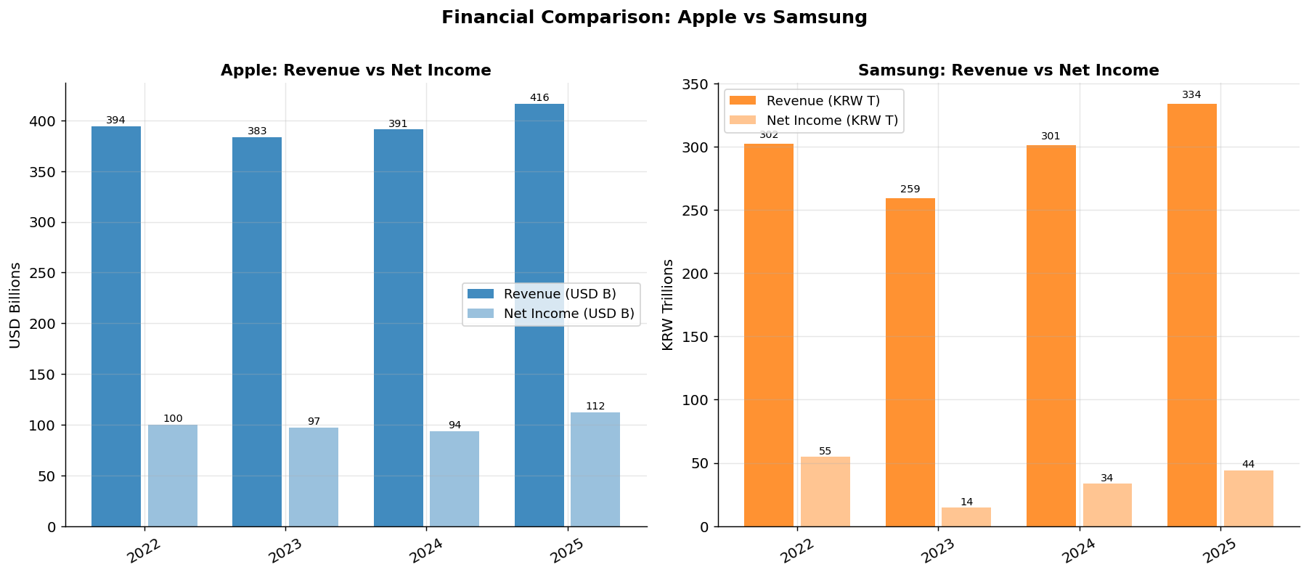
RQ2 — Revenue vs Net Income (2022-2025)
$416B
334T
-14%
Apple Revenue 2025 — USD — record high
Samsung Revenue 2025 — KRW — strong recovery
Samsung 2023 Decline — Semiconductor downturn
Apple vs Samsung | Competitive Financial & Market Analysis | MS in FinTech 2026
Notes:
SLIDE 13 — REVENUE & NET INCOME (1 min) Note: Apple reports in US Dollars and its fiscal year ends in September. Samsung reports in Korean Won — in trillions — and its fiscal year ends in December. We cannot directly compare the absolute numbers, but we can compare trends and growth rates. Looking at Apple: revenue grew from $394 billion in fiscal year 2022 to a record $416 billion in 2025. Net income tracked similarly, peaking at $112 billion in 2025. Apple's revenue is remarkably stable — it does not swing dramatically year to year — which reflects the predictable upgrade cycle of the iPhone and the steady growth of Services. Samsung's story is much more volatile. Revenue peaked at 302 trillion KRW in 2022, then fell sharply to 259 trillion in 2023 — that is a 14% decline. Why? The global semiconductor industry entered a severe downturn in 2023. After the COVID-era boom in electronics demand, inventories built up and DRAM and NAND memory prices collapsed. Samsung's semiconductor division, which is actually its largest business by operating profit in good years, swung to a near-zero operating income. The company recovered strongly in 2024 and 2025 as memory prices rebounded and AI-driven demand for high-bandwidth memory took off. The key takeaway: Apple's diversification into Services creates earnings stability. Samsung's dependence on commodity semiconductor pricing creates earnings cyclicality.

Slide 14
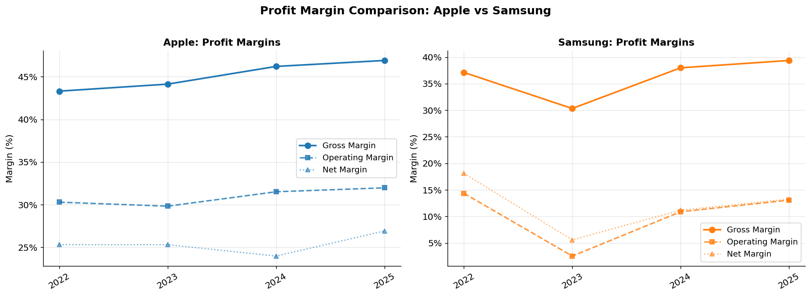
RQ2 — Profit Margins: Apple vs Samsung
Avg 2022-25
Margin | Apple | Samsung
Gross | 45.1% | 36.2%
Operating | 30.9% | 10.2%
Net | 25.4% | 12.0%
KEY INSIGHT: Apple gross margin (~47%) is roughly 10 pp higher than Samsung (~37%) reflecting premium brand positioning and high-margin Services revenue. Apple net margin (~25%) is more than double Samsung (~12%).
Apple vs Samsung | Competitive Financial & Market Analysis | MS in FinTech 2026
Notes:
SLIDE 14 — PROFIT MARGINS (1.5 min) Profit margins tell us how much of every dollar of revenue a company actually keeps. There are three key margins we track. Gross margin is Revenue minus Cost of Goods Sold, divided by Revenue. It measures how profitable the core product is before any operating expenses. Apple averages 45% gross margin — meaning for every $100 of iPhone or Mac or Service revenue, $45 is gross profit. Samsung averages 36%. That 9 percentage point gap is enormous and persistent. Why the difference? Two reasons. First, Apple's pricing power — it charges premium prices for iPhones while manufacturing costs are largely fixed. Second, the composition of revenue — Apple's Services segment (App Store, iCloud, advertising) has gross margins above 70%, dramatically higher than hardware. This segment is now roughly 25% of Apple's total revenue and growing. Operating margin strips out R&D and sales expenses too. Apple averages 31% — remarkable for a hardware company. Samsung averages just 10% because it spends heavily on R&D for semiconductors and competes on price in consumer electronics. Net margin — the bottom line after taxes and interest — shows Apple at 25% versus Samsung at 12%. This means Apple keeps 25 cents of every dollar of revenue as profit, while Samsung keeps only 12 cents. Look at Samsung's 2023 figures — gross margin dropped to just 30% and operating margin to 2.5%. That is a near-complete margin collapse driven by the semiconductor downturn. It shows how cyclical Samsung's business model is compared to Apple's more defensive one.

Slide 15
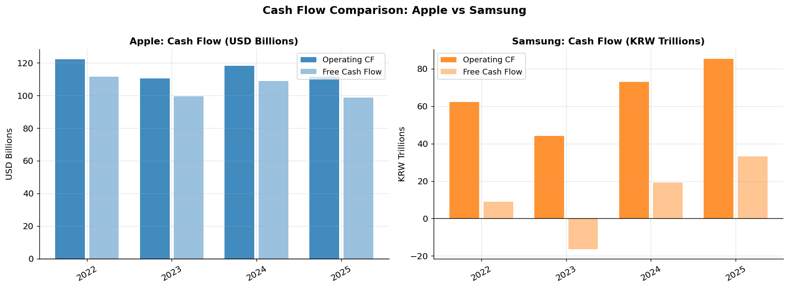
RQ2 — Cash Flow Analysis (2022-2025)
Apple FCF ~$100B/yr
Samsung FCF negative in 2023
Both recovered strongly by 2025
World-class cash generation machine
Heavy semiconductor capex investment
Operational efficiency improvements paid off
Apple vs Samsung | Competitive Financial & Market Analysis | MS in FinTech 2026
Notes:
SLIDE 15 — CASH FLOW (1 min) Free Cash Flow is arguably the most important financial metric for valuing a company. The formula is: Operating Cash Flow minus Capital Expenditure. It tells you how much real cash the business generates after reinvesting what is needed to maintain and grow operations. Apple's free cash flow is approximately $100 billion per year — consistently, every single year of our data. To put that in perspective: that is roughly the entire annual GDP of a mid-sized country. Apple uses this cash to buy back its own stock — it has retired trillions of dollars of shares since 2012 — which is one of the main mechanisms through which the stock price has risen so dramatically. Samsung's cash flow picture is radically different. In 2022, Samsung generated strong operating cash flow of around 50 trillion KRW. But in 2023, free cash flow turned negative. Why? Two reasons: operating income collapsed due to the semiconductor downturn, and simultaneously Samsung massively increased capital expenditure — building new fabrication plants and investing in next-generation HBM (High Bandwidth Memory) for AI applications. This is the classic semiconductor industry pattern: you must invest heavily even when times are bad in order to be competitive when the cycle turns up. Both companies recovered strongly by 2025, which is consistent with what we saw in the revenue and margin charts. The divergence in their cash flow profiles perfectly illustrates the contrast between Apple's asset-light, services-driven model and Samsung's capital-intensive, manufacturing-driven model.

Slide 16
RQ3
Macroeconomic Regression
Can CPI inflation and interest rate changes explain monthly stock return variations?
Apple vs Samsung | MS in FinTech 2026
Notes:
SLIDE 16 — RQ3 SECTION INTRO (15 sec) Research Question 3 is where we bring in econometric theory. We ask: can macroeconomic factors — specifically inflation measured by the CPI and interest rates measured by the 10-year Treasury yield — explain the variation in monthly stock returns for Apple and Samsung? This is a classic question in empirical asset pricing.

Slide 17
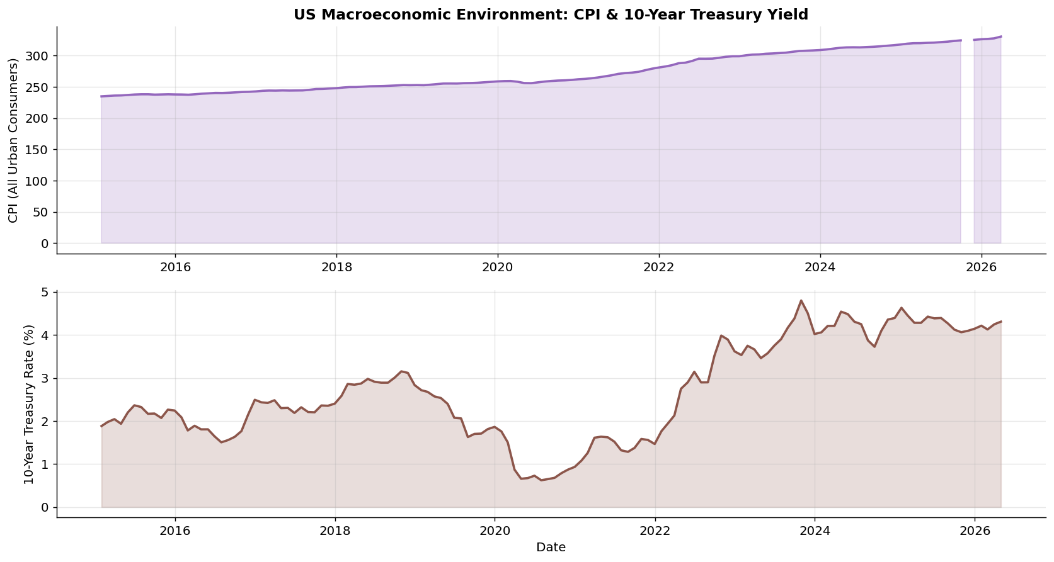
RQ3 — US Macroeconomic Environment: CPI & 10-Year Treasury Yield
Key Macro Events
2015-18
Low inflation & near-zero rates — ideal bull market conditions for tech growth stocks
2020
COVID: Fed cuts to 0%, massive QE. Rates hit historic lows. Tech stocks soar.
2022
CPI peaks at 9%+ — fastest rate hike cycle in 40 years (0% to 5.25%)
2023
Rates plateau. Tech stocks begin recovery despite elevated borrowing costs.
2024-25
Rate cuts begin. Inflation returning toward 2% Fed target. Recovery continues.
Apple vs Samsung | Competitive Financial & Market Analysis | MS in FinTech 2026
Notes:
SLIDE 17 — MACRO ENVIRONMENT (1 min) Before running the regression, let us understand the macro environment our stocks lived through. The top chart shows the US Consumer Price Index — CPI — from 2015 to 2026. The bottom chart shows the 10-Year Treasury yield over the same period. From 2015 to 2019 the environment was very stable: low inflation around 2%, near-zero interest rates following the post-2008 financial crisis policy. This was an ideal environment for growth stocks like Apple and Samsung because low discount rates make future cash flows worth more in present value terms. This is the Gordon Growth Model logic: stock price equals next dividend divided by (required return minus growth rate). When required return falls, price rises. Then COVID-19 hit in 2020. The Fed cut rates to essentially zero and deployed trillions in quantitative easing. The Treasury yield dropped below 0.7%. Tech stocks boomed. 2022 was the inflection point. The CPI peaked at over 9% — the highest since 1981. The Fed responded with the most aggressive rate-hiking cycle in 40 years, raising the federal funds rate from 0% to 5.25% in 18 months. The 10-year Treasury yield jumped from 1.5% to nearly 5%. This raised the discount rate for all future corporate cash flows — directly pressuring growth stock valuations. By 2024 inflation began cooling back toward the Fed's 2% target, and rate cuts began. Both stocks rallied in anticipation. Understanding this macro backdrop is essential context for interpreting our regression results.

Slide 18
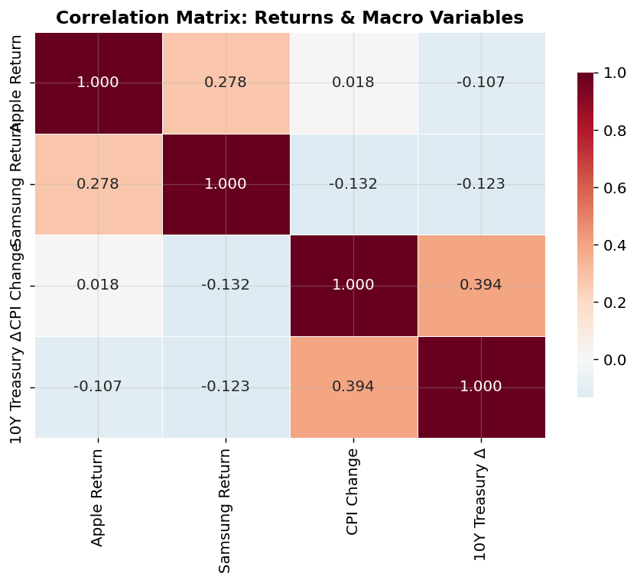
RQ3 — OLS Regression Setup & Correlation Heatmap
OLS Regression Model
Model Equation:
Ret(t) = b0 + b1*CPI_chg + b2*T10Y_chg + e(t)
Variables:
Ret(t) : Monthly pct_change() of closing price
CPI_chg : pct_change() of monthly CPI (CPIAUCSL)
T10Y_chg : monthly diff() of 10Y Treasury yield
n = 134 monthly observations (2015-2026)
X = add_constant(df_reg[['CPI_chg','T10Y_chg']])
ols_apple = OLS(df_reg['Apple_ret'], X).fit()
ols_samsung = OLS(df_reg['Samsung_ret'], X).fit()
Apple vs Samsung | Competitive Financial & Market Analysis | MS in FinTech 2026
Notes:
SLIDE 18 — REGRESSION SETUP (1.5 min) Our regression model is a standard OLS — Ordinary Least Squares — linear regression. OLS minimizes the sum of squared residuals to find the line of best fit through the data. The model equation is: Return(t) = beta-zero plus beta-one times CPI-change plus beta-two times Treasury-yield-change plus epsilon. The dependent variable — what we are trying to explain — is the monthly stock return, computed as pct_change() of the closing price at month end. The independent variables — the explanatory factors — are: first, the monthly percentage change in CPI, which represents how fast inflation is moving; and second, the monthly change in the 10-year Treasury yield in percentage points, which represents how interest rate expectations are shifting. We have 134 monthly observations from January 2015 to early 2026. The theoretical predictions come from two places. The Discounted Cash Flow model says rising discount rates — proxied by rising Treasury yields — should reduce stock valuations by increasing the denominator in the present value formula. The Fisher Effect says higher inflation can signal monetary tightening ahead, which is also negative for equity valuations. The heatmap on the right shows the correlation matrix between all four variables in our regression dataset. Crucially, CPI change and Treasury yield change have a moderate positive correlation with each other — they tend to rise together. But both have very low correlation with stock returns, which already hints that our R-squared values will be low.

Slide 19
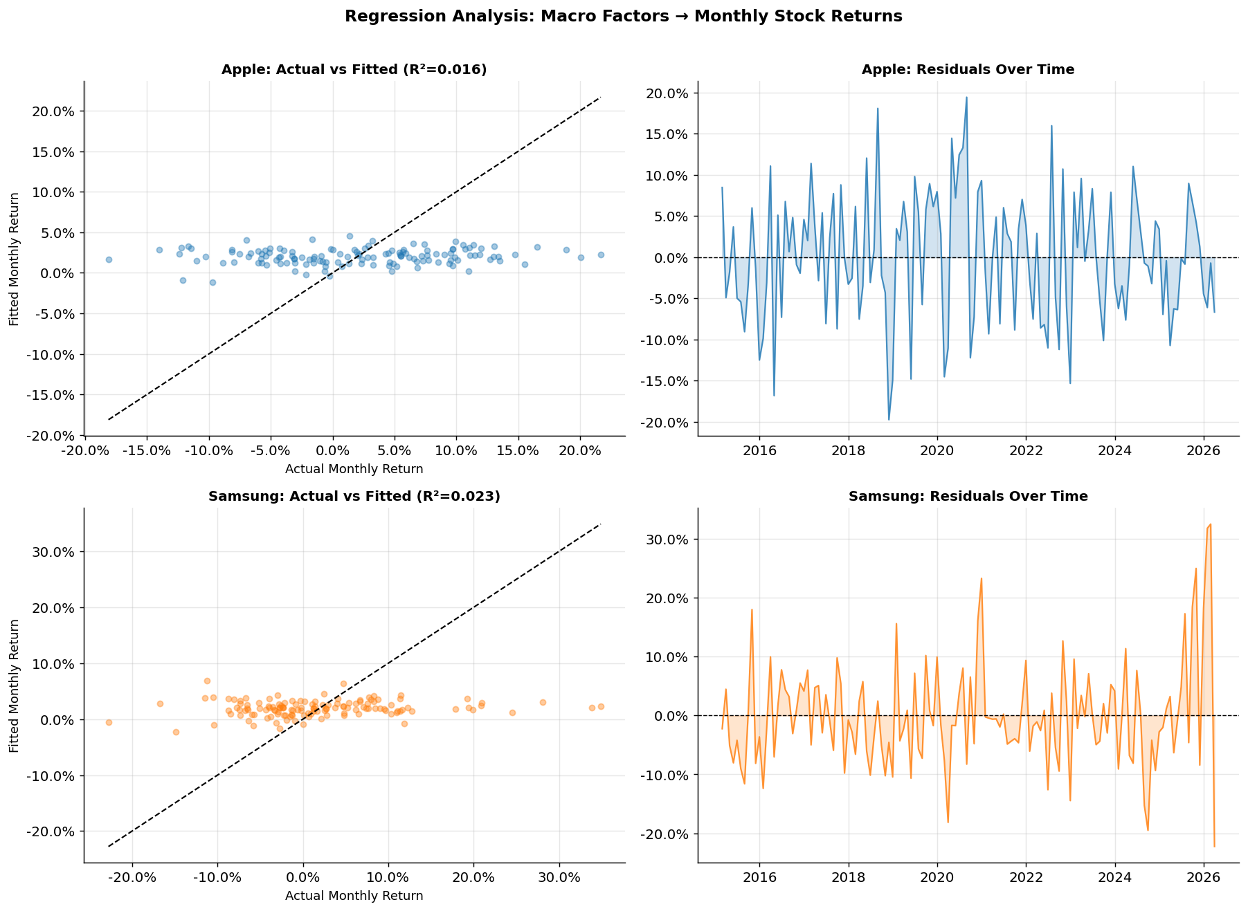
RQ3 — OLS Results: Actual vs Fitted & Residual Plots
0.016
Apple R-sq
Only 1.6% variance explained
0.023
Samsung R-sq
Only 2.3% variance explained
p=0.35
F-stat (Apple)
Not significant at 5% level
< 0
T10Y Coeff Both
Rising rates hurt both stocks
Apple vs Samsung | Competitive Financial & Market Analysis | MS in FinTech 2026
Notes:
SLIDE 19 — REGRESSION RESULTS (1.5 min) Now for the results. The four charts show Actual versus Fitted values and Residuals over time for both Apple and Samsung. Looking at the Actual versus Fitted scatter plots on the left — if our model were a good fit, the dots would cluster tightly around the diagonal dashed line. Instead, the dots are scattered everywhere. The model's fitted values barely move at all, while actual returns swing wildly from minus 20% to plus 20% in a month. The R-squared for Apple is 0.016, meaning our two macro variables explain only 1.6% of the variation in Apple's monthly returns. For Samsung it is 0.023 — just 2.3%. The F-statistics for both models have p-values above 0.20, which means we cannot even reject the null hypothesis that all coefficients are jointly zero at the 5% significance level. The residual plots on the right show large, unpredictable errors throughout the entire period. This confirms the model is not systematically biased — it does not consistently over- or under-predict — but it is simply missing most of the information. What does this mean? It means that changes in the CPI and the 10-year Treasury yield, while they make intuitive theoretical sense as drivers of stock prices, are not sufficient on their own to predict monthly returns. The vast majority of monthly return variation is driven by company-specific factors: quarterly earnings reports, product announcements, analyst upgrades and downgrades, M&A speculation, and geopolitical events. This is actually consistent with what we know from academic finance — most of the variance in individual stock returns is idiosyncratic, not systematic.

Slide 20
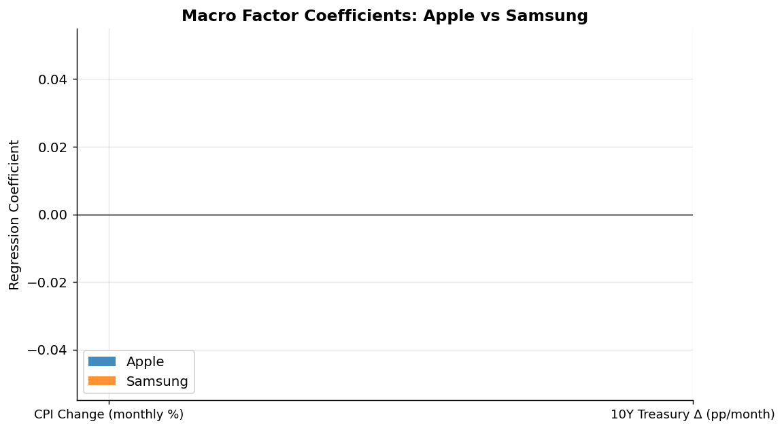
RQ3 — Macro Factor Coefficient Comparison & Interpretation
Interpretation
CPI -> Apple (+2.08)
Counterintuitive positive. Inflation may lag rate hikes when stocks already priced in rises.
CPI -> Samsung (-3.36)
Higher inflation hurts Samsung more — reflects KRW/USD dynamics and chip demand cycles.
T10Y -> Both Negative
Consistent with theory: rising rates -> higher discount rate -> lower PV of future earnings.
Neither Significant
p-values all >0.10. Firm-specific events dominate far more than macro variables alone.
KEY FINDING: Macro factors provide directionally meaningful but statistically weak signals. Most monthly return variation is driven by earnings surprises, product launches, and geopolitical events — not CPI or Treasury yields alone.
Apple vs Samsung | Competitive Financial & Market Analysis | MS in FinTech 2026
Notes:
SLIDE 20 — COEFFICIENTS (1 min) The bar chart compares the regression coefficients between Apple and Samsung for our two macro variables. For the CPI change coefficient: Apple has a positive coefficient of plus 2.08, while Samsung has a negative coefficient of minus 3.36. These have opposite signs, which is interesting. For Apple, the positive sign might reflect a delayed market reaction — when CPI is rising, the economy might still be growing, and Apple's consumer demand holds up. For Samsung, the negative sign more clearly reflects the hit to Korean export competitiveness and semiconductor demand when US inflation rises. However — and this is critical — neither coefficient is statistically significant. The p-values for CPI are 0.45 for Apple and 0.30 for Samsung. We need p-values below 0.05 to declare statistical significance at the 5% level. We cannot reject the null hypothesis that these coefficients are actually zero. For the Treasury yield change: both Apple and Samsung have negative coefficients, meaning rising interest rates are associated with lower monthly returns for both stocks. This is directionally consistent with financial theory — the Dividend Discount Model tells us higher discount rates reduce the present value of future cash flows. But again, neither coefficient is statistically significant. The conclusion from RQ3 is nuanced: the signs of the coefficients align with theory, providing some comfort that we have the direction right. But the magnitudes are small and the statistical significance is absent, meaning we cannot confidently attribute stock return variation to these macro factors with a two-variable model.

Slide 21
Summary of Key Findings
RQ1
Stock Performance
& Correlation
RQ2
Financial
Fundamentals
RQ3
Macroeconomic
Regression
Apple +1,016% vs Samsung +956% total return
Apple gross margin 45% vs Samsung 36%
CPI + Treasury -> R-sq of only 1.6-2.3%
Sharpe ratios nearly identical (~1.03)
Apple net margin 25% vs Samsung 12%
F-statistics not significant at 5% level
Daily correlation r = 0.068 — surprisingly low
Apple free cash flow ~$100B/yr consistently
Rising rates carry negative coeff (theory OK)
Correlation spikes during market stress (2020)
Samsung badly hit by 2023 chip downturn
Residuals large — macro alone insufficient
Annualized volatility virtually equal: ~29-30%
Both companies recovered strongly in 2025
Firm-specific events dominate return drivers
Apple vs Samsung | Competitive Financial & Market Analysis | MS in FinTech 2026
Notes:
SLIDE 21 — SUMMARY (1 min) Let me bring everything together. Three research questions, three columns. RQ1 — Stock Performance and Correlation: Both companies delivered almost exactly the same total return over a decade — Apple slightly ahead at 1,016% versus Samsung's 956%. Their risk profiles are nearly identical: same volatility, same Sharpe ratio. Despite being direct product competitors, their daily return correlation is just 0.068 — essentially zero. This means they are driven by very different factors in their day-to-day trading. From a portfolio construction standpoint, holding both provides genuine diversification benefits. RQ2 — Financial Fundamentals: This is where they diverge sharply. Apple is a margin machine — 45% gross margin, 25% net margin, and $100 billion in free cash flow every year. Samsung is a capital-intensive manufacturer with lower margins — 36% gross, 12% net — and earnings that are highly cyclical, swinging dramatically with the semiconductor industry cycle. RQ3 — Macroeconomic Regression: Our two-variable OLS model using CPI change and Treasury yield change explains almost nothing — R-squared values of 1.6% and 2.3% respectively. The models are not statistically significant. However, the direction of the coefficients is theory-consistent: rising rates are associated with lower returns for both stocks. The main lesson is that firm-specific factors dominate macro factors for individual stock return variation.

Slide 22
Limitations & Future Work
Limitations
Future Work
Currency Risk
Fama-French 3-Factor Model
Samsung prices are in KRW. Analysis does not adjust for USD/KRW exchange rate movements which affect direct comparisons.
Add market beta (Rm-Rf), size factor (SMB), and value factor (HML) for richer return attribution.
Limited History
Product Launch Event Study
Only 4-5 years of annual financial statements available via yfinance — restricts long-term trend analysis.
Measure abnormal returns (CAR) around iPhone / Galaxy S launch announcements.
Omitted Variables
Semiconductor Cycle Model
Macro regression excludes market beta (S&P 500 / KOSPI), earnings momentum, and sector ETF flows.
Quantify Samsung margin volatility as a function of DRAM/NAND memory pricing cycles.
Survivorship Bias
Google Trends as Indicator
Both firms are industry leaders. Findings may not generalise to the broader tech or semiconductor sectors.
Test whether consumer search interest precedes stock price moves as a leading indicator.
Apple vs Samsung | Competitive Financial & Market Analysis | MS in FinTech 2026
Notes:
SLIDE 22 — LIMITATIONS & FUTURE WORK (1 min) Every study has limitations and ours are no different. Being honest about these is a sign of good research. Currency risk is real: Samsung trades in Korean Won. When we compute a correlation or run a regression using Samsung's KRW returns alongside Apple's USD returns and US macro data, we are implicitly ignoring the USD/KRW exchange rate. A stronger dollar makes Samsung's KRW returns look worse in dollar terms — this could affect our correlation and regression estimates. Limited financial history: yfinance only gives us 4-5 years of annual financial statement data. This is enough for the trend comparisons we did, but it prevents us from analyzing how these companies performed through longer cycles like the 2008 financial crisis. Omitted variables: this is the biggest issue for RQ3. Our regression has only two explanatory variables. Academic literature on the cross-section of stock returns, including the Fama-French model and the Carhart 4-factor model, shows that market beta, size, value, and momentum factors explain much more return variation than macro variables alone. Adding these factors would dramatically improve model fit. Survivorship bias: we picked the two winners. Both Apple and Samsung survived and thrived over this decade. We do not include Nokia or BlackBerry in our analysis — firms that were dominant in 2015 and failed. This biases our conclusions toward success stories. For future work, the most valuable extension would be implementing the Fama-French 3-factor model. A product launch event study using abnormal returns around iPhone and Galaxy announcements would also be directly actionable. And modeling Samsung through the semiconductor DRAM pricing cycle would give a much richer understanding of their earnings variability.

Slide 23
Thank You
Questions & Discussion
1
2
3
4
Darshil Gandhi
Apurva Awate
Sony Maharajan
Gabriela Rodriguez
Lead Analyst
Data Engineer
Macro Analysis
Financial Modelling
Apple vs Samsung — Competitive Financial & Market Analysis | MS in FinTech 2026
Notes:
SLIDE 23 — CLOSING (30 sec) Thank you very much for listening. To summarize our key message: Apple and Samsung are fascinating case studies in how two companies can deliver almost identical investment returns over a decade while having completely different business models, financial structures, and risk drivers. Apple wins on profitability and financial stability. Samsung wins on hardware scale and diversified technology manufacturing. Neither is definitively better as an investment — the market has priced them to deliver equivalent risk-adjusted returns. And on the macro question — yes, interest rates and inflation matter directionally, but stock returns are primarily stories about individual companies, not just the economic environment they operate in. We are happy to take any questions. Thank you.

