Slide 1
Apple vs Samsung
Competitive Financial & Market Analysis
Data Sources: Yahoo Finance (yfinance) | FRED (Federal Reserve)
Coverage: January 2015 – April 2026
Companies: Apple Inc. (AAPL, NASDAQ) | Samsung Electronics (005930.KS, KRX)
| Spring 2026 | Group Project

Slide 2
Meet the Team
Apple vs Samsung — Competitive Financial & Market Analysis
AA
DG
SM
GR
Apurva Awate
Darshil Gandhi
Sony Maharjan
Gabriela Rodriguez

Slide 3
Agenda
01
02
Research Background & Questions
Data Collection
Why Apple vs Samsung, and what we aim to discover
Sources, coverage, and variable definitions
03
04
Data Cleaning & Manipulation
Analysis 1 — Stock Performance & Correlation
Processing steps applied to prepare data
Price trends, correlation, and volatility (2015–2026)
05
06
Analysis 2 — Financial Fundamentals
Analysis 3 — Macro Regression
Revenue, profitability margins, and cash flow
Inflation and interest rates as return predictors
07
08
Discussion & Limitations
Team Roles & References
Key findings, limitations, and future work
Contributions and data sources

Slide 4
Research Background & Questions
Research Background
Apple and Samsung are the world's two largest smartphone vendors and fierce competitors across hardware, software, and services. Analyzing their financial and market data provides insight into how competitive rivalry, macroeconomic forces, and business model differences shape investor outcomes over a full decade.
RQ 1
RQ 2
RQ 3
Stock Performance & Correlation
Financial Fundamentals
Macro Regression
How have Apple and Samsung stock prices performed and correlated over 2015–2026? Do they move together or independently?
How do Apple and Samsung compare on key financial metrics — revenue growth, profitability margins, and free cash flow?
Can macroeconomic factors (US CPI inflation and 10-year Treasury yield changes) explain monthly stock return variations?

Slide 5
Significance of the Study
$
Investor Decision-Making
~
Cross-Market Dynamics
Both stocks are held by millions of retail and institutional investors. Understanding their risk and return dynamics is directly actionable for portfolio construction.
Apple trades on NASDAQ (USD) and Samsung on KRX (KRW). Comparing them illuminates how U.S. and Korean markets respond differently to the same global events.
#
Business Model Contrast
%
Macro Sensitivity
Apple's high-margin services model versus Samsung's hardware-heavy semiconductor business makes this an ideal case study in strategic divergence.
The 2022–2023 rate-hike cycle had outsized impact on tech valuations. Studying which firm was more macro-exposed informs future investment strategy.

Slide 6
Theoretical Framework
EMH
MPT
CAPM
APT
Efficient Market Hypothesis
Modern Portfolio Theory
Capital Asset Pricing Model
Arbitrage Pricing Theory / OLS
Fama (1970)
Markowitz (1952)
Sharpe (1964)
Ross (1976)
Asset prices reflect all available information — abnormal returns arise only from risk differences.
Diversification reduces unsystematic risk; the efficient frontier maximizes return for a given risk level.
Expected return = Rf + β(Rm − Rf). Beta measures systematic market risk that cannot be diversified away.
Multi-factor regression (macro variables: CPI, rates, GDP) explains cross-sectional return variation.

Slide 7
Data Collection
Source 1 — Yahoo Finance
Source 2 — FRED (Federal Reserve)
via yfinance Python library | https://finance.yahoo.com
via pandas-datareader | https://fred.stlouisfed.org
Tickers:
AAPL (NASDAQ) | 005930.KS (KRX)
Series 1:
CPIAUCSL — CPI All Urban Consumers
Frequency:
Daily OHLCV stock prices
Frequency:
Monthly (seasonally adjusted)
Series 2:
DGS10 — 10-Year Treasury Rate
Coverage:
Jan 1, 2015 – Apr 2026
Frequency:
Daily
Financials:
Annual: income stmt, balance sheet, cash flow (4–5 years)
Coverage:
Jan 2015 – Apr 2026
Key Vars:
Close, Revenue, Net Income, Gross Profit, Op. Income, Free Cash Flow
Key Vars:
CPI_US (inflation proxy), Treasury_10Y (rate level)

Slide 8
Data Cleaning & Manipulation Process
1
Index & Parsing
2
Missing Value Handling
Converted date strings to DatetimeIndex; set date as index for all DataFrames and sorted chronologically.
Identified NaN gaps (weekends/holidays, monthly CPI vs daily treasury). Dropped rows where both close prices were missing.
3
Data Type Conversion
4
Subsetting & Filtering
Cast price/volume columns to float64. Converted financial statement values to numeric using pd.to_numeric(errors='coerce').
Extracted specific rows from financial statements (Revenue, Net Income, Gross Profit, Operating Income). Filtered to 2015–2026.
5
New Column Generation
6
Merging & Resampling
Computed daily returns (pct_change), profit margins, normalized prices (base=100), and annualized volatility (std × √252).
Resampled daily prices to monthly (last day). Merged stock returns, CPI changes, and treasury yield changes via inner join on date.
7
Aggregation
8
Scaling
Computed mean, median, min/max. Applied groupby on year for annual correlations. Calculated 90-day and 252-day rolling correlations.
Scaled Apple financials to USD billions (÷1e9), Samsung to KRW trillions (÷1e12) for readability in charts and tables.

Slide 9
Analysis 1
Stock Price Performance & Correlation

Slide 10
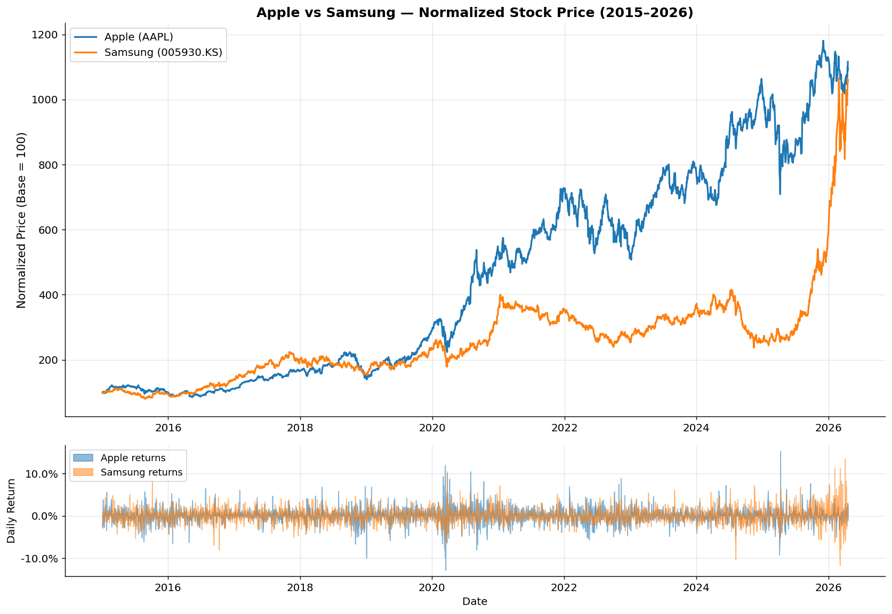
RQ 1 — Normalized Stock Price Performance (2015–2026)

Slide 11
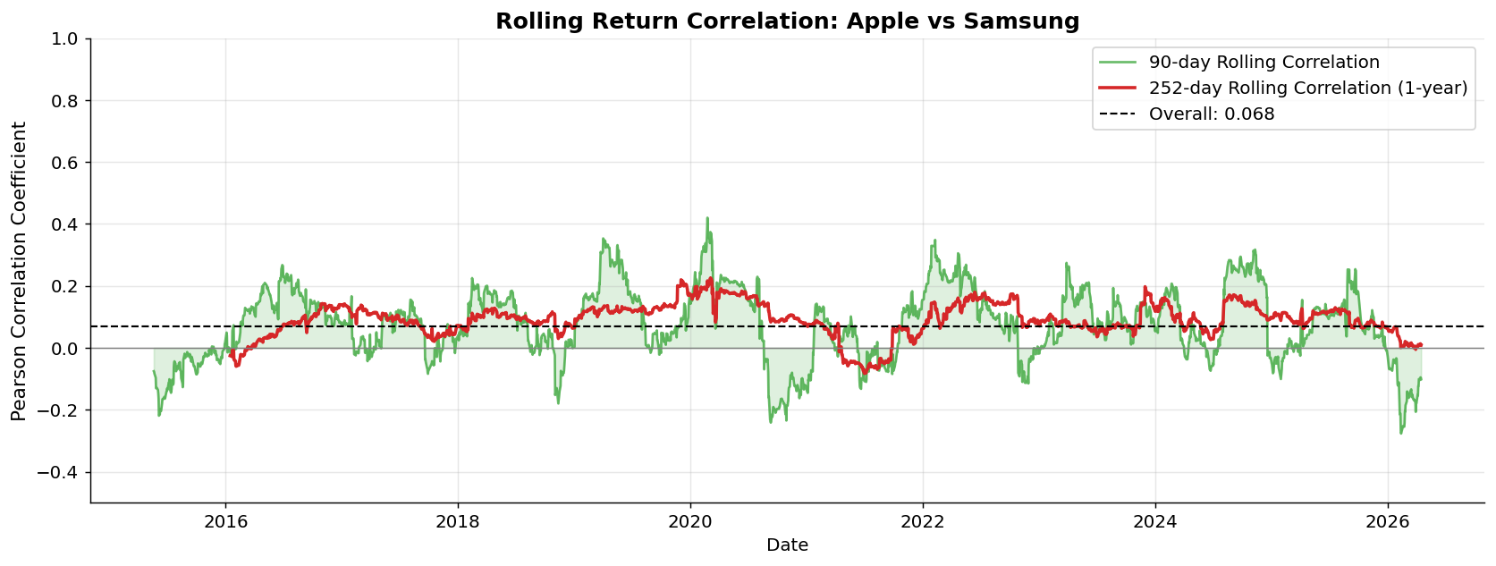
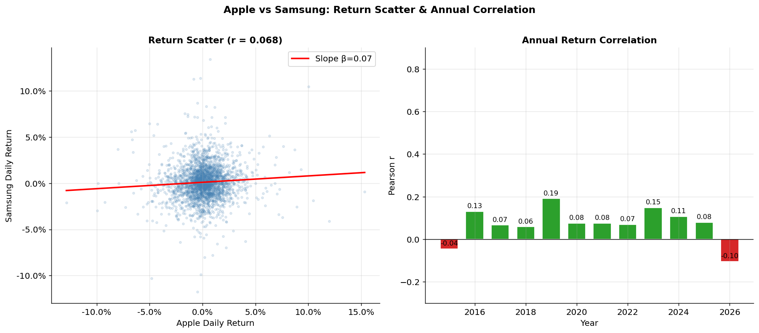
RQ 1 — Return Correlation: Rolling & Annual Breakdown
Key Findings
Overall r
0.068 (very low)
Peak corr.
~0.45 (COVID 2020)
Best year
2020: r = 0.44
Apple CAGR
31.0% annualized
Samsung CAGR
30.5% annualized
Apple vol.
29.4% annualized
Samsung vol.
29.9% annualized
Apple Sharpe
1.05
Samsung Sharpe
1.02

Slide 12
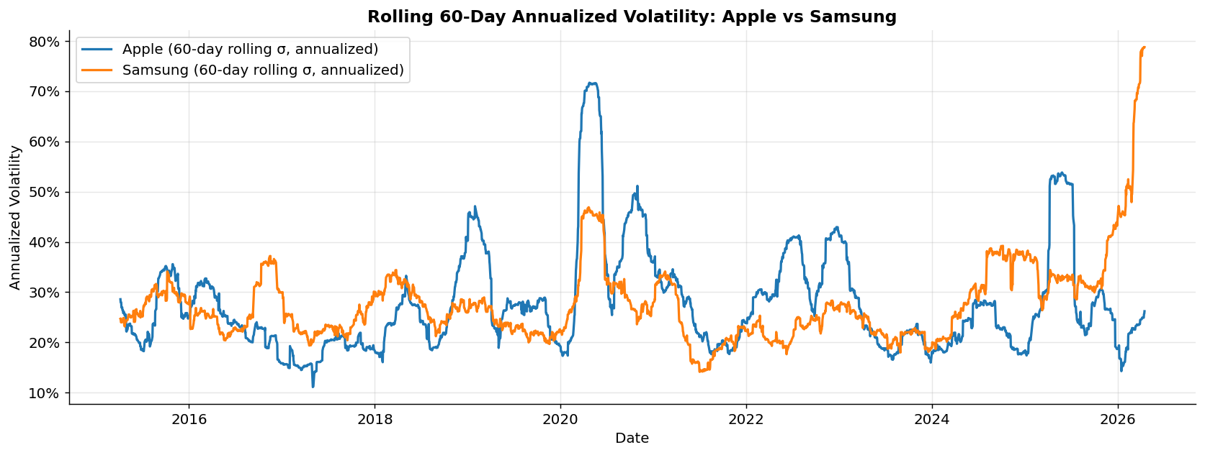
RQ 1 — Rolling Annualized Volatility
Both stocks maintain similar annualized volatility (~29–30%), with synchronized spikes during COVID-19 (March 2020) and the 2022 rate-hike cycle. Samsung shows slightly higher peak volatility during the 2023 semiconductor downturn.

Slide 13
Analysis 2
Financial Fundamentals Comparison

Slide 14
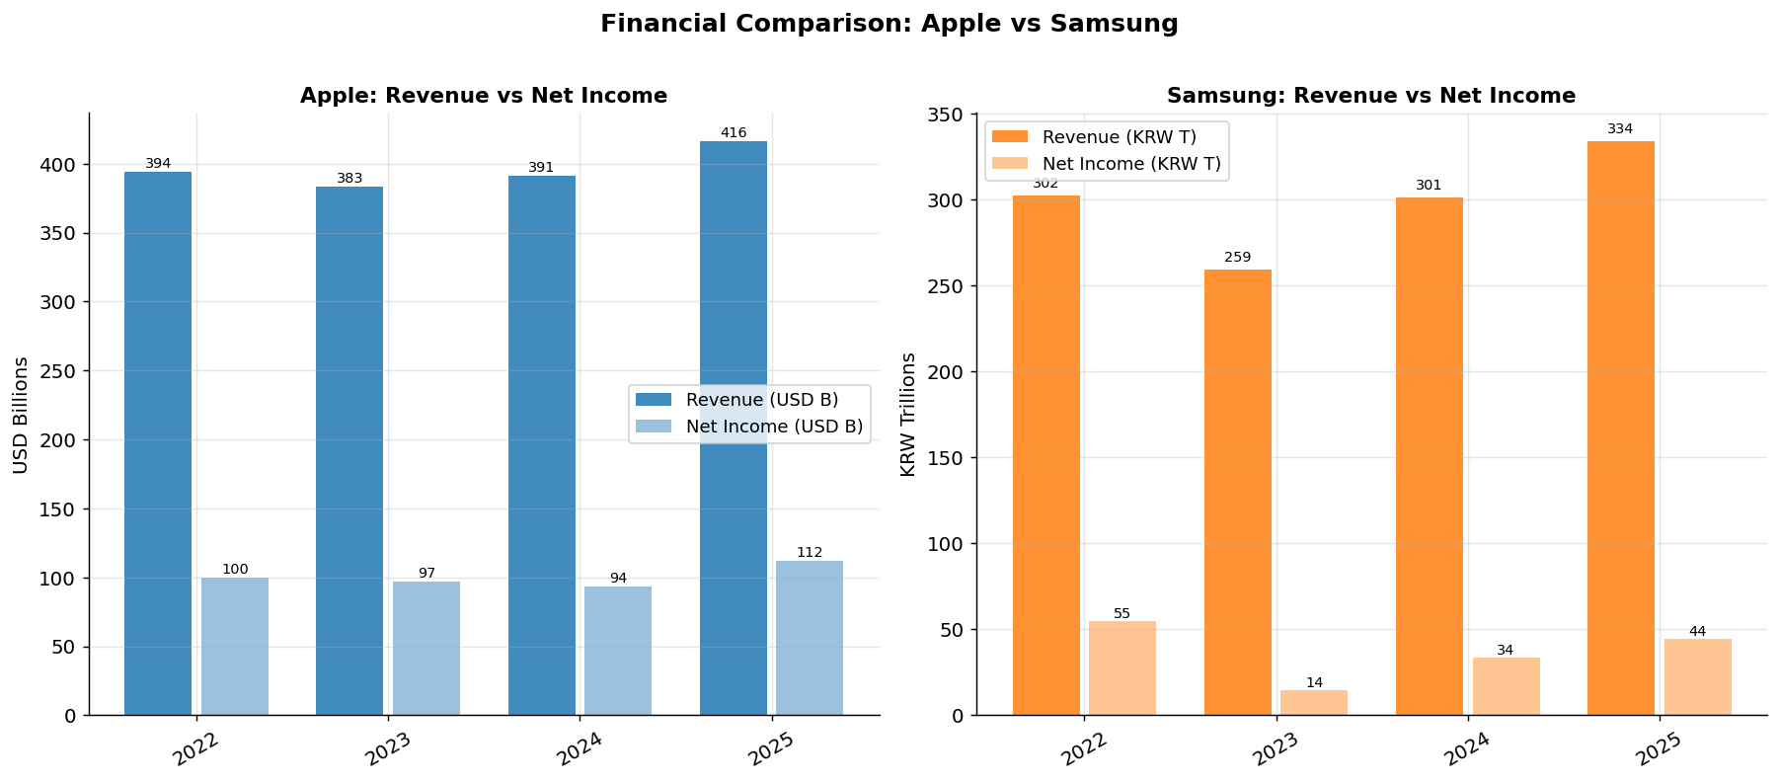
RQ 2 — Revenue & Net Income (2022–2025)
Apple: Revenue stable ~$383–416B USD. Strong net income ~$94–112B.
Samsung: Revenue dipped in 2023 (chip downturn) but recovered strongly to KRW 334T by 2025.

Slide 15
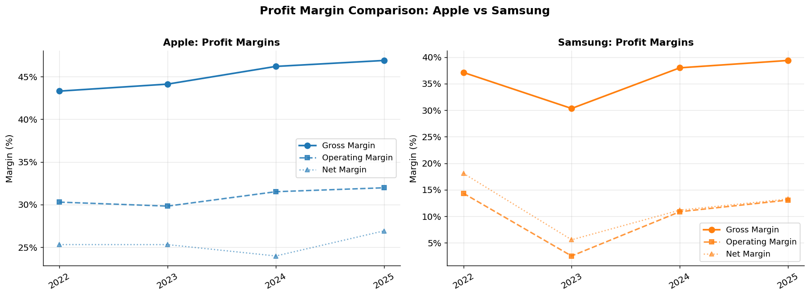
RQ 2 — Profit Margin Comparison
Metric | Apple Avg | Samsung Avg | Advantage
Gross Margin | ~47% | ~37% | Apple
Operating Margin | ~31% | ~8% | Apple
Net Margin | ~25% | ~12% | Apple

Slide 16
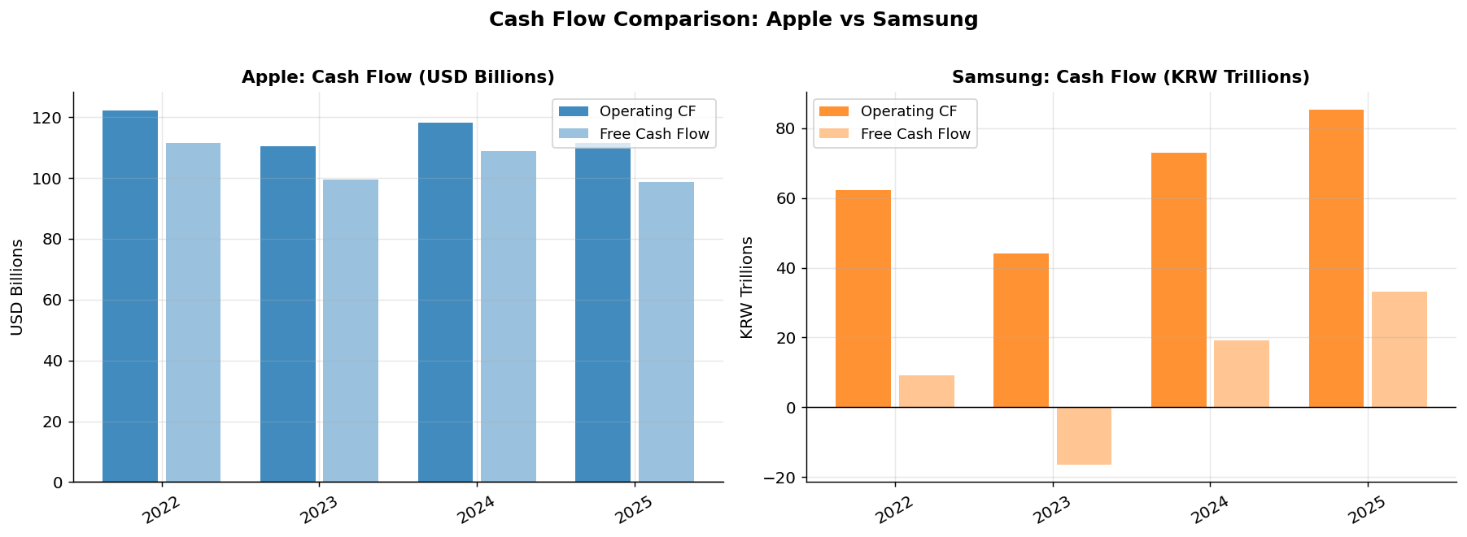
RQ 2 — Cash Flow Comparison
Apple FCF
Samsung FCF
~$100B/year consistently. Returns capital via buybacks ($90B+/yr). World-class cash generation relative to revenue.
Highly volatile. Turned negative in 2023 due to massive chip fab investment. Recovered sharply to positive in 2025.

Slide 17
Analysis 3
Macroeconomic Regression Analysis

Slide 18
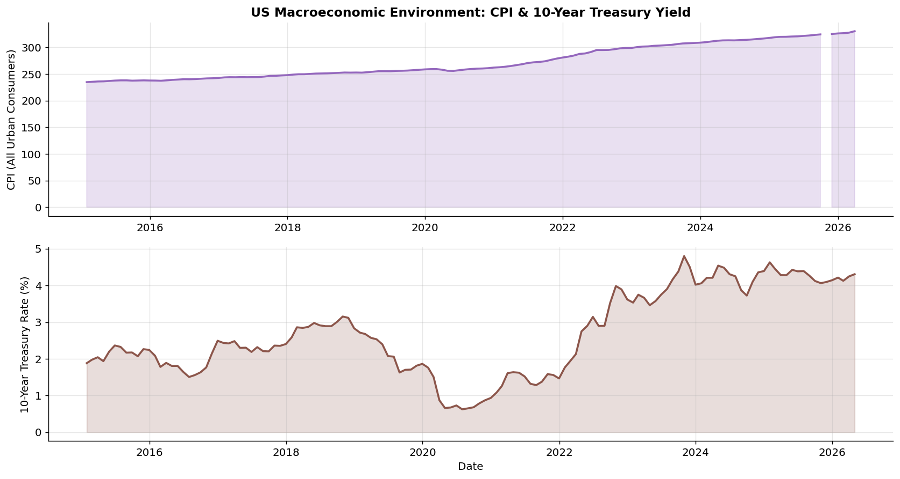
RQ 3 — US Macroeconomic Environment (2015–2026)
Macro Context
2015–2019
Low inflation (~1–2%), gradual Fed normalization. Favorable for tech.
2020
COVID: Fed cuts to 0%. CPI initially dipped then surged with stimulus.
2021–2022
Inflation peaked at 9%. Fed raised rates 525bps — tech repriced sharply.
2023–2024
Inflation cooling. Fed pivot discussions. Tech stocks rebounded.
2025–2026
CPI near 3% target. Stable rates. Both stocks near all-time highs.

Slide 19
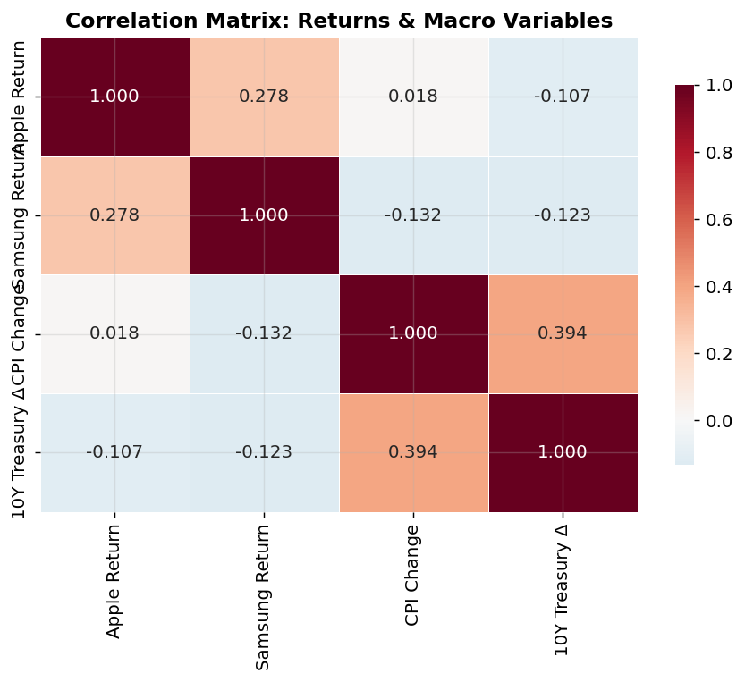
RQ 3 — Correlation Heatmap & Regression Setup
OLS Regression Setup
Monthly Return = α + β₁ × CPI_Chg + β₂ × ΔT10Y + ε
Dep. Var:
Monthly stock return (Apple or Samsung)
CPI_Chg:
Monthly % change in US CPI
ΔT10Y:
Monthly change in 10-yr Treasury (pp)
N:
134 monthly observations (2015–2025)
Method:
OLS via statsmodels (Python)
Hypothesis:
Rising inflation/rates reduce growth stock returns

Slide 20
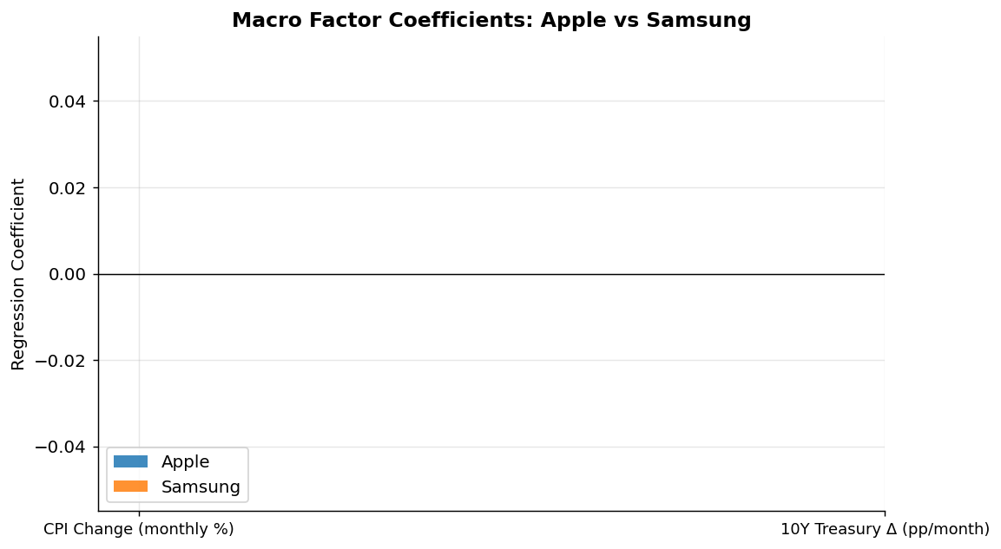
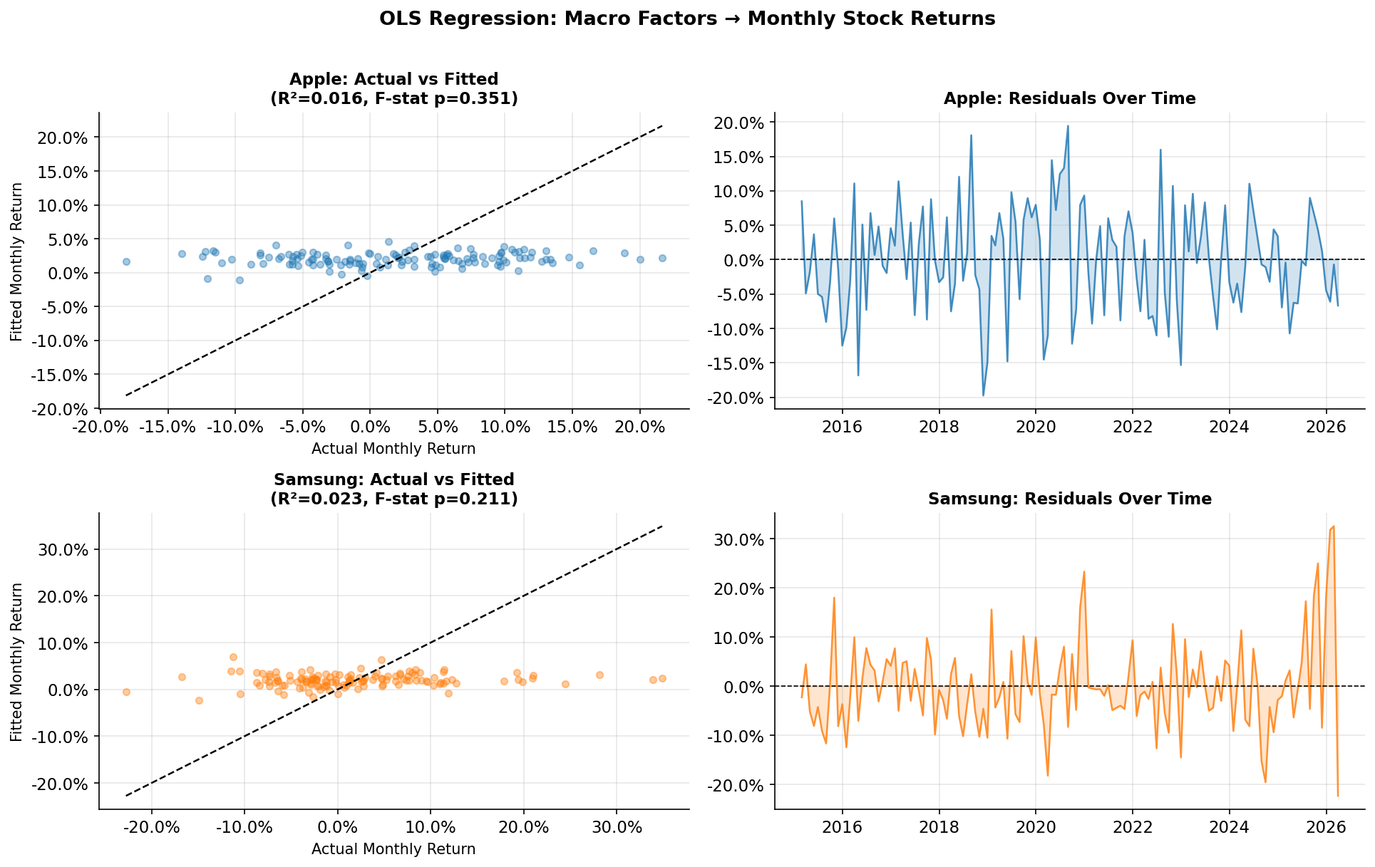
RQ 3 — Regression Results
Regression Summary
Apple
R²:
0.016
F-stat p:
0.351
CPI coef:
+2.08 (p=0.45)
10Y coef:
–0.054 (p=0.15)
Samsung
R²:
0.023
F-stat p:
0.211
CPI coef:
–3.36 (p=0.30)
10Y coef:
–0.040 (p=0.37)
Low R² and non-significant F-stats confirm macro factors alone weakly predict returns. Firm-specific events dominate.

Slide 21
Discussion & Key Conclusions
RQ 1 — Stock Performance
RQ 2 — Financial Fundamentals
RQ 3 — Macro Regression
Both stocks: ~1,000% total return (2015–2026)
Apple outperforms on all margin metrics (gross ~47% vs Samsung ~37%)
Macro factors explain <3% of monthly return variance
Apple: 31.0% CAGR | Samsung: 30.5% — near-identical risk-adjusted returns
Apple's services segment boosts margin quality and reduces cyclicality
Coefficient signs align with theory (higher rates → lower Apple returns)
Daily return correlation very low (r=0.068) despite being direct competitors
Samsung driven by semiconductor cycles — sharp 2023 downturn, strong 2025 recovery
Neither model statistically significant (F-stat p > 0.2)
Correlation rises during crises (COVID 2020) but time-varying
Apple FCF ~$100B/yr; Samsung's is volatile and capital-intensive
Firm-specific events (earnings, product launches) dominate
Similar volatility (~29–30%), driven by different events
Both companies improved margins in FY2025
A Fama-French model would substantially improve fit

Slide 22
Limitations & Future Work
Limitations
1. Currency Risk: Analysis doesn't adjust for USD/KRW exchange rate fluctuations, affecting cross-currency comparability.
2. Financial Statement Coverage: Only 4–5 years of annual financials available via yfinance, limiting long-term trend analysis.
3. Omitted Variables: Regression omits market beta, earnings surprises, and sector ETF flows.
4. Survivorship Bias: Both firms are industry leaders; findings may not generalize to broader tech sector.
Future Work
1. Apply Fama-French 3-factor model to control for market, size, and value risk premia.
2. Event study: analyze abnormal returns around major product launches (iPhone, Galaxy S-series).
3. Incorporate Google Trends data as a consumer interest leading indicator.
4. Extend to a panel of smartphone sector peers (Sony, Xiaomi, TSMC) for broader competitive analysis.

Slide 23
References
1
Yahoo Finance. (2026). Apple Inc. (AAPL) Historical Data & Financial Statements. https://finance.yahoo.com/quote/AAPL
2
Yahoo Finance. (2026). Samsung Electronics (005930.KS) Historical Data. https://finance.yahoo.com/quote/005930.KS
3
Federal Reserve Bank of St. Louis. (2026). Consumer Price Index (CPIAUCSL). https://fred.stlouisfed.org/series/CPIAUCSL
4
Federal Reserve Bank of St. Louis. (2026). 10-Year Treasury Rate (DGS10). https://fred.stlouisfed.org/series/DGS10
5
McKinney, W. (2010). Data Structures for Statistical Computing in Python. Proceedings of the 9th Python in Science Conference, 51–56.
6
Seabold, S., & Perktold, J. (2010). Statsmodels: Econometric and Statistical Modeling with Python. Proc. 9th Python in Science Conf.
7
Hunter, J. D. (2007). Matplotlib: A 2D Graphics Environment. Computing in Science & Engineering, 9(3), 90–95.
8
Pedregosa, F., et al. (2011). Scikit-learn: Machine Learning in Python. Journal of Machine Learning Research, 12, 2825–2830.

Slide 24
Thank You
Questions & Discussion
Apple vs Samsung — Competitive Financial & Market Analysis | | Spring 2026
~1,000%
r = 0.068
47% vs 37%
Total Return
Both Stocks
Return
Correlation
Gross Margin
Apple vs Samsung

