Slide 1
B
S&P
Crypto vs Traditional Markets
Analyzing Bitcoin & S&P 500: Correlation, Crash Behavior & Volatility
Team: Gabriella Rodriguez • Sony Maharajan • Apurva Awate • Darshil Gandhi
Masters in Financial Technology | April 30, 2026

Slide 2
Presentation Agenda
01
Research Background & Theory
04
RQ2: Crash / Hedge Analysis
Bitcoin, correlation, hedging & volatility explained
Does BTC protect in downturns?
02
Data Collection & Cleaning
05
RQ3: Volatility Comparison
Yahoo Finance + FRED, 2016–2025
How risky is crypto vs equities?
03
RQ1: Correlation Analysis
06
Conclusions & Discussion
Is BTC linked to the stock market?
Key findings, limitations, future work

Slide 3
Research Background & Significance
Why This Study Matters
Research Questions
Bitcoin has grown from a niche experiment into a $1 trillion+ asset class, attracting institutional investors and retail traders alike.
As crypto enters mainstream portfolios, investors must understand:
- Does BTC diversify or amplify risk?
- Can it hedge against market downturns?
- How much more volatile is it really?
RQ 1
Is Bitcoin correlated with the stock market?
Pearson r, rolling correlation, OLS regression
RQ 2
Does Bitcoin act as a hedge during crashes?
Performance during 2018, COVID, 2022 bear market
RQ 3
How does volatility compare?
Annualised vol, rolling vol, VaR, return distribution

Slide 4
What is Bitcoin?
Bitcoin in Simple Terms
Bitcoin by the Numbers
Bitcoin (BTC) is a decentralized digital currency created in 2009 by the pseudonymous Satoshi Nakamoto. It runs on a technology called blockchain — a public ledger that records every transaction without needing a bank or government. Key properties: Fixed supply of 21 million coins — making it scarce like gold Operates 24/7, 365 days — no trading halts Decentralized — no central authority controls it Highly liquid — billions traded daily worldwide Why compare to S&P 500? The S&P 500 tracks the 500 largest US companies. It is the global benchmark for equity market performance. Comparing the two helps us understand if crypto behaves like a stock, a currency, or something entirely different.
2009
Year created
21M
Max supply (coins)
$88K
Price (Dec 2025)
$1.7T
Market cap (peak)
#1
Largest cryptocurrency

Slide 5
Theory: What is Correlation?
Correlation measures how two assets move in relation to each other. We use the Pearson Correlation Coefficient (r), which always falls between -1 and +1.
Formula: r = (Cov(X,Y)) / (StdDev(X) x StdDev(Y)) — computed on daily returns
r = -1
r = 0
r = +1
r = 0.25
Perfect Negative
No Correlation
Perfect Positive
Our Result
Assets move in exactly opposite directions. When one rises 1%, the other falls 1%. Ideal hedge.
Assets move completely independently. Adding them together maximises diversification.
Assets move in exactly the same direction. No diversification benefit from holding both.
BTC and S&P 500 share weak positive link. BTC mostly moves independently — some diversification.
Why it matters: A low or negative correlation between two assets means holding both reduces your overall portfolio risk (diversification).

Slide 6
Theory: What Makes a Good Hedge?
A hedge is an asset that holds its value — or rises — when the rest of your portfolio falls. Investors use hedges to reduce losses during market crashes.
Ideal Hedge
Bitcoin Expectation
What We Found
Falls less than equities during crashes
Some analysts called BTC "digital gold"
BTC fell -36.7% during COVID crash
Negative or zero correlation with stocks
Limited supply = store of value narrative
BTC fell -58.6% in 2022 bear market
Retains intrinsic value independently
Decentralized = independent of governments
BTC amplified losses in every crash we studied
Gold is the classic example — rose during COVID
Should be uncorrelated with traditional markets
Correlation spiked to 0.7+ during selloffs
U.S. Treasury Bonds also rise in crises
Early data (2016–2019) supported this view
BTC behaves as a risk-on growth asset, not a hedge
Takeaway: Bitcoin failed to act as a safe haven. It is better understood as a high-risk, high-reward speculative growth asset.

Slide 7
Theory: Understanding Volatility
Volatility measures how much an asset's price fluctuates over time. Higher volatility = bigger swings up AND down = higher risk. We use annualised standard deviation of daily returns, multiplied by sqrt(252) to express it as a yearly figure.
SD
Standard Deviation
VaR
Value at Risk (VaR)
Measures how spread out daily returns are around the average. A larger spread = higher volatility. We annualise by multiplying by the square root of 252 trading days.
The worst expected daily loss at a given confidence level. At 95% VaR, on 95% of days your loss will be smaller than this number. BTC VaR is -6% vs S&P's -1.65%.
FAT
Fat Tails & Kurtosis
ROL
Rolling Volatility
Normal distributions assume extreme events are rare. But crypto has "fat tails" — meaning very large gains or losses happen far more often than you would expect statistically.
Volatility is not constant — it changes over time. We compute it over 30-day rolling windows to see how risk evolves. Crypto volatility spikes during market stress events.

Slide 8
Data Collection
B
Source 1: Yahoo Finance
FED
Source 2: FRED (Federal Reserve)
Bitcoin (BTC-USD)
S&P 500 Index
Asset:
Bitcoin (BTC-USD)
Asset:
S&P 500 Index
Frequency:
Daily (7 days/week)
Frequency:
Daily (business days only)
Coverage:
Jan 2016 – Dec 2025
Coverage:
Jan 2016 – Dec 2025
Records:
3,652 observations
Records:
2,523 observations
Access:
yfinance Python library
Access:
pandas_datareader library
Variable:
Daily closing price (USD)
Variable:
Index level

Slide 9
Data Cleaning & Preparation
1
Handle Missing Values
FRED occasionally reports no value on thin trading days. We forward-fill S&P 500 gaps, then drop any remaining NaN rows after the inner join.
2
Merge & Align Dates
Inner join on date index keeps only days where BOTH assets have data (2,431 matching business days). BTC weekend data is excluded.
3
Type Conversion & Sort
Both columns cast to float64. Index set as DatetimeIndex and sorted ascending. Year column added for groupby operations.
4
Generate New Columns
Daily simple returns (pct_change), log returns, cumulative returns (base 100), 30-day rolling volatility, and 90-day rolling correlation.
5
Subset & Aggregation
Post-2020 subset for focused analysis. Annual statistics computed via groupby(Year) with mean, std, min, max, and total return aggregations.

Slide 10
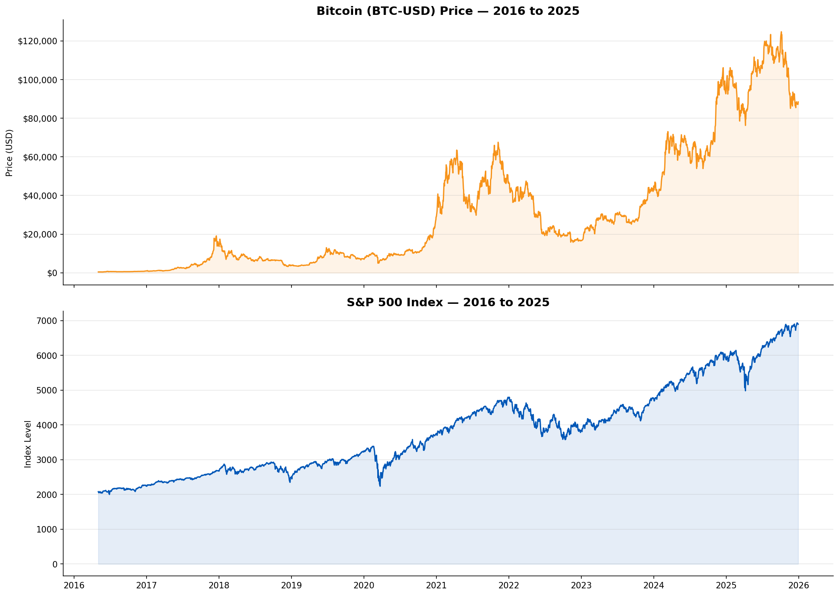
EDA — Price History: 2016 to 2025

Slide 11
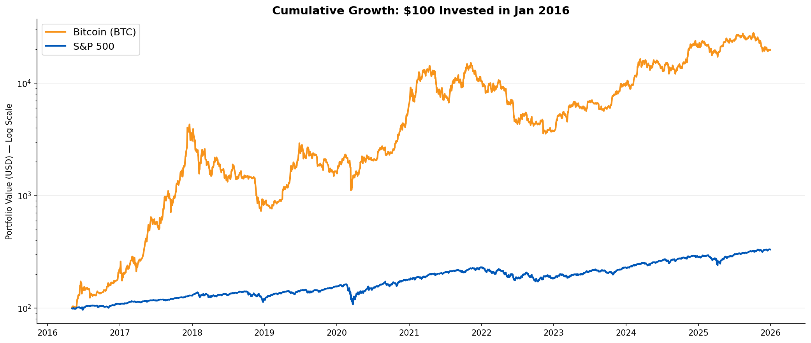
$100 Invested in 2016: A Tale of Two Assets
Bitcoin
$19,887
from $100
S&P 500
$331
from $100
Note: Log scale used so both assets remain visible on the same chart.

Slide 12
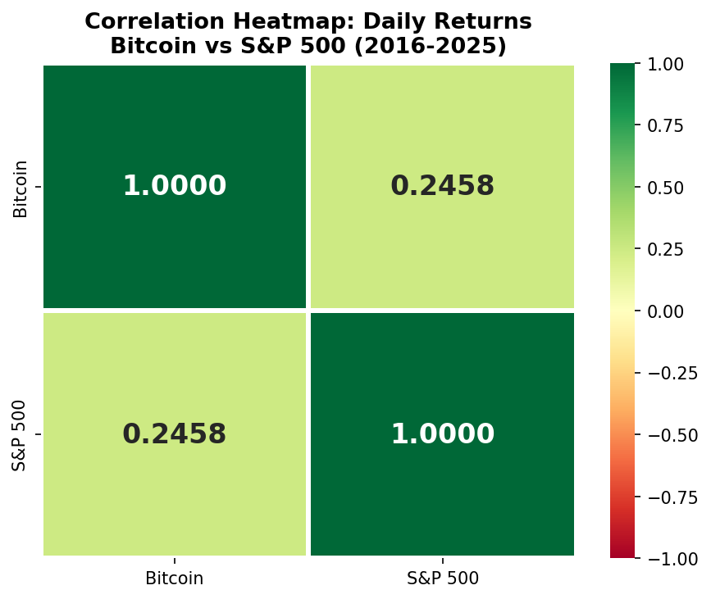
RQ 1
Is Bitcoin Correlated with the Stock Market?
Pearson r
Key Findings
0.246
r=0.246 is significant — BTC has measurable but limited equity linkage
~94% of BTC variance is NOT explained by S&P 500 moves
p-value < 0.0001
Statistically significant
Weak-to-moderate positive
correlation
Correlation has risen post-2020 with institutional adoption
Beta=0.91: BTC moves ~0.91% per 1% S&P move on correlated days
Beta = 0.91 | R-squared = 0.060

Slide 13
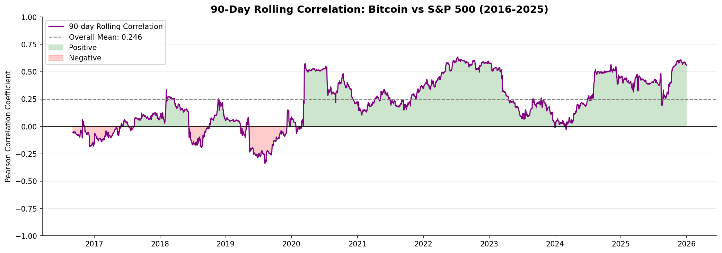
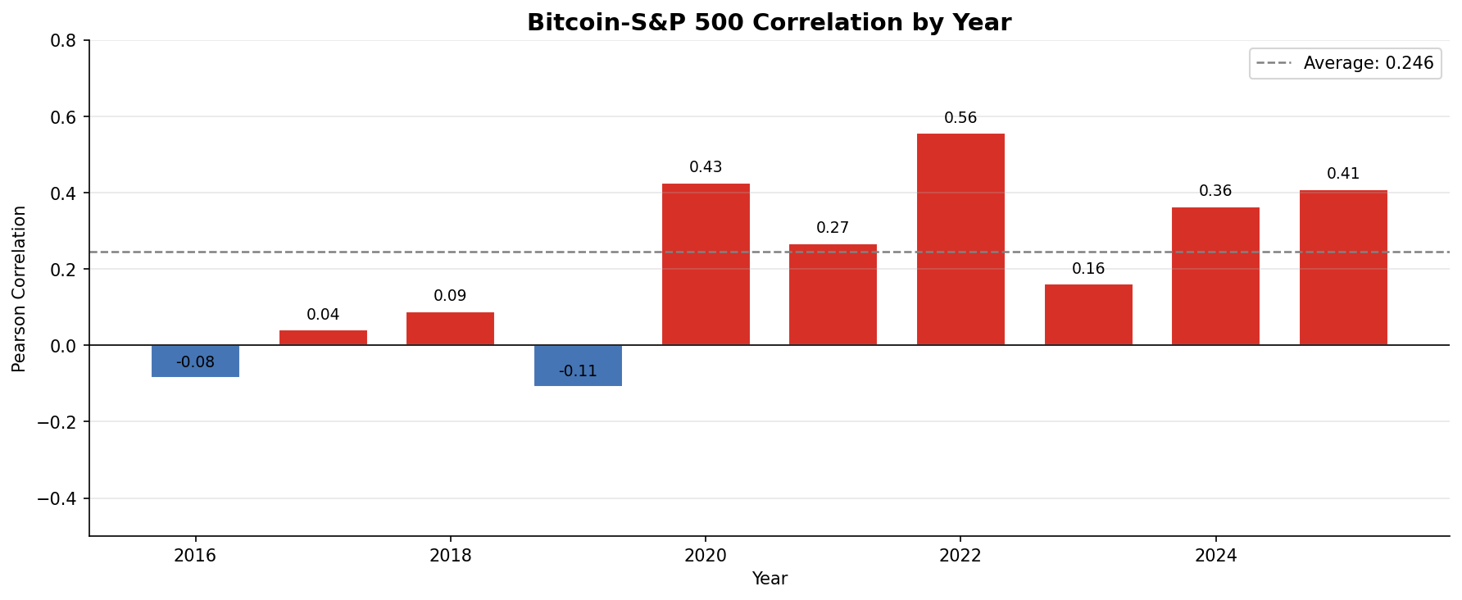
RQ1 — Correlation Changes Over Time
2016–2019
Near-zero correlation — BTC traded independently of equities
COVID 2020
Correlation spiked as all risk assets sold off together
2022–2025
Elevated correlation as institutional investors drove linkage

Slide 14
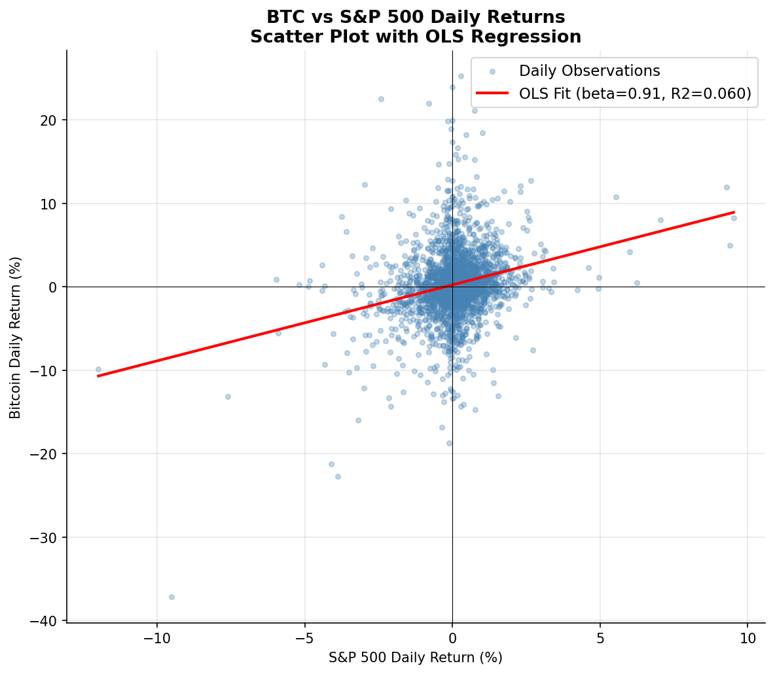
RQ1 — OLS Regression: BTC Returns on S&P 500
Regression Output
Beta (beta)
0.912
Alpha (intercept)
0.00128
R-squared
0.0604
p-value (beta)
< 0.0001
Interpretation:
For every 1% S&P 500 move, BTC moves ~0.91%. But R2=0.06 — the market explains only 6% of BTC variance.

Slide 15
RQ 2
Does Bitcoin Hedge Against Market Crashes?
Q4 2018 Sell-Off
COVID Crash 2020
2022 Bear Market
Sep 20 – Dec 24, 2018
Feb 19 – Mar 23, 2020
Jan 3 – Oct 12, 2022
66 trading days
23 trading days
202 trading days
S&P 500 return:
S&P 500 return:
S&P 500 return:
-19.1%
-33.6%
-24.9%
Bitcoin return:
Bitcoin return:
Bitcoin return:
-36.3%
-36.7%
-58.6%
NOT a hedge — amplified losses
NOT a hedge — amplified losses
NOT a hedge — amplified losses
Verdict: Bitcoin amplified losses in every major crash — it does NOT act as a safe-haven or hedge asset

Slide 16
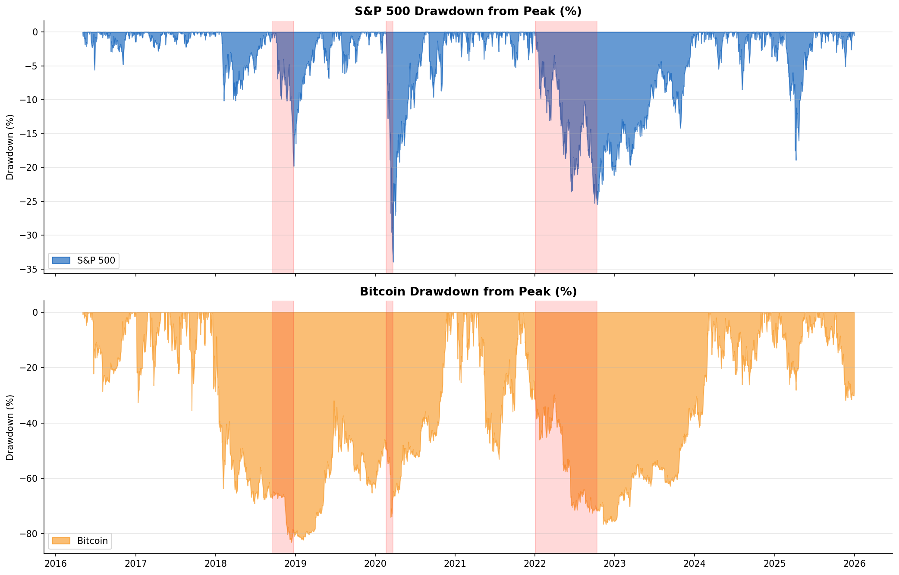
RQ2 — Drawdown: BTC Fell Further in Every Crash
Red shaded bands indicate the 3 major crash windows. BTC consistently shows deeper and longer-lasting drawdowns.

Slide 17
RQ 3
How Does Volatility Compare?
BTC Annual Vol
Volatility Ratio
BTC VaR 95%
BTC Annual Ret.
66.2%
3.7x
-6.0%
75%
vs S&P 500: 17.9%
BTC is 3.7x more volatile
vs S&P 500: -1.65%
vs S&P 500: 13.6%
Risk Metrics Comparison
Metric
Bitcoin
S&P 500
Ratio
Annualised Volatility
66.2%
17.9%
3.7x
Max Single-Day Loss
-46.5%
-11.9%
~4x
VaR (95%, daily)
-6.0%
-1.65%
3.6x
Excess Kurtosis
6.3 (fat tails)
13.2
—

Slide 18
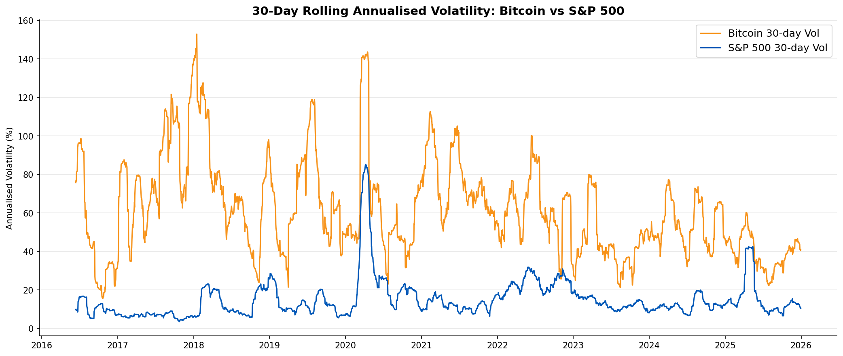
RQ3 — Rolling 30-Day Volatility Over Time
Bitcoin Volatility
S&P 500 Volatility
BTC vol peaks above 150% annualised during major crypto events (2017 bull run, COVID, 2021-22 cycle).
S&P vol peaked during COVID (Mar 2020). Even its largest spike remains below BTC's average level.

Slide 19
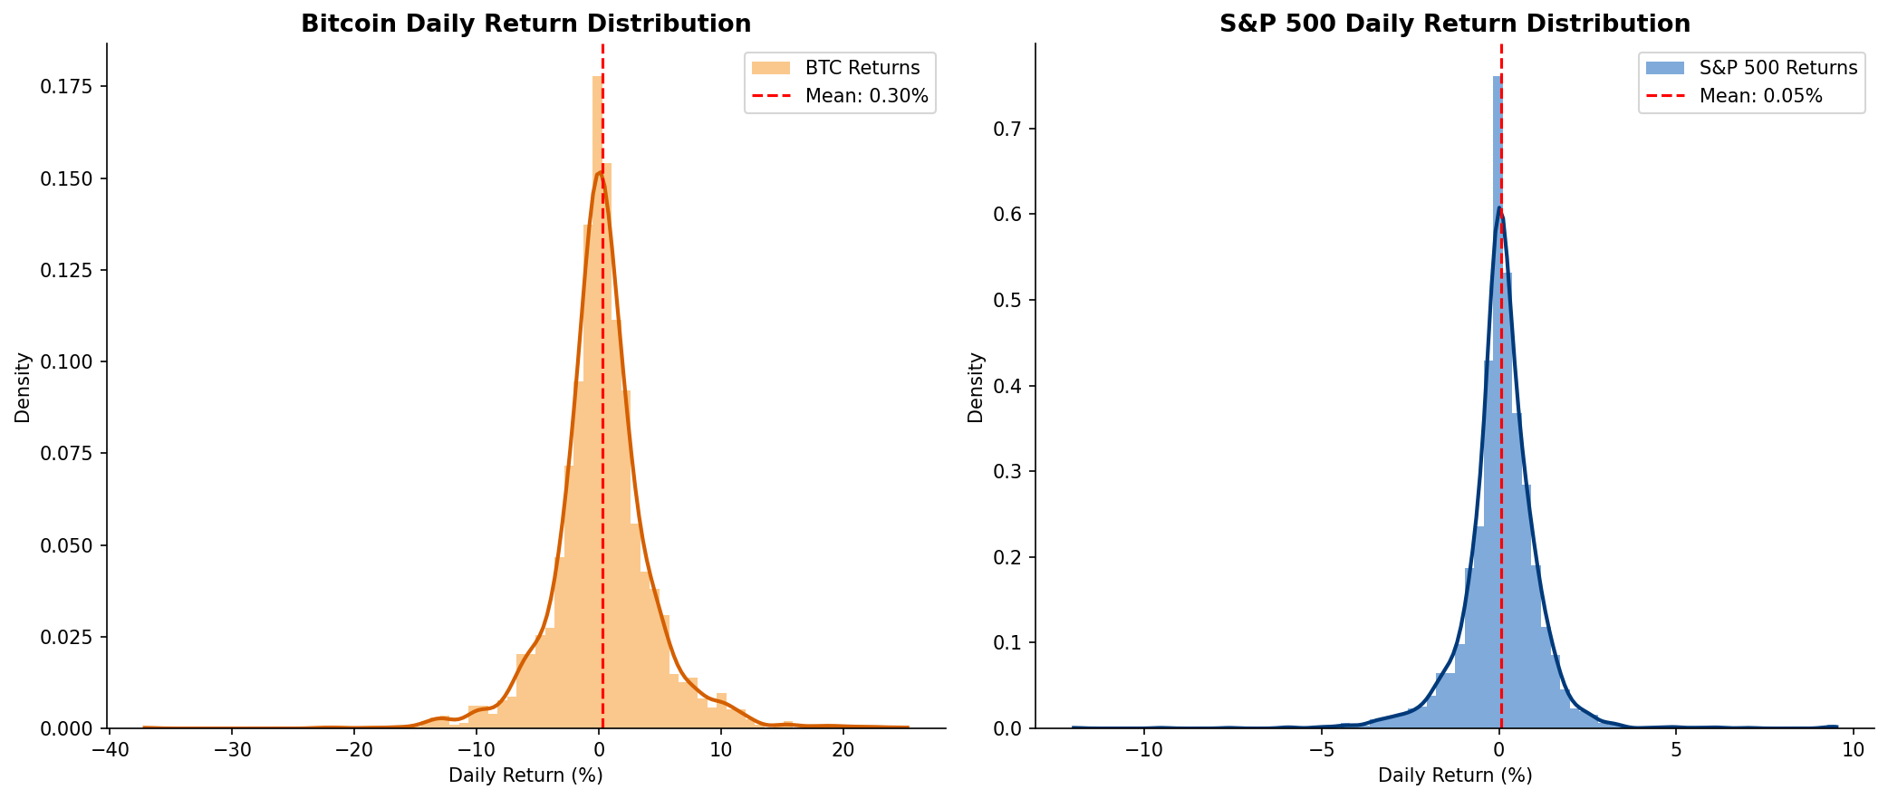
RQ3 — Return Distribution: Fat Tails in Crypto
BTC shows a far wider distribution with extreme daily swings (+20% to -46%) vs S&P 500 (+11% to -12%). Higher kurtosis = fatter tails = more extreme daily events.

Slide 20
Summary of Findings
RQ1
BTC has a statistically significant but moderate positive correlation with the S&P 500 (r=0.246). This link has strengthened post-2020 with institutional adoption. Beta of 0.91 — BTC amplifies equity moves on correlated days. R2=0.06 means 94% of BTC variance remains unexplained by equities.
Correlation
RQ2
Bitcoin did NOT hedge in any of the 3 major crashes. COVID 2020: BTC fell -36.7% vs S&P -33.6%. 2022 bear market: BTC -58.6% vs S&P -24.9%. BTC behaves as a high-risk growth asset that sells off in risk-off environments — not a safe haven like gold.
Hedge
RQ3
BTC is 3.7x more volatile than the S&P 500 (66.2% vs 17.9% annualised). VaR at 95% is -6.0% (BTC) vs -1.65% (S&P). Despite extreme risk, BTC delivered ~75% annualised return vs 13.6% — a highly asymmetric risk/reward profile.
Volatility

Slide 21
Discussion, Limitations & Future Work
Limitations
Future Research
Price data only — fundamentals, on-chain metrics and regulation not included
Include Ethereum, gold, bonds and DeFi tokens for broader asset comparison
Bitcoin alone does not represent all crypto (Ethereum, DeFi, altcoins missing)
Add Google Trends and Fear & Greed Index as sentiment data sources
S&P 500 is U.S.-centric — global markets may show different BTC relationships
Apply GARCH(1,1) models for dynamic volatility estimation
Correlations are time-varying and unstable — past patterns may not persist
Use Markov regime-switching models to capture correlation structural breaks
Weekend BTC trades excluded by inner join on business days
Extend analysis to international equity indices (Nikkei, FTSE, DAX)

Slide 22
Team Contributions
Member | Role | Tasks & Responsibilities
Gabriella Rodriguez | Research Lead | Formulated all three research questions and the study framework. Defined the scope, hypotheses, and analytical approach for the project.
Sony Maharajan | Presentation Designer | Designed and built the PowerPoint presentation. Created the visual layout, slide structure, charts styling, and overall slide narrative.
Apurva Awate | Data Engineer | Collected data from Yahoo Finance (BTC-USD) and FRED (S&P 500). Handled data cleaning, merging, missing value treatment, and data validation.
Darshil Gandhi | Lead Analyst | Conducted all statistical analysis — correlation, regression, crash analysis, volatility modeling. Wrote the Jupyter notebook and interpreted all findings.

Slide 23
References
[1] Yahoo Finance. (2025). Bitcoin USD (BTC-USD) Historical Data. Retrieved via yfinance Python library. https://finance.yahoo.com
[2] Federal Reserve Bank of St. Louis (FRED). (2025). S&P 500 Index [SP500]. pandas-datareader. https://fred.stlouisfed.org/series/SP500
[3] McKinney, W. (2010). Data structures for statistical computing in Python. Proceedings of the 9th Python in Science Conference, 51-56.
[4] Bouri, E., et al. (2017). On the hedge and safe haven properties of Bitcoin. Finance Research Letters, 20, 192-198.
[5] Corbet, S., et al. (2018). Exploring dynamic relationships between cryptocurrencies and other financial assets. Economics Letters, 165, 28-34.
[6] Dyhrberg, A. H. (2016). Hedging capabilities of Bitcoin. Is it the virtual gold? Finance Research Letters, 16, 139-144.
[7] Seaborn: Statistical Data Visualization. (2021). https://seaborn.pydata.org
[8] Hunter, J. D. (2007). Matplotlib: A 2D graphics environment. Computing in Science & Engineering, 9(3), 90-95.

Slide 24
B
Thank You!
Questions & Discussion Welcome
Gabriella • Sony • Apurva • Darshil | Masters in Financial Technology | April 2026

