Slide 1
B
S&P
Crypto vs Traditional Markets
Analyzing Bitcoin & S&P 500: Correlation, Crash Behavior & Volatility
Data: Yahoo Finance (BTC-USD) • FRED Federal Reserve (S&P 500) • 2016–2025
Financial Technology | Masters Program | April 30, 2026

Slide 2
Presentation Agenda
01
Research Background & Questions
04
RQ2: Crash / Hedge Analysis
Why crypto vs equities matters today
Does BTC protect in downturns?
02
Data Collection & Cleaning
05
RQ3: Volatility Comparison
Yahoo Finance + FRED, 2016–2025
How risky is crypto vs equities?
03
RQ1: Correlation Analysis
06
Conclusions & Discussion
Is BTC linked to the stock market?
Key findings and limitations

Slide 3
Research Background & Significance
Why This Study Matters
Research Questions
Bitcoin has grown from a niche experiment into a $1 trillion+ asset class, attracting institutional investors and retail traders alike.
As crypto enters mainstream portfolios, investors must understand:
- Does BTC diversify or amplify risk?
- Can it hedge against market downturns?
- How much more volatile is it really?
RQ 1
Is Bitcoin correlated with the stock market?
Pearson r, rolling correlation, OLS regression
RQ 2
Does Bitcoin act as a hedge during crashes?
Performance during 2018, COVID, 2022 bear market
RQ 3
How does volatility compare?
Annualised vol, rolling vol, VaR, return distribution

Slide 4
Data Collection
B
Source 1: Yahoo Finance
FED
Source 2: FRED (Federal Reserve)
Bitcoin (BTC-USD)
S&P 500 Index
Asset:
Bitcoin (BTC-USD)
Asset:
S&P 500 Index
Frequency:
Daily (7 days/week)
Frequency:
Daily (business days only)
Coverage:
Jan 2016 – Dec 2025
Coverage:
Jan 2016 – Dec 2025
Records:
3,652 observations
Records:
2,523 observations
Access:
yfinance Python library
Access:
pandas_datareader library
Variable:
Daily closing price (USD)
Variable:
Index level

Slide 5
Data Cleaning & Preparation
1
Handle Missing Values
FRED occasionally reports no value on thin trading days. We forward-fill S&P 500 gaps, then drop any remaining NaN rows after the inner join.
2
Merge & Align Dates
Inner join on date index keeps only days where BOTH assets have data (2,431 matching business days). BTC weekend data is excluded.
3
Type Conversion & Sort
Both columns cast to float64. Index set as DatetimeIndex and sorted ascending. Year column added for groupby operations.
4
Generate New Columns
Daily simple returns (pct_change), log returns, cumulative returns (base 100), 30-day rolling volatility, and 90-day rolling correlation.
5
Subset & Aggregation
Post-2020 subset for focused analysis. Annual statistics computed via groupby(Year) with mean, std, min, max, and total return aggregations.

Slide 6
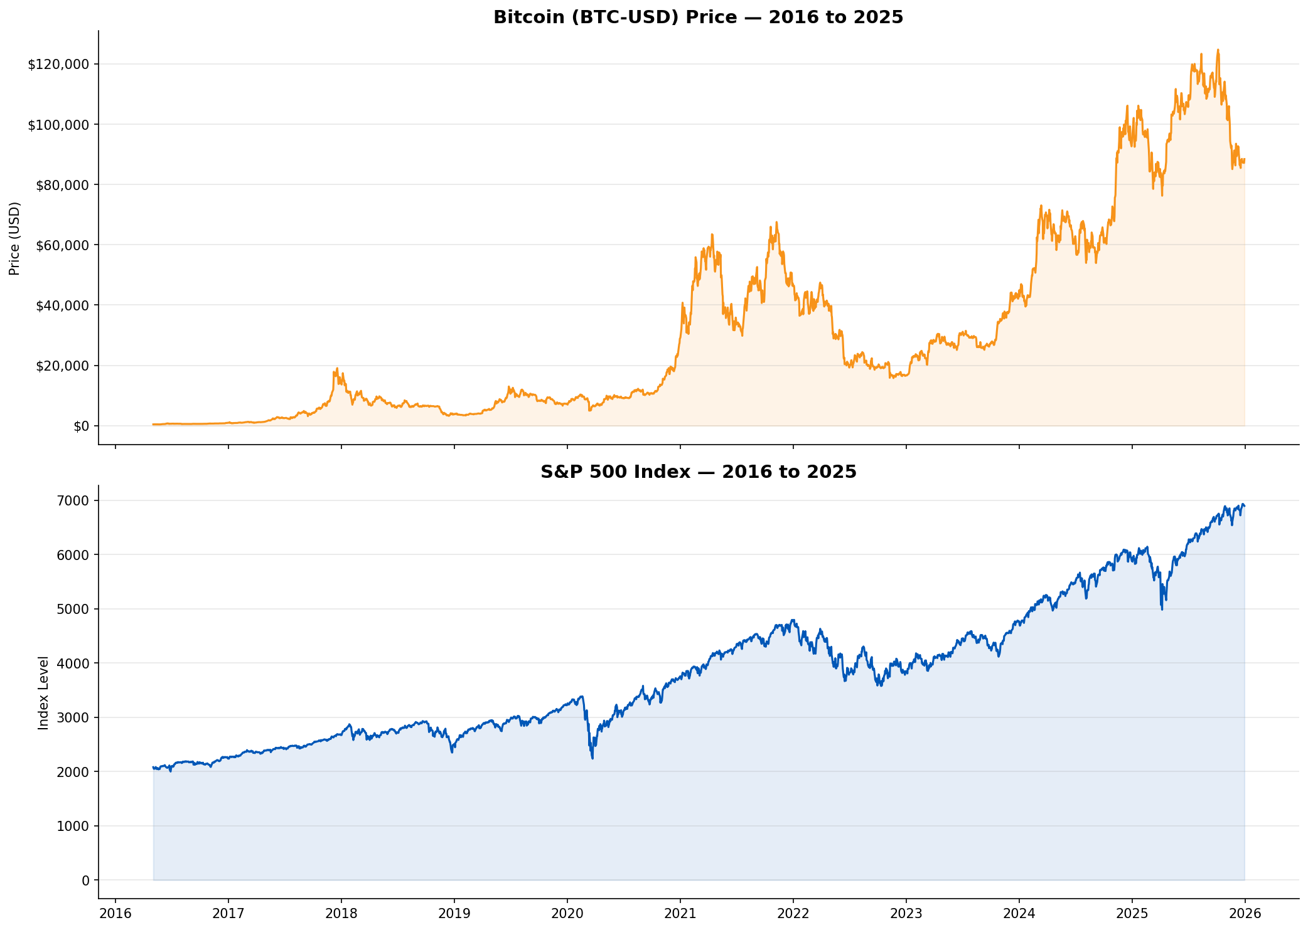
EDA — Price History: 2016 to 2025

Slide 7
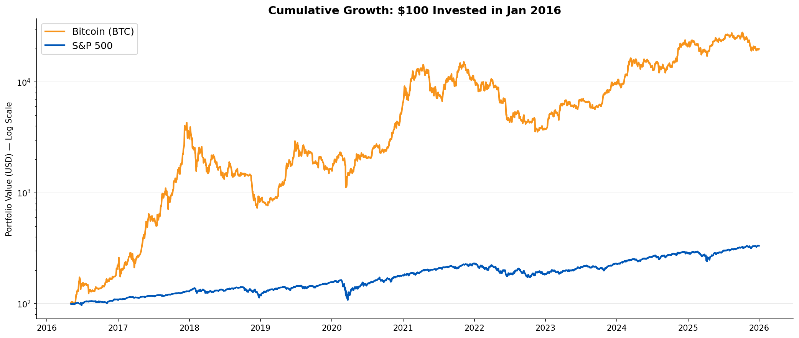
$100 Invested in 2016: A Tale of Two Assets
Bitcoin
$19,887
from $100
S&P 500
$331
from $100
Note: Log scale used so both assets remain visible on the same chart.

Slide 8
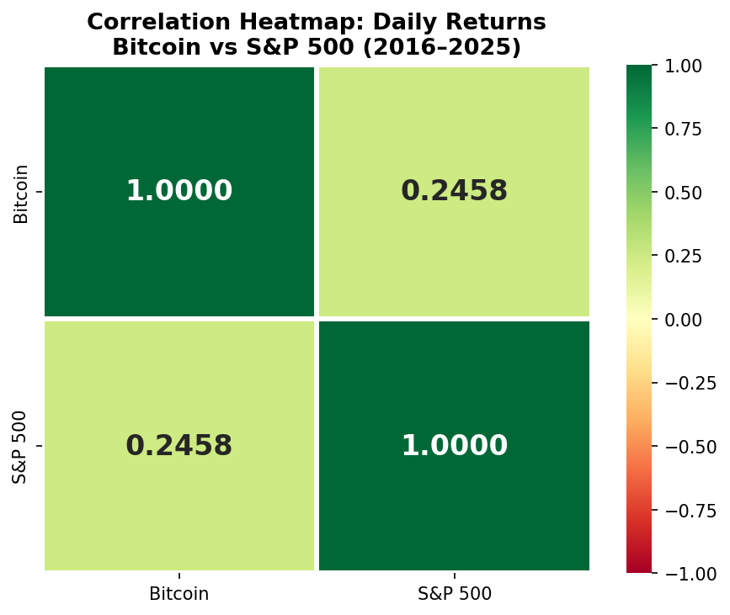
RQ 1
Is Bitcoin Correlated with the Stock Market?
Pearson r
Key Findings
0.246
r=0.246 is significant — BTC has measurable but limited equity linkage
~94% of BTC variance is NOT explained by S&P 500 moves
p-value < 0.0001
Statistically significant
Weak-to-moderate positive
correlation
Correlation has risen post-2020 with institutional adoption
Beta=0.91: BTC moves ~0.91% per 1% S&P move on correlated days
Beta = 0.91 | R-squared = 0.060

Slide 9
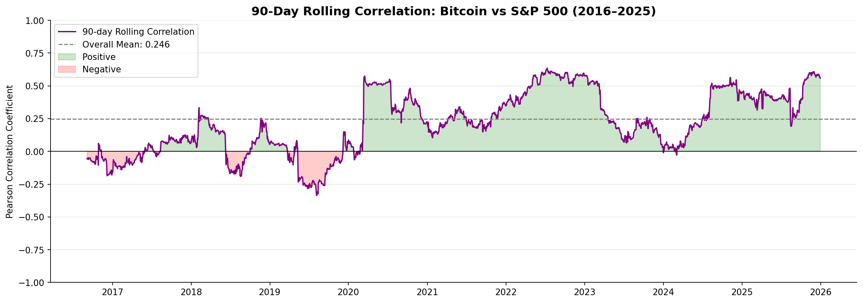
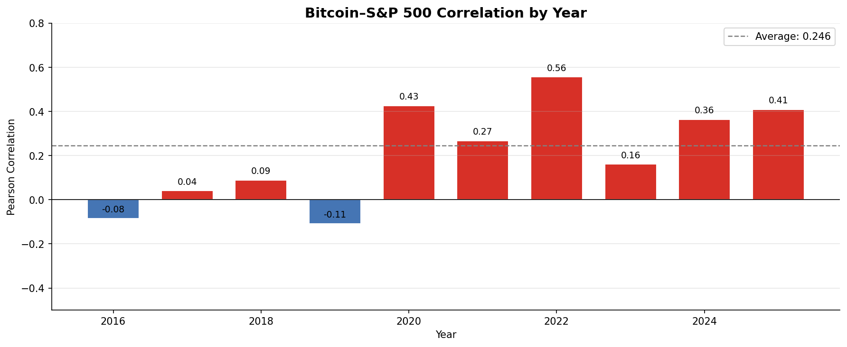
RQ1 — Correlation is Not Constant Over Time
2016–2019
Near-zero correlation — BTC traded independently of equities
COVID 2020
Correlation spiked as all risk assets sold off together
2022–2025
Elevated correlation as institutional investors drove linkage

Slide 10
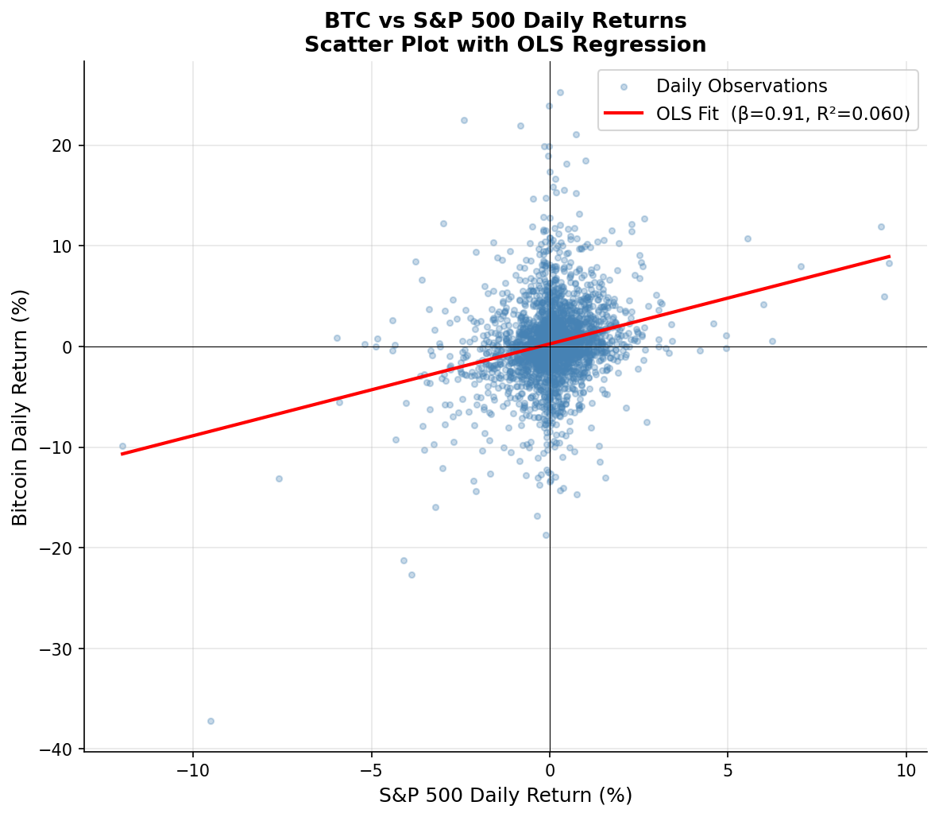
RQ1 — OLS Regression: BTC Returns on S&P 500
Regression Output
Beta (beta)
0.912
Alpha (intercept)
0.00128
R-squared
0.0604
p-value (beta)
< 0.0001
Interpretation:
For every 1% S&P 500 move, BTC moves ~0.91%. But R2=0.06 — the market explains only 6% of BTC variance.

Slide 11
RQ 2
Does Bitcoin Hedge Against Market Crashes?
Q4 2018 Sell-Off
COVID Crash 2020
2022 Bear Market
Sep 20 – Dec 24, 2018
Feb 19 – Mar 23, 2020
Jan 3 – Oct 12, 2022
66 trading days
23 trading days
202 trading days
S&P 500 return:
S&P 500 return:
S&P 500 return:
-19.1%
-33.6%
-24.9%
Bitcoin return:
Bitcoin return:
Bitcoin return:
-36.3%
-36.7%
-58.6%
NOT a hedge — amplified losses
NOT a hedge — amplified losses
NOT a hedge — amplified losses
Verdict: Bitcoin amplified losses in every major crash — it does NOT act as a safe-haven or hedge asset

Slide 12
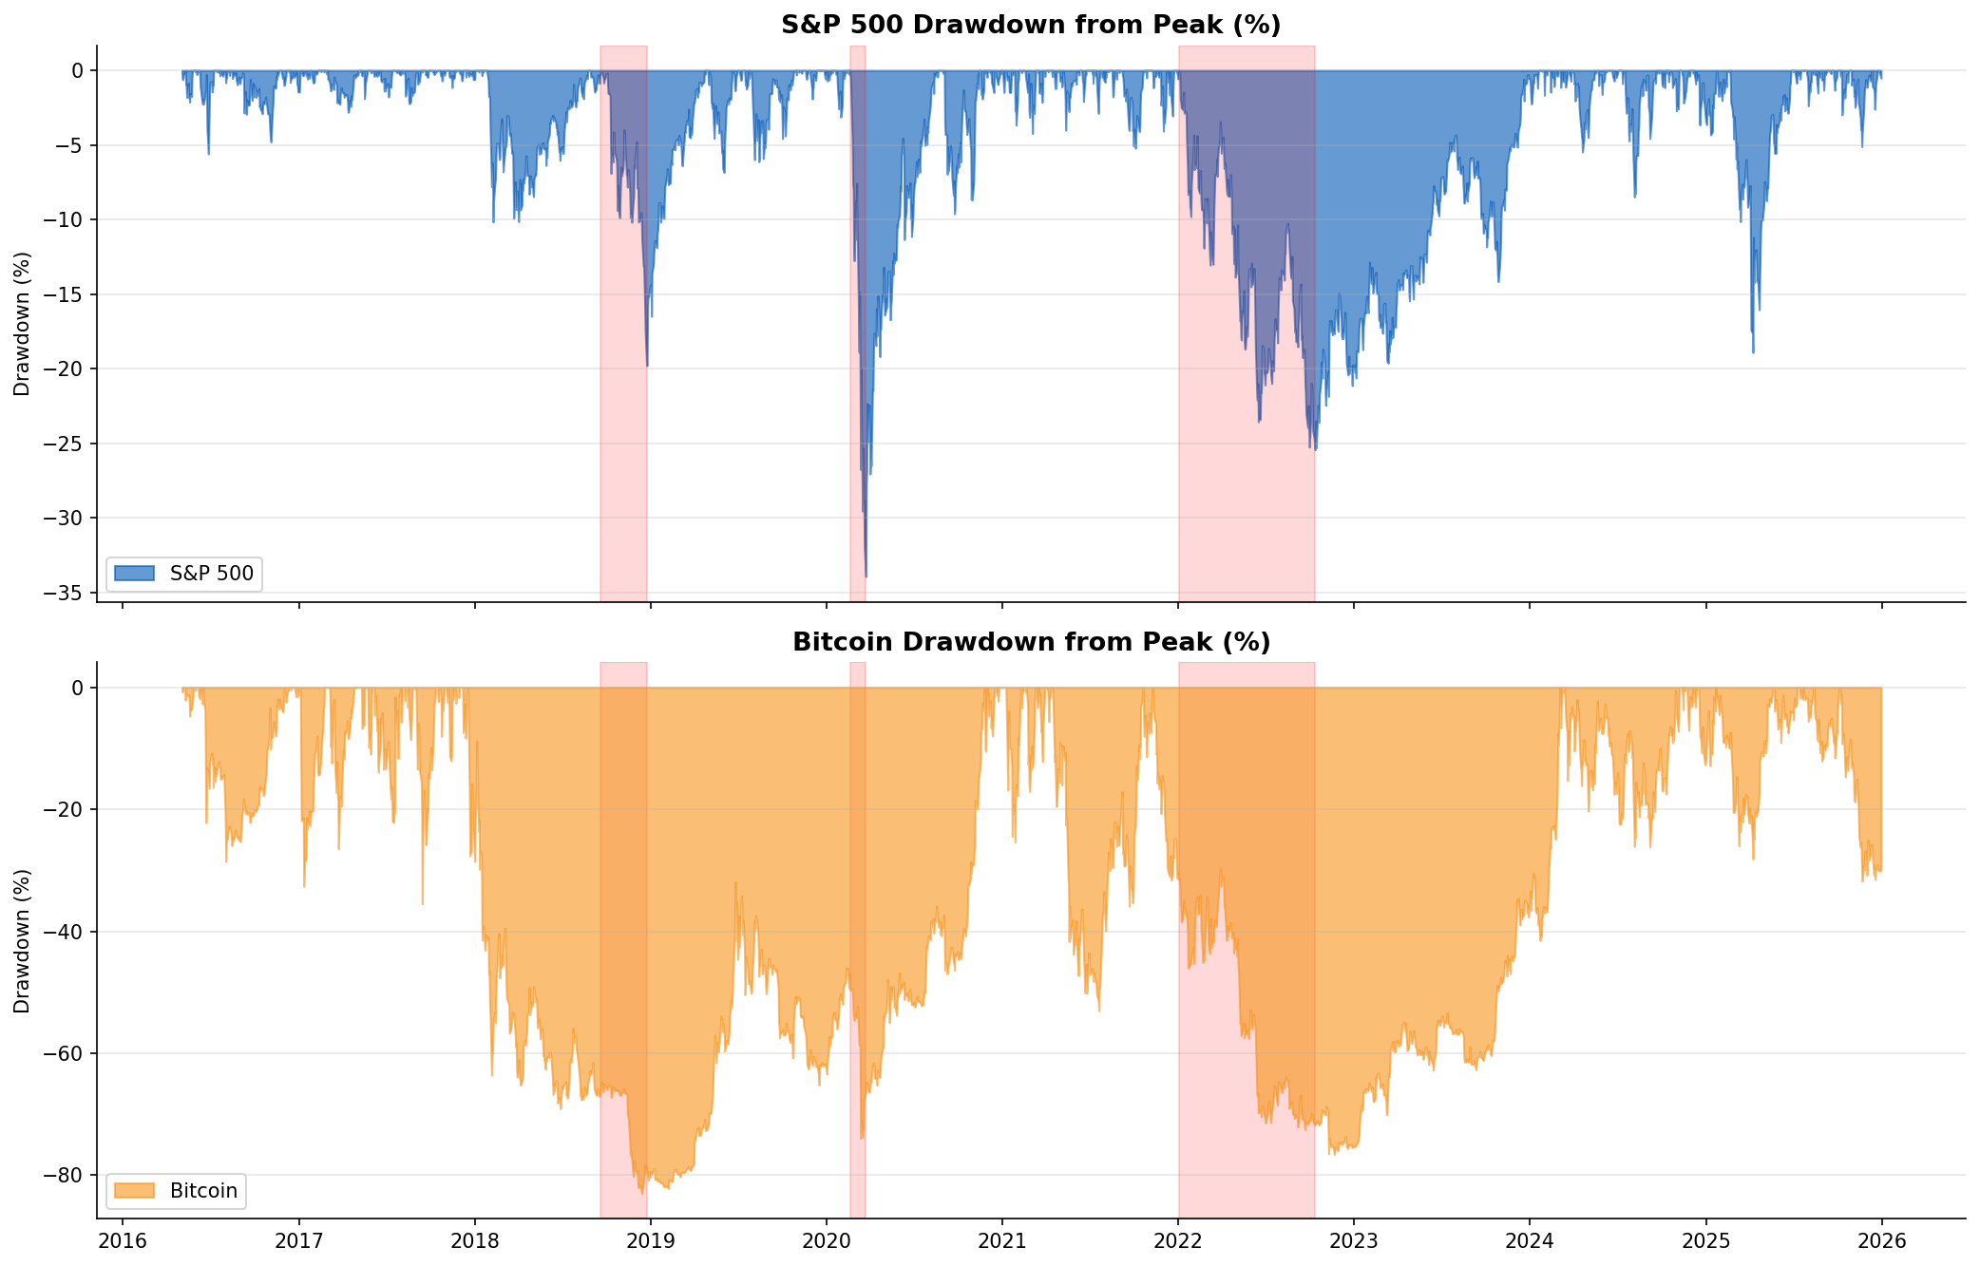
RQ2 — Drawdown: BTC Fell Further in Every Crash
Red shaded bands indicate the 3 major crash windows. BTC consistently shows deeper and longer-lasting drawdowns.

Slide 13
RQ 3
How Does Volatility Compare?
BTC Annual Vol
Volatility Ratio
BTC VaR 95%
BTC Annual Ret.
66.2%
3.7x
-6.0%
75%
vs S&P 500: 17.9%
BTC is 3.7x more volatile
vs S&P 500: -1.65%
vs S&P 500: 13.6%
Risk Metrics Comparison
Metric
Bitcoin
S&P 500
Ratio
Annualised Volatility
66.2%
17.9%
3.7x
Max Single-Day Loss
-46.5%
-11.9%
~4x
VaR (95%, daily)
-6.0%
-1.65%
3.6x
Excess Kurtosis
6.3 (fat tails)
13.2
—

Slide 14
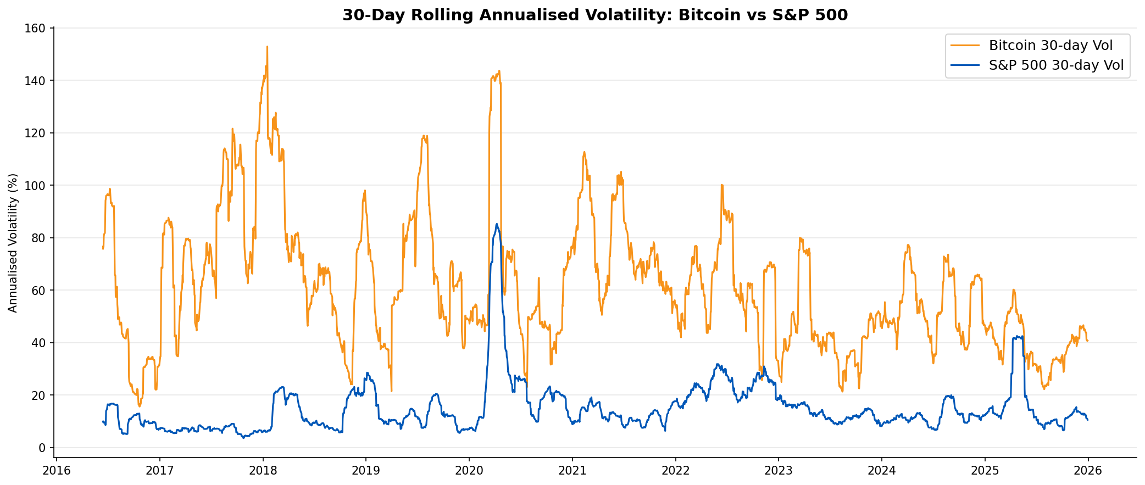
RQ3 — Rolling 30-Day Volatility Over Time
Bitcoin Volatility
S&P 500 Volatility
BTC vol peaks above 150% annualised during major crypto events (2017 bull run, COVID, 2021-22 cycle).
S&P vol peaked during COVID (Mar 2020). Even its largest spike remains below BTC's average level.

Slide 15
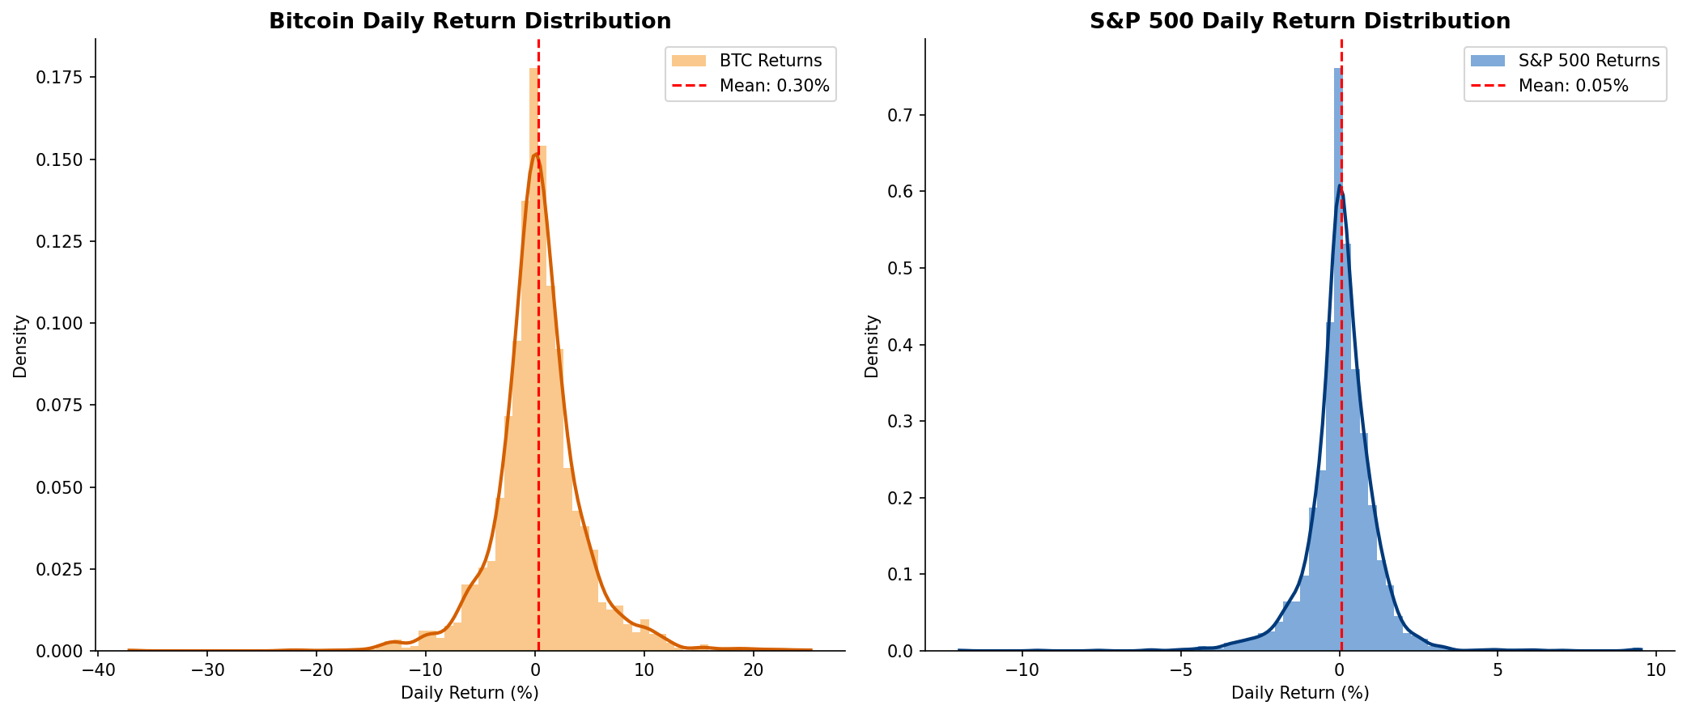
RQ3 — Return Distribution: Fat Tails in Crypto
BTC shows a far wider distribution with extreme daily swings (+20% to -46%) vs S&P 500 (+11% to -12%). Higher kurtosis = fatter tails = more extreme daily events.

Slide 16
Summary of Findings
RQ1
BTC has a statistically significant but moderate positive correlation with the S&P 500 (r=0.246). This link has strengthened post-2020 with institutional adoption. Beta of 0.91 — BTC amplifies equity moves on correlated days. R2=0.06 means 94% of BTC variance remains unexplained by equities.
Correlation
RQ2
Bitcoin did NOT hedge in any of the 3 major crashes. COVID 2020: BTC fell -36.7% vs S&P -33.6%. 2022 bear market: BTC -58.6% vs S&P -24.9%. BTC behaves as a high-risk growth asset that sells off in risk-off environments — not a safe haven like gold.
Hedge
RQ3
BTC is 3.7x more volatile than the S&P 500 (66.2% vs 17.9% annualised). VaR at 95% is -6.0% (BTC) vs -1.65% (S&P). Despite extreme risk, BTC delivered ~75% annualised return vs 13.6% — a highly asymmetric risk/reward profile.
Volatility

Slide 17
Discussion, Limitations & Future Work
Limitations
Future Research
Price data only — fundamentals, on-chain metrics and regulation not included
Include Ethereum, gold, bonds and DeFi tokens for broader asset comparison
Bitcoin alone does not represent all crypto (Ethereum, DeFi, altcoins missing)
Add Google Trends and Fear & Greed Index as sentiment data sources
S&P 500 is U.S.-centric — global markets may show different BTC relationships
Apply GARCH(1,1) models for dynamic volatility estimation
Correlations are time-varying and unstable — past patterns may not persist
Use Markov regime-switching models to capture correlation structural breaks
Weekend BTC trades excluded by inner join on business days
Extend analysis to international equity indices (Nikkei, FTSE, DAX)

Slide 18
Team Contributions
Member | Role | Tasks & Responsibilities
Member 1 | Project Lead / Data Engineer | Data collection from Yahoo Finance & FRED, data cleaning pipeline, index alignment, missing value handling
Member 2 | Statistical Analyst | Correlation analysis (RQ1), Pearson r, rolling correlation, OLS regression, yearly groupby aggregations
Member 3 | Risk Analyst | Crash/hedge analysis (RQ2), drawdown calculations, crash window identification and performance comparison
Member 4 | Quantitative Analyst | Volatility analysis (RQ3), rolling vol, VaR, return distribution, skewness & kurtosis analysis
Member 5 | Visualization & Presentation | All matplotlib/seaborn charts, PowerPoint slides, and final narrative/conclusions

Slide 19
References
[1] Yahoo Finance. (2025). Bitcoin USD (BTC-USD) Historical Data. Retrieved via yfinance Python library. https://finance.yahoo.com
[2] Federal Reserve Bank of St. Louis (FRED). (2025). S&P 500 Index [SP500]. pandas-datareader. https://fred.stlouisfed.org/series/SP500
[3] McKinney, W. (2010). Data structures for statistical computing in Python. Proceedings of the 9th Python in Science Conference, 51-56.
[4] Bouri, E., et al. (2017). On the hedge and safe haven properties of Bitcoin. Finance Research Letters, 20, 192-198.
[5] Corbet, S., et al. (2018). Exploring dynamic relationships between cryptocurrencies and other financial assets. Economics Letters, 165, 28-34.
[6] Dyhrberg, A. H. (2016). Hedging capabilities of Bitcoin. Is it the virtual gold? Finance Research Letters, 16, 139-144.
[7] Seaborn: Statistical Data Visualization. (2021). https://seaborn.pydata.org
[8] Hunter, J. D. (2007). Matplotlib: A 2D graphics environment. Computing in Science & Engineering, 9(3), 90-95.

Slide 20
B
Thank You!
Questions & Discussion Welcome
Crypto vs Traditional Markets | Financial Technology | April 2026

