Slide 1
We acknowledge the Bailai (By-ee-lee), Gurang, Gooreng Gooreng and Taribelang Bunda (Tara-bell-ang Bunn-duh) people who are the traditional custodians of this land.

Slide 2
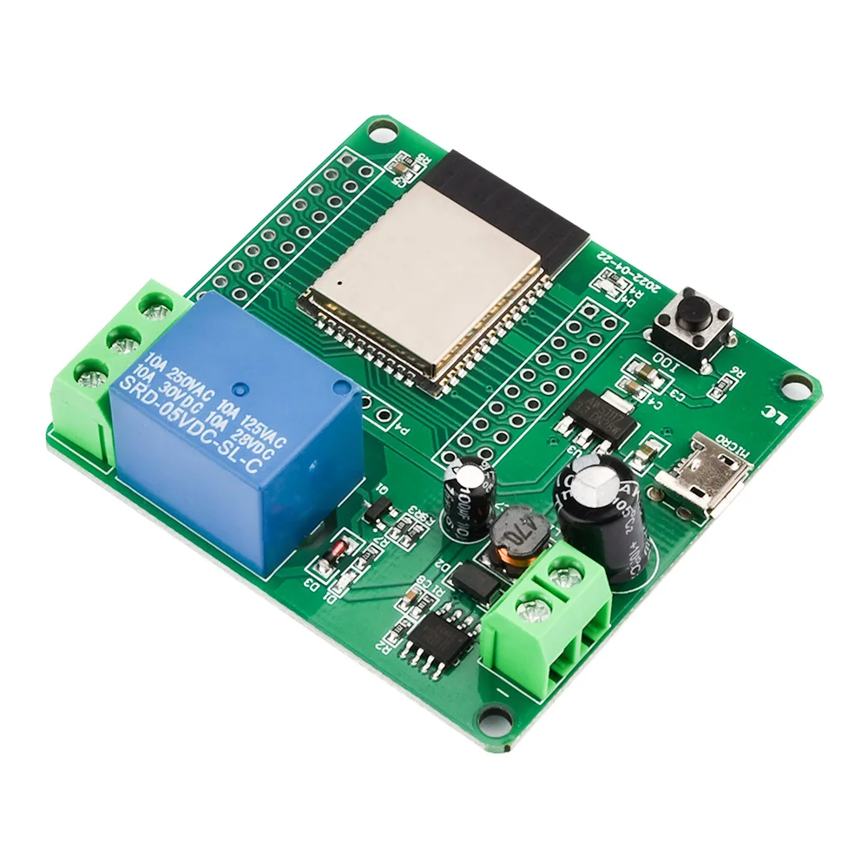
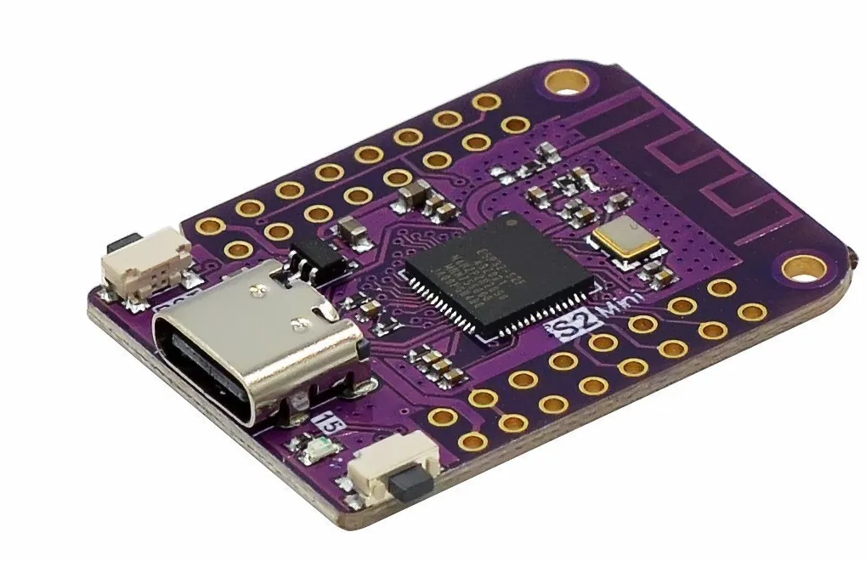
Tasmota + Berry
Not just for home automation
Darryl Bond
Notes:
How many have used Tasmota?
How many have heard of Berry/

Slide 3
ESP32 SOC
ESP8266 released in 2014 by Expressif
The ESP32 series of microcontroller are a substantial evolution on the ESP8266
Faster, Dual Core CPU with more memory and many more GPIO
CPU architecture using the Xtensa LX6 ISA like the ESP8266.
Some models use the RISC-V ISA
Addition of Bluetooth on most models
Many more ADC in addition to DAC and hardware counters
Notes:
ESP8266 was released in 2014.
Inexpensive SOC with useful IO, but included Wifi.
Default firmware, responded to modem AT commands. It was expected that it would be a peripheral to provide Wifi support for other processors.
To their credit, Expressif made development tools available to the open source community.
Arduino support quickly followed.

Slide 4
ESP Family
 | ESP8266 | ESP32 | ESP32-S2 | ESP32-S3 | ESP32-C3 | ESP32-C6
CPU | Xtensa32Bit | Xtensa32Bit | Xtensa 32 Bit | Xtensa 32bit + | RISC-V 32bit | RISC-V 32bit +
Cores | 1 | 2 | 1 | 2 | 1 | 1
Clock | 80-160MHz | 160-240MHz | 160-240MHz | 160-240MHz | 120MHz | 160MHz
RAM | 160kB | 520KB | 320KB | 512KB | 300KB | 512KB
Flash | External SPI Flash
Wifi 802.11 b/g/n | ✔ | ✔ | ✔ | ✔ | ✔ | +ax +Zigbee
Bluetooth | ✘ | Classic & BLE | ✘ | BLE | BLE | Bluetooth5 + LE
GPIO | 18 | 34 | 34 | 45 | 22 | 22
DAC | ✘ | 2 | 2 | 2 | ✘ | ✘
ADC | 1 10bit | 18 12bit | 20 | 20 | 2 | 7
Interfaces | SPI-I2C-I2S | ✔ +CAN | ✔ +CAN | ✔ +CAN | ✔ | ✔
Notes:
There are many variations between models, for instance, ESP32-S3 and C6 include a Low power 20MHz co-processor.
More CPU’s are in the pipeline.
Expressif have indicated that RISC-V is there long term strategy.
C6 contains Wifi6 and zigbee radios

Slide 5
ESP32 Software Support
Expressif IDF is the official Development Framework
Arduino support early for ESP8266
Arduino support continued with ESP32
PlatformIO with VSCode
Supports most Arduino libraries
Notes:
Arduino uses g++
PlatformIO also uses g++

Slide 6
Tasmota
Tasmota was first called Sonoff-MQTT-OTA, first commit in 2016 by Theo Arends.
Tasmota grew into a fully fledged ecosystem for virtually any ESP8266/ESP32 based device.
Tasmota was not designed for Home Assistant, although it eventually grew to interface to it. It is not really comparable with ESPHome.
A Tasmota device can be stand alone
Notes:
- Tasmota began as Sonoff-MQTT-OTA with a commit on 25th January 2016, by Theo Arends. Its goal was to provide ESP8266 based ITEAD Sonoff devices with MQTT and 'Over the Air' or OTA firmware.
- What started as a simple way to hack a cloud bound Sonoff Basic (one of the first cheap and accessible smart home devices in the market) into a locally controlled device has grown into a fully fledged ecosystem for virtually any ESP8266/ESP32 based device.
- Tasmota capabilities overlap with ESPHome and interfaces with home assistant via MQTT and HA auto-configuration.

Slide 7
ESP8266 Tasmota Design
Peripheral Device drivers and configuration to assign GPIO
Wifi with Over the Air upgrade capability.
MQTT support
Comprehensive command set
Rule Engine
Capacity limits of ESP8266 meant that there were many different images to support the required drivers or functions
Notes:
- Device drivers for many devices are part of the image
- The ESP8266 storage and memory limits meant that all possibe features or device drivers could not be supported all together.
- Indeed, an OTA upgrade involves 2 steps. First step loads a minimal image, then the full image is installed over it.

Slide 8
Commands and Rules
Command
Rule
There are other triggers depending on the peripherals configured
POWER1 ON
websend [192.23.1.20] power1 0
ON POWER1#STATE=1 DO RULETIMER1 600 ENDON
ON RULES#TIMER=1 DO POWER1 0 ENDON
ON ANALOG#A0div10 DO DIMMER %value% ENDON
Notes:
In the command example. Assuming a relay has been configured.
POWER1 ON turns on the first relay
Using websend allows peer to peer commands
An example rule
When POWER1 is turned on a timer is loaded with 600 (seconds)
When the timer expires the relay is turned off
When ANALOG A0 changes more than 1% adjust the dimmer by the returned value
These examples do not need anything else to operate.

Slide 9
Road to ESP32
  A scripting engine that worked with Tasmota was needed:
    General purpose programs
    Ability to write device drivers without recompiling
  Review of options
    Micropython - took over the machine
    LUA - heavyweight and obscure syntax
    https://github.com/cesanta/elk – Javascript Syntax
    Berry – Python Syntax
Notes:
Write conventional programs with normal language construction
Device drivers need to interface closely with Tasmota which is providing the usual infrastructure
Micropython would replace Tasmota
LUA consumed too much resources
In the end, the choice came down to the developer preferred pythonese to javascript

Slide 10
Berry
Lightweight: A well-optimized interpreter using very few resources.
Fast: optimized one-pass bytecode compiler and register-based virtual machine.
Powerful: supports imperative programming, object-oriented programming, functional programming.
RAM saving: RAM usage starts at ~10kb
Additional libraries provided, with deep hooks into Tasmota
Notes:
Berry is just a library and Berry programs are called within the Tasmota event loop.
Interpreter
Bytecode compiler
Programming types
Additional libraries
Tasmota hands control to the Berry until a call is made back into Tasmota or script execution finishes.

Slide 11
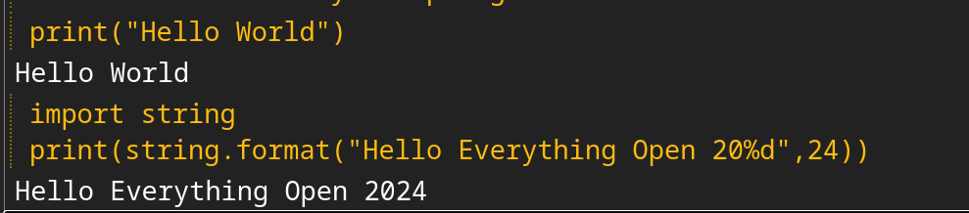
Berry Code
Tasmota incorporates a Web based UI to Berry: Berry Scripting console
Notes:
Berry code can be executed from the Berry console, much like python.

Slide 12
Program Execution
Berry programs in the file-system can be executed:
  by the load() function from the Berry console
  Run at startup if named ‘autoexec.be’ which can then load() other files.
  From the Tasmota console using the ‘br’ command
  From a tasmota rule
ON Time#Minute=0 DO br load(“midnight.be”) ENDON
ON DS18B20#Temperature<10
DO WEBSEND[192.168.10.3] br load(“TooCold.be”)
Notes:
The load() function looks for that filename or with a .be extension, loads and executes.
If the program has not been loaded previously, it is compiled to bytecode then executed. The bytecode is stored as the filename with a .bec extension.
This also applies if the file is newer than the bytecode file.
Berry VM can be restarted with the ‘brrestart’ console command

Slide 13
Support Libraries
Berry has a number of modules that can be imported as required:
  String
  JSON
  MATH
  MQTT
  Tasmota
  GPIO
Notes:
String library contains the usual string functions, formatting, counting occurrences,search etc
JSON library contains function for serialising and deserialising JSON strings. Very useful as lots of calls to Tasmota returns a JSON string.
MATH
MQTT (publishing and subscribing)
Tasmota library contains many functions and classes for getting data and manipulating tasmota internals.

Slide 14
Tasmota module
Send a Tasmota command from Berry
Create a Tasmota command in Berry
Timers
tasmota.cmd(“dimmer 60”)
def hello_from_berry()
print(“Hello from Berry”)
end
tasmota.add_cmd(“hello”,hello_from_berry)
tasmota.set_timer(600,hello_from_berry)
tasmota.add_cron("*/10 * * * * *",hello_from_berry)
Notes:
Tasmota.cmd performs the same function as typing a command from the console.
Create a new tasmota command called ‘hello’ that can be used from the console or rule
Timers are the obvious mechanism to create future events. Berry execution can cease until the timer expires.
The cron function adds a second component to the standard cron time format.
This example calls the hello_from_berry function every 10 seconds.

Slide 15
Tasmota module
add_rule()
read_sensors()
get_power() / set_power() / get_switches()
url_get()
rtc()/time_str()
Web interface functions
...
Notes:
Poorly written Berry programs can take prevent Tasmota performing the other functions, so an event mechanism is required. We saw time based events previously.
The add_rule() method is very powerful. It allows a tasmota event to trigger a berry function. This is the most efficient way to wait on IO. The triggers are exactly the same as Rule triggers discussed earlier.
read_sensors() polls configured sensors
Polling and setting digital IO
Url retrieval
Time functions. Tasmota uses NTP for real time setting, so requires access to an NTP server for wall clock time.
Functions to add features to the Tasmota web interface

Slide 16
Tasmota Module (Driver)
Berry can be used to add device drivers
Override driver class methods as required
Add fast_loop() to Tasmota main loop
  fast_loop function called 200 times/sec
class MyDriver
def every_second()
# do something
end
end
d1 = MyDriver()
tasmota.add_driver(d1)
Notes:
Class methods include
every_second()
every_250ms()
every_100ms()
fast_loop() needs to be registered separately

Slide 17
Driver with fast_loop
class my_driver
def every_100ms()
# called every 100ms via normal way
end
def fast_loop()
# called at each iteration, and needs to be registered separately and explicitly
end
def init()
# register fast_loop method
tasmota.add_fast_loop(/-> self.fast_loop())
end
end
tasmota.add_driver(my_driver()) # register driver
Notes:
Example from the documentation showing the overridden every_100ms() method
The Fast_loop() is added in the class init() method
The / arrow is the creation of a closure, in Berry a closure is best explained as a synthetic function pointer.

Slide 18
Other Modules
  MQTT
    Subscribe and publish MQTT messages
  GPIO
    Perform operations on GPIOs
    Read and write hardware counters
  WIRE
    I2C bus operations
  PERSIST
    Manage persistent data
Notes:
Publish to Tasmota configured MQTT Server
Subscribe to a topic which calls a Berry function on receipt
Direct access to GPIO, bypassing tasmota
I2C bus devices for device drivers
Persistent data written to a file in JSON format
Others for socket programming etc.

Slide 19
LVGL Graphics
Inexpensive ESP32 hardware with touch graphics displays
Uses LVGL Tasmota firmware image.
Berry calls into LVGL library
Notes:
Special Tasmota image for LVGL. Some other features are removed for capacity limitations

Slide 20
Matter
Matter protocol implemented in Berry
UI implemented in Berry
ESP8266 does not support Berry and Matter
ESP32 can be configured as a Matter bridge to ESP8266 Tasmota device
Notes:
Drivers can be complex
Berry can be used for core functionality
Code can be stored in flash with little RAM impact.
Matter is implemented in Berry
UI in Berry
ESP8266 does not have sufficient resources to run Berry and therefore Matter
An Tasmota ESP32 can be configured as a Matter bridge to a Tasmota ESP8266 device

Slide 21
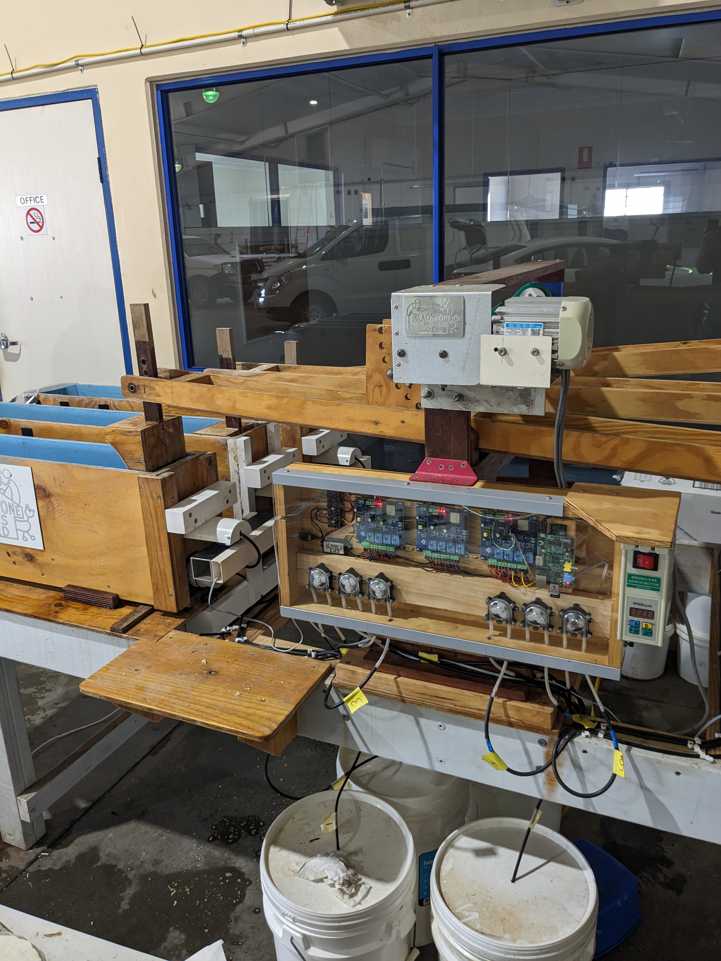
Home Automation?
Notes:
Wave tank project for local university Phd student.
Variable speed drive runs the wave mechanism. Drive is soft started by a Berry program in one controller.
Relay modules control a pump for each wave tank to simulate tides with a berry function
ESP8266 Load cells weight the tanks to provide water level feedback.
Raspberry Pi Model A is Wifi AP, MQTT broker and overall web interface.
Queue video

Slide 22
Links
Tasmota Documentation https://tasmota.github.io/docs
Tasmota Berry Doc https://tasmota.github.io/docs/Berry/
Berry Introduction (in 20 minutes of less) https://tasmota.github.io/docs/Berry-Introduction/
The Berry Script Language Reference Manual https://berry.readthedocs.io/en/latest/

