Slide 1

Label every ticket, then decide whether a person should handle it
PROBLEM 03 · TICKET TRIAGE
Ticket
Four models
Correctness
Cost rule
Decision
Channel, product, subject and body, read as one text
Category, priority, team and sentiment, each calibrated
p_correct: how likely the chosen team is right
Expected misroute cost vs hand-off cost
Route to a team
or send to a human, at most 15%
8×
15%
Every ticket
a misrouted P1 outage costs 8 times handing it to a person
the most the human triage desk can take on
gets a team or a person, with the reason why
03 Ticket Triage · 1
Notes:
The task has two parts. First, put four labels on every ticket: category, priority, assigned team and sentiment. Second, decide which tickets a person should handle instead, with at most 15% of a batch going to people. Every model reads channel, product, subject and body as one text. Category is TF-IDF plus logistic regression. Priority is an ordinal model. Team is a gradient-boosted stacker that learns product exceptions, for example switch firmware going to Network-Support. Sentiment uses gradient-boosted trees. All probabilities are temperature-calibrated. A separate correctness model predicts how likely the chosen team is right. That feeds a cost rule, explained on the next slide. Why it matters: in the pack's cost matrix, a misrouted P1 costs 8, while handing a P1 to a person costs 1. The human triage desk can take at most 15% of tickets. So the job is to spend that limited desk time on the tickets where a wrong route would hurt most. Method: 30,000 labelled tickets, split 70/15/15 into TRAIN, VAL and TEST. Every model choice was made on VAL with a pre-written rule: paired bootstrap, the 95% interval must exclude zero. TEST was scored once at the end.

Slide 2
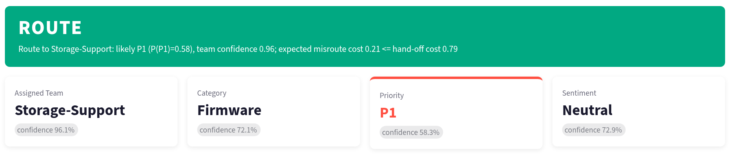
A person takes the ticket only when a misroute would cost more
WHEN TO HAND OFF
Expected cost, per ticket
Guards: always a person
Misroute: (1 − p_correct) × priority-weighted misroute cost
A product never seen in training
Hand-off: priority-weighted hand-off cost
An empty or very short body (under 20 characters)
In a batch, the biggest savings go to people first, up to the 15% cap.
03 Ticket Triage · 2 · Screenshot: the app's Single Ticket tab
Notes:
For each ticket we compare two expected costs, using the cost matrix from the pack. The misroute cost is the chance the team is wrong, one minus p_correct, times the misroute cost weighted by the predicted priority. The hand-off cost is the priority-weighted cost of sending it to a person. If handing off is cheaper, it goes to a person. In a batch, the tickets with the largest savings go first, up to 15%. Two guards always force a hand-off: a product the model never saw, and an empty or very short body. The screenshot is the app. An Alletra 6010 outage on a payments cluster: the model is 96% sure it's Storage-Support, so the expected misroute cost, 0.21, is below the hand-off cost, 0.79, and it routes, as P1. Every decision comes with this reason string, so an agent can see why.

Slide 3
Lower routing cost than the 15% rule, with a third fewer hand-offs
RESULTS ON THE LOCKED TEST SET · 4,500 TICKETS
Routing cost per ticket (lower is better)
Label quality
Route everything, no hand-offs
Metric | TEST
Category macro-F1 | 0.862
Priority macro-F1 | 0.769
Team macro-F1 | 0.898
Sentiment macro-F1 | 0.886
P1 recall | 0.838
Escalation-risk F1 | 0.858
0.1700
Hand off the 15% least confident
0.1350 · 15.0% handed off
Ours: expected-cost rule
0.1331 · 9.7% handed off
03 Ticket Triage · 3 · TEST macro-F1 within 0.007 of VAL, so selecting on VAL did not overfit
Notes:
These are TEST numbers, scored once after everything was locked on VAL. Routing everything costs 0.170 per ticket. Handing off the 15% least-confident tickets brings that to 0.135. Our expected-cost rule gets slightly lower, 0.133, while handing off only 9.7% of tickets instead of 15%. That's about a third fewer tickets landing on people for the same or better cost, and 22% lower cost than routing everything. On the labels: team macro-F1 is 0.90. P1 recall is 0.84, because we label a ticket P1 whenever the calibrated P1 probability is at least 0.225. Missing a P1 is the expensive mistake, so we trade some precision for recall. On the eval file, 691 of 6,000 tickets, 11.5%, are handed off, under the 900-ticket cap.

Slide 4
Fewer tickets for people, fewer costly mistakes
BUSINESS IMPACT · PER 10,000 TICKETS
−22%
970
81%
routing cost vs routing every ticket
tickets for the human desk, not 1,500
of P1 outages flagged as P1
369 cost units saved, the cost of 46 misrouted P1 outages
Up from 53% for a plain baseline (VAL)
530 fewer than the 15% rule, with room left for surges
Recommendation
Use it as the first-line router: about 90% of tickets go straight to a team, and the triage desk handles the 10% where a mistake costs most. Every decision carries its reason, so agents can check it.
03 Ticket Triage · 4 · TEST results scaled to 10,000 tickets; cost units from the pack's cost matrix (1 unit = one P1 hand-off)
Notes:
This slide puts the TEST results in business terms, per 10,000 tickets. Cost: routing everything costs 0.170 per ticket; our rule costs 0.133. Over 10,000 tickets that's 1,700 cost units down to 1,331, a saving of 369. In the pack's cost matrix one unit is the cost of handing a P1 to a person, and a misrouted P1 costs 8, so the saving equals about 46 misrouted P1 outages. People: the rule hands off 9.7% of tickets, so the triage desk sees about 970 per 10,000. Handing off the least-confident 15% would send 1,500, for a higher cost. That's 530 tickets of desk time freed, and headroom under the 15% cap for a surge. Critical outages: on VAL, 81% of true P1 tickets are labelled P1, up from 53% for a plain TF-IDF baseline. On TEST it's 84%. Recommendation: deploy it as the first-line router, with the human desk taking the tickets the rule hands off. Every decision carries its reason string, so agents can see and challenge it. No LLM is involved and nothing leaves the network.

Slide 5
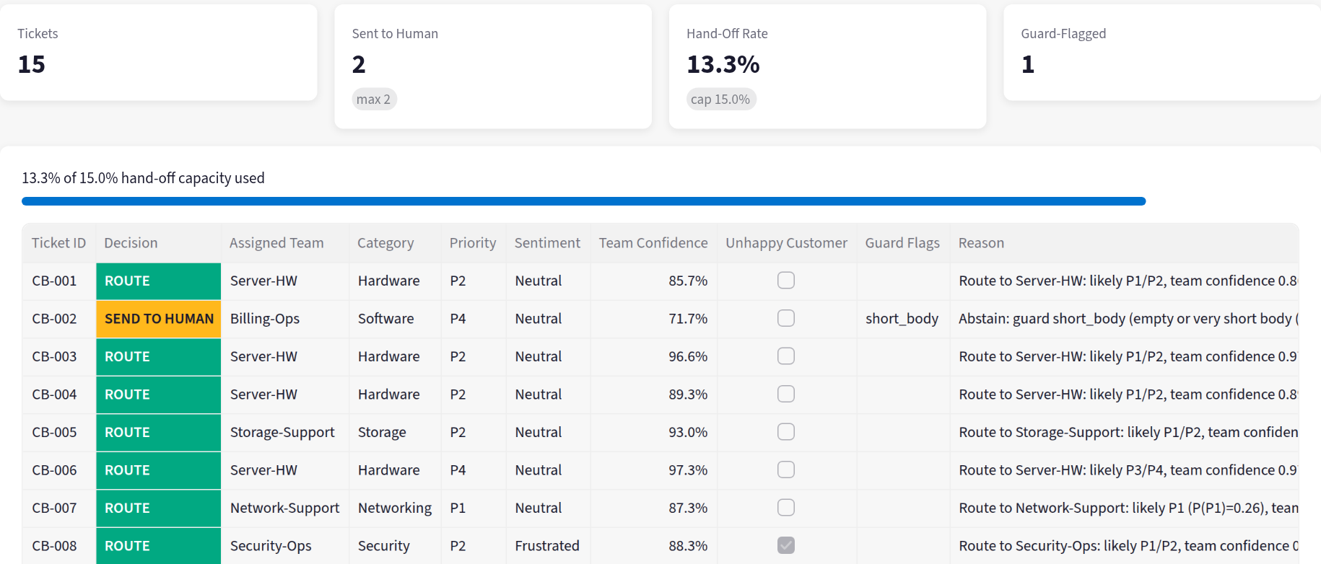


Holds on other languages, misses a new kind of ticket
CURVEBALL TICKETS AND NEXT STEPS
Holds
Malay and German outages routed to the right team
"it broke" handed off by the short-body guard
Misses
Server-room aircon failure sent to Server-HW
Payments outage in 140 stores scored P2, not P1
Sarcastic complaint read as Neutral
Facilities guard
Empty-content guard
Refit on all data
~165 eval tickets routed to IT
Vague follow-ups get a person
43% more training data
03 Ticket Triage · 5 · Screenshot: the app's Batch CSV tab on the 15 curveball tickets
Notes:
The pack's 15 curveball tickets test edge cases. The screenshot is the app's batch tab scoring them: 2 of 15 go to a person. What holds: character n-grams carry the Malay ticket (server won't boot) and the German one (packet loss on the core switch) to the right teams, with no translation. The two-word "it broke" ticket is caught by the short-body guard. What misses: the server-room aircon failure is a facilities problem, a category the model never saw, and it gets routed to Server-HW. About 195 eval tickets look like this and only about 29 are handed off. The payments outage across 140 stores came out P2 rather than P1. And the sarcastic "Wow, what an achievement" complaint is read as Neutral. Next steps, in order, each tied to a risk it removes: a facilities guard for room power and cooling, since about 165 such eval tickets currently go to IT teams that cannot fix them; a guard for tickets with no real content, like "same thing as before"; and refitting the final models on all 30,000 rows instead of 21,000, which is 43% more training data at no extra cost.

Slide 6
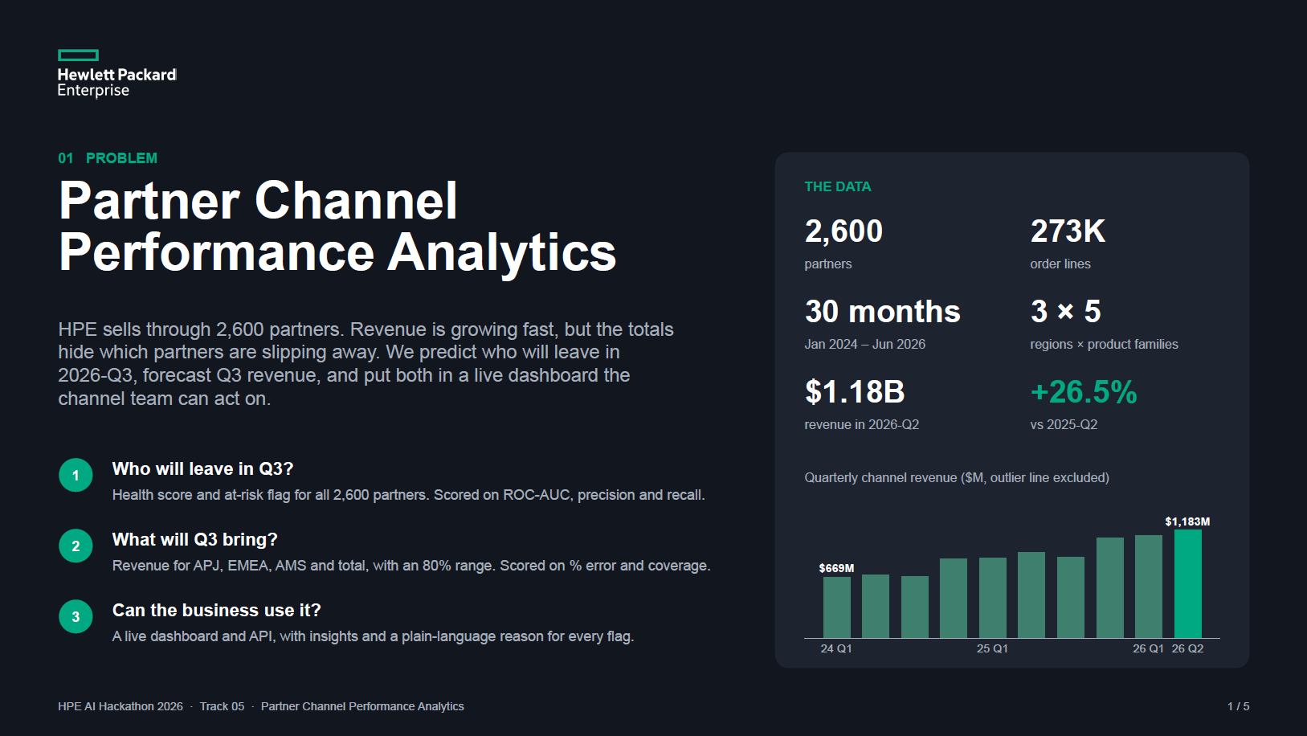

Slide 7
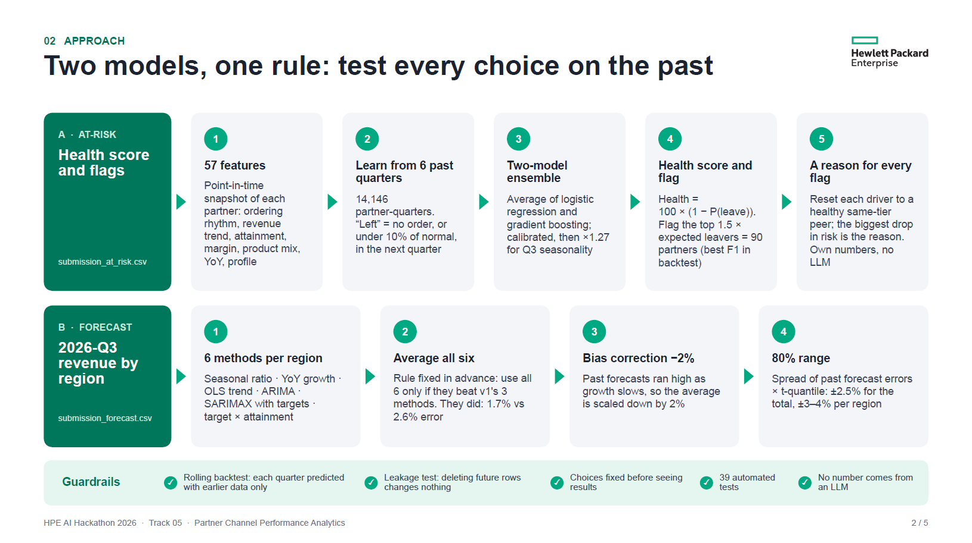

Slide 8
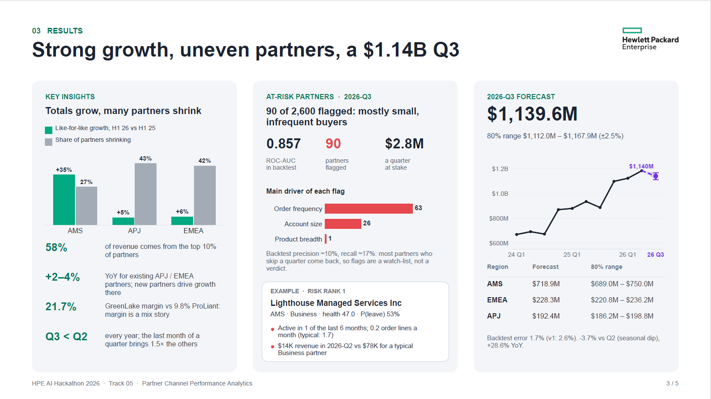

Slide 9
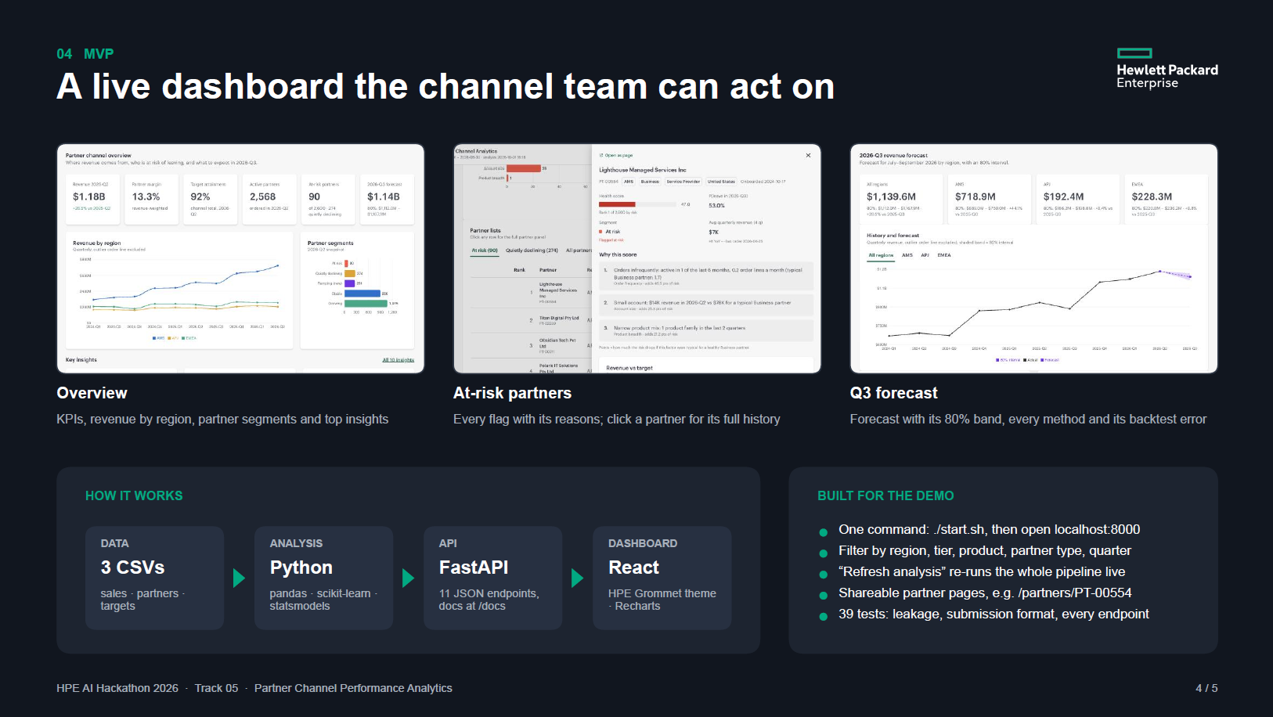

Slide 10
