Slide 1


Transport for NSW
By Darryl Rusli

Slide 2
Context
The LPIA team provides TfNSW legal services.
The purpose of this project is to support the new structure of Legal, Privacy, and Internal Audit branch (LPIA)

Slide 3
Questions
The legal matters worked by team and teams members
Type of law the matters relate
Supported internal Business clients
Proportion of internal matters vs external matters
Average Duration of legal matters

Slide 4
Data Pipeline
Context
Questions
Data Cleansing
Visualisation
Summary
Data Description

Slide 5
Data Description
Data shape
270 observations
8 features

Slide 6
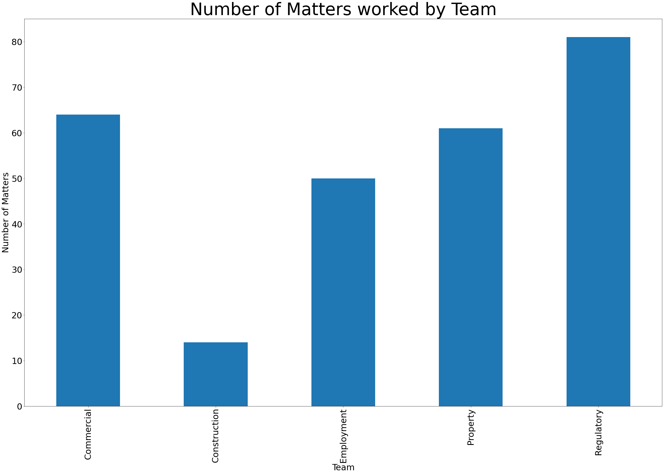
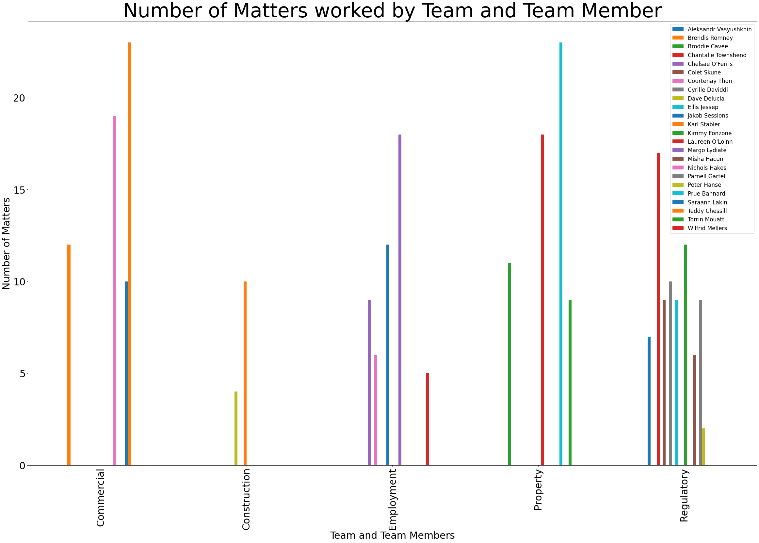
Matters worked by Team and Members
Insights: Regulatory team has done the biggest number of matters

Slide 7
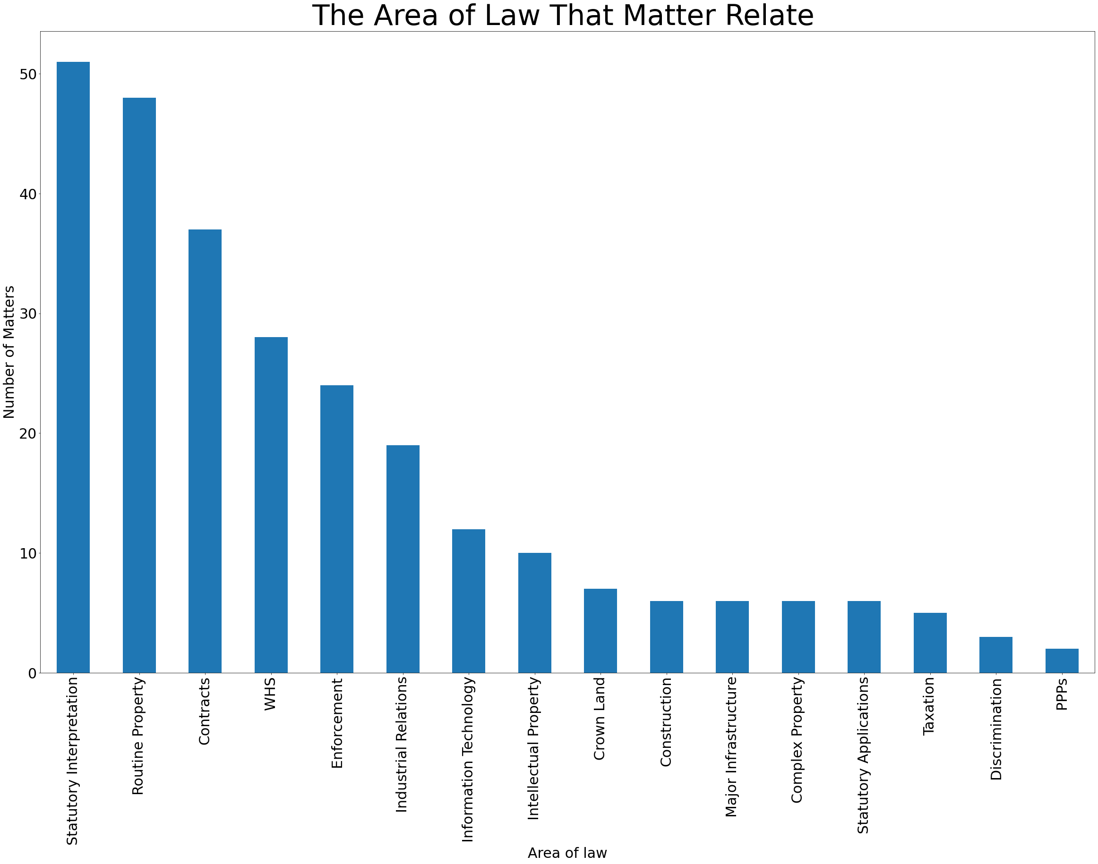
Area of Law
Insights:
There are 16 areas of law that legal matters relate to
Statutory interpretation are the area that has been worked the most by legal team

Slide 8
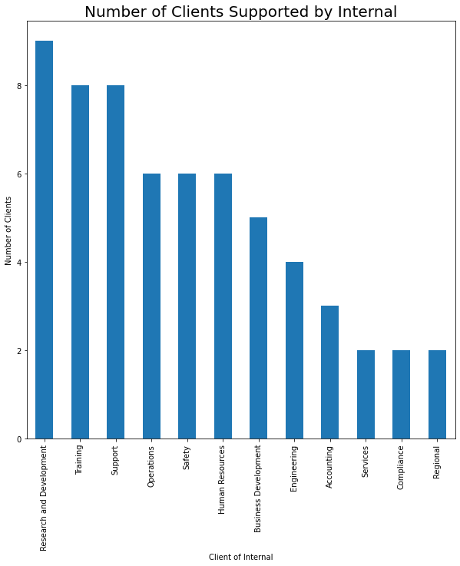
Internal Business clients
Insights:
12 supported internal business clients
Top internal clients
Research and development
Training and Support
Operations, safety, and HR

Slide 9
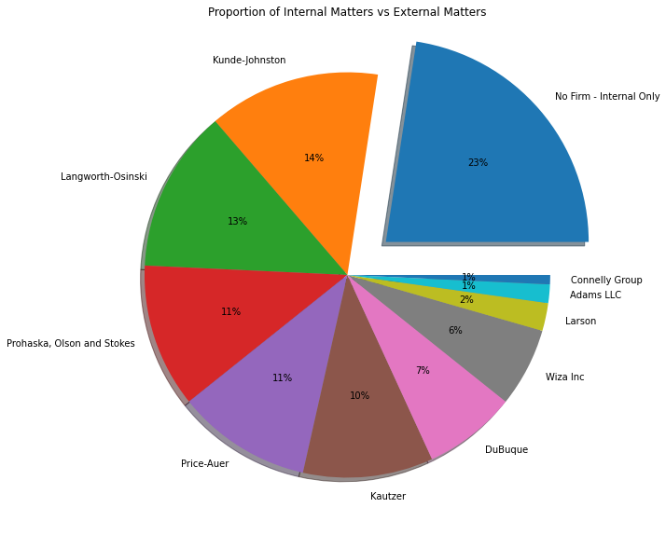
Internal Matters vs External Matters
Insights: Internal matters cover 23% of the whole proportion where the external matter covers 77%

Slide 10
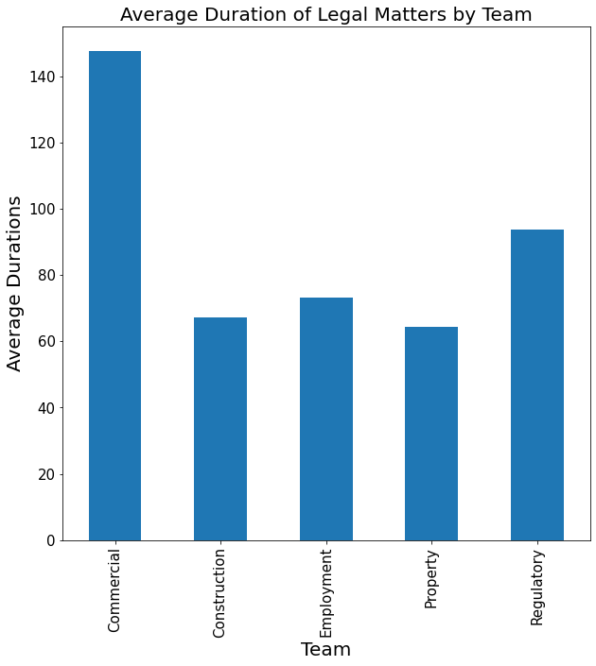
Average durations of legal matters
Insights: Commercial are the type legal matters that takes the longest time to be completed
Overall Average: 95 days

Slide 11
Summary
Regulatory team has done the biggest number of matters
There are 16 areas of law that legal matters relate to
Statutory interpretation are the area that has been worked the most by legal team
12 supported internal business clients
Top internal clients
Research and development
Training and Support
Operations, safety, and HR
Internal matters cover 23% of the whole proportion where the external matter covers 77%
Commercial are the type legal matters that takes the longest time to be completed

Slide 12
THANK YOU
Questions?

